Slide 1
RSIT-ATT&CK
25-Jan-21
Koen Van Impe – koen.vanimpe@cudeso.be

Slide 2
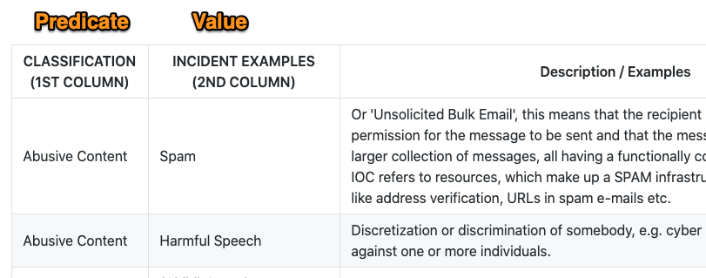
Current RSIT taxonomy
machinev1
JSON
MISP taxonomy
Predicates (cat 1)
Description (cat2)
Expanded
Value

Slide 3
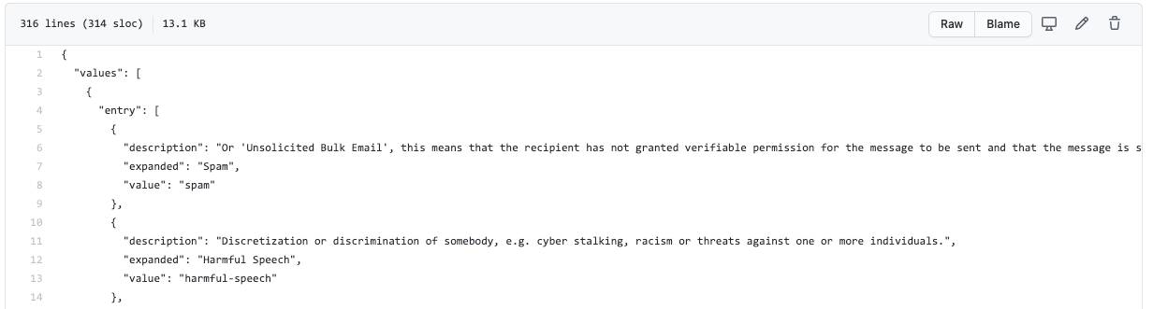
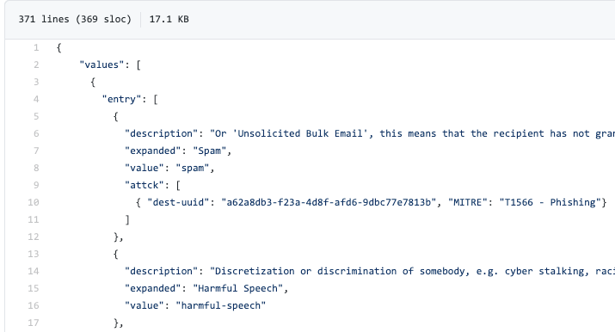
Add ATT&CK
Extra field “attck”
One or more ATT&CK techniques
dest-uuid: Relation to MISP ATT&CK Galaxy / Cluster
MITRE: ID + title

Slide 4
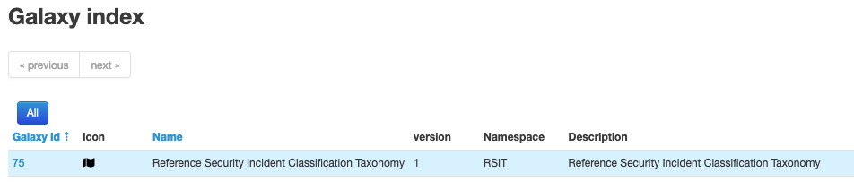
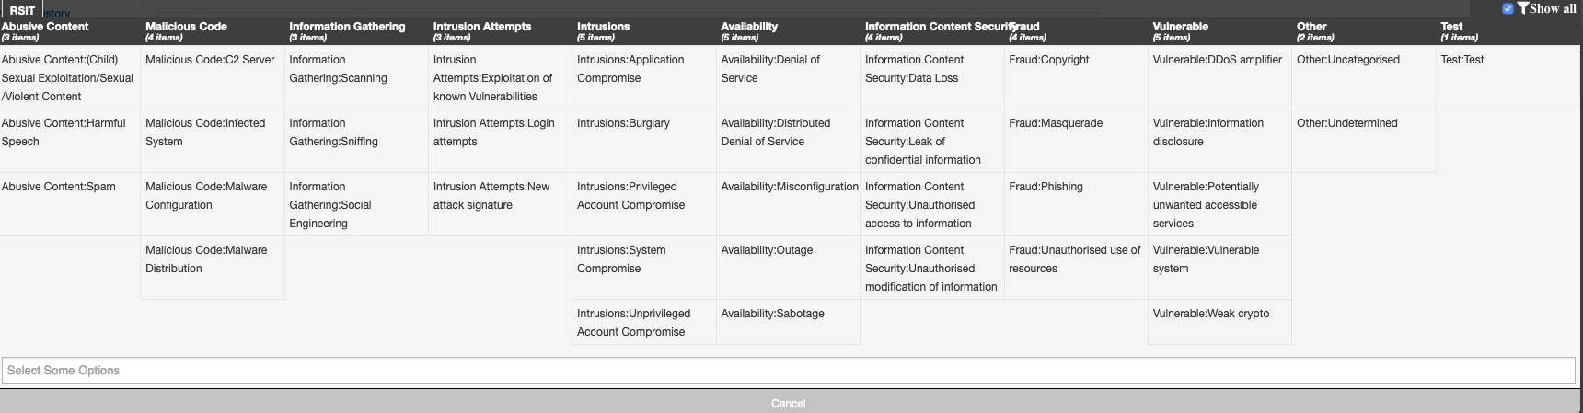
MISP Galaxy/Cluster

Slide 5
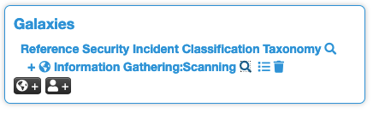
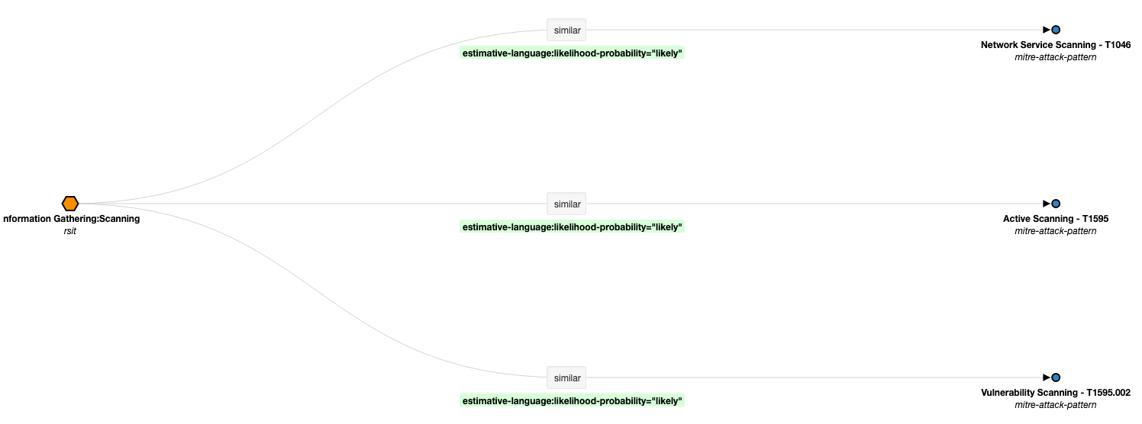
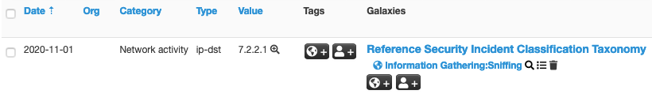
Linked to a MISP event
Or an attribute

Slide 6
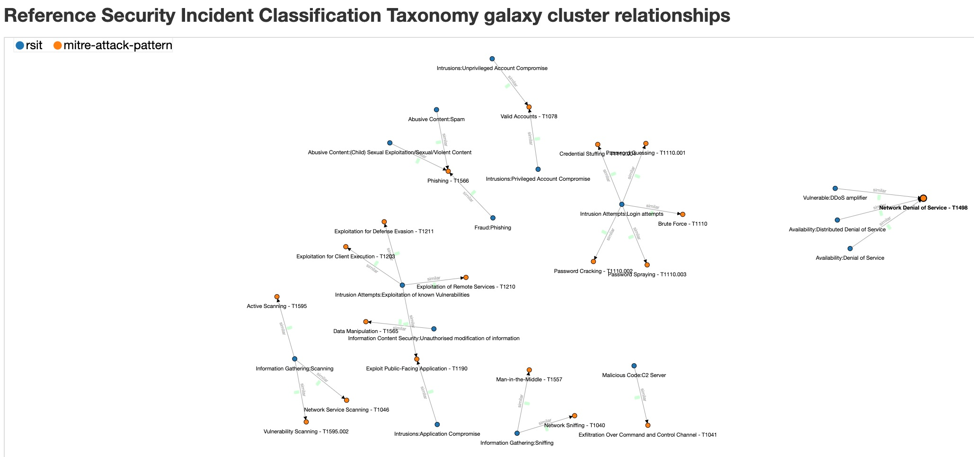
Relationships

Slide 7
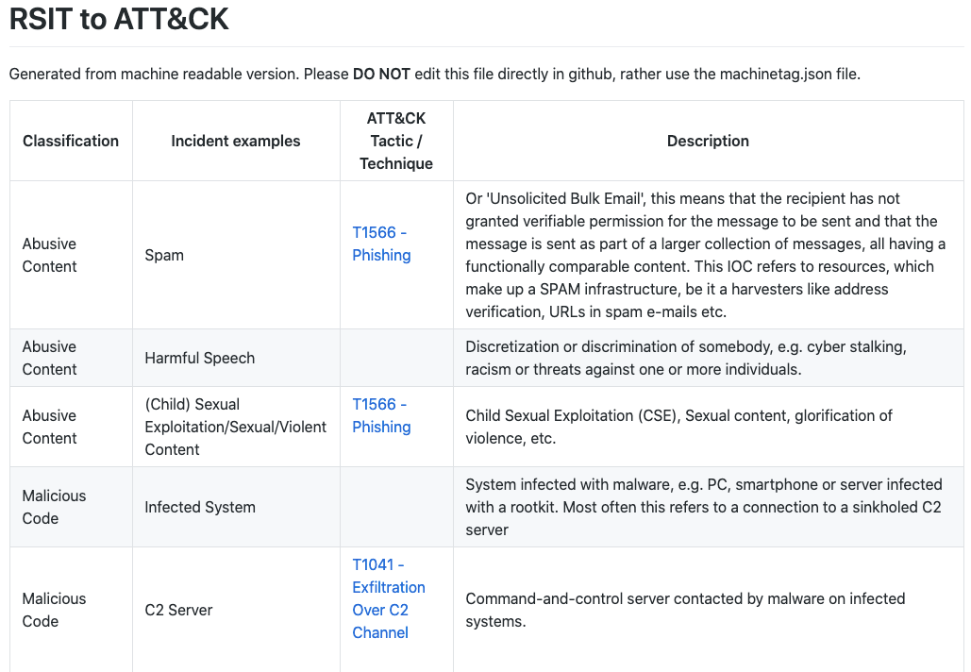
Human Readable

Slide 8
Files and Scripts
Files (in PR)
clusters_rsit.json galaxy_rsit.json
Put as clusters/rsit.json galaxy/rsit.json
machinetag.json
MISP Taxonomy file (machinev1)
rsit_2_attck.md
Human readable table of RSIT to ATT&CK
Scripts
https://github.com/cudeso/rsit-attck (not on ENISA to prevent clutter)
Create human readable table
python3 machinetag2human.py machinetag.json rsit_2_attck.md
Create MISP Galaxy/Cluster
python3 convert-rsit-to-attck.py

Slide 9
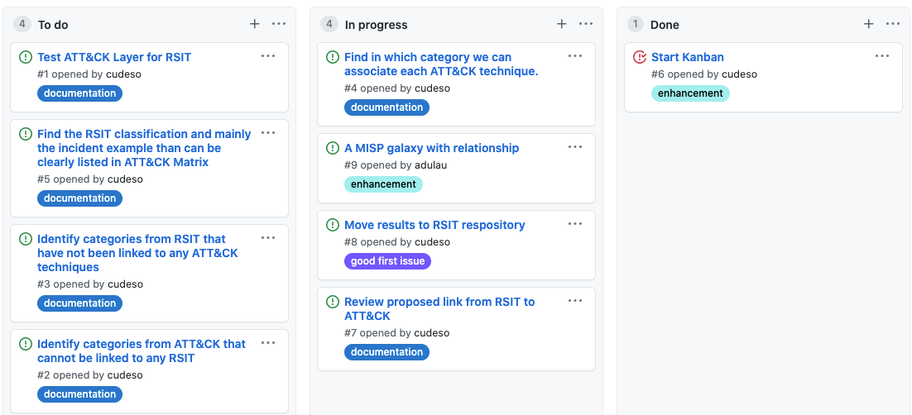
Next ...
Add RSIT2ATTCK as MISP Galaxy/Cluster PR
Use new format of machinetag.json
You can still keep the current taxonomy file
Add scripts to ENISA repository
Documentation + complete ENISA/RSIT repository
Create ATT&CK to RSIT
ATT&CK Navigator layersq

