Slide 1
MISP playbooks, Proving the value of cyber threat intelligence and ICS-CSIRT.io
Hack.LU - Lightning Talks
TLP:CLEAR

Slide 2












Koen Van Impe
Freelancer
Incident response, threat intelligence, security monitoring
Open source contributions
MISP modules, taxonomies, automation and integration with DFIR tools, ...
MISP “tip-of-the-week”
MISP-Playbooks
OSINT threat feed
botvrij.eu
koen.vanimpe@cudeso.be
https://www.cudeso.be
https://www.vanimpe.eu
https://github.com/cudeso

Slide 3

Koen Van Impe
Freelancer
Incident response, threat intelligence, security monitoring
Open source contributions
MISP modules, taxonomies, automation and integration with DFIR tools, ...
MISP “tip-of-the-week”
MISP-Playbooks
OSINT threat feed
botvrij.eu
koen.vanimpe@cudeso.be
https://www.cudeso.be
https://www.vanimpe.eu
https://github.com/cudeso
@cudeso

Slide 4




MISP playbooks
https://github.com/misp/misp-playbooks
MISP
MISP Playbooks
Jupyter notebooks
Python PyMISP
Code
Markdown
MISP playbooks address common use-cases encountered by SOCs, CSIRTs or CTI teams to detect, react and analyse specific intelligence received by MISP.
The MISP playbooks are built with Jupyter notebooks and contain
Documentation in Markdown format, including text and graphical elements
Computer code in Python, primarily PyMISP to interact with MISP and other sources for enrichment and notification

Slide 5
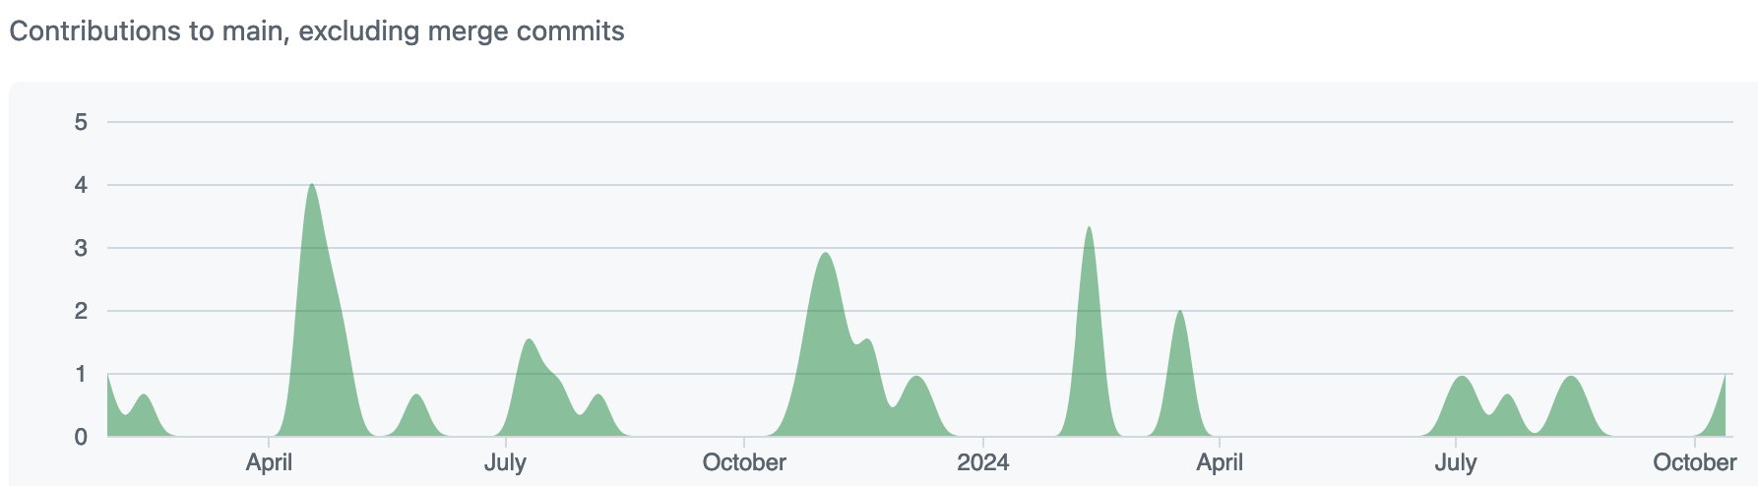
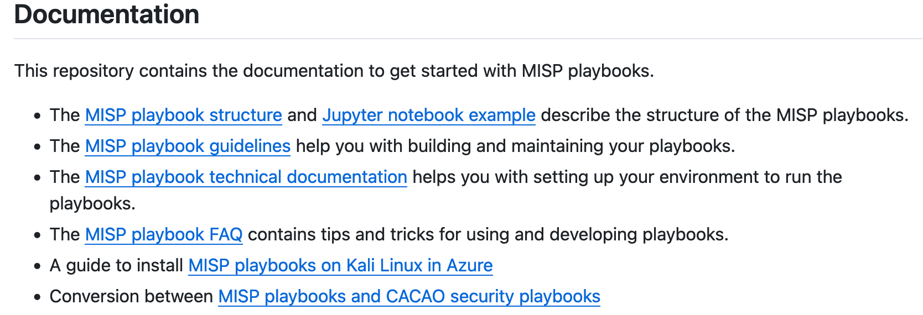
MISP playbooks
https://github.com/misp/misp-playbooks
Published on GitHub
https://github.com/MISP/MISP-playbooks
Guidance and technical documentation
Structure of playbooks
Recommendations to write your own playbooks
Setting up the environment (JupyterLab)
Conversion scripts to CACAO security playbooks
24 playbooks

Slide 6
MISP playbooks
https://github.com/misp/misp-playbooks
Playbooks for MISP users
Playbooks for MISP administrators
Create events from Sentinel incidents
Triage
Hash checks
CTI work
Curation and quality assurance
Threat actor profiling
Become better acquainted with the MISP features
MISP objects
Warning lists
Investigations
IP and domain information
Query Elastic for indicators
Verify indicators in Timesketch
Timestamps in MISP
Lookup CVE details
Incidents
Phishing
Deal with malware investigations
JARM fingerprints
User management
Provision users and organisations
Event management
Bulk delete of events
Your playbook?
Request new playbooks via a GitHub issue
Submit your own playbooks via pull requests

Slide 7

Proving the value of cyber threat intelligence
https://github.com/cudeso/proof-value-cti
Demonstrate value of cyber threat intelligence (CTI) within an organisation
How can CTI support the organisation?
Tactical, operational and strategic level
Already a lot of resources available, but not always that easy to start with
Practical, pragmatic and collaborative
Not a new standard or framework
No intention of reinventing the wheel
Something simple that you can use in conversation such as “why would spend money on CTI”?
Organisations looking at how to operationalise CTI
Published an initial list of ideas on GitHub
https://github.com/cudeso/proof-value-cti
Room for improvement
Store “value” descriptions in YAML files (‘DFIQ.org’). Or JSON?
+: generate “human” readable and ”machine” readable output

Slide 8
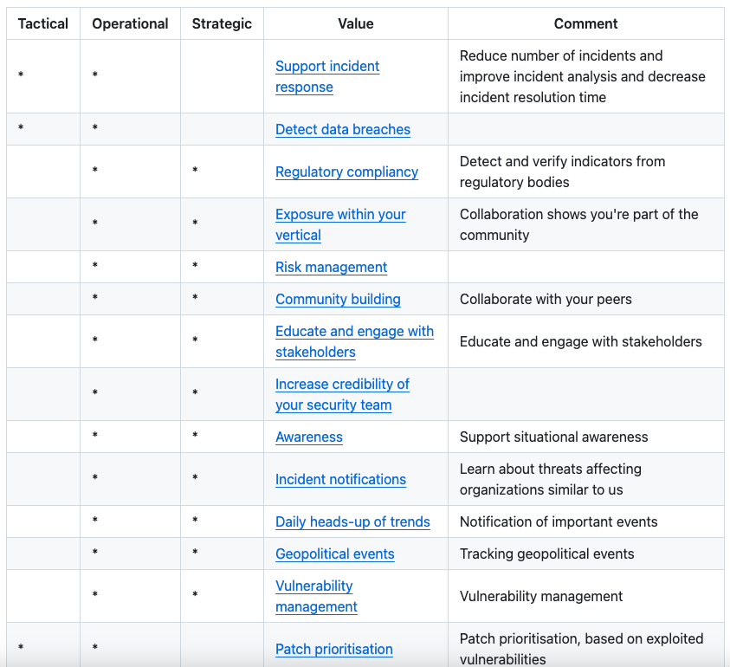
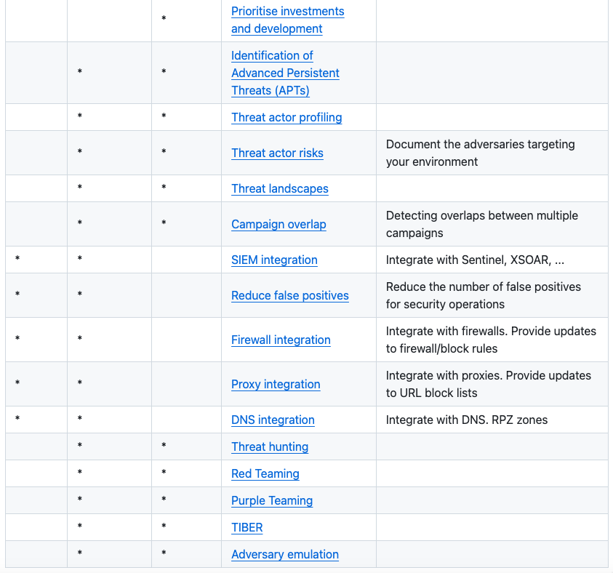
Proving the value of cyber threat intelligence
https://github.com/cudeso/proof-value-cti

Slide 9
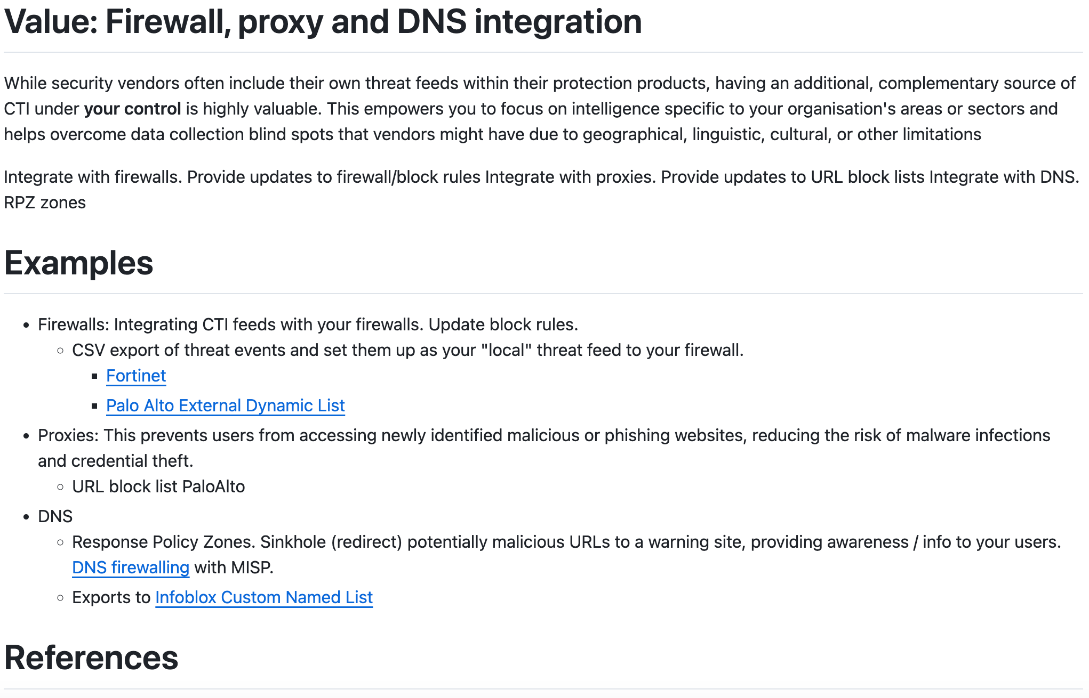
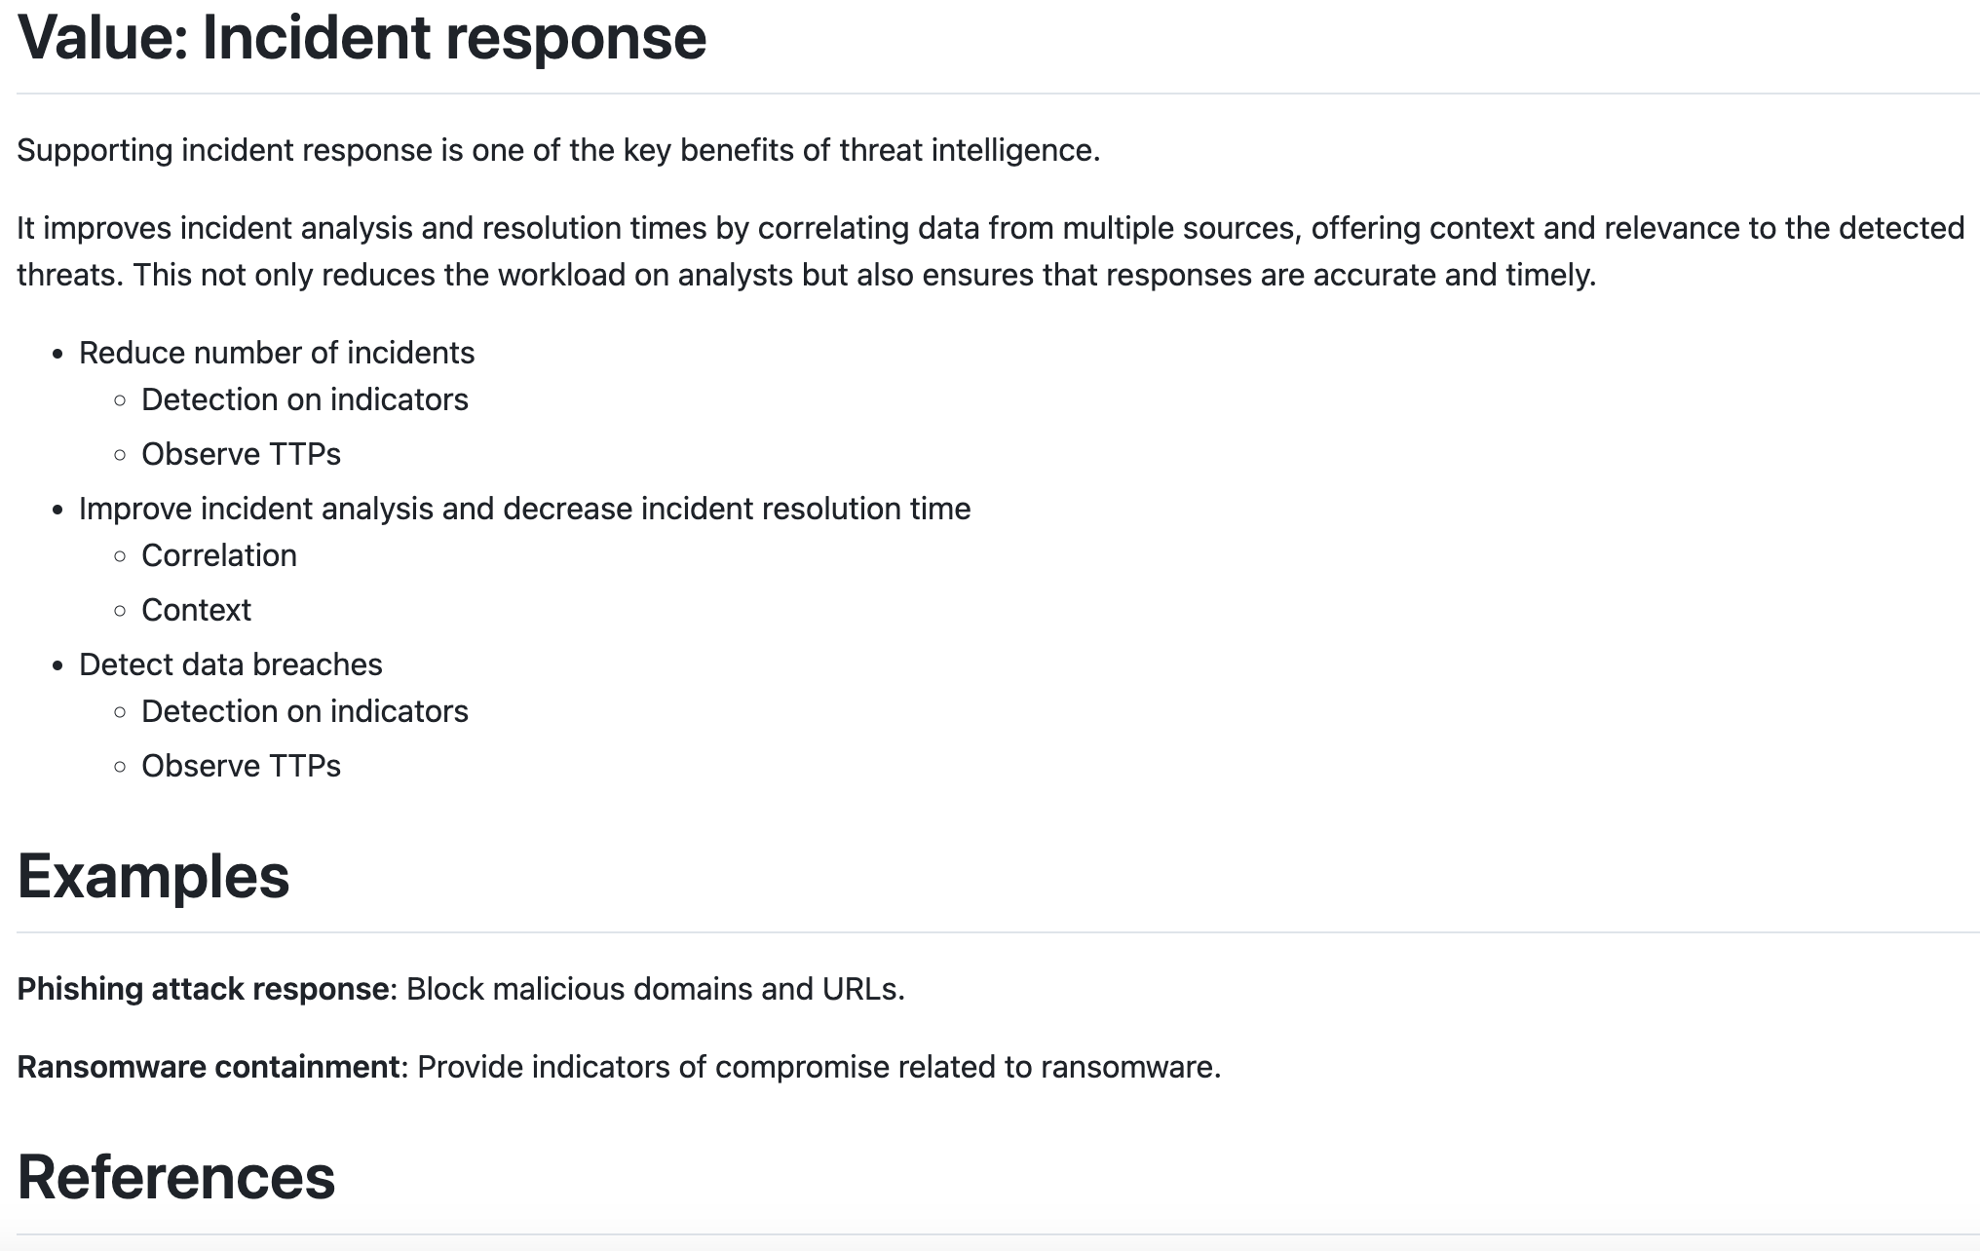
Proving the value of cyber threat intelligence
https://github.com/cudeso/proof-value-cti

Slide 10


ICS-CSIRT.io
https://www.ics-csirt.io/
ICS-CSIRT.io
Community to disseminate security information on industrial control systems
Not affiliated or linked with a governmental or commercial partner
Membership is free
In return, submit content (website/MISP)
OpenCVE (“advisories” > NVD)
https://cve.ics-csirt.io/
Replace with ‘Vulnerability Lookup’?
https://github.com/cve-search/ vulnerability-lookup
MISP community (“threats”)
https://misp.ics-csirt.io/

Slide 11
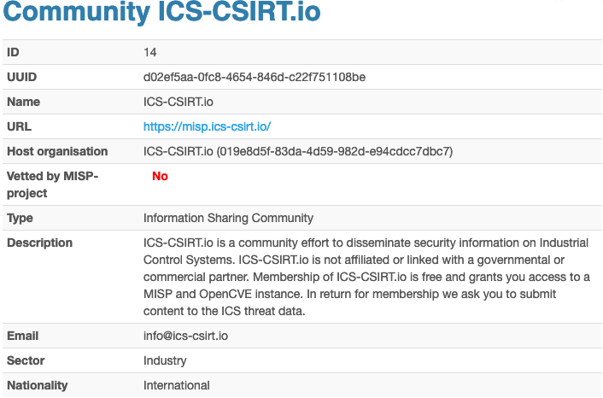
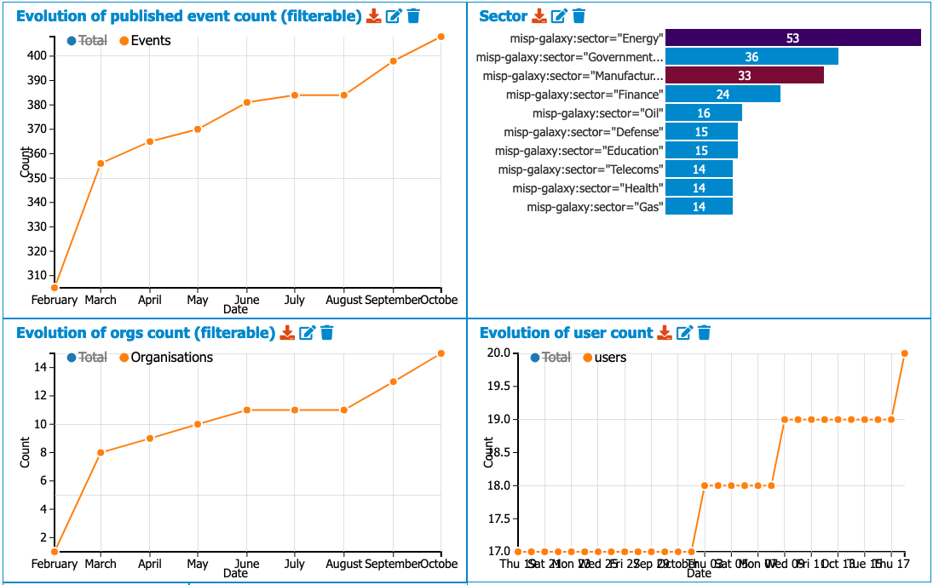
ICS-CSIRT.io
https://www.ics-csirt.io/

Slide 12
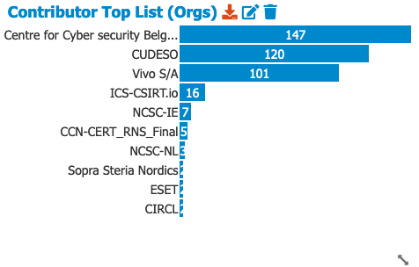


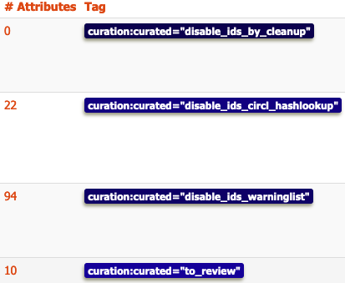
ICS-CSIRT.io
https://www.ics-csirt.io/
Bootstrapped with shareable threat events from MISPPRIV
Curation process
Matches with common warning lists and hashlookup are automatically disabled
Manual relevance check
Sharing guidelines (similar to MISPPRIV)
All shared information must adhere to the Traffic Light Protocol (TLP) classification system
Users are responsible for the accuracy and integrity of the information they contribute
Users must respect the privacy and confidentiality of the information shared on the platform
Users must comply with the dissemination restrictions associated with each TLP level
If a TLP classification is not set on an event, the default classification is TLP:AMBER

