Slide 1
LZRW1 Compressor & Decompressor
ECE 571
Introduction to SystemVerilog
By Manas Karanjekar, Mark Chernishoff, and Parker Ridd

Slide 2
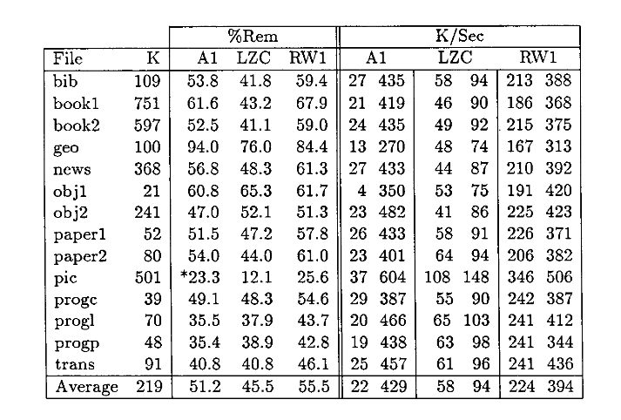
What does it do?
Compression saves space
Hardware compression is increasingly relevant
LZRW1 is extremely fast
According to Williams, it is 4x faster than the LZC, which is what the compress command on UNIX used to use
LZRW1 is easier to implement in hardware than other compression algorithms
Average filesize is 55.5% of original in experiment performed by Williams

Slide 3

Inspiration
Loosely based on OpenCores implementation of LZRW1 compressor (https://opencores.org/project,lzrw1-compressor-core)
We wanted to make compressor AND a decompressor
Designed it from scratch based on algorithm by Ross N Williams detailed in “An Extremely Fast Ziv-Lempel Data Compression Algorithm”

Slide 4
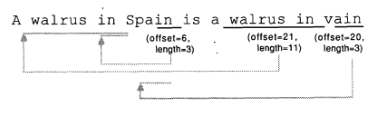
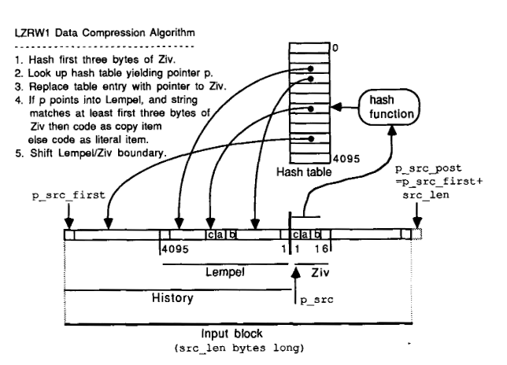
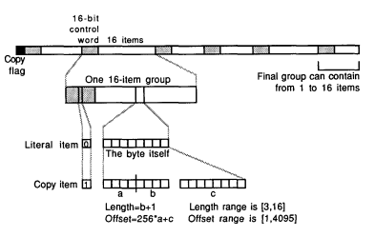
Algorithm
Ziv | Hashtbl addr | pntr
A w | 3EA | 1
wa | 939 | 2
wal | 451 | 3
alr | A53 | 4
lru | 893 | 5
… | … | …
“An Extremely Fast Ziv-Lempel Data Compression Algorithm”, Ross N Williams
Notes:
<Walk through an example of a compression>
<Walk through an example of a decompression?>
<Maybe include a block diagram?>

Slide 5
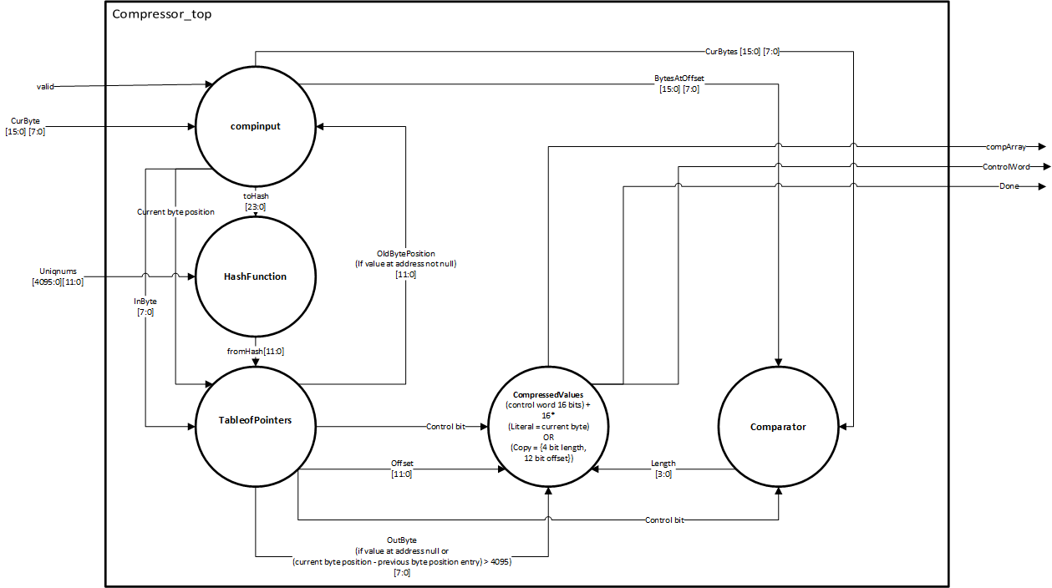

Design: Compressor

Slide 6
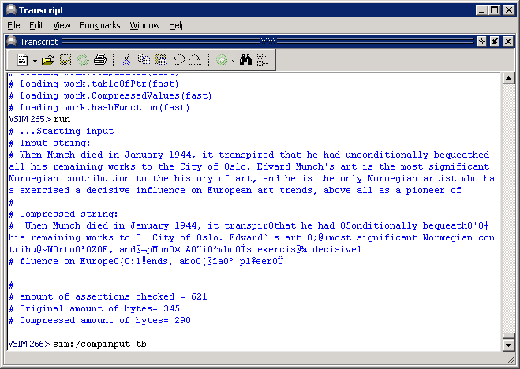
Results -- Compressor
Concurrent Assertions
Check compressed value when control bit is high/low
Check length > 3 when control bit high
Check control word when when control bit high

Slide 7
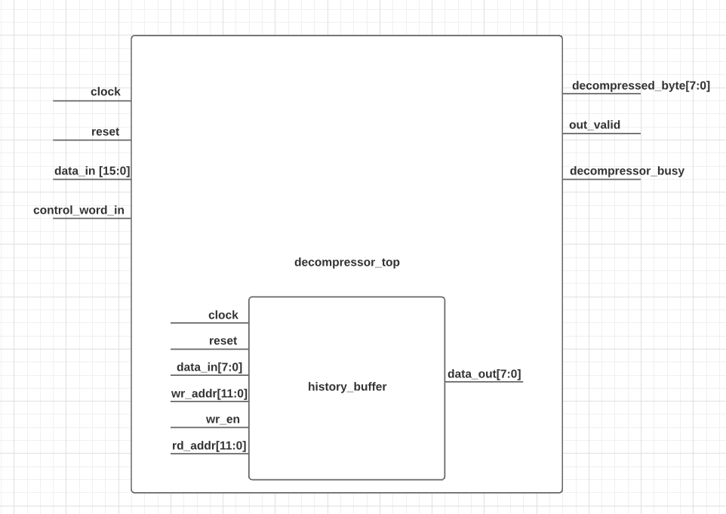
Design: Decompressor

Slide 8
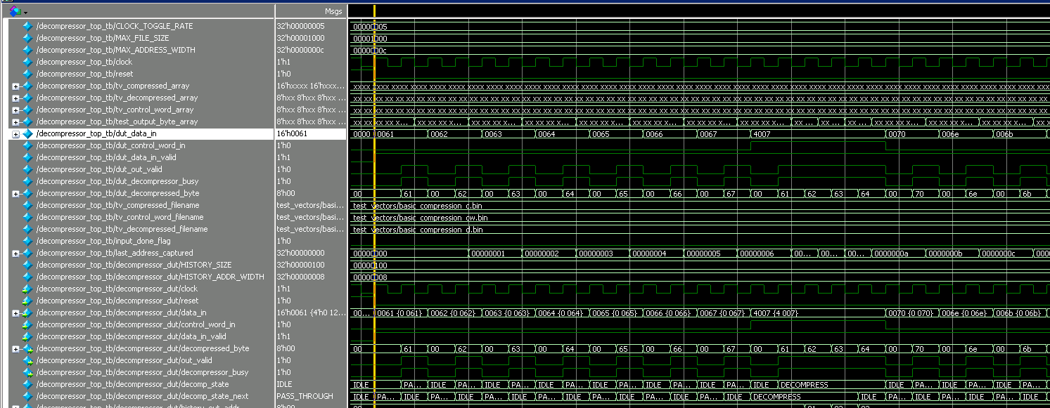
Results -- Decompressor
Input: abcdefg䀇pnk
䀇 = 0x4007
Decompression result: abcdefgabcdpnk

Slide 9
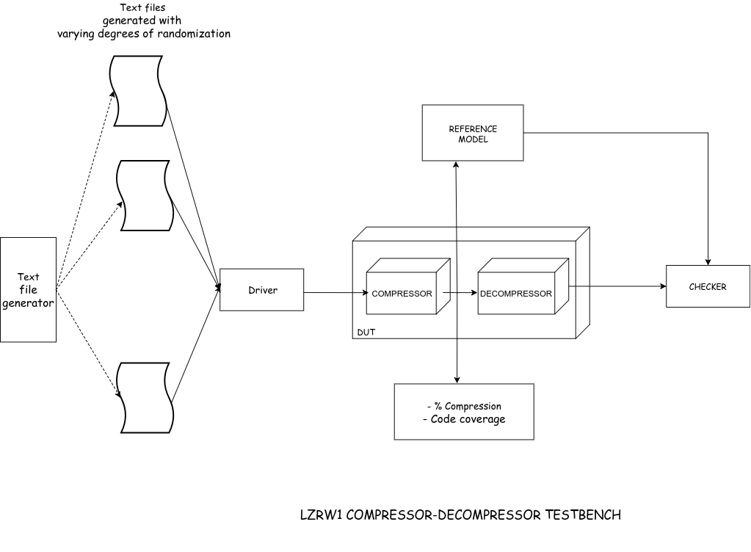
Design: Testbench

Slide 10
SystemVerilog Constructs
Constrained randomization stimulus generation (usage of variables, randcase and randomize() functions)
Weighted distribution using dist keyword
Virtual functions and polymorphism
String operations
File handling tasks in SystemVerilog
Assertions included in modules

Slide 11

Progress
Compressor and Decompressor coded
Decompressor verified via individual testbench
Compressor verified by input/output comparison
Completed constrained random stimulus generation
Feedthrough testbench is a work in progress
Firm plan for completion by 12/7

Slide 12

Emulation Plan
Standalone mode operation for VeloceSolo
The stimulus and output txt files generation will be done on the emulator
Offline checking for decompressed output

Slide 13
Contributions
Mark: Compressor integration
Manas: Main testbench and hash function
Parker: Decompressor integration

Slide 14
Questions

Slide 15
References
Schrittwieser, Lukas. “LZRW1 Compressor Core :: Overview Overview.” OpenCores, 7 Apr. 2013, opencores.org/project,lzrw1-compressor-core.
Williams, R.n. “An Extremely Fast Ziv-Lempel Data Compression Algorithm.” [1991] Proceedings. Data Compression Conference, 1991, doi:10.1109/dcc.1991.213344.

