Slide 1
Web Application for a Cafe
Dilara Madinger

Slide 2
Purpose
Website for a café. In this case, a Russian café.
Database has users, purchases, food items.
Web App has 3 tiers of usage:
1 general public
2 registered users
3 administrators

Slide 3
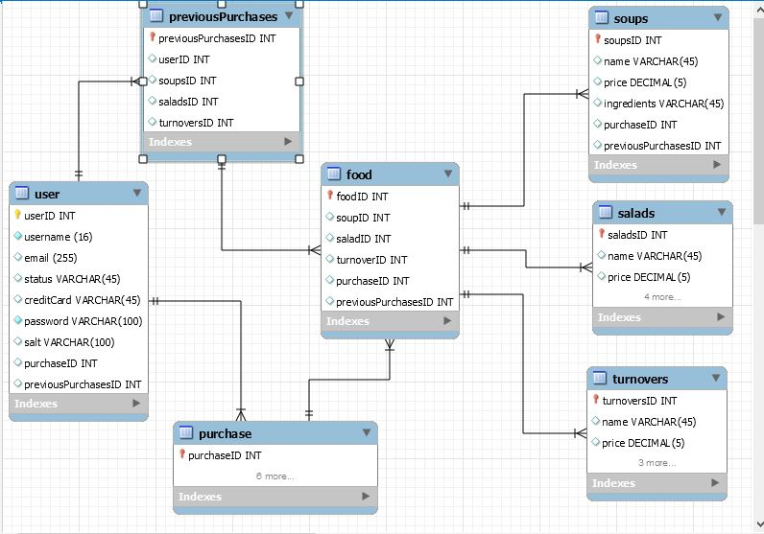
Database

