Slide 1
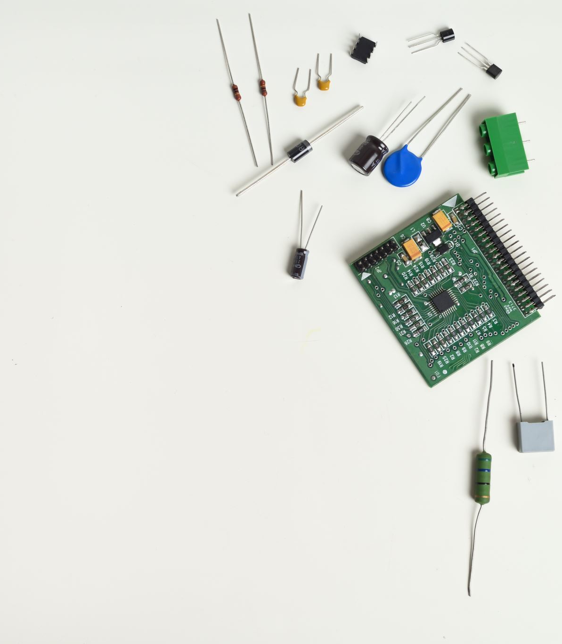


FINAL WORK SOFTWARE ENGINEERING
Pedro Cueli Rodríguez
Javier Santos Menéndez
María Cano Rodríguez

Slide 2

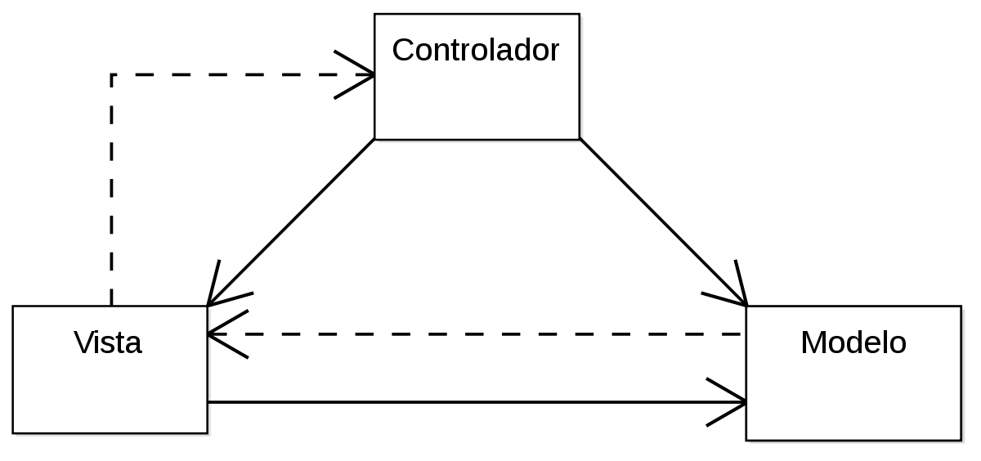
Architecture – Model View Controller (MVC)
Model- The central component of the patter.
View- Any representation of information such as a chart, diagram or table.
Controller- Accepts input and converts it to commands for the model or view.

Slide 3
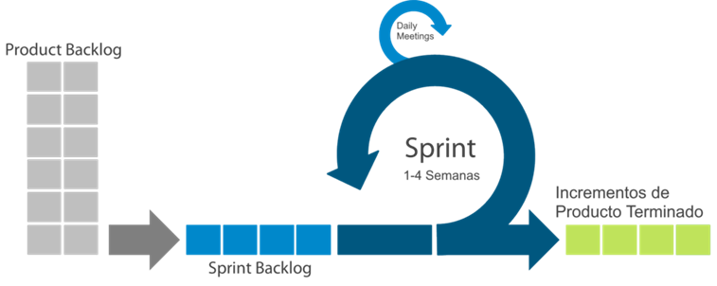


Sprints Management
First Sprint:
2 hours of meeting
1 week duration
7 user history
Second Sprint:
1 week duration
Third Sprint:
1 week duration
Fourth Sprint:
1 week duration
Finished product increments

Slide 4
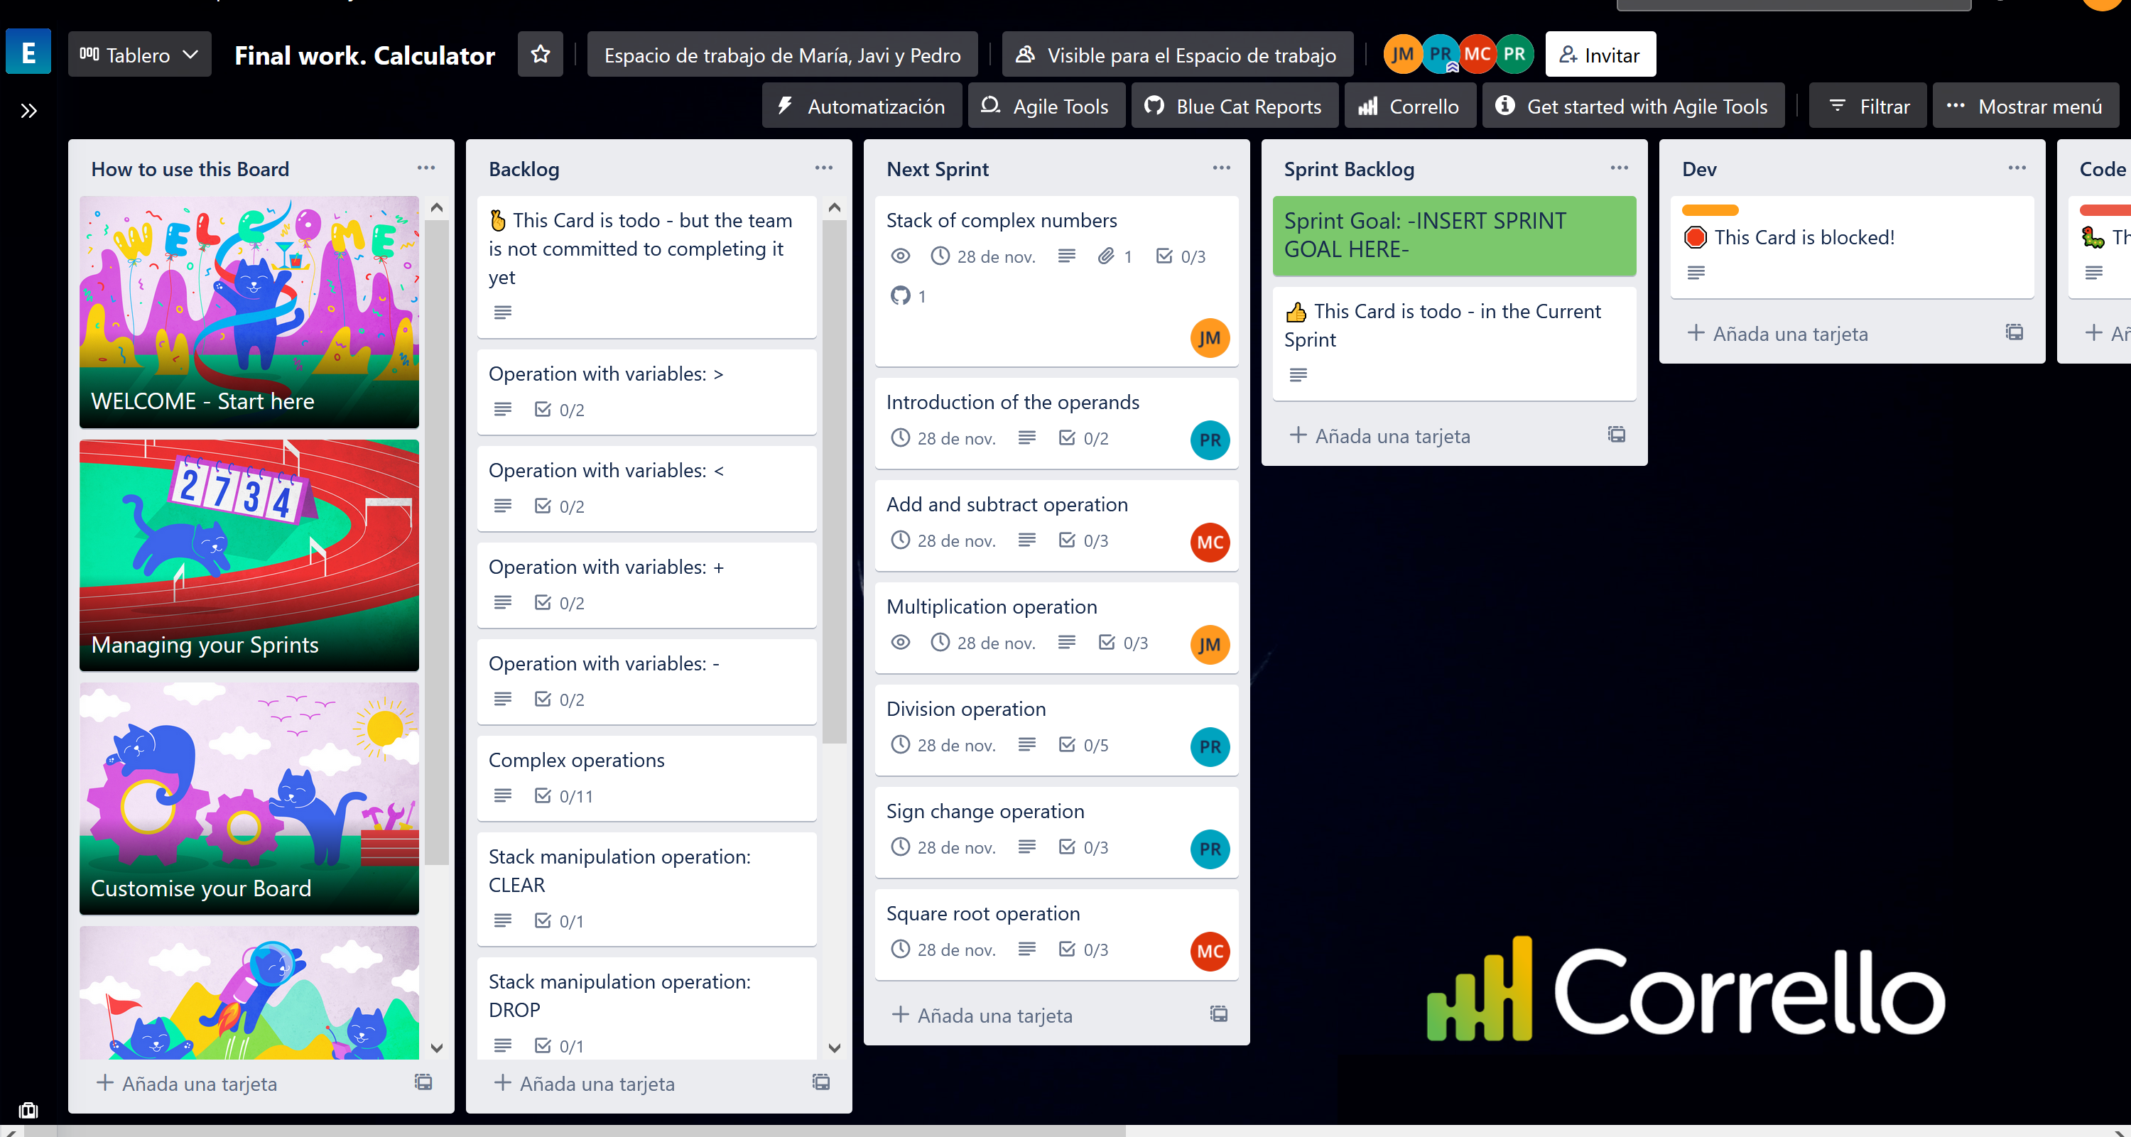
Notes:
Now we are going to see the user stories part and its planning. We have defined all the user stories of the project

Slide 5
