Slide 1
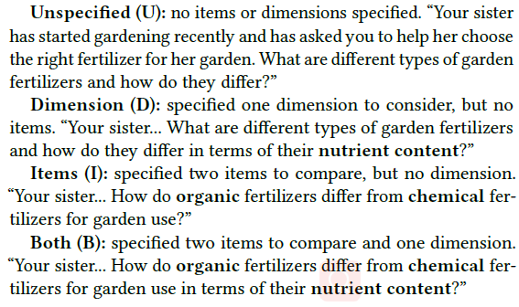
Capra, R., & Arguello, J. (2019, July). Using Trails to Support Users with Tasks of Varying Scope. In Proceedings of the 42nd International ACM SIGIR Conference on Research and Development in Information Retrieval (pp. 977-980).
RQ1：what are task characteristics that influence a user‘s ability to gain benefits from others’ trails（task version）
RQ2：what is the impact of a “mismatch” between a current user‘s task and previous user’s task which originated the trail（trail version）
User study
4×2：task version

Slide 2
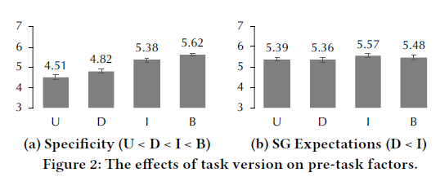
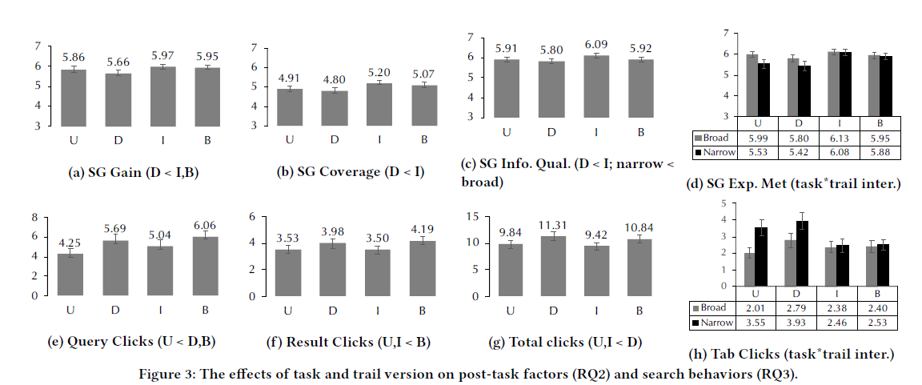
trail version： ①broad trail condition; ②narrow trail condition
Notes:
①broad trail condition, the trails came from participants in a previous study who completed task version U (no items or dimensions) for the same task topic. ②narrow trail condition, the trails came from participants who completed task version B (two items, one dimension).
相同scope的trail最好，否则提供宽径的

Slide 3
Hendahewa, C. , & Shah, C. . (2017). Evaluating user search trails in exploratory search tasks. Information Processing & Management, 53(4), 905-922.
RQ1 : Can we assist struggling users by recommending them better search paths in order to improve their search performance and reach the task goal?
RQ2 : Provide a set of metrics for performance assessment based on the recommended search trails.
Conclusion：the information coverage and the order of the recommended queries and pages at the end of each search trail are more important than merely providing a set of useful or relevant Web pages to the under-performing users.

Slide 4
①introducing new sub topics can act as a way of improving the exploration and knowledge discovery of users；early identification of struggling and recommendation of search trails leads to higher information gains
②发现的可能性：recommended order of search trails surpasses both random and actual order of search trails in terms of LD measure. Again, this emphasizes that the recommended search trail order ensures hard-to-discover pages are found first.
③检索式顺序：once a user has gathered information throughout their search processes, sites that have the most clicks would yield a higher goodness measure when their information is deemed useful by an increasingly better informed user.
④网页顺序：recommended order of search trails outperforming random and actual orders of search trails

Slide 5
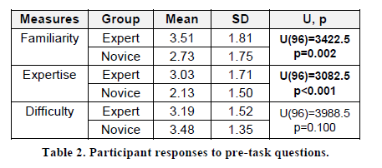
Xiaojun Yuan and Ryen White. 2012. Building the trail best traveled: effects of domain knowledge on web search trailblazing. In Proceedings of the SIGCHI Conference on Human Factors in Computing Systems (CHI ’12). Association for Computing Machinery, New York, NY, USA, 1795–1804.
RQ1：How users blaze trails in a Web search context；
RQ2：Similarities and differences in how domain experts and novices blaze trails, and if and how the trails eventually generated by the two groups differ

Slide 6
Trailblazing Process
从检索式看：Previous work has shown that the Web is fertile ground for those without medical training to become unduly concerned about serious medical conditions .新手更多关注严重方向而专家更加关注实际解决办法，This underscores the importance of domain expertise when searching in a sensitive topic area such as healthcare, and provides a good use case for when trails may have a positive impact on search decisions.
从URL看：专家多使用政府和教育网站（为了帮助非专业人士理解）
轨迹：专家筛选掉了更多的URL, experts found more sophisti-cated information, but filtered it for inclusion in the trails.
时间：专家检索得更快
专家的URL更具相关性：we obtained human relevance judgments for over one hundred thousand queries that were randomly sampled by frequency from the query logs of the Bing commercial search engine

Slide 7
Trail Outcomes
网站：domain-specific medical sites were more popular than search engines among experts. The most popular domain for novices was google.com
信息来源和展现方式会影响网站的选择：Experts selected pages providing summary and structured information while novices favored content-rich pages
搜索轨迹结构：
搜索轨迹价值：被试自评
Notes:
专家会选择有摘要、结构的网页，而新手会偏向于使用内容丰富（可能很复杂）的网页

Slide 8
Ryen W. White and Jeff Huang. 2010. Assessing the scenic route: measuring the value of search trails in web logs. In Proceedings of the 33rd international ACM SIGIR conference on Research and development in information retrieval (SIGIR ’10). Association for Computing Machinery, New York, NY, USA, 587–594
Four sources (origin, destination, sub-trail, and full-trail), which: (i) provide more relevant information? (ii) provide more topic coverage? (iii) provide more topic diversity? (iv) provide more novel information? (v) provide more useful information?

Slide 9
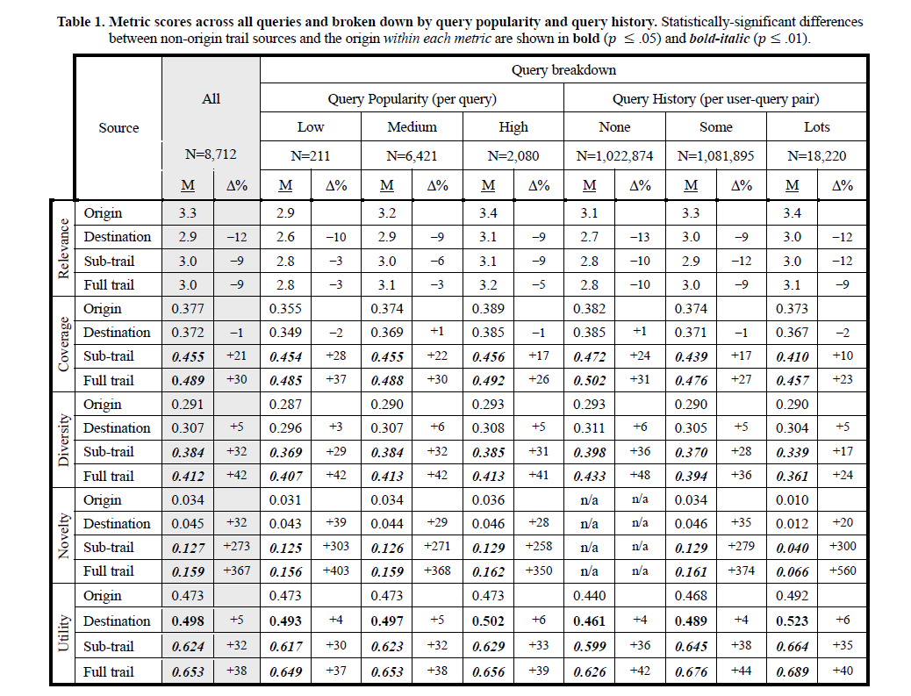

Slide 10
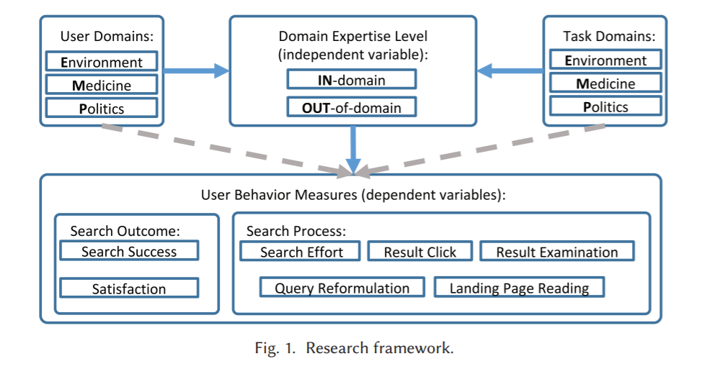
Mao, J., Liu, Y., Kando, N., Zhang, M., & Ma, S.(2018). How does domain expertise affect users' search interaction and outcome in exploratory search?. Acm Transactions on Information Systems, 36(4), 42.1-42.30.
RQ1: What is the relationship between domain expertise and search outcomes?
RQ2: Which user behaviors, including how the user formulates queries, interacts with SERPs, and reads the landing pages, will be affected by domain expertise in exploratory search?
RQ3: Are the influences of domain expertise consistent across different knowledge domains?

Slide 11
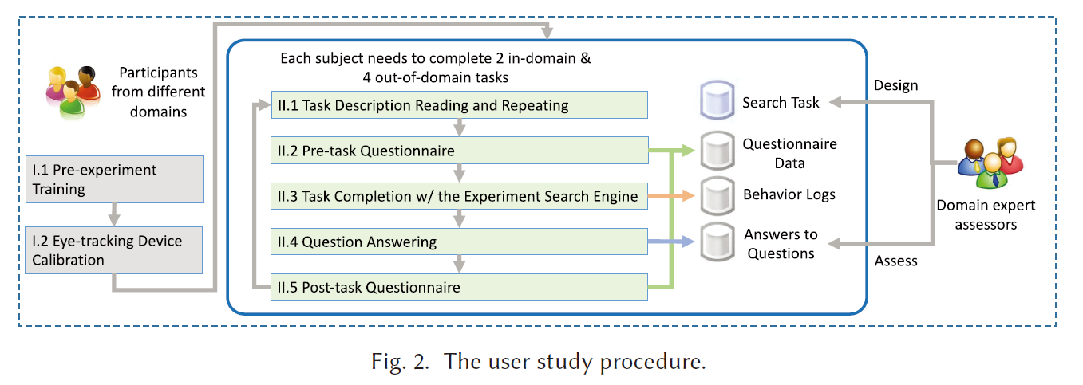

control the task and domain effects
declarative domain knowledge（用户关于搜索的主题领域的知识）and procedural domain-specific search strategies(特定领域的程序性的搜索策略)

Slide 12
①Our analysis confirms that a high domain expertise level often leads to a higher success rate in completing the search tasks，但满意度没有显著区别；
②with task descriptions being the major source for query vocabulary, the participants may use more new query terms from landing pages and SERPs when exploring unfamiliar domains;
③ We find that the results clicked by domain experts may not be more relevant. Therefore, we should rethink about how to exploit domain experts click logs.
④With an eye tracker, we find that the nonexpert users use more terms encountered during search as their query terms, especially in the medicine domain. We should enhance the query suggestion function for highly technical domains like the medicine domain because exploring such domains may require domain-specific query vocabulary.
⑤because the effects of domain expertise level on users search behavior may be different in different knowledge domains, when trying to personalize the search results according to the user s domain knowledge level, we need to develop different models for different knowledge domains
Notes:
领域专家拥有更高的搜索任务完成成功率，但是专家用户和新手用户在搜索满意度方面没有显著差异。
领域专家可以更有效的完成搜索任务；任务描述是用户检索词的主要来源，熟悉的领域和不熟悉的领域对比，用户在探索不熟悉的领域时，会更多地使用来自SERPs界面和内容页面的词语作为检索词；被领域专家点击的结果页面不一定更有用；领域专家在阅读内容页面时认知负担较小。
来自政治领域的被试在完成领域内搜索任务时，投入较少的搜索努力并感到更满足；医学领域的被试使用了更多新的查询术语（而不是来自任务描述、内容页面或SERP页面），这些术语可能来自他们的先验知识他们的专业领域。

Slide 13
Liu, J., & Zhang, X.(2019). The role of domain knowledge in document selection from search results. Journal of the Association for Information Science and Technology, 70(11), 1236-1247.
RQ1. Do people with different levels of DK select the same or different set of documents for the same search topic?
RQ2. For the selected documents on the search result pages (SERPs), are there differences between DK experts and novices regarding the documents ranking positions
RQ3. Are there differences between domain experts and novices in assessing the relevance of their selected documents, including the documents that were selected by both groups
RQ4. Do the documents selected by domain experts have different features than those selected by domain novices

Slide 14
研究设计
The study designed an experimental search system using the Indri search engine from the Lemur toolkit.2 The system s underlying data set used a subset of the MEDLINE bibliographic database (Hersh &amp; Voorhees, 2009) in the Text Retrieval Conference s (TREC3) 2004 Genomics track data collection. This subset was for the period of year 2000 2004 (n = 1.85 million), the size of which was large enough to allow reasonable retrieval efficiency
The topics were selected based on the consideration of balancing (i) MeSH categories, (ii) the specificity levels of the topics, and (iii) search difficulty levels.
(ii)Task specificity was determined by the level of the task topic keywords in the MeSH tree, specifically, the path length to the root in the MeSH category tree, as judged by an external expert in the biomedical area hired in the study. A topic having a MeSH hierarchy level of higher than three was considered as a general, and otherwise, specific.
A participant’s DK level was determined by two factors: (i) his/her familiarity rating for the MeSH terms, and (ii) his/her search topic familiarity and expertise ratings in the pretask questionnaires.

Slide 15
结果
Although some common documents (less than a quarter of all documents) were selected by both high and low domain knowledge users, the two groups selected different sets of documents, and the number of documents read by domain experts was higher than for novice users
domain novices tended to view documents ranked on the top of the SERPs (that is, those deemed more relevant by the systems)
domain experts were found to have higher self-assessed relevance scores, and their selected documents also had higher relevance scores assessed by the TREC gold-standard evaluation
domain experts selected documents that were longer, had more MeSH terms, and more general MeSH terms.
Notes:
虽然有一些共同的文档（少于所有文档的1/4）是被高领域知识水平用户和低领域知识水平用户同时选择，但是两组用户选择的文档集合存在差异，而且领域专家阅读的文档数量高于新手用户。
领域的新手用户更倾向于查看在SERPs页面上排序较高的文档。
领域专家对自己所选定的文档的相关性的自我评分较高，他们所选的文档由TREC评定的分数也更高。
领域专家选择的文档较长，他们选择的文档中拥有更多的MeSH词汇表中的术语，和更多宽泛的MeSH词汇。

Slide 16
O'Brien, H. L. , Kampen, A. , Cole, A. W. , & Brennan, K. . (2020). The Role of Domain Knowledge in Search as Learning. CHIIR '20: Conference on Human Information Interaction and Retrieval.
探索性检索中的Search as Learning（检索策略不同）
Participants who are less familiar with search topics may achieve greater knowledge gains. The search may have turned up more new information for NE（新手） than for DE（领域专家）.
With the exception of the fact-finding task, DE self-reported greater learning gains than NE。
General searchers wrote longer summaries than domain experts, but there were no significant differences in the learning outcomes between the two groups.

Slide 17
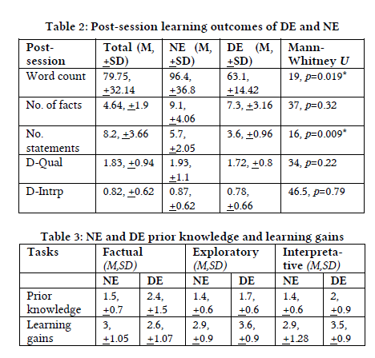
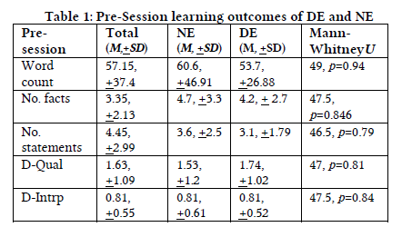
4. gains是被试的主观判断
Notes:
D-qual：学习深度，D-intrp：学习广度

Slide 18
Ryen W. White, Susan T. Dumais, and Jaime Teevan. 2009. Characterizing the influence of domain expertise on web search behavior. In Proceedings of the Second ACM International Conference on Web Search and Data Mining – WSDM’09, ACM Press, Barcelona, Spain, 132.
检索行为不同
White et al. found differences in DE s and NE’s search behaviours. Specifically, DEs issued longer queries with more domain-specific vocabulary terms; spent more time searching and visited more pages; and drew upon more technical sources.

Slide 19
Hsieh-Yee, I. . (1993). Effects of search experience and subject knowledge on the search tactics of novice and experienced searchers. Journal of the American Society for Information Science, 44(3), 161-174.
Data analyses showed that subject knowledge interacted with search experience, and both variables affected searchers behavior in four ways:
(1) when questions in their subject areas were searched, experience affected searchers use of synonymous terms, monitoring of the search process, and combinations of search terms;
(2) when questions outside their subject areas were searched, experience affected searchers reliance on their own terminology, use of the thesaurus, offline term selection, use of synonymous terms, and combinations of search terms;
(3) within the same experience group, subject knowledge had no effect on novice searchers; but——
(4) subject knowledge affected experienced searcher s reliance on their own language, use of the thesaurus, offline term selection, use of synonymous terms, monitoring of the search, and combinations of search terms.
The results showed that search experience affected searchers use of many search tactics, and suggested that subject knowledge became a factor only after searchers have had a certain amount of search experience.

Slide 20
Xie, I. , & Joo, S. . (2012). Factors affecting the selection of search tactics: tasks, knowledge, process, and systems. Information Processing & Management, 48(2), 254–270.
This study investigated whether and how different factors in relation to task, user-perceived knowledge, search process, and system affect users search tactic selection

Slide 21
1. procedure
First, participants were instructed to fill in a pre-questionnaire requesting their demographic information and their experience in searching for information. From the pre-questionnaire, data in relation to search task type, work task type, familiarity with topic, and familiarity with source were collected.
Second, participants were asked to keep an information interaction diary for 2 weeks to record the process of achieving one work-related and another personal-related task. The diaries require participants to log their source selections, search tactics, and reasons associated with why they applied or did not apply different types of search tactics. From the diaries, the authors attempted to identify factors behind their selection of search tactics qualitatively.
Third, think aloud protocols and logs were employed to record their search processes and associated verbal protocols. Participants were invited to come to the lab to search for information for one work-related and one personal search tasks. They were instructed to think aloud during their information-seeking process.
Finally, participants were also asked to fill in post-questionnaires. Their answers regarding their selection of information sources, their search tactics, their problems, and factors affecting their selection of search tactics were noted.

Slide 22
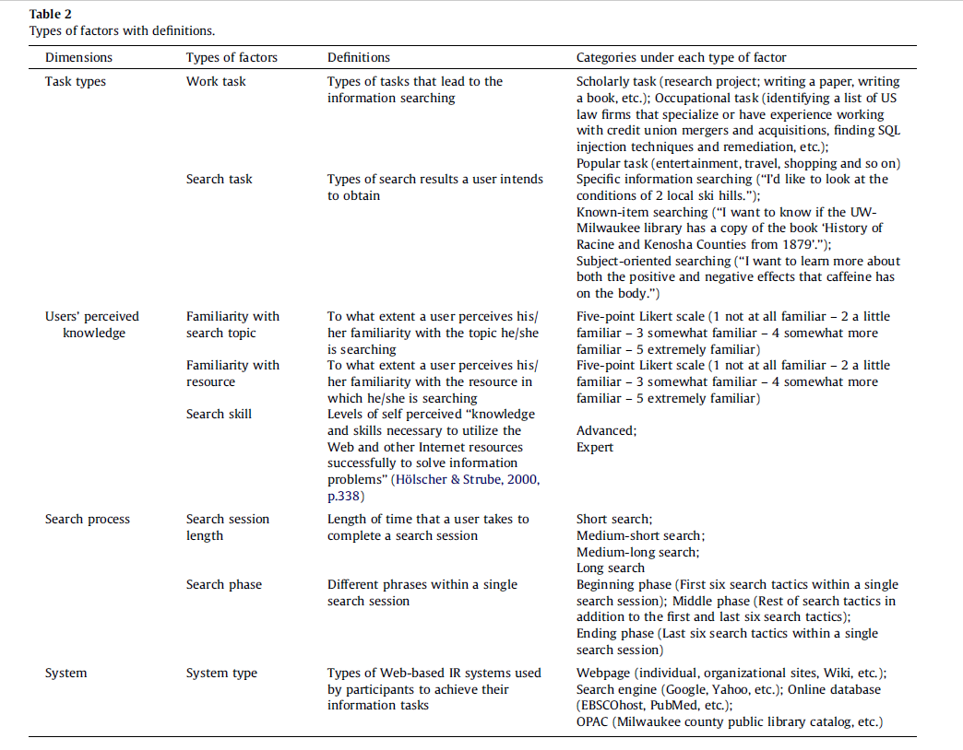

Slide 23
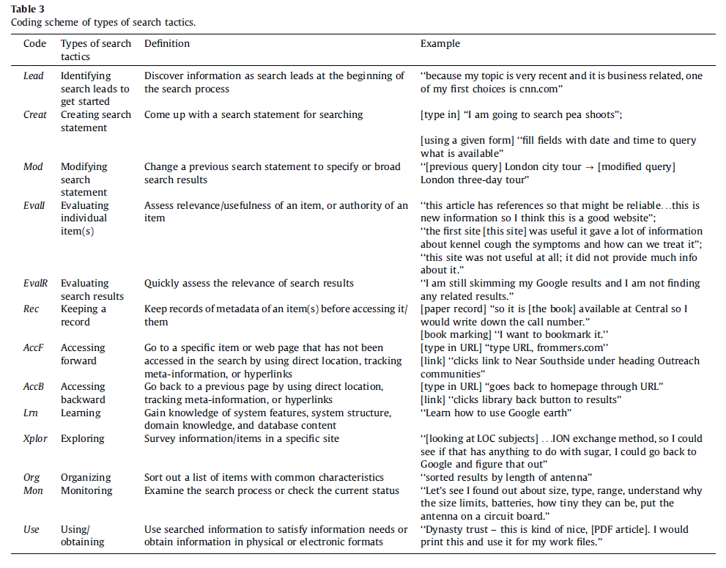

Slide 24
