Slide 1
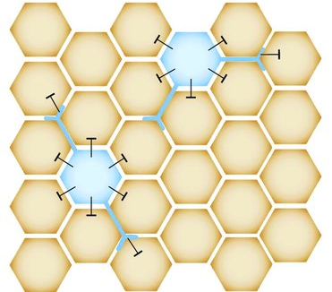
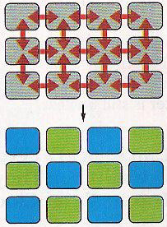
Notch signaling mediates lateral inhibition
Notch lateral inhibition
Intercellular short-range signaling
Non
Neural
Neural

Slide 2
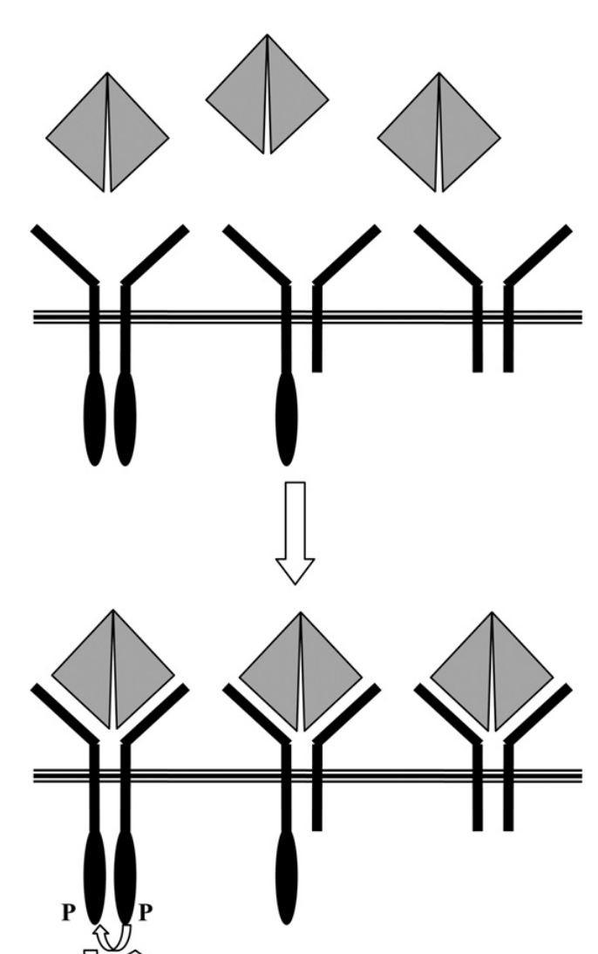
Dominant negative (DN) mutation
A mutation whose gene product adversely affects the normal, wild-type gene product within the same cell.
DN
DN
No or less ligand
X
X

Slide 3
Dominant-negative KUZ
Increases Notch activity
Decreases Notch activity
Has no activity in flies
gain a new function in flies
None of the above

Slide 4
KUZ most likely
Acts upstream of Notch
Acts downstream of Notch
Acts in parallel to Notch
Is not related to Notch pathway
None of the above

Slide 5
Why the authors conducted the experiments in both flies and frogs?
The frog and fly experiments are complementary
The Frog experiments are more compelling and convincing
The Frog experiments are more relevant to the understanding of the Notch signaling in humans
They tried to show that KUZ’s functions in Notch signaling are conserved.
There are some critical experiments that can not be done in flies.

Slide 6
KUZ is proposed to
Cleave Notch at the intracellular domain to generate activated Notch
Cleave Notch at the extracellular domain
C. Form a co-receptor with Notch
D Facilitate Notch interaction with Delta
E. None of the above

Slide 7
KUZ cleavage of Notch
was demonstrated convincingly
was not shown convincingly
was a hypothesis not supported by any experimental evidence
The results in Figure 5 are consistent with KUZ cleavage of Notch.
There are better explanations to the results seen in Figure 5

