Slide 1
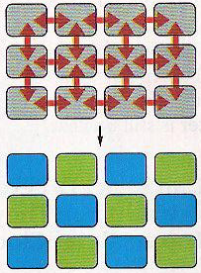
How do equivalent cells acquire different cell fates?

Slide 2

What is the major issue that the authors tried to address?
LIN-12 and Notch are similar proteins
LIN-12 acts differently from Notch
LIN-12 or Notch intracellular domain has an intrinsic biological activity
How LIN-12 intracellular domain act to affect cell fate
How Notch works in Drosophila

Slide 3
LIN-12(intra) acts like
An activated LIN-12
A LIN-12 mutant without an activity
A protein that gains a new function
A protein that needs to act through another protein
A protein that act through the endogenous LIN-12 protein

Slide 4
Delta is
A Notch-like receptor
A putative Notch ligand
A protein that acts downstream of Notch
A protein that antagonizes Notch activity
None of the above

Slide 5
Notch
is a membrane protein
can be in the nucleus
acts downstream of Delta
Normally suppresses the neural fate
All of the above

Slide 6
What did you really learn from reading this paper?
How neurogenesis is regulated in flies
How vulva development is regulated in worms.
Notch and LIN-12 have a conserved acting mechanism
LIN-12 and Notch look alike in structure
All of the above

Slide 7
What is the most interesting question that is not resolved in this paper?
How does LIN-12 specify the AC and VU cell fate?
How does Notch suppress the neural fate?
How do Notch and LIN-12 acquire a conserved acting mechanism
How do LIN-12 and Notch evolve to have similar structures
Why is Notch observed on both plasma membrane and the nucleus?

