Slide 1
    What is cell signaling?
Mechanisms that one cell uses to communicate with and influence the behavior of another cell.
In a broader sense, the signaling could include environmental cues received by a cell
Smell
Light
Mechanic pressure
Sound
Heat
Biological molecules
Others

Slide 2
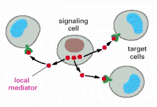
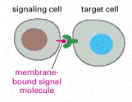

Three ways by which cells communicate with one another
Long or short ranch signaling by secreted molecules
Slow, less specific
But can signal to multiple cells
Signaling strength is distance-dependent
Contact signaling by plasma-membrane-bound molecules
Faster, very specific
But only affect a few cells
Contact signaling via GAP junctions
Very fast, very specific
Also affect a few cells

Slide 3
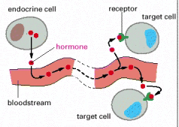
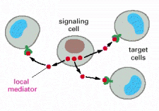
Three strategies of cell signaling by secreted molecules
1) Endocrine
Specialized endocrine cells secrete hormones, peptides, or biomolecules which travel through the bloodstream to target cells that are distributed widely throughout the body.
2) Paracrine
Cells secrete local chemical mediators to affect neighboring cells which usually are not the same cells as the signaling cell. To become a local mediator that acts only on adjacent cells, these molecules are rapidly taken up by target cells, destroyed by extracellular enzymes, or immobilized by extracellular matrix.

Slide 4
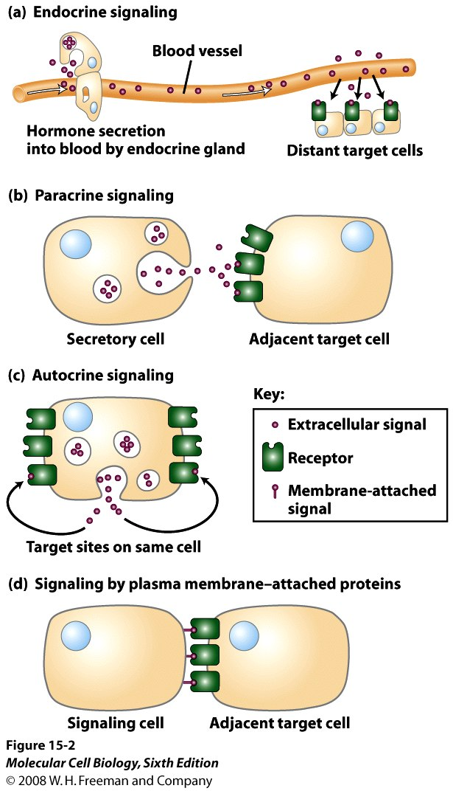
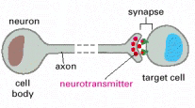
3) Autocrine
A cell secretes local chemical mediators to affect itself. Many growth factors act through this mode.
4) Synaptic signaling
Nervous system. Cells secrete neurotransmitters at specialized junctions called chemical synapses; the neurotransmitter diffuses across the synaptic cleft, typically a distance of about 50 nm, and acts only on the adjacent post-synaptic target cell.

Slide 5

Which of the followings has the faster signaling speed?
Endocrine signaling
Synaptic signaling
Signaling by paracrine
All have similar speeds
It may vary on cell types

Slide 6
Which of the signaling mode can reach the farthest target cells?
Endocrine signaling
Synaptic signaling
Signaling by paracrine
Both endocrine and synaptic signaling
All can

Slide 7
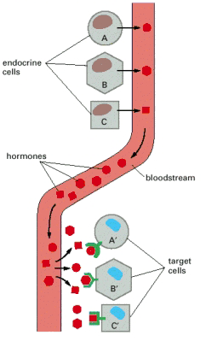
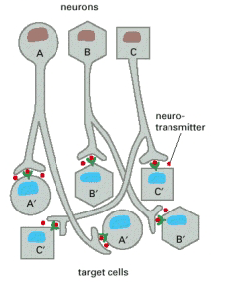
Comparison of endocrine and synaptic signaling
Slow (minutes or even hours)
Very Fast
Specificity depend on ligands and receptors
Precise
Diluted in the blood
Not Diluted

Slide 8
The biochemistry of the cell signaling
The nature of the signals
A. Environmental cues: light, chemicals, sound, food, mechanical pressure, pheromones, and heat
B. Cellular signals
Chemicals (Ions), gas (NO, CO, O₂), hormones, peptides, lipids, and growth factors.
- membrane-bound or membrane-independent
- hydrophilic signals: can not diffuse into a cell and signal by binding to a cell surface receptor
- hydrophobic signals: carried by carrier protein in the blood and can enter the cells through plasma membrane

Slide 9
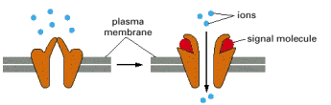
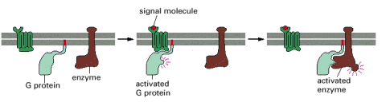
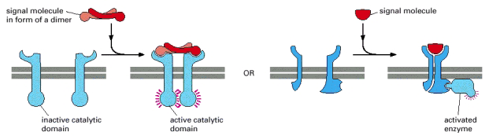
Receptors (the molecule that receives the signal)
    1) Ion channel-linked receptors
2) G-protein-linked seven transmembrane receptors
3) Enzyme-linked receptors:
-receptor protein kinases: tyrosine kinases, serine/threonine kinases
-receptors coupled to protein kinases
-protein tyrosine phosphatase receptors
-receptors with other catalytic or non-catalytic domains

Slide 10
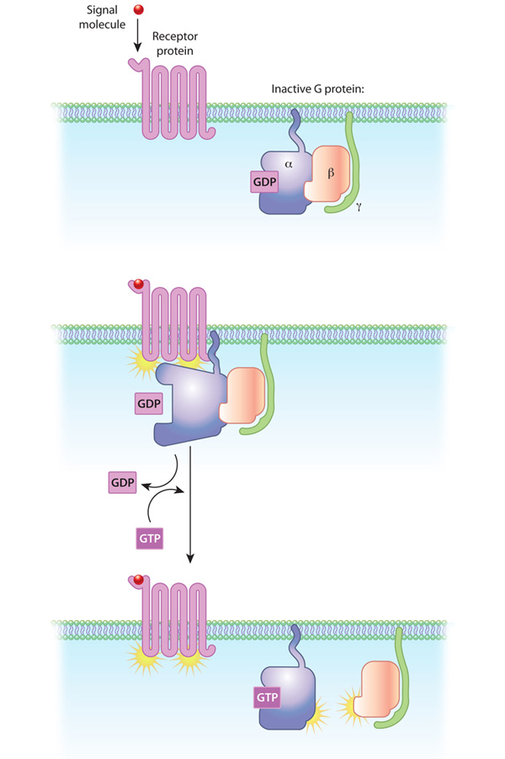
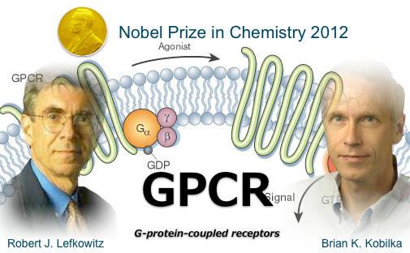

Slide 11
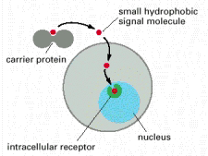
4) Intracellular Receptors—Steroid hormone receptors

Slide 12
Animal Development

Slide 13


Slide 14
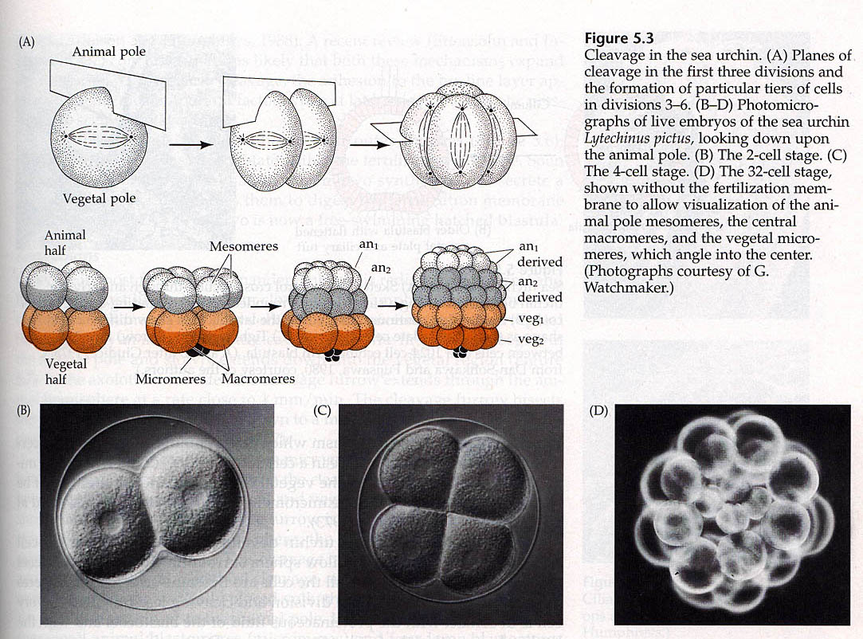
Cleavage and Blastomere
In all animal species known so far, differentiation begins by a process called cleavage, a series of mitotic divisions whereby the enormous volume of egg cytoplasm is divided into numerous smaller, nucleated cells. These cleavage-stage cells are called blastomeres.

Slide 16
THE DECISION OF LIFE VS. DEATH
Proliferation
Signals
Differentiation
Death

Slide 17
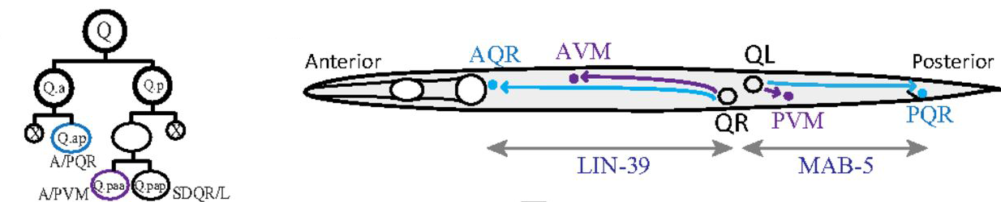
Cells often migrate to function

Slide 18
Why differentiation starts with cell division or cleavage?
It generates different cells
How does cell division generate two different cells?
Unequal distribution of
cytoplasmic determinants
Unequal cell division
Cell-cell interaction
A
B
A
B
A
B

Slide 19
Three different types of embryo development
Mosaic Development (autonomous specification):
determined by local determinants and no cell-cell interaction
Experimental test?
remove one blastomere, the blastomere still develop as it will be in the intact embryo
2) Regulative Development (conditional specification):
determined by cell-cell interaction and local determinants not important (e.g. mouse)
Experimental test: if remove one blastomere, the other blastomeres will take over and the embryo is fine.
Intermediate (Xenopus, fly and C. elegans)
local determinants and cell-cell interaction are both important.

Slide 20
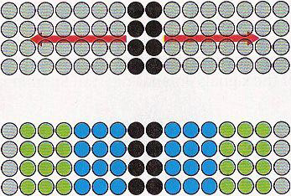
Cell-cell interaction affects cell fate determination
Intercellular long-range signaling (Wnt signalling in fly)
This signaling mode most likely is mediated by
Light
Sound
Membrane-bound proteins
Secreted factors
Lipid

Slide 21
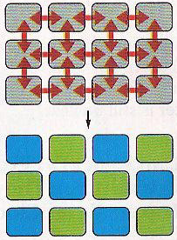
Intercellular short-range signaling
This signaling mode most likely is mediated by
Ion
Gas
Membrane-bound proteins
Secreted factors
Sound

Slide 22
Intercellular relay signaling
5
4
3
1
2
4
5
2
3

Slide 23
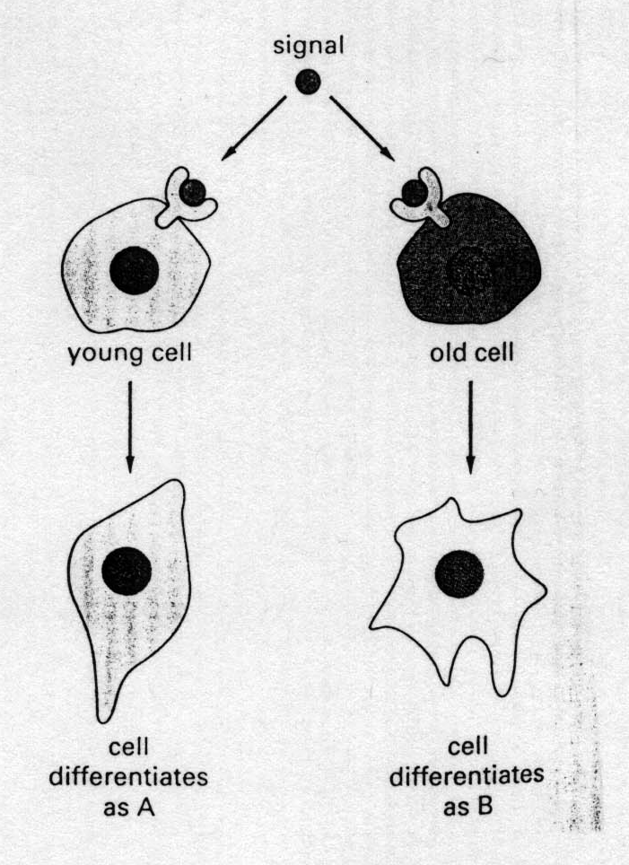
Three different ways by which a target cell responds to a signal
Position (EMS and P2)
ABp
ABp
ABa
P2
ABa
P2
EMS
EMS
Time
    Concentration (Morphogen)
Morphogen
D
C
B
A
B
C
D

