Slide 1
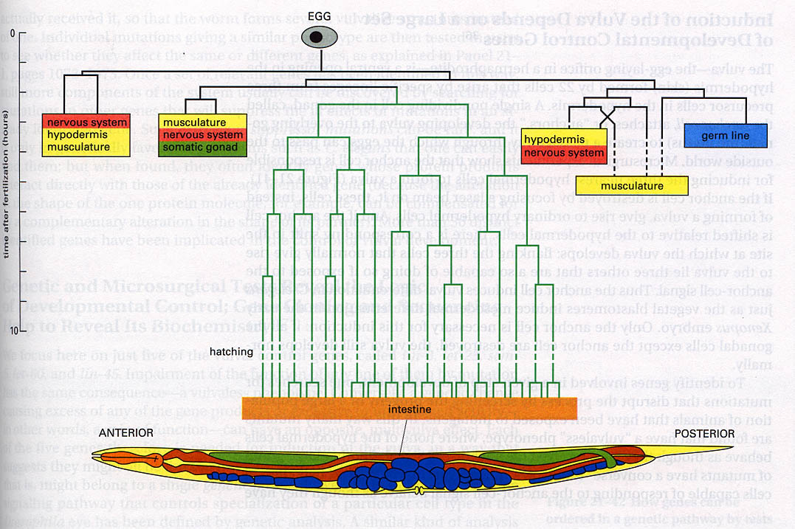
Embryo Development in C. elegans

Slide 2
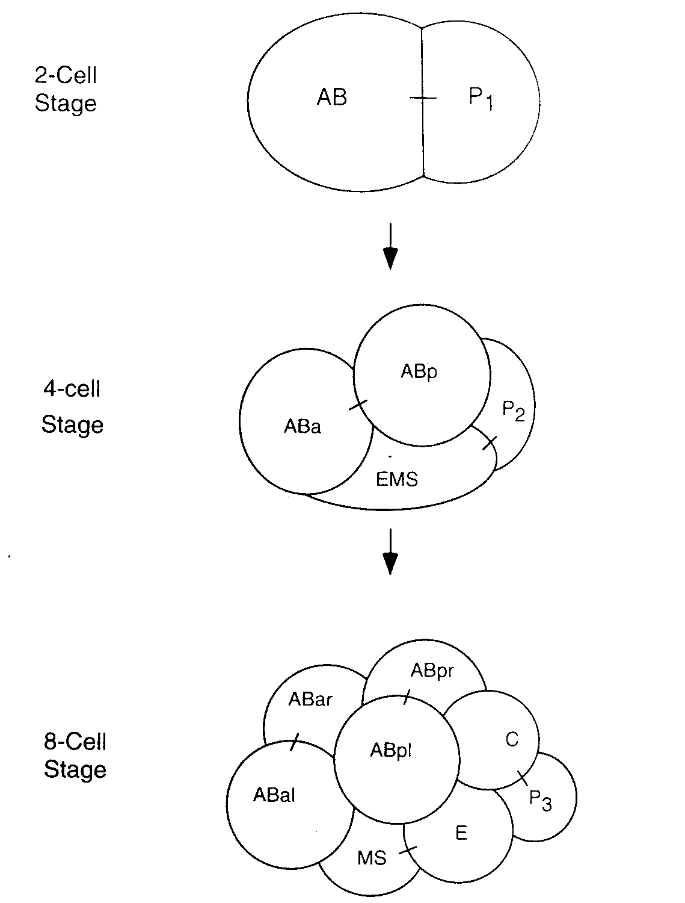


Slide 3
AB
P
AB
P
No differentiation
AB
P
P1 signals to AB

Slide 4
ABp
ABa
P2
EMS
glp-1
apx-1
ABa
P2
ABa
ABp
EMS
ABa
P2
EMS
ABp
Genetic Screen
ABa
ABa
P2
ABa
P2
EMS
EMS
glp-1
apx-1

Slide 5
ABp
ABa
P2
EMS
Some time after cell division
Immediately after cell division
ABp
ABa
P2
ABp
ABp
ABa
P2
ABa
P2
EMS
EMS
P2
EMS
Gut
No Gut
Gut

Slide 6
ABp
P2
ABa
mom-2
EMS
mom-5

