Slide 1
Prof. Ding Xue, Ph.D.
Department of MCD Biology
492-0271 (office)
ding.xue@colorado.edu
http://mcdb.colorado.edu/labs/xue/MCDB4426.htm

Slide 2

Why are you taking this class?
Just for fun
To get easy credits
To learn how to read and think about science
This might be a less boring class
I don’t really know

Slide 3
What is this class?
A different class, how science is created and done!
Combination of multiple fields and several model organisms
What are we going to discuss?
Important developmental biology questions
How we are made?
How different tissues and organs develop and are shaped?
How cells talk to one another?
Different biological techniques and approaches

Slide 4
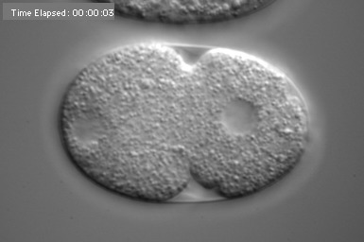

Slide 5
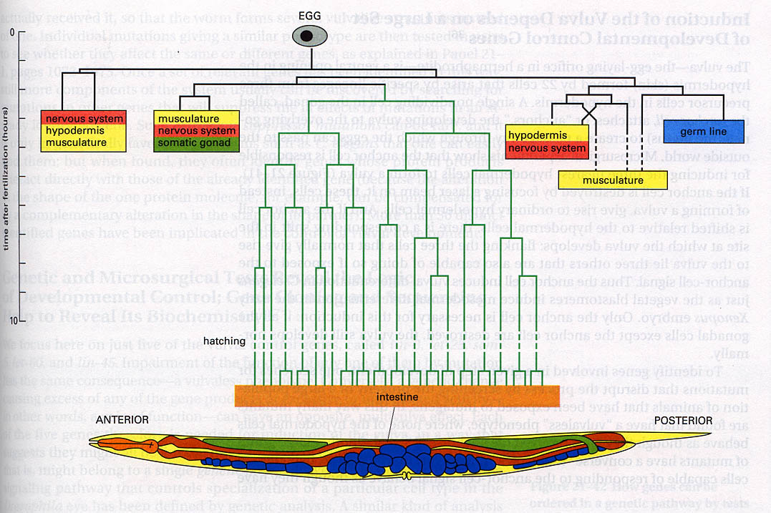
Embryo Development in C. elegans

Slide 6
Cell Signaling & Animal Development

Slide 7
How are specialized cell types generated by a single fertilized egg?
Differentiation

Slide 8
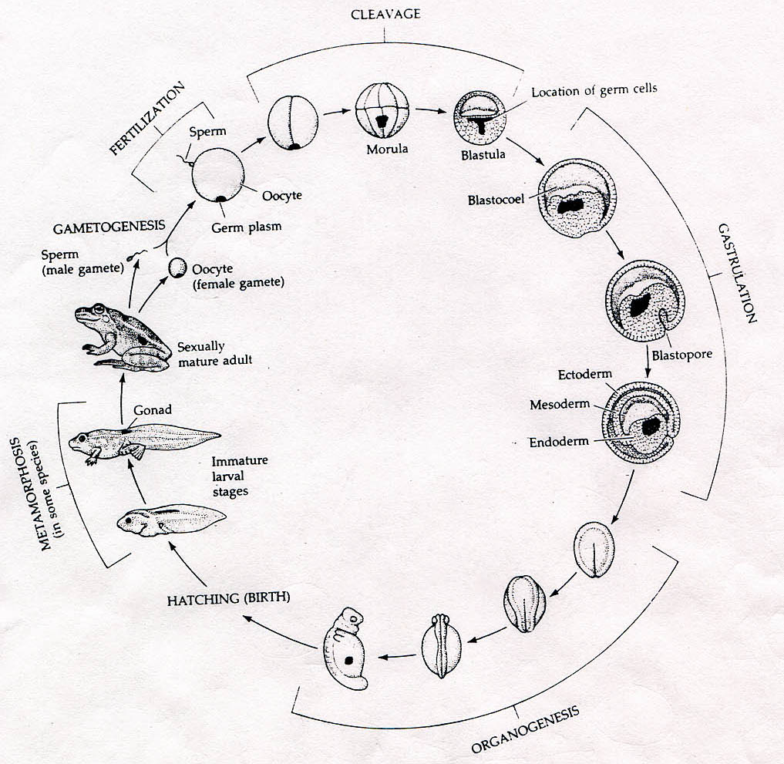
What are the mechanisms that make an egg to generate a great diversity of cell types?

Slide 9
How does a fertilized egg generate a great diversity of cell types
1) Different Genome
    2) The same genome expresses different sets
    of genes in different cell types
3) Localized Cytoplasm determinants
4) All of the above

Slide 10
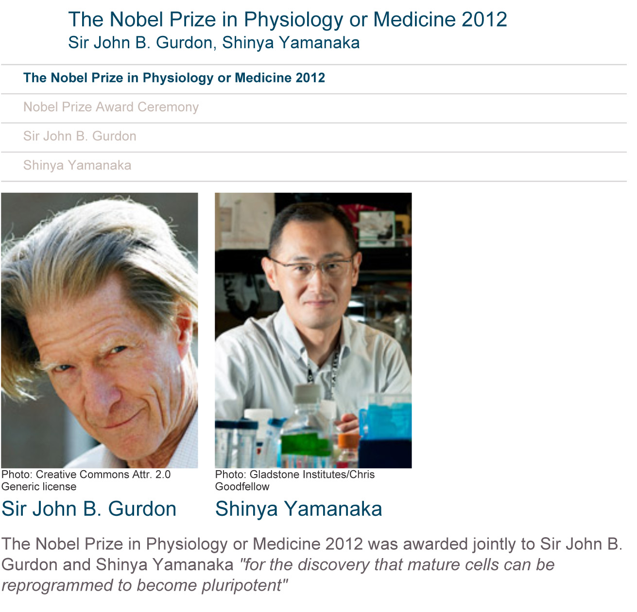

Slide 11
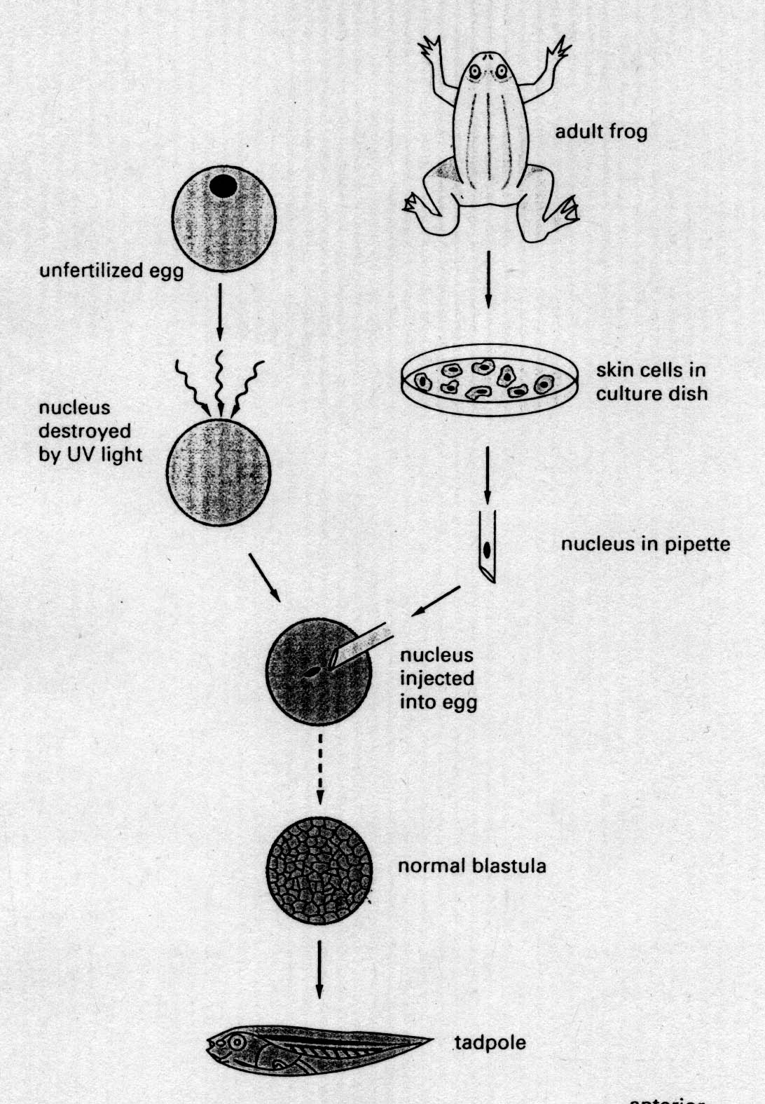
Transplantation experiment
John Gurdon

Slide 12
What does this transplantation experiment tell you?
Localized cytoplasm determinants are important
The genome stays the same during cell differentiation
Skin cells have the potential to generate all cell types
You don’t really need nuclei for cell differentiation
The oocyte without a nucleus did just fine

Slide 13
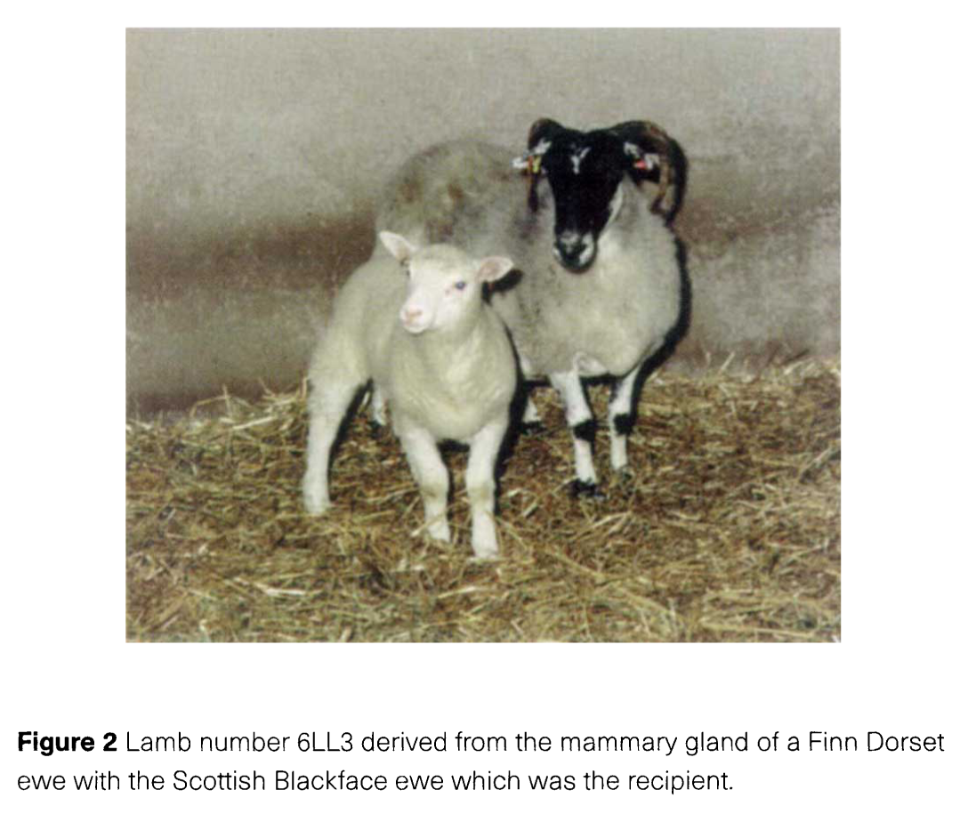
Cloning Lamb

Slide 14
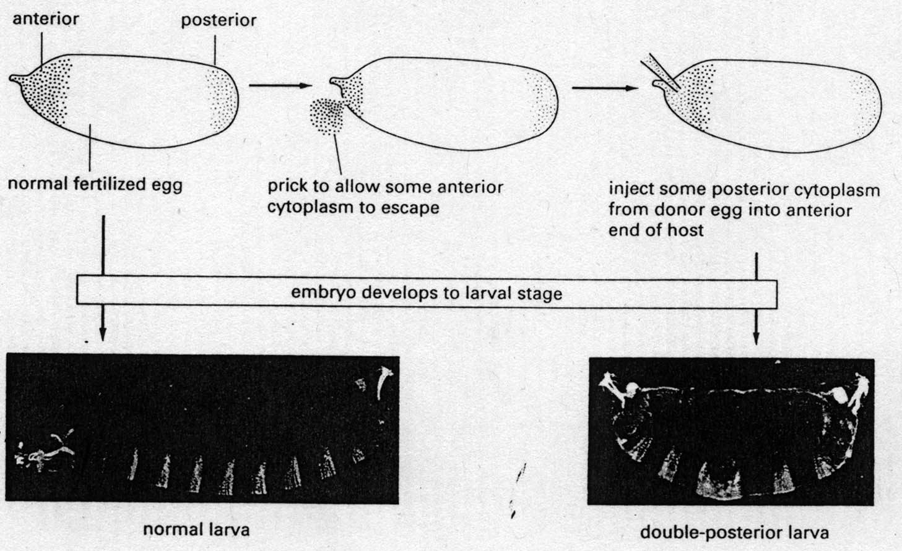

Slide 15
What does this transplantation experiment tell you?
Cytoplasmic determinants are different in the anterior and posterior regions
The genome is different in the anterior and posterior regions
The anterior region is damaged by pricking. So it differentiates like the posterior region
The anterior region sometimes can just fail to differentiate properly
None of above

Slide 16
What we are going to discuss
Cell signaling and Animal development-- General introduction of cell-cell signaling and its role in regulating animal development
Signaling molecules in cell growth and differentiation-- Signals, Receptors, and pathways
Signaling pathways in the development of model organisms
Signaling in Life vs. Death

Slide 17
Format
Mostly paper discussions with a few lectures.
Informal -- my job is to teach and encourage you to think and to ask about Science
My expectation of you
Read
Learn
Think
Ask

Slide 18
Requirement
Molecular biology, cell biology, biochemistry, genetics, maybe developmental biology
Has time to read
Interested in thinking
Not too interested in grades as a senior
I will not be a traditional grader. Effort is #1, activity and participation are what I am looking for.
i-clicker system will be used in discussions and answering questions. So get yourself a clicker!

Slide 19
Grading system
Two exams (take home and in class) (50%)
Participation in classroom discussion (40%)
Attendance (10%).
Grading in participation and discussion will emphasize whether you have read the papers thoroughly so that you can explain the figures and tables well and your willingness to discuss them more than the clarity of how you present and discuss information. In other words, my emphasis is on getting you to think about, criticize, interpret, and discuss scientific experiments without being intimidated about speaking up.

Slide 20
    What is cell signaling?
Mechanisms that one cell uses to communicate and influence the behavior of another cell.
In a broader sense, the signaling could include environmental cues received by a cell
Smell
Light
Mechanic pressure
Heat
A biological molecule
Others

Slide 21
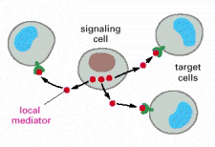
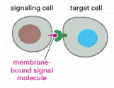

Three ways by which cells communicate with one another
Long or short ranch signaling by secreted molecules
Slow, less specific
But can signal to multiple cells
Signaling strength is distance-dependent
Contact signaling by plasma-membrane-bound molecules
Faster, very specific
But only affect a few cells
Contact signaling via GAP junctions
Very fast, very specific
Also affect a few cells

