Slide 1
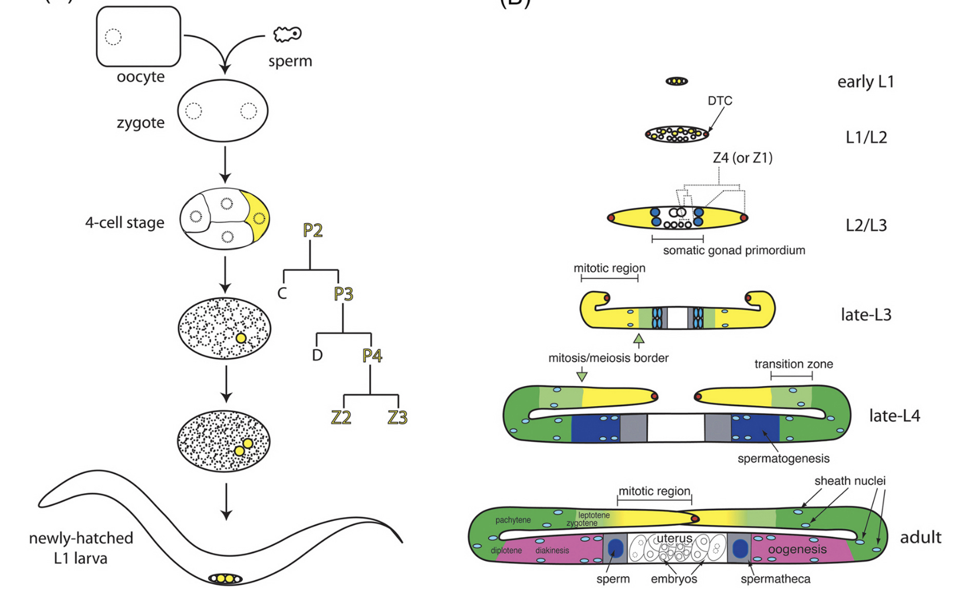

Slide 2

What is the major issue of this paper?
How C. elegans germ cells divide?
How germline specification is achieved?
What is the function of the MEX-3 protein?
Where are mex-3 and gld-1 proteins localized?
How totipotency of germ cells is maintained?

Slide 3
In mex-3 gld-1 double mutant some germ cells can transdifferentiate into
Neurons
Intestine cells
Muscle cells
Neurons and muscle cells
All of the above

Slide 4
What is the most important concept that you learn from reading this paper?
The localization patterns of MEX-3 and GLD-1
How pluripotency of a germ cell can be maintained by translational regulators at the level of RNA
What kind of protein GLD-1 is
C. elegans is a good animal model for studying germ cell maintenance
PAL-1 and HLH-1 play an important role in transdifferentiation of germ cells in the mex-3 gld-1 double mutant

Slide 5
Why loss of MEX-3 or GLD-1 by itself exhibits very mild or no germ cell transdifferentiation defect?
because there is a third, more important gene that maintains germ cell totipotency
B. because MEX-3 and GLD-1 act in parallel to prevent germ cell transdifferentiation
C. because MEX-3 and GLD-1 need to act in the same pathway to prevent germ cell transdifferentiation
None of the above
E. All of the above

Slide 6
What are the important questions that remain to be addressed and need to be analyzed in subsequent study?
A. How does MEX-3 function?
What are factors beside MEX-3 and GLD-1 that play a role in maintaining germ cell totipotency?
How MEX-3 and GLD-1 coordinate to prevent differentiation of germ cells?
What are the targets of MEX-3 and GLD-1?
All of the above

