Slide 1
Maternal Effects
Rare case
P0
m/+ x m/+
wild-type
m/+ x m/+
wild-type
F1
m/m
m/m
Phenotype
mutant
wild-type
F2
m/m
m/m
Phenotype
mutant
mutant
A maternal effect is the phenomenon where the genotype of a mother is expressed in the phenotype of its offspring, unaltered by paternal genetic influence

Slide 2

How did the author verify that mom mutants produce more mesoderm?
By dye staining
By immunostaining using an antibody specific for pharyngeal muscle cells
By polarized light
By isolation and reconstitution experiments
None of the above

Slide 3
How did the authors find out in which blastomere mom-2 acts to affect EMS cell fate determination?
By examining the cell lineage
By antibody staining
By genetic analysis
By isolation and reconstitution of blastomeres
All of the above

Slide 4
How did the authors know that mom-2 encodes a WNT homologue
By transformation rescue
By antisense RNA phenocopy
By sequencing analysis and identifying mom-2 mutations in the WNT homologue
All of the above (A +B + C)
B + C

Slide 5
What is Wnt signaling in your opinion?
It is a receptor important for cell-cell interaction
It is a secreted protein important for cell-cell interaction
It refers to both the receptor and the signal and the upstream and downstream components
It has nothing to do with cell-cell signaling
It refers to the signaling cell, the signaling molecule, and its upstream components

Slide 6
What is the most important thing that you learn from reading this paper?
What is the receptor in EMS that receives the signal from P2?
What is the ligand that signals from P2 to EMS
Wnt signaling can change orientation of mitotic spindle
Genetic analysis is very powerful in identifying signaling components of a biological process
Isolation and reconstitution of blastomeres is a
powerful method to understand embryo development.

Slide 7
ABp
ABa
P2
EMS
Some time after cell division
Immediately after cell division
ABp
ABa
P2
ABp
ABp
ABa
P2
ABa
P2
EMS
EMS
P2
EMS
Gut
No Gut
Gut

Slide 8
Five genes (mom-1, 2, 3, 4, 5) have been identified to be important for gut differentiation
ABp
P2
ABa
mom-2
EMS
mom-5
MOM-1: Drosophila PORCUPINE
MOM-2: Wnt homologue
MOM-3: Drosophila and human Wntless
MOM-4: MAP kinase kinase kinase homologue
MOM-5: Frizzled homologue

Slide 9
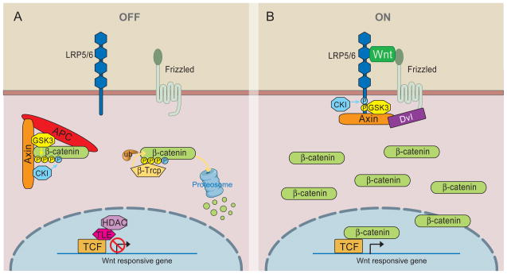
WNT signaling
MOM-2
MOM-5
POP-1

Slide 10
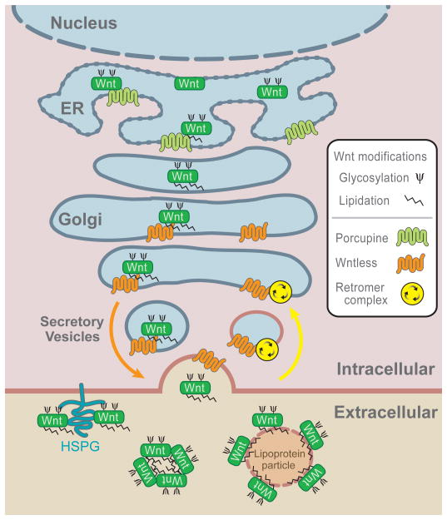
WNT Biogenesis
MOM-2
MOM-1
MOM-3

