Slide 1
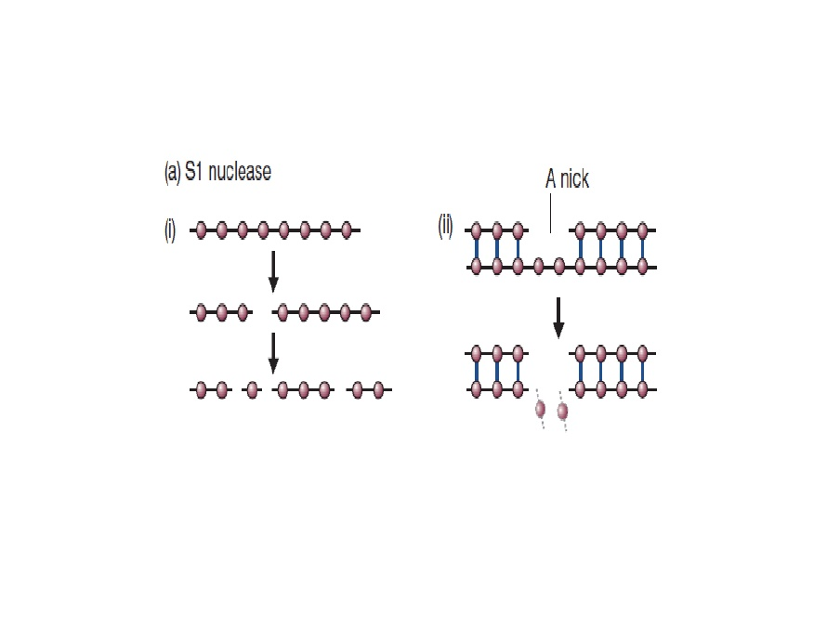
S1 Nuclease degrades single-stranded nucleic acids, releasing 5'-phosphoryl mono- or oligonucleotides. It is five times more active on DNA than on RNA. S1 Nuclease also cleaves dsDNA at the single-stranded region caused by a nick, gap, mismatch or loop

Slide 2
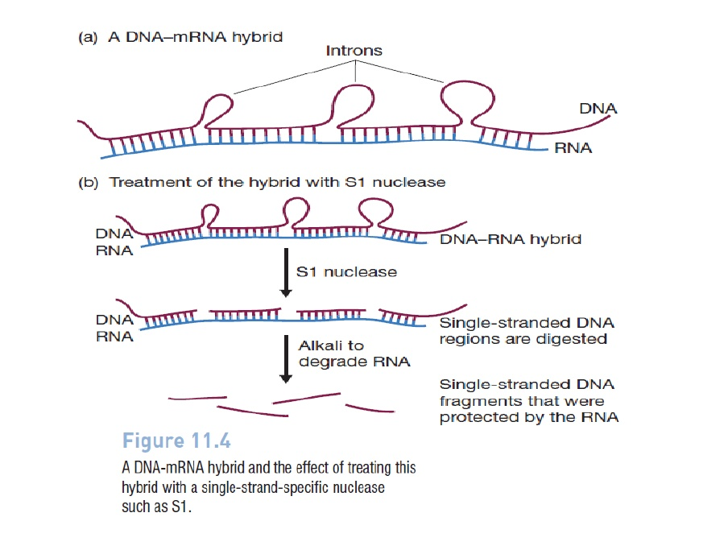

Slide 3
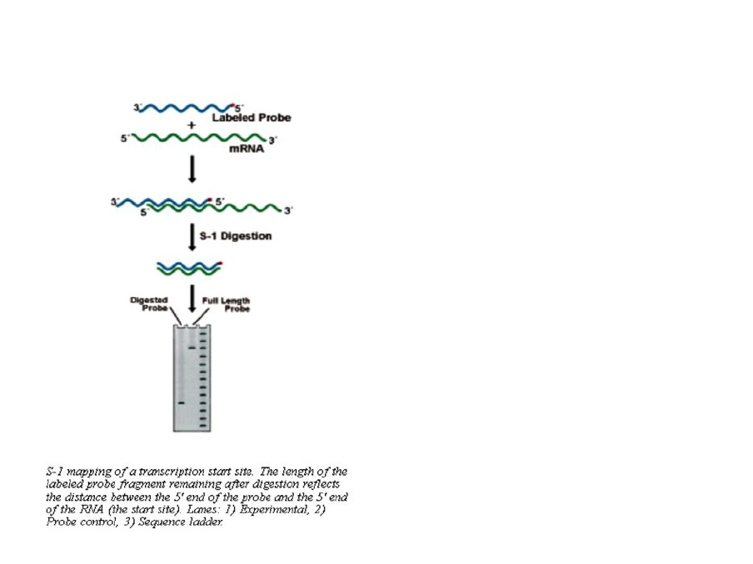

Slide 4
Let-7 is
a small DNA molecule that inhibits transcription of its target gene
a small DNA molecule that inhibits translation of its target mRNA
Possibly a small RNA that inhibits translation of its target mRNA
A small RNA that inhibits transcription of its target gene
None of the above

Slide 5
Let-7 was discovered
by looking for interesting RNAs that might affect developmental timing in C. elegans.
by genetic screens for mutations that affect developmental timing in C. elegans.
by examining all the lethality genes that affect developmental timing in C. elegans
by looking for lin-4-like small RNAs that affect developmental timing in C. elegans
All of the above

Slide 6
Let-7 likely acts by
A. antagonzing the activity of lin-4 small RNA
B. inhibiting the translation of lin-41 mRNA
C. directly activating the translation of lin-29
D. inhibiting the translation of lin-14
E. None of the above

Slide 7
From this paper, you learn that microRNA acts by
binding to the target protein
binding to the 3’ UTR of the target mRNA
binding to the promoter of the target gene
binding to the intron of the target transcript
binding to the coding region of the target transcript

Slide 8
What are the next most important experiments that you want to do with let-7 based on this paper?
A Whether similar microRNAs exist and act to regulate gene expression in other organisms?
B What are other in vivo targets of let-7?
C How does let-7 regulate gene expression in C. elegans?
D How is let-7 activity regulated?
E Whether let-7 is modified in different developmental stages

