Slide 1
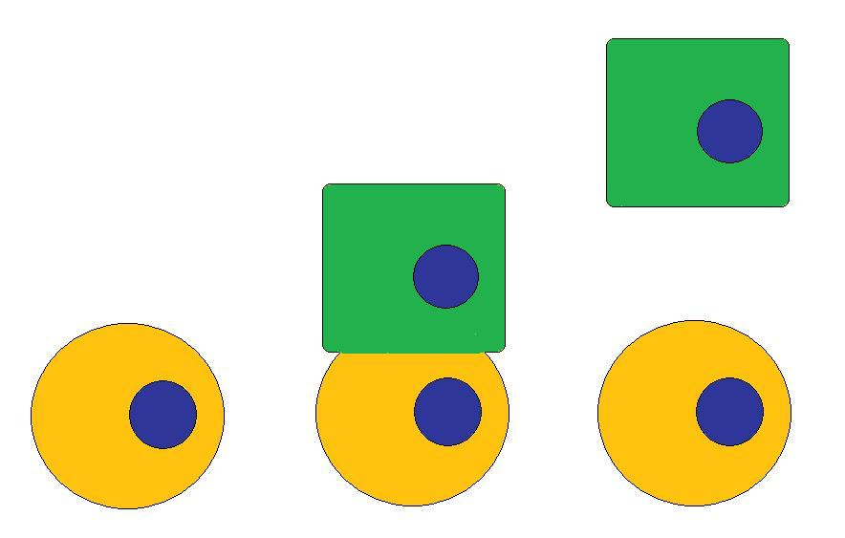
Stem Cells
Self-renews
Differentiates
Progenitor cell
Stem cell
Stem cell
Slides are from Stem Cell Education Outreach Program (SCEOP)

Slide 2


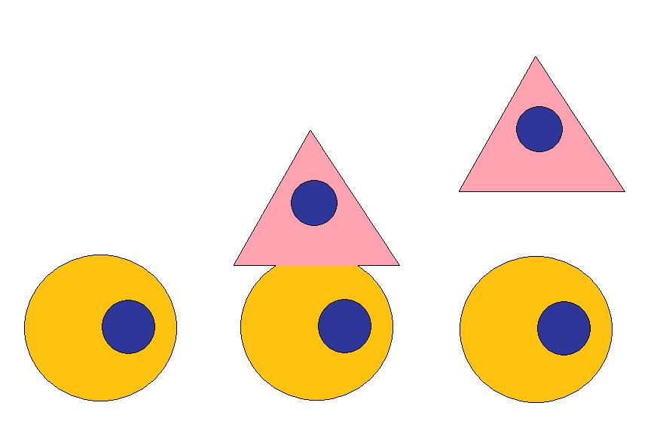
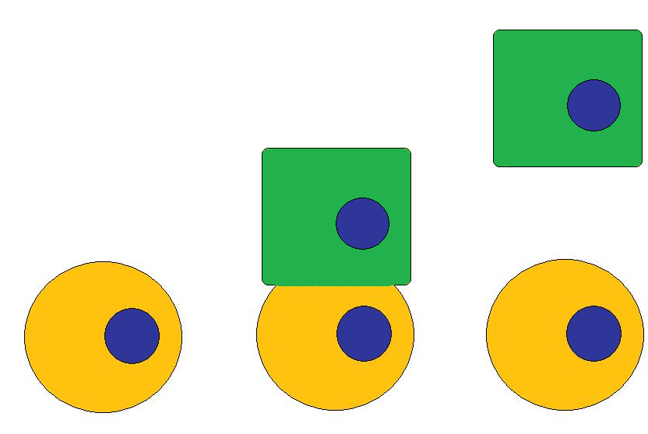
DIFFERENTIATION
DIFFERENTIATION
→ SELF – RENEWAL →
Slides are from Stem Cell Education Outreach Program (SCEOP)

Slide 3

What is the major issue of this paper?
How C. elegans embryos divide?
How germline specification is achieved?
What is PIE-1 protein?
Where is pie-1 mRNA localized?
How germline blastomeres divide?

Slide 4
How did the authors clone the pie-1 gene?
Through Antibody staining
Tc1 transposon insertion or tagging combined with genetic mapping
C. elegans lineage analysis
They cloned the gene by pure luck
They cloned the gene by a candidate approach

Slide 5
What is the most important concept that you learn from reading this paper?
The localization patterns of PIE-1
How pluripotency of a stem cell can be maintained by a general repressor
What kind of protein PIE-1 is
C. elegans is a good animal model for studying germ cell specification
PIE-1 associates with centrosomes during cell division

Slide 6
How did the authors reach the conclusion that PIE-1 might be a localized general repressor?
A. from antibody staining
B. from cell lineage analysis
C. from its interactions with other somatic-cell determining genes
D. from its protein sequence
E. From A + B + C

Slide 7
What are the important questions that remain to be addressed and need to be resolved in subsequent study?
A. How does PIE-1 function?
How PIE-1 is selectively degraded in somatic daughters?
How does PIE-1 associate with centrosomes?
What are the repression targets of PIE-1?
All of the above

Slide 8
