Slide 1



Project title:
Generic UVM for Soft Processors
Follow-up Thread

Slide 2
Agenda
Introduction & History
Problem Definition
Objective
Related Work
Contribution
Proposed Solution
Results
Comparison with related work
Demo
Conclusion & Future work

Slide 3
Introduction & History
Leading up to the past decade, Digital IC development and verification suffered severely, due to lack of efficiency and testing constraints on manually-established test benches. Older environments included poorly-written VHDL/Verilog models, and almost 60% of the total project time involved an extreme hassle to adequately verily or even achieve basic functional testing.
Although System Verilog quickly took the mantle as the industry’s first Hardware Description and Verification Language (HDVL), it wasn’t long until proper verification plans and Constrained-Random Verification (CRV) were introduced as main pillars of the Universal Verification Methodology (UVM); implementing a real-world test-case generator in a pseudo-random controlled and constrained randomness.
UVM blocks can tackle complex multiple-pipeline CPU designs/ISA’s, including multiple-precision operations; while being absolutely re-usable, encapsulated, and accommodates wide range of design sizes and types, in addition to providing functional coverage methodologies.

Slide 4
Problem Definition
The time spent by the verification engineers to verify the functionality of any complex design using ordinary verification plans consumes more than half of the total project time.
Even after using OVM and UVM with the verification process nowadays, we still need something as generic and reusable as possible; so that we can reach the golden dream: only one verification methodology for everything; to save effort, time and cost.

Slide 5
Objective
The objective of our project is: only one generic UVM used to verify the functionality of three different open-source cores (soft processors), based on three different ISAs and having different number of pipeline stages (Ri5cy, Leon 2.4 and Amber a23/a25).

Slide 6
Related Work
We didn’t find any related works with the same idea/concept of a generic UVM (the same UVM test bench without any tweaking) to verify different IPs or soft processors (cores); all the related works are based on the idea of implementing a UVM test bench to verify only one DUT (can be reused but after tweaking the source code itself).
Some of the references we toke as guidelines during this milestone:
“The UVM Primer: An Introduction to the Universal Verification Methodology” by Ray Salemi.
“Five Stage Pipelined MIPS Processor Veriﬁcation using UVM” from GitHub + the source code.
“UVM Cookbook” from Mentor Graphics Verification Academy.

Slide 7
Contribution
The team members: Kholoud Mahmoud, Randa Ahmed, Karim Ayman, Mostafa Ayman, Waleed Samy and Yasser Ibrahim.
The contributions (till this point of the time plan):
Task | Description | Contributors
Task #1 | Survey | All the team members
Task #2 | Ri5cy core verification plan | All the team members
Task #3 | Leon 2.4 core verification plan | Randa, Karim and Mostafa
 | Amber a23/a25 core verification plan | Kholoud, Waleed and Yasser
 | The general verification plan | All the team members
Task #4 (1st milestone in the implementation) | Implementing the Sequence, the Sequence items and the Packages | Karim and Mostafa
 | Implementing the Driver and the Interface | Waleed and Yasser
 | Implementing the Monitor | Kholoud
 | Implementing the Scoreboard | Randa
 | Editing, connecting the components of the test bench together, debugging and testing | All the team members

Slide 8
Proposed Solution
The user can use our generic UVM with any core (soft processor) of our three cores (or any available core with the same instructions) after attaching only 2 things to the test bench:
The core package: includes all the core instructions and its format mapping.
The core interface: (1) includes the ports of the top-level module (core interface), (2) each interface has functions that the driver use to drive instructions or data to the DUT and (3) deals with clk and timing to deal with each processor regarding the timing constraints.
The generic UVM Test Bench
X Package
X Interface

Slide 9
Results
The desired output of the project is: only one generic UVM used to verify the functionality of three different open-source cores (soft processors), based on three different ISAs and having different number of pipeline stages (Ri5cy, Leon 2.4 and Amber a23/a25).
Until now, we’ve successfully reached our first milestone of the implementation of our generic UVM: a fully functional generic UVM to test the functionality of one instruction with our three different DUTs, the rest of the instructions will need just some changes in the timing inside the interface functions (to reach the critical path).
The architecture of our generic UVM test bench is represented in the next slide.

Slide 10
Generic UVM for Soft Processors Test Bench Architecture
top
GUVM_test
GUVM_env
GUVM_scoreboard
GUVM_result_transaction
GUVM_agent
Sequencer
target_seq_item
GUVM_sequence
GUVM_monitor
GUVM_driver
target_seq_item
target_seq_item
GUVM_sequence_item
leon_seq_item
amber_seq_item
riscy_seq_item
target_seq_item
GUVM_interface
write_to_monitor
DUT
leon_interface
amber_interface
riscy_interface
Leon DUT
Amber DUT
Riscy DUT
target_pkg
riscy_pkg
leon_pkg
amber_pkg
include GUVM.sv
Instruction_enums
Get_format function
Specified data or instruction
of each processor
`
include GUVM.sv
Instruction_enums
Get_format function
Specified data or instruction
of each processor
include GUVM.sv
Instruction_enums
Get_format function
Specified data or instruction
of each processor

Slide 11
Comparison with the Related Work
We are building a generic UVM to verify the functionality of three different open-source soft processors (or any available core with the same instructions and specifications), based on three different ISAs and having different number of pipeline stages (Ri5cy, Leon 2.4 and Amber a23/a25).
Comparing to the related works, we found none of them hosting the same idea/concept of a generic UVM (the same UVM test bench without any tweaking) to verify different IPs or soft processors, but they are all based on a quite similar UVM components infrastructure.

Slide 12
Demo
The user can use our generic UVM test bench by doing the following steps:
download the source code from GitHub with this link: https://github.com/cufeolm/codeGP.git
Run the .bat file of the desired core to start the test bench: a.bat for Amber core, l.bat for Leon core and r.bat for Ri5cy core.
Check the transcript file for results.
The following figures in the next slide are screenshots from the transcript showing the result of the generic UVM.

Slide 13
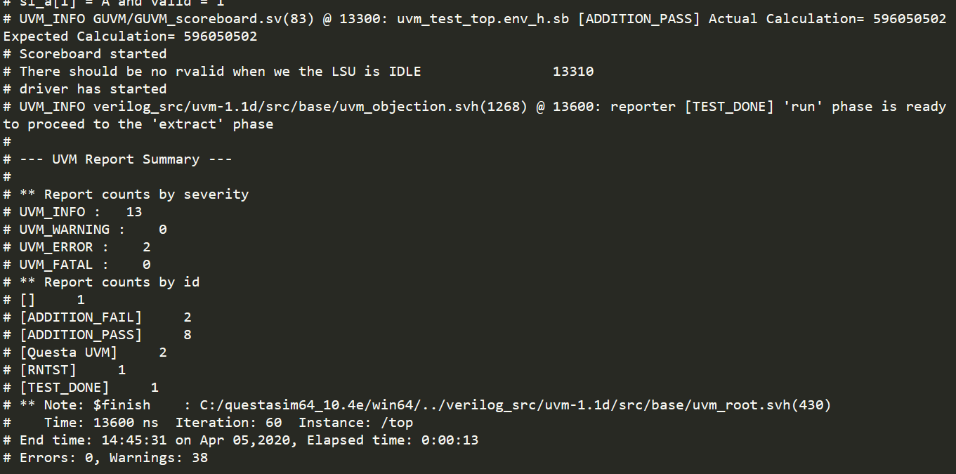
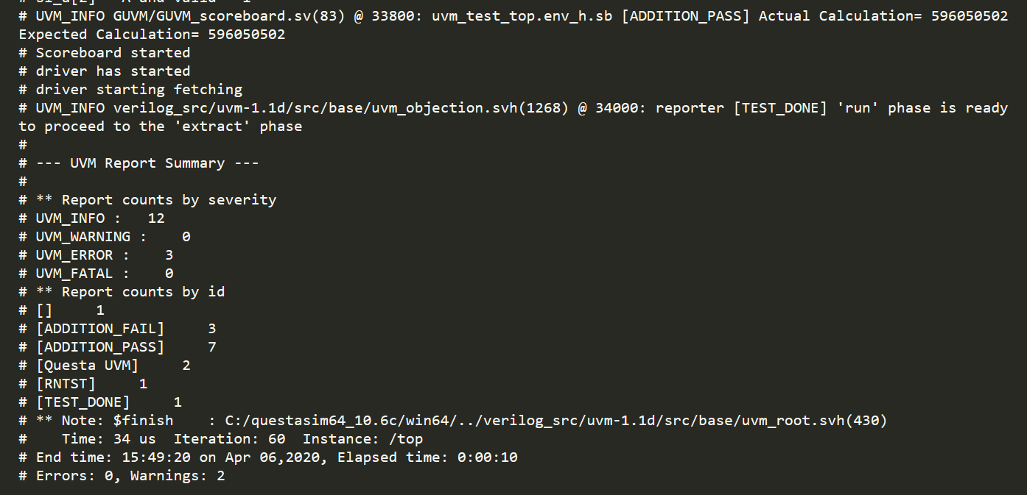
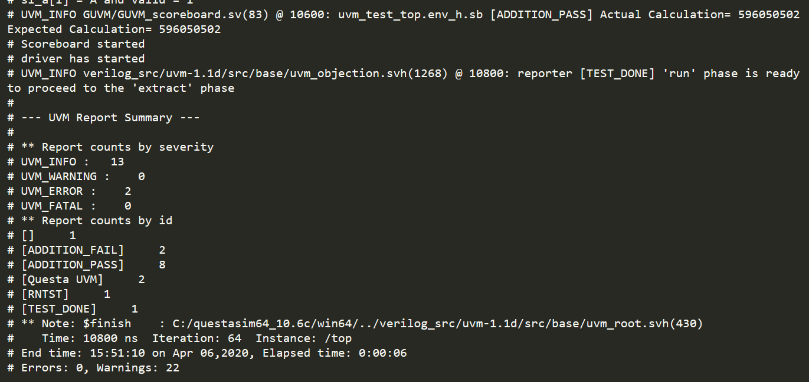
Ri5cy core
Amber core
Leon core

Slide 14
Conclusion & Future work
As a conclusion: with our 1st milestone of the implementation of the generic UVM, we have successfully proven the possibility/idea of creating only one UVM to verify more than core (soft processor).
The next milestones will cover the following:
Testing the functionality of the rest of the instructions of the three different cores.
Negative testing.
Future work:
A complete coverage for the three DUTs.
Applying the concept of the generic UVM on a complete SOC.
Applying different machine learning algorithms to reach the golden dream/goal: only one verification methodology to verify everything.

