Slide 1
Application lifecycle and metadata management
Citrix User Group Community

Slide 2
Topics
Lifecycle
Metadata
Integrations
Analytics
Reporting
Automation
Customization (SDK)

Slide 3
Application lifecycle
Applications are the muscles while users are the brains for business operation - Business must keep moving, apps will evolve
Starts somewhere in business with an idea or need to introduce a new application through development or purchase and continues until retirement

Slide 4
Application metadata
Metadata is “data about data”, the set of information associated with an application
Technical, business or process details
Metadata is determined by the business need and agreed upon by the people responsible for the process, business or technology
May be spread around multiple libraries. ERP, SAM, ITSM, CMDB…
Metadata exists before the application -> Create application stubs when working with development

Slide 5
Application discovery
Applications and devices from distribution systems via install capture or direct import from SCCM, from file share of manual capturing
Users and groups from Active Directory
Application usage from Lakeside SysTrack
Citrix AppDisks from XenDesktop New!
Windows updates from WSUS New!
Metadata collection from any system capable on CSV export ! New!

Slide 6
Desktop transformation
Windows 10, Windows Server 2016

Slide 7
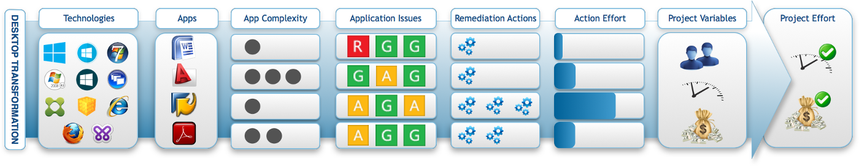
Operating systems
Applications
Browsers
Profiling New!
Security New!
Application compatibility assessment
Migration effort assessment
OS Build assessment New!
Patch impact assessment New!
Deployment solutions

Slide 11
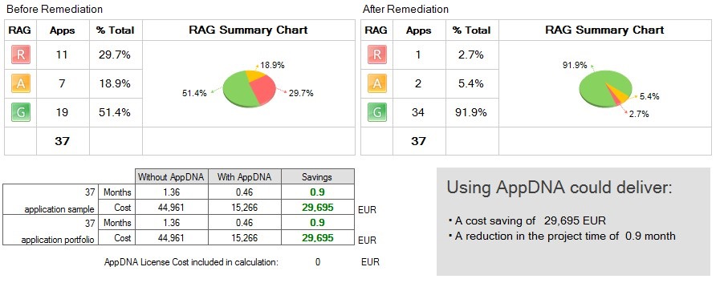
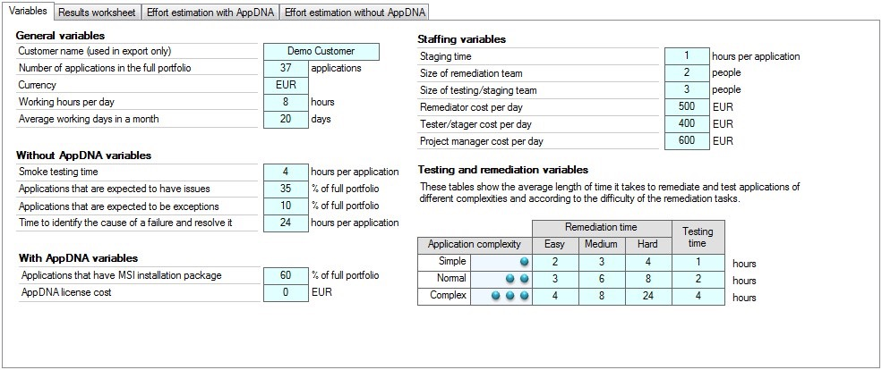
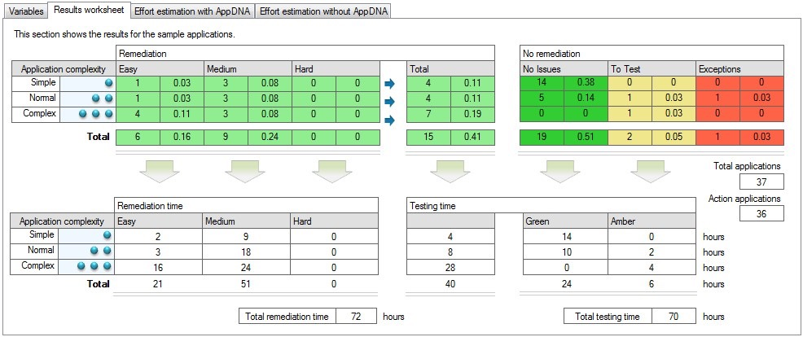

Slide 12
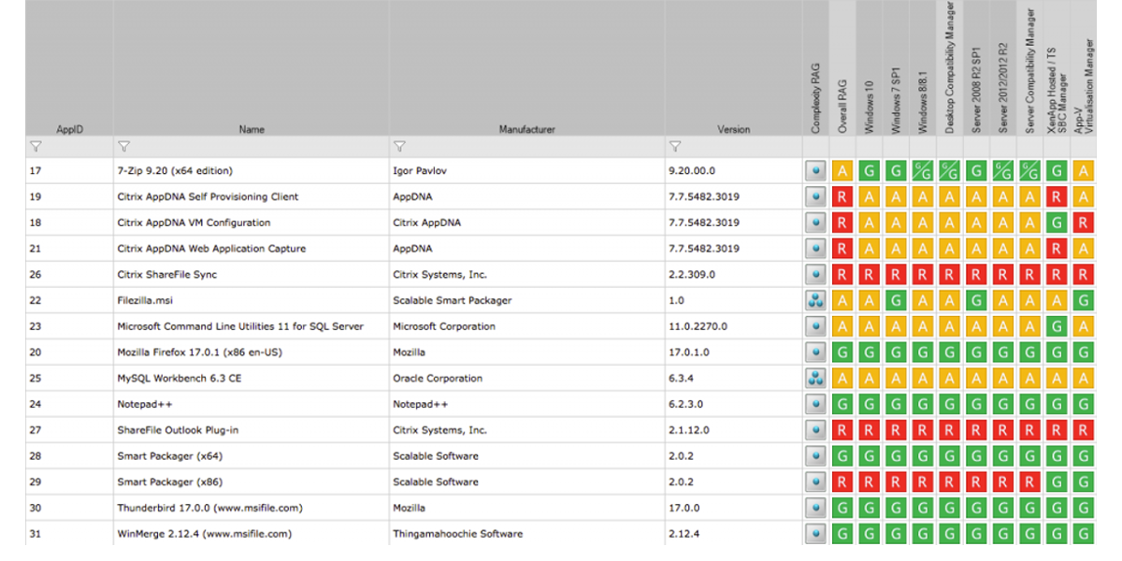

Slide 13
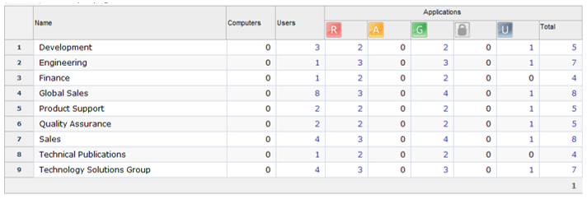

Slide 14
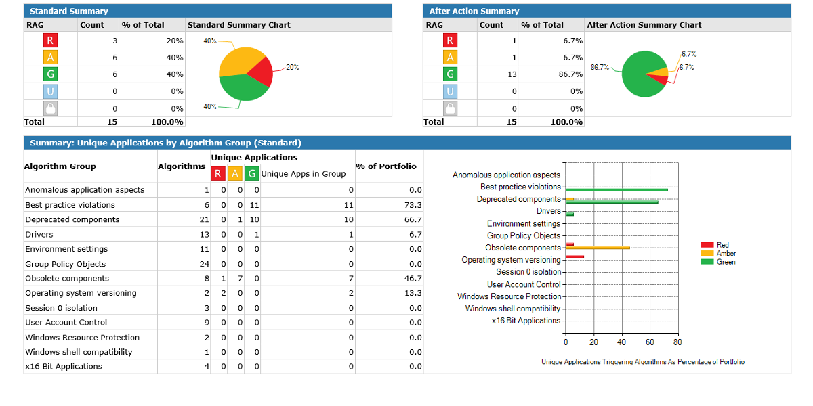

Slide 15
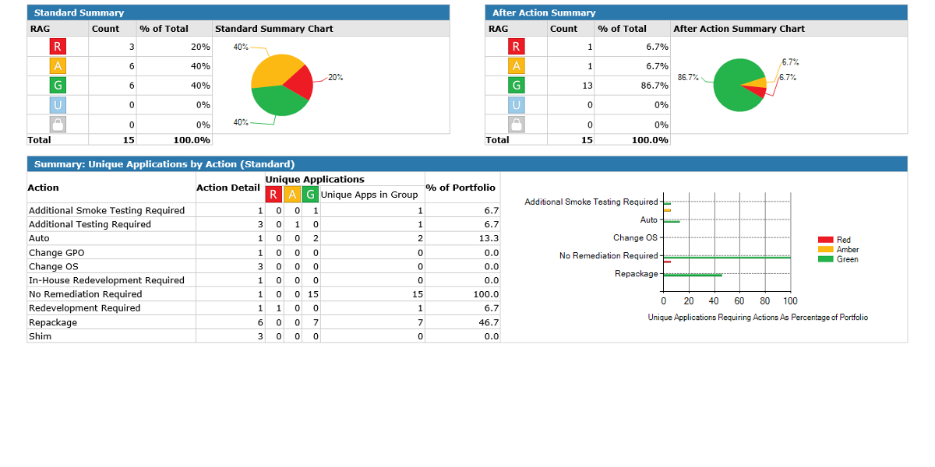

Slide 16
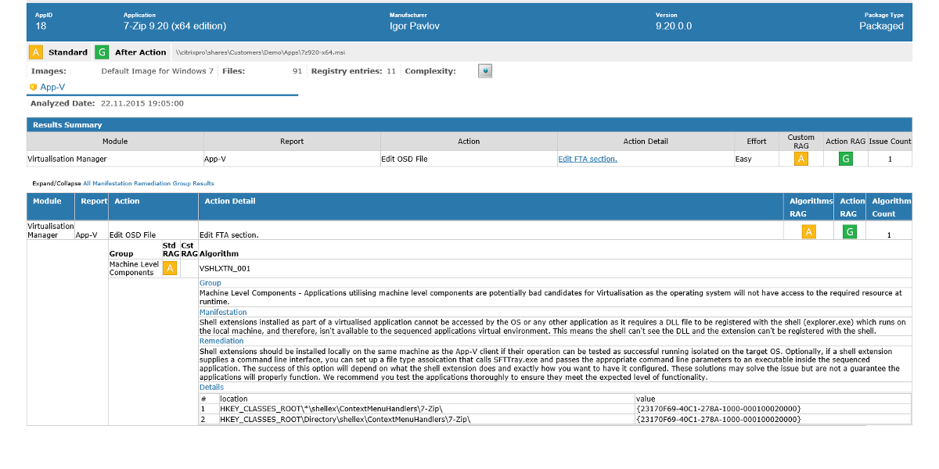

Slide 17
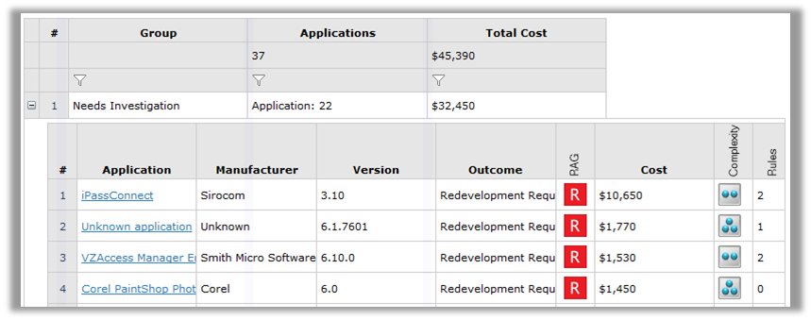

Slide 18
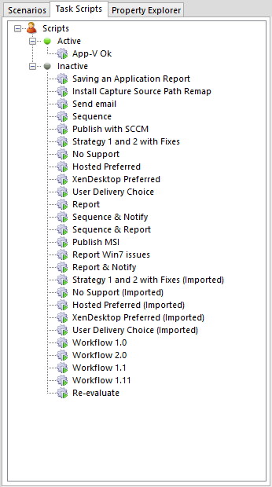
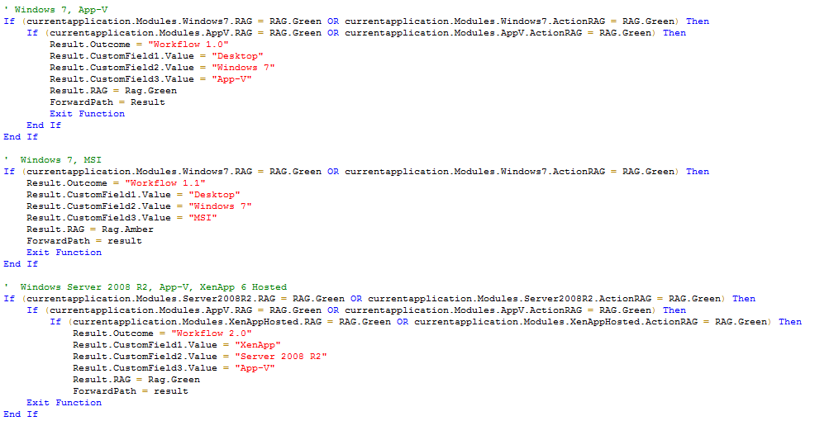
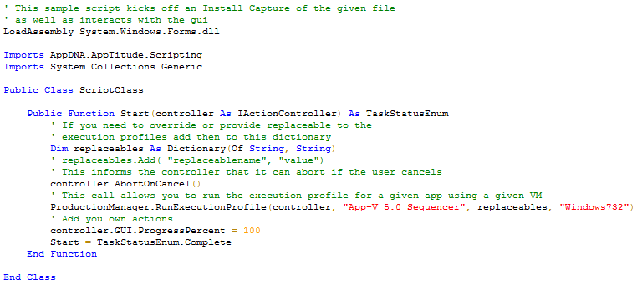
Automation

Slide 19
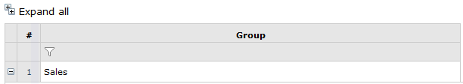

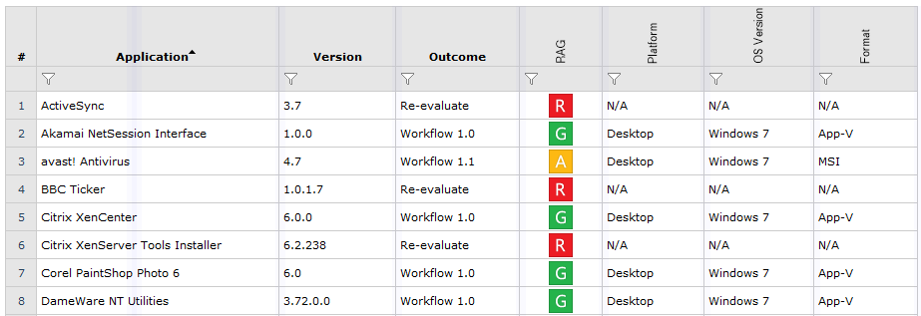
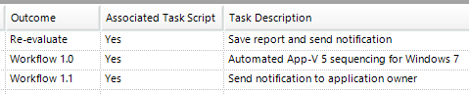
Automation

Slide 20
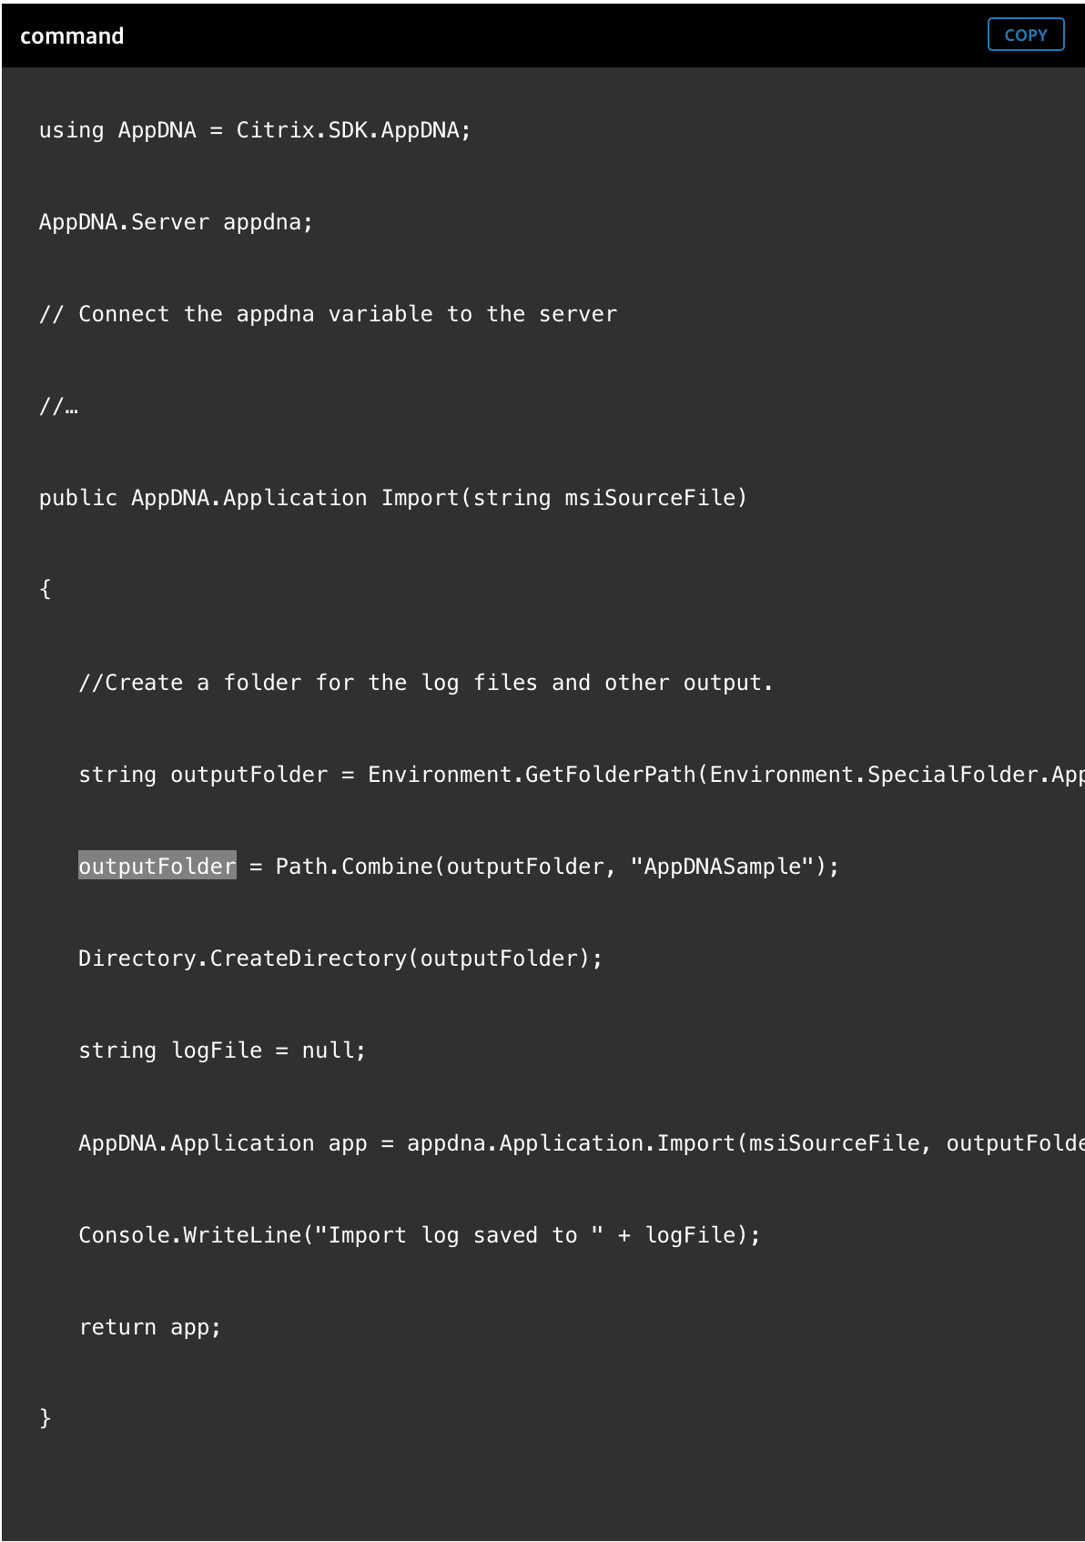
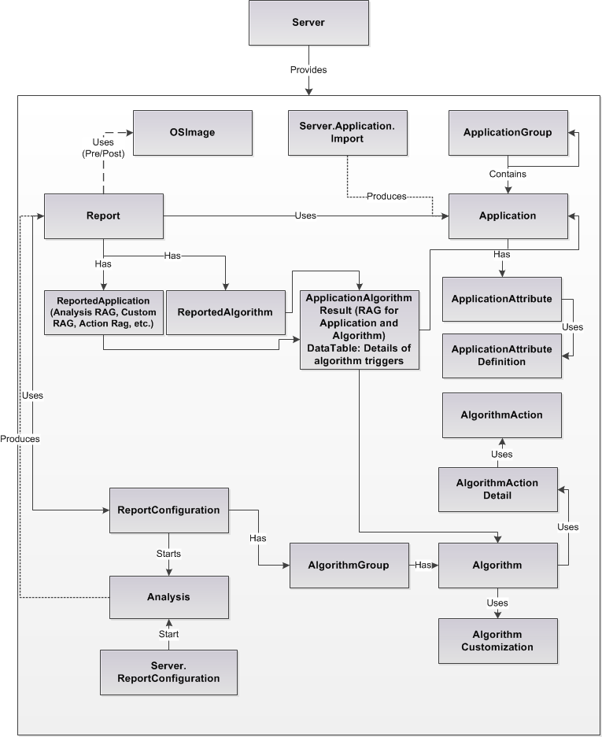
Customization (SDK)
void PrintApplicationAttributes(AppDNA.Application app)
{
foreach (var attribute in app.Attributes)
{
string valueString = string.Empty;
if (attribute.IsNull)
valueString = "<null>";
else
{
switch (attribute.Definition.DataType)
{
case AppDNA.AttributeDefinitionDataType.Boolean:
valueString = attribute.BooleanValue.ToString();
break;
case AppDNA.AttributeDefinitionDataType.DateTime:
valueString = attribute.DateTimeValue.ToString();
break;
case AppDNA.AttributeDefinitionDataType.Numeric:
valueString = attribute.NumericValue.ToString();
break;
case AppDNA.AttributeDefinitionDataType.Rag:
valueString = attribute.RagValue.ToString();
break;
case AppDNA.AttributeDefinitionDataType.String:
case AppDNA.AttributeDefinitionDataType.StringList:
valueString = attribute.StringValue;
break;
}
}
Console.WriteLine(attribute.Definition.Name + " : " + valueString);
}
}

Slide 21
Thanks!

