Slide 1
Women in Cancer
Cases
Janayah Moses, Nashara Marrow,
Stacey Asantey, Abigale Hewitt,
Cay’la-monee Watts

Slide 2
INTRODUCTION
We can see how cancer is starting to become an bigger issue especially within women.

Slide 3
Purpose
we can improve how we treat and manage cancer
understand what raises or lowers a person's risk of developing cancer
Keep track of the percentages throughout the years.

Slide 4
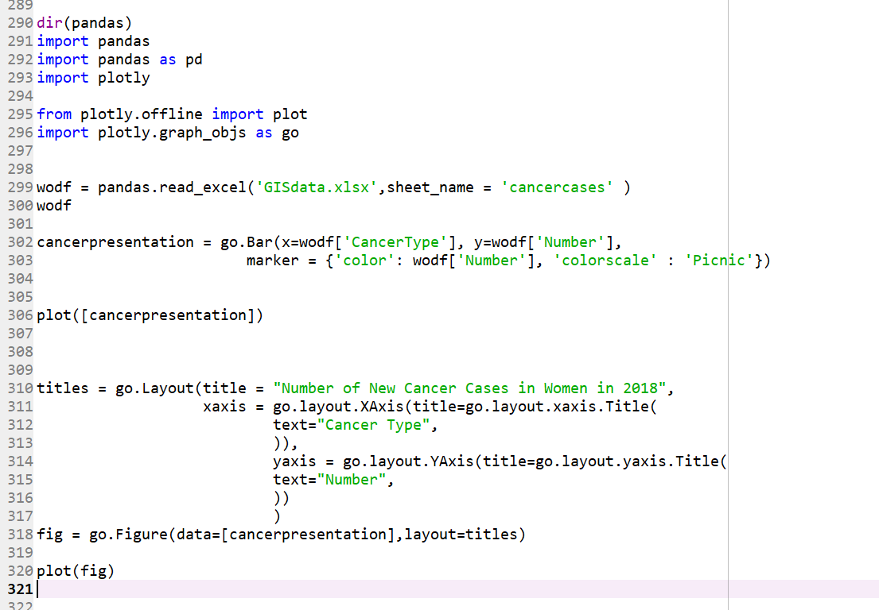
Methodology/Approach
To represent this data we used a series of configurations that provided enough information to create a graph for the percentages of women with cancer.

Slide 5
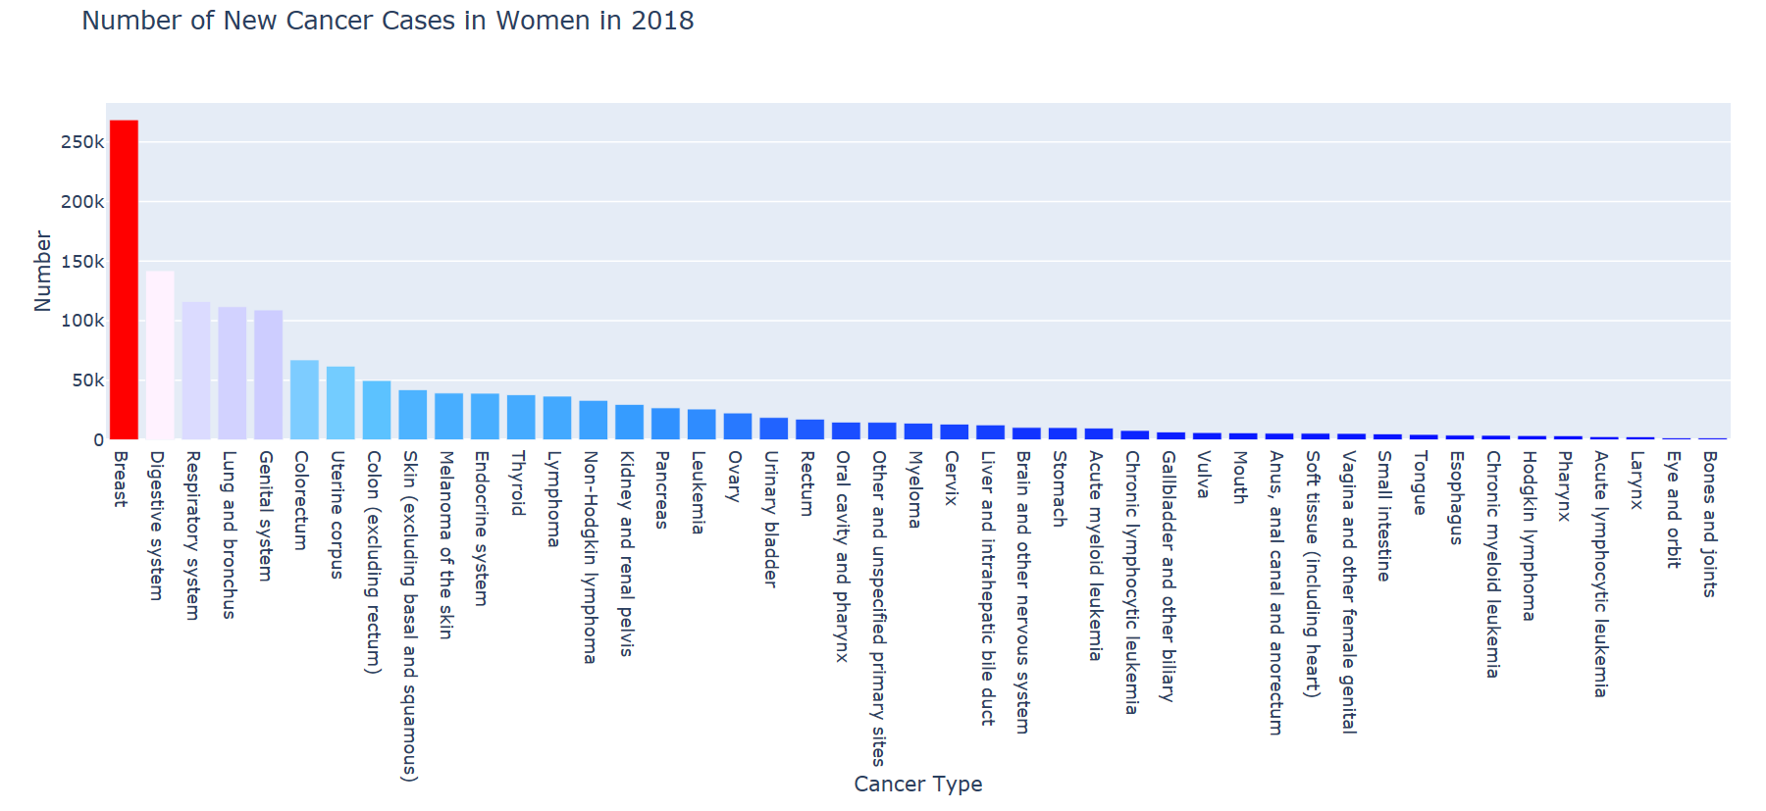
Cancer Graph

Slide 6

Interpretation
MORE AND MORE WOMEN ARE GETTING DIAGNOSED WITH CANCER !
BREAST CANCER is one of the main rapid growing sssssssssssssssddcancers !

Slide 7

The Problem
Environment
Lifestyle
Lack of Support
Lack of improvement in medicine and therapy
Wrong portrayal of people with cancer

Slide 8
Solutions
Cancer support groups
educational awareness
Clinical trials

Slide 9
Questions ?

