Slide 1
Introduction to Lidar Workflows with PDAL
Michael Rosen

Slide 2


Introduction to Lidar workflows with pdal
Michael Rosen, based on work by Bradley J Chambers.
Notes:
Brief intro

Slide 3

PDAL
PDAL - Point Data Abstraction Library
PDAL is a C++ BSD library for translating and manipulating point cloud data. It is very much like the GDAL library which handles raster and vector data. See Readers and Writers for data formats PDAL supports, and see Filters for filtering operations that you can apply with PDAL.
In addition to the library code, PDAL provides a suite of command-line applications that users can conveniently use to process, filter, translate, and query point cloud data. See Applications for more information.
https://www.pdal.io/
(… as opposed to support for CV integration, algorithmic research, interactive visualization / manipulation)

Slide 4
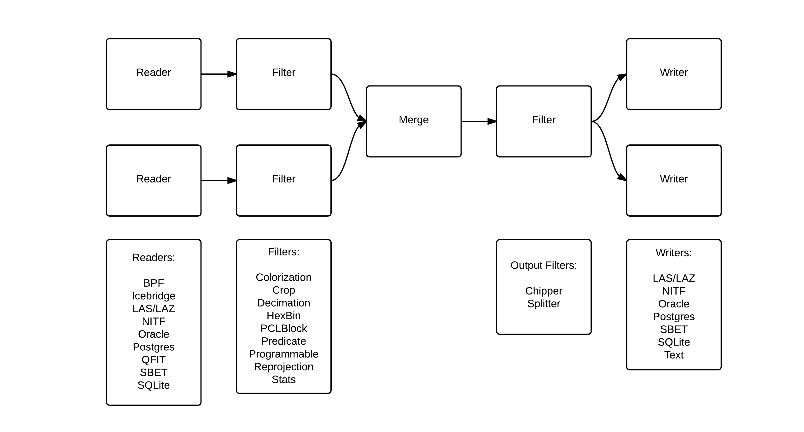
PDAL Pipeline Overview
Notes:
we’re going to start by taking a few minutes to describe PDAL
everything is a pipeline
even this is a bit more complicated than what we’d typically do, but it illustrates a point
we can write plugins to implement any of the stages

Slide 5
PDAL Stages

Slide 6
Readers
pdal.io/stages/readers.html
Notes:
growing list of readers
stages that can parse input file formats and read point cloud data
LAS with compression (LAZ) support is enough for many users, but not all

Slide 7
Writers
pdal.io/stages/writers.html
Notes:
growing list of writers
stages that can write point cloud data to known file formats
again, LAS with compression (LAZ) support is enough for many users, but not all

Slide 8
Filters
pdal.io/stages/filters.html
Notes:
growing list of filters, too
stages that operate on the point cloud anywhere in between read/write
two types
“filter” - modifying - setField - modifying points, e.g., add/modify attributes (color), location (are attributes still valid?)
“run” - decimating - erase/insert - e.g., crop

Slide 9
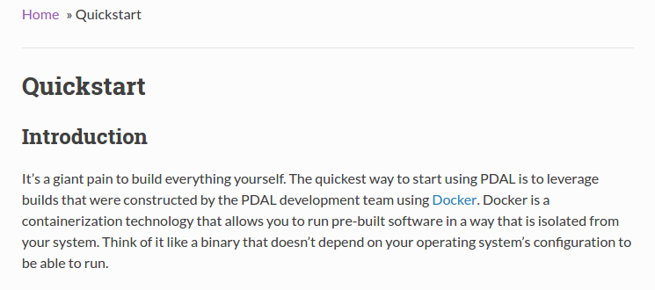
PDAL Basics: Docker
msr@msr-laptop ~/data/PDALPresentation $ sudo docker run -v ~/data/PDALPresentation:/data pdal/pdal:1.4 pdal --help
[sudo] password for msr:
Usage:
pdal <options>
pdal <command> <command options>
...
https://www.pdal.io/quickstart.html
Notes:
almost any (simple) pipeline can be constructed from the CLI
reader -> filter -> writer
multiple readers, multiple filters
linear

Slide 10
PDAL Basics: Commands
msr@msr-laptop ~/data/PDALPresentation $ sudo docker run -v ~/data:/data pdal/pdal:1.4 pdal --help
[sudo] password for msr:
Usage:
pdal <options>
pdal <command> <command options>
--command The PDAL command
--debug Sets the output level to 3 (option deprecated)
--verbose, -v Sets the output level (0-8)
--drivers List available drivers
--help, -h Display help text
--list-commands List available commands
--version Show program version
--options Show options for specified driver (or 'all')
The following commands are available:
- kernels.delta
- kernels.density
- kernels.diff
- kernels.ground
- kernels.hausdorff
- kernels.info
- kernels.merge
- kernels.pcl
- kernels.pipeline
- kernels.random
- kernels.smooth
- kernels.sort
- kernels.split
- kernels.tindex
- kernels.translate
See http://pdal.io/apps/ for more detail
Notes:
almost any (simple) pipeline can be constructed from the CLI
reader -> filter -> writer
multiple readers, multiple filters
linear

Slide 11
PDAL Basics: INFO command
$ pdal info C18075.las --summary
{
"filename": "C18075.las",
"pdal_version": "1.4.0 (git-version: 9cbe74)",
"summary":
{
"bounds":
{
"X":
{
"max": 427955.99,
"min": 426435.53
},
"Y":
{
"max": 4250569.79,
"min": 4249050.21
},
"Z":
{
"max": 1899.88,
"min": 168.82
}
},
"dimensions": "X, Y, Z, Intensity, ReturnNumber, NumberOfReturns, ScanDirectionFlag, EdgeOfFlightLine, Classification, ScanAngleRank, UserData, PointSourceId, GpsTime",
"num_points": 3183720,
"srs":
{
"compoundwkt": "COMPD_CS[\"unknown\",PROJCS[\"NAD83 \/ UTM zone 17N\", ...
Notes:
almost any (simple) pipeline can be constructed from the CLI
reader -> filter -> writer
multiple readers, multiple filters
linear

Slide 12
PDAL Basics: Translate
msr@msr-laptop ~/data/PDALPresentation $ pdal translate C18075.las C18075.laz
msr@msr-laptop ~/data/PDALPresentation $ ls -l C18075.la?
-rw-r--r-- 1 msr msr 89145040 Mar 15 14:30 C18075.las
-rw-r--r-- 1 msr msr 12169552 Mar 17 14:54 C18075.laz
msr@msr-laptop ~/data/PDALPresentation $ pdal --drivers
============================ ===================================================
Name Description
============================ ===================================================
...
writers.bpf "Binary Point Format" (BPF) writer support. BPF is
a simple DoD and research format that is used by
some sensor and processing chains.
writers.derivative Derivative writer
writers.gdal Write a point cloud as a GDAL raster.
writers.las ASPRS LAS 1.0 - 1.4 writer. LASzip support is also
available if enabled at compile-time. Note that
LAZ does not provide LAS 1.4 support at this time.
writers.null Null writer. Provides a sink for points in a
pipeline. It's the same as sending pipeline output
to /dev/null.
writers.pcd Write data in the Point Cloud Library (PCL)
format.
writers.pgpointcloud Write points to PostgreSQL pgpointcloud output
writers.ply ply writer
writers.sbet SBET Writer
writers.text Text Writer
Notes:
almost any (simple) pipeline can be constructed from the CLI
reader -> filter -> writer
multiple readers, multiple filters
linear

Slide 13
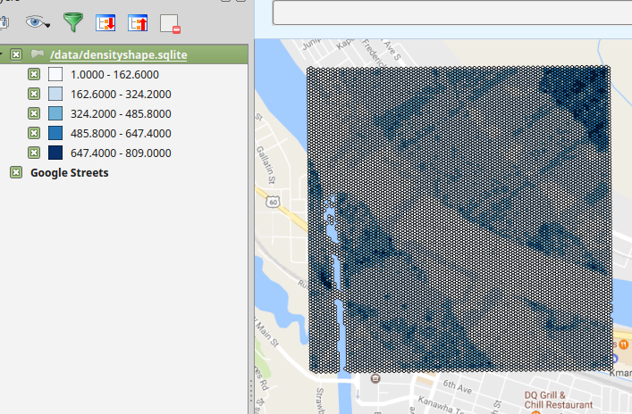
PDAL Basics: acquisition density
$ sudo docker run -v ~/data/PDALPresentation:/data pdal/pdal:1.4 pdal density -i /data/C18075.las -o /data/DensityShape.sqlite -f SQLite
Notes:
almost any (simple) pipeline can be constructed from the CLI
reader -> filter -> writer
multiple readers, multiple filters
linear

Slide 14
Pipelines / Filters

Slide 15
Pipelines / Filters
msr@msr-laptop ~/dev/cpp/pdal $ pdal --drivers
============================ ===================================================
Name Description
============================ ===================================================
filters.approximatecoplanar ApproximateCoplanar Filter
filters.assign Assign values for a dimension using a specified
value.
filters.chipper Organize points into spatially contiguous,
squarish, and non-overlapping chips.
filters.cluster Label clusters
filters.colorinterp Assigns RGB colors based on a dimension and a ramp
filters.colorization Fetch and assign RGB color information from a
GDAL-readable datasource.
filters.computerange Compute Range Filter
filters.crop Filter points inside or outside a bounding box or
a polygon
filters.decimation Rank decimation filter. Keep every Nth point
filters.divider Divide points into approximately equal sized
groups based on a simple scheme
filters.eigenvalues Eigenvalues Filter
filters.estimaterank EstimateRank Filter
filters.ferry Copy data from one dimension to another.
… and many more

Slide 16
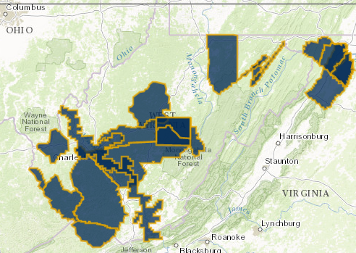
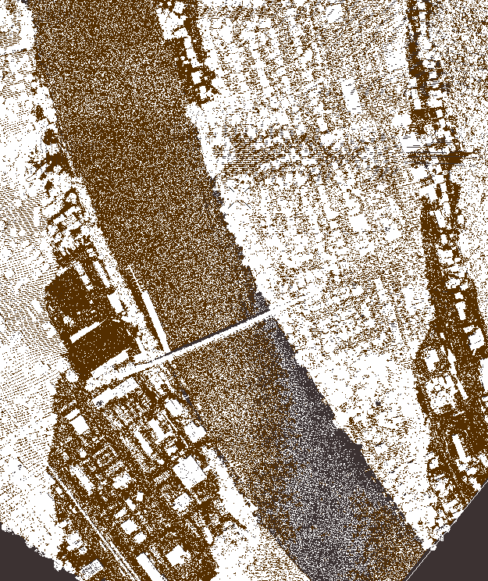
Original
C18075.las
http://www.wvview.org/data/lidar/SouthernWV/Comprehensive/

Slide 17
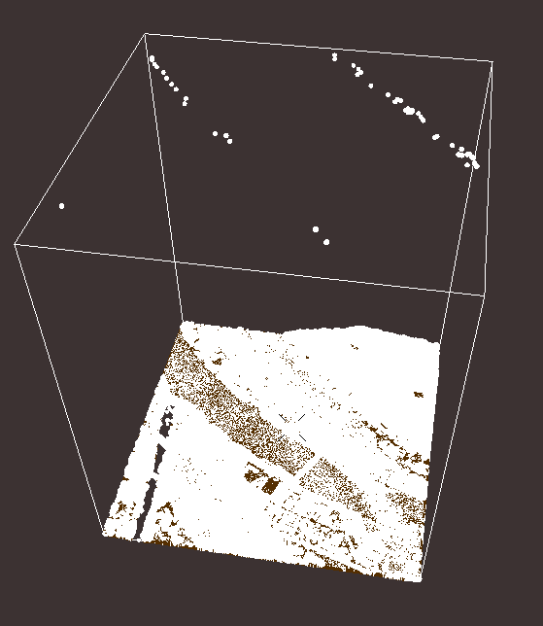
Noise Points

Slide 18
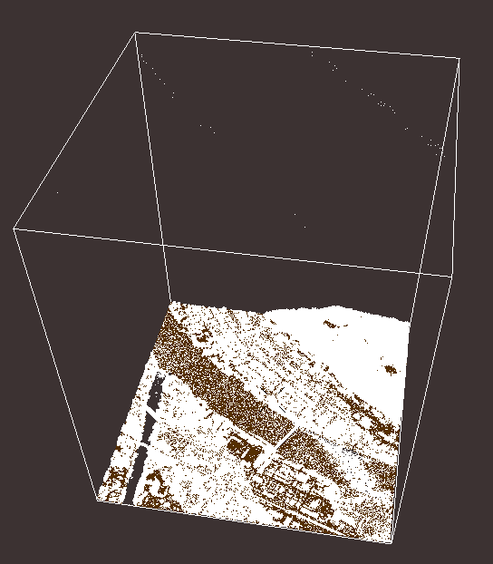
Original Values
Classifications

Slide 19
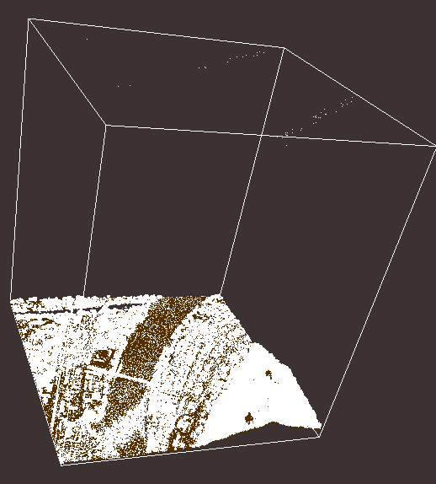
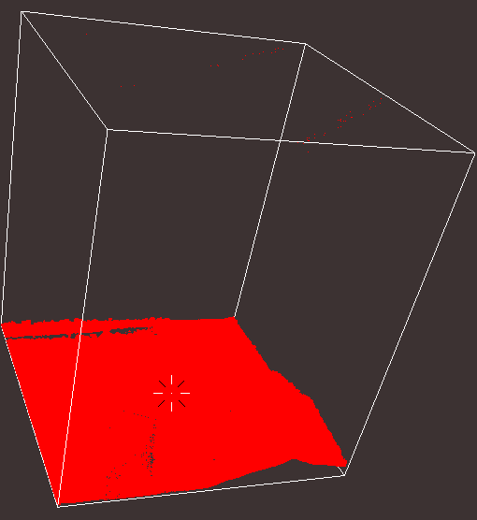
Set to Zero
Classifications
msr@msr-laptop ~/data/PDALPresentation $ echo '
{
"pipeline":[
"C18075.las",
{
"type":"filters.assign",
"assignment":"Classification[:]=0"
},
"C18075-reset.laz"
]
}' | pdal pipeline -s -v 5
(pdal pipeline writers.las Debug) Wrote 3183720 points to the LAS file

Slide 20
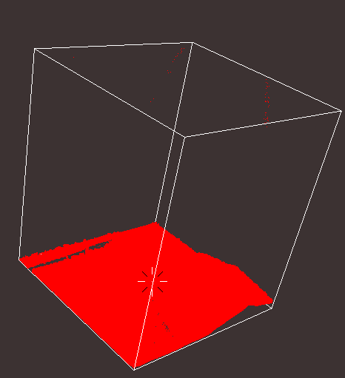
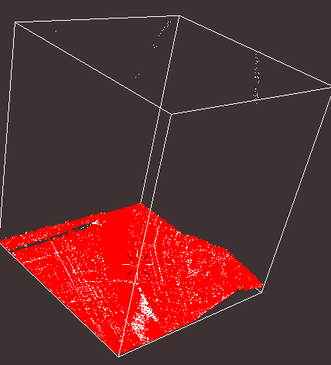
Label Outliers
Classifications
msr@msr-laptop ~/data/PDALPresentation $ echo '
{
"pipeline":[
"C18075-reset.laz",
{
"type":"filters.outlier"
},
"C18075-high-noise.laz"
]
}' | pdal pipeline -s -v 5
(pdal pipeline filters.outlier Debug) Labeled 30547 outliers as noise!
(pdal pipeline writers.las Debug) Wrote 3183720 points to the LAS file
Notes:
Sets classification value to 18 (LAS specification).

Slide 21
Curious about available options?
msr@msr-laptop ~/data/PDALPresentation $ pdal --options=filters.outlier
filters.outlier -- http://pdal.io/stages/filters.outlier.html
---------------------------------------------------------------
user_data
User JSON
log
Debug output filename
method [statistical]
Method [default: statistical]
min_k [2]
Minimum number of neighbors in radius
radius [1]
Radius
mean_k [8]
Mean number of neighbors
multiplier [2]
Standard deviation threshold
classify [true]
Apply classification labels?
extract
Extract ground returns?

Slide 22
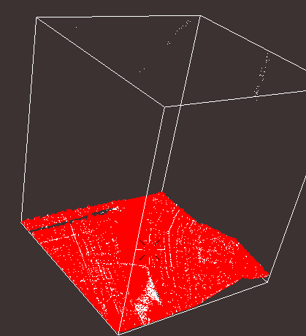
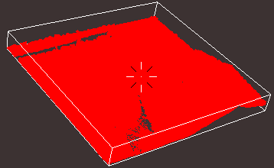
Denoised
msr@msr-laptop ~/data/PDALPresentation $ echo '{
"pipeline":[
"C18075-reset.laz",
{
"type":"filters.outlier",
"extract":true
},
"C18075-denoised.laz"
]
}' | pdal pipeline -s -v 5
(pdal pipeline filters.outlier Debug) Labeled 30547 outliers as noise!
(pdal pipeline filters.outlier Debug) Extracted 3153173 inliers!
(pdal pipeline writers.las Debug) Wrote 3153173 points to the LAS file

Slide 23
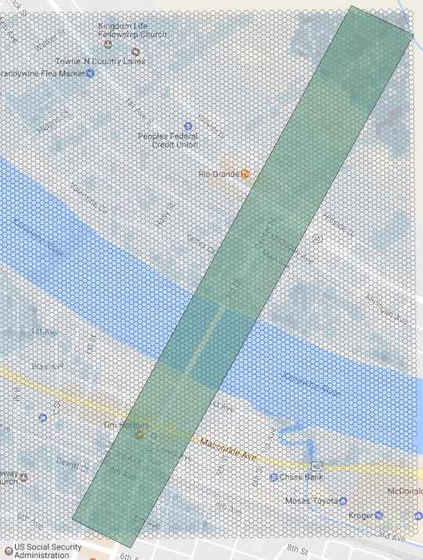
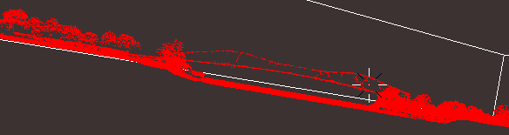
Elevation profile
msr@msr-laptop ~/data/PDALPresentation $ echo '
{
"pipeline":[
"C18075-denoised.laz",
{
"type":"filters.crop",
"polygon":"POLYGON ((426948.832773854024708 4249094.137953309342265,427780.490099926188122 4250581.691831773146987,427962.278885911568068 4250494.767989790998399,427119.376130757154897 4249007.281934319064021,426948.832773854024708 4249094.137953309342265))"
},
{
"type":"writers.las",
"filename":"C18075-denoise-xsect.las"
}
]
} ' | pdal pipeline -s

Slide 24
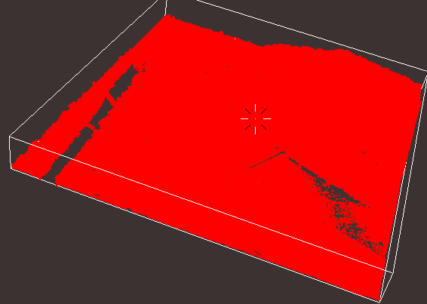
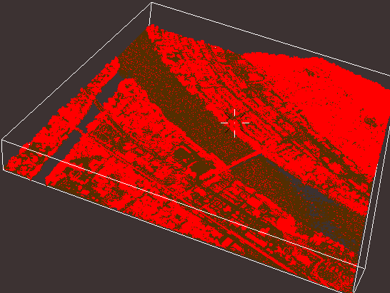
Ground CLASSIFICATION
$ pdal ground -i C18075-denoised.laz -o C18075-ground-class.laz --classify

Slide 25
Ground vs. Non-ground
Start with Classified ground points, drop them and use the writers.gdal to create a dem
msr@msr-laptop ~/data/PDALPresentation $ echo ' {
"pipeline":[
"C18075-ground-class.laz",
{
"type":"filters.crop",
"polygon":"POLYGON ((426948.832773854024708 4249094.137953309342265,427780.490099926188122 4250581.691831773146987,427962.278885911568068 4250494.767989790998399,427119.376130757154897 4249007.281934319064021,426948.832773854024708 4249094.137953309342265))"
},
{
"type":"writers.las",
"filename":"C18075-ground-class-xsect.las"
}
]
} ' | pdal pipeline -s

Slide 26
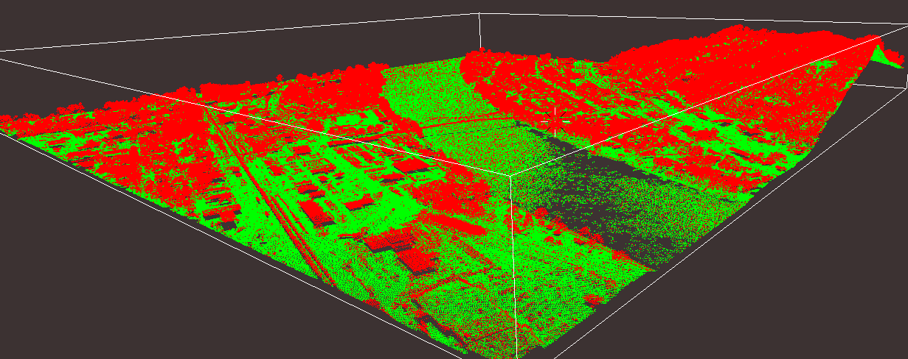
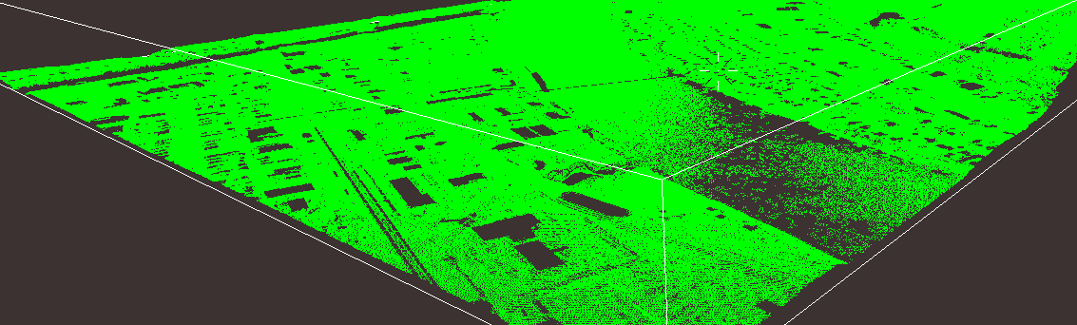
Remove non-ground points
msr@msr-laptop ~/data/PDALPresentation $ echo ' {
"pipeline":[
"C18075-ground-class.laz",
{
"type":"filters.range",
"limits":"Classification[2:2]"
},
{
"type":"writers.las",
"filename":"C18075-ground-only.las"
}
]
} ' | pdal pipeline -s

Slide 27
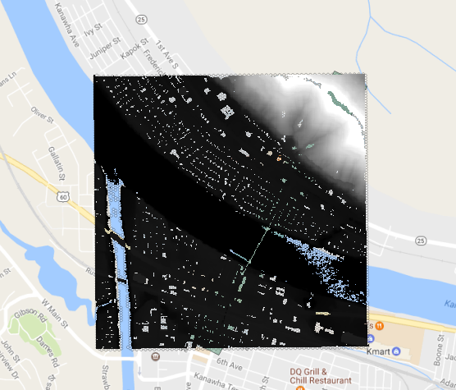
Remove non-ground points & Make a DEM
msr@msr-laptop ~/data/PDALPresentation $ echo '
> {
> "pipeline":[
> "C18075-ground-class.laz",
> {
> "type":"filters.range",
> "limits":"Classification[2:2]"
> },
> {
> "filename":"C18075-dtm.tif",
> "resolution":"2.0",
> "radius":"3.0",
> "output_type":"mean",
> "type": "writers.gdal"
> }
> ]
> }' | pdal pipeline -s

