Slide 1
How to Write Papers
Charles Ling
凌 晓 峰
i-cling@microsoft.com
ling@csd.uwo.ca
http://www.csd.uwo.ca/faculty/ling

Slide 2
Paper Writing Series
Today: Foundation of Writing Good Papers
Future talks by Yaqin, Harry, and Hongjiang
Potential topics
  How to write survey papers
  How to integrate research and paper writing
  Be scientifically rigor but not offensive
  Statistical tests for empirical experiments
  How reviewers accept and reject papers
  Sentences: templates and organization
  Professional writing: words to use and not
  Common mistakes/problems Chinese often make
Chalres Ling

Slide 3
Outline
Importance of Paper-writing Skills
What Makes a Good Paper
Why is it so Hard to Write Good Papers?
How to Improve
A Template for Good Papers
Avoid Run-on Sentences
Summary
Chalres Ling

Slide 4
Importance of Writing Skills
Publishing papers is critical for researchers
Publishing is hard
  Low acceptance rate
  Competing with good papers
  Reviewers are potential competitors
Chalres Ling

Slide 5
Outline
Importance of Paper-writing Skills
What Makes a Good Paper
Why is it so Hard to Write Good Papers?
How to Improve
A Template for Good Papers
Avoid Run-on Sentences
Summary
Chalres Ling

Slide 6
What Makes a Good Paper
Good paper = good content + writing skills
  Content and results: your job
Writing skills: Structure, flow, argument, …
  Logical, clear, succinct, consistent, …
  English
Standard must be high
  Your best efforts
  Compared with others, yours is good/best
  Don’t fool with the reviewers!
Chalres Ling

Slide 7
Outline
Importance of Paper-writing Skills
What Makes a Good Paper
Why is it so Hard to Write Good Papers?
How to Improve
A Template for Good Papers
Avoid Run-on Sentences
Summary
Chalres Ling

Slide 8
Why Is It hard?
Who are our readers/reviewers
Differences between thought and language
We are the “sales person”
Revisions: never be perfect
Our English is bad, but …
Nothing can replace experience, but …
Chalres Ling

Slide 9
Outline
Importance of Paper-writing Skills
What Makes a Good Paper
Why is it so Hard to Write Good Papers?
How to Improve
A Template for Good Papers
Avoid Run-on Sentences
Summary
Chalres Ling

Slide 10
How to Improve: In Readers’ Shoes
You know your work, but not your readers !
Reviewers/Readers: in the same broad area, but have not worked on your problems
Define terms, write about motivation and rationales, pose potential questions and answer them yourself
What are your contributions?
Show your elegance? Don’t!
    Unless for pure math, or when you are really famous
Chalres Ling

Slide 11
A Reviewer’s Comments
This paper attempts to explain the success of Naive Bayes classifiers by showing that …
Unfortunately, this paper was extremely difficult to follow. In fact, it took several readings before I even understood the paper's basic claims. The paper should have stated, at the beginning, that it is focusing on the representational (as opposed to learnability) issue: … It would also have been useful to connect this notation with something practical--for example, …
The arguments and proofs were difficult to follow. They would probably have been easier if the paper had first outlined their structure, before giving the details. …
Chalres Ling

Slide 12
How to Improve: What Reviewers Want
AAAI Reviewers (partial) check list:
Does the paper introduce a new problem or provide a new solution to an existing one?
What is the main result of the paper?
Is the result significant?
Is the paper technically sound?
Does the paper provide an assessment of the strengths and limitations of the techniques/result?
Is the paper clearly written so as to accessible to most AI researchers?
Does the paper reference appropriate related work?
Should the paper be nominated for a prize?
Chalres Ling

Slide 13
How to Improve: Note the Difference
Difference 1: Outlining vs details
Introduction
Previous Work
Our New Methods
  Algorithm
  Complexity
Comparisons
Conclusions
References
This type of engine uses a robot or apider (there's an arcane difference between the two that isn't very interesting) which constantly roams the World Wide Web searching for new or updated pages (what a wonderful job eh?)
When the robot visits a page it reads the whole thing, including any sub-pages on the same server connected to the page it's reading, then it visits all the external links on the pages it's read...and so on, you get the idea. A robot can only follow links.
It finds pages in two ways: by visiting pages it's been told about (ie. on its submission form) or by following links from other pages.
So, if your page isn't linked from anywhere else and you haven't registered it, there's no way it'll ever be found ?it'll be invisible. You can actually ensure that most of the deep engines don't index your pages by using special "no follow
Solutions:
  Introductory/summary sentences
  Appendix and footnotes to “hide” details
Chalres Ling

Slide 14
1. Introduction
…
The paper is organized as follows: In Section 2, we will review…
2. Review of Previous Work
Learning from noisy data has been extensively studied previously, and can be categorized into several classes. In the first class, entropy method is used. In the second class, …
Most entropy-based methods assume …
In sum, most previous work …
3. Augmented Naïve Bayes
In this section, we will discuss an improved version of Naïve Bayes. We will first introduce definition and motivations. We will then describe our improved algorithm, and give a proof of its complexity. Finally, …
3.1 Notations and Definitions
(I am making a point here; a tricky balance)
Chalres Ling

Slide 15
How to Improve: Note the Difference
Difference 2: non-linear vs linear process
X
(A1) This type of engine uses a robot or spider (there's an arcane difference between the two that isn't very interesting) which constantly roams the World Wide Web searching for new or updated pages (what a wonderful job eh?)
(A2) When the robot visits a page it reads the whole thing, including any sub-pages on the same server connected to the page it's reading, then it visits all the external links on the pages it's read...and so on, you get the idea. A robot can only follow links.
(A3) It finds pages in two ways: by visiting pages it's been told about (ie. on its submission form) or by following links from other pages.
(B1) So, if your page isn't linked from anywhere else and you haven't registered it, there's no way it'll ever be found ?it'll be invisible. You can actually ensure that most of the deep engines don't index your pages by using special "no follow
A1
B1
A2
B1
A3
Solutions:
  Use illustration and flow chart
  Use connecting words
Chalres Ling

Slide 16
Algorithm X has two components: A1 and B1. A1 is an improved version of … , which is, in turn, supported by A2. … We will describe X’s first component in the order of A1, A2, and A3. Afterwards, we discuss B1 and B2 in details.
A1 …
A2 …
A3 …
Recall that X consists of A1 and B1, and we have already described A in details. We will now explain B in detail below.
B1 …
B2 …
Chalres Ling

Slide 17
How to Improve: Sell Our Work
Unless it is an invited paper…
Purpose driven: debating: why are we good
  Logical flow
  Problem X is important
  Previous work A, B, … have been studied
  A, B have certain weakness
  We propose our new method D
  Experiment with D, compare with A, B
  D is better than A, B (rigorously tested)
  Why is D better? Why didn’t E, F work?
  Strengths and weaknesses of D
  Future work of D
Simplest is best: convey meanings
Professional: no careless mistakes
  Proof-reading
  Proper use of words
Chalres Ling

Slide 18
How to Improve: Revisions
It is tedious to read own paper
It is hard to find own mistakes
A lot of efforts for small, last improvement
Solutions
  Let your paper sit (2 x 5 < 5 x 2)
  Read it word by word
  Ask others to read
  Different roles of boss, colleagues, proof-reader
Revise carefully > 3 times, total > 5 times
Chalres Ling

Slide 19
How to Improve: English
Myth: My English is weak, so I have excuse
  Structure and logic: much more important
    Your role; proof-reader won’t help much
Solutions:
  Top-down organization, outline, logic, flow…
  Use other good papers as “sample”
  Use “cheap” English proof-reader
Chalres Ling

Slide 20
How to Improve: Experience
It does take a lot of efforts to improve
  Draft, revision, revision, revision, …
  Write many papers to learn
But there are ways to speed up
  This lecture series
  Books
  Record your own mistakes; eliminate them!
  Think about writing: 30%; writing: 70%
Chalres Ling

Slide 21
Solutions -- Why Is It hard?
Who are our readers/reviewers
Differences between thought and language
We are the “sales person”
Revisions: never be perfect
Our English is bad, but …
Nothing can replace experience, but …
Chalres Ling

Slide 22
Outline
Importance of Paper-writing Skills
What Makes a Good Paper
Why is it so Hard to Write Good Papers?
How to Improve
A Template for Good Papers
Avoid Run-on Sentences
Summary
Chalres Ling

Slide 23
A “Template” for Good Papers
Abstract
Introduction
Review of Previous Work
Our Work
Experiments and Comparisons
(Relation to Previous Work)
Conclusions
References
Others (Appendix, footnotes, etc.)
Chalres Ling

Slide 24
Process of Writing a Paper
(My own experience)
Top-down refinement
A 3-4 level outline, adjust many times
Start on Introduction, Previous Work, ...
Last: Summary, Abstract, (rethink) Title
Chalres Ling

Slide 25
Template - Abstract
Purpose: Summary of your work and contributions
Style
  What is the problem
  What is your solution and results (example; note: left-click on example figures to get back)
Chalres Ling

Slide 26
Template - Introduction
Purpose: Background, outline of your paper
Style
  Problem X is important
  Previous work A, B, … have been studied
  A, B have certain weakness (be careful here)
  We propose D, features of D (how much)
  Experiment with D, compared with A, B
  D is better than A, B (in certain aspects)
  Outline of the paper; example
Chalres Ling

Slide 27
Template: Previous Work
Purpose: draw the differences
Style
  Previous work: may split to several classes, e.g.
  Can review each work in one or several sentences
  Compare to yours (refer to later sections)
    May also put it after sections about your work
  Things to note:
    Do not miss important ones. Proper use of “e.g.”
    Do not misinterpret; do not overly criticize
    Emphasize the differences (example, bad example)
Chalres Ling

Slide 28
Template: Our Work
Purpose: describe our work – May split to several sections
Style
  Definition, notation (need motivation)
    In the shoes of your readers
  Algorithms: pseudo-code; diagram; explanations
  Answer potential questions from readers; e.g.
  Too much details (such as proof): appendix
  Exceptions: footnotes
Chalres Ling

Slide 29
Template: Experiments
Purpose: verifications
Style:
  Experiment design
    Detailed enough: can others replicate your work
    Simplest is best: concise, clear
  Comparisons (Is it scientific? T-test? Example)
  Discussions (make sense of the results)
  Draw conclusions
Chalres Ling

Slide 30
Template: Conclusions
Purpose: summary, future work(e.g.), closing
Style
  Quick summary
  Future work
  Closing
Chalres Ling

Slide 31
Template: References
Purpose: supporting claims; know well all previous work
Style
  Citation in text: what needs to be referred?
    Universally true: no need; opinions: YES
    Other people’s work: Yes
  Consistent
Chalres Ling

Slide 32
Template: Others
Acknowledgements (example)
Appendix
  Proofs: do not stop the flow
Footnotes
  Hide details and exceptions
Chalres Ling

Slide 33
Abstract, Introduction, Summary
Similar in nature
Differences (length; emphasis)
  Abstract: short; problem and your work
  Introduction: short or long; background, your work, outline of the paper
  Summary: short/medium; your work, future work
Chalres Ling

Slide 34
Summary -- A Template
Abstract
Introduction
Review of Previous Work
Our Work
Experiments and Comparisons
(Relation to Previous work)
Conclusions
References
Others (Appendix, footnotes, etc.)
Chalres Ling

Slide 35
Outline
Importance of Paper-writing Skills
What Makes a Good Paper
Why is it so Hard to Write Good Papers?
How to Improve
A Template for Good Papers
Avoid Run-on Sentences
Summary
Chalres Ling

Slide 36
Run-on Sentences
Two clauses are connected incorrectly as one sentence (by using a comma)
Examples:
  Most researchers claim that the Naïve Bayes can only represent linear functions, they are not quite correct ...
  It results in the problem of estimating the probability of unseen word pairs, that is, the pairs that do not occur in the training set.
  The complexity is not linear, it is because …
Why do Chinese often write run-on sentences?
Chalres Ling

Slide 37
【多維新聞社12日電】中文語音辨識軟體市場一年後將更加熱鬧滾滾。在中文語音辨識技術具世界領導地位的微軟中國研究院院長李開復表示，微軟的技術比現在已商業化的ＩＢＭ等都更佳，預計一年後將其中文話音輸入軟體商業化。而此將對廣大的華語人士帶來使用電腦的方便性。
中國時報十二日報導，微軟中國研究院是微軟在全球的四大先端技術研究中心之一，目前共有八十位研究人員，網羅了許多知名的華裔人才。像卡內基美隆大學電腦科學博士的李開復就發展出全球第一個以廣大詞彙、語料作連續語音辨識系統的人士，今年才卅八歲的他，在九八年被微軟邀請回大陸建置中國研究院。許多後進者都是以他的架構作語音輸入的開發研究。
Chalres Ling

Slide 38
Avoid Run-on Sentences
Use a “.”. Start a new sentence.
“,” plus a connecting word: “but”, “because”,
Use “;”: “; however,…”
Chalres Ling

Slide 39
Outline
Importance of Paper-writing Skills
What Makes a Good Paper
Why is it so Hard to Write Good Papers?
How to Improve
A Template for Good Papers
Avoid Run-on Sentences
Summary
Chalres Ling

Slide 40
Summary
Paper-writing skills are important
Paper-writing skills can be learned
  Think about our readers/reviewers
  Thought and language
  Flow: logical, convincing, consistent
  Style: simple, clear, concise
How-to-writing + writing = acceptance!
= Promotions
= Recognitions
Chalres Ling

Slide 41
Other Resources
Elements of Style, by William, Jr. Strunk, et al. 4th edition (August 1999)
The Chicago Manual of Style: The Essential Guide for Writers, Editors, and Publishers (14th Edition)
A manual for Writers of Term papers, Theses, and Dissertations, by Kate Turabian
Chalres Ling

Slide 42
Happy Paper Writing!
Thank You!

Slide 43
THE END
Chalres Ling

Slide 44
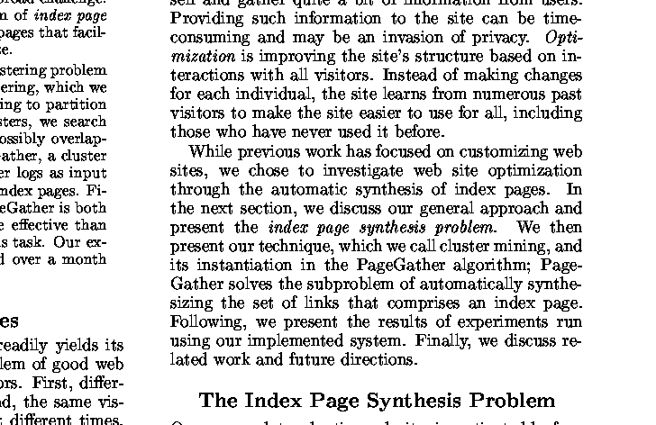
Chalres Ling

Slide 45
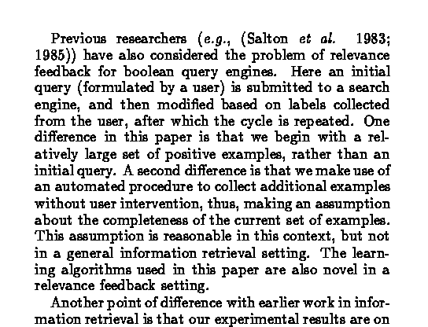
Chalres Ling

Slide 46
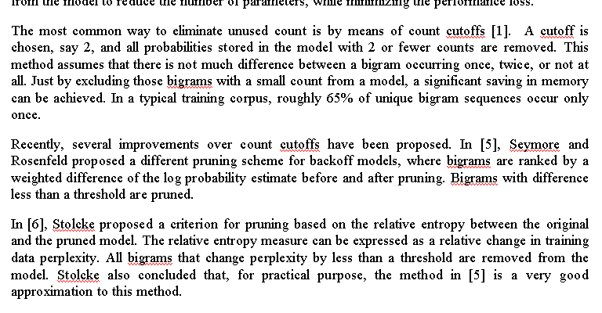
Chalres Ling

Slide 47
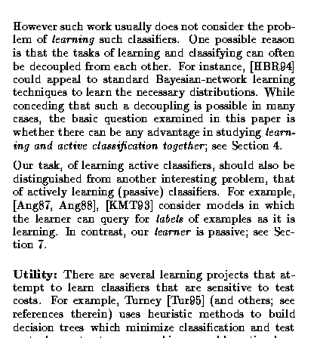
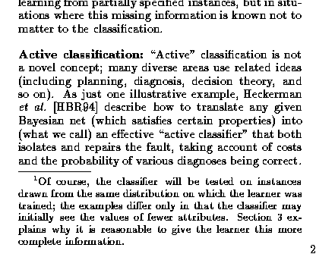
Chalres Ling

Slide 48
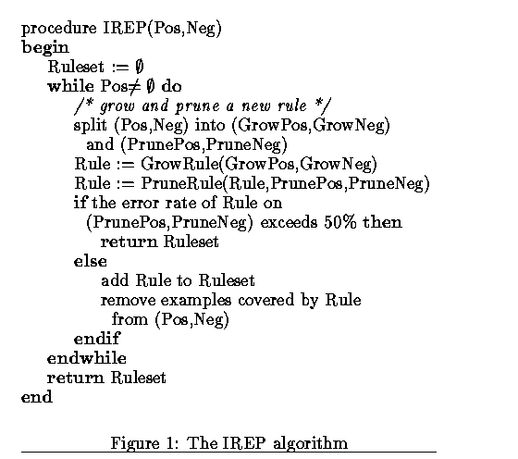
Back
Chalres Ling

Slide 49
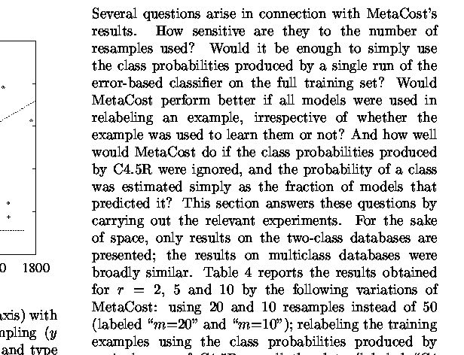
Chalres Ling

Slide 50
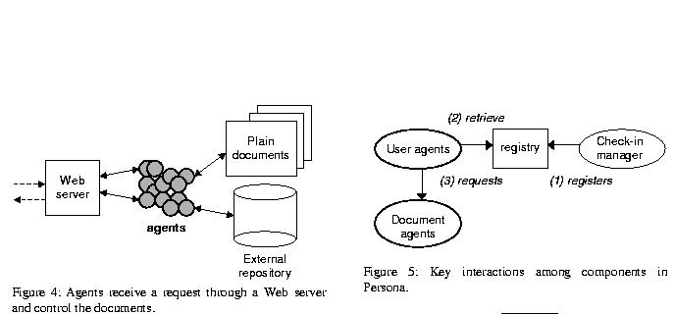
Chalres Ling

Slide 51
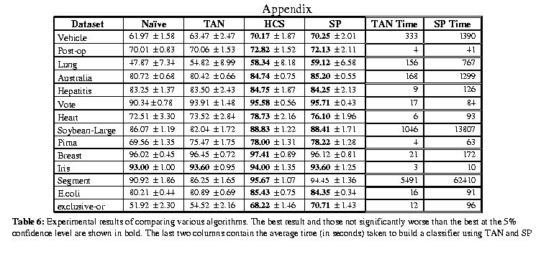
Chalres Ling

Slide 52
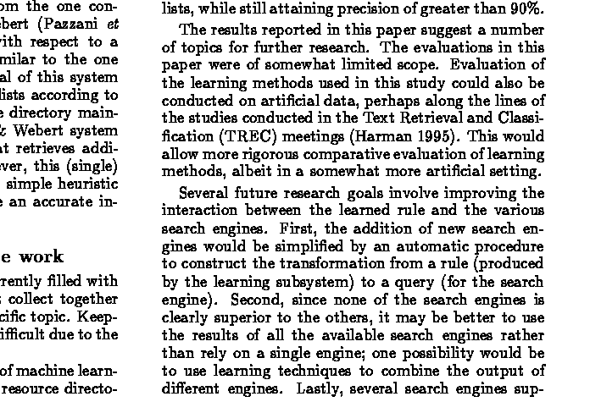
Chalres Ling

Slide 53
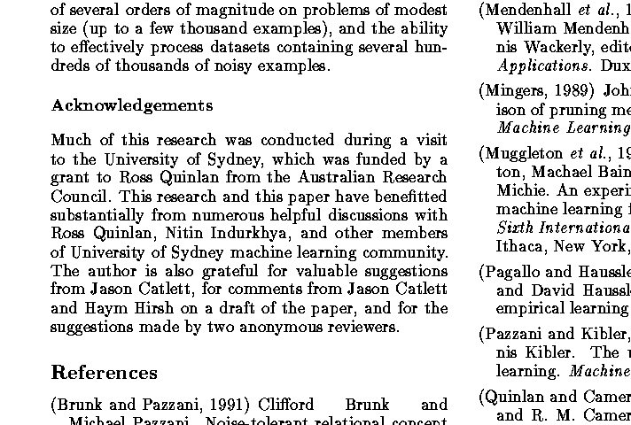
Chalres Ling

Slide 54
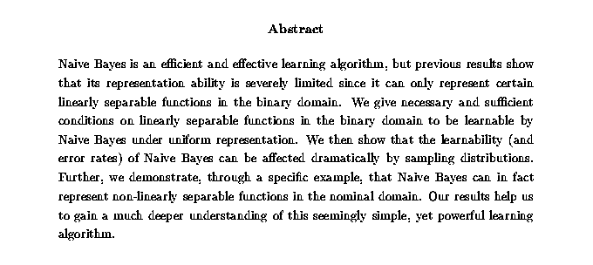
Chalres Ling

