Slide 1
Skeleton-bridged deep Mesh Generation from Single-view Images
Xiaoguang Han
The Chinese University of Hong Kong, Shenzhen
Shenzhen Research Institute of Big Data
Aug 24th, 2019

Slide 2
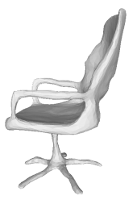
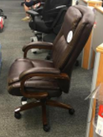

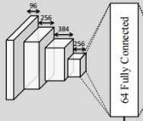
Task: Single-view Object Reconstruction
Problem formulation: Encoder-Decoder
Decoder ?

Slide 3
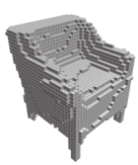

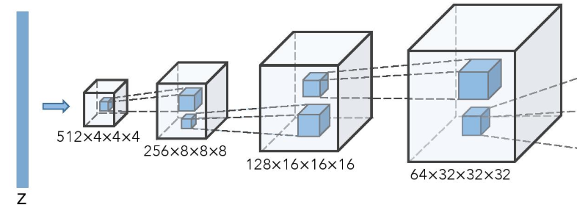
Exsiting works: Volume Decoder 1
Decoding voxels using 3D CNNs
Low-resolution output and high computational cost

Slide 4
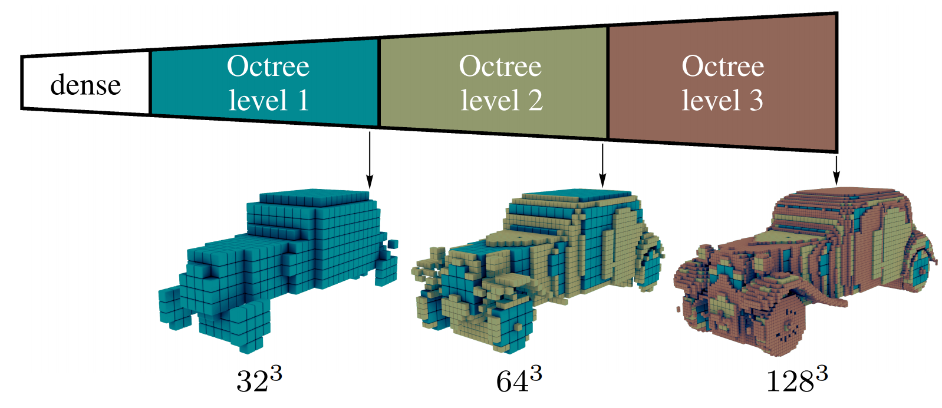
Exsiting works: Volume Decoder 2
Octree-based volume generation
Still low-resolution and also hard to train

Slide 5
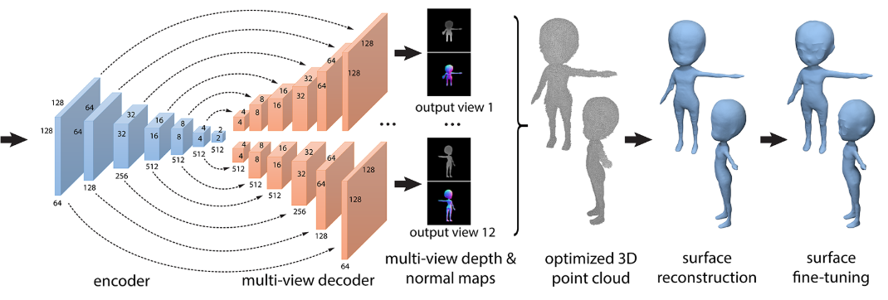

Exsiting works: Multi-view Depth Decoder
Infer multi-view depth maps and fuse them into a model
Low-accuracy output and inefficient model

Slide 6
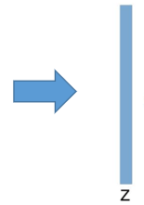
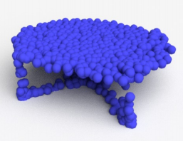
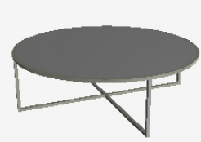
Exsiting works: Points Decoder
Regress the points' coordinates with CD loss
Too coarse to extract a mesh from the result
Deep Regression
1000 points

Slide 7
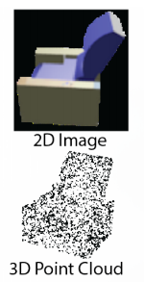
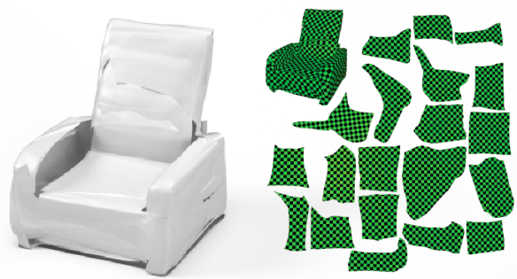
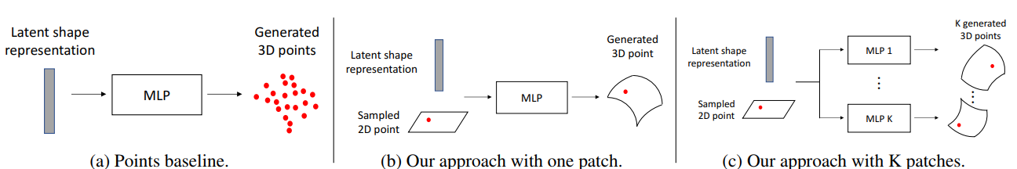
Exsiting works: Mesh Decoder 1
Atlasnet: transform multiple square meshes to fit the target surface
Overlapping and Messy output
Difficult to extract clean mesh

Slide 8
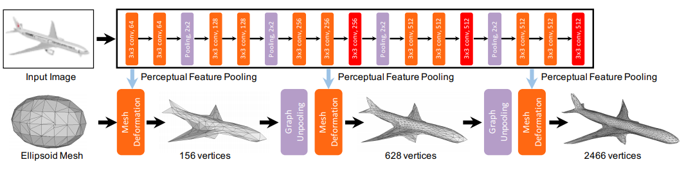
Exsiting works: Mesh Decoder 2
Pixel2Mesh: regress the deformation from a template to the target shape
Cannot handle shapes with complex topologies

Slide 9
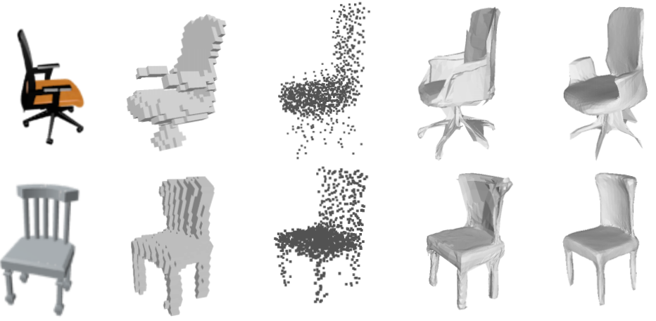
Challenges: complex topologies
3D-R2N2
PSG
AtlasNet
Pixel2Mesh

Slide 10
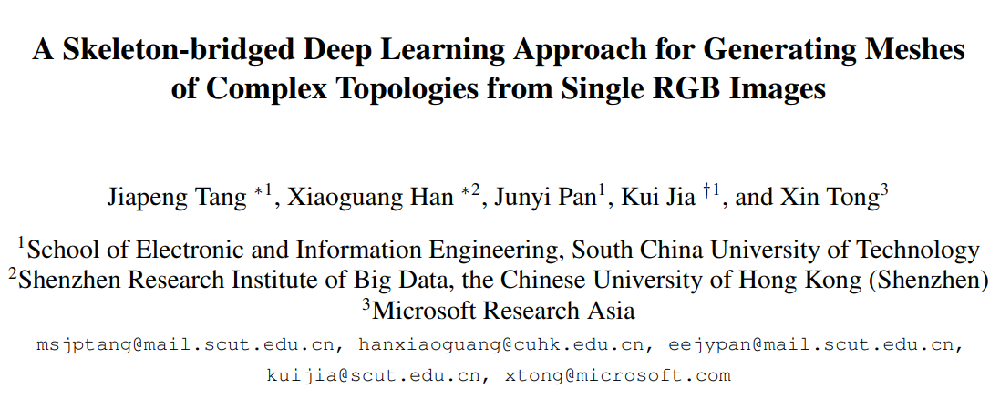
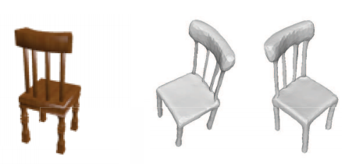
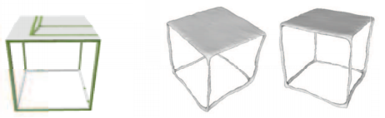

Slide 11
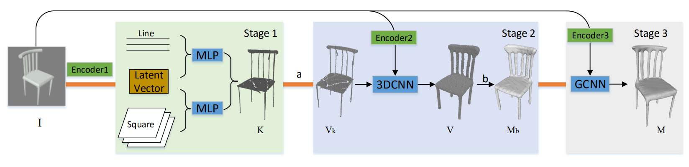
Our approach: skeleton-bridged and stage-wise
Image to Skeletal points to Skeleton volume to Base mesh to Final surface
Point Regression to Volumetric CNN to Graph CNN
Multiscale Encoders: from structure to surface details

Slide 12
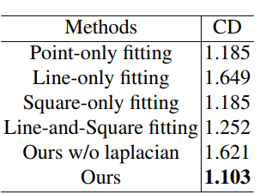
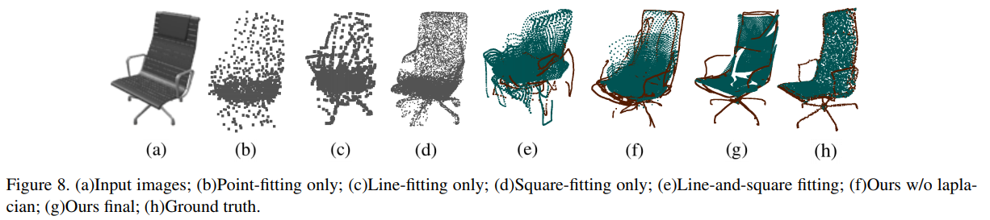
Skeleton Inference
Regress the skeletal points from the input image
Fitting CurSke and SurSke separately
Groundtruth preparation
- Meso-Skeleton extraction
- PCA-based CurSke/SurSke classification

Slide 13
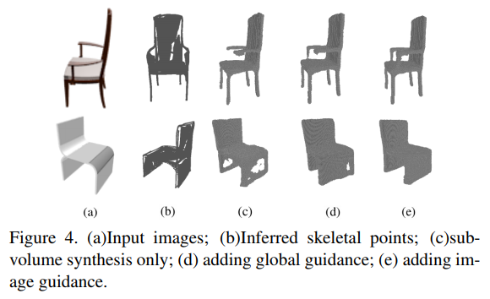
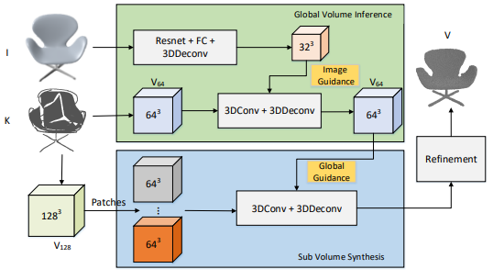
Skeleton to Base mesh
Skeletal points to volumetric representation
Global guidance subvolume synthesis
Mesh extraction from volume using marching cube

Slide 14
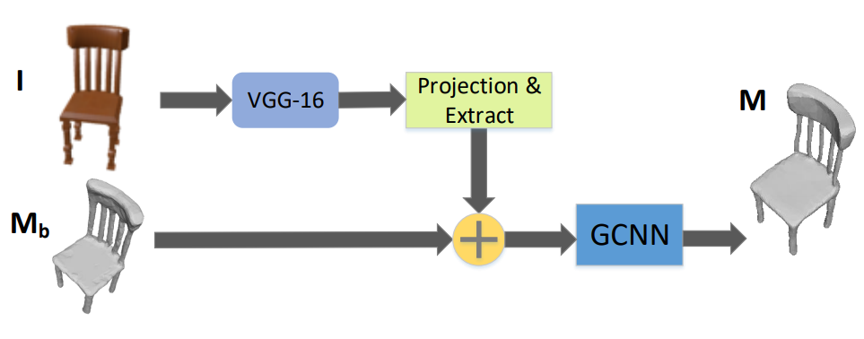
Mesh Refinement
Based on Pixel2Mesh: using GCNN to learning displacements

Slide 15
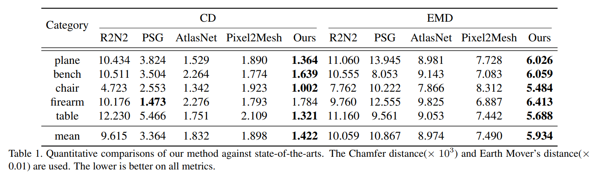
Results: Quantitative comparisons

Slide 16
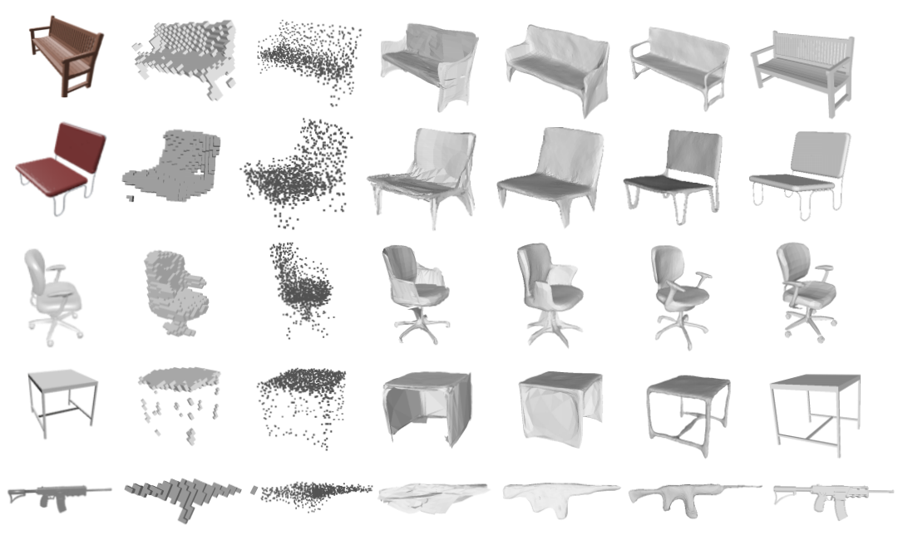
Results: Qualitative comparisons

Slide 17
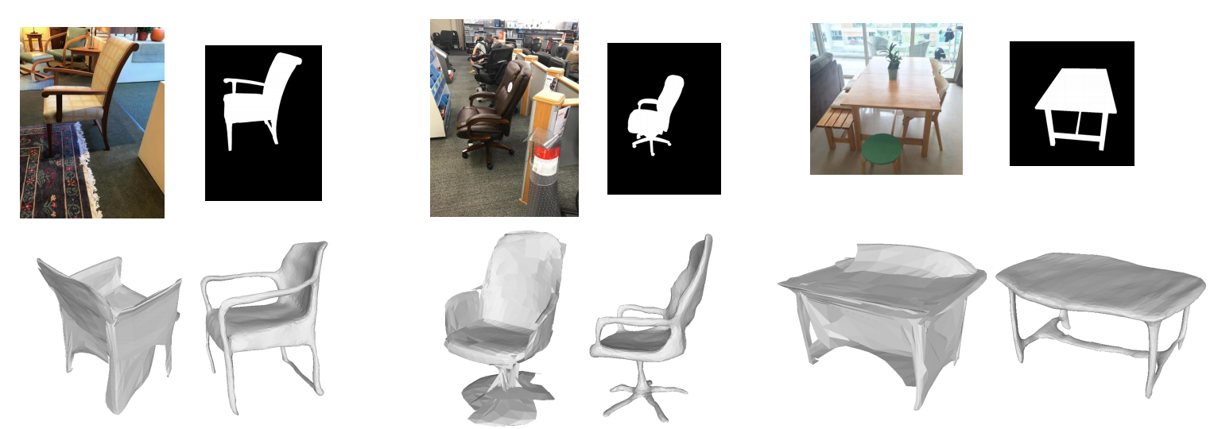
Results: On real images

Slide 18
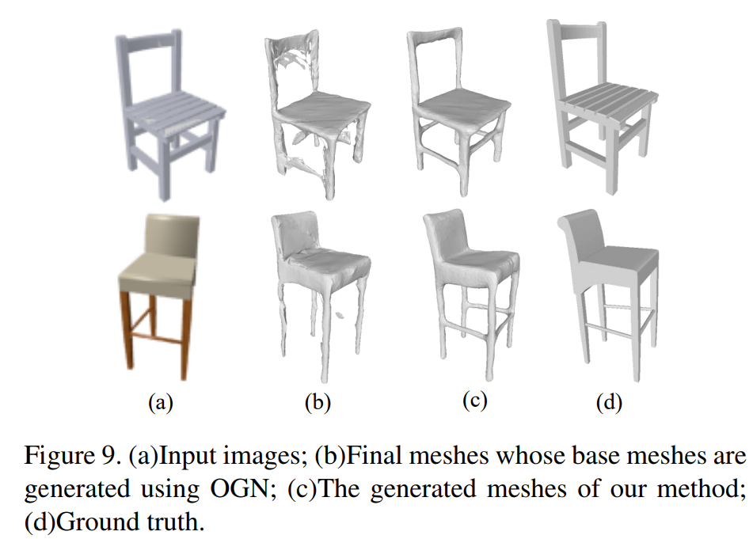
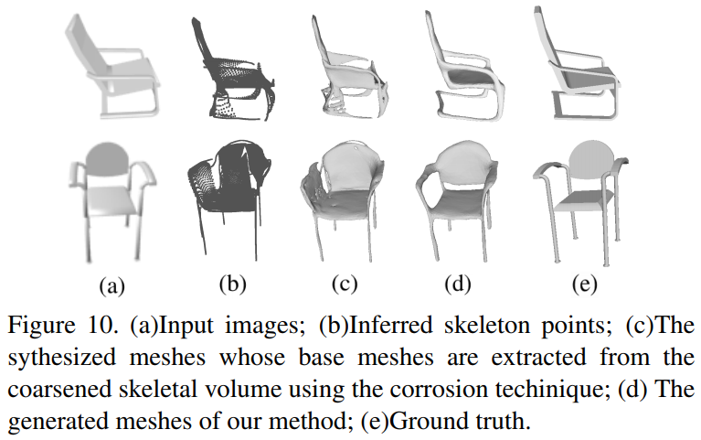
Ablation Studies on Mesh Generation
w/o skeleton inference
w/o voxel-based correction

Slide 19
Contribution summary
A novel stage-wise pipeline which takes respective advantages of different representations
A novel skeleton-bridged strategy that well-handles the shapes of complex topologies
A novel design of parallel streams for seperately inferring curve-like and surface-like skeletal points
State-of-the-art performance especially on the objects with local thin structures

Slide 20
Q&A

