Slide 1
Django Tutorial
Yonsei University
Dept. Computer Science
Yu-Min Kim

Slide 2
What is Django?
Python-based Web Backend Framework
Django Community
https://www.reddit.com/r/django/

Slide 3
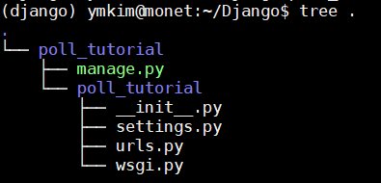
Make a Django project
Make virtual environment (python3)
Install Django

Slide 4
WTF?
Command line utility tool kit
All about Django settings (DB, Server, …)
URL mapper for our web-service
WSGI setup which enables our project
to interwork with an off-the-shelf
web-server

Slide 5
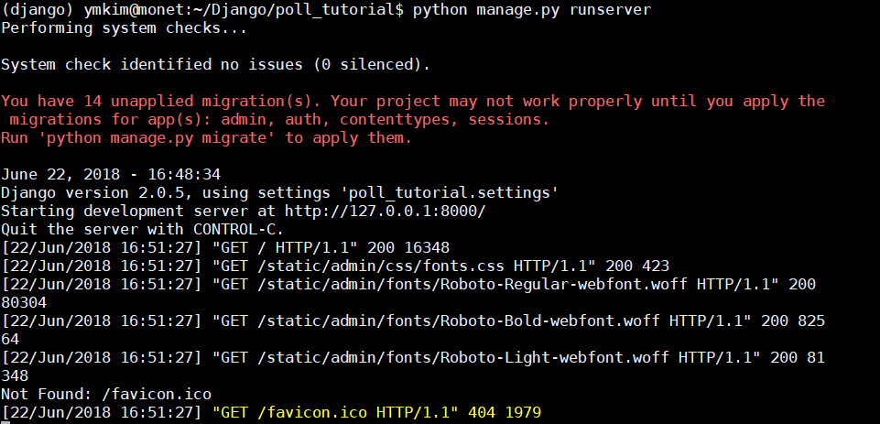
Now, you can run your web-service!

Slide 6
Project – App Relationship
Project
App
App
Configuration
App Configuration

Slide 7
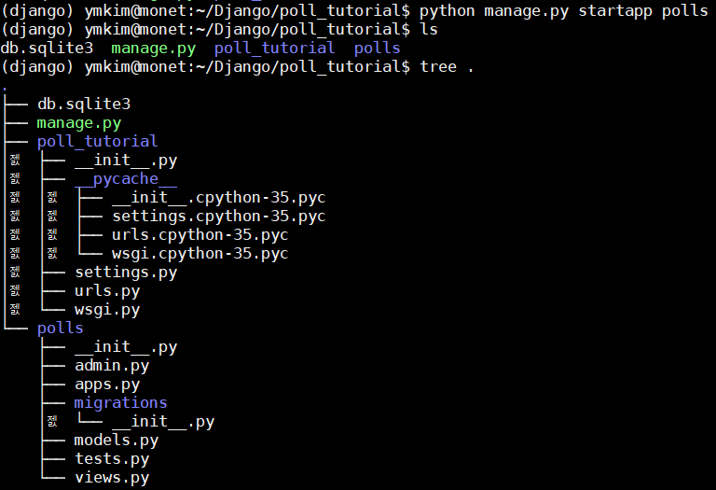
Make an app
A directory of
our new project
Description of data models
Automatically create DB tables using ORM technique.
Note that You haven’t write a line of code. Django made all for you!

Slide 8
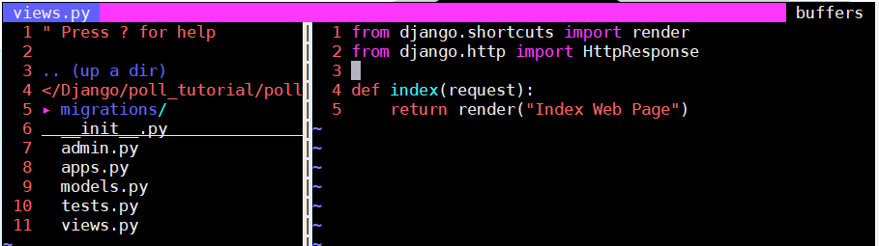
Django’s view

Slide 9
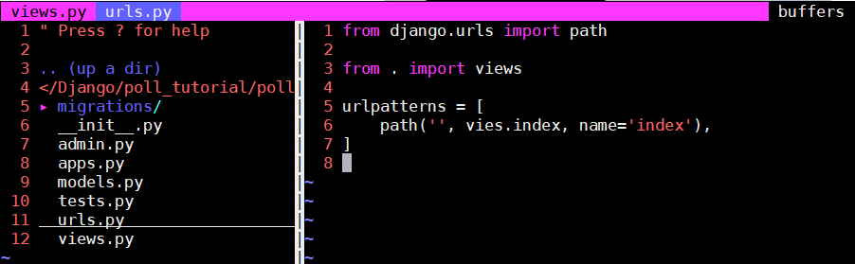
Django’s urls
To call view function, you need to map a url to it which is exactly what Django’s urls.py does.
For identification from templates
Make a new file ‘urls.py’ and type the codes in right-side

Slide 10
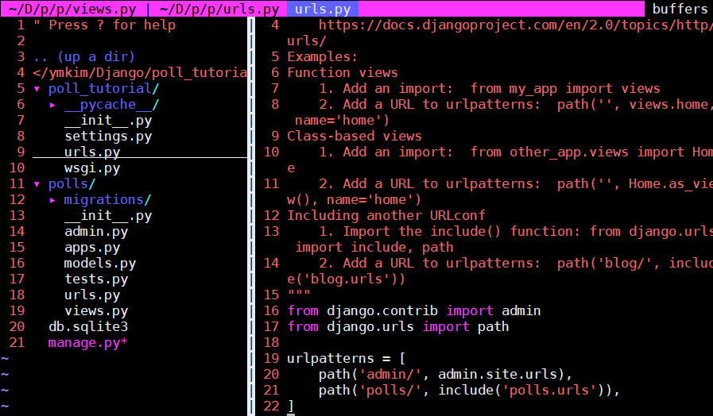
Django urls
This code routes the urls that start with ‘~/polls/’ to urls.py in ‘polls’ app.

Slide 11
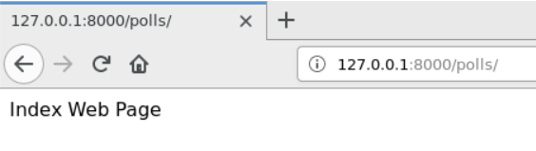
Django urls
For example, The routing process is like below.
“127.0.0.1:8000/polls/” ➔ urls.py of ‘poll-tutorial’ ➔ urls.py of ‘polls’ ➔ views.py of ‘polls’ ➔ ‘index’ view function of views.py ➔ Render proper web-page to the client

Slide 12
From request, to response
User
Internet
Web-Server (Backend)
HTTP Request
(url, request)
Web Server
Django Project
‘urls.py’ of the project
HTTP Response
(HTML)
A view function
‘views.py’ of the app
‘urls.py’ of the app

Slide 13
From request, to response
Ex)
url: https://www.naver.com/login/
Request:
{ ‘id’ : ‘Yu-Min Kim’,
‘pw’ : ‘secret’ }
HTTP Request
(url, request)
Ex)
url: “127.0.0.1:8000/polls/”
Request: None

Slide 14
From request, to response
Web Server
Apache2

Slide 15
From request, to response
Project
Django Project
App
App
Configuration
App Configuration

Slide 16
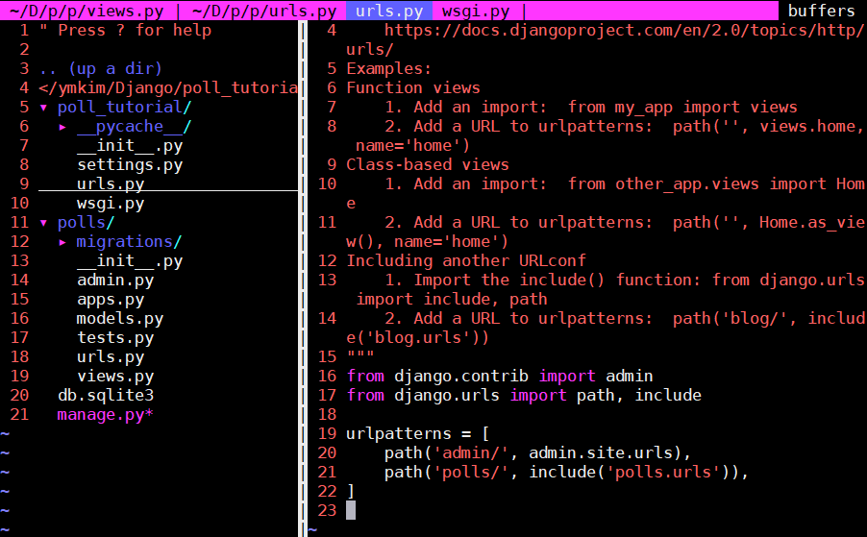
From request, to response
‘urls.py’ of the project

Slide 17
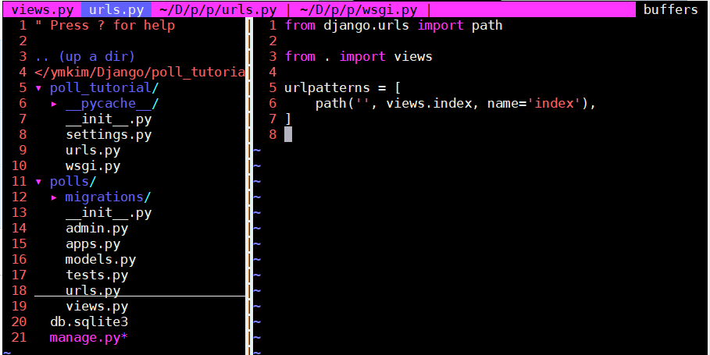
From request, to response
‘urls.py’ of the app

Slide 18
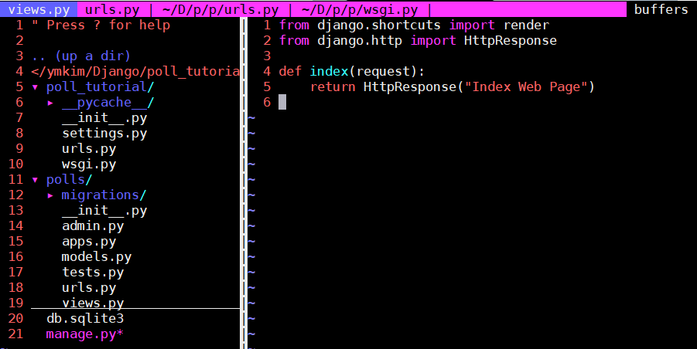
From request, to response
‘views.py’ of the app

Slide 19
From request, to response
HTTP Request
(url, request)
A view function

Slide 20
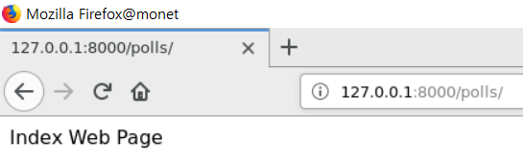
From request, to response
HTTP Response
(HTML)

