Slide 1
1
Online Store
Group 8 : MVPs
SERVICES
IDEA
TEAM
MARKETING
GOAL

Slide 2
Our Team
1
Nguyen Tuan Anh
Dang Trong Quoc Huy
Nguyen Dinh Thi
17110002
17110035
17110074

Slide 3
Steps to our Goal
1
Demo Application
Validation(Testing)
Implement/Coding
Design UI
Design Database

Slide 4
Function of website
1
STT | Function | Describtion
1 | Product managing | Admin can managing category or products such as create or edit and delete …
2 | Comment | User who is member can comment on the product
3 | Sign in/sign out/register | Only people who registered can managing category or products.
4 | Cart | Member can buy product then add to cart and user can managing their cart.

Slide 5
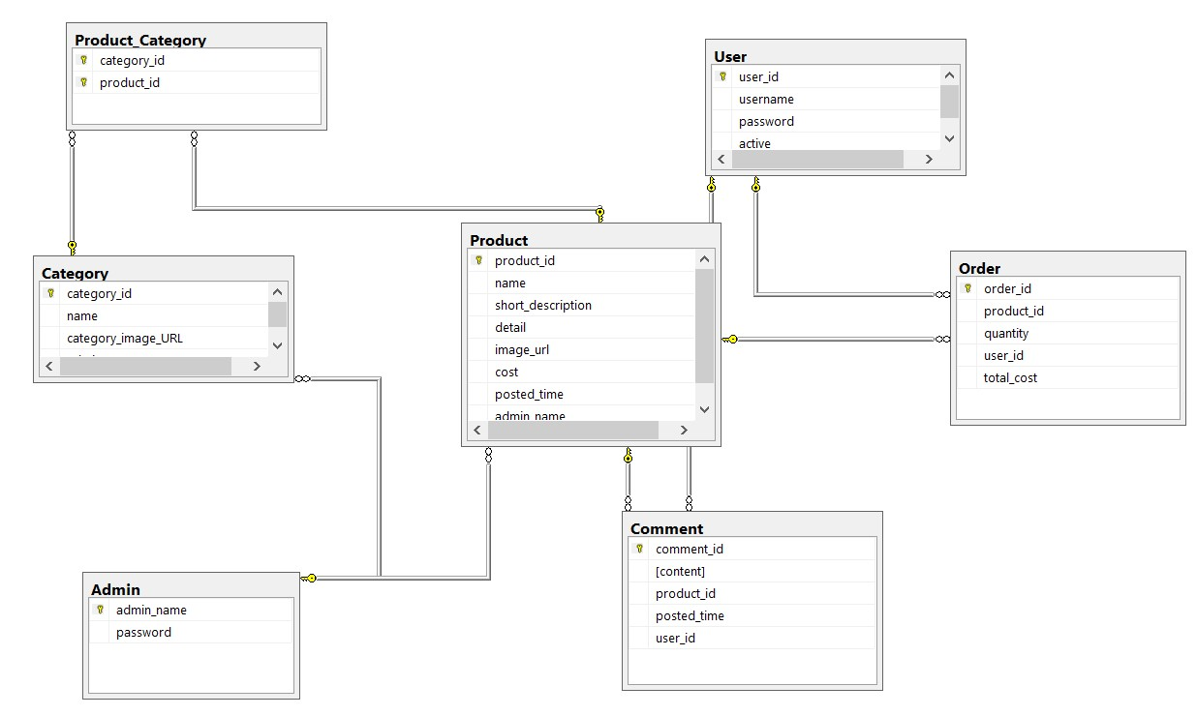

Database Diagram
1

Slide 6
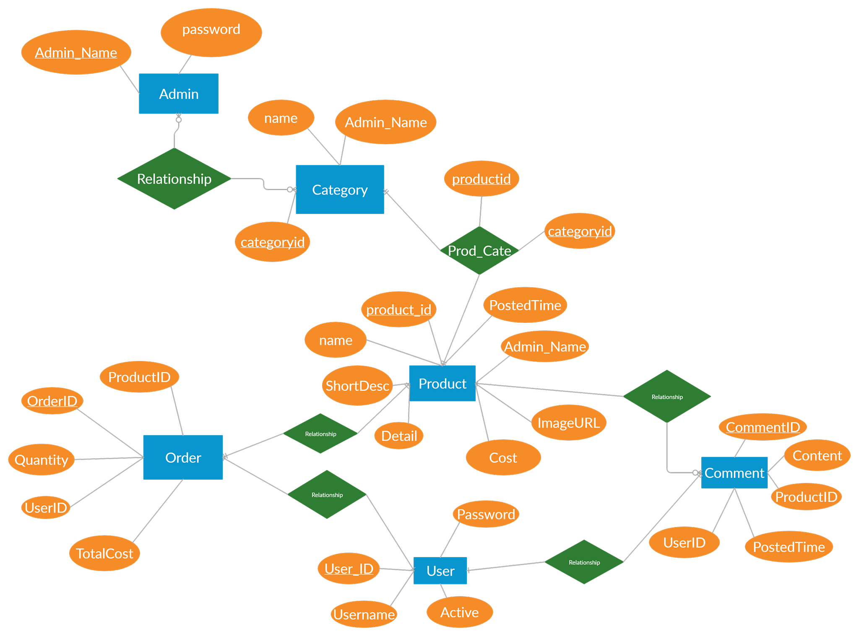
Database Diagram
1

Slide 7
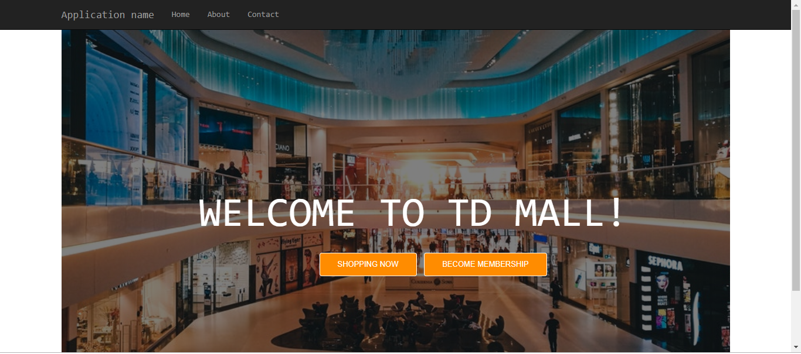
Application Over View
1

Slide 8
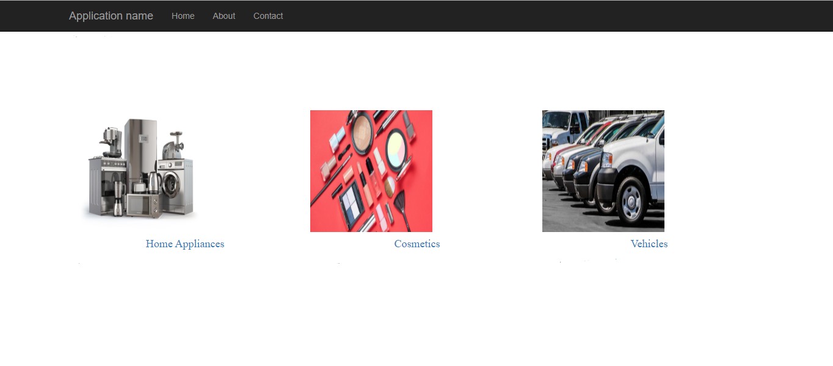
Application Over View
1

Slide 9
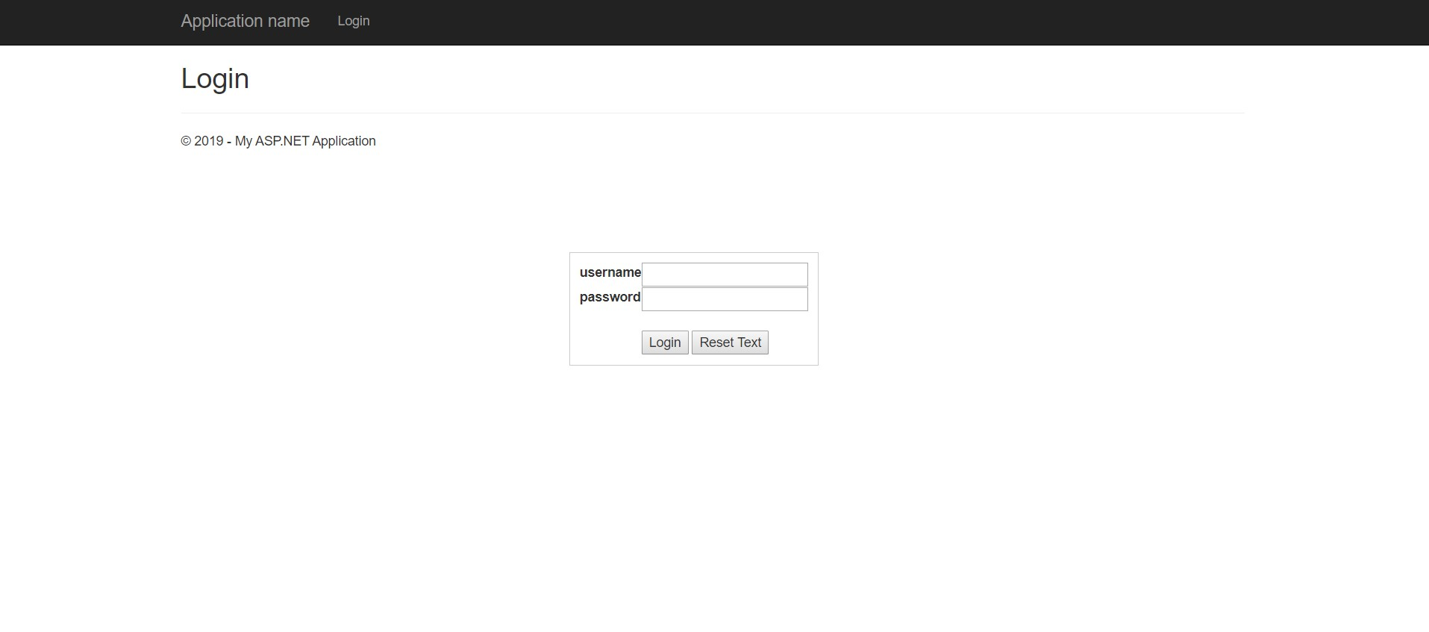
Application Over View
1

Slide 10
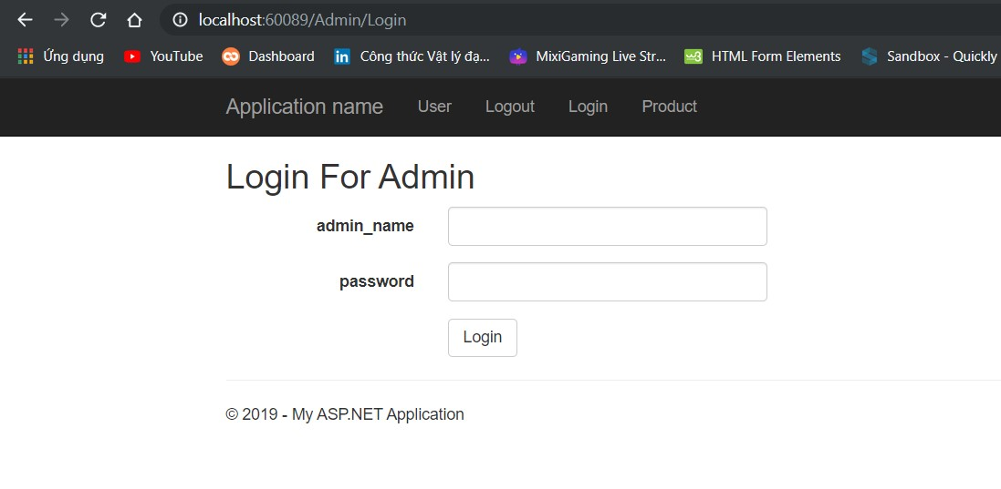
Application Over View
1

Slide 11
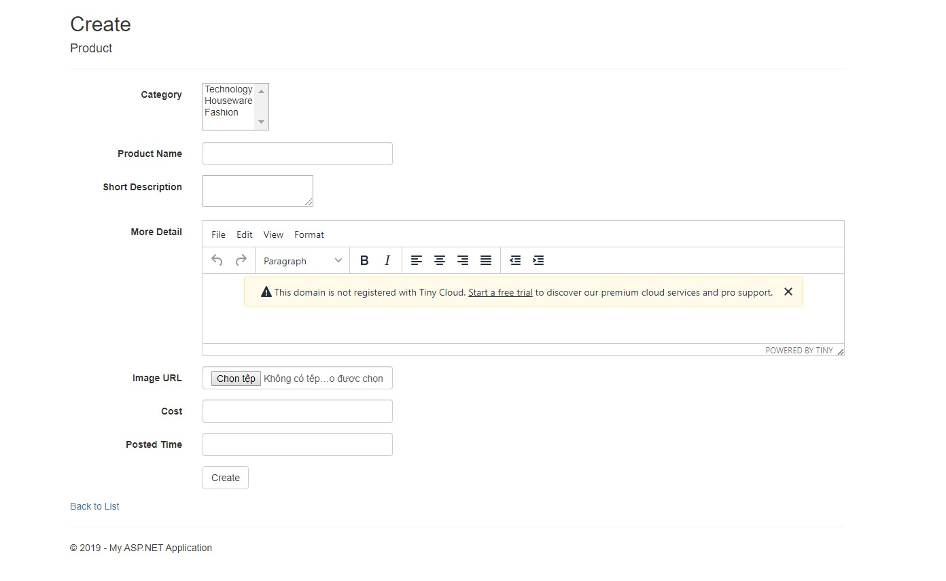
Application Over View
1

Slide 12
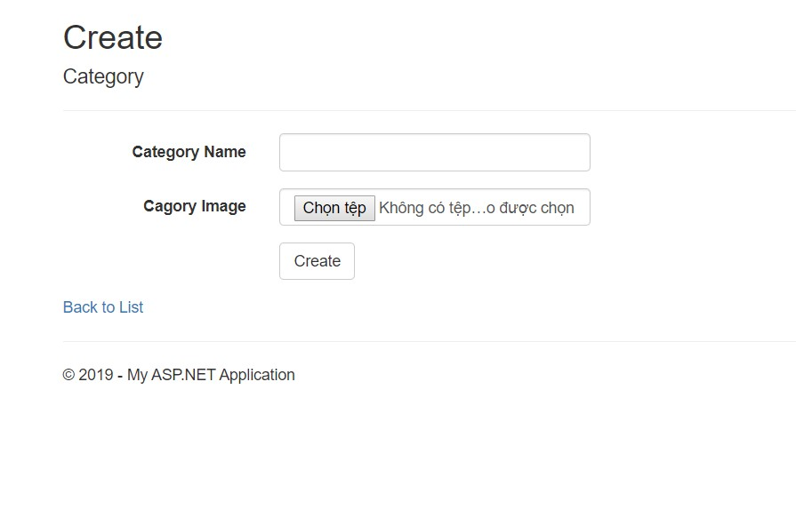
Application Over View
1

Slide 13
1
THANK
YOU
www.yourwebsite.com

