Slide 1
Introduction to Knowledge Organization Systems
G. Falquet
CUI – Université de Genève

Slide 2
Contents
Knowledge Engineering and Knowledge Representation
Thesauri and SKOS
Terminologies and TBX
A Lexical Ontology: WordNet

Slide 3
Knowledge Engineering and Knowledge Representation

Slide 4
Knowledge engineering
KE is an engineering discipline that involves integrating knowledge into computer systems in order to solve complex problems normally requiring a high level of human expertise (Feigenbaum & McCorduck, 1983).
Goal: building, maintaining and developing knowledge-based systems
Issues:
knowledge representation
knowledge acquisition methodologies
mathematical logic and reasoning

Slide 5
Data-Information-Knowledge (Tergan & Keller, 1998)
Data: Uninterpreted symbols (no meaning)
Information: Data that has been given meaning through interpretation by way of relational connection and pragmatic context
provides answers to “who”, “what”, “where”, “why”, “when”
express facts, opinions, objective information (based on facts), subjective information (cognitive analysis of facts), primary/secondary information
different format (verbal, print, visual, ...)
Knowledge: cognitively processed information, integrated into a human knowledge structure

Slide 6
Knowledge
information is outside the brain (“knowledge in the world”),
knowledge is inside (“knowledge in the head”)
provides answers to “how”
can be
explicit: can be expressed (words, numbers, formulae), shared, transmitted
tacit: highly personal, hard to formalize (insights, intuitions, hunches), based on beliefs, perceptions, emotions, mental models, ...

Slide 7
Aspects of domain knowledge
conceptual knowledge: propositional representation of abstract concepts and their semantic relations
episodic (memory of everyday events)
analogical representations (mental models)
procedural (condition-action pairs)
situated (socio-cultural context)

Slide 8
Knowledge, in general language
from en.wikipedia.org
expertise, and skills acquired by a person through experience or education; the theoretical or practical understanding of a subject;
what is known in a particular field or in total; facts and information;
awareness or familiarity gained by experience of a fact or situation
Knowledge (1. and 3.) is related to a person.

Slide 9
Knowledge, From (Brachman & Levesque, 2004)
“Mary knows that Paul is a physicist”
A relation between an agent (knower) and a proposition
A propositional attitude, among others
“Mary doubts that Paul is a physicist”
“Mary hopes that Paul is a physicist”
“Mary fears that Paul is a physicist”

Slide 10
Knowledge, in philosophy (to know something)
In philosophy: knowledge is "justified true belief." (Plato)
S knows that a proposition P is true if, and only if:
P is true
S believes that P is true,
S is justified in believing that P is true
... challenged by Gettier's argument
... repaired by Nozick
... re-challenged ...

Slide 11
Knowledge Representation
The field of study concerned with using formal symbols to represent a set of propositions believed by some putative agent. (Brachman & Levesque, 2004)

Slide 12
Knowledge representation
Defined by its roles (Davis, Shrobe, and Szolovits, 1993)
a surrogate
-- replaces real knowledge
a set of “ontological commitments”
-- a view of the world
a fragmentary theory of intelligent reasoning
-- logical, psychological, biological theory
a medium for efficient computation
a medium of human expression

Slide 13
Logical Pluralism
Logical Pluralism and Syntactic Heterogeneity (or plurality) of ontology languages is thus clearly an important issue, (Kutz & al., 2010)
Carnap, in ‘Die logische Syntax der Sprache’[35, Sect. 17], famously put forward his principle of logical tolerance as follows:
It is not our business to set up prohibitions, but to arrive at conventions. [. . . ] In logic there are no morals. Everyone is at liberty to build up his own logic, i.e. his own language, as he wishes. All that is required of him is that, if he wishes to discuss it, he must state his methods clearly, and give syntactical rules instead of philosophical arguments.
⇒ several languages/logics to "fully" describe some reality

Slide 14
Modal Logics
First-order Logic
Many-sorted First-order Logic.
Common Logic.
Relational Schemes.
Description Logics
Higher-Order Logics.
Temporal logic
Interval temporal logic
Epistemic logic
Dynamic logic
Description logic
Spatial logic
Intuitionistic logic

Slide 15
Knowledge organization systems
Schemes for organizing knowledge representation elements
thesauri
terminologies
ontologies
knowledge graphs
…

Slide 16
References
Feigenbaum, E. A.; McCorduck, P. (1983), The fifth generation (1st ed.), Reading, MA: Addison-Wesley, ISBN 978-0-201-11519-2, OCLC 9324691
Brachman, R., Levesque, H. (2004) Knowledge Representation and Reasoning. Morgan Kaufmann Series in Artificial Intelligence.
Davis, R., Shrobe, H., Szolovits, P. (1993). What is a Knowledge Representation? AI Magazine, 14(1):17-33, 1993.
Kutz, O., Mossakowski, T., & Lücke, D. (2010). Carnap, Goguen, and the Hyperontologies: Logical Pluralism and Heterogeneous Structuring in Ontology Design. Logica Universalis, pp. 255-333. Retrieved from http://www.informatik.uni-bremen.de/~till/papers/Hyperontology.pdf
Tergan, S.-O., Keller, T. (1998) Knowledge and Information Visualization. LNCS 3426, Springer.

Slide 17
Thesauri and SKOS

Slide 18
Thesaurus
Organized list of controlled and normalized terms that represent the concepts of a knowledge domain. Relations replace definitions
Main use : indexing document corpora with a controlled vocabulary
3 types of terms :
descriptors: may be used to index documents
non-descriptors: may not index documents, refer to the correct descriptor to use.
auxiliary words: cannot be use alone, must be coordinated with other descriptors.

Slide 19
Semantic relations
Broader/Narrower Term (BT/NT)
To create a hierarchical structure
May represent different conceptual relations
generic - specific
whole - part
class - instance
Association (RT related term)
Any other kind of relation

Slide 20
Terminological relations
Equivalence (Used For/Use)
Preferred term (descriptor)
Synonyms (non-descriptor)

Slide 21
Examples
Agriculture Organization's AGROVOC Thesaurus https://agrovoc.uniroma2.it/agrovoc/agrovoc/en/
Thésaurus Urbamet https://2ans-urbamet.developpement-durable.gouv.fr/exl-php/vue/mpd_thesaurus_urbam2_consultation
GEMET http://www.eionet.europa.eu/gemet .
FORUM on Information Standard Heritage
http://www.heritage-standards.org.uk/fish-vocabularies/

Slide 22
SKOS
A vocabulary to represent different families of knowledge organization systems, including
thesauri,
classification schemes,
subject heading systems,
taxonomies
These are widely recognized and applied in both modern and traditional information systems. They have much in common.

Slide 23
Elements
concept scheme comprising a set of concepts
concepts can be labeled with any number of lexical (UNICODE) strings
notations, which are lexical codes used to uniquely identify the concept (a bridge to existing systems)
concepts can be
documented with notes of various types
linked to other SKOS concepts via semantic relation properties
mapped to other SKOS concepts in different concept schemes (hierarchical, associative, close equivalent and exact equivalent)

Slide 24
No formal interpretation
concepts described through natural language
concepts may be arranged and organized into various structures
hierarchies (most commonly) or association networks.
structures have no formal semantics
cannot be interpreted as either formal axioms or facts about the world.
structures serve only to provide a convenient and intuitive
map of some subject domain,
which can then be used as an aid to organizing and finding objects, such as documents, which are relevant to that domain.

Slide 25
Example
<A> rdf:type skos:Concept ;
skos:prefLabel "love"@en ;
skos:altLabel "adoration"@en ;
skos:broader <B> ;
skos:inScheme <S> .
<B> rdf:type skos:Concept ;
skos:prefLabel "emotion"@en ;
skos:altLabel "feeling"@en ;
skos:topConceptOf <S> .
<S> rdf:type skos:ConceptScheme ;
dct:title "My First Thesaurus" ;
skos:hasTopConcept <B> .

Slide 26
Semantic relations
skos:semanticRelation
|
+— skos:related
|
+— skos:broaderTransitive
| |
| +— skos:broader
|
+— skos:narrowerTransitive
|
+— skos:narrower

Slide 27
Broader relations
broader is not transitive but broaderTransitive is
since broader ≤ broaderTansitive
if a broader b and b broader c then a broaderTransitive c .
but not a broader c
broader is not functional, poly-hierarchies are allowed
related is not transitive

Slide 28
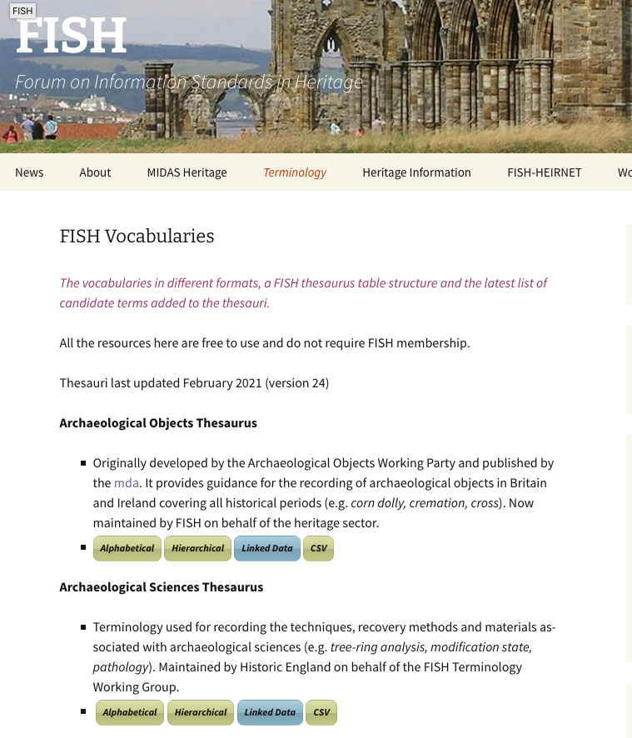
Examples
http://www.heritage-standards.org.uk/fish-vocabularies/
In SKOS

Slide 29
Schema interconnection (mappings)
Interconnecting concepts that belong to different schemes
closeMatch concepts that are sufficiently similar that they can be used interchangeably in some information retrieval applications
exactMatch high degree of confidence that the concepts can be used interchangeably
broadMatch hierarchical mapping
narrowMatch hierarchical mapping
relatedMatch associative mapping link

Slide 30
The matching relations are subrelations of their internal counterpart.
broadMatch ⊑ broader ⊑ broaderTransitive
narrowMatch ⊑ narrower ⊑ narrowerTransitive
relatedMatch ⊑ related

Slide 31
Entailment
<A> skos:broadMatch <B> .
entails
<A> skos:mappingRelation <B> .
<A> skos:broader <B> .
<A> skos:broaderTransitive <B> .
<A> skos:semanticRelation <B> .
<A> rdf:type skos:Concept .
<B> rdf:type skos:Concept .

Slide 32
Terminologies and TBX

Slide 33
TermBase eXchange (TBX)
international standard for representing and exchanging information about terms, words, and other lexical data
ISO standard 30042
XML format
https://www.tbxinfo.net

Slide 34
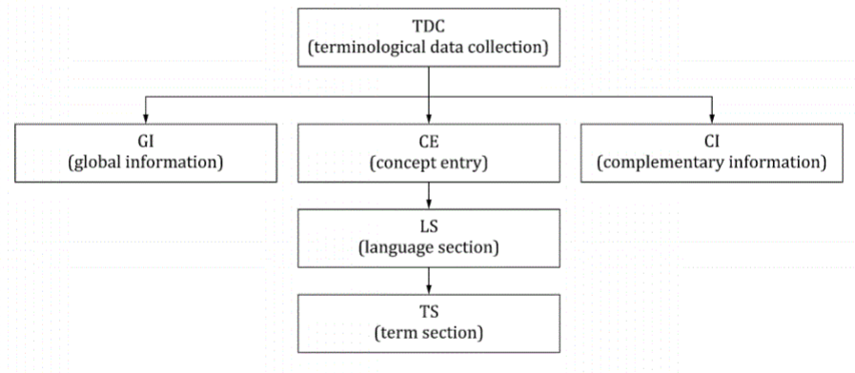
source: ISO 30042 standard

Slide 35
Concept Entry
Information about the concept as a whole, as designated by all the terms across all the language sections of the entry, includes:
domain to which the concept belongs (required)
link to an image illustrating the concept (optional)
definitions can be at the concept rather than language level

Slide 36
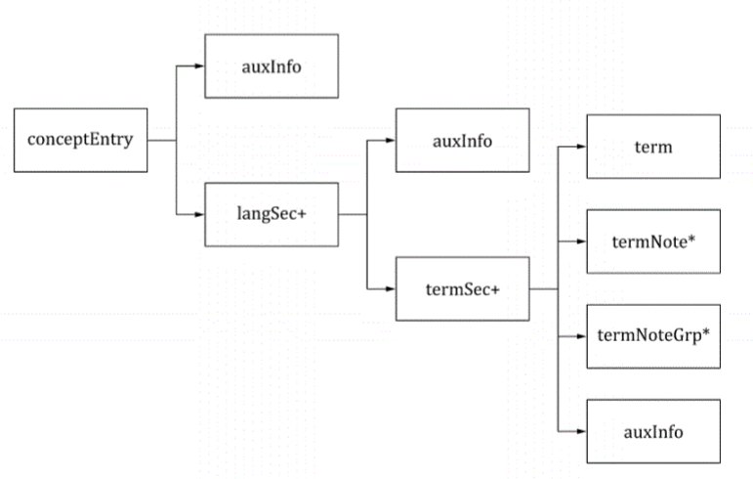

Slide 37
Language Section
All the terms in a particular language for a given concept
information about the language section as a whole:
language of the terms in this language section (required)
definition of the concept (optional).

Slide 38
Term section
Information about the term, such as:
- term type (full form, acronym, abbreviation, etc.)
- part of speech (noun, verb, etc.)
- contextual example of the term in a sentence or paragraph
- customer code (if this term is specific to a particular customer)
- project code (if this term is specific to a particular project)
- responsibility (if more than one person works on this termbase)
- cross-reference to another term (if applicable)
- usage note (usage notes can, for example, indicate regional variation).

Slide 39
Term Component
To describe the components (words) of multiword terms
e.g. “uninterruptible power supply”
linguistic information for each word
part of speech (noun, verb, adjective, adverb, preposition)
lexical gender
how words are hyphenated, inflected and pronounced.

Slide 40
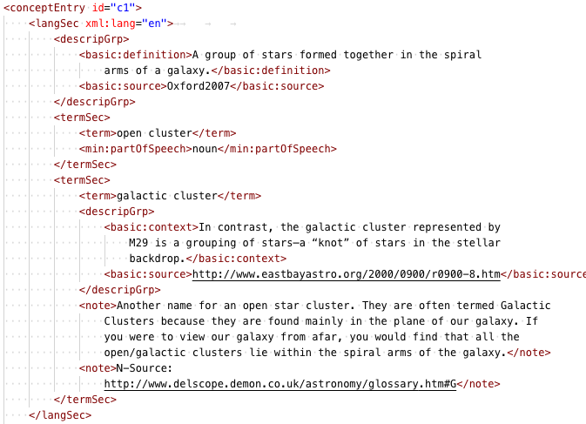

Slide 41
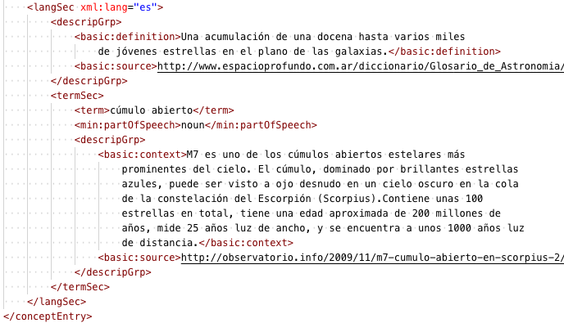

Slide 42
Conceptual Relations
hierarchical relations
broader (superordinate),
narrower (subordinate)
sibling (coordinate)
partitive relations
part of (pupil is-part-of eye)
associated relations
(for instance, the relation between “pitcher” and “baseball”).

Slide 43
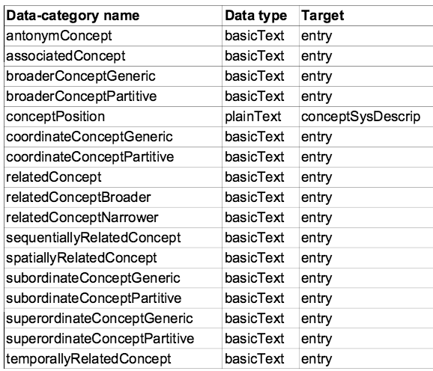

Slide 44
A Lexical Ontology: WordNet
http://wordnetweb.princeton.edu
http://wordnetweb.princeton.edu/perl/webwn

Slide 45
WordNet (overview)
a lexical ontology
conceptual level + linguistic level
limited set of relations
concept = "synset" (set of synonyms)
Contains
all the English words
all the meanings of these words

Slide 46
Definitions
vocabulary = set of words
word = (f, s)
f : lexical form = character string
s : sense
syntactic categories : names, adjectives, verbs, adverbs

Slide 47
Relations
Morphological
between forms
inflection, derivation, composition
Lexical semantics
relations between the word senses
semi-formalized definitions

Slide 48
Base WordNet (English)
≥ 166 000 words (f, s)
118 000 forms
90 000 senses
17% of polysemous words
40% of the words have synonyms

Slide 49
Exemple : polysemy
"table"
form
word
n.f.
n.f.
#table(1)
piece of furniture...
#table(2)
set of data...
sense
(concept)

Slide 50
http://wordnet.princeton.edu/perl/webwn

Slide 51
Synsets
"table"
form
"relation"
n.f.
n.f.
word
n.f.
synonymy
(synsets)
sense
#table(1)
piece of furniture...
#table(2)
set of rows in a database

Slide 52
morphological relations
"went"
form
"go"
inflection
word
v
v
(synsets)
sense

Slide 53
Semantic relations : hyperonymy
"furniture"
"table"
form
adj.
n.m
n.f.
word
hyperonym ("is a")
#furniture(1)
...
#table(1)
...
sense

Slide 54
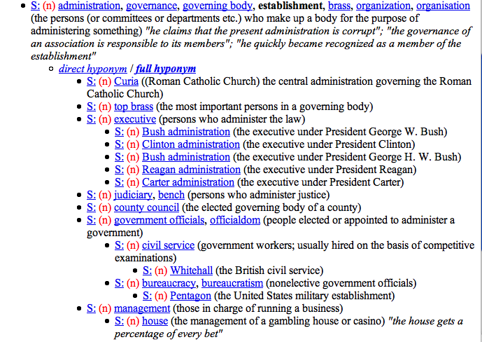

Slide 55
Hyponymy
A is a hyponym of B if the sentence
"A is a B"
is true
Encompasses notions such as superclass and instance.
a lion is a feline
Barcelona is a city
Wordnet also has an instance relation.

Slide 56
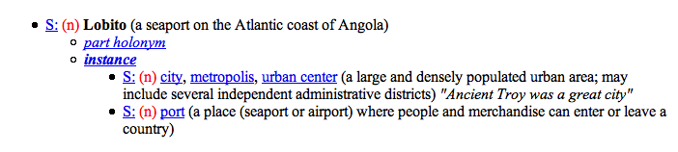

Slide 57
R. S. : meronymy (parthood)
"leg"
"table"
form
n.m.
n.m
n.f.
3 types :
- component
- substance
- member
word
meronym (has part)
#leg(3)
...
#table(1)
......
sense

Slide 58
Antonym
"soft"
"hard"
"easy"
forme
antonym
adj.
adj.
adj.
adj.
mot
#hard(3)
...
#hard(1)
...
sens

Slide 59
R. S. Troponymie
"savor"
"eat"
verb
verb.
troponym
#savor(1)
taste and enjoy ...
...
#eat(1)
...

Slide 60
Entailment
"fly"
"takeoff"
verb
verb
entails
#takeoff(1)
...
#fly(1)
action of ...

Slide 61
Applications
Natural language processing
Examples
normalization (replace synonyms by a standard form)
disambiguation: make explicit the meaning of each word in a text
several techniques (generally based on the word's context)
still a research topic

Slide 62
Application in information retrieval
Query Expansion
1. With synonyms
Q : automobile
exp(Q) : automobile OR car OR motorcar
Increases recall

Slide 63
Polysemy problem
How to expand 'car' ?
car, auto, automobile, machine, motorcar (a motor vehicle with four wheels; usually propelled by an internal combustion engine) "he needs a car to get to work"
car, railcar, railway car, railroad car (a wheeled vehicle adapted to the rails of railroad) "three cars had jumped the rails"
cable car, car (a conveyance for passengers or freight on a cable railway) "they took a cable car to the top of the mountain"
car, gondola (the compartment that is suspended from an airship and that carries personnel and the cargo and the power plant)
car, elevator car (where passengers ride up and down) "the car was on the top floor"
==> interactive interfaces

Slide 64
2. With hyponyms
a) increase recall
Q → Q OR hypo₁ OR hypo₂ OR ...
car → car OR ambulance OR beach wagon OR compact OR convertible OR coupe OR cruiser ...
b) specification (if too many answers)
Q → one select hyponym of Q
car → electric car
[requires user interaction]

Slide 65
Critique of WordNet by D. Lenat (CyC)
Too few semantic relations
thousands in CyC, 6 dans WN
inCyC : no. rel type ~= no. concepts/10
A richer knowledge base is required for true contextual disambiguation
"The police arrested the demonstrators because they feared violence"
"The police arrested the demonstrators because they advocated violence"
Who is "they" ?
A general world knowledge is necessary

Slide 66
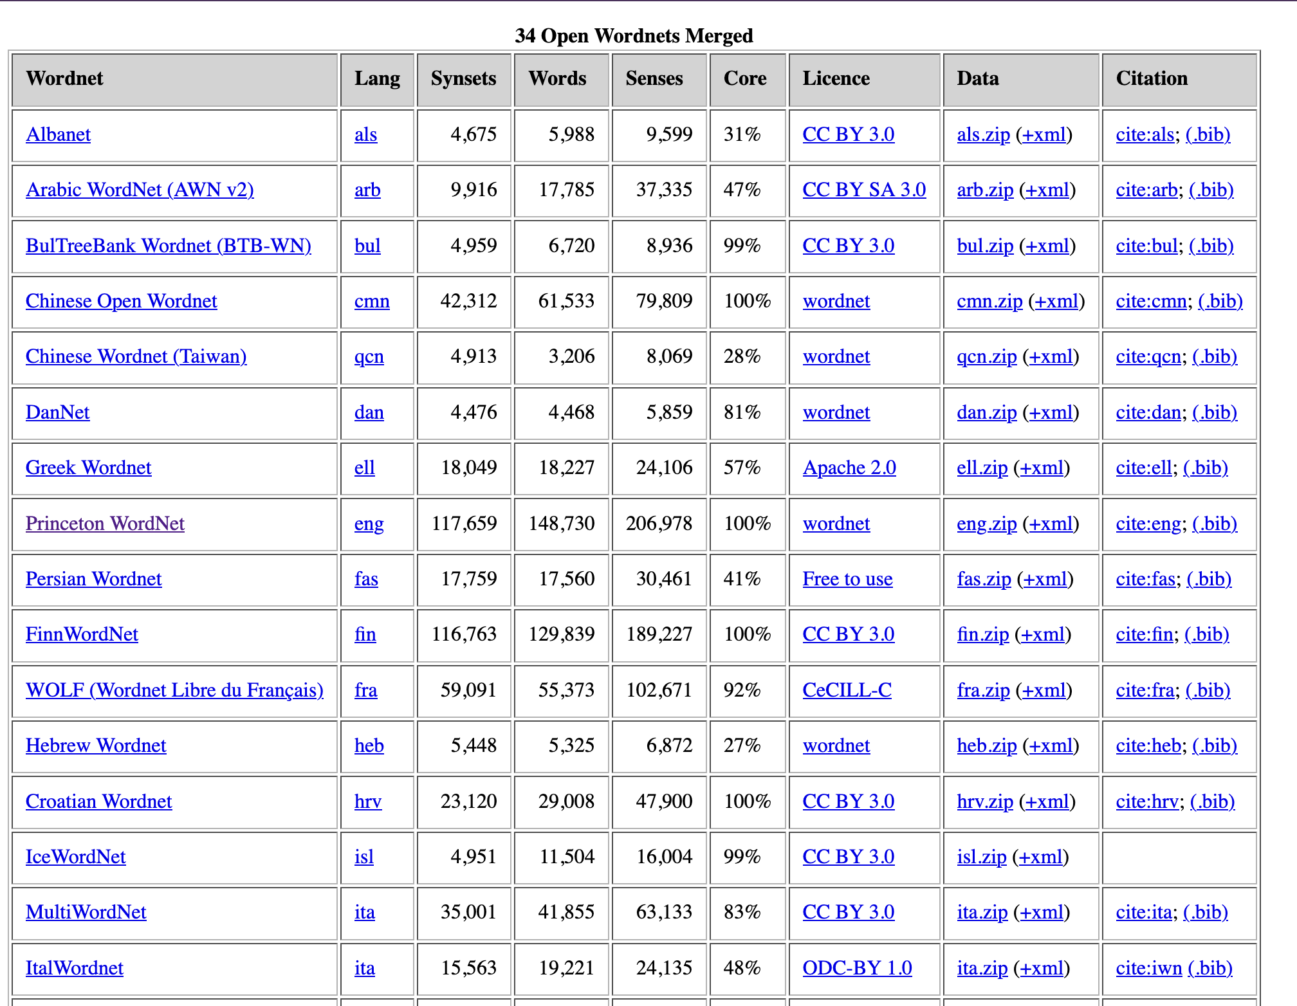
Other Wordnets

Slide 67
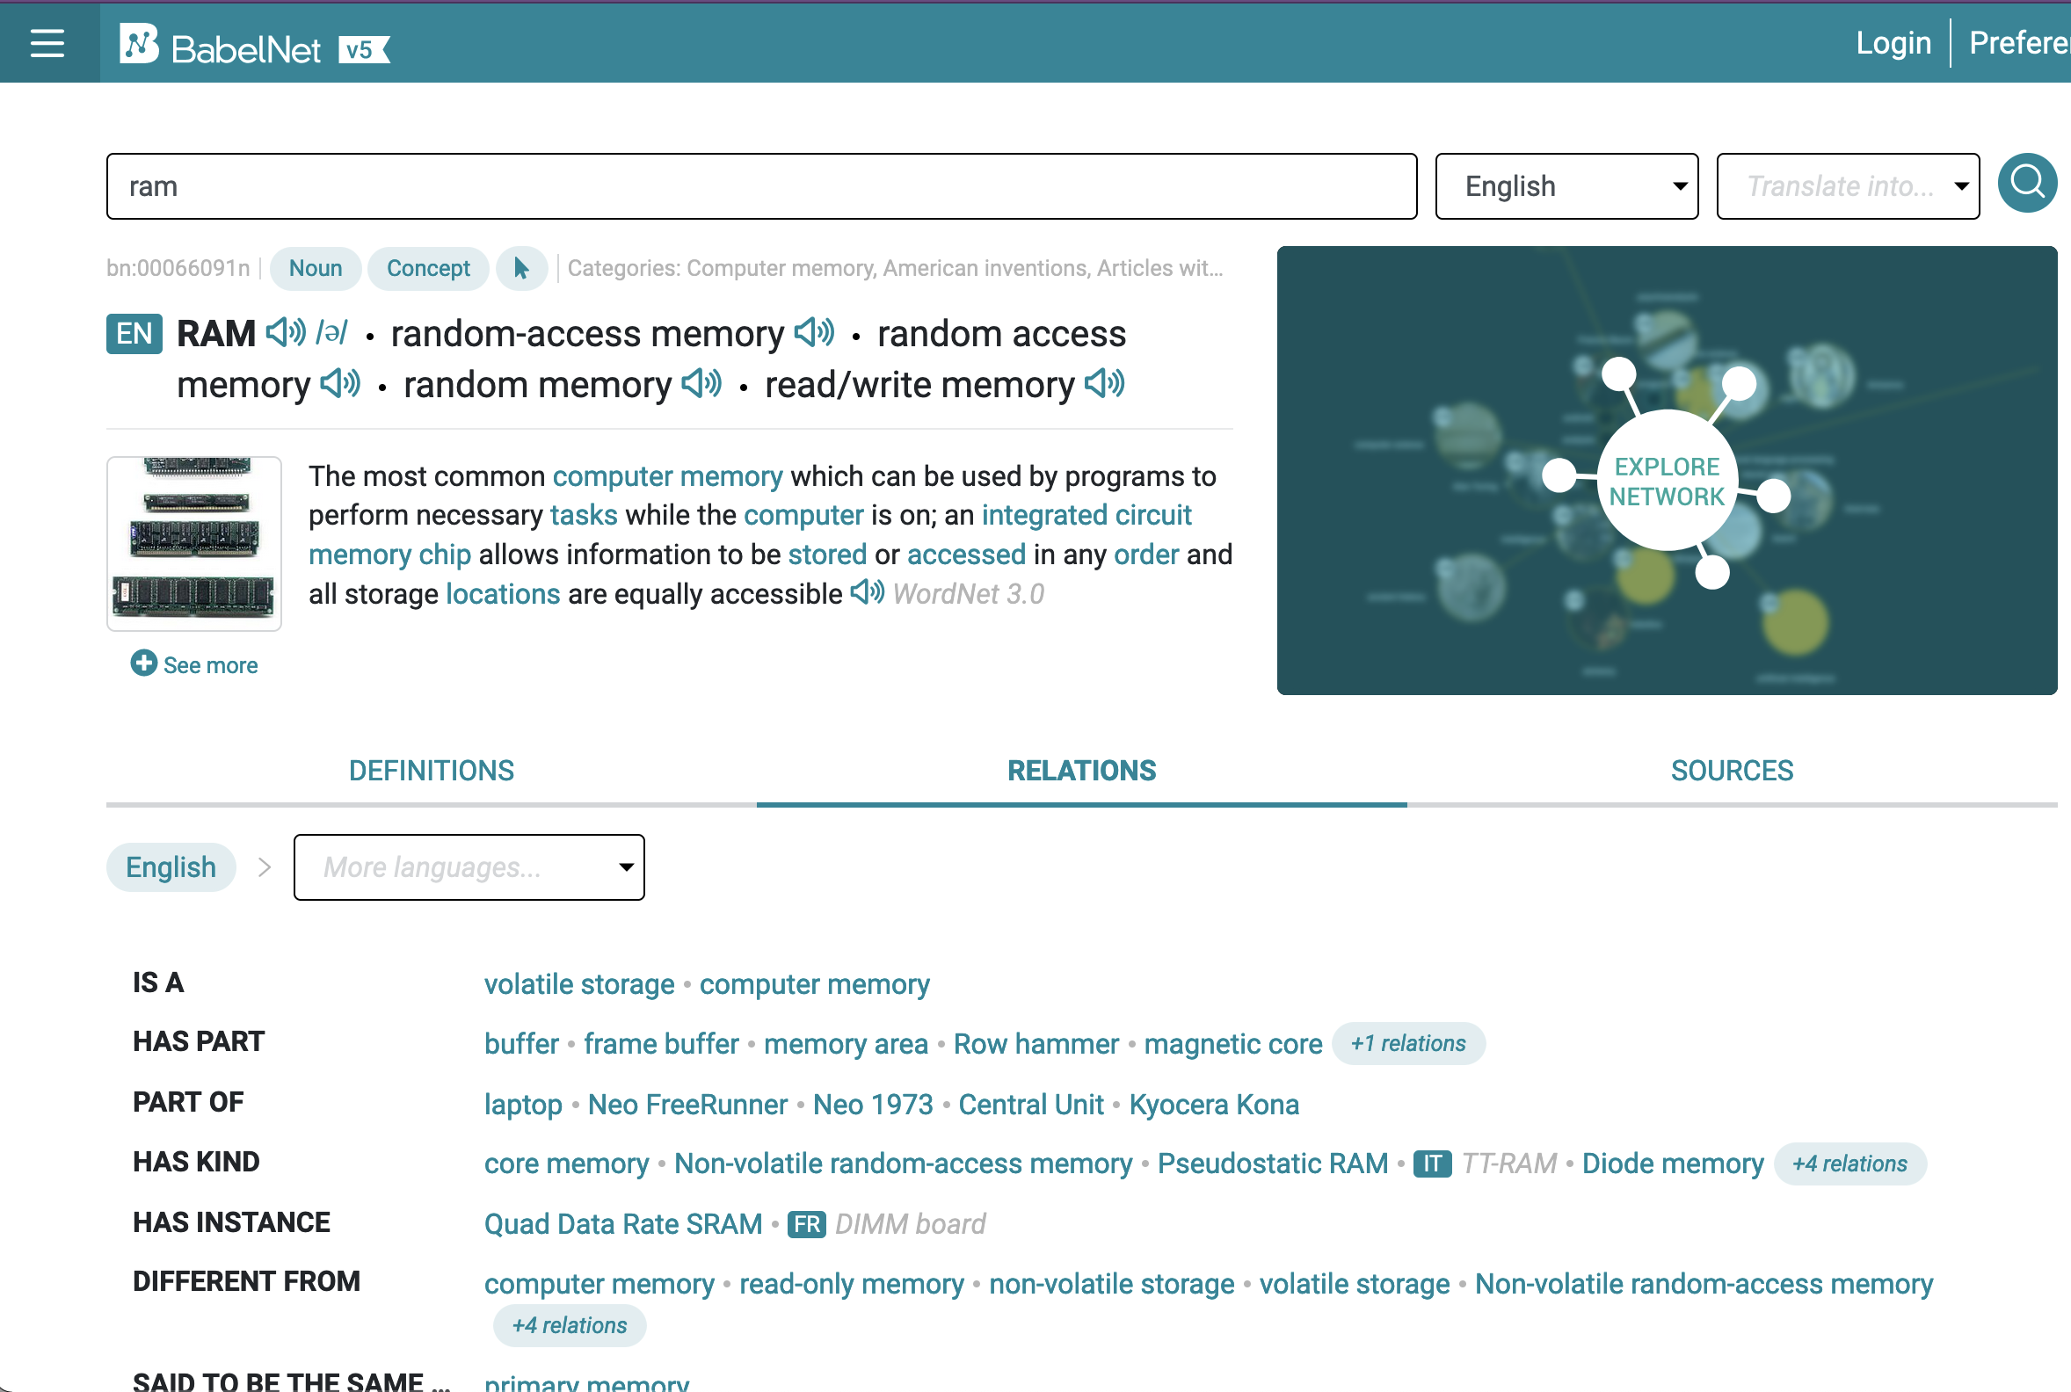
Derived project

