Slide 1
3 data science ideas
Biodiversity
Food
People
Lightning Talk
8 Jul 2017
Notes:
Lightning talks are there to enable the audience to review as many potentially exciting ideas as possible in a short space of time.
You are not there to provide the detail required for them to reproduce your work, you're there to inspire them to search out your work.
Get to your point early on. Don't leave it to the end. If you can make your point in 1 minute or 1 slide then go for it.
Use large images and as little text as possible
provide the minimum amount of background to give the context to make your point.
DELIVERY is more important than CONTENT

Slide 2
Thought 1
Singapore’s urban biodiversity has been in the news, are citizen postings useful for planning & conservation decisions?

Slide 3
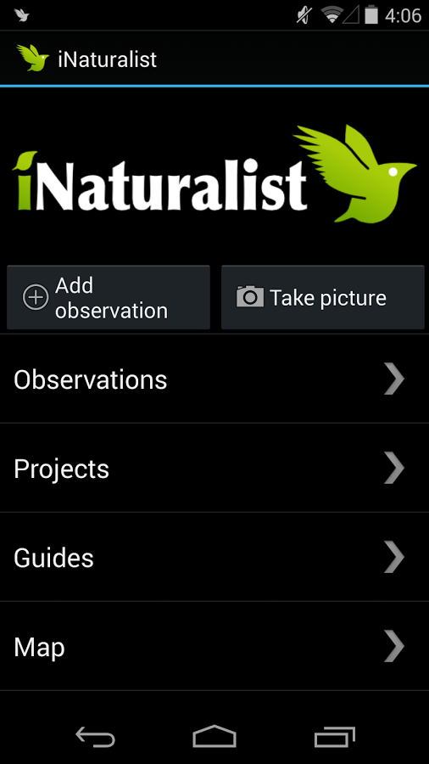
Question
Are “Research Grade” sightings posted on iNaturalist accurate enough to be used to inform planning of landuse and conservation priorisation, especially for the threatened and cryptic species?

Slide 4

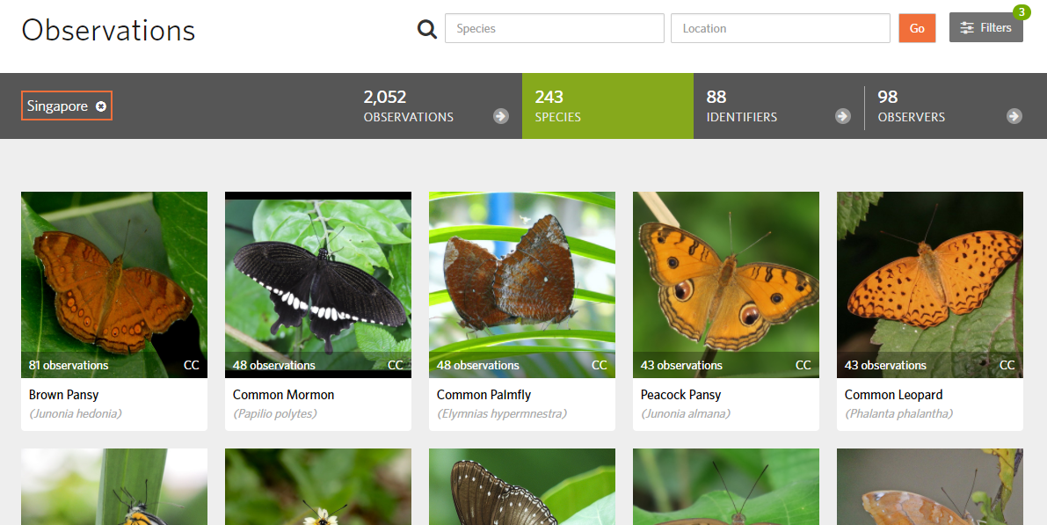
Null hypothesis:
“Research Grade” data submitted by citizens is not accurate enough to inform landuse and conservation priorisation decisions.
Alternative Hypothesis:
Community-rated “Research Grade” data are accurate enough to used to inform planning of landuse and conservation priorisation. These are likely information are submitted by individuals with most submitted observations, and are in the right locations and seasons
http://www.inaturalist.org/observations

Slide 5
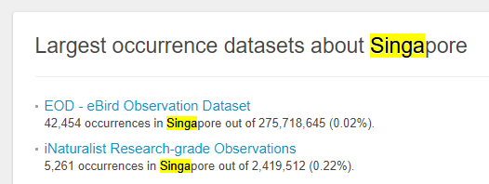
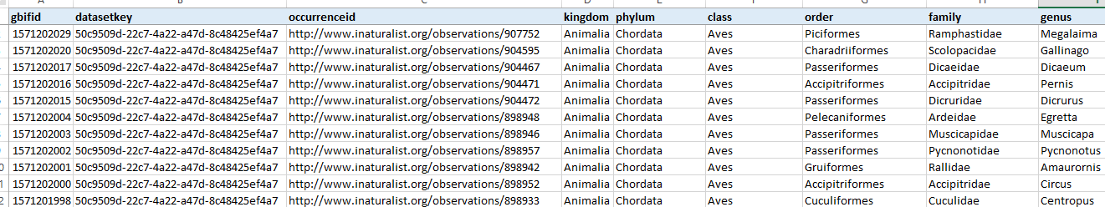
http://www.gbif.org/country/SG/about
GBIF.org Occurrence Download http://doi.org/10.15468/dl.okztbv
44 columns, some with missing data
Focus areas:
Birds
Butterflies
Otters
Dolphins

Slide 6
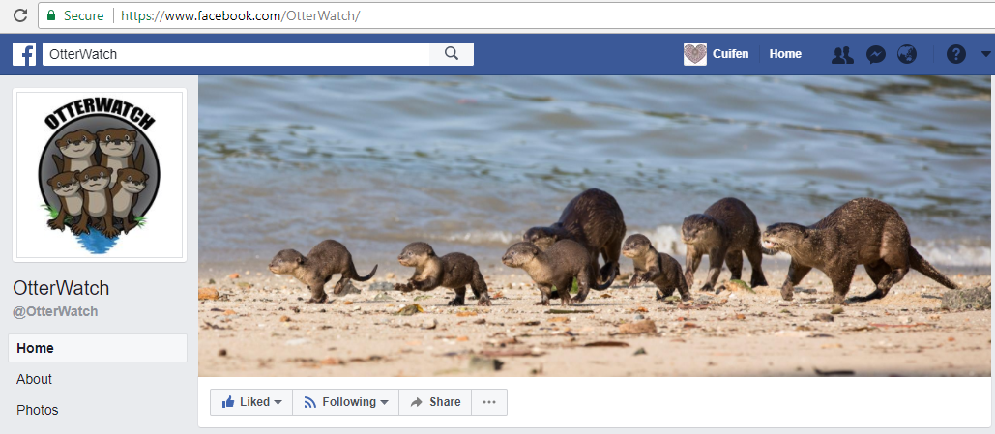
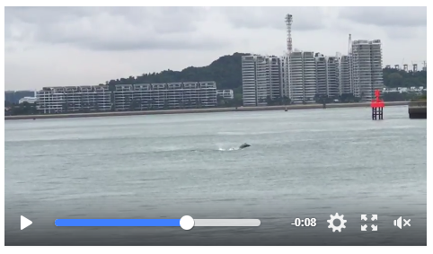
Other useful datasets
Individual / organisation postings on Facebook.
Call data by Facebook’s Official API (or the old fashioned way, search + download)
Dolphins!

Slide 7
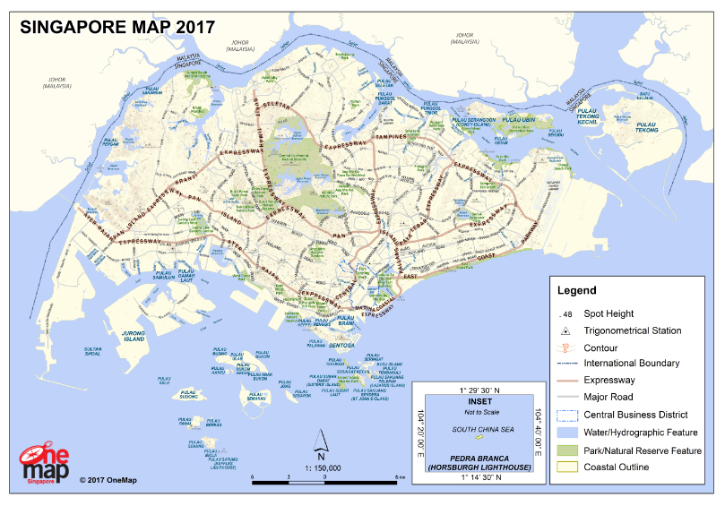

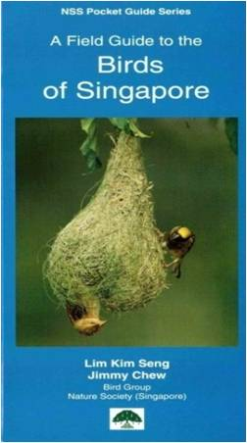
Other useful data sources
Built-up areas, parks, etc based on Singapore Map (JSON) available from OneMap

Slide 8
Thought 2
People have always been sharing, collaborating, lending, gifting. It is a mechanism that helps build friendship and family relations.
People are increasingly sharing across their immediate communities – where is this happening, what is being shared, and how is it happening?

Slide 9
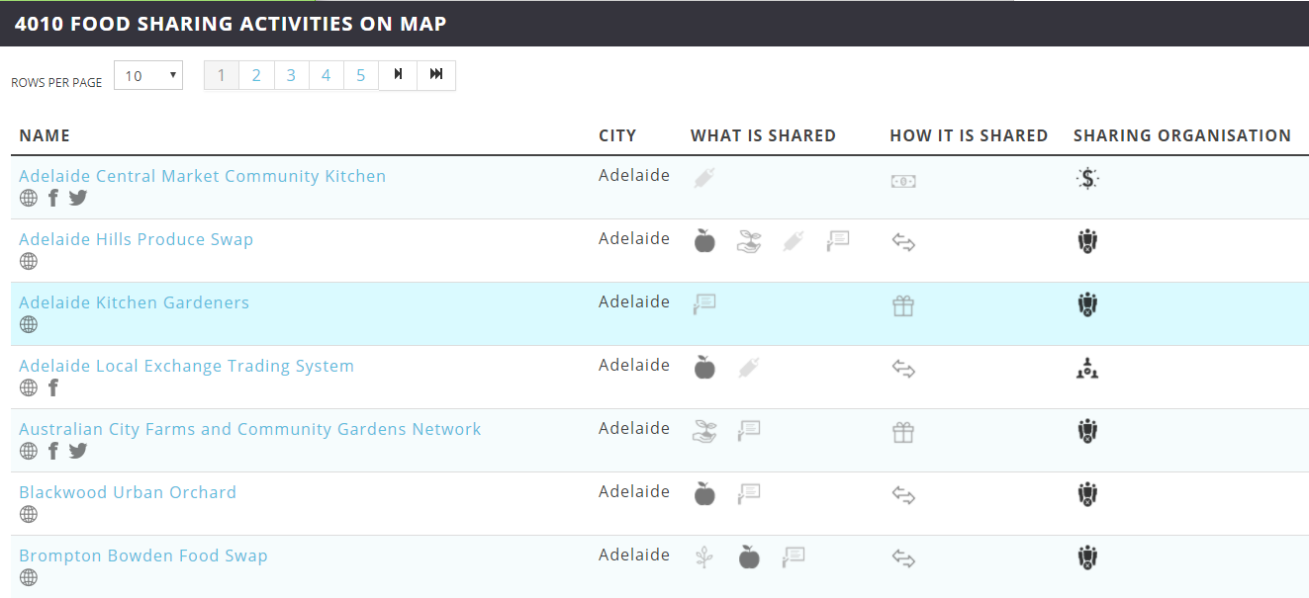
Question
What are the trends already emerging in ShareCity database? How does Singapore compare with other cities / countries?

Slide 10
Null hypothesis:
There are no useful trends.
Alternative Hypothesis:
The database already provides insights to trends, from which we can compare how Singapore is doing relative to others.

Slide 11
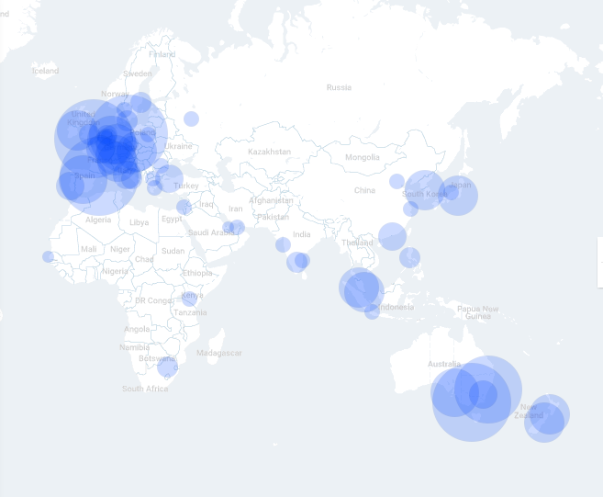
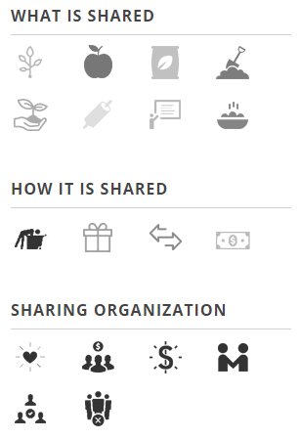
ShareCity database
Ongoing data collection for research, updated 2x year till 2020
Davies, A.R. et al. (2016) SHARECITY100 Database, Trinity College Dublin, Ireland.
http://sharecity.ie/research/sharecity100-database

Slide 12
Thought 3
There is a growing movement on food issues in Singapore. Where is this happening, what is being done, and where are the gaps?

Slide 13
Question
Anecdotally, there has been a surge in the “grow your own food movement”. Is this true? What is being grown, where and why? Is food grown enough for own use, or even to share? Is food grown where it is needed?

Slide 14
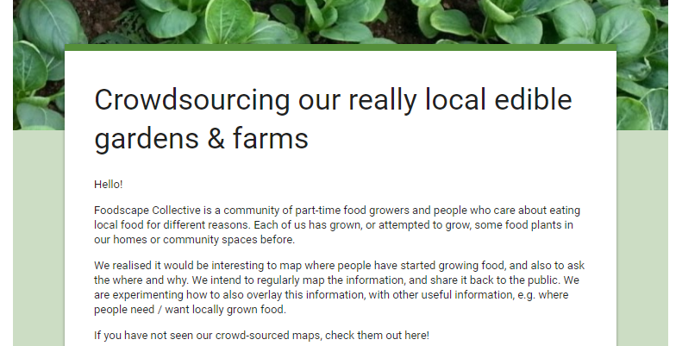
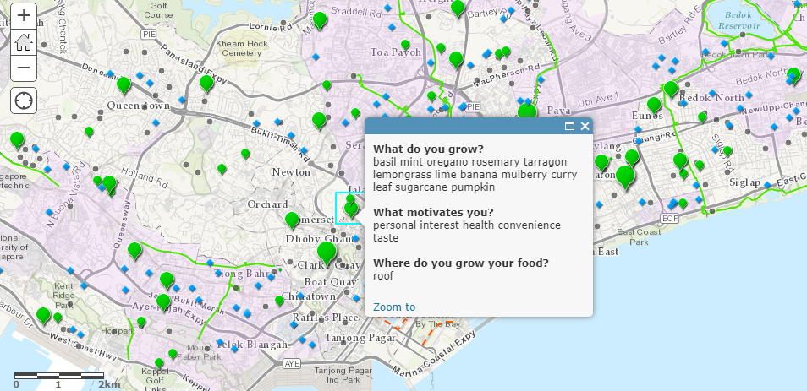

125 points after 4 days
Would like to tweak form to include quantity of harvest, ownership, etc
And to spread the form to more people over 1-2 weeks
http://arcg.is/1y3C17B

Slide 15
Null hypothesis:
There are no useful trends.
Alternative Hypothesis:
Crowd-sourcing and public data can provide us a reliable basis for extracting meaningful insights.

Slide 16
Some geospatial information which I already have from Data.Gov.sg or self-collected
Ground verification
Town
HDB
Parks
Park connector
Community gardens
Community spaces

