Slide 1
Exploiting Bounded Staleness to Speed up Big Data Analytics
Henggang Cui
James Cipar, Qirong Ho, Jin Kyu Kim,
Seunghak Lee, Abhimanu Kumar, Jinliang Wei, Wei Dai,
Greg Ganger, Phil Gibbons (Intel), Garth Gibson, and Eric Xing
Carnegie Mellon University
Notes:
This work is about how we exploit bounded staleness to speed up big data analytics.
Getting useful information from data is important. There’re extensive efforts from both system side and machine learning side trying to help people accomplish this more efficiently. Here I will first describe the specific class of big data applications that we are targeting at.

Slide 2
Big Data Analytics Overview
One iteration
Huge input data
Iterative program
fits model
Model parameters
(solution)
Notes:
Suppose we have some huge input data, which can be a set of webpages, documents, or etc. (HIT) Based on the application, we design a model that tries to explain the input data. The model, for example, can be the clustering of documents with similar topics. And we build a program to solve the model parameters by fitting the data.
The algorithm is usually iterative. It first makes an initial guess of the model parameters, and then (HIT) it goes through every entry of the input, and makes adjustment to the model parameters based on the input. Since the adjustment coming from one entry of the input can change the decision of another one, the program needs to (HIT) go through the input data multiple times, until the model parameters converge. (HIT) And we call one pass of the input data as one iteration.

Slide 3
Big Data Analytics Overview
Partitioned input data
Parallel iterative program
Model parameters
(solution)
Notes:
To make this program parallel. We can divide the input data into multiple partitions, and we have each computation thread compute on one partition of the data. During the computation, the threads concurrently read and update the shared model parameters based on their local input.

Slide 4
Big Data Analytics Overview
Goal: Less
sync overhead
Parameter server
Partitioned input data
Parallel iterative program
Model parameters
(solution)
Notes:
To make it easy for application developers, people are building systems called parameter servers to manage the globally shared model parameters.
In order to make the parameters converge, the parameter server provides mechanisms for computation threads to synchronize their updates. The common approach is to use Bulk Synchronous Parallel. But in a large system, this approach has much overhead.
Our work is to explore different synchronization models for parameter servers to reduce the synchronization overhead while still preserving reasonable consistency.

Slide 5
Outline
Two novel synchronization approaches
  Arbitrarily-sized Bulk Synchronous Parallel (A-BSP)
  Stale Synchronous Parallel (SSP)
LazyTable architecture overview
Taste of experimental results
Notes:
In this talk, I will first discuss two novel synchronization models as extensions to the traditional BSP one.
Then I will introduce our prototype system that supports these models.
Finally, I will show some selected experiment results.

Slide 6
Bulk Synchronous Parallel
  A barrier every clock (a.k.a. epoch)
    In ML apps, often one iteration over input data
Thread progress illustration:
0
1
2
3
4
Iteration
Thread 1
blocked by barrier
Thread 1
Thread 2
Iterations complete, updates visible
Updates not necessarily visible
Thread 3
0
1
2
3
4
Clock
Notes:
Traditionally, machine learning algorithms are often paralleled using the bulk synchronous parallel model, or BSP.
In BSP, the execution is divided into clocks, each with a barrier at the end. A clock can be understood as an epoch. When a computation thread finishes one clock, it propagates the updates and waits for other threads at the barrier. In this figure, the bars represent the progress of each thread, and thread-1 is waiting for the other two threads at the barrier. Clock is usually defined every fixed amount of work, and the common use of BSP is to do one iteration over the input data in each clock.
BSP guarantees that the threads can see all updates of all threads before the last clock. In this figure, thread-1 cannot see the updates of clock 2 from other threads.

Slide 7
Data Staleness
In BSP, threads can see "out-of-date" values
  May not see others' updates right away
  Convergent apps usually tolerate that
Allowing more staleness for speed
  Less synchronizing among threads
  More using cached values
  More delaying and batching of updates
But, too much staleness hurts convergence
  Important to have staleness bound
  Staleness should be tunable
0
1
2
3
0
1
2
3
Notes:
As a result, BSP implies that threads can see out-of-date values for the parameters. We call that data staleness. Machine learning applications can usually tolerate some amount of data staleness.
(HIT)
Moreover, sometimes we even want to allow more data staleness. Because it can increase system performance. For example, the computation threads can synchronize less often and they can use more stale data from their local cache instead of fetching the latest.
(HIT)
Certainly, too much staleness hurts the convergence, making the application converge very slowly or even diverge. So it’s important to make data staleness bounded. In this work, we point out that data staleness should be a first-class tunable parameter.

Slide 8
Arbitrarily-sized BSP (A-BSP)
  Work in each clock can be more than one iteration
    Less synchronization overhead
two iterations per clock
0
1
2
3
4
Iteration
Thread 1
Thread 1
blocked by barrier
Thread 2
Thread 3
0
1
2
Clock
Notes:
We discovered a more general use of the BSP model that can allow us to explicitly control data staleness. We find the work in each clock does not need to be exactly one iteration. Instead, it can be arbitrarily chosen. Usually it’s a multiple or fraction of one iteration, so we call it iters-per-clock. In this example, (HIT) we do two iterations in each clock. By changing iters-per-clock, we can explicitly trade data freshness for speed. A larger iters-per-clock makes the program faster by reducing the synchronization frequency, but at the cost of allowing the data being more stale. Even though it’s still BSP, we call it arbitrarily-sized BSP, or A-BSP in this work, in order to distinguish this more general use of BSP from the normal practice.

Slide 9
Problem of (A-)BSP: Stragglers
A-BSP still has the straggler problem
  A slow thread will slow down all
  Stragglers are common
  in large systems
Many reasons for stragglers
  Hardware: lost packets, SSD cleaning, disk resets
  Software: garbage collection, virtualization
  Algorithmic: calculating objectives and stopping conditions
0
1
2
3
4
0
1
2
Notes:
Even though we can reduce synchronization overhead by using a larger iters per clock under A-BSP, it still has the problem of stragglers. Because all threads have to wait at the barrier, a slow thread slows down the whole system.
There can be many reasons for stragglers, examples include loss of network packets, SSD cleaning, and also software background activities such as garbage collection.

Slide 10
Stale Synchronous Parallel (SSP)
  Threads are allowed to be slack clocks ahead of the slowest thread
0
1
2
3
4
Iteration
Thread 1 at clock 3
Thread 1
Thread 2
Thread 2 at clock 2
Thread 3
0
1
2
3
4
Clock
[HotOS’13, NIPS’13]
Slack of 1 clock
Notes:
To solve the straggler problem, we propose another model, called stale synchronous parallel, or SSP.
In SSP, the execution is also divided into clocks, and updates are propagated at the end of each clock. But instead of having barriers, SSP allows threads to be some number of clocks ahead of the slowest one, which is controlled by a slack parameter.
So in SSP, different threads can be doing the work of different clocks, as long as the fastest one is no more than slack clocks ahead of the slowest one. Here is an example of SSP with a slack of one clock. You can see that thread 1 is at clock 3, while thread 2 has not finished clock 2 yet. A larger slack means less synchronization. As a result, changing the slack parameter is another way of controlling data staleness.

Slide 11
Two Dimensional Config. Space
Iters-per-clock and slack are both tunable
  A-BSP is SSP with a slack of zero
  Every SSP config. has an A-BSP counterpart
  with the same data staleness bound
SSP (iters-per-clock=1, slack=1):
A-BSP (iters-per-clock=2, slack=0):
0
1
2
3
4
0
1
2
3
4
Iteration
Iteration
Clock
Clock
0
1
2
3
4
0
1
2
Notes:
SSP also allows arbitrary amount of work in each clock, so A-BSP is actually a special case of SSP where the slack is always zero.
The two parameters of SSP form a two dimensional configuration space, and there are multiple ways to achieve the same data staleness bound. And as we discussed in the paper, any SSP configuration has a counterpart of an A-BSP one that provides the same data staleness bound.
In the rest of the talk, we will focus on comparing two approaches. One is SSP that does exactly one iteration in each clock using slacks, and the other one is A-BSP that does multiple iterations in each clock but has no slack.

Slide 12
LazyTable Architecture
Client-lib
Server
Server
Client-lib
Server
Client-lib
Server
Partitioned input data
Parallel iterative program on LazyTable
Model parameters
(sharded)
Notes:
Next I will briefly introduce our prototype system LazyTable that supports both models.
LazyTable is a parameter server that manages global shared state for big data applications.
It supports the SSP model, and also the A-BSP model by using a slack of zero.
LazyTable is composed of a cluster of tablet servers and a client library.
(HIT) The parameter data managed by LazyTable is sharded among multiple tablet servers.
(HIT) and the application workers access these data through the client library.
(HIT) The tablet servers and application clients can run in the same set of machines.

Slide 13
LazyTable Architecture
Client-lib
Server
Server
See the paper for more details
Client-lib
Server
Client-lib
Server
Partitioned input data
Parallel iterative program on LazyTable
Model parameters
(sharded)
Notes:
Our systems have multiple levels of caches and use prefetching to reduce the fetch latency. Please read our paper for more implementation details.

Slide 14
Primary Experimental Setup
Hardware information
  8 machines, each with 64 cores & 128GB RAM
Basic configuration
  One client & tablet server per machine
  One computation thread per core
Notes:
Next, I will show you some selected experiment results from our paper.
For most experiments, we use a cluster of 8 machines, each with 64 cores.
On each machine, we launch one client process and one tablet server, and the client process creates 64 computation threads, one thread per core.

Slide 15
Application Benchmark #1
Topic Modeling
  Algorithm: Gibbs Sampling on LDA
  Input: NY Times dataset
    300k docs, 100m words, 100k vocabulary
  Solution quality criterion: Loglikelihood
    How likely the model generates observed data
    Becomes higher as the algorithm converges
    A larger value indicates better quality
More apps described and used in paper
Notes:
We run experiment on several real world machine learning applications. In this talk, I will only discuss the results of Topic Modeling, and for other applications, we observed similar behaviors.
We use the new york times dataset, which has one hundred million words in total.
We use loglikelihood as the solution quality metric, which essentially means how likely the output model can generate the observed data. So a larger value indicates better solution quality.

Slide 16
Controlling Data Staleness
SSP
  Larger slack -> more staleness
A-BSP
  Larger iterations-per-clock -> more staleness
The tradeoffs with increased staleness
Notes:
In the first set of experiments, we show the tradeoff of data freshness and system performance under SSP and A-BSP.

Slide 17
Staleness Increases Iters/sec
iters-per-clock is 1
Notes:
We first run SSP with iters per clock being one and change the slack.
The first graph shows the iteration speed.
The x-axis is time, and the y-axis is number of iterations completed.

Slide 18
Staleness Increases Iters/sec
iters-per-clock is 1
Notes:
When the slack is zero, it becomes the traditional BSP case, and we use that as the baseline.

Slide 19
Staleness Increases Iters/sec
larger iters per sec with more
staleness
iters-per-clock is 1
Notes:
Then we increase the slack to one clock. As shown in the blue curve, it completes more iterations per second.
That is because the computation threads are less likely to wait because of the slack.

Slide 20
Staleness Increases Iters/sec
iters-per-clock is 1
Notes:
As we continue to increase slack, the iteration speed continues to increase, but the returns are diminishing.
Generally, as we increase the slack parameter, the program completes more iterations per second.

Slide 21
Staleness Reduces Converge/iter
iters-per-clock is 1
Notes:
The second graph shows the convergence quality after completing some number of iterations.
The x-axis is the number of iterations completed, and the y-axis is the degree of convergence. The exact value of the y-axis doesn’t matter, because we only compare the cost of reaching the same convergence using different configurations.

Slide 22
Staleness Reduces Converge/iter
iters-per-clock is 1
Notes:
The black curve shows the convergence of the baseline BSP configuration after doing some number of iterations.

Slide 23
Staleness Reduces Converge/iter
more iters to converge with
more staleness
iters-per-clock is 1
Notes:
The blue curve shows the result with a slack of one clock.
The right way to understand this graph is to draw a horizontal line, and compare the number of iterations it needs to reach the same convergence.
With a slack of one, we need more iterations to reach the same convergence, because the threads use potentially more stale data for their computation, and that hurts the quality of each iteration.

Slide 24
Staleness Reduces Converge/iter
iters-per-clock is 1
Notes:
Generally, as we increase the slack parameter, the effectiveness of each iteration decreases, and the program needs more iterations to converge.

Slide 25
Sweet Spot Balances the Two
Speed up with
a good slack
Notes:
So there’s a tradeoff between the speed and the effectiveness of each iteration.
Combining these two factors, we show a graph of the convergence over time.
Here, the x-axis is time used, and the y-axis is convergence.
We draw a horizontal line again and compare the time it takes to reach the same convergence.
The result shows that with a reasonable slack, SSP can reach the same convergence in less time than BSP.
For A-BSP, it behaves the same way when we increase iters-per-clock, and similar effects are observed in other applications as well.

Slide 26
Key Takeaway Insight #1
The sweet spot
Convergence
per iteration
Iterations
per second
Convergence
per second
Fresher data
Staler data
Notes:
The takeaway message is that both SSP and A-BSP are ways of explicitly controlling data staleness.
With more data staleness, the iteration goes faster, but we need more iterations to reach the same convergence. Combining these two factors, there’s a sweet spot in the middle, which can only be achieved when data staleness is tunable.

Slide 27
SSP vs A-BSP
Similar performance
  In the absence of stragglers
What about environment with stragglers?
Notes:
In our basic experiment set up, we find the performance of SSP and A-BSP are similar, because our carefully controlled experiment testbed minimizes the variation on the execution speed of threads. So there are no stragglers in the system.
(HIT) What if we have stragglers?

Slide 28
Straggler Experiment #1
Stragglers caused by background disruption
  Fairly common in large, shared clusters
Experiment setup
  One disrupter process per machine
    Uses 50% of CPU cycles
  Work (disrupt) or sleep randomly for t seconds
    10% work, 90% sleep
More straggler experiments in the paper
Notes:
To compare the behavior of SSP and A-BSP in face of stragglers, we designed some experiments that artificially introduce stragglers to the system. Here I will only describe one of them.
We emulate stragglers by introducing some other background CPU intensive task to the system. In a shared cluster, it’s a quite common source of stragglers. We design the following experiment, we create a disrupter process on each machine, and have it take half of the CPU when active, so it becomes a disrupt. We make the disrupter randomly work or sleep. The duration of each disrupt is “t” seconds.
We pick one SSP configuration and one A-BSP configuration that provide the same data staleness bound, and analyze their behaviors in face of stragglers.

Slide 29
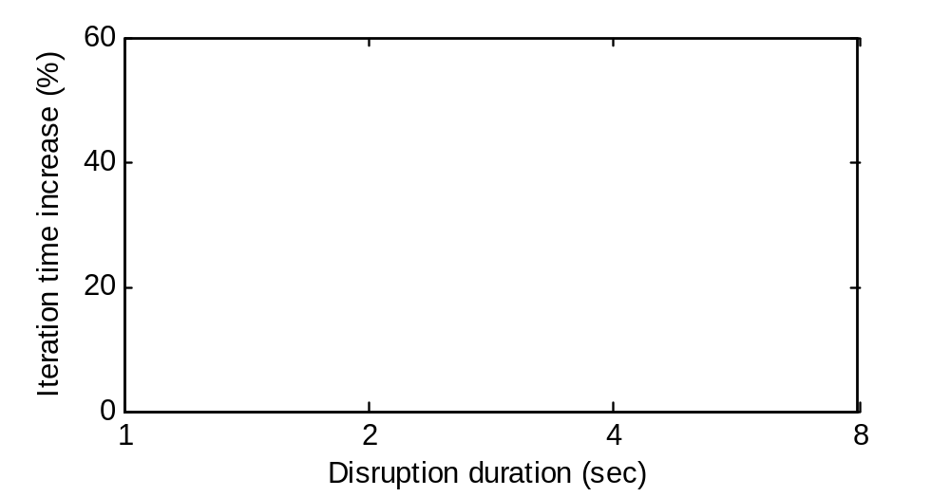
Straggler Results #1
w/o disrupt, each iter takes 4.2 sec
Notes:
The x-axis is t, which is the duration of each disrupt, and the y-axis the percentage of run time increment due to the disrupt.

Slide 30
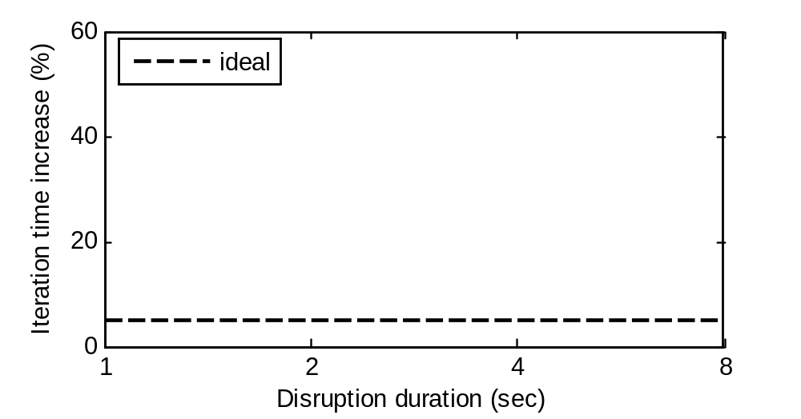
Straggler Results #1
Ideally 5%, because 50% slow down with 10% probability
w/o disrupt, each iter takes 4.2 sec
Notes:
Ideally, the disrupt should only slow down the execution by 5%, because on each machine, the disrupter is active for 10% of the time, and takes half of the CPU when active.

Slide 31
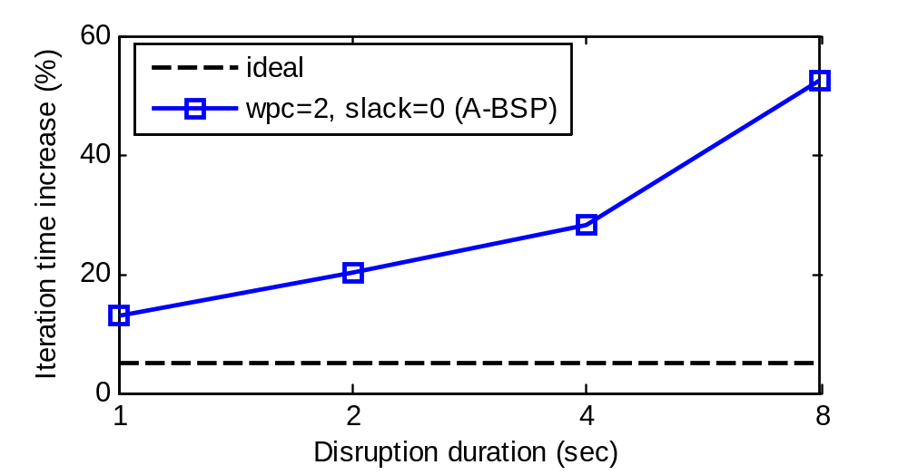
Straggler Results #1
Ideally 5%, because 50% slow down with 10% probability
w/o disrupt, each iter takes 4.2 sec
Notes:
The blue line shows the result of A-BSP. Essentially, the execution is slowed down more when each disrupt is longer.

Slide 32
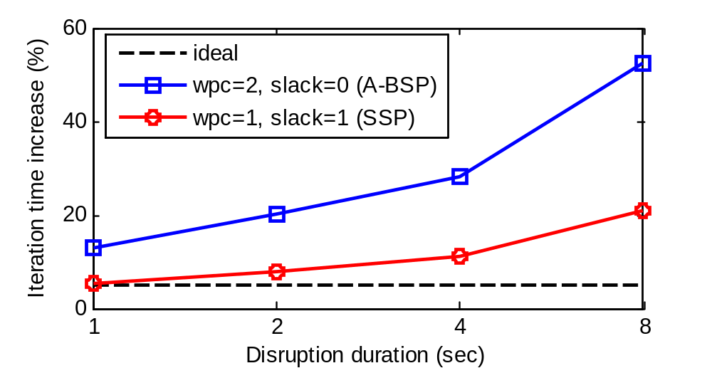
Straggler Results #1
Ideally 5%, because 50% slow down with 10% probability
SSP tolerates transient stragglers
w/o disrupt, each iter takes 4.2 sec
Notes:
The red line shows the result of SSP, and it provides the same data staleness bound as the A-BSP one, so we only compare their iterations per second. When the duration of each disrupt is small enough compared with the iteration time, the stragglers are transient stragglers, and they can be mitigated by the slack of SSP. In that case, the behavior is close to the ideal curve. But when the duration of each disrupt is too long, the stragglers become constant stragglers. To deal with constant stragglers, we should instead use load balancing techniques.
But in that case, the performance is still better than A-BSP.
So compared to A-BSP, SSP is more tolerant of transient stragglers.

Slide 33
Conclusion
Staleness should be tuned
  By iters-per-clock and/or slack
LazyTable implements SSP and A-BSP
  See paper for details
Key results from experiments
  Both SSP and A-BSP are able to exploit the staleness sweet-spot for faster convergence
  SSP is tolerant of small transient stragglers
  But SSP incurs more communication traffic
Notes:
To conclude, in this work, we formulate the concept of data staleness, and show that it can be tuned by changing iters-per-clock and/or the slack.
We describe the implementation of LazyTable, which supports both SSP and A-BSP.
And we did extensive experiment, showing interesting results.
First, both A-BSP and SSP are ways of exploiting the staleness sweet-spot for faster convergence.
Second, SSP is more tolerant of transient stragglers because of the absence of barriers.
Third, SSP incurs more communication traffic due to its finer-grained division of clocks. I did not cover that part in this talk. Please read our paper for more details.

Slide 34
References
J. Cipar, G. Ganger, K. Keeton, C. B. Morrey, III, C. A. Soules, and A. Veitch. LazyBase: trading freshness for performance in a scalable database. Eurosys’12.
J. Cipar, Q. Ho, J. K. Kim, S. Lee, G. R. Ganger, G. Gibson, K. Keeton, and E. Xing. Solving the straggler problem with bounded staleness. HotOS’13.
NYTimes: http://archive.ics.uci.edu/ml/datasets/Bag+of+Words
Q. Ho, J. Cipar, H. Cui, S. Lee, J. Kim, P. Gibbons, G. Gibson, G. Ganger, and E. Xing. More effective distributed ML via a stale synchronous parallel parameter server. NIPS’13.

Slide 35
BACK-UP

Slide 36
Example: Topic Modeling
word-topic table
Topic
modeler
doc-topic
table
Corpus of
documents
... | ... | ... | ...
Doc i | Topic 1: 0.8 | Topic 2: 0.1 | ...
... | ... | ... | ...
Notes:
Here I will show you the example of topic modeling in a very high level. Suppose we have a bunch of documents from wikipedia, and topic modeling can be used to find documents that share the same topic. Now the input data is the set of documents, each contains a list of words. We also need to provide the number of topics that we want to classify into, and then the output model can tell us the probability distribution that each document belongs to each of the topics. For example, it might tell use some document #i is 80% topic 1, 10% topic 2, and etc. I will not go through the exact detail of how it works, but at a high level, suppose most of words in this document belongs to Sports topic, it’s very likely to be a Sports related document. That is also the same for the words. If some word occurs in Sports documents quite often, it’s very likely to be a Sports related word. We can imagine that this procedure needs to take multiple iterations to converge.

Slide 37
BSP Progress and Staleness
  (i, j) represents iteration i, work uint j
Thread
1
...
(2,a)
(2,b)
(3,a)
(3,b)
(4,a)
(4,b)
2
...
(2,c)
(2,d)
(3,c)
(3,d)
(4,c)
(4,d)
3
...
(2,e)
(2,f)
(3,e)
(3,f)
(4,e)
(4,f)
Clock
2
3
4
barrier
barrier
barrier
barrier
Notes:
For BSP, we have a barrier every one iteration of work.
We use a tuple i,j to represent the work j of iteration i of the original sequential execution, so this 2-a means work a of iteration 2.
When the threads complete the work of iteration 2, they wait for each others at the barrier.
Then, they do iteration 3, blocked by the barrier again, and then do iteration 4.
We investigate the maximum data staleness by looking at thread-3. When it’s doing work f of iteration 4, it can only see the updates before the last barrier, and the updates from these 5 shaded works are not necessarily visible.

Slide 38
A-BSP Progress and Staleness
  A-BSP, wpc = 2 iterations
Thread
1
...
(2,a)
(2,b)
(3,a)
(3,b)
(4,a)
(4,b)
2
...
(2,c)
(2,d)
(3,c)
(3,d)
(4,c)
(4,d)
3
...
(2,e)
(2,f)
(3,e)
(3,f)
(4,e)
(4,f)
1
2
Clock
barrier
barrier
Notes:
Now we do A-BSP, with work per clock being two iterations,
The execution is divided into 2 clocks instead of 4, and we have a barrier every two iterations of work.
When thread-3 is doing work f of iteration 4, it sees the updates before the last barrier, and these eleven shaded updates might not be visible.
Compared with the BSP case, we have only half the number of barriers here, and data staleness is doubled.

Slide 39
SSP Progress and Staleness
  SSP, wpc = 1 iteration, slack = 1 clock
  Same staleness bound as the A-BSP one
    But more flexible
  Data staleness for SSP with wpc and slack:
    wpc x (slack + 1) - 1
Slack of 1 clock
Thread
1
...
(2,a)
(2,b)
(3,a)
(3,b)
(4,a)
(4,b)
2
...
(2,c)
(2,d)
(3,c)
(3,d)
(4,c)
(4,d)
3
...
(2,e)
(2,f)
(3,e)
(3,f)
(4,e)
(4,f)
Clock
2
3
4
Notes:
When we do SSP with work per clock being one iteration and a slack of one clock, the execution is also divided into 4 clocks, but we don’t have barriers after each clock. Here, thread 3 can start the work of clock 3 even though the other two threads have not finished their clock 2. And then in the next clock, thread 1 catches up. The threads don’t have to wait as long as their progress are within the slack of one clock.
When thread-3 is doing work f of iteration 4, because of the slack of one clock, it is only guaranteed to see updates up to clock 2. Updates of clock 3 and clock 4 are not necessarily visible. (hit)
We find that the data staleness bound of this SSP example is the same as the previous A-BSP one, but SSP allows more flexibility in the progress of threads. In general, we have the following formula for the data staleness bound.

Slide 40
SSP VS A-BSP
A-BSP is SSP with a slack of zero
Data staleness bound
  SSP {wpc, slack} == A-BSP {wpc x (slack + 1), 0}
SSP is a “pipelined” version of A-BSP
  Tolerates transient stragglers
Notes:
In summary, A-BSP is a special case of SSP where the slack is always zero.
And in terms of data staleness bound, all SSP configuration has a counterpart of an A-BSP one that provides the same data staleness guarantee.
Because of the slack, the SSP execution is more flexible and allows some threads being temporarily slower. It can be understood as a pipelined version of A-BSP that can tolerate transient stragglers.

Slide 41
LazyTable Architecture
Client process-0
Client process-1
App. thread
App. thread
App. thread
App. thread
Client library
Client library
Thread
cache/oplog
Thread
cache/oplog
Thread
cache/oplog
Thread
cache/oplog
Process
cache/oplog
Process
cache/oplog
Tablet server process-0
Tablet server process-1

Slide 42
Stragglers: Delay
Delaying some threads
  Artificially introduce stragglers to the system
  Have some threads sleep() for a time
Experiment setup
  Threads sleep “d” seconds in turn
    Threads of machine “i” sleep at iteration “i”
  Compare influence of different “d”
Notes:
Another type of stragglers is those caused by delays.
In particular, we emulated this effect by having threads in each machine sleep “d” seconds in turn. For example, all threads on machine one sleep at iteration one, so they become stragglers, and then threads on machines two.
The influence of the stragglers are dependent on the length of the delay, d.
And we will compare the behavior with different d s.

Slide 43
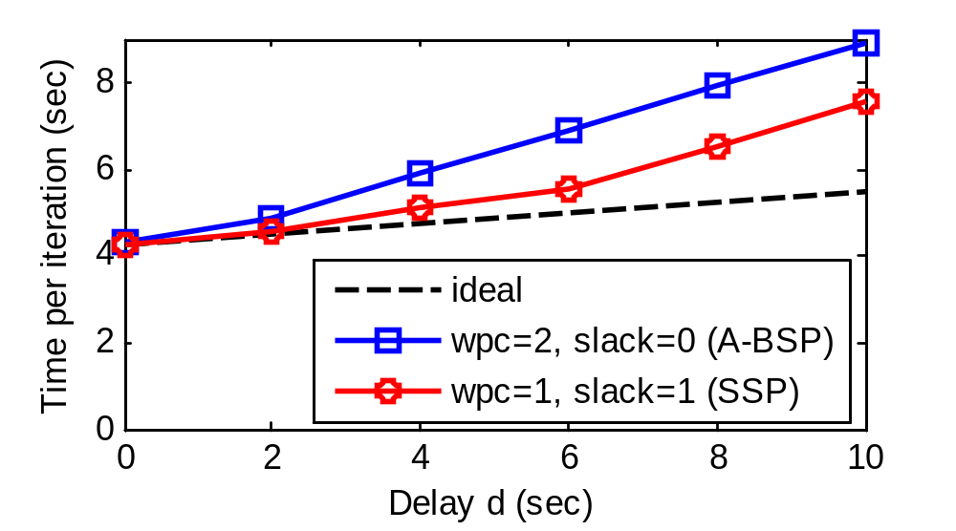
Stragglers: Delay (Results)
A-BSP slow down: d/2 per iter
SSP tolerates transient stragglers
Ideal slow down: d/8 per iter
on 8 machines
Notes:
The red line shows the result of SSP where the slack is one clock.
When the delay is small enough, the behavior is close to the ideal case, because the slack of SSP can tolerate the transient stragglers. But when the delay is too high, the stragglers become constant stragglers, the slow down increases, but the performance is still better than that of A-BSP.
Constant straggler is a load balancing problem and cannot be solved by SSP.

Slide 44
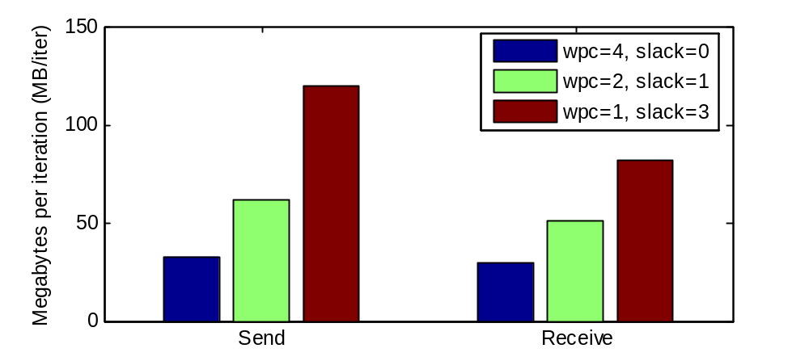
The Cost of Increased Flexibility
Comparing {wpc=X, ...} with {wpc=2X, ...}
  Bytes sent doubled (send update twice as often)
  Bytes received almost doubled
smaller wpc, larger slack
Notes:
In this experiment, we compare the amount of communication traffic for three configurations with the same data staleness bound, but different work per clock.
The result shows that when we decrease work per clock, the traffic increases. Because a smaller work per clock means we need to have more clocks for doing the same amount of work. As a result, the updates are propagated more often, and we might also fetch data more often.
Since the slack of A-BSP is always zero, it always uses the largest work per clock to provide the same data staleness guarantee. As a result, compared to A-BSP, SSP incurs more traffic.

Slide 45
Key Takeaway Insight #3
SSP incurs more traffic
  Finer grained division of clocks
  Avoiding barriers is still a win,
  if communication is not the bottleneck
Notes:
The takeaway message here is that because SSP uses a smaller work per clock for the same staleness bound than A-BSP, it incurs more traffic.
But if’s communication is not the bottleneck, avoiding barriers still makes it a win.

Slide 46
Prefetching
Conservative prefetch
  refresh row only when it’s too stale
Aggressive prefetch
  refresh row every clock

Slide 47
Prefetching (results)
wpc = 1 iter, slack = 7 clocks

