Slide 1
GeePS: Scalable deep learning on distributed GPUs with a GPU-specialized parameter server
Henggang Cui
Hao Zhang, Gregory R. Ganger, Phillip B. Gibbons, and Eric P. Xing
PARALLEL DATA LABORATORY
Carnegie Mellon University
Notes:
Hello, I’m Henggang Cui from CMU. Here, I will tell you our work of scaling deep learning on distributed GPUs with a GPU-specialized parameter server.

Slide 2


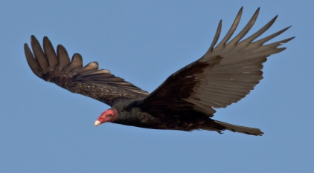
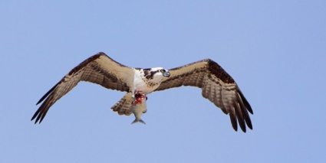
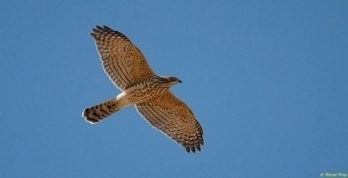
Image classification w/ deep learning
Deep neural network:
interconnected neurons
Eagle
Vulture
read/update
params
Osprey
Accipiter
Machine learning program
Model parameters:
connection weights
(solution)
Training data:
images w/ labels
Notes:
I will start with some background on deep learning. In particular, I will use image classification as a concrete example.
The image classification task classifies an image into one of the set of given labels. The classifier is trained with many training images with known labels.
(HIT) The classifier often uses a structure called deep neural network. The neural network consists of many layers of interconnected neurons. (POINT) The bottom layer of neurons are the pixels of the input image, and the top layer is the predicted probability that this images should be assigned with each of the labels. To classify an image, we will do a forward pass through the network, from bottom to the top, and the value of each neuron is computed according to the neurons from the layer below and the connection weights. Those connections weights are the parameters of this model.
(HIT) We will use a machine learning program to learning those model parameters from the training data, with many iterations, until the model converges.

Slide 3
Distributed deep learning
Eagle
Parameter server
Vulture
read/update
params
Osprey
Accipiter
Partitioned
Training data
Distributed
ML workers
Shared
model parameters
Notes:
It is often too slow to train a neural network with just a single machine. Instead, we want to parallelize it over a cluster of machines. To do that, we can partition the training data over multiple workers.
(HIT) Those workers will collaboratively train the shared model parameters with their training data. In particular, they will need to concurrently read and update the shared model parameters.
(HIT) It is challenging to do that efficiently at large scale. One popular approach of doing that is to manage those shared model parameters with a parameter server architecture. The parameter server provides APIs for the machine learning workers to read and update the parameter data, and it hides the distributed system details from the application developers.

Slide 4
Distributed deep learning
Eagle
Parameter server
Vulture
read/update
params
for GPUs
Osprey
Accipiter
Partitioned
Training data
Distributed
GPU ML workers
Shared
model parameters
Notes:
However, the traditional parameter servers are all designed for CPU-based machine learning applications. But people often do deep learning using GPUs. And we indeed find many problems of using a traditional CPU-based parameter server to host GPU applications.
So in this work, we design a parameter server that is specialized for GPU applications.

Slide 5
Outline
Background
Deep learning with GPUs
Parallel ML using parameter servers
GeePS: GPU-specialized parameter server
Experiment results
Notes:
Here’s the outline of my talk.
First, I will give more background about GPUs and the parameter server approach.
Then, I will introduce our new system, GeePS.

Slide 6
A machine with no GPU
Network
CPU cores
Local
storage
...
NIC
DRAM
(CPU memory)
Notes:
To describe GPUs, I will start with a machine with no GPUs. (POINT) So here, we have some CPU cores, some CPU memory, and NIC and disk.

Slide 7
A machine with a GPU device
Network
CPU cores
Local
storage
...
NIC
GPU device
GPU cores
DRAM
(CPU memory)
GPU
memory
(a few GB)
Small GPU memory
Expensive to copy between GPU/CPU mem
Notes:
Then, here is the GPU device. It is a separate device with many cores and a separate device memory, and we call it GPU memory.
(HIT) One of the limitations of GPU computing is that the GPU cores can only accesses the GPU memory. The GPU memory is quite small, only a few gigabytes. We can copy data between GPU memory and CPU memory, but it is very expensive. Doing this data transfer can stall the useful computation.

Slide 8
Single GPU machine learning
Staging memory
for input data batch
Input data file
(training data)
a mini-batch of training data
Input
data
Intermediate
data
Parameter data
CPU memory
GPU memory
Notes:
(POINT) Next, I will show you the basic structure of a machine learning program using GPUs. In particular, I will focus on where each piece of the data stays, so I removed the CPU cores and GPU cores and left only the CPU memory and GPU memory here.
(HIT) The machine learning application keeps all its data in GPU memory, including input data, intermediate data, and parameter data. The input data are the training images, the intermediate data are the neuron values in the network, and the parameter data are the connection weights.
(HIT) For every iteration, the application will read one batch of the training images from the disk to its GPU memory. And it trains this batch of training data using GPUs, and make adjustments to the parameter data.
(In this talk, we define one iteration as the training of one mini-batch of training data.)
We can scale this program to multiple machines, with a traditional CPU-based parameter server.

Slide 9
Multi-GPU ML via CPU param. serv.
Staging memory
for input data batch
Input data file
(training data)
Input
data
Intermediate
data
1. Expensive CPU/GPU
data transfer
Parameter cache
Param working copy
Parameter server shard 0
CPU memory
GPU memory
Network
2. Only works when
data fits in GPU memory
Notes:
(HIT) With a parameter server, the parameter data is now stored distributedly in the parameter server.
(HIT) In order to reduce network traffic and latency, the parameter server often has a client side cache that caches one copy of the parameter data locally.
(HIT) The application cannot directly do computations on the cached data. Instead, it will need a piece of GPU memory to keep a working copy of the parameter data, for its computation.
(HIT) In every iteration, the application will refresh its parameter data from the parameter server. Because the CPU-based parameter cache keeps everything in CPU memory, each time the application accesses the parameter data, some expensive data transfer needs to be done between GPU and CPU memory. This will stall the useful computation.
(HIT) Another problem of this setup is that it only works when everything fits in GPU memory. So the GPU memory size will limit the scale of the problems we can handle.

Slide 10
Outline
Background
Deep learning with GPUs
Parallel ML using parameter servers
GeePS: GPU-specialized parameter server
Maintaining the parameter cache in GPU memory
Batch access with GPU cores for higher throughput
Managing limited GPU device memory
Experiment results
Notes:
So, we designed GeePS to address the described problems.

Slide 11
Multi-GPU ML via GeePS
Staging memory
for input data batch
Input data file
(training data)
Input
data
Intermediate
data
CPU/GPU transfer
in the background
Parameter cache
Param working copy
Parameter server shard 0
Staging memory for parameter cache
Parameter cache
CPU memory
GPU memory
Network
PS access through GPU memory
Higher PS throughput
Notes:
Let’s see what’s different in GeePS.
(HIT) GeePS keeps the parameter cache in GPU memory, so that the application can directly access the parameter data through GPU memory.
Moreover, by using the GPU memory and GPU cores, GeePS can process the data access operations in large batches with the GPU cores. So it has a higher throughput.
(HIT) With GeePS, we still need to transfer data between GPU and CPU memory, in order to talk through the network. But it’s handled inside GeePS, and GeePS will make it happen in the background. I will talk about that later.

Slide 12
Outline
Background
GeePS: GPU-specialized parameter server
Maintaining the parameter cache in GPU memory
Batch access with GPU cores for higher throughput
Managing limited GPU device memory
Experiment results
Notes:
So far, I have covered two of the specializations of GeePS. Both of them address the performance issue.
Our third specialization will address the problem of limited GPU memory size. It will allow us to train networks that do not fit in GPU memory.

Slide 13
Layer-by-layer computation for DNN
For each iteration (mini-batch)
A forward pass
Then a backward pass
Each time only data of two layers are used
Class probabilities
Training images
Notes:
Our design exploits the fact that the deep learning application has a layer-by-layer data access pattern. For example, here’s a neural network with four layers.

Slide 14
Layer-by-layer computation for DNN
For each iteration (mini-batch)
A forward pass
Then a backward pass
Each time only data of two layers are used
Class probabilities
Training images
Notes:
For every iteration, we first do a forward pass, from bottom to top, to compute the neuron values.

Slide 15
Layer-by-layer computation for DNN
For each iteration (mini-batch)
A forward pass
Then a backward pass
Each time only data of two layers are used
Class probabilities
Training images

Slide 16
Layer-by-layer computation for DNN
For each iteration (mini-batch)
A forward pass
Then a backward pass
Each time only data of two layers are used
Class probabilities
Training images
Notes:
Then, we do a backward pass, from top to bottom, to adjust the model parameters according to the classification errors.

Slide 17
Layer-by-layer computation for DNN
For each iteration (mini-batch)
A forward pass
Then a backward pass
Each time only data of two layers are used
Class probabilities
Training images

Slide 18
Layer-by-layer computation for DNN
For each iteration (mini-batch)
A forward pass
Then a backward pass
Each time only data of two layers are used
Class probabilities
Training images
Use GPU mem as a cache to keep actively used data
Store the remaining in CPU mem
Notes:
For each step of the forward pass or backward pass, we actually use only two layers of data, and the connection weights between them.
This means that we can use the GPU memory as a cache, to keep only the actively used data in GPU memory. We will keep the remaining data in CPU memory, and move it back and forth in the background.

Slide 19
GPU memory management
Staging memory
for input data batch
Input data file
(training data)
GPU mem owned by app
Input
data
Intermediate
data
Param working copy
Parameter server shard 0
Staging memory for parameter cache
Parameter cache
CPU memory
GPU memory
Network
Notes:
I will show you how GeePS does that.
Before we add the memory management design, the application has its working parameter data and its local data in the GPU memory.
In order to have GeePS manage all the GPU memory, we will first try to take control of those GPU memory.

Slide 20
GeePS-managed buffers
Staging memory
for input data batch
Input data file
(training data)
GeePS managed buffers
Input
data
Intermediate
data
Access buffer pool
Parameter server shard 0
Staging memory for parameter cache
Parameter cache
CPU memory
GPU memory
Network
Notes:
So we first replace the application’s working parameter data memory with a GeePS-managed access buffer pool.
Each time the application accesses the parameter data, GeePS will allocate a buffer from this buffer pool and gives the pointer to the application.

Slide 21
GeePS manages local data also
Staging memory
for input data batch
Input data file
(training data)
GeePS managed local data
Local data
Access buffer pool
Parameter server shard 0
Staging memory for parameter cache
Parameter cache
CPU memory
GPU memory
Network
Notes:
And GeePS will also manage the local data for the application.
(Also, GeePS encourages the application to store its input data and intermediate data also in the parameter server. (POINT) And we call them local data here.
The application will tell us that these data are local, so that we don’t need to send them to other machines.)

Slide 22
Use CPU memory when not fit
Staging memory
for input data batch
Input data file
(training data)
GPU mem owned by GeePS
Local data
(CPU part)
Local data
Parameter cache
(CPU part)
Access buffer pool
Parameter server shard 0
Staging memory for parameter cache
Parameter cache
CPU memory
GPU memory
Network
Notes:
Now, all the GPU memory is managed by GeePS, so that it can decide which data should stay in GPU memory and which data can be kept in CPU memory. When everything fits in GPU memory, we will still keep everything in GPU memory.
(HIT) However, when we train a larger neural network, the data no longer fits in GPU memory.
(HIT) We will have to keep them in CPU memory. Now let’s see how we use the GPU memory.

Slide 23

Use CPU memory when not fit
Staging memory
for input data batch
Input data file
(training data)
Local data
(CPU part)
2x the size of largest layer
Access buffer pool
Parameter cache
(CPU part)
Parameter server shard 0
CPU memory
GPU memory
Network
Notes:
First, we need some GPU memory to store the actively used data at each computational step, which is this buffer pool. The buffer pool is essentially a GPU cache, to allow GeePS to move data back and forth between GPU memory and CPU memory. This is all done in the background and is overlapped with the GPU computation.
We often make the buffer pool two times the size of the largest layer, to allow double buffering.

Slide 24
Use CPU memory when not fit
Staging memory
for input data batch
Input data file
(training data)
Local data
(CPU part)
Access buffer pool
Parameter cache
(CPU part)
Pinned local data
Parameter server shard 0
Staging memory for parameter cache
Pinned param cache
CPU memory
GPU memory
Network
Notes:
When we have more available GPU memory, we can pin a subset of the local data or parameter cache in the GPU memory. (POINT) For example, here the local data that was originally stored in CPU memory is now pinned in GPU memory, so that we don’t need to transfer them back and forth any more. This saves us data transfer work.
So, by using GPU memory as a cache, GeePS can handle problems that do not fit in GPU memory.

Slide 25
Outline
Background
GeePS: GPU-specialized parameter server
Maintaining the parameter cache in GPU memory
Batch access with GPU cores for higher throughput
Managing limited GPU device memory
Experiment results
Notes:
Next, I will show you our experiment results.

Slide 26
Experimental setups
Cluster information
Tesla K20C GPUs with 5 GB GPU memory
Dataset and model
ImageNet: 7 million training images in 22,000 classes
Model: AlexNet
25 layers, 2.4 billion conns
total memory consumption 4.5 GB
Notes:
We use a cluster of GPU machines. Each machine has 5 gigabytes of GPU memory.
In this talk, I’m only going to tell you our image classification results, on the ImageNet dataset. For this dataset, we used the convolutional neural network AlexNet.

Slide 27
System setups
GeePS-Caffe setups
Caffe: single-machine GPU deep learning system
GeePS-Caffe: Caffe linked with GeePS
Baselines
The original unmodified Caffe
Caffe linked with CPU-based PS (IterStore ^{[Cui SoCC’14]})
Notes:
We evaluate GeePS by linking it with a popular single machine GPU-based deep learning program, called Caffe. The original Caffe only runs on a single machine, and we scale Caffe to multiple machines, by using GeePS to manage its parameter data and local data.
We will compare this setup with two baselines. We compare it with the original unmodified Caffe, and we compare it with Caffe linked with a CPU-based parameter server.

Slide 28
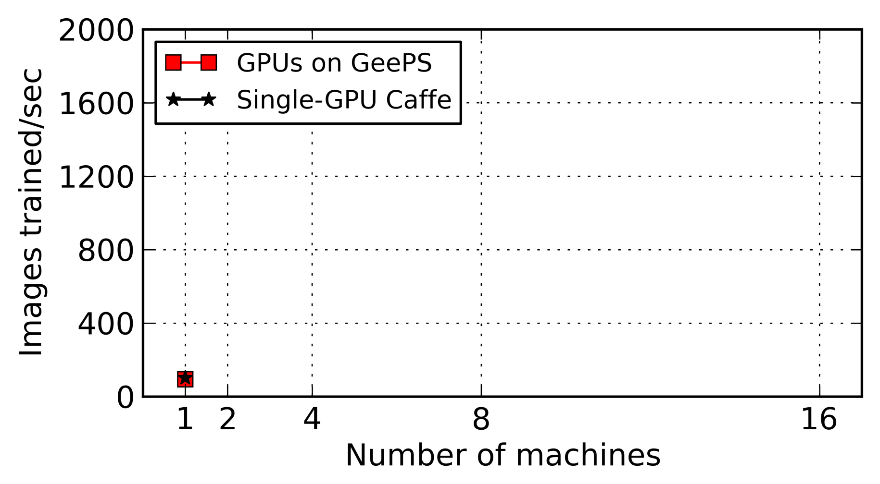
Training throughput
Notes:
Here, I will focus on the results of training throughput. The X axis is the number of machines we use. The Y axis is the number of images trained per second, and

Slide 29
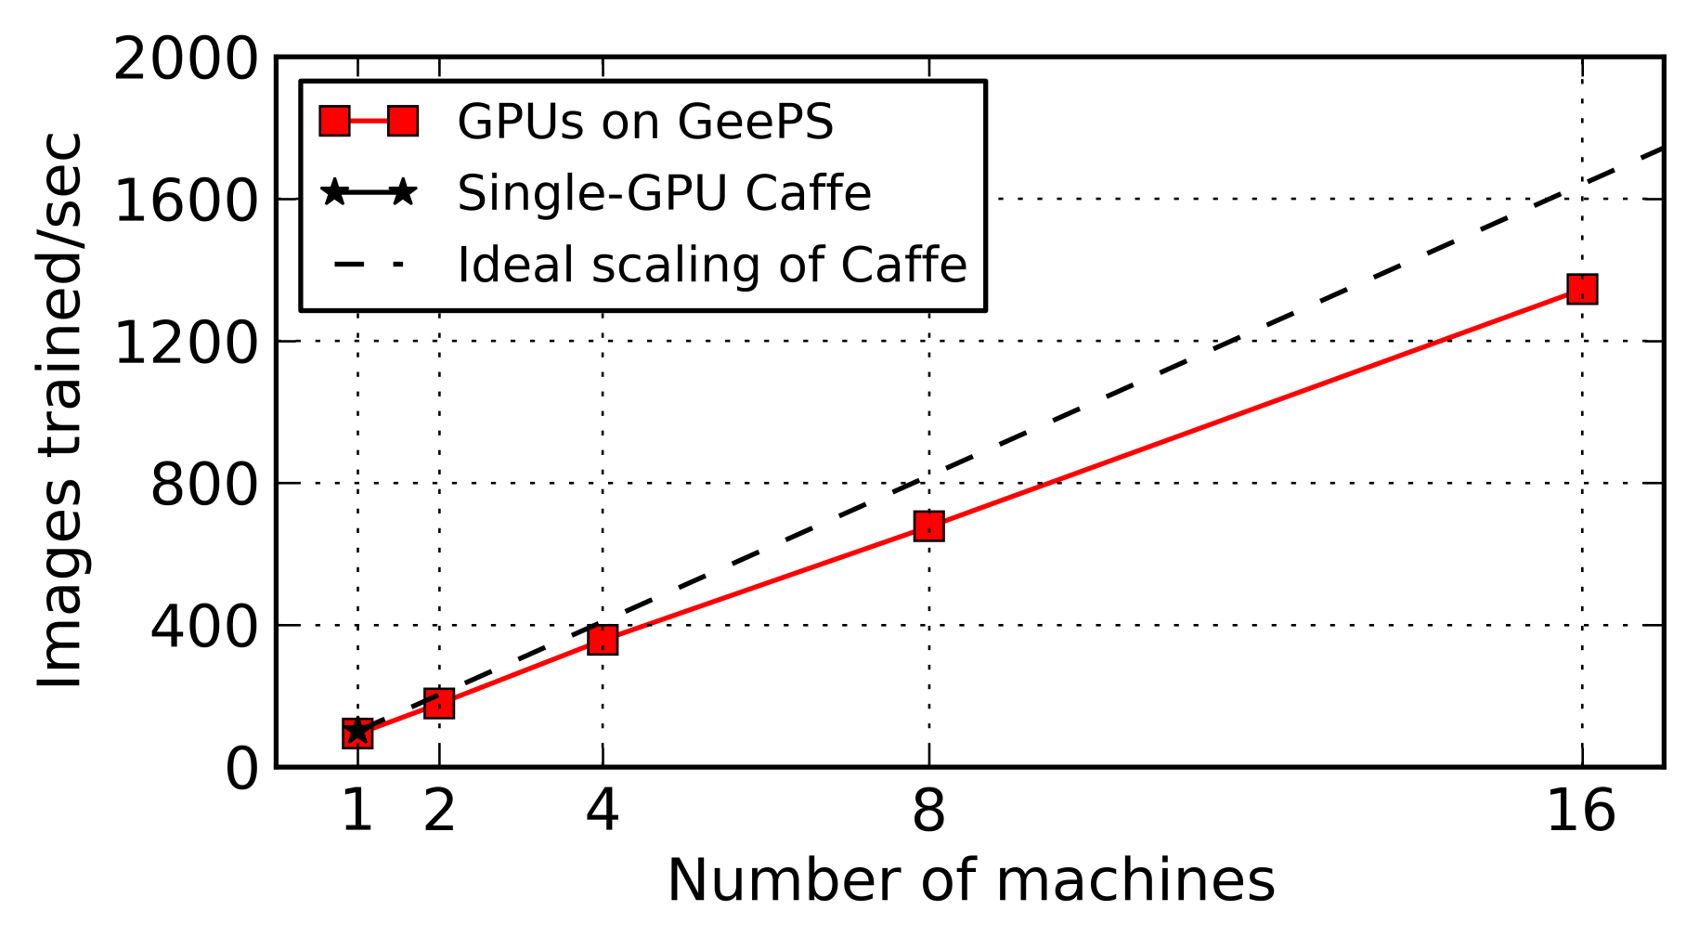
Training throughput
GeePS scales close to linear with more machines
with 16 machines, it runs 13x faster than Caffe
only 8% GPU stall time
Notes:
We first compare GeePS with the original Caffe. Caffe only works on a single machine, but we use this dashed line to represent the ideal Caffe scalability. We can see that GeePS scales relatively close to ideal. When we use 16 machines, GeePS runs 13 times faster than single-machine Caffe.

Slide 30
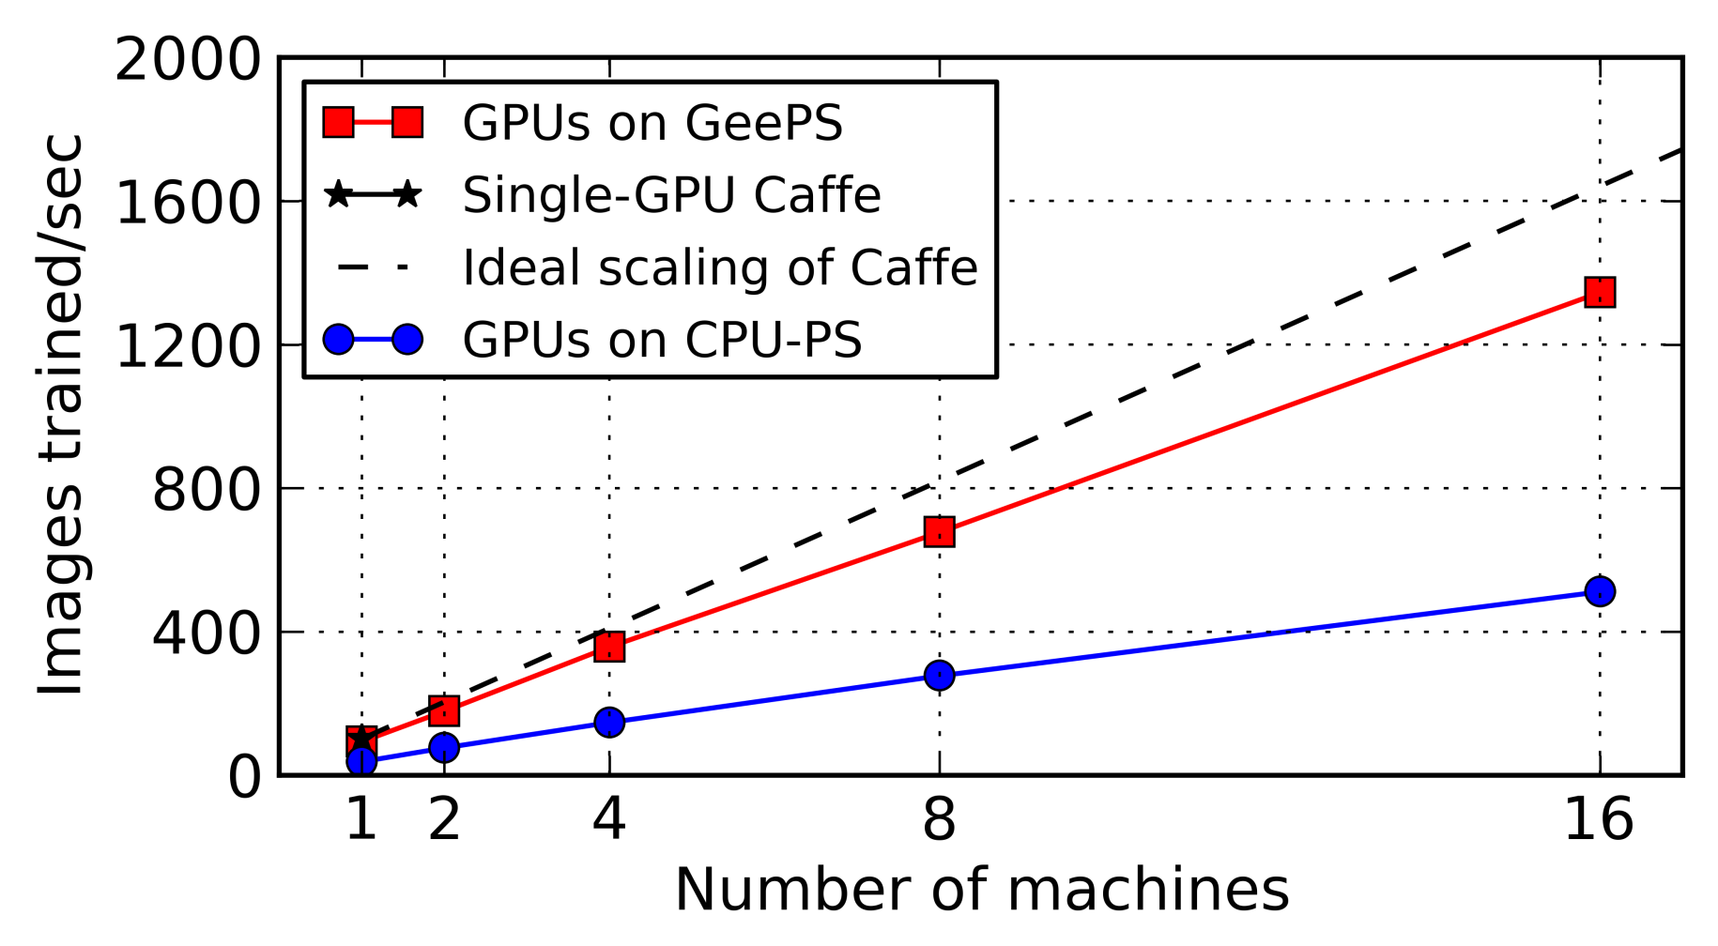
Training throughput
GeePS is much faster than CPU-based PS
2.6x higher throughput
reduces GPU stall time from 65% to 8%
Notes:
We then compare GeePS with Caffe linked with a traditional CPU-based parameter server. For this setup, we still use Caffe to do computations with GPUs, but each time it accesses the parameter data, we have to transfer data between GPU memory and CPU memory in the foreground. Because of this overhead, this CPU-PS setup is 2 and a half times slower than GeePS. This CPU-PS setup has 65 percent GPU stall time, while GeePS has only 8 percent, because it transfers the data in the background.

Slide 31
More results in the paper
Good scalability and convergence speed for
GoogLeNet network
RNN network for video classification
Handle problems larger than GPU memory
Only 27% reduction in throughput with 35% memory
3x bigger problems with little overhead
Handle models as large as 20 GB
Support 4x longer videos for video classification
Notes:
There are more interesting results in the paper. For example, GeePS has good scalability and convergence speed for other networks such as GoogLeNet, and other problems, such as RNNs for video classification.
For GPU memory management, GeePS can handles three times bigger problems without much overhead, and we can use GeePS train networks with up to 20 gigabytes of model parameters.

Slide 32
Conclusion
GPU-specialized parameter server for GPU ML
13x throughput speedup using 16 machines
2x faster compared to CPU-based PS
Managing limited GPU memory
By managing GPU memory inside GeePS as a cache
Efficiently handle problems larger than GPU memory
Enable use of data-parallel PS model
Notes:
In conclusion, we design a parameter server for GPU machine learning applications, with high throughput and scalability.
It is able to efficiently manage the limited GPU memory as a cache, and transfer data between GPU and CPU memory in the background, allowing us to train models that do not fit in GPU memory.
All while, it maint,hjhjains an easy-to-use data-parallel parameter server model for the application.

Slide 33
References
[IterStore] H. Cui, A. Tumanov, J. Wei, L. Xu, W. Dai, J. Haber-Kucharsky, Q. Ho, G. R. Ganger, P. B. Gibbons, G. A. Gibson, and E. P. Xing. Exploiting iterative-ness for parallel ML computations. In ACM SoCC, 2014.
[Caffe] Y. Jia, E. Shelhamer, J. Donahue, S. Karayev, J. Long, R. Girshick, S. Guadarrama, and T. Darrell. Caffe: Convolutional architecture for fast feature embedding. arXiv preprint arXiv:1408.5093, 2014.
[ImageNet] J. Deng, W. Dong, R. Socher, L.-J. Li, K. Li, and L. Fei-Fei. Imagenet: A large-scale hierarchical image database. In IEEE CVPR, 2009.
[ProjectAdam] T. Chilimbi, Y. Suzue, J. Apacible, and K. Kalyanaraman. Project Adam: Building an efficient and scalable deep learning training system. In USENIX OSDI, 2014.

Slide 34
Additional related work
T. Chen, et al. MXNet: A flexible and efficient machine learning library for heterogeneous distributed systems. arXiv preprint arXiv:1512.01274, 2015.
H. Zhang, et al. Poseidon: A system architecture for efficient GPU-based deep learning on multiple machines. arXiv preprint arXiv:1512.06216, 2015.
A. Krizhevsky, I. Sutskever, and G. E. Hinton. ImageNet classification with deep convolutional neural networks. In NIPS, 2012.
J. Dean, et al. Large scale distributed deep networks. In NIPS, 2012.
C. Szegedy, et al. Going deeper with convolutions. arXiv preprint arXiv:1409.4842, 2014.
R. Wu, S. Yan, Y. Shan, Q. Dang, and G. Sun. Deep image: Scaling up image recognition. arXiv preprint arXiv:1501.02876, 2015.
A. Coates, B. Huval, T.Wang, D.Wu, B. Catanzaro, and N. Andrew. Deep learning with COTS HPC systems. In ICML, 2013.

Slide 35
Backup Slides

Slide 36
Interface to GeePS-managed buffer
Read
Buffer “allocated” by GeePS
Data copied to buffer
PostRead
Buffer reclaimed
PreUpdate
Buffer “allocated” by GeePS
Update
Updates applied to data
Buffer reclaimed
Notes:
Here is the list of our interfaces to the GeePS managed buffers. I just talked about reads. Post-read is for after the application finishes using the read buffer, it will call post-read to release the buffer.
Similarly, when the application updates data, it first request a buffer by calling pre-update. And when it has the updates ready in the buffer, it calls update, and GeePS will apply the updates and reclaim the buffer.

Slide 37
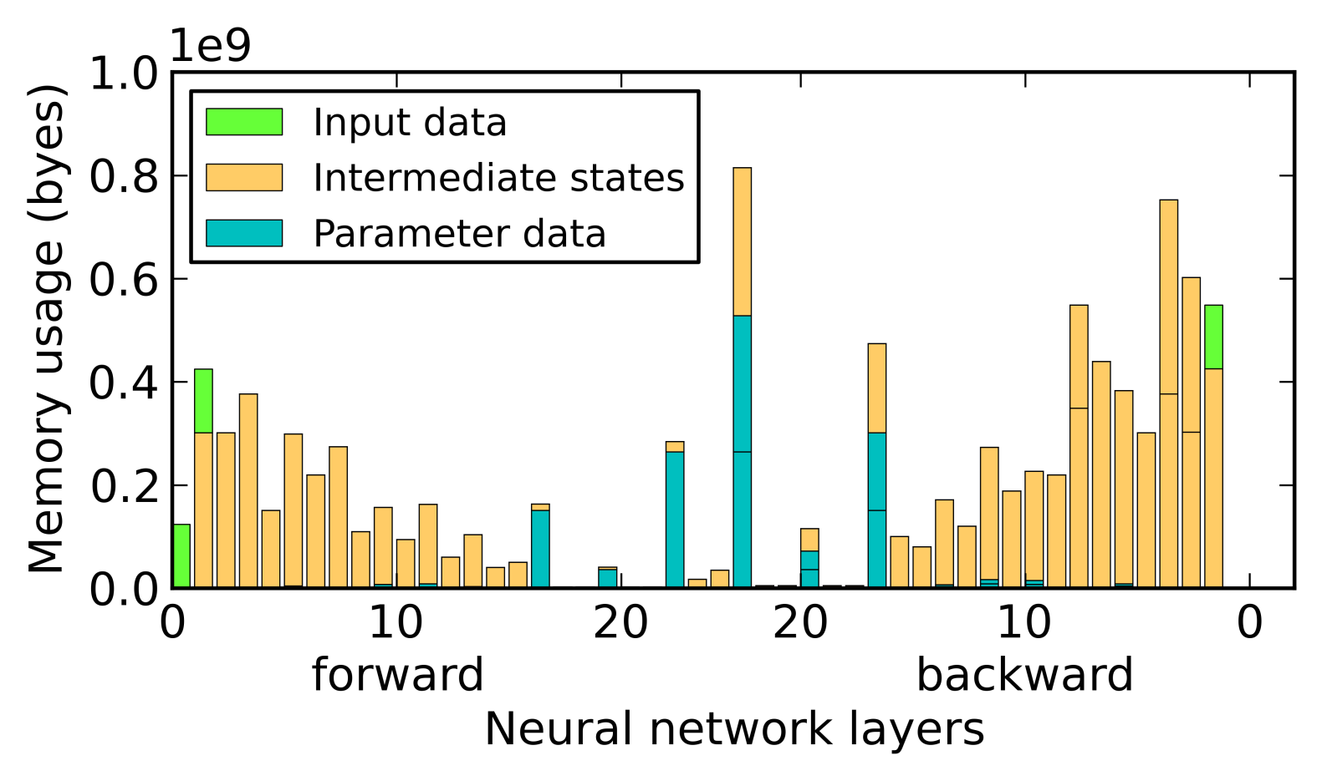

Data placement policy
GPU memory
peak
Access
buffer
- Pin as much local data as can in GPU memory - Select local data that causes peak usage
Notes:
So as our policy, we will first pin the local data in GPU memory. We will choose the local data that is (POINT) at peak memory usage and pin it in GPU memory.

Slide 38
Data placement policy
GPU memory
to GPU memory
Intermediate states
Access
buffer
(smaller)
Pin as much local data as can in GPU memory Select local data that causes peak usage
Notes:
(POINT) So, we will pin this piece of data in GPU memory. It is some intermediate states. After we pin it in GPU memory, (POINT) we can reserve a smaller space for the access buffer now.

Slide 39
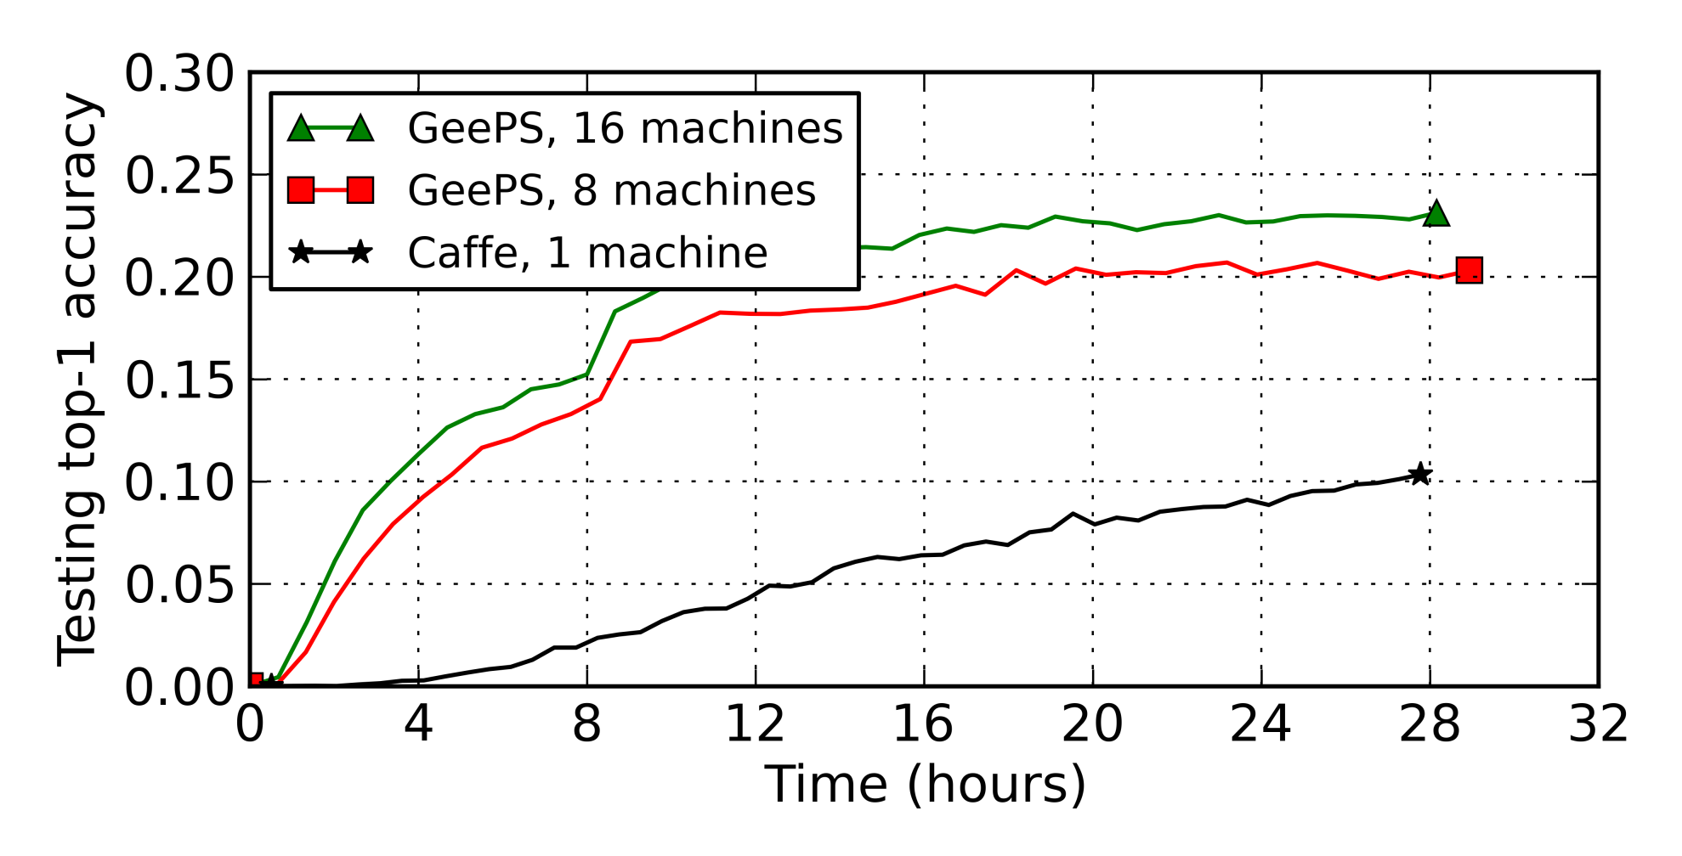
Image classification accuracy
To reach 10% classification accuracy:
6x faster with 8 machines
8x faster with 16 machines
Notes:
We also compare the model convergence speed. In this figure, the X axis is time, and the Y axis is the classification accuracy on the testing images.
To reach the same classification accuracy, such as 10%, GeePS with 8 machines is 6 times faster than Caffe.

Slide 40
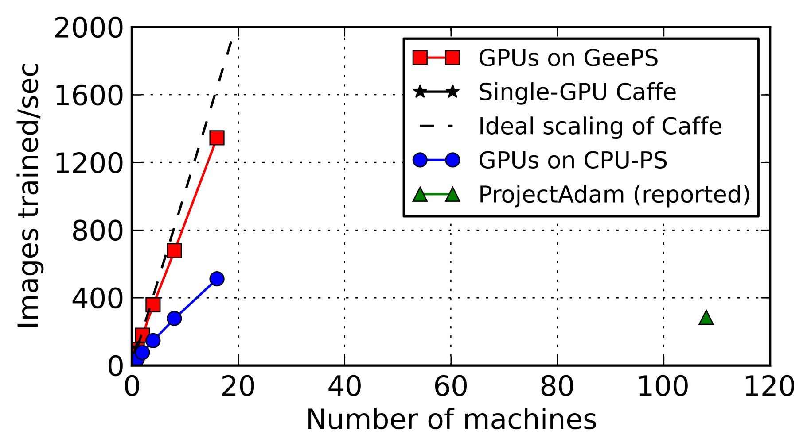
Training throughput (more)
Notes:
We then compare GeePS with Caffe linked with a traditional CPU-based parameter server. For this setup, Caffe still performs the computations using GPUs, but each time it accesses the parameter data, it has to transfer data to CPU memory. Because of this overhead, this CPU-PS setup is 2 and a half times slower than GeePS. This CPU-PS setup has 65 percent GPU stall time, while GeePS has only 8 percent, because it transfers the data in the background.

Slide 41
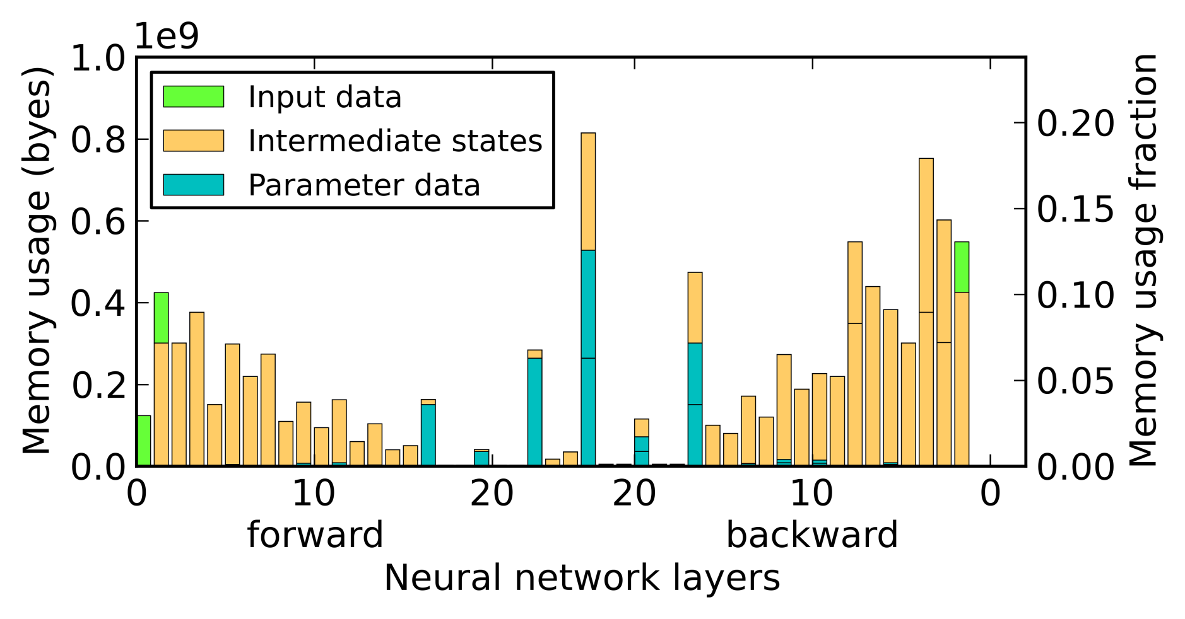
Per-layer memory usage
Notes:
Next, I will show how well can we manage the GPU memory. The memory usage graph of this neural network is the same as the one I have shown before. And I will use the memory management policy that I described before.

Slide 42
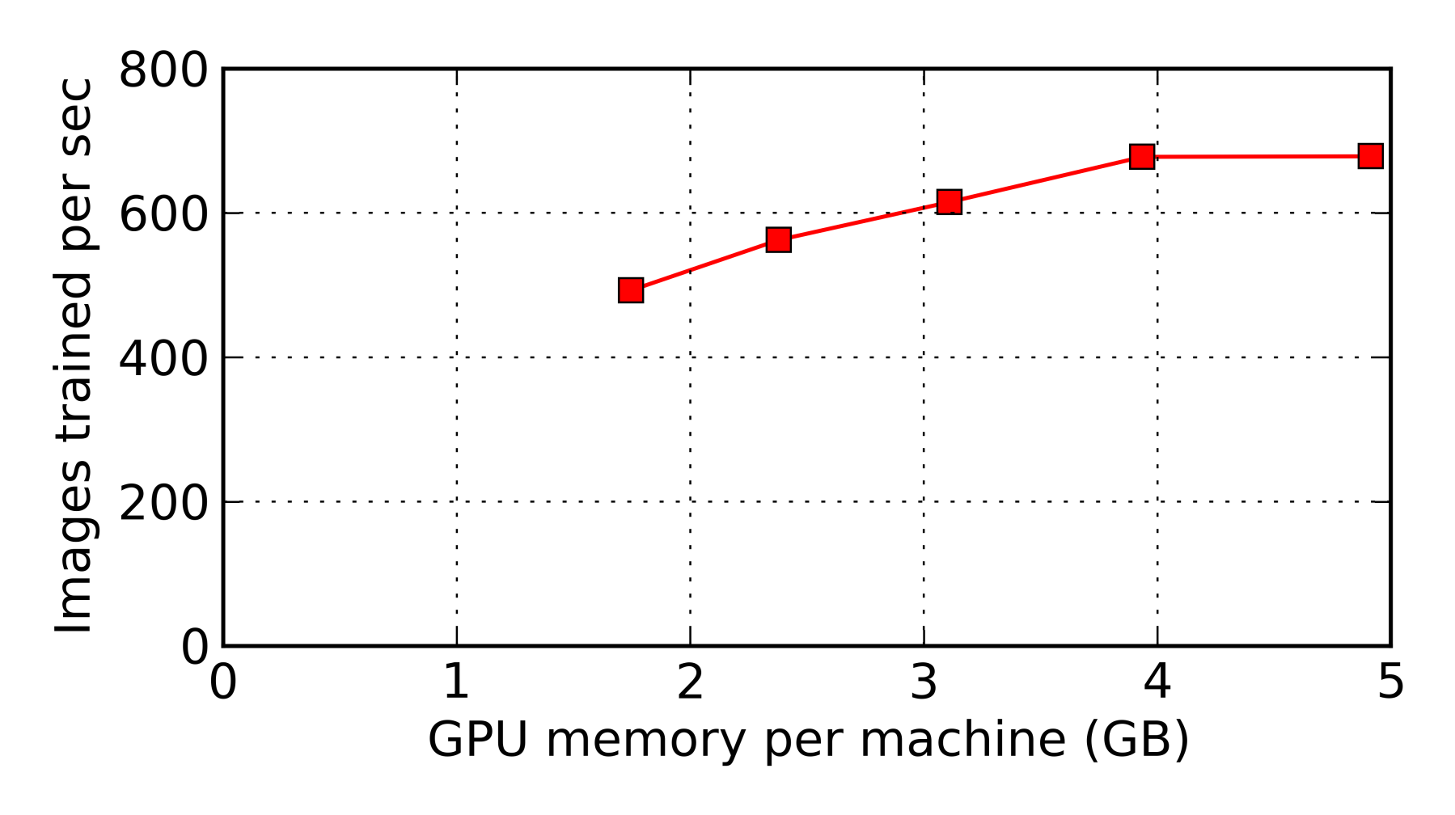
Throughput vs. memory budget
All data in GPU memory
Only buffer pool in GPU memory
Twice the peak size for double buffering
Only 27% reduction in throughput with 35% memory
Can do 3x bigger problems with little overhead
Notes:
We measure the image training throughput when we assign different amount of GPU memory for GeePS to use. The X axis here is the GPU memory budget, and the Y axis is the throughput. The rightmost point is when everything is in GPU memory. The leftmost point is the case we store all parameter data and local data in CPU memory, and we make the buffer pool twice the size as the peak memory usage for double buffering.
Comparing these two points, we have only 27% reduction in throughput when we use only 35 percent of the GPU memory.
This result means that we can do 3 times bigger problems using GeePS, with little overhead.

Slide 43
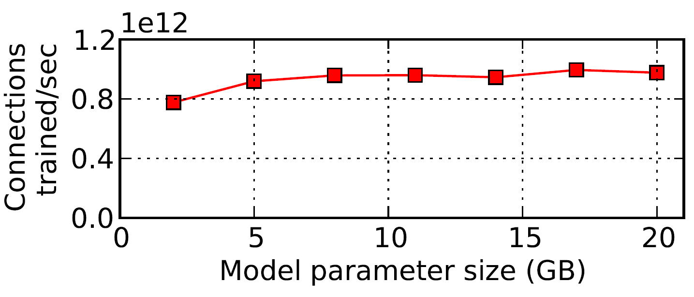
Larger models
Models up to 20 GB

Slide 44
Layer-by-layer computation for DNN
For each iteration (mini-batch)
A forward pass
Then a backward pass
Each time only data of two layers are used
Class probabilities
Training images

Slide 45
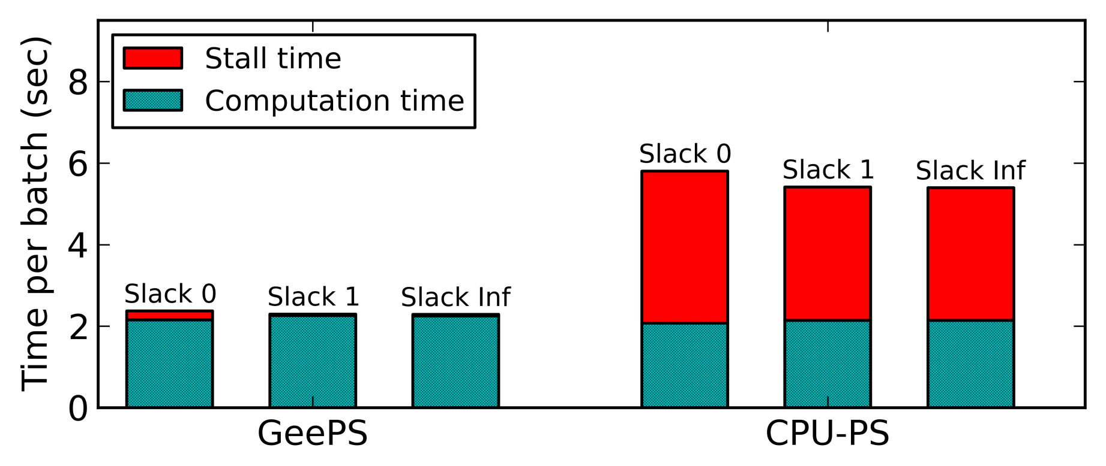
Computation vs. stall times
Even for slack 0, updates of a layer can be sent to other machines before the updates of other layers finish
CPU-PS has much overhead of transferring data between GPU/CPU memory in the foreground

Slide 46
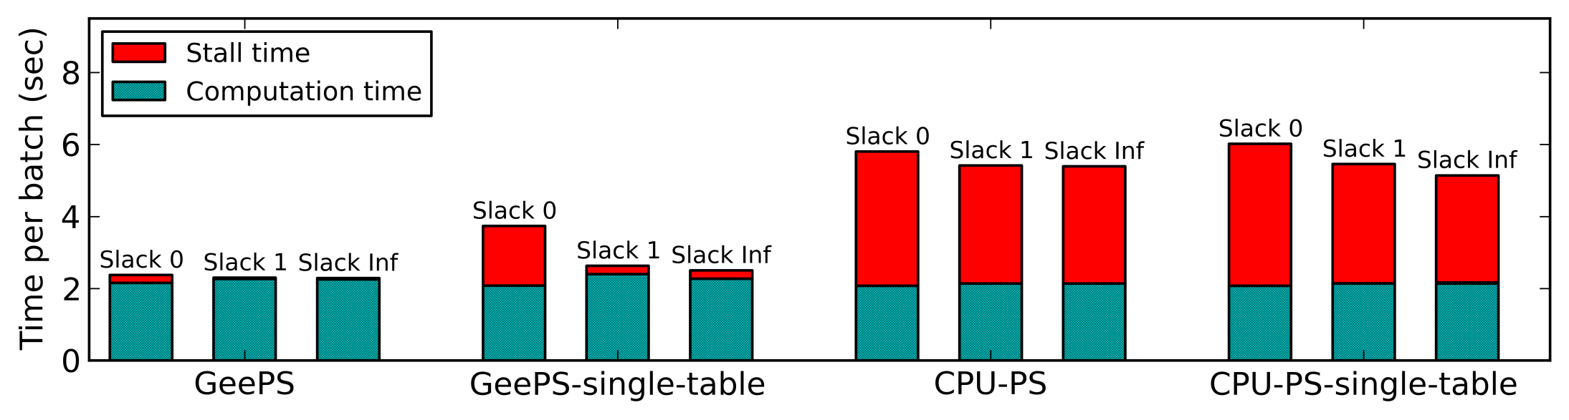
Computation vs. stall times (more)
GeePS and CPU-PS: updates of each layer are sent in distinct batches
Single-table: updates of all layers are sent in a single batch

Slide 47
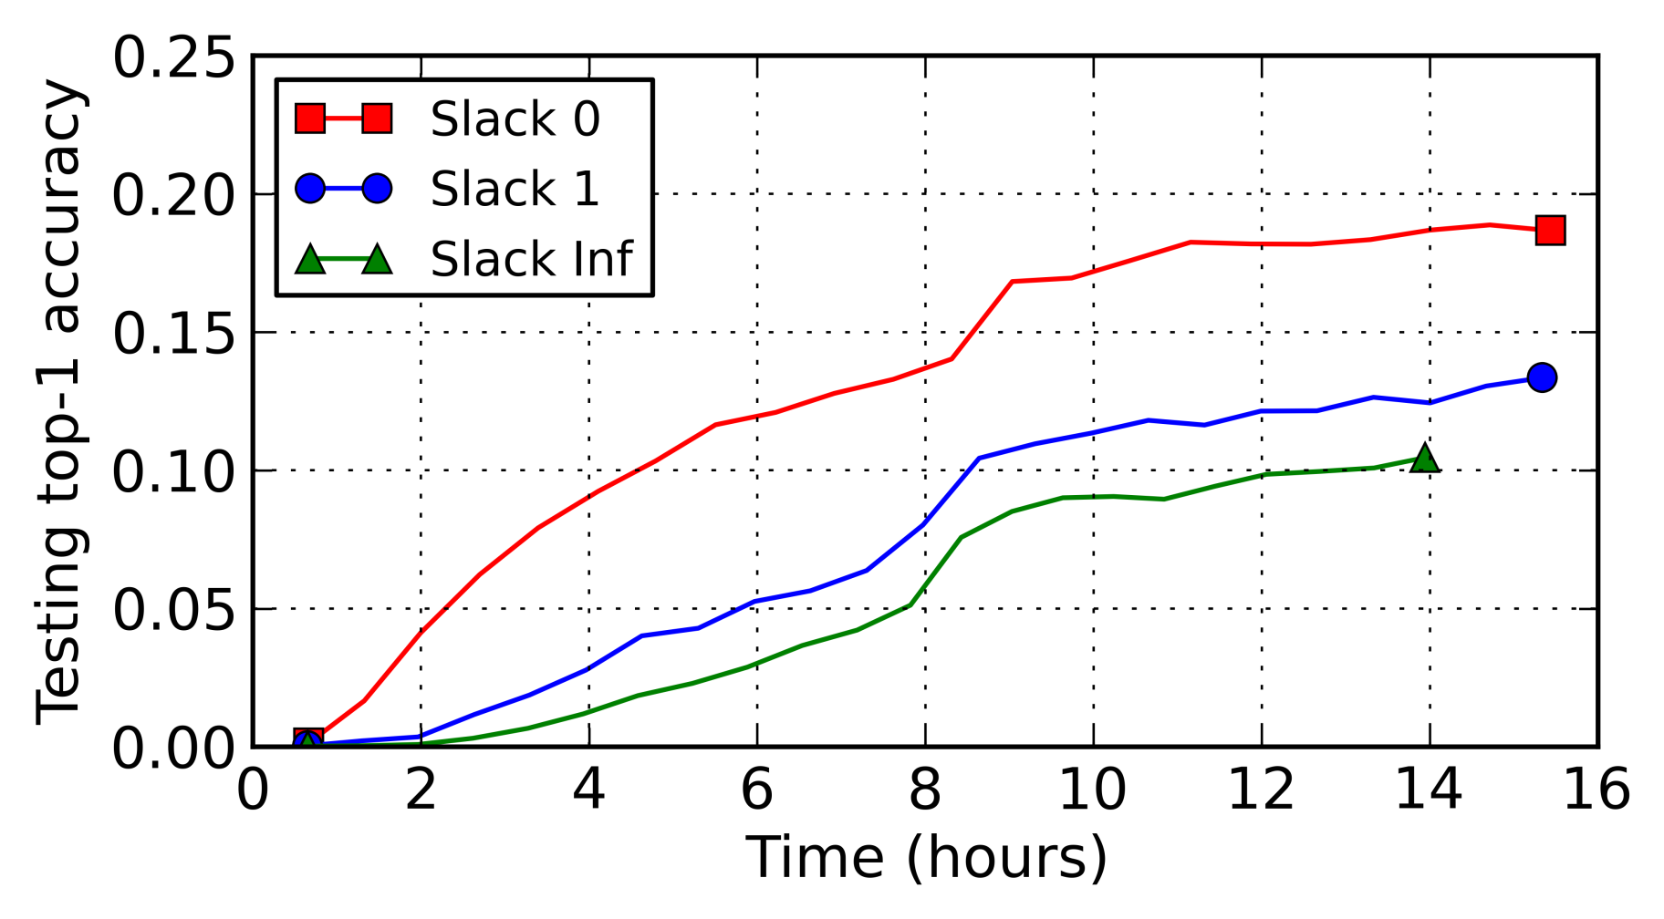
Convergence with data staleness
The data staleness sweet spot is Slack 0
because the GPUs perform huge amount of computation every clock

