Slide 1
Exploiting iterative-ness for parallel ML computations
Henggang Cui
Alexey Tumanov, Jinliang Wei, Lianghong Xu, Wei Dai, Jesse Haber-Kucharsky,
Qirong Ho, Gregory R. Ganger, Phillip B. Gibbons (Intel), Garth A. Gibson, Eric P. Xing
PARALLEL DATA LABORATORY
Carnegie Mellon University
Notes:
My name is Cui. In this talk, I will present our work of improving the performance of parameter server systems by exploiting iterativeness.
.

Slide 2
One slide overview
Iterativeness arises in some ML apps
Consequence: repeated data access sequences
Repeating pattern can be exploited
Detect with minor effort
Either in a real or a "virtual" iteration
Specialize structures and policies to known pattern
Data partitioning, prefetching, lock avoidance, pre-marshalled structures, etc.
Next
Parallel machine learning
PageRank as one example
Notes:
First I will give a one slide overview of our work. We find many machine learning computations have the property that they repeatedly do the same sequence of access to the data, and this repeated access sequence can be exploited. In this work, we implement and evaluate two mechanisms to gather the access sequence with minor effort, either in a real iteration or in a “virtual” iteration. And we apply system level optimizations based on such information.
(HIT) In the next few slides, I will first talk about the class of parallel machine learning problems that we target at. Then I will use PageRank as an example application to show how the iterativeness causes repeated access sequences.

Slide 3
Parallel machine learning
Eg. a web graph
Eg. page ranks
One iteration
READ, INC
Input data
Iterative program fits model
Model parameters
(solution)
Notes:
Suppose we have some huge input data, which might be a web graph. (HIT) Machine learning applications explain the data using predesigned models, and use algorithms to fit the model parameters. The model, for example, can be the rank of each webpage. (HIT) The solving algorithm is often iterative. It first makes an initial guess of the model parameters, and then it iterates over the input, and makes adjustment to the model parameters based on the input. The algorithms go through the input data multiple times, until the model parameters converge, and we call one such pass over the input data as an iteration.

Slide 4
Parallel machine learning
Bulk Synch Parallel:
barrier each iter
INC: associative updates
Parameter server
READ, INC, CLOCK
Input data
Parallel iterative
workers
Model parameters
(solution)
Notes:
To solve bigger problems, people can divide the input data into multiple parts, and we have each worker compute on one part of the input. During the computation, these workers concurrently read and update the shared model parameters based on their input. (HIT) To make it easy for application developers, people build systems called parameter servers to manage the globally shared model parameters. The parameter server can use bulk synchronous parallel to synchronize the views of different workers. In bulk synchronous parallel, a barrier is placed at the end of each iteration, and the workers exchange their updates at the barrier. (HIT) The updates are often just increments to the model parameters, so they can be merged without any conflicts. I’m just using BSP as one example, our solution works for other synchronization models as well.

Slide 5
Parallel machine learning
Goal: improve performance by exploiting iterativeness
Parameter server
READ, INC, CLOCK
Input data
Parallel iterative
workers
Model parameters
(solution)
Notes:
The performance of the parameter server is often the bottleneck of the whole computation. The goal of our work is to improve the performance of parameter servers by exploiting the iterativeness property of the applications.

Slide 6
Example: PageRank
Input data: a set of links, stored locally
Parameter data: ranks of pages, stored in parameter server
Page-0
Link-0
Worker-0
All ranks set to some value
LOOP
FOREACH link from i to j
read Rank(i)
Rank(j) += change of Rank(i)
ENDFOREACH
WHILE NOT CONVERGE
Link-2
Link-3
Page-2
Link-1
Worker-1
Page-1
Notes:
What is iterativeness. I will use PageRank as an example. Here the input data is a web graph, represented by a set of links, and we want to calculate the rank of each page. (HIT) The algorithm is very simple. (SLOW) We first set all ranks to some initial value, and for each link for I to j, we read the rank of I, and we update the rank of j based on the change of rank I. We repeat such procedure, until the ranks converge. (HIT) The computation can be paralleled by assigning links to different workers. Here we assign link 0 and link 1 to worker 0, and another two links to worker 1. The input data is stored locally in workers, and the ranks are globally shared and are stored in the parameter server, .

Slide 7
Example: PageRank
Input data: a set of links, stored locally
Parameter data: ranks of pages, stored in parameter server
Page-0
Worker-0:
LOOP
# Link-0
READ page[2].rank
INC page[0].rank
# Link-1
READ page[1].rank
INC page[2].rank
CLOCK
WHILE NOT CONVERGE
Link-0
Worker-0
Link-2
Link-3
Page-2
Link-1
Worker-1
Repeated operation sequence depends only on input data
Does not depend on ranks
Page-1
Notes:
Now let’s look at the parameter server operations of Worker 0. In each iteration, it reads the rank of page 2, increases the rank of page 0, reads the rank of page 1, increases the rank of page 2, and synchronize. (HIT) We find here is a repeated operation sequence for each worker, and this operation sequence is only dependent on the input data, and does not depend on the current value of parameter data.

Slide 8
Repeated operation sequences
Many examples of ML applications
Including Topic Modeling and Collaborative Filtering
Knowledge of repeated operation sequence can be exploited to improve efficiency
50x speed up for PageRank
Talk outline
Ways to obtain per-iter operation sequences
Optimizations with pre-knowledge of operations
Experiment results
Notes:
The repeated operation sequence is widely observed in iterative applications. More examples include Topic Modeling and Collaborative Filtering. (HIT) Our work shows that these repeated operation sequence can be exploited to improve performance. For example, our designed optimizations provide 50x speed up on PageRank, over no optimization. (HIT) In this talk, I will first describe our ways of obtaining the operation sequence, and then describe our designed optimizations using such knowledge. Finally I will show our experiment results.

Slide 9
Obtain per-iter operation sequences
Parameter server operations
READ
INC
CLOCK
Can be thought of as barrier
Two ways of obtaining it
Gather in the first iteration
Gather in a “virtual iteration”
LOOP
READ page[2].rank
INC page[0].rank
READ page[1].rank
INC page[2].rank
CLOCK
WHILE NOT CONVERGE
Notes:
The parameter server operations often include READ, INC, and CLOCK. (HIT) We implement and evaluate two ways of obtaining the operation sequences. Gather in the first iteration, and gather in a “virtual iteration”.

Slide 10
Gather in the first iteration
// Gather in first iter
load_data()
init_param_vals()
do {
if (first iteration)
ps.start_gather()
do_iteration()
if (first iteration)
ps.finish_gather()
} while (not stop)
// Original
load_data()
init_param_vals()
do {
do_iteration()
} while (not stop)
Notes:
We first look at a typical application code using parameter servers. It first loads the input data from the file system and sets some initial parameter values. Then it does iterative computation. (HIT) To help gather the operation sequence, (POINT) we can add these four lines of code in blue. This code annotates the start and end of the first iteration, so that the parameter server can record the operation sequence of a whole iteration. At the call of finish gather, the parameter server can apply the optimizations based on the gathered information. If the operation sequences change dramatically after say a hundred iterations, we can do this again.

Slide 11
Gather in the first iteration
+ Little programmer effort
Only need to annotate iteration boundaries
- Considerable performance overhead
The first iteration runs without optimizations
More cost to apply the optimizations
States from the first iteration need to be migrated
Notes:
The benefits of gathering in the first iteration is that it involves very little programmer effort. However, it will cause the first iteration to run without optimization. Moreover it will be quite expensive to apply the optimizations, because our optimizations involves data partitioning, and data structures are built based on the gathered information. If we have real data access before setting up the new data structures, we have to migrate all the states in some old temporary data structures to the new ones.

Slide 12
Gather in a virtual iteration
Just to remind you
// Gather in virtual iter
load_data()
ps.start_gather(virtual)
do_iteration()
ps.finish_gather()
init_param_vals()
do {
do_iteration()
} while (not stop)
// Gather in first iter
load_data()
init_param_vals()
do {
if (first iteration)
ps.start_gather()
do_iteration()
if (first iteration)
ps.finish_gather()
} while (not stop)
Operations between start_gather(virtual) and finish_gather() are recorded but return without any action. Nearly free.
Notes:
To solve these problems, we propose another way of doing that, what we call virtual iteration. After the input data is loaded and before any access to the parameter data is performed, we have the workers to do one iteration virtually. These three lines are the added code. Now the annotation is outside the iteration loop and even before init parameters. The start gather call has a virtual flag, telling the parameter server that we are starting a virtual iteration. During the virtual iteration, the parameter server only records the operations, and returns immediately without taking any action. For example, when a worker calls the READ function, the function returns with no data copied into the read buffer. So the virtual iteration is nearly free.

Slide 13
Gather in a virtual iteration
- Programmer needs to be more careful
do_iteration() needs to work with virtual READ/INC
Computation must be independent of param value
+ Better performance
No operations performed during virtual iteration
No state migration
All real iterations run at optimized speed
Notes:
To work with virtual iteration, the application function needs to work with situations where READ and INC operations has no effect. That is true when the computation is independent of parameter values. By gathering during the virtual iteration, we can achieve much better performance. Because the first iteration can run at the optimized speed and moreover, we don’t need to migrate states. Later in the talk, we use virtual iteration as the default information gathering mechanism.

Slide 14
Optimizations on informed access
Optimizations applied at finish_gather()
1. Cross-machine parameter data placement
2. Prefetching
3. Static cache policies
4. More efficient static data structures
5. NUMA-aware memory management
Prototyped on IterStore
A “parameter server library”
An improved version of LazyTable
Notes:
At the finish_gather() function, the operation sequence of each worker is summarized and exchanged across all workers. We implement and evaluate five optimizations that exploit the knowledge of these operation sequences. We prototype these on IterStore, a parameter server that runs as a library in the application worker program. It’s an improved version of our previous system LazyTable.

Slide 15
IterStore architecture
Machine
App worker
App worker
IterStore library
Shared parameter data
Notes:
I will first give you a very high level overview of the system architecture. The application process in each machine creates several worker threads and it links to the IterStore library to store the shared parameter data.

Slide 16
IterStore architecture
Machine
App worker
App worker
IterStore library
Param data organized as rows
Master store
Notes:
The parameter data is organized as a collection of rows, and the rows are stored in the master store module of our library.

Slide 17
IterStore architecture
Machine-0
Machine-1
App worker
App worker
IterStore library
Rows are sharded across machines
Master shard-0
Master shard-1
Notes:
When we add one more machine to the cluster, we not only get more worker threads, but we also have one more machine to store the rows. IterStore will shard the rows across all machines. The master store shard on each machine stores only one shard of the rows.

Slide 18
IterStore architecture
Machine-0
Machine-1
App worker
App worker
IterStore library
Process cache
Process cache
Master shard-0
Master shard-1
Notes:
Because the rows can potentially be stored in other machines, each machine has a process cache to keep the working set of the rows and we batch updates in the process cache.

Slide 19
IterStore architecture
Machine-0
Machine-1
App worker
App worker
IterStore library
Thread cache
Thread cache
Process cache
Master shard-0
Master shard-1
Notes:
One more level above, each worker thread has a private thread cache. We will discuss more on these two levels of caches when we describe the optimizations later.

Slide 20
1: Parameter data placement
Cross-machine parameter data placement
Store each row at the machine accessing it most
Balance the load for rows without clear affinity
Machine-0
Machine-1
Master shard-0
Master shard-1
Notes:
I will describe each of our optimizations one by one. Remember that we shard the rows across the master store of all machines, the first optimization is about how we assign rows to machines. With the knowledge of operation sequences, IterStore is able to store each row in the machine that access it most often. In that diagram, these colorful squares are rows, and we decide the master store shard that stores each row based on the knowledge of operation sequences. By doing that, we can reduce the amount of remote access. There can be ties. When there is a tie, we choose the machine with the least load.

Slide 21
2: Prefetching
Prefetching
Prefetch to process cache at the beginning of clock
Rows expected to be read in the clock
Fetched in a single message
Process cache
prefetch
Master shard-0
Master shard-1
Notes:
The second optimization is prefetching. Under the BSP model, the workers need to get a fresh view of the parameter data every clock. Instead of demand fetching the rows when they are used, IterStore prefetches rows to the process cache based on the knowledge of operation sequences. At the beginning of each clock, each process cache fetches the rows that are going to be read from the master store. Because all rows are fetched in a single request, the row data can be sent in a single message.

Slide 22
3: Static cache policies
Static cache policies
Decide rows to be cached based on access sequence
Cache rows with higher utilities
Never evict rows, no cache eviction overhead
Use a 2nd (dynamic) cache for items not in static cache
static
Thread cache
Process cache
Dynamic cache
Notes:
(SLOW) IterStore has two levels of caches, a thread cache that is used by a single worker thread, and a process cache that is shared by the whole process. With the knowledge of operation sequences, IterStore can use some static caching policies for these caches. (SLOW) At the setup time, it will decide the rows to be cached in each level of caches, based on some utility function. The decided cache entries are never evicted. Therefore, we have no cache eviction overhead. For the process cache, because the cost of cache misses is high, if we do need to cache something that is not in the static cache, we can cache it in a secondary dynamic cache.

Slide 23
4: Static data structures
Static hash map
Immutable index
No global lock needed for index concurrency
Entries stored in a contiguous block of memory
Can be sent in a single message without marshalling
Thread cache and master shared
Hash maps
Each accessed by one thread
Process cache
Concurrent hash map
Notes:
The fourth optimization is that we build static data structures based on the knowledge of operation sequences. The major data structures in IterStore are thread cache, process cache and master shard. All of them are hash maps. Hash maps can be tricky. (SLOW) For example, to Send entries in a hash map, we will need to copy these entries to some sending buffer, one by one. So, there’s a marshalling cost. Moreover, the process cache is used by multiple threads, concurrent add and deletion of entries in a hash map is very expensive. But we can eliminate these overheads by exploiting the knowledge of operation sequences. (SLOW) Using the static cache policies that I just described in the previous slide, the entries that will be stored in these hash maps are determined, which means we don’t need to support dynamic add or deletion. As a result, we can store the key value pairs in the hash map in a contiguous block of memory. And we use an immutable index to random access them. Because we don’t add or delete entries, no index lock is needed. And because key value pairs are stored in block of memory, they can be packed into a single message without any marshalling.

Slide 24
5: NUMA memory management
NUMA effect in multi-socket machines
Lower latency to access local memory
Partition cache and master store structures
Place each partition local to managing threads
Socket-0
Socket-1
Process cache
Mem
Mem
Cores
Cores
Master shard
Faster to access local memory
Socket-0
Socket-1
Notes:
The fifth optimization is NUMA aware memory management. In multi-socket machines, the latencies are different to access different parts of memory. As shown in this figure, the latency is lower for this core in socket 0 to access the memory of socket 0 than accessing the memory of socket 1. That is called NUMA effect. Because IterStore creates its data structures in the setup time, it can better manage the location of allocated memory. (HIT) IterStore partitions the cache and master shard into multiple partitions. And each partition is managed by one set of communication threads. In NUMA machines, IterStore will allocate memory local to the managing threads, in order to reduce access latency.
I have actually skipped many implementation details of our IterStore system and the optimizations, so please talk with me in the poster session.
please read our paper if you are interested in this part.

Slide 25
Experiment setup
Cluster information
8 machines, each with 64 cores & 128GB RAM
64 application worker threads per machine
Application benchmarks
PageRank: twitter-graph (40m nodes, 1.5b edges)
Collaborative Filtering: netflix (480k-by-18k sparse matrix)
Topic Modeling: nytimes (100m tokens, 300k docs)
Notes:
Next, I will show you our experiment results.
We use a cluster of 8 machines. Each machine has 64 cores. We run one application worker thread on each core.
We use PageRank, Collaborative Filtering, and Topic Modeling as our example applications, and the sizes of the input data sets are listed on the slides.

Slide 26
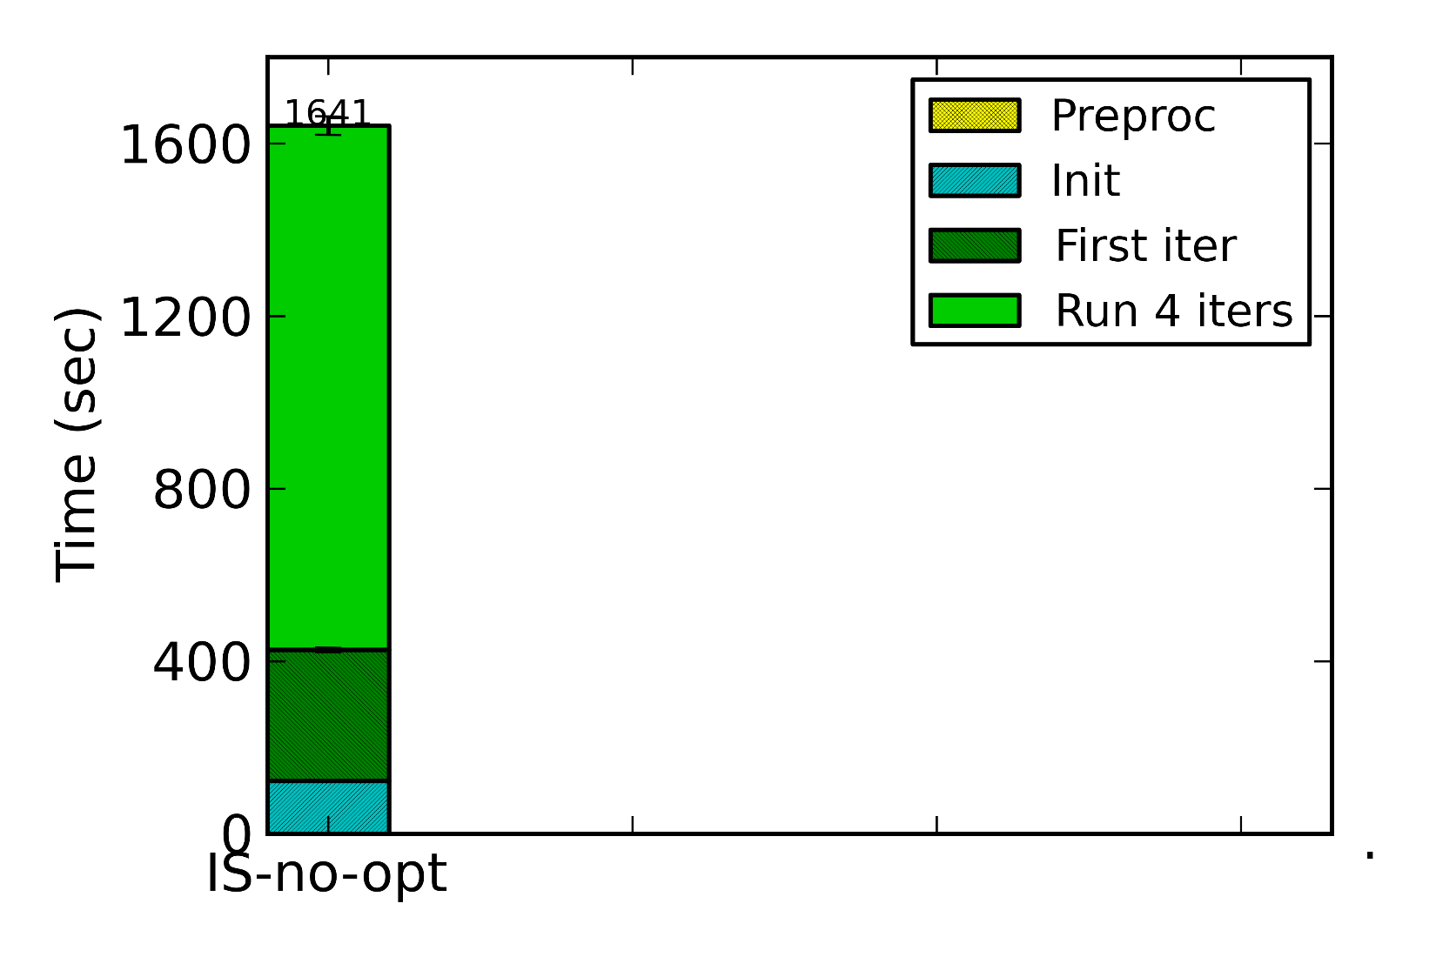
Overall performance: PR, 5 iters
PageRank
Notes:
In the first set of results, we measure the overall runtime to finish 5 iterations. We divide the overall run time into four parts. Preprocessing time is spent to apply the optimizations, including setting up the data structures. Initialization time is spent to set initial values to the parameter data, and we measure the time to complete the first iteration and the rest four iterations separately. So there four stacks in total on each bar. The first bar is IterStore without the optimizations. It does not have the preprocessing stack.

Slide 27
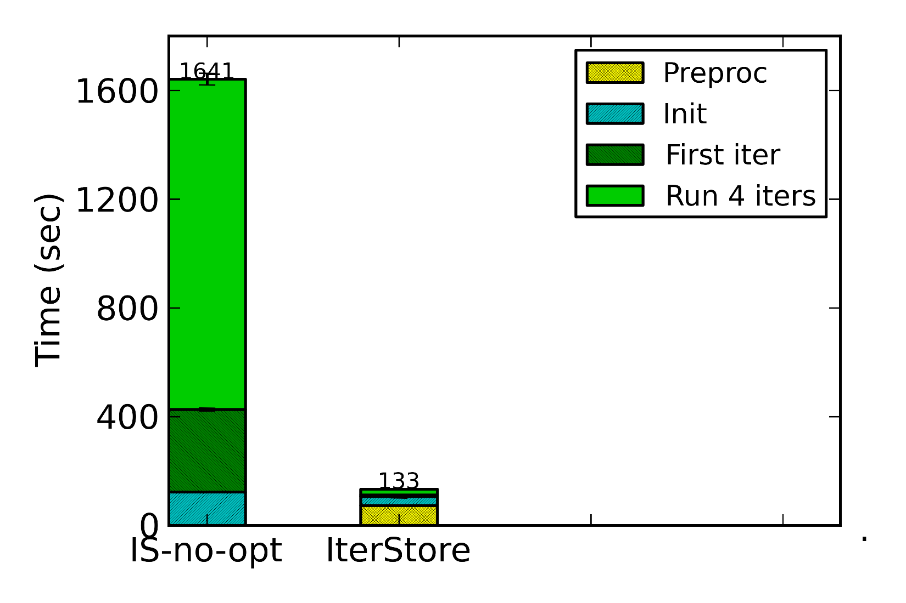
Overall performance: PR, 5 iters
12x speed up on overall time,
50x speed up on per iteration time
PageRank
Notes:
The second bar is IterStore with the optimizations turned on, and it collects operation sequences in a virtual iteration. There is a yellow stack at the bottom, representing the preprocessing cost. Despite of that cost, we finish the computation in much less time, because the per iteration time is significantly reduced due to the optimizations. We achieve 50x speed up on per iteration time, and 12x speed up on the overall run time.

Slide 28
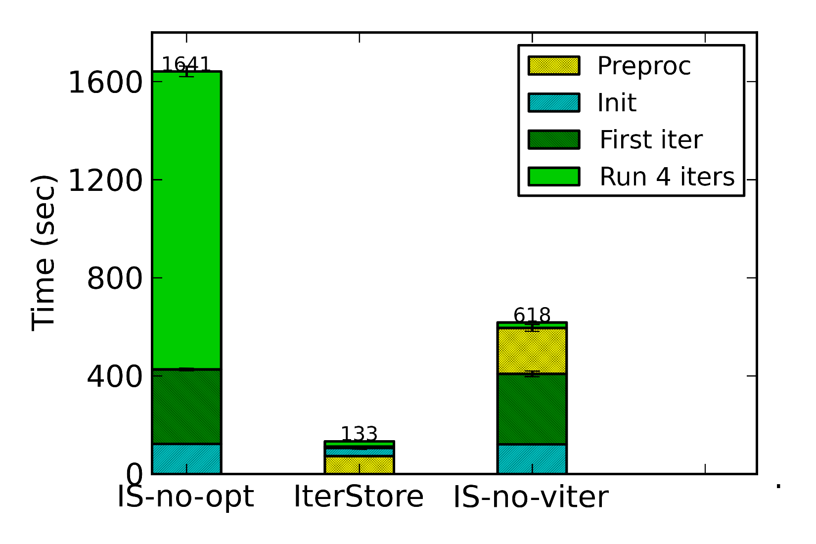
Overall performance: PR, 5 iters
Virtual-iter gathering performs
better than first-iter gathering
PageRank
Notes:
The third bar is IterStore with optimizations, but gathers operation sequences in the first iteration. The ordering of the stacks is a little different. The yellow stack is in the middle, because we apply the optimizations after the first iteration. Because of that, the first iteration runs at the unoptimized speed, and the rest four iterations run at the optimized speed. We also find it spends more time on the preprocessing step, because we have to migrate all the states generated in the first iteration to the new data structures. So in terms of performance, it’s better to do a virtual iteration.

Slide 29
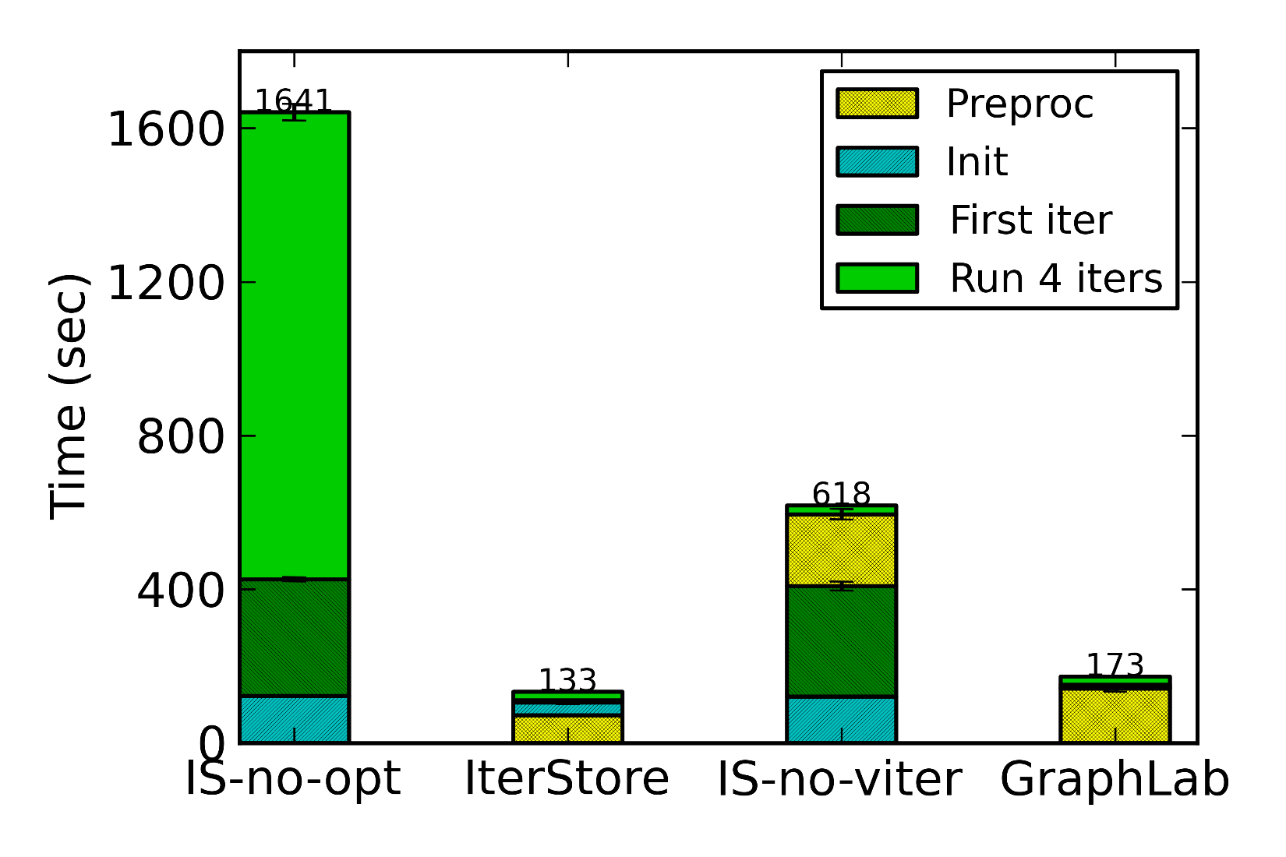
Overall performance: PR, 5 iters
PageRank
Faster than GraphLab even on PageRank
Notes:
We also compare our system to GraphLab. IterStore with the optimizations is faster than GraphLab. But PageRank is actually one of the most suitable applications for GraphLab. It might not be fair for us, so how about other applications?

Slide 30
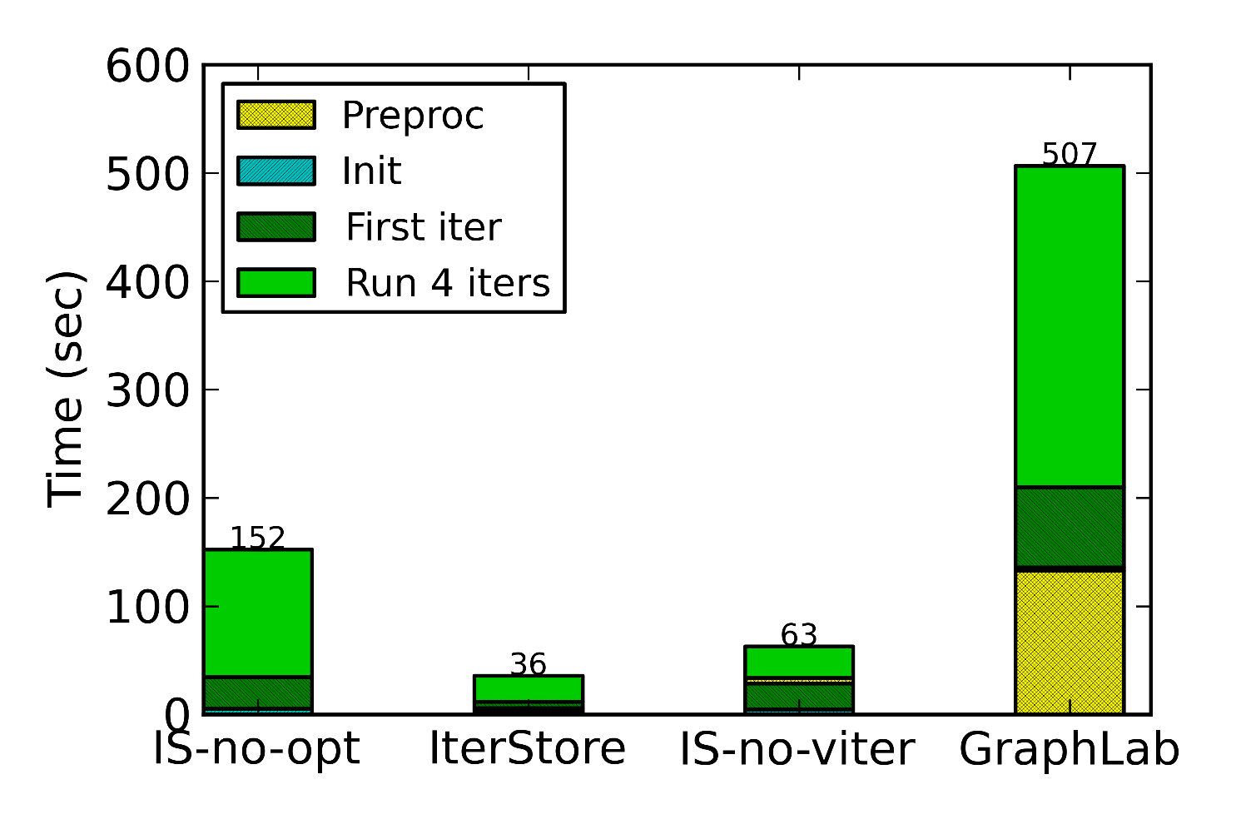
Overall performance: CF, 5 iters
Collaborative Filtering
More speed up over GraphLab
Notes:
When it comes to collaborative filtering. IterStore is significantly faster than GraphLab, and it’s faster than GraphLab even without the optimizations. That is because the GraphLab abstraction couples parameter data with computation. Some applications, such as PageRank, fit well in this abstraction, but it’s not suitable for other applications, such as collaborative filtering and topic modeling.

Slide 31
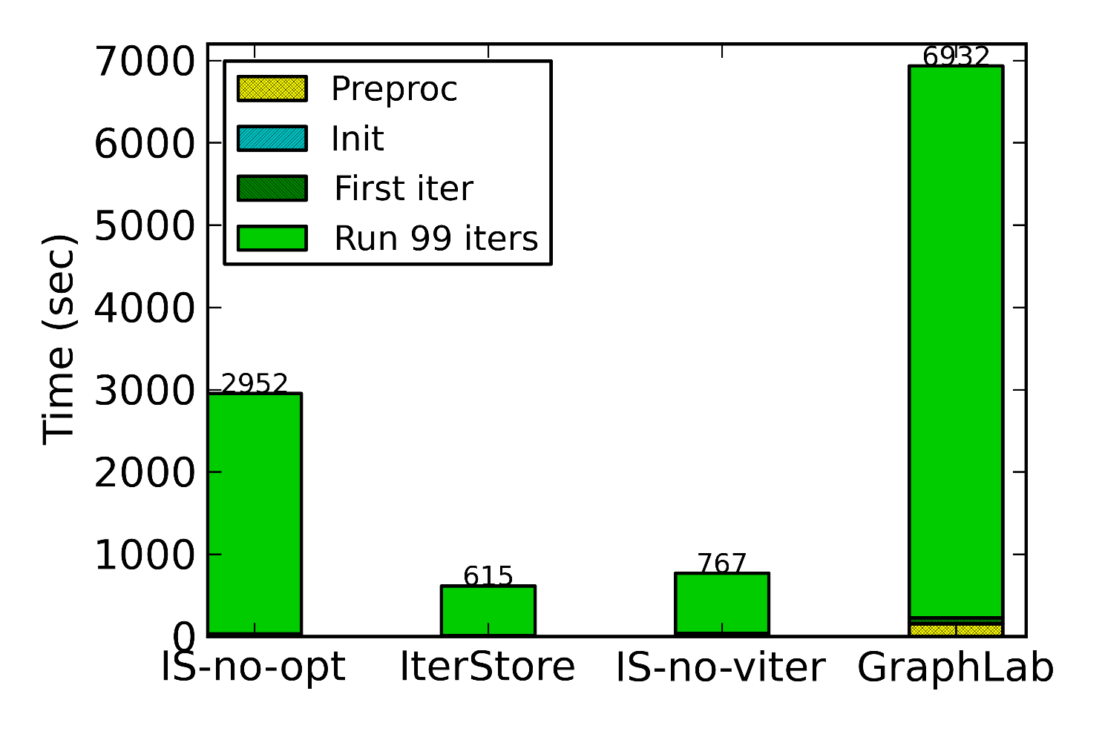
Overall performance: CF, 100 iters
Collaborative Filtering
Preprocessing time is amortized
over more iterations
Notes:
We also evaluate the performance with more iterations run. When we do a hundred iterations, our optimizations provide more overall speed up. That is because the preprocessing time is amortized over more iterations.

Slide 32
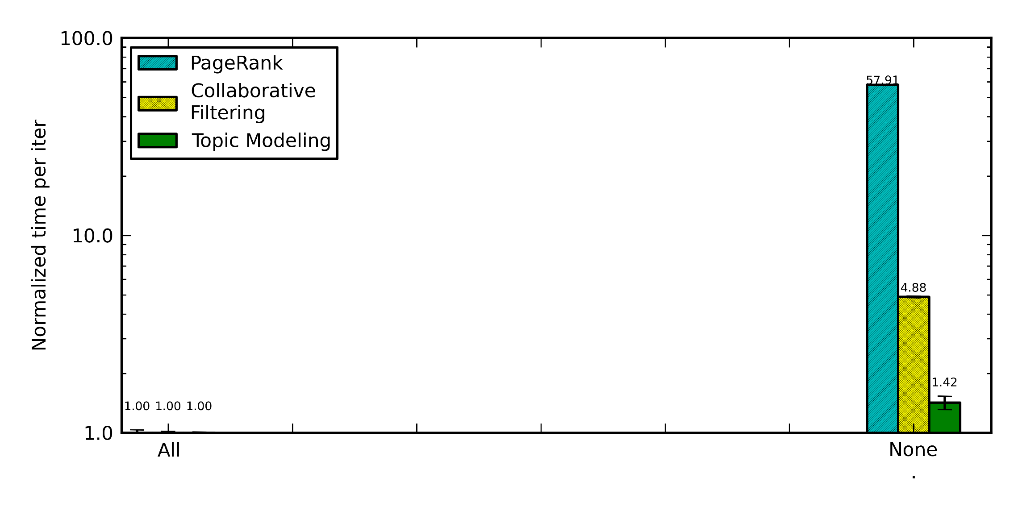
Optimization break down
Turn off one optimization each time
Notes:
In the next set of experiments, we break down the effectiveness of each of our five optimizations by turning off one of them each time. We use the case with all optimizations turned on as the baseline, and compare the normalized time per iteration. The right most bars are for the no optimization case. Each of the three bars represent one application.

Slide 33
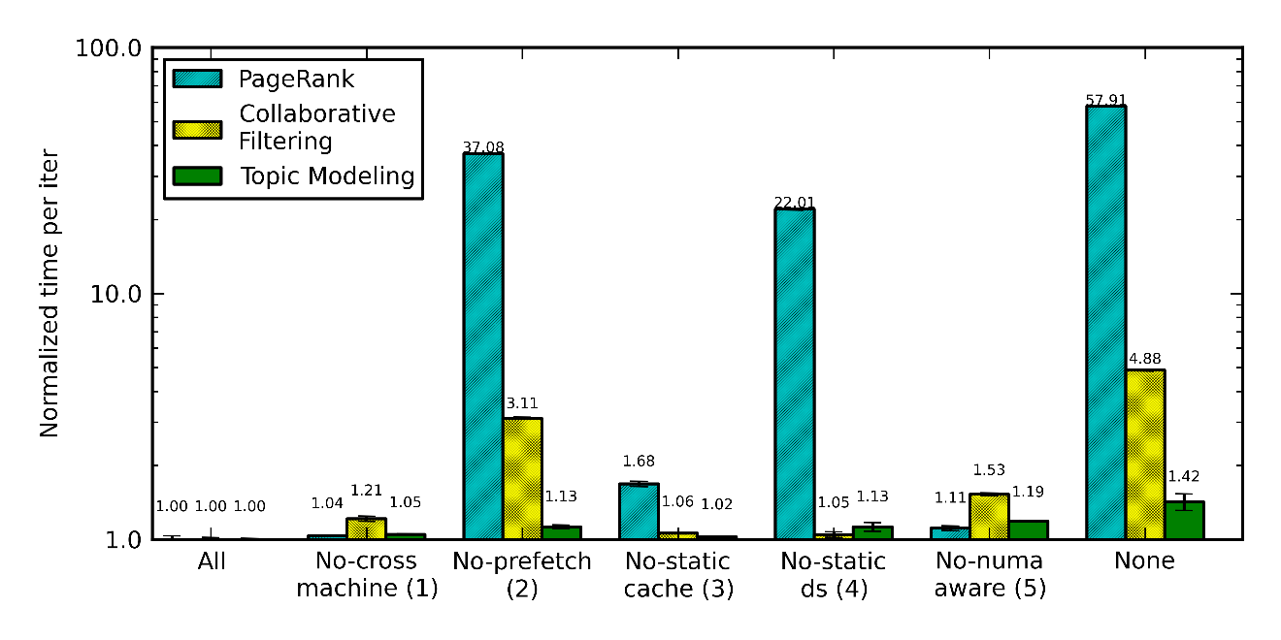
Optimization break down
Turn off one optimization each time
PR: prefetch + static_ds
PR: prefetch + static_ds CF: prefetch + numa_aware
Notes:
I will not go through each of the bars one by one. The important observation here is that different optimizations are most effective for different applications. (HIT) PageRank benefits most from prefetching and static data structures, (HIT) and collaborative filtering benefits most from prefetching and numa-aware memory management.

Slide 34
Sensitivity to information accuracy
Inaccurate information can be caused by
Work migration
Skipped work due to parameter convergence
Experiment method
Keep real operation sequences fixed
Report more operations than performed
Report less operations than performed
Compare normalized time per iteration
No inaccuracy as the baseline
Notes:
We also investigate the behavior of our system when the reported operation sequences from workers are not exactly the same as what they really do for each iteration. For example, when we migrate work from worker A to worker B, worker A will perform less operations than it reported and worker B will perform more operations than reported. Another situation is skipped work. When a worker find some parameters have already converged, it might want to skip the update of these parameters, and that will cause the actual performed operations be fewer than reported. We did experiments to emulate both of these two situations. Here’s how we do that. We keep the real operation sequence of each worker fixed, and for each set up, we make their reported operations be a little different from what they really do. In the first set of experiments, we make them report more operations than performed. In the second set of experiments, we make them report fewer operations than performed. We compare the normalized time per iteration of different settings.

Slide 35
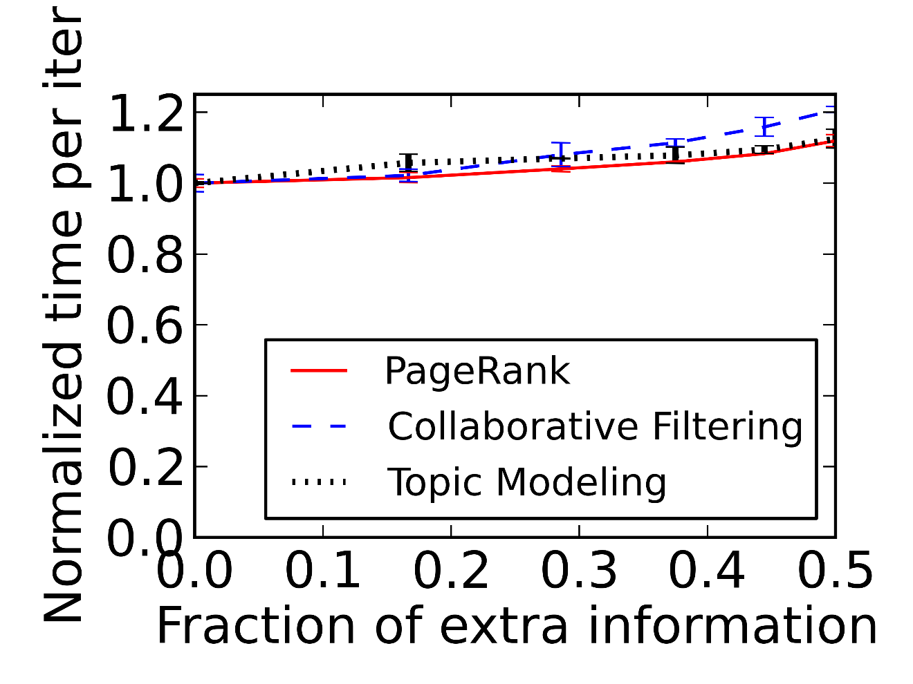
Sensitivity to information accuracy
Report more operations than performed
Can be caused by work migration or skipped work
All are insensitive to extra information
Notes:
In the first set of experiments, we have each worker report more operations than performed, and that can be caused by work migration or skipped work. The x axis is the fraction of extra reported operations. The y axis is the normalized timer per iteration, using no extra information as the baseline, so the ideal value is one. (HIT) With some extra information reported, the applications run only slightly slower, so they are insensitive to false information. That actually answers the question of how our approach works when some parameters already converge. There is almost no hurt if the reported information is more than performed.

Slide 36
Sensitivity to information accuracy
Report less operations than performed
Can be caused by work migration
CF and TM are insensitive to missing information
Notes:
In the second set of experiments, we have each worker report less operations than real. That can only happen if we migrate work. The x axis is the fraction of unreported operations over all operations. The y axis is still the normalized timer per iteration. (HIT) For collaborative filtering and topic modeling, the slow down is tiny, meaning that they are insensitive to missing information.

Slide 37
Conclusion
Many ML applications exhibit iterativeness
Same sequence of operations every iteration
Systems can exploit repeated op sequences
Speed up real ML benchmarks by up to 50x
Two ways of gathering such operation sequence
Better performance when doing virtual iteration
Notes:
To conclude, we find many machine learning applications have the property of iterativeness. That is, they apply the same sequence of operations to the parameter data every iteration. By exploiting these repeated operation sequences, our system could speed up real machine learning benchmarks by up to 50x. We propose two ways of gathering such operation sequences, in the first iteration or in a virtual iteration. We find the performance is better when doing virtual iteration.

Slide 38
References
[Parameter Server] A. Ahmed, M. Aly, J. Gonzalez, S. Narayanamurthy, and A. J. Smola. Scalable inference in latent variable models. In WSDM, 2012.
[LazyTable] H. Cui, J. Cipar, Q. Ho, J. K. Kim, S. Lee, A. Kumar, J. Wei, W. Dai, G. R. Ganger, P. B. Gibbons, G. A. Gibson, and E. P. Xing. Exploiting bounded staleness to speed up big data analytics. In USENIX ATC, 2014.
[GraphLab] J. Gonzalez, Y. Low, H. Gu, D. Bickson, and C. Guestrin. PowerGraph: Distributed graph-parallel computation on natural graphs. In OSDI, 2012.
[Nytimes] http: //archive.ics.uci.edu/ml/datasets/Bag+of+Words.
[Twitter graph] H. Kwak, C. Lee, H. Park, and S. Moon. What is twitter, a social network or a news media? In WWW, 2010.

Slide 39
Backup Slides

Slide 40
Sensitivity to information accuracy
When the actual access is more than reported
Notes:
The first set of experiments measures the case where the actual access is more than reported. We have each worker thread report an incomplete set of their accesses. The x axis is the number of unreported accesses over the total number of accesses. We use the case where all accesses are reported as the baseline, and plot the time per iteration of different configurations in relative to the baseline at the y axis.

Slide 41
IterStore architecture
Process-0
Process-1
App. worker
App. worker
IterStore library
Thread cache
Process cache
Master shard-0
Master shard-1
Partition-0
Partition-1
Key space partitioning
Notes:
And in order to improve the communication throughput, the key space is divided into multiple partitions

Slide 42
IterStore architecture
Machine-0
Machine-1
App. worker
App. worker
App. worker
App. worker
IterStore library
IterStore library
Process cache
Master shard-0
Master shard-1

Slide 43
IterStore architecture
Machine-0
Machine-1
App. worker
App. worker
App. worker
App. worker
IterStore library
IterStore library
Thread cache
Process cache
Master shard-0
Master shard-1

Slide 44
IterStore architecture
Machine-0
Machine-1
App. worker
App. worker
App. worker
App. worker
IterStore library
IterStore library
Thread cache
Process cache
Partition-0
Partition-1
Master shard-0
Master shard-1
Partition-0
Partition-1
Partition-0
Partition-1

Slide 45
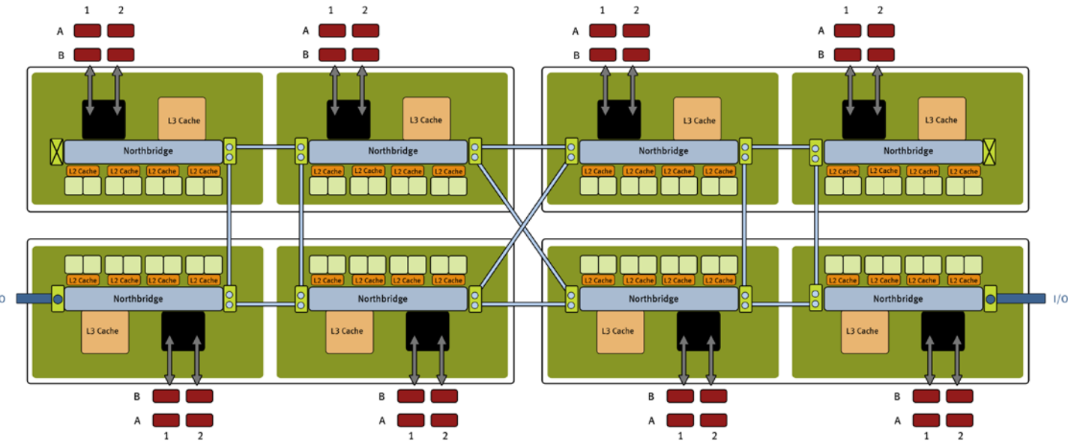
5: NUMA memory management
NUMA zones in multi-socket machines
Lower latency to access memory in local zone
Partition cache and shard structures
Place each partition local to managing threads
Memory in a NUMA zone
Faster to access locally
Notes:
Because most memory allocation work is done at a setup step, IterStore can manage the location of allocated memory to improve performance. For machines with multiple sockets, there is a concept of NUMA zones. The latency is lower for a core to access memory in its local numa zone than a remote one. IterStore partitions the cache and shard data structures, and uses a unique set of communication threads to manage each partition. We place each partition of the data structures local to the managing threads.
I have actually skipped most of the details of our IterStore system and the optimizations, so please read our paper if you are interested in this part.

