Slide 1
Scalable deep learning on distributed GPUs with a GPU-specialized parameter server
Henggang Cui
Gregory R. Ganger and Phillip B. Gibbons
PARALLEL DATA LABORATORY
Carnegie Mellon University
Notes:
In this talk, I will present our work of doing scaling deep learning with a GPU-based parameter server.

Slide 2

Image classification w/ deep learning
Unidentified flying raptor
Eagle? Vulture? Osprey? Accipiter?
Notes:
I will first give some background on deep learning, and I will use image classification as a concrete example.
Suppose we have the picture of an unidentified flying raptor, a UFR. We want to know whether it’s an eagle, a vulture, or an osprey.
This is not an easy task even for humans, but we can teach a machine to do that using deep learning.

Slide 3


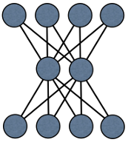


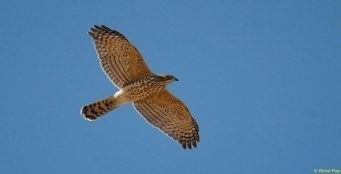
Image classification w/ deep learning
Deep neural network:
interconnected neurons
Eagle
Vulture
read, update
Osprey
Accipiter
Model parameters:
connection weights
(solution)
Machine learning program
Input training data:
images w/ labels
Notes:
To do image classification, we can train a classifier using some training data. The training data is a lot of images with known labels.
(HIT) In deep learning, we use a deep neural network as the classifier, so deep learning is essentially training this deep neural network with a lot of training data.
The neural network consists of some interconnected neurons. (POINT) The first layer of neurons are the pixels of the input image, and the last layer is the predicted label of that image. The neurons in the middle are intermediate states. There is a value associated with each neuron, and each connection here also has a weight associate with it. To react to an image, the network will do a forward pass, from the first layer to the last layer, and activate each neuron by taking the weighted sum of all its connected neurons from the layer below. The topology of this network is predefined, but there connections weights need to be trained, and they are called the parameters of this neural network model.
(HIT) We can learn these parameters from training data, using machine learning. For each training image, we do a forward pass, calculate the predicted labels, compare it will the true label, and then do a backward pass to adjust the connection weights.

Slide 4
Distributed deep learning
Eagle
Parameter server
Vulture
read, update
for GPUs
Osprey
Accipiter
Partitioned
input training data
Distributed
ML workers
Shared
model parameters
Notes:
Because we might have millions of training images, we want the model training to be parallelized over multiple machines. To do that, we can partition the training data, and each worker trains the model on just one partition of the data.
(HIT) Because they train the same model, they will share the model parameters. The workers will need to read and update the shared model parameters concurrently.
(HIT) To make it easy for the machine learning people, people are building systems called parameter servers to manage these shared model parameters for machine learning applications. If you remember the talks earlier this morning about the parameter servers and my talks in previous years on parameter servers. Yes, that’s the parameter server.
(HIT) In this work, we design a parameter server that is specialized for GPUs.

Slide 5
Outline
Background
Deep learning with GPUs
Parallel ML using parameter servers
GeePS: GPU-specialized parameter server
Maintaining the parameter cache in GPU memory
Batch operations for higher throughput
Managing limited GPU device memory
Experiment results
Notes:
Here’s the outline of my talk.
I will first talk about the background of deep learning using GPUs and a most straightforward way of making it parallel, using the traditional parameter server.
Then, I will present our new system, GeePS. It is a parameter server specialized for GPUs.
Finally, I will show you our experiment results.

Slide 6
A machine with GPU device
DRAM
(CPU memory)
...
GPU device
NIC
GPU cores
CPU cores
GPU
memory
(a few GB)
Local
storage
Network
Notes:
People often train neural networks on GPUs. I will first give some backgrounds on GPUs, and I will start with a machine with no GPUs. (POINT) So here, we have some CPU cores, (HIT) and we have a DRAM that can be accessed by the CPUs. (HIT) The machine has a NIC that connects to the network (HIT) and has some persistent storage.
(HIT) Then, here is the GPU device. It is a separate device. (HIT)

Slide 7
A machine with GPU device
DRAM
(CPU memory)
- Large number of small cores
- Single instruction, multiple data
...
GPU device
NIC
GPU cores
CPU cores
GPU
memory
(a few GB)
Local
storage
Network
Notes:
The GPU device has a lot of small cores, and these cores do computations in a single instruction multiple data fashion. So it has potential for large speedups, but we want to use them carefully.

Slide 8
A machine with GPU device
DRAM
(CPU memory)
- Small GPU memory
- Expensive to copy between GPU/CPU mem
...
GPU device
NIC
GPU cores
CPU cores
GPU
memory
(a few GB)
Local
storage
Network
Notes:
One of the limitations of GPU computation is that the GPU cores can only accesses a small piece of separate device memory, and we call it GPU memory. The GPU memory is quite small, only a few gigabytes. We can copy data between GPU memory and CPU memory, but it is very expensive.

Slide 9
Single GPU machine learning
Staging memory
for input data batch
Input data file
train in mini-batches
Input
data
Intermediate
states
Parameter data
CPU memory
GPU memory
Notes:
(POINT) Then I will show you the basic architecture of a GPU machine learning program. Here we have a piece of CPU memory, and a piece of GPU memory. The GPU memory is much smaller than CPU memory. We have a file that stores input training data.
(HIT) The input data can only be read to the CPU memory, and then copied to the GPU memory.
Because the input data is quite large, each time we just train on a small batch of the input data, and then we train the next batch. This is called mini-batching.
(HIT) We store the model parameter values in GPU memory,
(HIT) and it also has some intermediate states, essentially the states of the neurons.

Slide 10
GPU ML on CPU parameter servers
Staging memory
for input data batch
Input data file
Input
data
Intermediate
states
Parameter cache
Parameter server shard 0
CPU memory
GPU memory
Network
IterStore: a CPU Param Server
Notes:
As I have said, we can do machine learning on multiple machines by using a parameter server. Traditional, the parameter servers is CPU-based and knows nothing about GPUs. But we can still use them to host GPU applications, and I will show you how to do that using our previous parameter server system IterStore.
(HIT) (POINT) IterStore runs as a library linked to the machine learning application. Inside IterStore, we shard the parameter data across all machines.
(HIT) In order to reduce network traffic and latency, each machine has a parameter cache that caches one copy of the parameter data locally.

Slide 11
GPU ML on CPU parameter servers
Staging memory
for PS access
Staging memory
for input data batch
Input data file
Sub-optimal
PS throughput
Only works when data fits in GPU memory
Expensive
CPU/GPU
data movement
Input
data
Intermediate
states
Parameter cache
Parameter working copy
Parameter server shard 0
CPU memory
GPU memory
Network
IterStore: a CPU Param Server
Notes:
(POINT) The application will need a piece of memory to store its working copy of the parameter data, for its computation. On every clock, the application will refresh its parameter data from the parameter server.
(HIT) Because IterStore does not understand GPU memory, the application can only read data to some staging CPU memory. Then it copies the data to its GPU memory. This is very expensive and will stall the computation.
The second problem of this approach is that the a CPU-based parameter server cannot fully exploit the performance potential of GPUs.
Also, this setup only works when our data fits in GPU memory. Since GPU memory is very small, it will limit the scale of the problems we can solve.

Slide 12
Outline
Background
Deep learning with GPUs
Parallel ML using parameter servers
GeePS: GPU-specialized parameter server
Maintaining the parameter cache in GPU memory
Batch operations for higher throughput
Managing limited GPU device memory
Experiment results
Notes:
As a result, we design a parameter server that is specialized for GPUs. GeePS allows the application to directly access data through GPU memory. Also, it allows applications to work on problems that do not fit in GPU memory by swapping data to CPU memory in the background.

Slide 13
GPU ML on GeePS
Staging memory
for input data batch
Input data file
Access PS
through GPU memory
Input
data
Intermediate
states
CPU/GPU copy
in the background
Parameter working copy
Parameter server shard 0
Staging memory for parameter cache
Parameter cache
CPU memory
GPU memory
Network
GeePS: a GPU Param Server
Notes:
Here is the structure of our machine learning program that uses GeePS.
(POINT) GeePS keeps the parameter cache in GPU memory, and the application can directly access parameter data through GPU memory.
(HIT) Certainly, we still need to copy data between GPU and CPU memory when we send data through the network. But because it’s inside the parameter server, we can optimize this. We will make this data movement happen less often and do that in the background.
(Moreover, we will have higher parameter server throughput by using GPUs.)

Slide 14
Parallelism w/ batched access
Applications access data in batches
Read_batch
Update_batch
Millions of values in one batch
Allow all GPU cores to execute in parallel
Notes:
To exploit the parallelism of GPUs, GeePS provides an interface that allows the application to read and update parameter data in large batches. One batched access is often millions of values. And these batched read and update operations will be executed by all GPUs and the throughput is much higher than using CPUs.

Slide 15
Outline
Background
GeePS: GPU-specialized parameter server
Maintaining the parameter cache in GPU memory
Batch operations for higher throughput
Managing limited GPU device memory
Experiment results
Notes:
So by keeping the parameter cache in GPU memory, we can perform data movement in the background.
And we provide interfaces for batch operations, so that we have higher data access throughput.
Remember that the GPU memory is quite small and it sometimes limits the scale of problems that we can solve. Next, I will show you how GeePS address this problem.

Slide 16
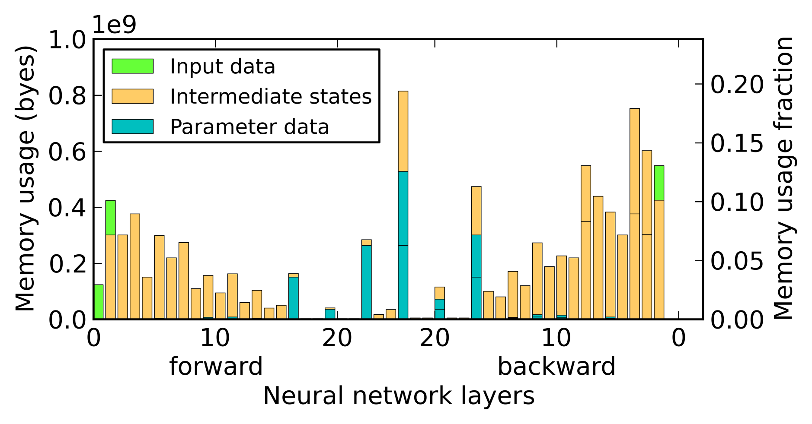
Managing limited GPU memory
Memory usage fluctuation of a neural network
Only 20% of total memory at peak usage
Notes:
First, to motivate this approach. We find for neural network training, the application does not always use all data all the time. Instead, it just uses a small fraction of the data. This graph shows the memory usage of training our neural network. The network has 25 layers, we do one forward pass, from zero to 24 and a backward pass from layer 24 to 0. Each bar here stands for the memory usage of that layer. We find that even at the peak usage, (POINT) we use only 20% of all data, so that we can hopefully swap the rest 80% data out to CPU memory.

Slide 17
Managing limited GPU memory
Staging memory
for input data batch
Input data file
App has its own buffer
Input
data
Intermediate
states
Parameter working copy
Parameter server shard 0
Staging memory for parameter cache
Parameter cache
CPU memory
GPU memory
Network
Notes:
We use GeePS to manage the GPU memory and swap data to CPU memory if necessary. I will first talk about how do we get control of all the GPU memory, and then I will talk about how do we manage these memory.
Back to our system diagram. (POINT) The application has a piece of memory that stores a working copy of the parameter data. It needs that for its computation.
(POINT) Each time the application makes parameter server calls, it gives us the pointer to this piece of memory as the buffer.
But we don’t want to do that. We don’t want the application to use its own buffer.

Slide 18
GeePS-managed buffers
Staging memory
for input data batch
Input data file
GeePS manages all buffers
Input
data
Intermediate
states
Access
buffer pool
Parameter server shard 0
Staging memory for parameter cache
Parameter cache
CPU memory
GPU memory
Network
Notes:
(SLOW) So we let the application get rid of parameter data working copy memory. (POINT) We will provide some memory for the application to use.
GeePS will maintain a pool of access buffers. Each time the application reads the data, GeePS will allocate a buffer from the buffer pool and copy the parameter data to the buffer, and give the application the pointer to the buffer.

Slide 19
Interface to GeePS-managed buffer
Read
Buffer “allocated” by GeePS
Data copied to buffer
Post-read
Buffer reclaimed
Pre-update
Buffer “allocated” by GeePS
Update
Updates applied to data
Buffer reclaimed
Notes:
Here is the list of our interfaces to the GeePS managed buffers. I just talked about reads. Post-read is for after the application finishes using the read buffer, it will call post-read to release the buffer.
Similarly, when the application updates data, it first request a buffer by calling pre-update. And when it has the updates ready in the buffer, it calls update, and GeePS will apply the updates and reclaim the buffer.

Slide 20
GeePS manages local data also
Memory usage fluctuation of a neural network
Intermediate states consume most memory
Notes:
Now the application does not have its own memory to store parameter data any more. (POINT) But we find the intermediate states actually consumes more memory. So GeePS should manage these intermediate states also.

Slide 21
GeePS manages local data also
Staging memory
for input data batch
Input data file
Input
data
Intermediate
states
Access
buffer pool
Parameter server shard 0
Staging memory for parameter cache
Parameter cache
CPU memory
GPU memory
Network
Notes:
(POINT) Here, the application has memory for its input data and intermediate states.

Slide 22
GeePS manages local data also
Staging memory
for input data batch
Input data file
Access
buffer pool
Local data
Parameter server shard 0
Staging memory for parameter cache
Parameter cache
CPU memory
GPU memory
Network
Notes:
GeePS encourages the application to store its input data and intermediate data also in the library. (POINT) Because GeePS does not distinguish input data and intermediate states, so we just call them local data here.
The application will tell us that these data is local, so that we don’t need to send them to other machines.
Now, we finally have all GPU memory managed by GeePS. How is the memory managed then?
The application will tell us how much GPU memory we are supposed to use. And if we find the GPU memory is not large enough to store everything, we will store some of the data in CPU memory.

Slide 23

Swapping data to CPU memory
Staging memory
for input data batch
Input data file
Local data
(CPU part)
Access
buffer pool
Parameter cache
(CPU part)
Pinned local data
Parameter server shard 0
Staging memory for parameter cache
Pinned param cache
CPU memory
GPU memory
Network
Notes:
Here’s how we do it. Suppose the size of the parameter data and local data become larger than our GPU memory. We divide the parameter cache and local data into two parts, a part that is pinned in GPU memory, and a part that is in CPU memory.
(POINT) The pinned local data and pinned parameter cache was there in the previous slide also, and these two CPU part data is newly added. We will try to pin as much data as possible in GPU memory, and we put the rest in CPU memory. We will copy them to the access buffer when they are used.
(SLOW) You can understand the GPU memory as a special kind of cache. The GPU part of the local data and parameter cache are entries that are pinned in the cache. The access buffer pool is used for GeePS to copy data back and forth between GPU memory and CPU memory.

Slide 24
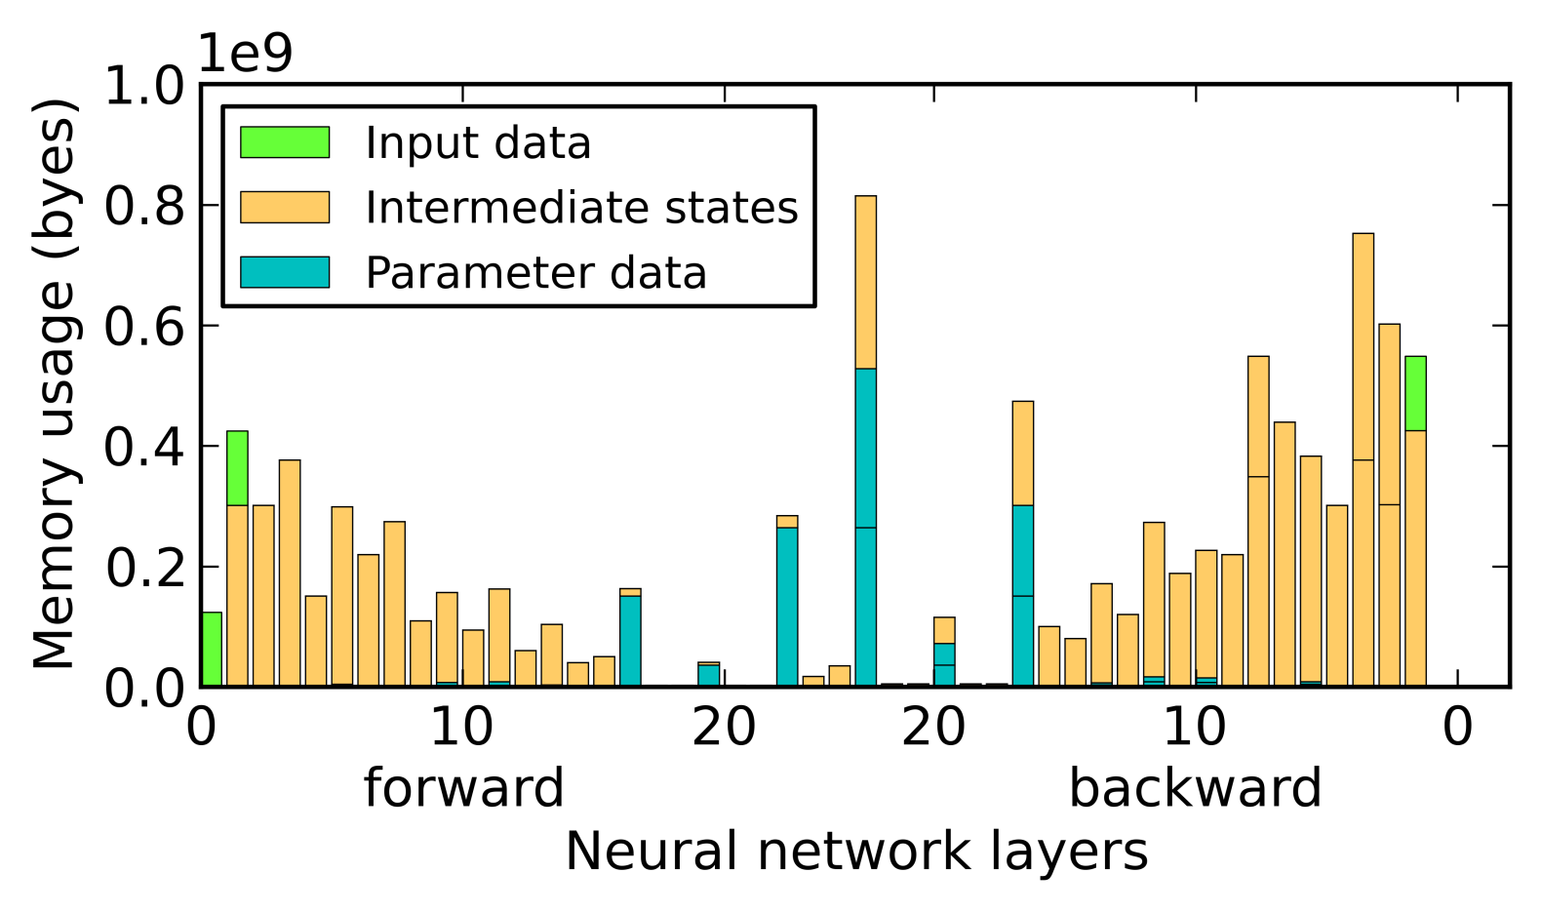
Data placement policy
- The set of data entries used by the app is known
- Can gather such info from iterative ML apps ^{[iterstore]}
Notes:
Now I will show you how we decide which data do we pin in GPU memory. First, we assume that we know the access pattern of the application, essentially this graph, because previous work show that it’s easy to get such information from iterative machine learning applications, including our neural network one.
(POINT) If we look at those bars more carefully, you might probably notice that each bar is divided into multiple segments. Each segment is a batch of data that is accessed the application. We pin data in GPU memory in the unit of data batches.

Slide 25
Data placement policy
GPU memory
peak
Access
buffer
- Access buffers need to be in GPU memory
- Must be big enough for peak memory usage
- Local data kept in GPU memory needs no access buffers
Notes:
We will start with everything in CPU memory. In that case, (POINT) we will only have the access buffer pool in GPU memory, because we will use the access buffer pool to move data back and forth between GPU memory and CPU memory. The size of this buffer pool needs to be at least big enough to store all actively used data at the peak memory usage.
In our implementation, if the local data is pinned in GPU memory, they do not take any access buffer space. But for the parameter data, because they are not local, they still need to go through the access buffer.
(Moreover, keeping them in GPU memory can save us the work of copying them.)

Slide 26
Data placement policy
GPU memory
peak
Access
buffer
- Pin as much local data as can in GPU memory - Select local data that causes peak usage
Notes:
So as our policy, we will first pin the local data in GPU memory. We will choose the local data that is (POINT) at peak memory usage and pin it in GPU memory.

Slide 27
Data placement policy
GPU memory
to GPU memory
Intermediate states
Access
buffer
(smaller)
Pin as much local data as can in GPU memory Select local data that causes peak usage
Notes:
(POINT) So, we will pin this piece of data in GPU memory. It is some intermediate states. After we pin it in GPU memory, (POINT) we can reserve a smaller space for the access buffer now.

Slide 28
Data placement policy
GPU memory
next peak
Intermediate states
Access
buffer
(smaller)
- Keep moving local data to GPU memory
Notes:
(POINT) We will keep doing that. To pin more local data in GPU memory.

Slide 29
Data placement policy
GPU memory
next peak
Intermediate states
Access
buffer
(smaller)
- Keep moving local data to GPU memory
- If still have space, put parameter data
Notes:
When we have pinned all local data in GPU memory and if we still have space, (POINT) we will start to pin some parameter data in GPU memory, until there is no more space.

Slide 30
Data movement in background
Read/update with two background threads
Allocator for read and pre-update
Reclaimer for post-read and update
Overlap data movement with computation
Notes:
So now, some data is pinned in GPU memory, and some data is still in CPU memory. When the data is in CPU memory, we need to perform expensive data movement to access the data in CPU memory.
In order not to stall the useful computation work of the application, GeePS is able to perform the data access in the background. Here’s how we do that. We have two background threads. The allocator thread performs the read and pre-update operations, and the reclaimer thread performs the post-read and update operations. This design allows us to overlap data movement with computation.

Slide 31
Outline
Background
GeePS: GPU-specialized parameter server
Maintaining the parameter cache in GPU memory
Batch operations for higher throughput
Managing limited GPU device memory
Experiment results
Notes:
So, using GeePS, we can handle problems that do not fit in GPU memory by maintaining the GPU memory as a cache.
Next, I will show you our experiment results.

Slide 32
Experimental setups
Cluster information
Each machine has
one Tesla K20C GPU with 5 GB GPU memory
Machines connected with 40 Gbps Ethernet
Neural network implementation
Caffe: single-machine GPU deep learning system
Use GeePS to store param and local data
Image classification dataset
ImageNet: 14 million images with 22,000 classes
Neural network size
25 layers, 2.4 billion connections
Notes:
We use a cluster of GPU machines, each has 5 gigabytes of GPU memory.
We use an existing single machine deep learning implementation, called Caffe. And we use GeePS to store both the parameter data and local data for Caffe.
We run the image classification task, using the full ImageNet dataset, with 14 million images labeled into 22 thousand classes.
The neural network we use has 25 layers and 2.4 billion connections. We try to use the same neural network as the ProjectAdam paper used. But we are not able to get all the details of their network. But at least, the network that we use has the same number of layers and same number of connections as the one ProjectAdam uses. So at least the training throughput is relevant.

Slide 33
System baselines
Single GPU worker
The original unmodified Caffe
GPU workers with CPU-based parameter server
Caffe linked with IterStore
CPU workers with CPU-based parameter server
ProjectAdam (reported numbers from OSDI’14)
Notes:
We compare our performance with three classes of systems.
First, we compare with the original unmodified Caffe.
Second, we use a CPU-based parameter server IterStore.
Third, we compare with the reported numbers of ProjectAdam from their OSDI paper. The ProjectAdam system uses CPU workers and CPU parameter servers.

Slide 34
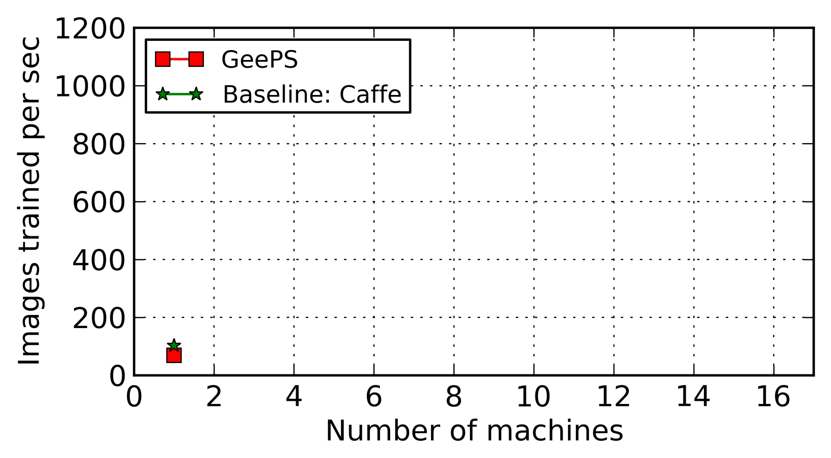
Training throughput
Initial overhead for keeping data in GeePS
Notes:
We first compare the training throughput. The Y axis is the number of images that we can train in one second, and the X axis is the number of machines we use.
When we use one machine, GeePS is slightly slower than Caffe, because it has some initial overhead of storing data in the parameter server.

Slide 35
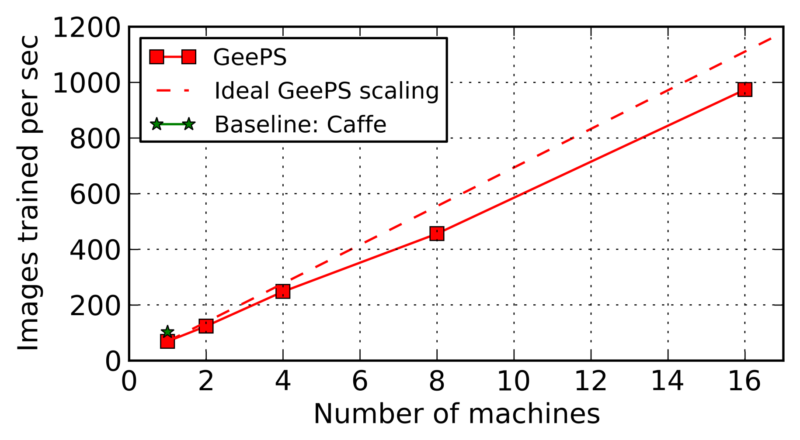
Training throughput
- GeePS scales close to linear with more machines
- With 16 machines, GeePS runs 9.5x faster than Caffe
Notes:
When we use more machines, GeePS scales almost linearly. The dash line here is the idea line. When we use 16 machines, GeePS runs 14 times faster than its own single machine setup, and nearly 10 times faster than Caffe, the optimized single machine system.

Slide 36
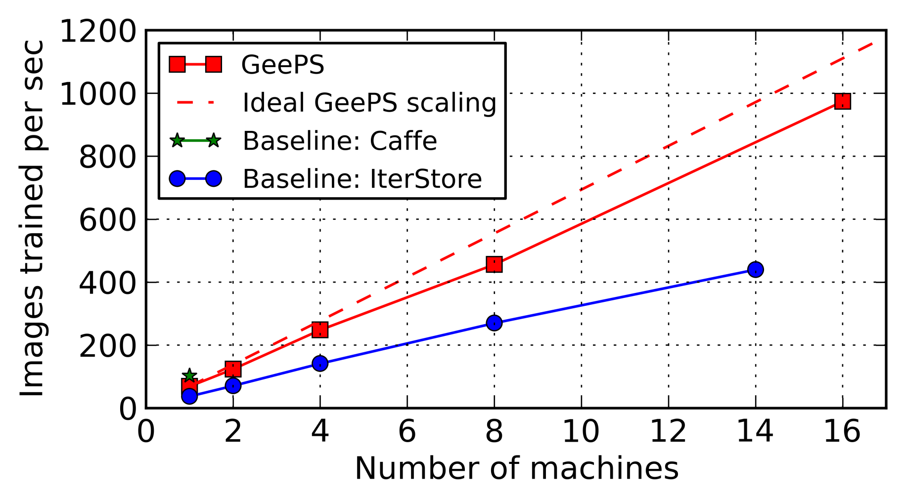
Training throughput
70% more throughput than IterStore
Notes:
Then we compare to IterStore, the CPU-based parameter server, GeePS is about 2 times faster.

Slide 37
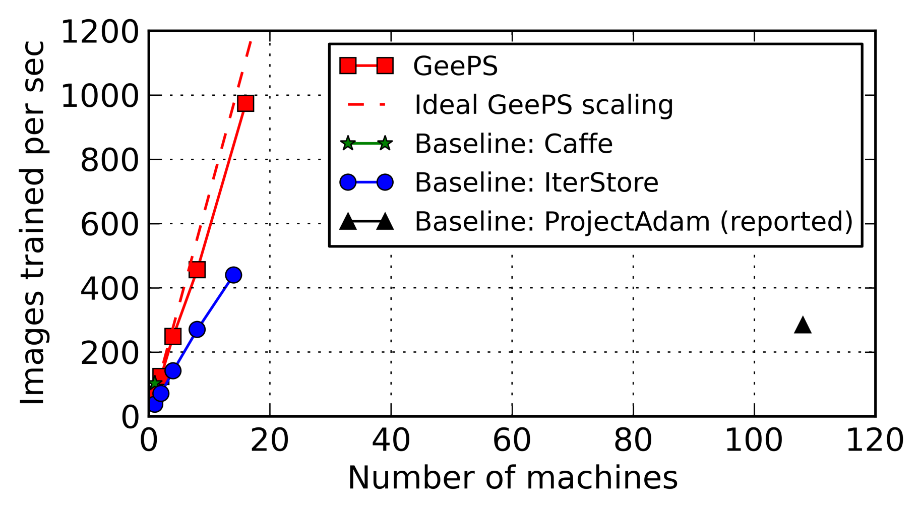
Training throughput
4 machines
108 machines
- GeePS with 4 machines close to ProjectAdam with 108
Notes:
Then we compare with the reported numbers of ProjectAdam.
They report that they train about 300 images per second using a hundred and eight machines, while GeePS needs just a little more than four machines to reach the same throughput.
That is because we use GPUs, and the computation runs much faster on GPUs.

Slide 38
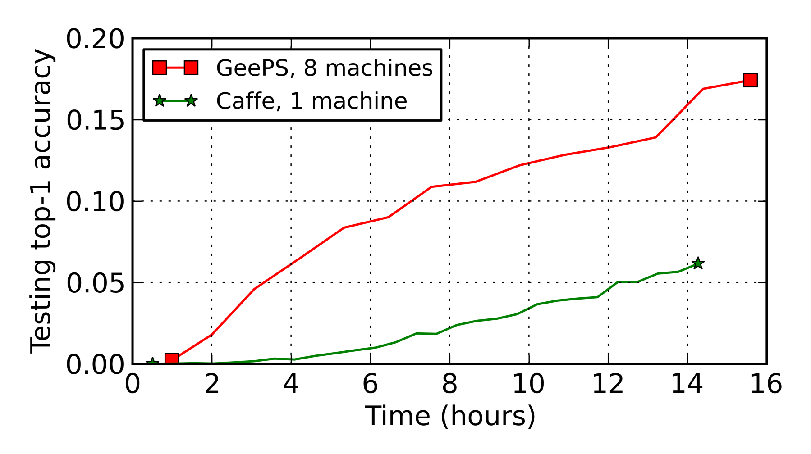
Image classification accuracy
To reach 5% classification accuracy:
Caffe needs 12.2 hours
GeePS needs only 3.3 hours (3.7x speedup)
Notes:
Our throughput scales pretty well. But the throughput itself doesn’t say how good we speed up machine learning. The real measure is how quickly you can move toward good solution.
So, we compare the classification accuracies. The Y axis here shows the classification accuracy. It is defined as the fraction of the testing images that are correctly labeled by the model. The X axis is the run time.
We run GeePS on 8 machine, and Caffe on one machine. To compare the performance, we compare how long does each of them take to reach the same accuracy, which is 5 percent here.
Caffe needs 12 hours, while GeePS needs only 3 hours. It is about 4 times speedup.

Slide 39
Image classification accuracy
- ProjectAdam with 58 machines reach 13.6% in one day
- GeePS with 8 machines spends only 12.6 hours
Notes:
The ProjectAdam paper reports that they get 13.6 percent accuracy in one day using 58 machines. GeePS spends only 12 hours using 8 machines, because the computation runs much faster on GPUs.

Slide 40
Managing GPU memory
Memory usage fluctuation of the neural network
Same figure as shown before
Notes:
Next, I will show how well can we manage the GPU memory. The memory usage graph of this neural network is the same as the one I have shown before. And I will use the memory management policy that I described before.

Slide 41
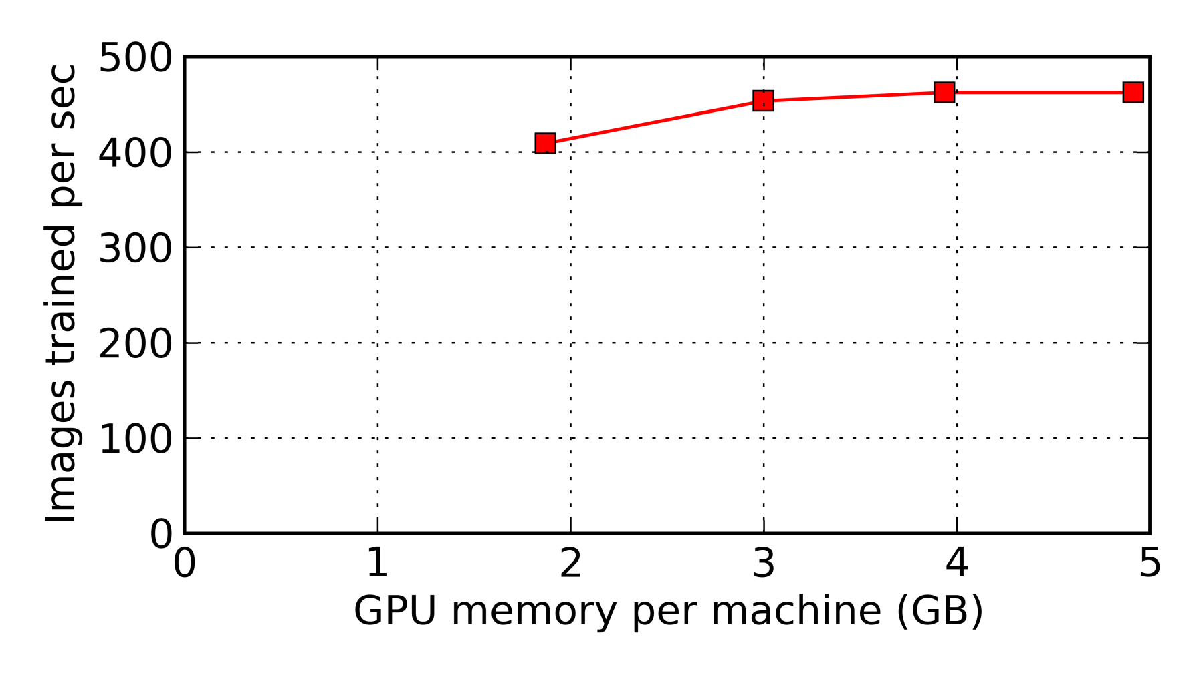
Throughput vs. memory budget
All data in GPU memory
Only buffer pool in GPU memory
Twice the peak size for double buffering
- 88% of the original throughput with 38% memory usage
- Can do 2.5x bigger problems with little overhead
Notes:
We measure the image training throughput when we assign different amount of GPU memory for GeePS to use. The X axis here is the GPU memory budget, and the Y axis is the throughput. The rightmost point is when everything is in GPU memory. The leftmost point is the case we store all parameter data and local data in CPU memory, and we make the buffer pool twice the size as the peak memory usage for double buffering.
Comparing these two points, we get about 90 percent of the throughput when we use only 40 percent of the GPU memory.
This result means that we can do 2.5 times bigger problems using GeePS, with little overhead.

Slide 42
Conclusion
GPU-specialized parameter server for GPU ML
10x throughput speedup using 16 machines
About 2x faster compared to CPU-based PS
Managing limited GPU memory
By managing all GPU memory inside GeePS
Swap data to CPU memory if necessary
Can handle 2.5x larger problems with low overhead
Enable use of data-parallel PS model
Notes:
In conclusion, we design a GPU-based parameter server for GPU machine learning applications.
It provides about 10 times throughput speedup using 16 machines, and is about 2 times faster than a CPU-based parameter server.
It is able to efficiently manage the limited GPU memory, by managing all GPU memory inside GeePS and swapping data to CPU memory if necessary. When we put data in CPU memory, it can get handle 2.5 times larger problems with low overhead.
All while, it maintains an easy-to-use data parallel parameter server model.

Slide 43
References
[IterStore] H. Cui, A. Tumanov, J. Wei, L. Xu, W. Dai, J. Haber-Kucharsky, Q. Ho, G. R. Ganger, P. B. Gibbons, G. A. Gibson, and E. P. Xing. Exploiting iterative-ness for parallel ML computations. In ACM SoCC, 2014.
[ProjectAdam] T. Chilimbi, Y. Suzue, J. Apacible, and K. Kalyanaraman. Project Adam: Building an efficient and scalable deep learning training system. In USENIX OSDI, 2014.
[Caffe] Y. Jia, E. Shelhamer, J. Donahue, S. Karayev, J. Long, R. Girshick, S. Guadarrama, and T. Darrell. Caffe: Convolutional architecture for fast feature embedding. arXiv preprint arXiv:1408.5093, 2014.
[ImageNet] J. Deng, W. Dong, R. Socher, L.-J. Li, K. Li, and L. Fei-Fei. Imagenet: A large-scale hierarchical image database. In IEEE CVPR, 2009.

Slide 44
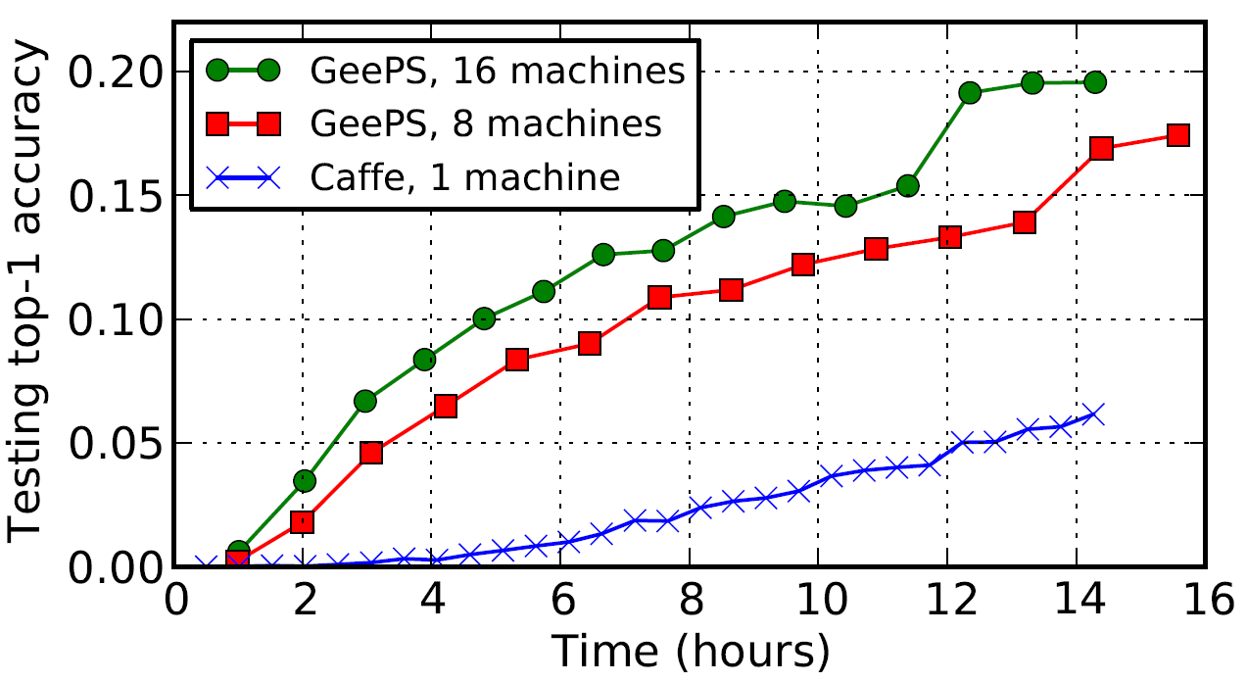
Accuracies

Slide 45
Additional related works
A. Krizhevsky, I. Sutskever, and G. E. Hinton. Imagenet classification with deep convolutional neural networks. In NIPS, 2012.
J. Dean, G. Corrado, R. Monga, K. Chen, M. Devin, M. Mao, A. Senior, P. Tucker, K. Yang, Q. V. Le, et al. Large scale distributed deep networks. In NIPS, 2012.
C. Szegedy, W. Liu, Y. Jia, P. Sermanet, S. Reed, D. Anguelov, D. Erhan, V. Vanhoucke, and A. Rabinovich. Going deeper with convolutions. arXiv preprint arXiv:1409.4842, 2014.
R. Wu, S. Yan, Y. Shan, Q. Dang, and G. Sun. Deep image: Scaling up image recognition. arXiv preprint arXiv:1501.02876, 2015.
A. Coates, B. Huval, T.Wang, D.Wu, B. Catanzaro, and N. Andrew. Deep learning with cots hpc systems. In ICML, 2013.

Slide 46
Backup Slides

Slide 47
Managing limited GPU memory
Why?
GPU memory is much smaller than main memory
5 GB for our Tesla K20C GPU
Swap data to CPU memory when necessary
Notes:
\To address this problem, GeePS is able to swap data to CPU memory when necessary.

Slide 48
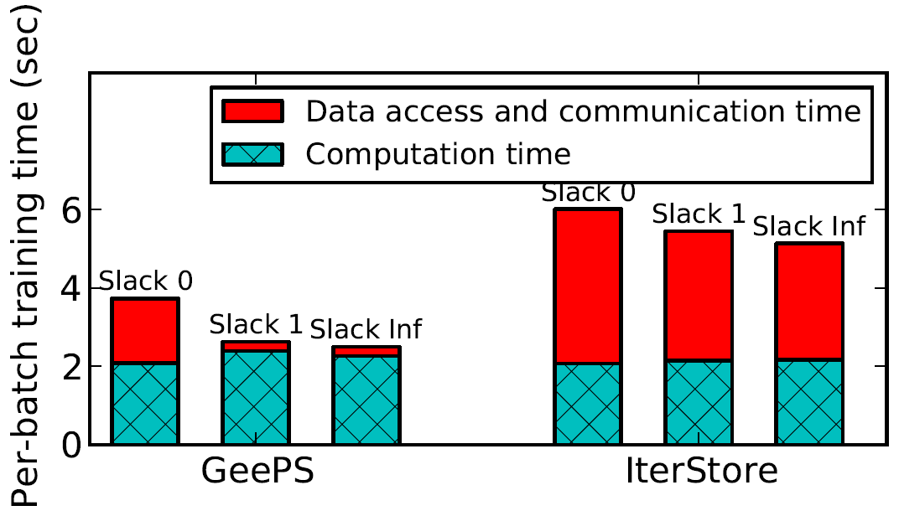
Computation vs. comm. times

Slide 49
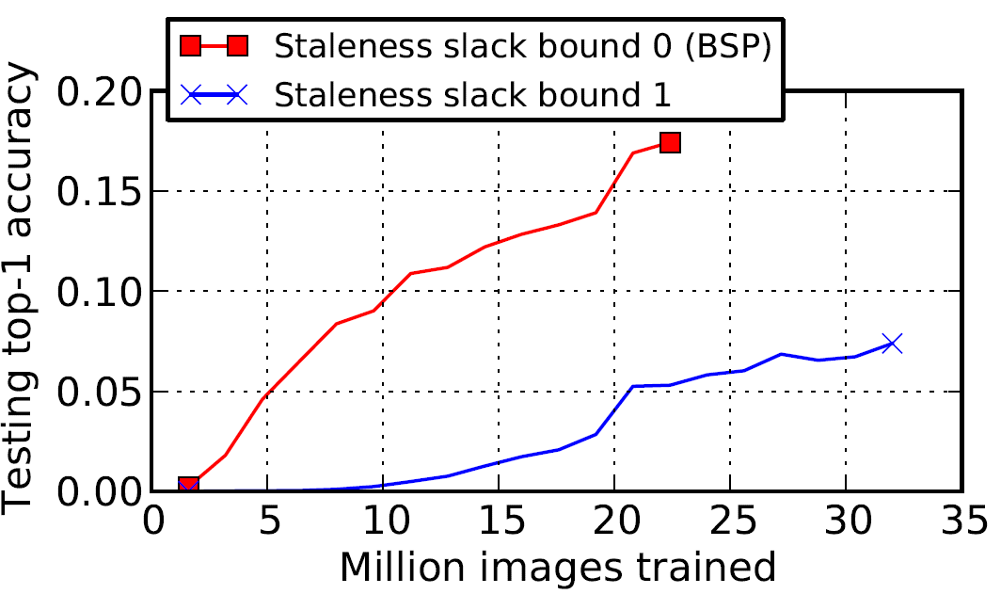
Convergence of Slack 1 vs. Slack 0

Slide 50
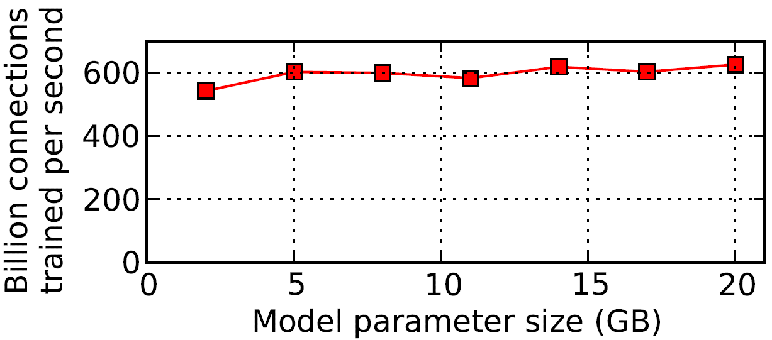
Larger models

Slide 51
Fully connected layer
Label probs
Connection weights
Fully connected layer
Intermediate states
Convolutional layer
Image pixels
Input layer

