Slide 1

Using Data Transformations for
Low-latency Time Series Analysis
Henggang Cui (CMU)
Kimberly Keeton, Indrajit Roy, Krishnamurthy Viswanathan (HP Labs)
Gregory R. Ganger (CMU)
PARALLEL DATA LABORATORY
Carnegie Mellon University
Notes:
I am Cui from CMU. In this talk, I will present our work about doing efficient data analytics on time series data. The approach that we take here is to do data transformations when the data is uploaded to the database, and we do analytics on the transformed data. This is a joint work with my colleagues in HP Labs.

Slide 2


Time series data analytics
Time series data
e.g., temperatures
Analytical queries
e.g., search for correlation
temperature
2015
2000
2001
2002
correlated
year
2000
2001
2002
Time Series Database
Notes:
I will first describe the class of data analytics problems that we are handling here.
We are targeting at time series data. Time series data is series of data that is indexed by time. For example, if we record the daily temperatures of a city for a year, they are time series data.
(HIT) We often store the time series data in the database, which is often a specialized time series database.
So what do we do with the data?
(HIT) Besides just reading the data from the database, we want to do analytics on the data.
For example, we might be interested in finding out in which year, the temperatures are most similar to this year.
The similarity of two time series is often defined by their correlation.
The latency of doing an analytical query is defined as how soon the user gets the result after he issues the query.

Slide 3
Goals and previous approaches
Goals
  Low latency queries
    Sub-second latency for interactive queries
  Handle large data size
    Queries on both recent data and historical data
Previous approaches
  Archive data in compact forms [e.g., Cypress]
    But, does not provide for low-latency interactive queries
  Keep/use only recent data [e.g., Scuba]
    But, excludes use of historical data
  Provide approximate results via sampling [e.g., BlinkDB]
    But, not for recent data or complex analytics
Notes:
The goal of our work is to do data analytics on time series data with low latency. For interactive queries, users often need the latency to be less than a second. Also, we want to handle large amount of data, so that we can do analytics on both recent data and historical data.
Previous approaches cannot achieve our goals. They either fail to provide low latency or they limit analytics queries
to using either only the recent data or only historical data.

Slide 4
Data transformations at ingest
Ingest-time transformation
DataTransform
Ingest
Transformed data
(e.g., freq domain representation)
Query
Raw Data
Query-time processing
Notes:
The approach that we take is to transform the data when it’s ingested to the database.
In the traditional approach, people store the raw data in the database and they do analytical queries on the raw data. This approach is not efficient when the data size is large. (HIT) We should transform the data. The transformation here can be any types of data preprocessing. For example, it can be simple summaries like taking the maximal and minimal values of a range, or it can be more sophisticated ones, like frequency domain transformations. We will keep both the raw data and transformed data in the database. When the user asks a query, our query engine will pick the most suitable data to use. It’s very likely to be the transformed data.

Slide 5
Data transformation examples
Wavelet transform for temperature data
  Frequency domain representation
  Can calculate correlations directly from it
  Data ranges can be approximated with few coefficients
    Much smaller than raw data w/ small amount of error
Other transformations implemented
  Count-min sketch, ARMA model fitting, FFT, etc.
they are sparse
Temperatures
Wavelet coefficients
Notes:
In this talk, I will use wavelet transform on temperature data as the example. Wavelet is a frequency domain representation of timeseries data. It is similar to Fourier transform. It is suitable for finding correlations, because we can calculate the correlation of two data ranges directly from their wavelet coefficients. Moreover, the wavelets are often sparse, that is most coefficients are zero or close to zero, so that we can approximate a range of timeseries data with just a few large wavelet coefficients. So compared to using the raw data, it is a lot faster to read the wavelets and do calculations on the wavelets.
Besides wavelet transform, we also have many other use cases with other interesting transformations, such as count-min sketch and ARMA model fitting. But I will not cover them in this talk, and please read our paper for more details.

Slide 6


Aperture
Timeseries DB with ingest-time transformation
  User defined ingest-time transformations
  Answer queries using transformed data
(same diagram)
Ingest-time transformation
Ingest
DataTransform
Transformed data
(e.g., freq domain representation)
Query
Raw Data
Query-time processing
Notes:
We implemented our ingest-time transformation design in our prototype system, called Aperture.
Aperture is a timeseries database. It allows users to define ingest-time transformations, and it can answer queries using the transformed data.
Next, I will describe each of the two parts.

Slide 7
Ingest-time transformations
Transform ingested data for every window
  Window is a range of rows
Generate and store windows of transformed data
Temperature table
Wavelet table
city | date | value
PGH | 1/1/2000 | 35.2
PGH | 1/2/2000 | 36.3
... | ... | ...
PGH | 12/31/2000 | ...
... | ... | ...
city | date | wavelets
PGH | 1/1/2000 | <wavelets>
... | ... | ...
wavelet transform:
window size: 1 year,
error bound: 10%
Notes:
Users can define transformations in our framework. The input of each transformation is one window of input rows, and the output is one window of transformed rows. Here I will use our temperature data as an example. As shown in the lefthand side, we have some temperature data. We use the city name and date as the key, and we use another value column to store the temperatures.
(HIT) Suppose we want to do a wavelet transform, with window size being a year, our system will group every one year of data as the input window and give it to a specified user defined function. That user defined function will calculate the wavelet coefficients of that window, and keep only the large coefficients as the output, within a given error bound.

Slide 8
Ingest-time transformations
Chained transformations
  E.g., data cleansing then wavelets
Multiple versions of transformed data
  E.g., with different error bounds or window sizes
Wavelet (<5%err)
DataCleanse
Wavelet (<10%err)
Wavelet (<20%err)
Raw
Cleansed
Wavelets
Notes:
Our system provides several features that enable more sophisticated use cases. Here I will describe two of them.
(HIT) First, the users can chain multiple transformations together. For example, they can cleanse the data before doing the wavelet transform.
(HIT) Second, in order to satisfy the requirements of different queries, we encourage users to keep multiple versions of transformed data, with different error bounds or different window sizes. Often, the transformed data with higher error bounds are more compact. If the query can tolerate that error, it can be answered with a lower latency with the more compact data.

Slide 9
Query processing
Workflow of analytical query tasks on raw data
1. fetch data from DB
2. calculation
DB query
result
data
Notes:
Next, I will describe how the queries use the transformed data in our system. I will start with the basic workflow of an analytical query that uses only the raw data. First, based on the use case, we write a database query, and we fetch the data from the database. Then, we do some analytical calculations on the data.

Slide 10
Query processing
Analytical query tasks using transformed data
DB query
1. choose transformation
2. translate query
3. fetch data from DB
(much faster)
4. calculation
(much faster)
translated query
transformed data
(much smaller)
result
Notes:
So how do we use the transformed data?
(HIT) First, we need to choose a transformation, based on the how much error we can tolerate.
Then, we translate the database query from the original one to a query using the transformed data.
(HIT) Then we fetch the transformed data from the database. Because the transformed data is smaller, so it’s faster to fetch the transformed data. When we do calculations on the transformed data, it is also faster.
Our system provides a set of helper functions that help users to choose transformations and to translate queries.

Slide 11
Choosing transformation
Based on user-defined utility functions
If (not func == wavelet): utility = 0
If (window_size > 1 year): utility = 0
If (error_bound > 10%): utility = 0
utility = window_size * error_bound
6 versions of wavelet transformed data
10 years
Window size
1 year
5%
10%
20%
Error bound
Notes:
In this talk, I will only describe the choosing transformation part.
The users specify their preference on transformations using a utility function.
Here I will use wavelet transform example again. Suppose we have 6 versions of wavelet transformed data, with different window sizes and error bounds. We can see that the ones with larger error bounds are smaller in size.
And we have a utility function. The utility function picks the wavelet transform, and requires the window size to be no more than a year, (HIT) so we rule out three of the transformations. And it requires the error bound to be no more than 10%, (HIT) then we rule out another one. For the two options left, (HIT) we choose the one with a larger error bound and window size, because it is smaller. It is more compact

Slide 12
Aperture implementation
Implemented on top of LazyBase ^{[Cipar et} ^{al., Eurosys’12]}
1. Receive
2. Sort
3. MergeSort
Client
upload
Sorted
upload
DB file
Notes:
Next, I will briefly describe the implementation of our system. We implement Aperture on top of an existing database developed in HP Labs, called LazyBase. The ingestion pipeline of LazyBase has three stages. First it receives the data from the client, then it sorts the received data, and finally it merges the newly received data with the previously stored data.

Slide 13
Aperture implementation
Implemented on top of LazyBase ^{[Cipar et al., Eurosys’12]}
  Extend Sort stage to Sort+Transform
Raw data
2. Sort+
Transform
1. Receive
3. MergeSort
Client
upload
Transformed data
Notes:
We implemented our approach by taking advantage of this pipeline. We extend the sort stage to transform the data after the sorting. So the output of the extended sort plus transform stage will contain both the raw data and the transformed data.

Slide 14
Evaluation setup
Hardware information
  HP ProLiant DL580 machines, each with
    60 Xeon E7-4890 @2.80GHz cores
    1.5 TB RAM
    Running Fedora 19
  One machine for the results in this talk
  Multiple machines for scalability experiments
Notes:
Next, I will show you our experiment results.
We run our experiments on the HP proliant servers, each with 60 cores and 1.5 terabytes memory. We use one machine for the experiments that I show here in this talk, but we use multiple machines for our scalability experiments.
(Database files kept in in-memory file system
Because this machine has 1.5 terabytes memory, we keep our database files in an in-memory file system in our experiments.)

Slide 15
Evaluation: correlation search
Dataset
  Climatic data from National Climatic Data Center
  Daily temperature, dew point, and wind speed from hundreds of stations since 1930s
Table schemas
  {metric, station, date, value}
  350 million rows in total
Testing query task
  Given 10 years of temperature data in station X
  Find all data series with correlation > 0.8
Notes:
In this talk, I will only show you the results of the correlation search use case. That is the one that I have been using throughout the talk as the examples. We use a dataset from national climatic data center. It contains daily temperature, dew point, and wind speed records from hundreds of stations.
(HIT) We store the data in the following table schema. We use metric name, station name, and date as the key, and we use another column to store the values. And there are 350 million rows in total.
(HIT) We evaluate the query performance using the following query task. We randomly pick one station and randomly pick 10 years of temperatures in that station, and we search for all ranges of 10 years with correlations larger than 0.8, from all metrics and all stations.

Slide 16
Data transformations
Only 4% overhead on ingestion throughput
Raw
Cleansed
Wavelet x6, with
- window size: 1 month and 1 year
- error bound: 5%, 10%, and 20%
Notes:
To speed up the query, we do the following transformations.
First, we cleanse the data. Then we do six wavelet transforms, with different window sizes and error bounds.
In our experiments, the ingestion throughput with these transformations added is only 4% lower compared to using no transformations. So doing these transformations has only minimal overhead on the ingestion throughput.

Slide 17
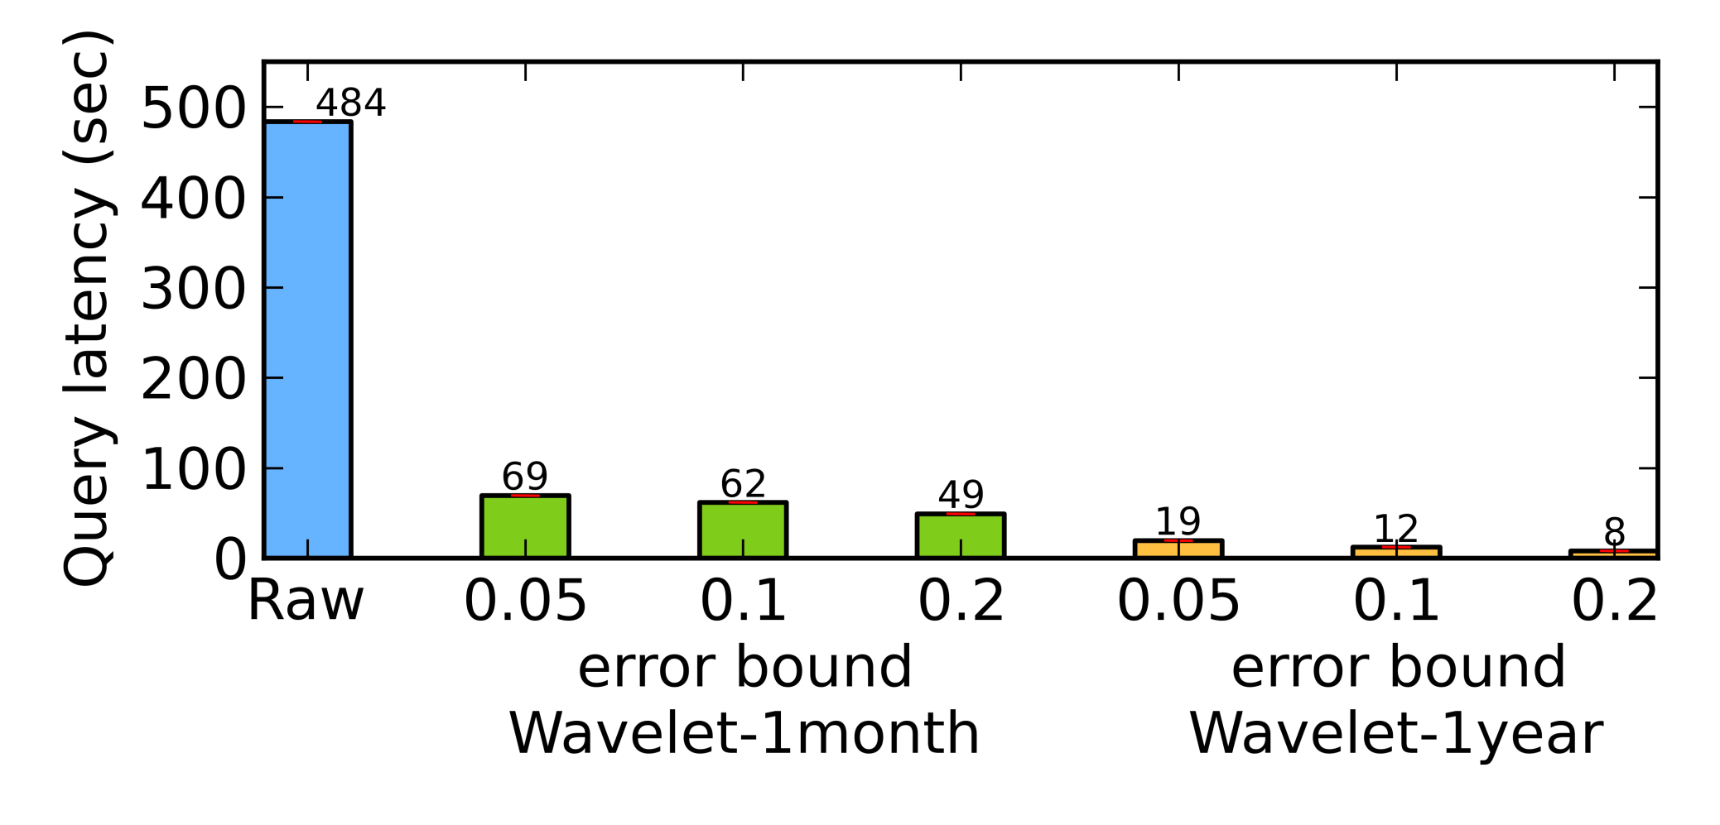
Query latencies
Lower latencies when using
larger granularities or error bounds
50x reduction
Notes:
Then, I will show you the latencies of our testing query task. The latency here includes both the time to fetch the data from the database and the time to calculate the correlations.
Although our query engine is able to select the most suitable transformed data to answer the query, we still show the latencies of using different versions of transformed data. This helps us know how the error bound and window size affect the latency.
The blue bar shows the latency using the raw data. The three green bars are wavelets with one month window and three different error bounds, from 5% to 20%. The three shorter orange bars are wavelets with one year window.
We see that when we use larger windows or error bounds, we get lower query latencies. And compared to using the raw data, we can get about 50x reduction in query latency.

Slide 18
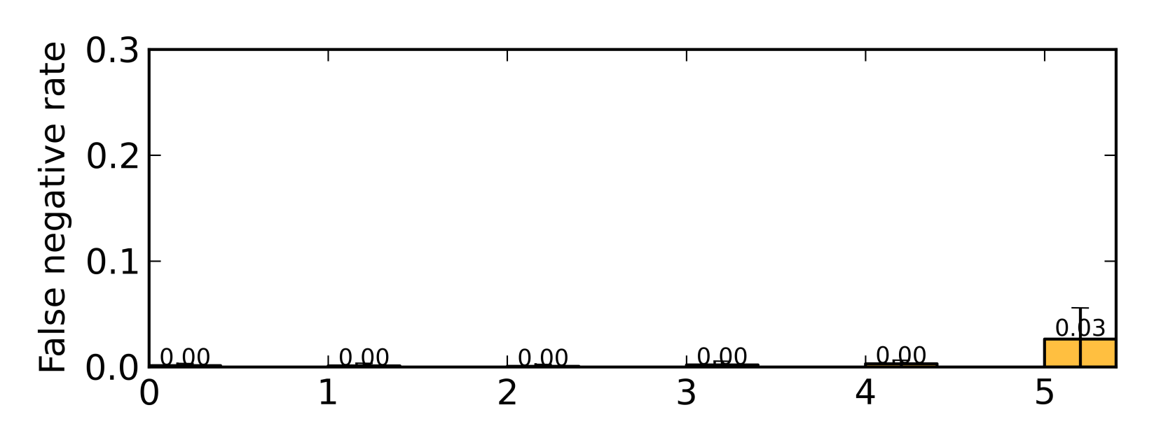
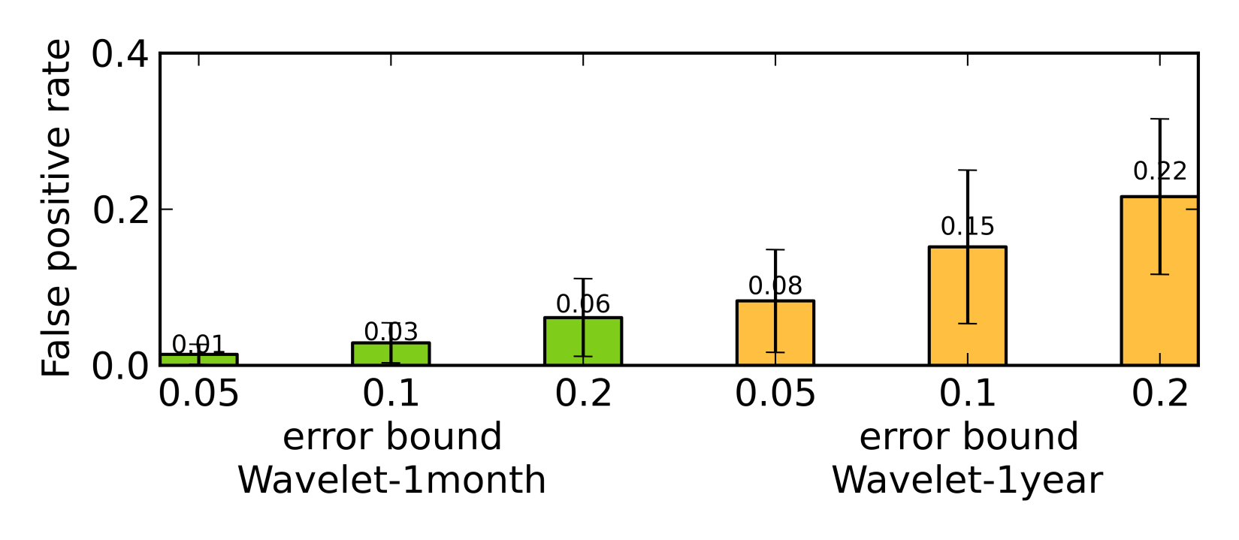
Errors of query results
15% false positives, <1% false negatives
but 40x reduction in query latency
but can eliminate false positives via validation
Notes:
How about the errors of the query results? Since the output of this query task is the set of highly correlated time ranges, we define the query error as the false negative rate and false positive rate.
The first graph shows the false negative rates, and the second graph shows the false positive rates.
The result shows that we get more query errors as we use more compact data. Using the transformed data with 10% error, for example, we get 15% false positive rate and less than 1% false negative rate, but the latency is reduced by 40x. Although the false positive rate seems high, we can actually eliminate all false positives by validating the detected highly correlated ranges using the raw data. Because the highly correlated ranges are often just a small fraction of the whole range, the validation procedure will be relatively fast.

Slide 19
Other use cases
Event occurrence monitoring
  Transform: event logs → count-min sketches
    Bloom filter-like summaries
  Query use: determine frequency of an event type
Anomaly detection
  Transform: observations → list of anomalies
  Query use: find anomalies in a time range
Notes:
The correlation search use case is just one of our many use cases described in the paper.
Here I will briefly mention some other use cases.
In a use case called event occurrence monitoring, we transform the event logs into count-min sketches, which are bloom filter like summaries. And from these summaries, queries can determine the frequency of certain type of events.
In the anomaly detection use case, we do a transformation that labels anomalous observations. At the query time, users can use such transformed data to quickly identify anomalies in a certain time range.

Slide 20
Conclusions
Aperture: ingest-time transformation for efficient time series data analytics
  User-defined transformations when data ingested
  Answer analytical queries using transformed data
Many real-world use cases
  1~4 orders of magnitude reduction in query latency
  Less than 20% query error
  Less than 10% ingestion overhead
Notes:
In conclusion, we design a time series database system that does data transformations on the data when it is ingested, and it answers analytical queries using the transformed data. We evaluate our approach in many real-world use cases. In some use cases, we get up to 4 orders of magnitude reduction in query latency. The query errors are all less than 20%, and the ingestion overheads are less than 10%.
Thank you. I’m ready to take questions.

Slide 21
Backup Slides

Slide 22
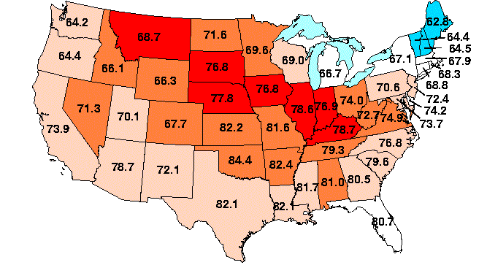
Time series data analytics
Temperature data
Search for correlation
correlated
2000
2001
2002
Time Series Database

Slide 23
Aperture
Timeseries DB with ingest-time transformation
Data stored as sorted rows in tables
  E.g.
User defined ingest-time transformations
Answer queries using transformed data
city | date | value
... | ... | ...
Notes:
We implemented our ingest-time transformation approach in our prototype system, called Aperture.
Aperture is a database for timeseries data. It stores data as sorted rows in tables. Here is a possible schema to store our temperature data. We can use the city name and date as the key, and we use another value column to store the temperatures.
Aperture allows users to define transformations that will be applied on the data when data is ingested to the database, and it can answer queries using transformed data.
I will first describe the ingest-time transformation part of our system, and then I will describe the query processing part.

Slide 24
Ingest-time transformations
Transform ingested data for given ranges
  E.g., every year of data in one city
Generate and store ranges of transformed data
Input table
Output table
city | date | value
PGH | 1/1/2000 | 35.2
PGH | 1/2/2000 | 36.3
... | ... | ...
PGH | 1/1/2001 | 48.9
PGH | 1/2/2001 | 55.0
... | ... | ...
... | ... | ...
city | date | wavelets
PGH | 1/1/2000 | <wavelets>
PGH | 1/1/2001 | <wavelets>
... | ... | ...
wavelet
transform:
window size: 1 year,
error bound: 10%
Notes:
Aperture provides a framework that allows users to define transformations.
The input of each transformation is one range of input rows, and the output is one range of transformed rows.
Here I will use the wavelet transform as one example. So here, in the left hand side, we have the temperature data. The user specifies the transformation to use one year of temperatures as the input. So our system groups every one year of data as one window passes it to a user defined function. That user defined function calculates the wavelet coefficients of that range of data, and writes only the large ones to satisfy a given error bound as the output.

Slide 25
Choosing transformation
Based on user-defined utility functions
If (not func == wavelet): utility = 0
If (window_size > 1 year): utility = 0
If (error_bound > 10%): utility = 0
utility = window_size * error_bound
Wavelet (1year, 5%err)
Wavelet (10years, 5%err)
Wavelet (1year, 10%err)
Wavelet (10years, 10%err)
Wavelet (1year, 20%err)
Wavelet (10years, 20%err)
Notes:
In this talk, I will only talk about the transformation selection part.
The users can specify their preference on transformations using a utility function.
Here I will use wavelet transform as the example again. Suppose we have 6 versions of wavelet transformed data, with different window sizes and error bounds. The ones with larger error bounds and window sizes are smaller.
And we have a utility function. The utility function picks the wavelet transform, and requires the window size to be no more than a year, (HIT) so we rule out three of the transformations. And it requires the error bound to be no more than 10%, (HIT) then we rule out another one. For the two options left, (HIT) we choose the one with the highest error bound and window size, because it is smaller.

Slide 26
Translate query
Translate queries to fetch transformed data
GET(table=Raw,
city=PGH,
time>=1/1/2000,
time<1/1/2010)
city | date | value
PGH | 1/1/2000 | <value>
PGH | 1/2/2000 | <value>
... | ... | ...
PGH | 12/31/2009 | <value>
Translate according to selected transformation
GET(table=
Wavelet(1year,10%err),
city=PGH,
time>=1/1/2000,
time<1/1/2010)
city | date | wavelets
PGH | 1/1/2000 | <wavelets>
PGH | 1/1/2001 | <wavelets>
... | ... | ...
PGH | 1/1/2009 | <wavelets>
Notes:
Then we translate the database query according to the transformation.
Because our ingest-time transformation framework assign keys to transformed data
Suppose we choose this wavelet transform with 1 year window and 10% error bound,

Slide 27
Aperture implementation
Implemented on top of LazyBase ^{[Cipar et. al., Eurosys’12]}
Client
upload
Receive
Sort
MergeSort
: unsorted raw data
: sorted raw data
Notes:
We implement Aperture on top of an existing database system, LazyBase. The LazyBase ingestion pipeline has three stages. It first receives the data from the client, then sorts the data, and finally merges the newly received data with the other data.

Slide 28
Aperture implementation
Implemented on top of LazyBase ^{[Cipar et. al., Eurosys’12]}
Client
upload
Receive
Sort+Transform
MergeSort
: unsorted raw data
: sorted raw data
: sorted and transformed data

Slide 29
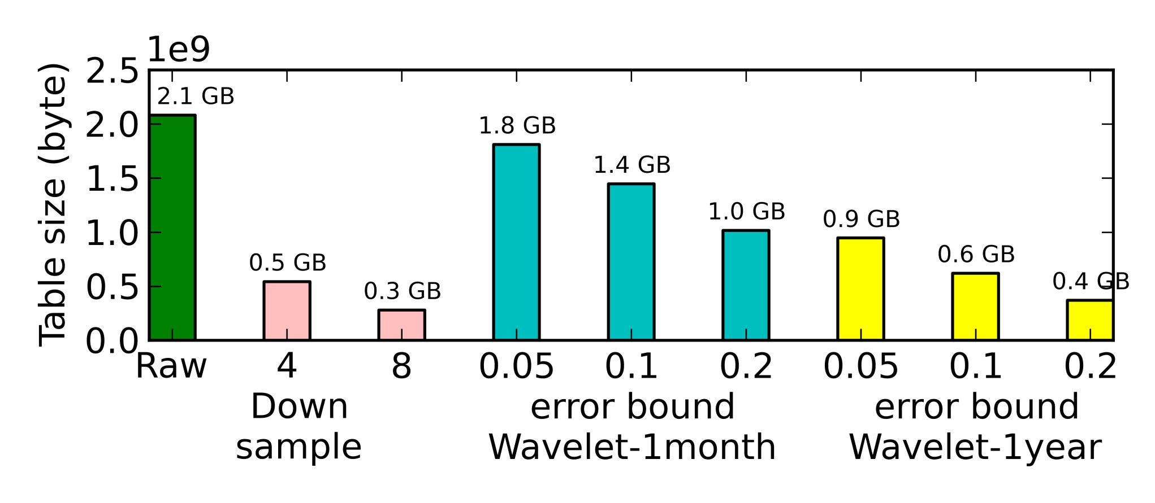
Data size

Slide 30
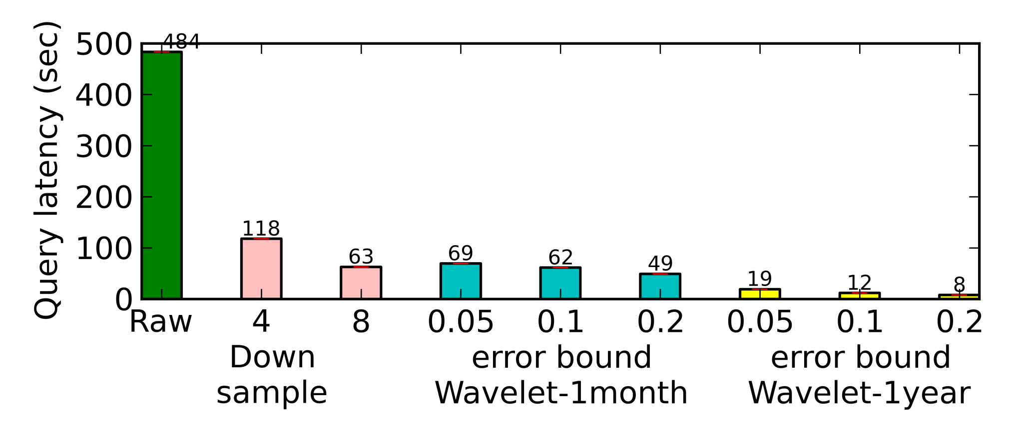
Latency

Slide 31
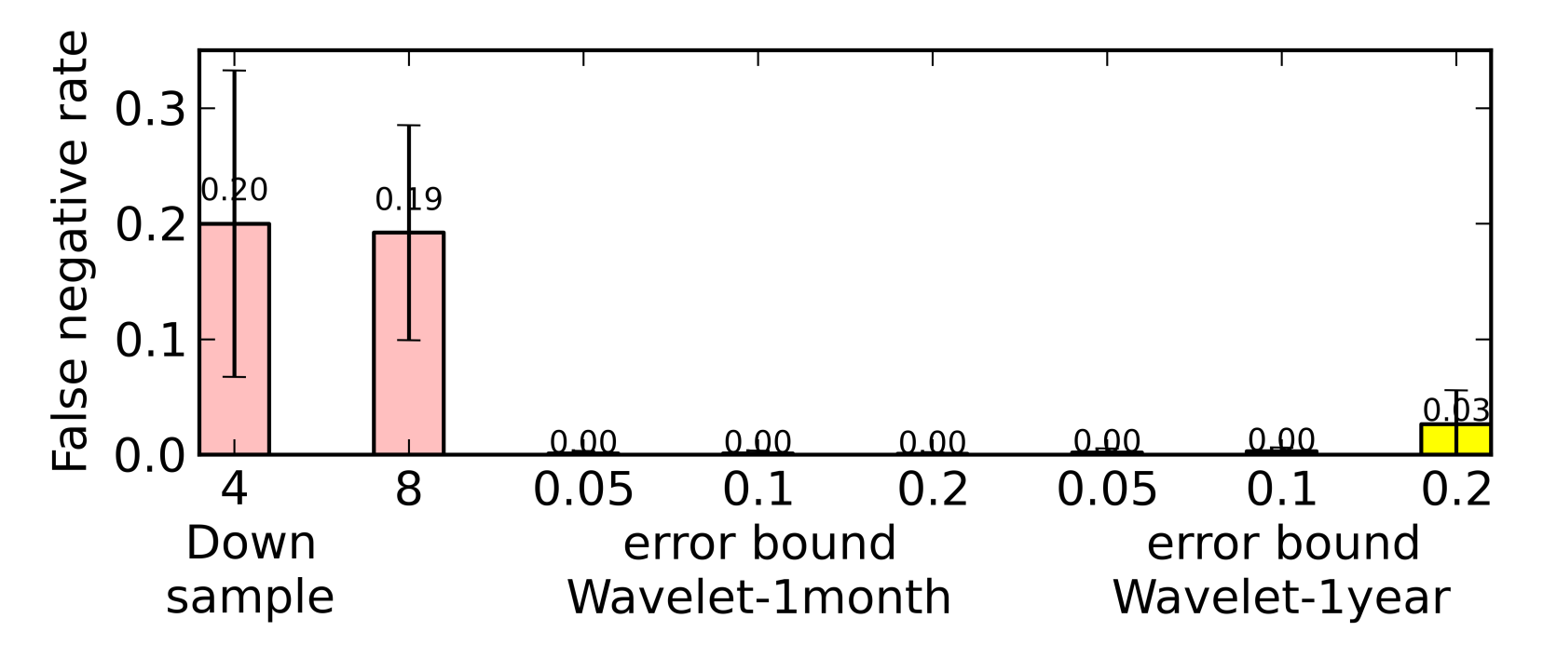
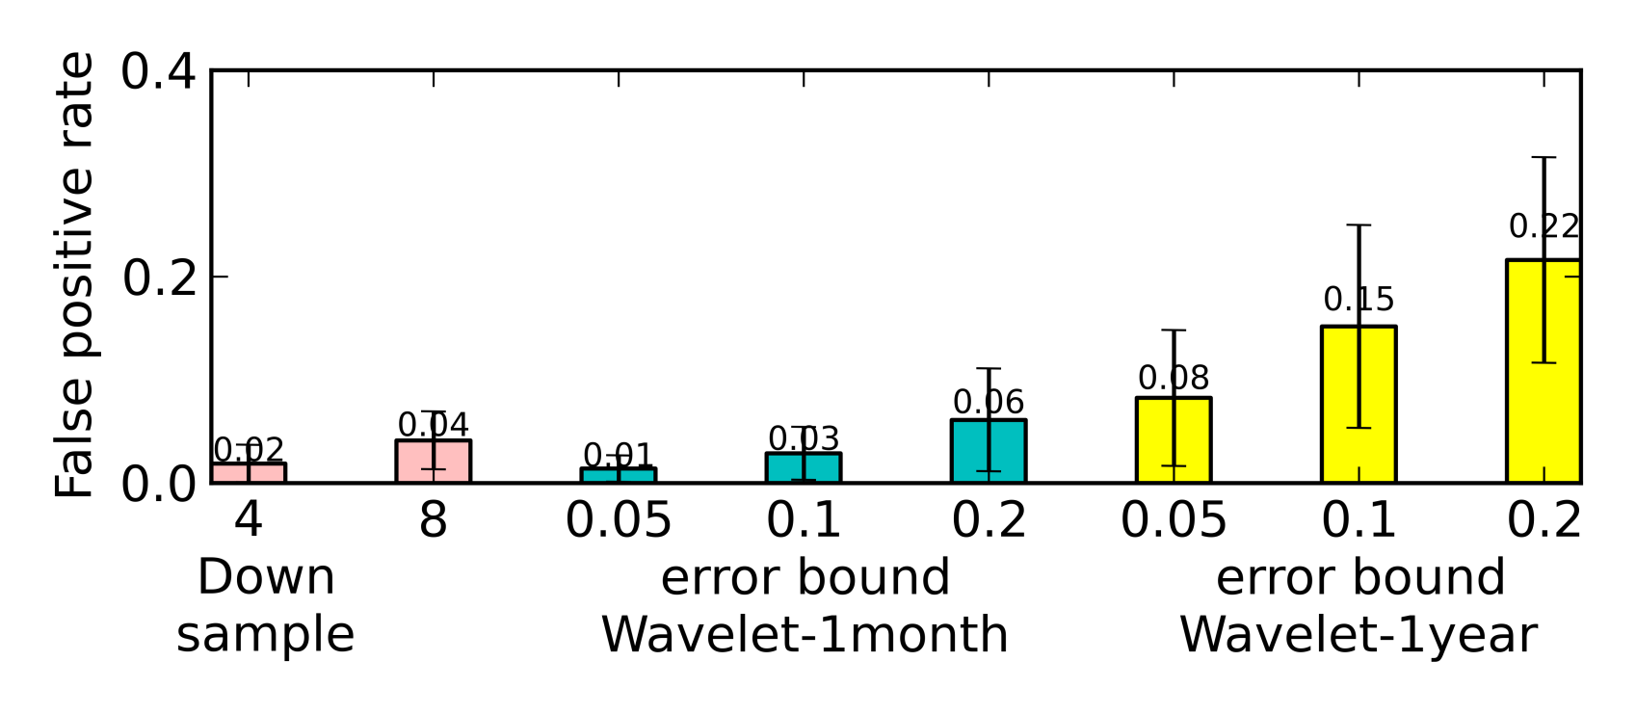
False positive/negative rates

Slide 32
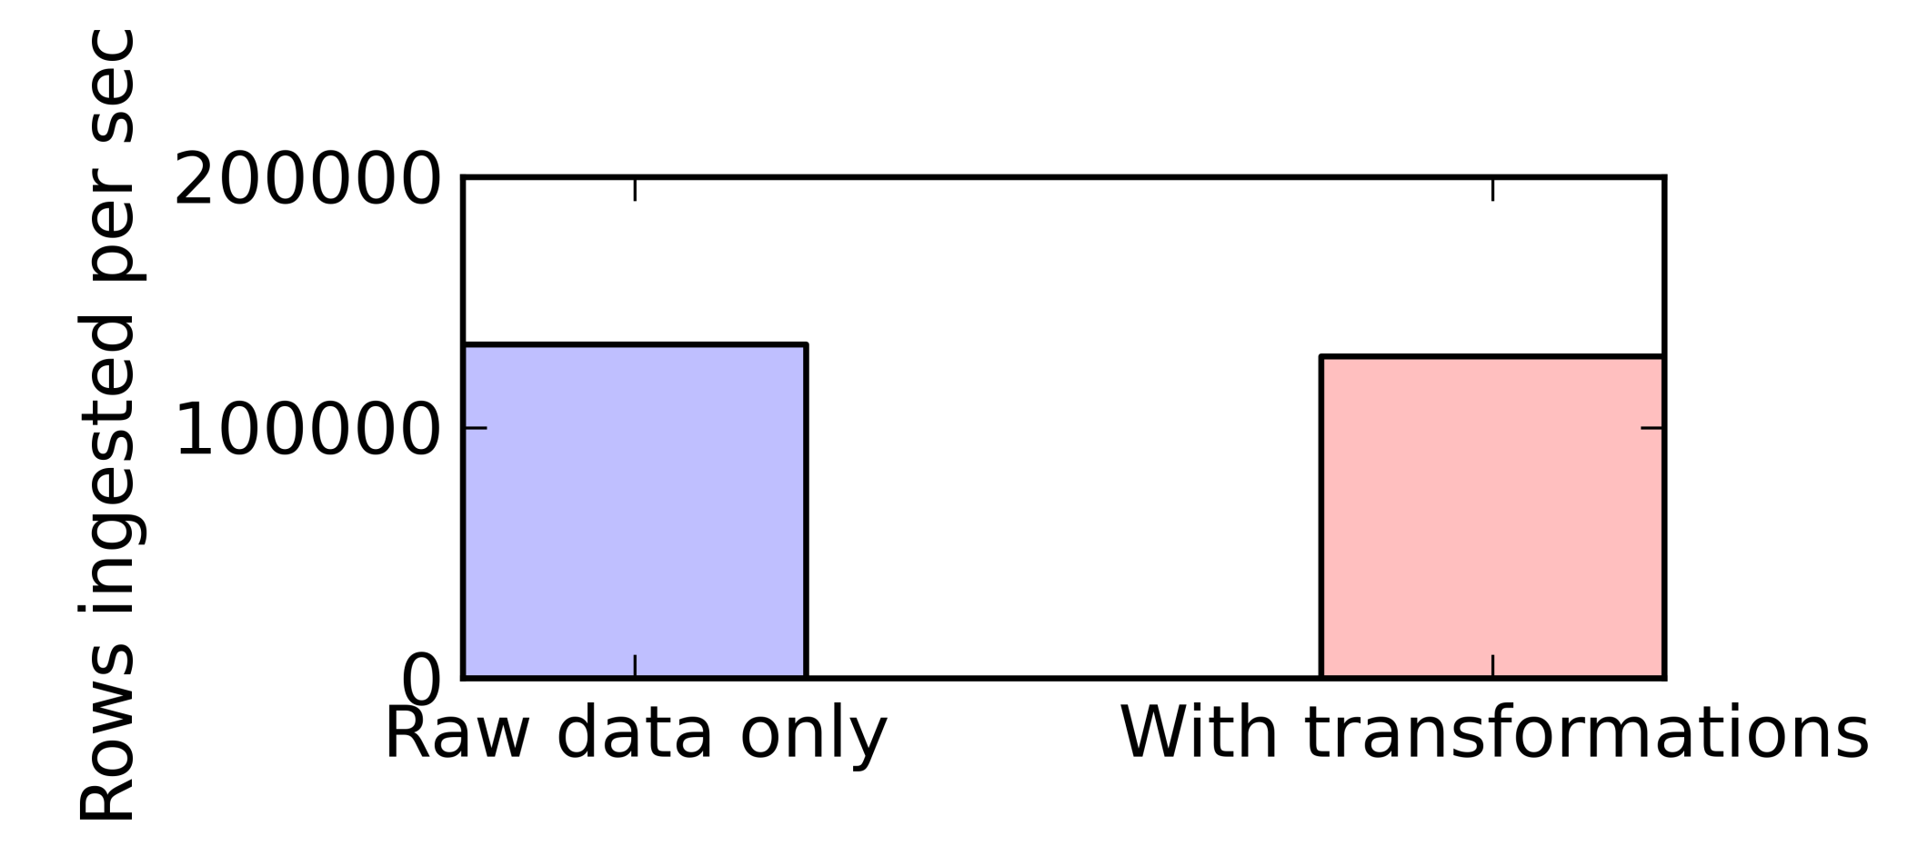
Ingestion overhead
Only 4% overhead to do 6 wavelet transformations
Notes:
How about the overhead at the ingest-time? We measure the ingestion throughput when we do the six wavelet transforms, and compare it with the throughput with no transformations. It is only 4% lower. So doing these transformations has only minimal overhead on the ingestion throughput.

Slide 33
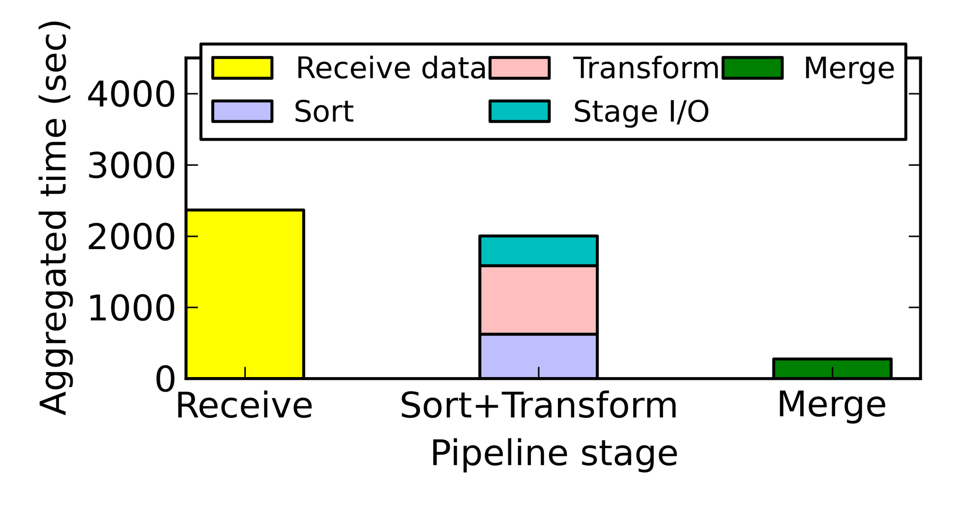
Ingestion overhead
Cost of transformations is just a little more than sorting
Less time to sort+transform the data than receiving it
Notes:
Here I will explain why there is so little overhead.

Slide 34
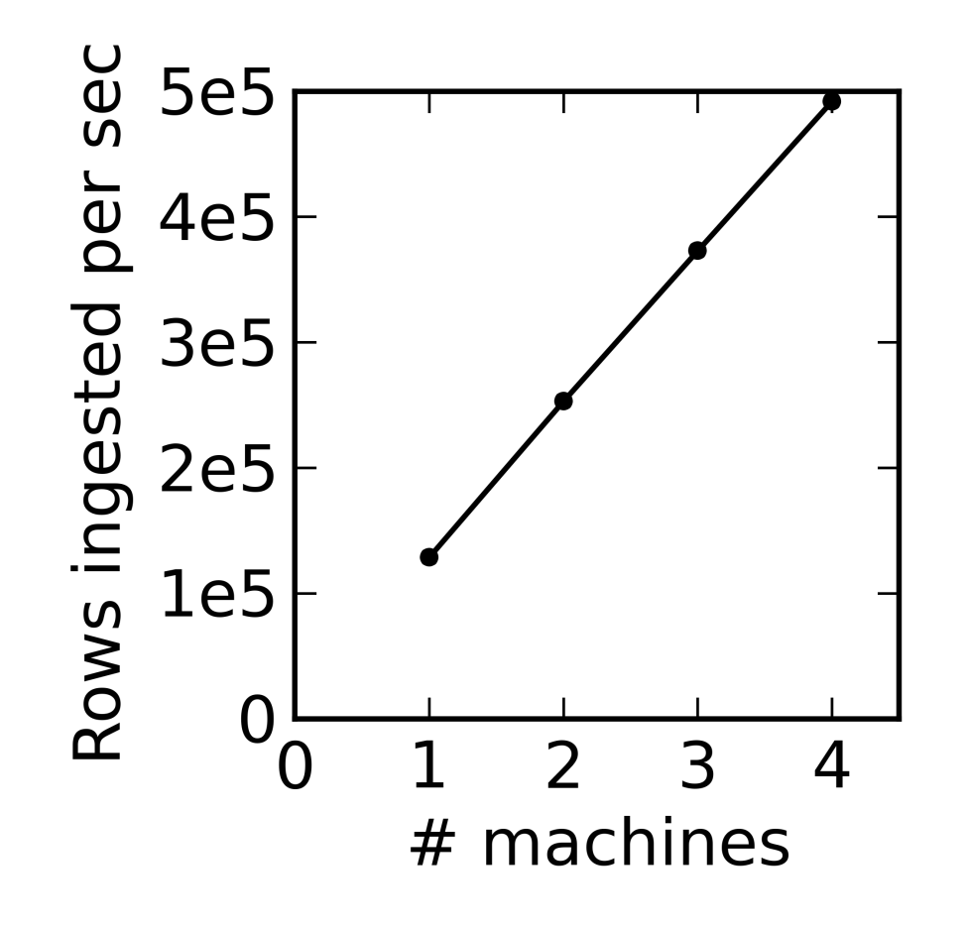
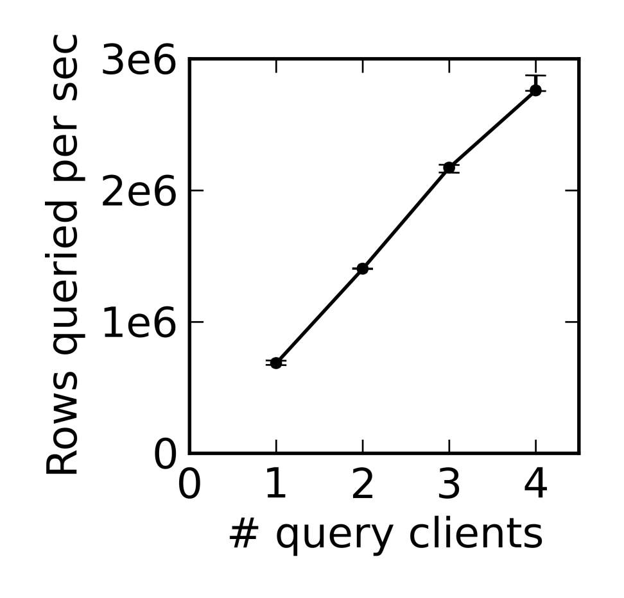
Scalability

