Slide 1

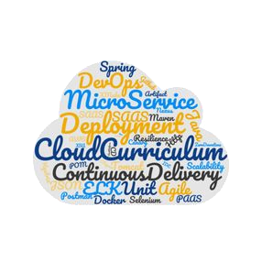

D R A F T Under Construction !
Kubernetes Microservice-based sample app: Bulletinboard

Slide 2
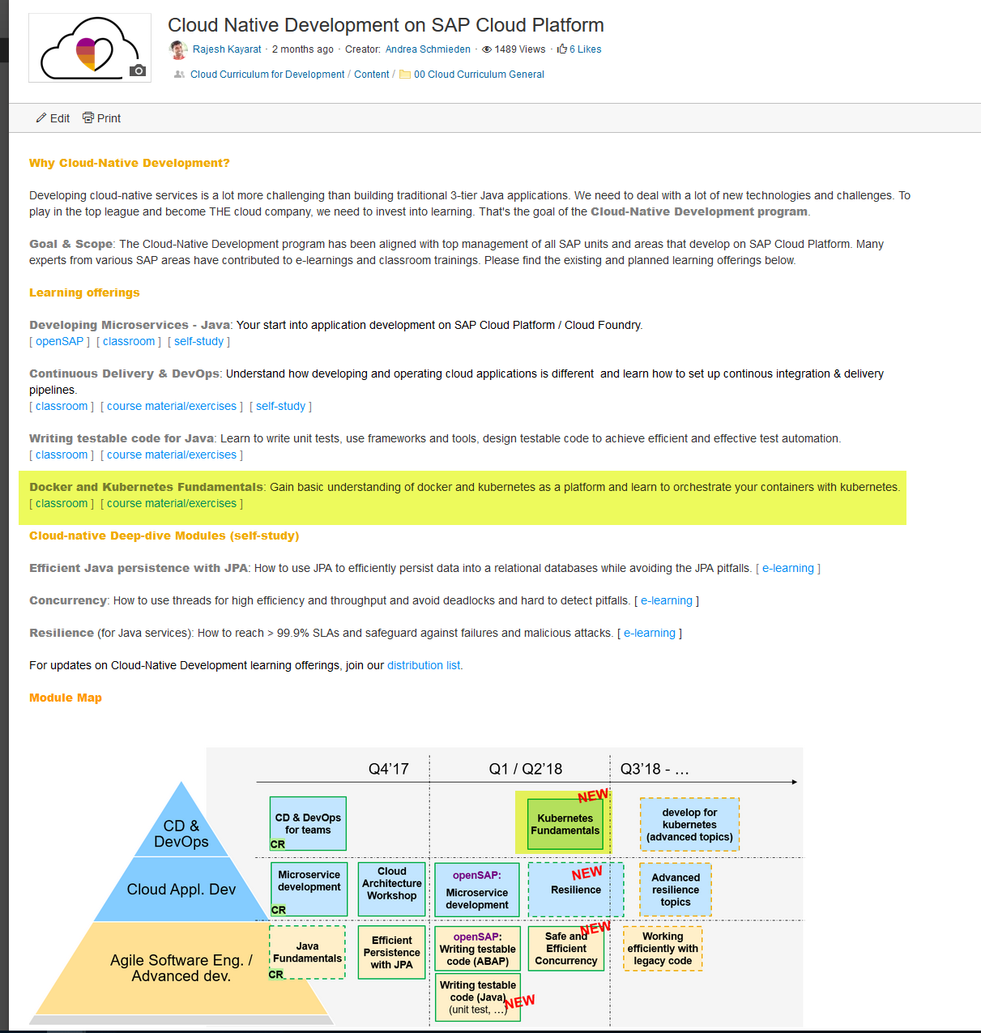
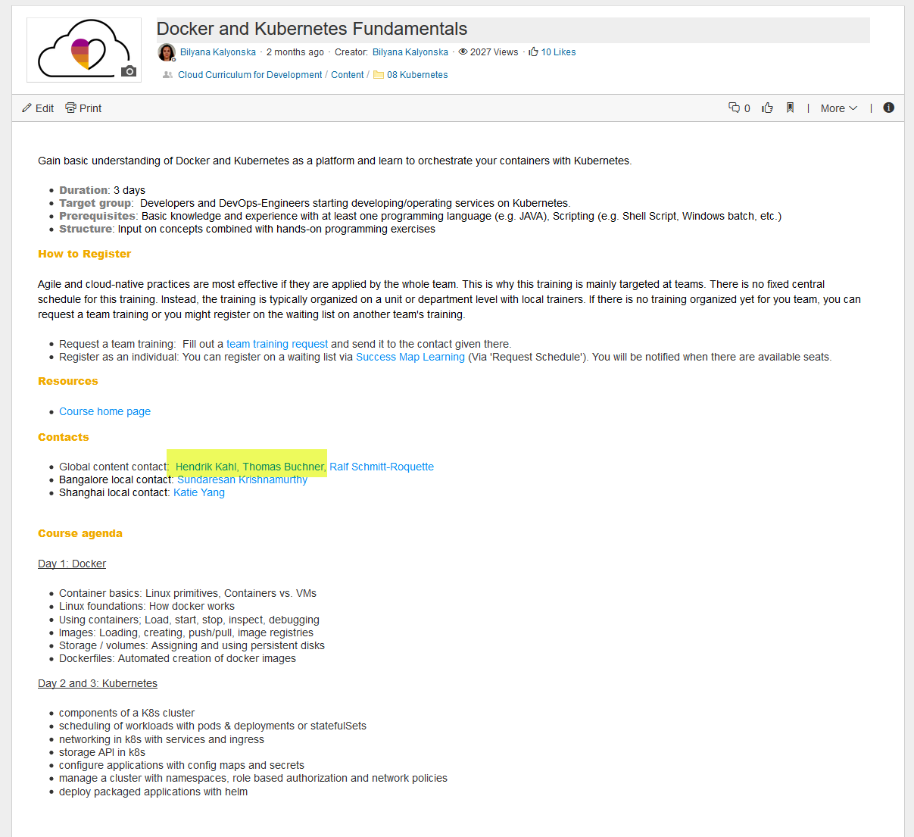
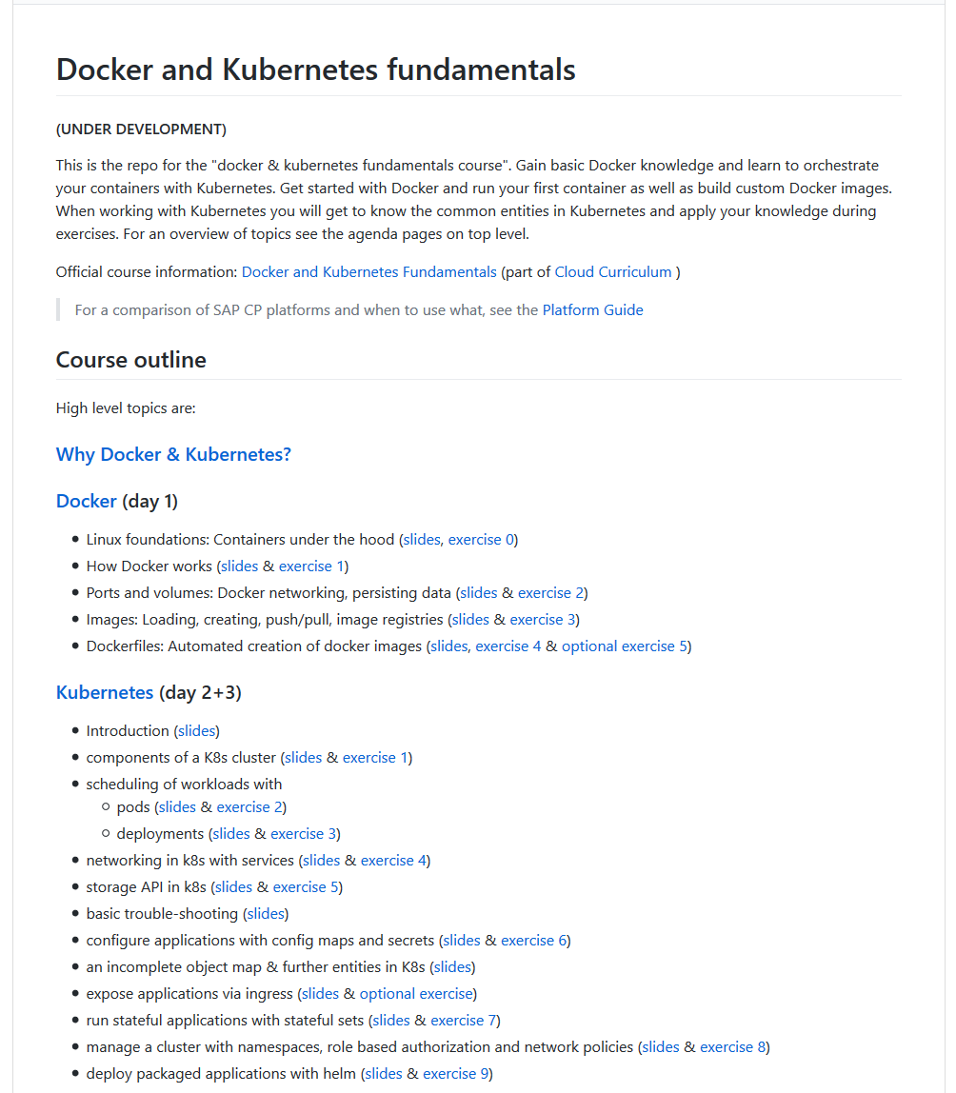
Cloud Curriculum: Docker & K8s Fundamentals training

Slide 3
Goal of Day 4
Apply what you learned in day 1-3 on Docker & K8s, based on a sample application/microservices with connected database and communication across to other microservice
Cloud Curriculum Bulletinboard
Keep it simple:
Bulletinboard: no security, Approuter, UAA, Multi Tenancy, etc.
Only basics K8s scenarios
No CD pipeline/ Docker image build, no upload to Docker Registry (e.g. SAP Artifactory) as part of the exercises (of course as demo)
Not 100% reference for later productive usage ! (Will be done in other training)

Slide 4
Changes from CF Bulletinboard RefApp to K8s Day4 Bulletinboard
CF Bulletinboard RefApp:
Not a complete business application
Used to show certain concepts
Start point for K8s-Day4- Bulletinboard
Still lots of components
Client
Components in CF
approuter
uaa-bulletinboard
bulletinboard-ads
bulletinboard-users
bulletinboard-statistics
application
UI
applogs-bulletinboard
postgresql-ads
mq-bulletinboard
postgresql-users
postgresql-users

Slide 5
Changes from CF Bulletinboard RefApp to K8s Day4 Bulletinboard
Changes:
Reduced Scope
Removed CF Components
Removed RabbitMQ
Client
Components in CF
approuter
uaa-bulletinboard
bulletinboard-ads
bulletinboard-users
bulletinboard-statistics
application
UI
applogs-bulletinboard
postgresql-ads
mq-bulletinboard
postgresql-users
postgresql-users

Slide 6
Code Changes to Ads application
We Removed:
Security/UAA Part
Multitenancy
RabbitMQ
Feature Flags
We added:
Environment variable to toggle calls to users
We changed:
VCAP_Services -> application-k8s.yml

Slide 7
Application in K8s: Steps to be taken
Ensure your Application is parameterizable/ ready for external configuration (In general/ K8s specific)
Create a Docker Image for your Application, considering parameterization/ external configuration
Create/ use an existing Docker Image for your Database, as well parametrizable.
Make available Application Docker Image in public available Docker registry, e.g. SAP Artifactory DMZ (and DB Docker Image, if not available on e.g. public Docker Hub)
Choose the right K8s entities for parameterization/ external configuration: ConfigMap and Secret
Choose the right K8s entities for your scenario – Stateless vs. Statefull and Horizontal Scaling: Deployment vs Statefulset.
Choose the right K8s entities for exposing your Application internal & external/Internet and network security, etc.: Service, Ingress, NetworkPolicy, etc.

Slide 8
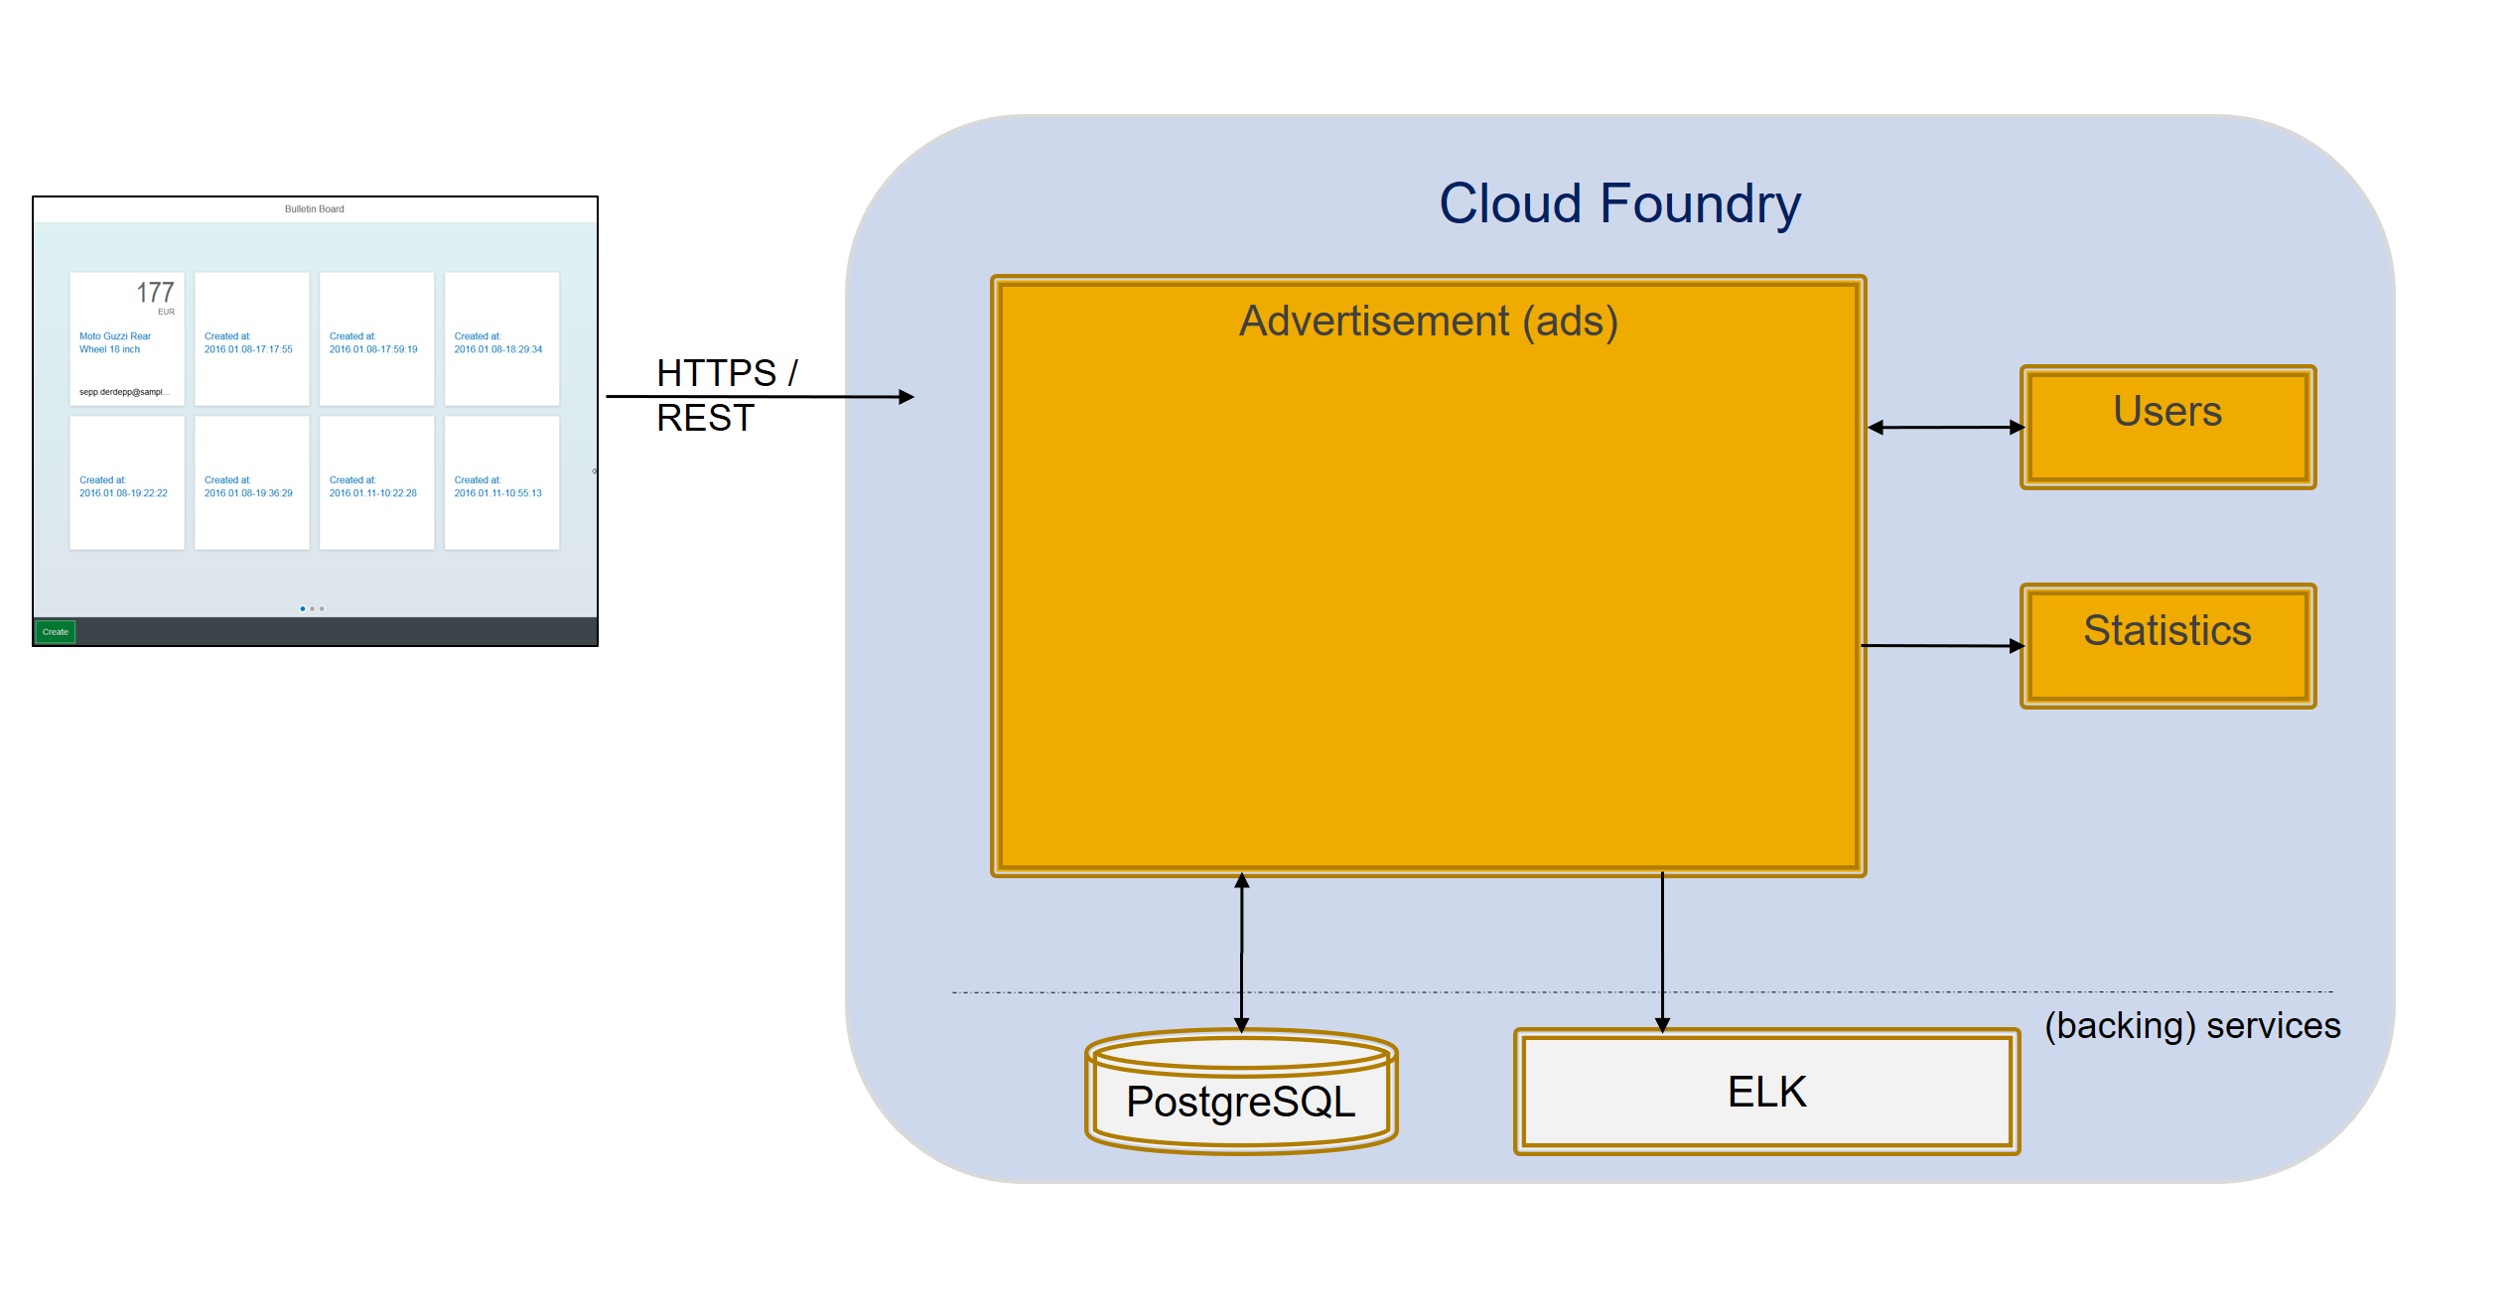
Cloud Curriculum, Reference/ Sample Microservice: bulletinboard

Slide 9
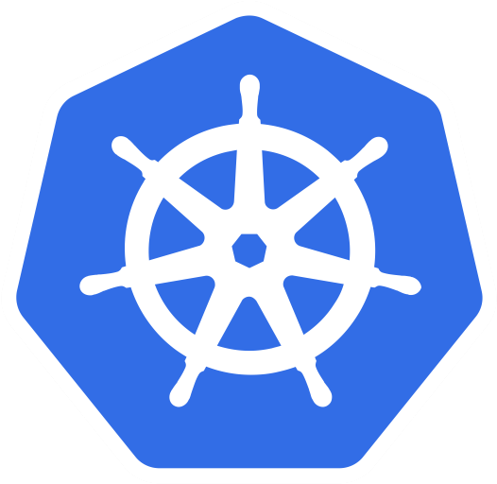
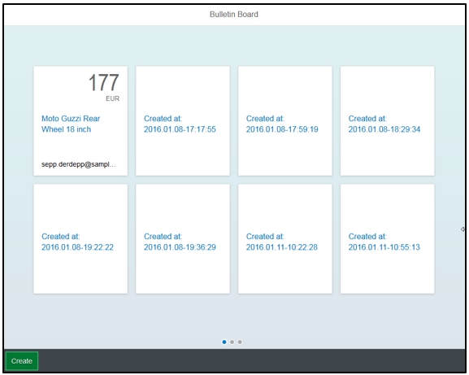

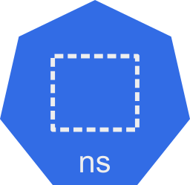


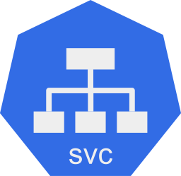

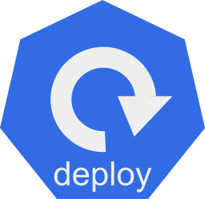
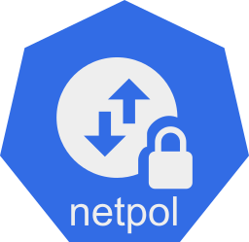


How to bring bulletinboard into K8s ?
?
… cluster, namespace, pod, deployment, statefulset, replicaset, … ???????

Slide 10
How to bring bulletinboard into K8s ?
HTTP/ REST
HTTPS/ REST
bulletinboard- ads
bulletinboard-users
postgresql
postgresql

Slide 11
General considerations: Scaling - Option 1 DB gets multiple instances (if needed)
bulletinboard- ads
bulletinboard-users
postgresql
postgresql
postgresql
postgresql
postgresql
postgresql

Slide 12
General considerations: Scaling - Option 2 Both – app and DB get multiple instances (if needed)
bulletinboard- ads
bulletinboard-users
bulletinboard- ads
bulletinboard-users
bulletinboard- ads
bulletinboard-users
postgresql
postgresql
postgresql
postgresql
postgresql
postgresql

Slide 13
General considerations: Scaling - Option 3 App gets multiple instances (if needed)
bulletinboard- ads
bulletinboard- ads
bulletinboard-users
ü
postgresql
postgresql

Slide 14
General considerations: external configuration for app and DB
ToDo

Slide 15


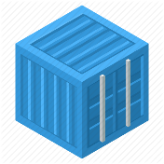
Bulletinboard in K8s: Target picture overall
ingr/ svc
HTTP/ REST
svc
HTTPS/ REST
nwp
nwp
bulletinboard- ads
bulletinboard-users
cm
cm
sec
pod
sec
pod
deployment
deployment
svc
svc
nwp
postgresql
nwp
postgresql
cm
cm
https://github.wdf.sap.corp/slvi/docker-k8s-training/blob/k8s-bulletinboard/kubernetes/k8s-bulletinboard/README.md
sec
pod
sec
pod
statefulset
statefulset
Notes:
- Discuss statefulset vs deployment
- Discuss headless service vs ???
- Discuss service vs ingress

Slide 16
Bulletinboard in K8s: Target picture overall
ingr/ svc
HTTP/ REST
svc
HTTPS/ REST
nwp
nwp
bulletinboard- ads
bulletinboard-users
cm
cm
sec
pod
sec
pod
deployment
deployment
svc
svc
nwp
postgresql
nwp
postgresql
cm
cm
sec
pod
sec
pod
statefulset
statefulset
Notes:
- Discuss statefulset vs deployment
- Discuss headless service vs ???
- Discuss service vs ingress

Slide 17


Bulletinboard in K8s: Exercise “Ads DB“
ingr/ svc
HTTP/ REST
svc
HTTPS/ REST
nwp
nwp
bulletinboard- ads
bulletinboard-users
cm
cm
sec
pod
sec
pod
deployment
deployment
svc
svc
nwp
postgresql
nwp
postgresql
cm
cm
sec
pod
sec
pod
statefulset
statefulset
Notes:
- Discuss statefulset vs deployment
- Discuss headless service vs ???
- Discuss service vs ingress

Slide 18
Bulletinboard in K8s: ads DB
Docker container: postgres:9.6
configmap: ads-db-configmap
secret: ads-db-secret
pod: ads-db-statefulset-0
statefulset: ads-db-statefulset

Slide 19
Bulletinboard in K8s: ads DB
pod DNS-name: ads-db-statefulset-0.ads-db-service
‘headless’ service:
ads-db-service
Docker container: postgres:9.6
configmap: ads-db-configmap
secret: ads-db-secret
pod: ads-db-statefulset-0
statefulset: ads-db-statefulset

Slide 20
Bulletinboard in K8s: Dependencies across entities – ads DB
Statefulset:
‘ads-db-statefulset’
Service (headless):
‘ads-db-service’
Configmap:
‘ads-db-configmap’
Secret:
‘ads-db-secret’

Slide 21
Bulletinboard in K8s: ads DB - labels
pod DNS-name: ads-db-statefulset-0.ads-db-service
‘headless’ service:
ads-db-service
component: ads
module: db
Docker container: postgres:9.6
configmap: ads-db-configmap
secret: ads-db-secret
pod: ads-db-statefulset-0
statefulset: ads-db-statefulset

Slide 22
Bulletinboard in K8s: ads DB – details labels & selector
selector: component: ads module: db
statefulset: ads-db-statefulset
component: ads
module: db
pod: ads-db-statefulset-0
component: ads
Docker container: postgres:9.6
module: db

Slide 23
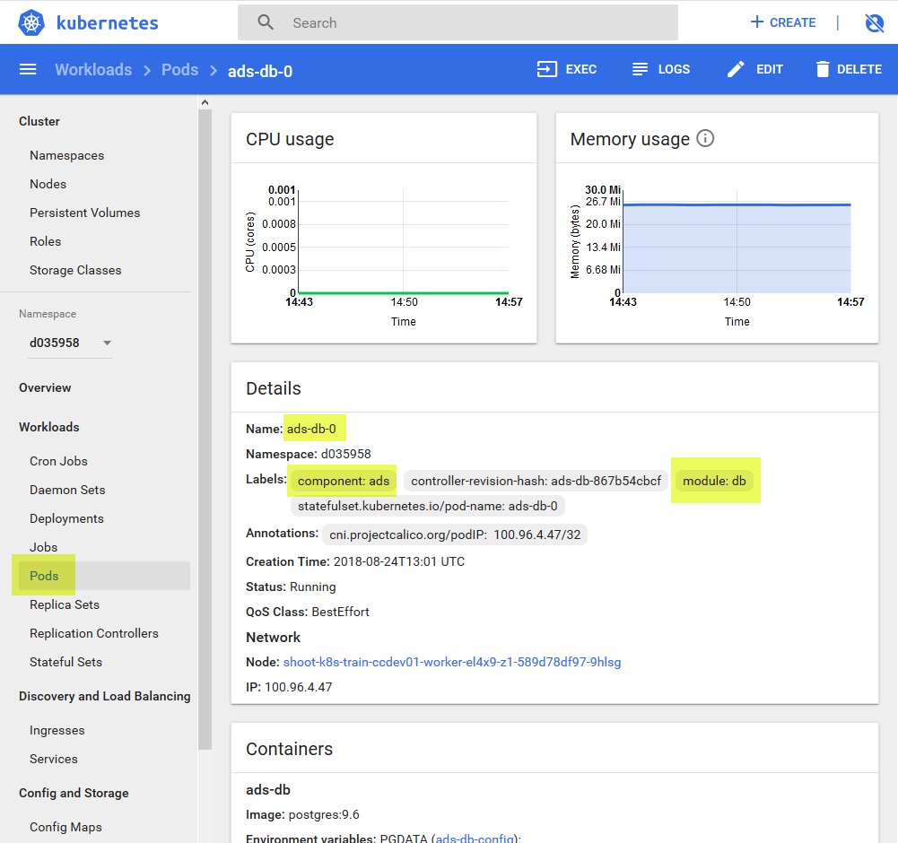
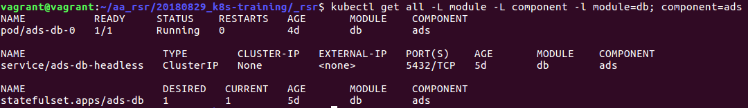
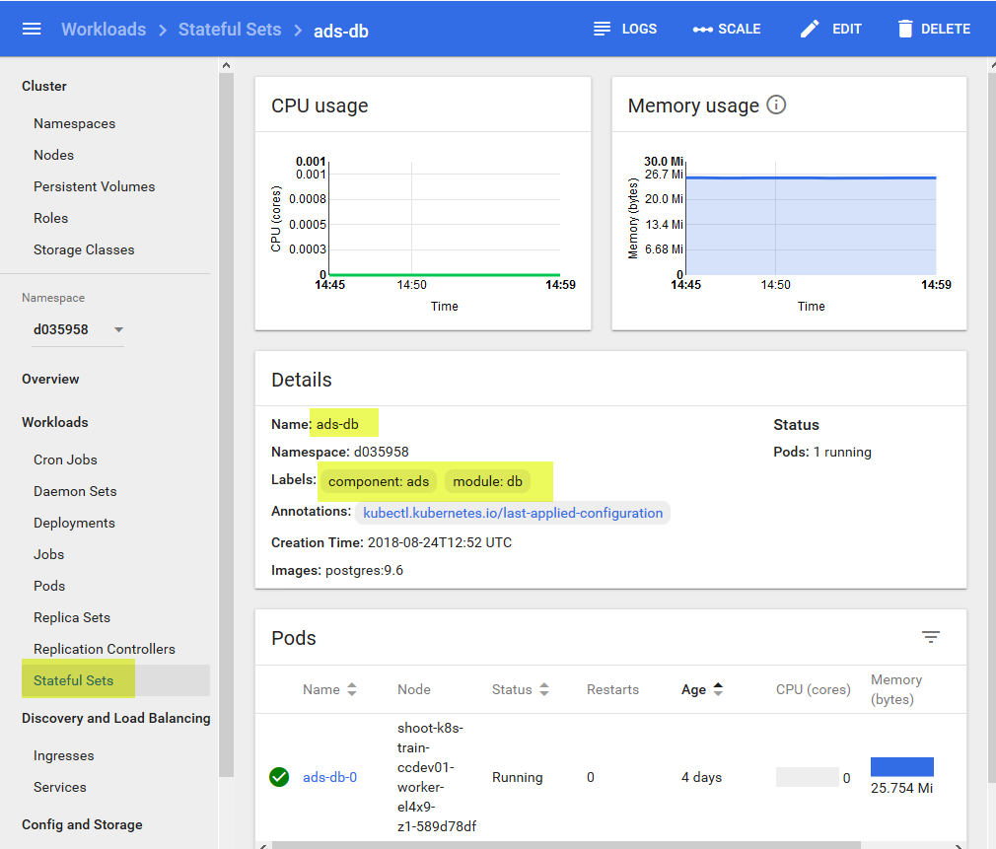
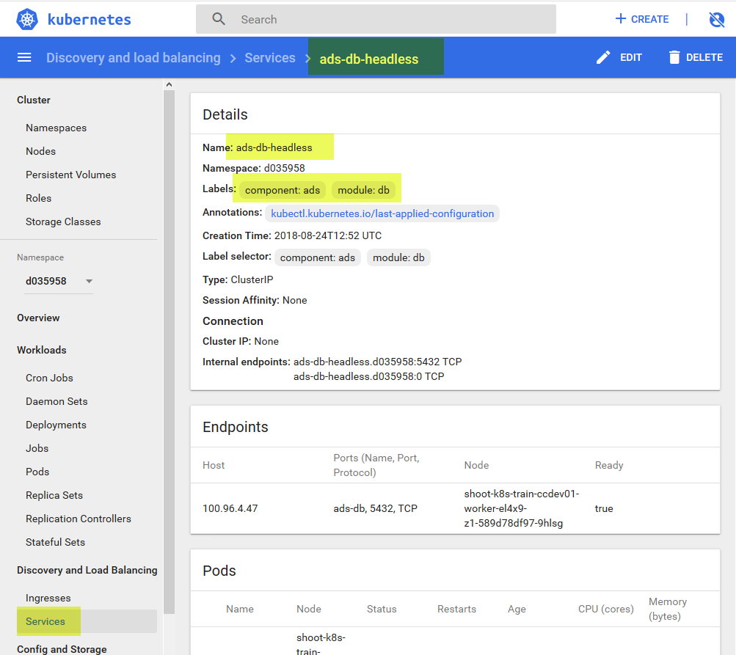
Bulletinboard in K8s: ads DB - labels
pod DNS-name: ads-db-0.ads-db-headless
‘headless’ service:
ads-db-headless
component: ads
module: db
configmap: ads-db-init
Docker container: postgres:9.6
configmap: ads-db
secret: ads-db-secrets
pod: ads-db-0
statefulset: ads-db

Slide 24
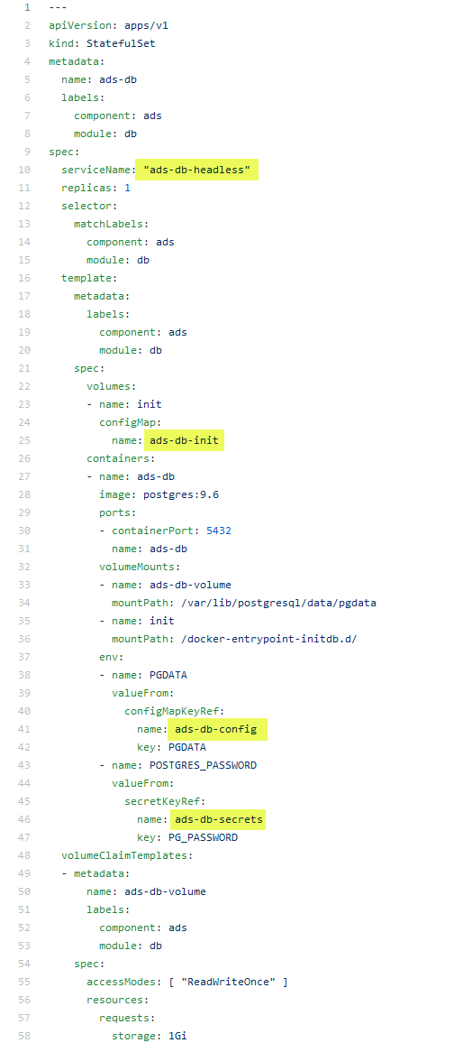
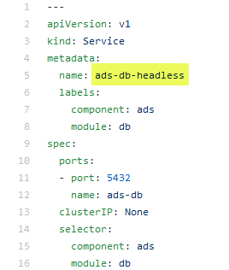
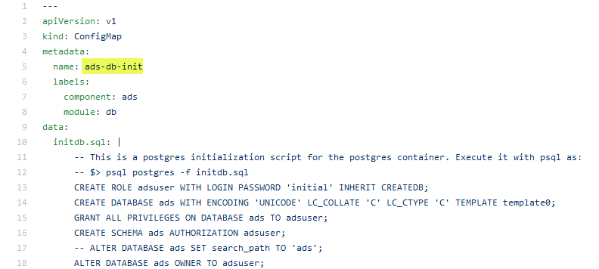
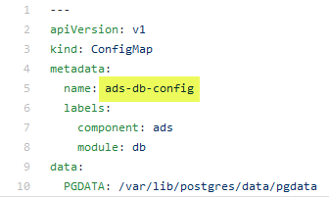
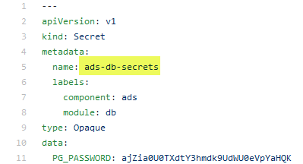
Bulletinboard in K8s: Dependencies across entities - 2
ads-db-service.yaml
ads-db.yaml
To be adapted !
ads-db-init.yaml
ads-db-config.yaml
ads-db-secret.yaml
Notes:
ToDO
Adapt path …/data/pgdata
Rename secret PD_PASSWORD ?
Secrets → secret ?

Slide 25
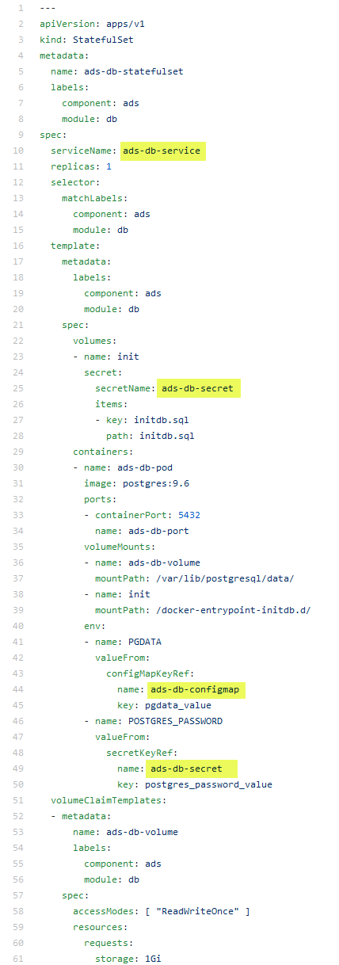
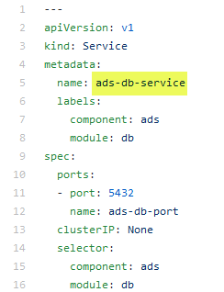
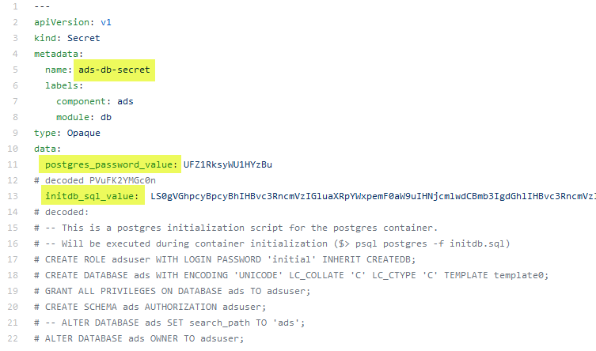
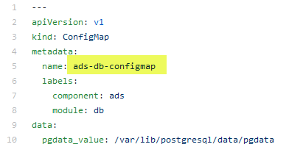
Bulletinboard in K8s: Dependencies across entities - 2
ads-db-service.yaml
ads-db-statefulset.yaml
ads-db-secret.yaml
ads-db-configmap.yaml
https://github.wdf.sap.corp/slvi/docker-k8s-training/tree/k8s-bulletinboard/kubernetes/k8s-bulletinboard/solutions/ads

Slide 26
Bulletinboard in K8s: Exercise “ads App”
ingr/ svc
HTTP/ REST
svc
HTTPS/ REST
nwp
nwp
bulletinboard- ads
bulletinboard-users
cm
cm
sec
pod
sec
pod
deployment
deployment
svc
svc
nwp
postgresql
nwp
postgresql
cm
cm
ü
sec
pod
sec
pod
statefulset
statefulset
Notes:
- Discuss statefulset vs deployment
- Discuss headless service vs ???
- Discuss service vs ingress

Slide 27
Bulletinboard in K8s: Exercise “ads app”
ingr/ svc
HTTP/ REST
svc
nwp
nwp
bulletinboard- ads
bulletinboard-users
cm
cm
sec
pod
sec
pod
deployment
deployment
svc
svc
nwp
postgresql
nwp
postgresql
cm
cm
ü
sec
pod
sec
pod
statefulset
statefulset
Notes:
- Discuss statefulset vs deployment
- Discuss headless service vs ???
- Discuss service vs ingress

Slide 28
Bulletinboard in K8s: ads app
configmap: ads-app-configmap
bulletinboard- ads
secret: ads-app-secret
pod: ads-app…ent-xx-yy
deployment: ads-app-deployment

Slide 29
Bulletinboard in K8s: ads app
…ingress.<cluster>.k8s-train.shoot.canary.k8s-hana.ondemand.com/ads
ingress:
ads-app-ingress
service:
ads-app-service
configmap: ads-app-configmap
bulletinboard- ads
configmap: ads-app-secret
pod: ads-app…ent-xx-yy
deployment: ads-app-deployment

Slide 30
Bulletinboard in K8s: Dependencies across entities – Ads app
deployment:
‘ads-app’
Configmap:
‘ads-app-configmap’
Secret:
‘ads-app-secret’

Slide 31
Bulletinboard in K8s: ads app - labels
….ingress.<cluster>.k8s-train.shoot.canary.k8s-hana.ondemand.com/ads
component: ads
ingress:
ads-app-ingress
module: app
service:
ads-app-service
configmap: ads-app-configmap
bulletinboard- ads
secret: ads-app-secret
pod: ads-app…ent-xx-yy
deployment: ads-app-deployment

Slide 32
Bulletinboard in K8s: Target picture - labels
selector: component: ads module: app
deployment: ads-app-deployment
component: ads
module: app
replicaset: ads-app-deployment-xx
component: ads
module: app
pod: ads-app…ent-xx-yx
component: ads
pod: ads-app…ent-xx-yy
component: ads
pod: ads-app…ent-xx-yz
component: ads
Docker container: bulletinboard- ads:v.0x
module: app
Docker container: bulletinboard- ads:v0.x
module: app
Docker container: bulletinboard- ads:v.0x
module: db

Slide 33
Bulletinboard in K8s: ads DB - labels
pod DNS-name: ads-db-0.ads-db-headless
‘headless’ service:
ads-db-headless
component: ads
module: db
configmap: ads-db-init
Docker container: postgres:9.6
configmap: ads-db
secret: ads-db-secrets
pod: ads-db-0
statefulset: ads-db

Slide 34
Bulletinboard in K8s: Dependencies across entities - 2
ads-db-service.yaml
ads-db.yaml
ads-db-init.yaml
ads-db-config.yaml
ads-db-secret.yaml

Slide 35
Bulletinboard in K8s: Exercise “Network policies & TLS for Ads app”
ingr/ svc
HTTP/ REST
svc
HTTPS/ REST
nwp
nwp
bulletinboard- ads
bulletinboard-users
cm
cm
ü
sec
pod
sec
pod
deployment
deployment
svc
svc
nwp
postgresql
nwp
postgresql
cm
cm
ü
sec
pod
sec
pod
statefulset
statefulset
Notes:
- Discuss statefulset vs deployment
- Discuss headless service vs ???
- Discuss service vs ingress

Slide 36
More on Network Policies
2 policyTypes:
Ingress: rules for incoming traffic
Egress: rules for outgoing traffic
3 kinds of Rules:
ipBlock: range of IP addresses given as CIDR
podSelector: labels of Pods allowed
namespaceSelector: labels of Namespaces
Last two can be combined to specify certain pods in certain namespases (since 1.11)

Slide 37
Network Policy for Ads:DB
Ingress:
Allow traffic from ads:app
Egress:
no egress traffic
Pods Ads:DB only receives requests from Ads:App
Pods Ads:DB don’t send any requests to anybody.
bulletinboard- ads
component: ads
module: app
pod: ads-app…ent-xx-yy
Postgresql
component: ads
module: db
pod: ads-db-statefulset-0
Notes:
Who is “talking” to ads:db? A: ads:app
In which direction does the traffic go? -> Ingress
Does ads:db talk to anybody by itself? -> no Egress

Slide 38
Network Policies for Ads:App
Ingress:
Allow traffic from ingress-controller in kube-system namespace
Egress:
Allow traffic to kube-DNS
Allow traffic to Ads:DB
app: nginx-ingress
Ingress-controller
bulletinboard- ads
component: ads
component: controller
name: kube-system
module: app
origin: gardener
pod
pod: ads-app…ent-xx-yy
Request to: ads-db-0….
Namespace: kube-system
Namespace: <your Space>
Request to dns: get ip of ads-db-0….
k8s-app: kube-dns
Postgresql
component: ads
Kube-DNS
module: db
pod
pod: ads-db-statefulest-0

Slide 39
Exercise 3: Network policies & TLS

Slide 40
Configmaps, Files and Mountpoints
Docker image
Filesystem: /bulletinboard*.jar /config/application-k8s.yml
Envs: SPRING_PROFILES_ACTIVE USER_ROUTE POST_CHECK_USER
bulletinboard- ads
component: ads
secret: ads-app-secret
module: app
configmap: ads-app-configmap
pod: ads-app-xx-yy
Docker image
Filesystem: /*/postgres /docker-entrypoint-initdb.d/initdb.sql /var/lib/postgres/data
Envs: PGDATA POSTGRES_PASSWORD
Postgresql
component: ads
module: db
VC-template: ads-db-volume
secret: ads-db-secrets
configmap: ads-db-configmap
pod: ads-db-statefulset-0
Notes:
Overview over where which value and file and data comes from.

Slide 41
Exercise 3: Network policies & TLS

Slide 42

Bulletinboard in K8s: Exercise “Users App + DB with helm”
ingr/ svc
HTTP/ REST
svc
HTTPS/ REST
nwp
nwp
bulletinboard- ads
bulletinboard-users
cm
cm
ü
sec
pod
pod
deployment
deployment
svc
svc
nwp
postgresql
nwp
postgresql
cm
cm
ü
sec
pod
sec
pod
statefulset
statefulset

Slide 43
Bulletinboard in K8s: The user helm chart I
/: gives a 'Users: OK' string and 200 code.
/api/v1.0/users: takes GET/POST to read or post user data
/api/v1.0/users/{id}
The users app:
stores user data
ads:app asks users:app for user-data to check if user is premium user (= a user allowed to change ads data)
No UI
Api: / : returns ‘Users: OK’ if running /api/v1.0/users : GET/POST /api/v1.0/users/{id} : GET/PUT/DEL
Data-fields: id: int; permiumUser: bool; email: email
The chart “bulletinboard-users”:
Chart.yaml
values.yaml
templates/
users-app.yaml
users-db.yaml
networkpolicies.yaml
post-install-job.yaml
_helpers.tpl
Notes.txt
contains basic Chart info
Contains config values for users-db and users-app
contains text functions used in the yamls
contains a note written after install of the chart

Slide 44

Bulletinboard in K8s: The user helm chart II
networkpolicies.yaml
users-app.yaml
HTTP/ REST
svc
Network Policy for
user-app
user-db
ConfigMap
Service
Deployment
nwp
bulletinboard-users
cm
Curl to create premium-user 42
pod
deployment
svc
users-db.yaml
post-install-job.yaml
ConfigMap
Secret
Service
StatefulSet
Job
nwp
postgresql
Image with curl
cm
pod
sec
pod
Job
statefulset

Slide 45
Exercise 4: bulletinboard-user helm chart

Slide 46
Bulletinboard in K8s: Exercise “Helm chart for Ads App & Ads DB”
ingr/ svc
HTTP/ REST
svc
HTTPS/ REST
nwp
nwp
bulletinboard- ads
bulletinboard-users
cm
cm
sec
pod
sec
pod
deployment
deployment
svc
svc
nwp
postgresql
nwp
postgresql
cm
cm
sec
pod
sec
pod
statefulset
statefulset
Notes:
- Discuss statefulset vs deployment
- Discuss headless service vs ???
- Discuss service vs ingress

Slide 47
Overview
This is a technically advanced OPTIONAL Exercise. You will need to know a lot more about helm than for the other exercises.
We want you to transfer the yamls of ads-app & ads-db into a helm chart.
We want you to parametrize some parts of this to learn how you could do this.
You will write & use some template functions.
helm install --debug --dry-run . will become your friend.

Slide 48
More on helm: Go template Engine
Helm uses a go template engine to manipulate the chart templates into the final yamls used on kubernetes.
Templates folder can contain files with a leading _ (typically _helper.tpl). These files are not transferred into a yaml but can contain custom template functions to make the templating easier.
Such template functions are accessed via: {{ template “nameOfTemplate” . }}, meaning the string generated by the template will be put at that place.
There is also {{ include “nameOfTemplate” . }} which does the same thing except that the string can be passed onto other build in functions in a (bash like) pipe.
Also there is {{- and -}} which does the same as {{ and }} except it also removes leading/trailing whitespaces and line breaks.

Slide 49
Helm templates: scopes
template & include takes actually 2 arguments, first is the name, second a scope known inside.
The context/scope . : To use e.g. the Values object in template they have to be passed into it. They are contained in the root scope. It is referenced by a . (self reference) and has to be passed as this into the template call.
{{ template “aTemplate” . }} here you can use .Values etc in the template.
{{ template “anOtherTemplate” }} in this template .Values are not accessible
You could also pass a subscope of . , which will then be the basis for references: e.g. {{ template “aTemplate” .Values }}, inside “aTemplate” you have access to all Values (without needing to add .Value before)

Slide 50
Helm templates: variables
Templates can contain variables which can be reused later in the same template. They always have a $ as the first char of their name. How you create a variable: {{ $string := “I’m a string” }} How you use a variable: {{ print $string }}
Objects to get data:
.Values: contains a map of values.yaml data
.Release: contains a map of release information like .Release.Name to get the generated release name
.Chart: contains a map of Chart.yaml data
.Files: Object to access files in your charts. e.g. .Files.Get “a relative path to a file” gets you the content of the file as a string.

Slide 51
Helm templates: pipes
Pipes are used to pass a string from one function to the next (like in bash):
A few build in functions
quote: surrounds a given string with “
indent X: adds indent of X whitespaces to a given string
b64enc: encodes a given string in base64
replace X Y: replaces substring X with Y in a given string
trunc X: truncates a given string after X chars
trimSuffix X: trims trailing string X from a given string
printf X …: prints string X , if X contains %s etc. print takes further arguments for these.
tpl X Y: takes string X and applys template engine with scope Y on it before passing it along.
Examples: {{- printf "%s-%s" .Release.Name $name | trunc 63 | trimSuffix "-" -}} {{- tpl (.Files.Get "initdb.txt") . | b64enc }}

Slide 52
Application in K8s: Steps to be taken
Ensure your Application is parameterizable/ ready for external configuration (In general/ K8s specific)
Create a Docker Image for your Application, considering parameterization/ external configuration
Create/ use an existing Docker Image for your Database, as well parametrizable.
Make available Application Docker Image in public available Docker registry, e.g. SAP Artifactory DMZ (and DB Docker Image, if not available on e.g. public Docker Hub)
Choose the right K8s entities for parameterization/ external configuration: ConfigMap and Secret
Choose the right K8s entities for your scenario – Stateless vs. Statefull and Horizontal Scaling: Deployment vs Statefulset.
Choose the right K8s entities for exposing your Application internal & external/Internet and network security, etc.: Service, Ingress, NetworkPolicy, etc.

Slide 53
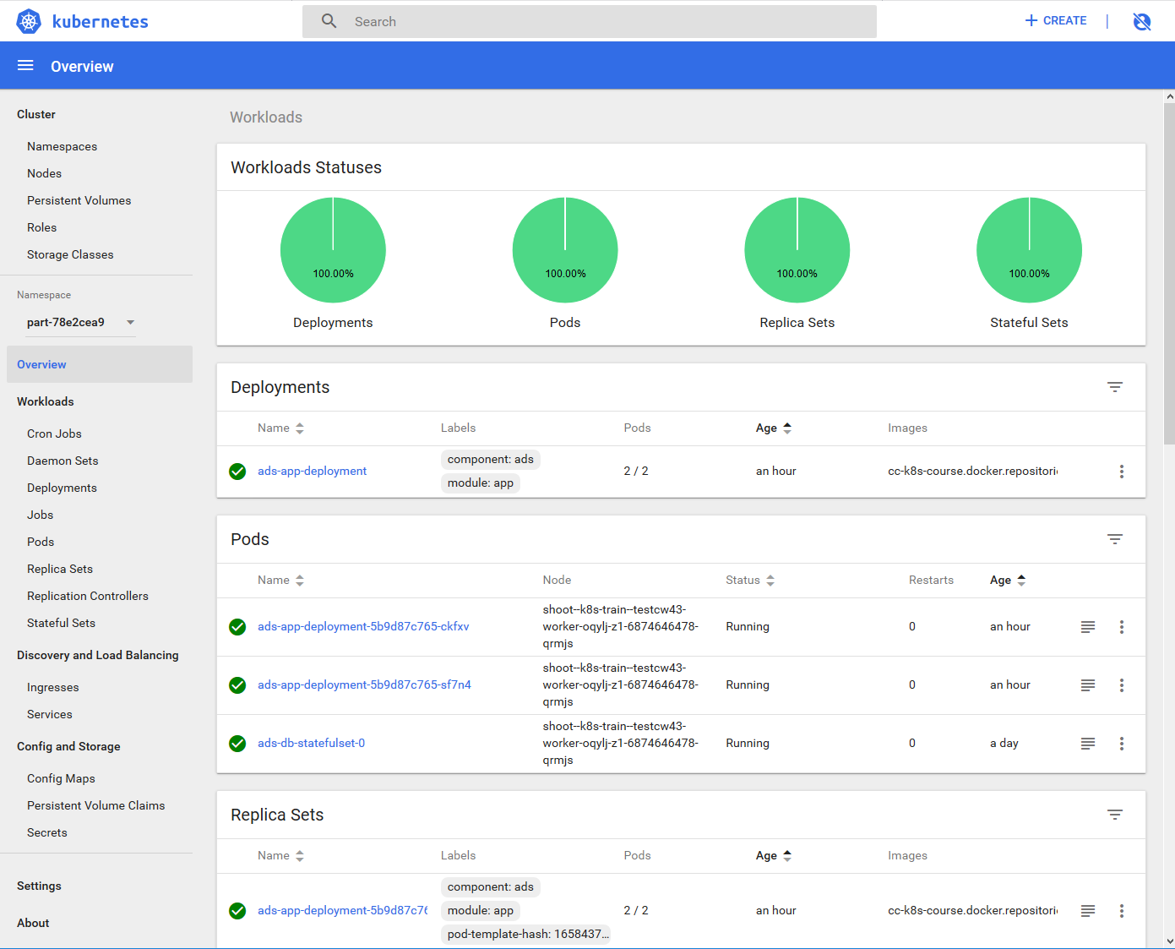
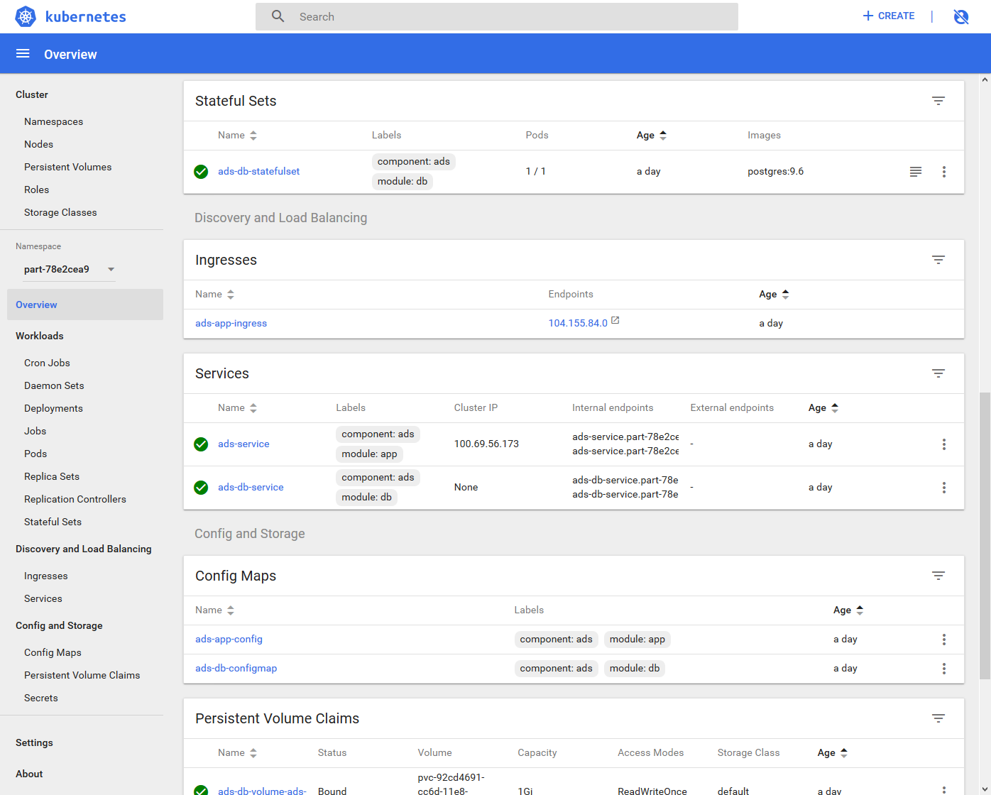
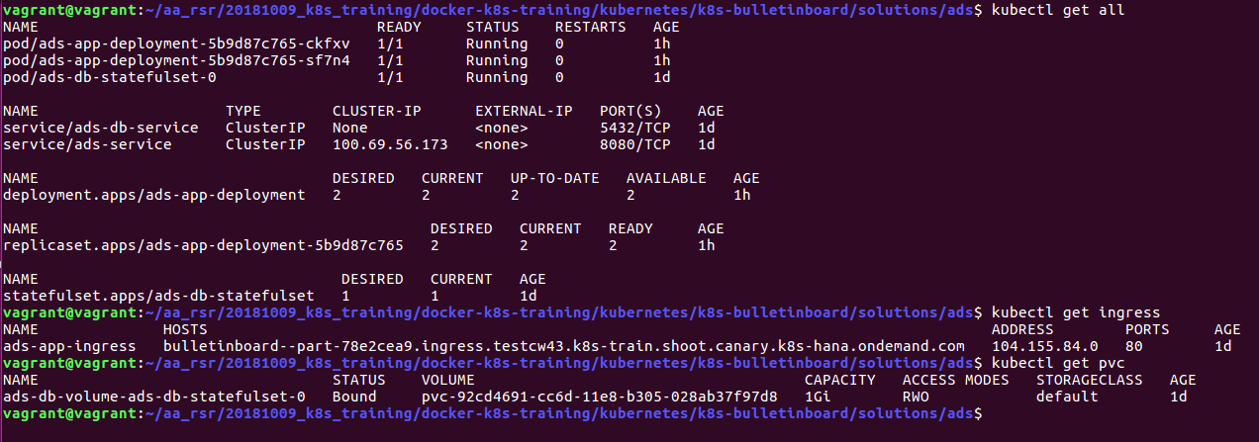
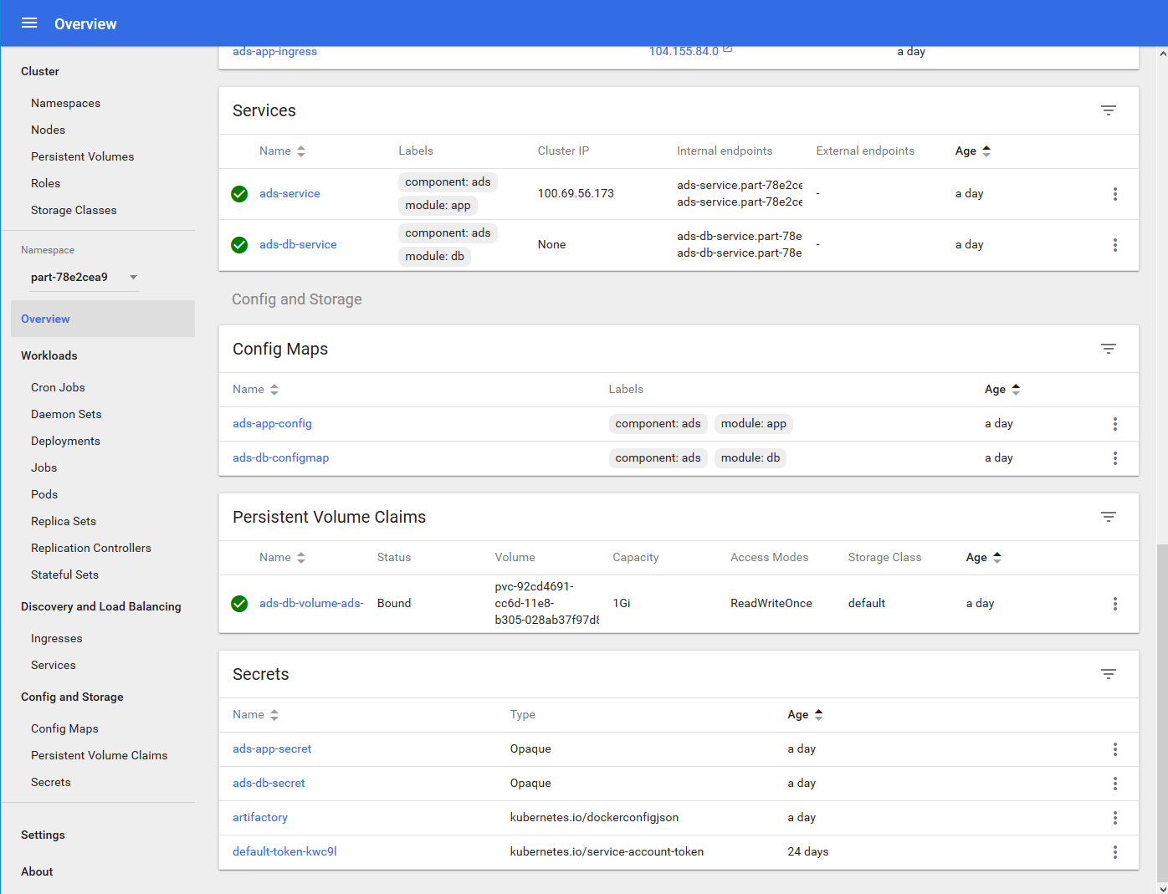
Bulletinboard in K8s:
https://api.testcw43.k8s-train.shoot.canary.k8s-hana.ondemand.com/api/v1/namespaces/kube-system/services/https:kubernetes-dashboard:/proxy/#!/overview?namespace=part-78e2cea9

Slide 54
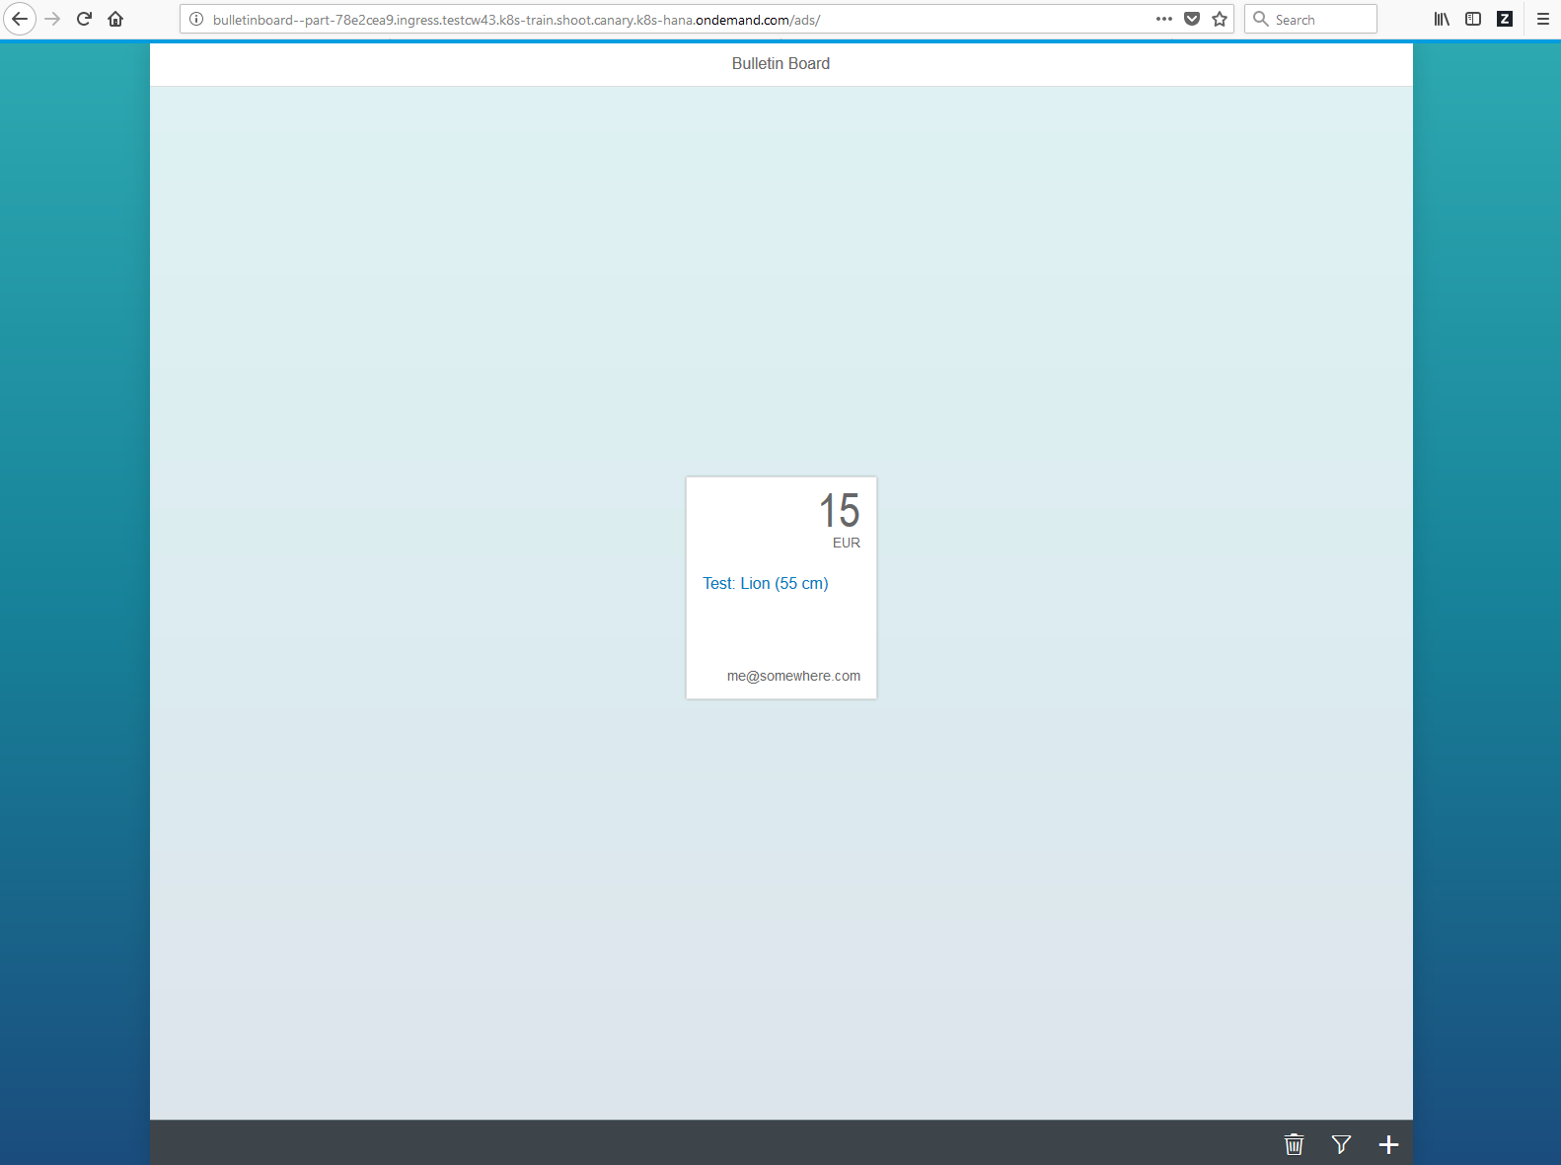
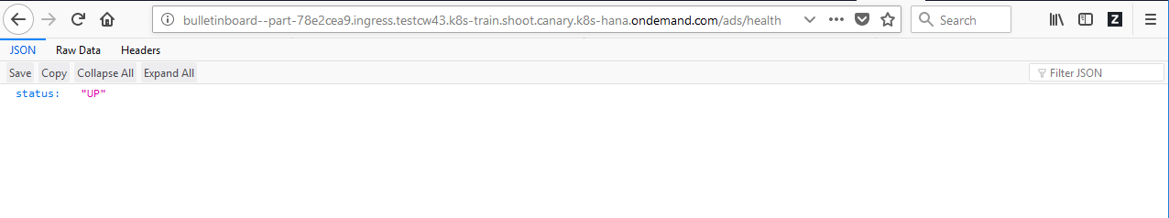
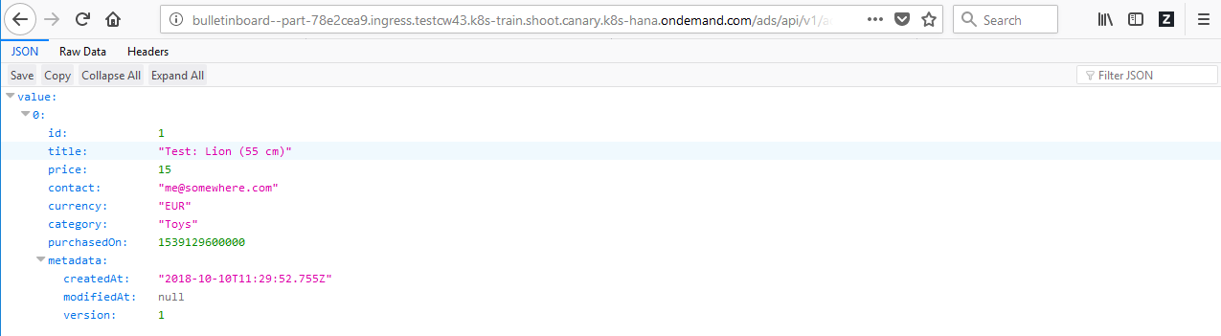
Bulletinboard in K8s:
http://bulletinboard--part-78e2cea9.ingress.testcw43.k8s-train.shoot.canary.k8s-hana.ondemand.com/ads/

Slide 55
Appendix

Slide 56
What YOU will do in exercise #0x
nginx
nginx
nginx
content
config
tls certs

Slide 57

Demo
Notes:
Show all namespaces in cluster
If not yet mentioned, explain that everyone has their own namespace. Please be a good citizen and don’t sabotage the others.
Query a pod from a dedicated namespace ( e.g. kube-system), explain “-n <namespace>” flag

Slide 58
Bulletinboard in K8s: ads app
configmap: ads-app-config-envs
bulletinboard- ads
configmap: ads-app-config-files
pod: ads-app-xx-yy
deployment: ads-app

Slide 59
Bulletinboard in K8s: ads app
ads.ingress.ccdev01.k8s-train.shoot.canary.k8s-hana.ondemand.com
ingress:
ads-app-ingress
service:
ads-app-service
configmap: ads-app-config-envs
bulletinboard- ads
configmap: ads-app-config-files
pod: ads-app-xx-yy
deployment: ads-app

Slide 60
Bulletinboard in K8s: Dependencies across entities – Ads app
deployment:
‘ads-app’
Configmap:
‘ads-app-config-envs’
Configmap:
‘ads-app-config-files’

Slide 61
Bulletinboard in K8s: ads DB
configmap: ads-db-init
Docker container: postgres:9.6
configmap: ads-db
secret: ads-db-secrets
pod: ads-db-0
statefulset: ads-db

Slide 62
Bulletinboard in K8s: ads DB
pod DNS-name: ads-db-0.ads-db-headless
‘headless’ service:
ads-db-headless
configmap: ads-db-init
Docker container: postgres:9.6
configmap: ads-db
secret: ads-db-secrets
pod: ads-db-0
statefulset: ads-db

Slide 63
Bulletinboard in K8s: Dependencies across entities – ads DB
Statefulset:
‘ads-db’
Service:
‘ads-db-headless’
Configmap:
‘ads-db-init’
Configmap:
‘ads-db-config’
Secret:
‘ads-db-secret’

Slide 64
Bulletinboard in K8s: ads DB - labels
pod DNS-name: ads-db-0.ads-db-headless
‘headless’ service:
ads-db-headless
component: ads
module: db
configmap: ads-db-init
Docker container: postgres:9.6
configmap: ads-db
secret: ads-db-secrets
pod: ads-db-0
statefulset: ads-db

Slide 65
Bulletinboard in K8s: ads DB – details labels & selector
selector: component: ads module: db
statefulset: ads-db
component: ads
module: db
pod: ads-db-0
component: ads
Docker container: postgres:9.6
module: db

Slide 66
Bulletinboard in K8s: Helm chart for Ads App & Ads DB
ingr/ svc
HTTP/ REST
svc
HTTPS/ REST
nwp
nwp
bulletinboard- ads
bulletinboard-users
cm
cm
sec
pod
sec
pod
deployment
deployment
svc
svc
nwp
postgresql
nwp
postgresql
cm
cm
sec
pod
sec
pod
statefulset
statefulset
Notes:
- Discuss statefulset vs deployment
- Discuss headless service vs ???
- Discuss service vs ingress

Slide 67
Bulletinboard in K8s: Target picture overall
HTTPS/ REST
ingr/ svc
HTTP/ REST
svc
nwp
nwp
bulletinboard- ads
bulletinboard-users
cm
cm
sec
pod
sec
pod
deployment
deployment
svc
svc
nwp
postgresql
nwp
postgresql
cm
cm
sec
pod
sec
pod
statefulset
statefulset
Notes:
- Discuss statefulset vs deployment
- Discuss headless service vs ???
- Discuss service vs ingress

Slide 68
Bulletinboard in K8s: Exercise “ads DB“
ingr/ svc
HTTP/ REST
svc
nwp
nwp
bulletinboard- ads
bulletinboard-users
cm
cm
sec
pod
sec
pod
deployment
deployment
svc
svc
nwp
postgresql
nwp
postgresql
cm
cm
sec
pod
sec
pod
statefulset
statefulset
Notes:
- Discuss statefulset vs deployment
- Discuss headless service vs ???
- Discuss service vs ingress

Slide 69


Bulletinboard in K8s: Target picture
ingr/ svc
HTTP/ REST
svc
nwp
nwp
bulletinboard- ads
bulletinboard-users
cm
cm
sec
pod
sec
pod
deployment
deployment
svc
svc
nwp
postgresql
nwp
postgresql
cm
cm
sec
pod
sec
pod
statefulset
statefulset
Notes:
- Discuss statefulset vs deployment
- Discuss headless service vs ???
- Discuss service vs ingress

Slide 70
Bulletinboard in K8s: ads DB
ingr/ svc
HTTP/ REST
svc
nwp
bulletinboard- ads
nwp
bulletinboard-users
cm/ sec
cm/ sec
deployment
deployment
svc
svc
nwp
postgresql
nwp
postgresql
cm/ sec
cm/ sec
statefulset
statefulset
Notes:
- Discuss statefulset vs deployment
- Discuss headless service vs ???
- Discuss service vs ingress

Slide 71
Bulletinboard in K8s: ads DB
ingr/ svc
HTTP/ REST
svc
nwp
bulletinboard- ads
nwp
bulletinboard-users
cm/ sec
cm/ sec
deployment
deployment
svc
svc
nwp
postgresql
nwp
postgresql
cm/ sec
cm/ sec
statefulset
statefulset
Notes:
- Discuss statefulset vs deployment
- Discuss headless service vs ???
- Discuss service vs ingress

Slide 72
Bulletinboard in K8s: ads DB
pod DNS-name: ads-db-0.ads-db-headless
‘headless’ service:
ads-db-headless
Docker container: postgres:9.6
pod: ads-db-0
statefulset: ads-db

Slide 73
Bulletinboard in K8s: Target picture
ingr/ svc
HTTPS/ REST
svc
HTTPS/ REST
bulletinboard- ads
bulletinboard-users
nwp
nwp
cm/ sec
ü
cm/ sec
deployment
deployment
svc
svc
nwp
postgresql
nwp
postgresql
cm/ sec
ü
cm/ sec
statefulset
statefulset
Notes:
- Discuss statefulset vs deployment
- Discuss headless service vs ???
- Discuss service vs ingress

Slide 74

Bulletinboard in K8s: Target picture
ingr/ svc
HTTPS/ REST
svc
HTTPS/ REST
bulletinboard- ads
bulletinboard-users
nwp
nwp
cm/ sec
cm/ sec
deployment
deployment
svc
svc
nwp
postgresql
nwp
postgresql
cm/ sec
ü
cm/ sec
statefulset
statefulset
Notes:
- Discuss statefulset vs deployment
- Discuss headless service vs ???
- Discuss service vs ingress

Slide 75
Bulletinboard in K8s: Target picture
ingr/ svc
HTTPS/ REST
svc
HTTPS/ REST
nwp
bulletinboard- ads
nwp
bulletinboard-users
cm/ sec
cm/ sec
pod
pod
deployment
deployment
svc
svc
nwp
postgresql
nwp
postgresql
cm/ sec
cm/ sec
pod
pod
statefulset
statefulset
Notes:
- Discuss statefulset vs deployment
- Discuss headless service vs ???
- Discuss service vs ingress

Slide 76
Bulletinboard in K8s: Target picture
ingr/ svc
HTTPS/ REST
svc
HTTPS/ REST
bulletinboard- ads
bulletinboard-users
nwp
nwp
cm/ sec
cm/ sec
deployment
deployment
svc
svc
nwp
postgresql
nwp
postgresql
cm/ sec
cm/ sec
statefulset
statefulset
Notes:
- Discuss statefulset vs deployment
- Discuss headless service vs ???
- Discuss service vs ingress

Slide 77
Bulletinboard in K8s: Target picture
ingr/ svc
HTTPS/ REST
svc
HTTPS/ REST
bulletinboard- ads
bulletinboard-users
nwp
nwp
cm/ sec
cm/ sec
deployment
deployment
svc
svc
nwp
postgresql
nwp
postgresql
cm
cm/ sec
sec
statefulset
statefulset
Notes:
- Discuss statefulset vs deployment
- Discuss headless service vs ???
- Discuss service vs ingress

Slide 78
Bulletinboard in K8s: Target picture
pod DNS-name: ads-db-0.ads-db-headless
‘headless’ service:
ads-db-headless
component: ads
module: db
configmap: ads-db-init
Docker container: postgres:9.6
component: ads
configmap: ads-db
module: db
secret: ads-db-secrets
component: ads
pod: ads-db-0
module: db
statefulset: ads-db

Slide 79
Bulletinboard in K8s: Dependencies across entities - 1
Statefulset:
‘ads-db’
Service:
‘ads-db-headless’
Configmap:
‘ads-db-init’
Configmap:
‘ads-db-config’
Secret:
‘ads-db-secrets’

Slide 80
Bulletinboard in K8s: Target picture
K8s
ingr/ svc
HTTPS/ REST
svc
HTTPS/ REST
bulletinboard- ads
bulletinboard-users
nwp
nwp
cm/ sec
cm/ sec
deployment
deployment
svc
svc
nwp
postgresql
nwp
postgresql
cm/ sec
cm/ sec
statefulset
statefulset
Notes:
- Discuss statefulset vs deployment
- Discuss headless service vs ???
- Discuss service vs ingress

Slide 81
Bulletinboard in K8s: Step 1 – DB for bulletinboard-ads
K8s
ingr/ svc
HTTPS/ REST
svc
HTTPS/ REST
bulletinboard- ads
bulletinboard-users
nwp
nwp
cm/ sec
cm/ sec
deployment
deployment
svc
svc
nwp
postgresql
nwp
postgresql
cm/ sec
cm/ sec
statefulset
statefulset

Slide 82
Scaling: Option 1 – App gets multiple instances, if needed
K8s
bulletinboard- ads
bulletinboard-users
bulletinboard- ads
bulletinboard-users
bulletinboard- ads
bulletinboard-users
postgresql
postgresql

Slide 83
Scaling: Option 2 – DB gets multiple instances, if needed
K8s
bulletinboard- ads
bulletinboard-users
postgresql
postgresql
postgresql
postgresql
postgresql
postgresql

Slide 84
Scaling: Option 3 – Both – app and DB get multiple instances, if needed
K8s
bulletinboard- ads
bulletinboard-users
bulletinboard- ads
bulletinboard-users
bulletinboard- ads
bulletinboard-users
postgresql
postgresql
postgresql
postgresql
postgresql
postgresql

Slide 85
Bulletinboard in K8s: Target picture
K8s
ingr/ svc
HTTPS/ REST
svc
HTTPS/ REST
bulletinboard- ads
bulletinboard-users
nwp
nwp
cm/ sec
cm/ sec
deployment
deployment
svc
svc
nwp
postgresql
nwp
postgresql
cm/ sec
cm/ sec
statefulset
statefulset
Notes:
- Discuss statefulset vs deployment
- Discuss headless service vs ???
- Discuss service vs ingress

Slide 86
Bulletinboard in K8s: Step 1 – DB for bulletinboard-ads
K8s
ingr/ svc
HTTPS/ REST
svc
HTTPS/ REST
bulletinboard- ads
bulletinboard-users
nwp
nwp
cm/ sec
cm/ sec
deployment
deployment
svc
svc
nwp
postgresql
nwp
postgresql
cm/ sec
cm/ sec
statefulset
statefulset

Slide 87
Bulletinboard in K8s: Dependencies across entities - 1
Statefulset:
‘ads-db’
Service:
‘ads-db-headless’
Configmap:
‘ads-db-init’
Configmap:
‘ads-db-config’
Secret:
‘ads-db-secrets’

Slide 88
Cloud Curriculum, Reference/ Sample Microservice: bulletinboard
K8s
ingr/ svc
HTTPS/ REST
svc
HTTPS/ REST
bulletinboard- ads
bulletinboard-users
nwp
nwp
cm/ sec
cm/ sec
deployment
deployment
svc
svc
nwp
postgresql
nwp
postgresql
cm/ sec
cm/ sec
statefulset
statefulset

Slide 89
xxx

Slide 90
Cloud Curriculum, Reference/ Sample Microservice: bulletinboard
K8s
ingr/ svc
HTTPS/ REST
svc
HTTPS/ REST
bulletinboard- ads
bulletinboard-users
nwp
nwp
cm/ sec
cm/ sec
deployment
deployment
svc
svc
nwp
postgresql
nwp
postgresql
cm/ sec
cm/ sec
statefulset
statefulset

Slide 91
Cloud Curriculum, Reference/ Sample Microservice: bulletinboard
K8s
ingr/ svc
HTTPS/ REST
svc
HTTPS/ REST
bulletinboard- ads
bulletinboard-users
nwp
nwp
cm/ sec
cm/ sec
deployment
deployment
svc
svc
nwp
postgresql
nwp
postgresql
cm/ sec
cm/ sec
statefulset
statefulset

Slide 92
Cloud Curriculum, Reference/ Sample Microservice: bulletinboard
ing/ svc
HTTPS/ REST
svc
HTTPS/ REST
bulletinboard- ads
bulletinboard-users
cm/ sec
cm/ sec
deployment
deployment
svc
svc
postgresql
postgresql
cm/ sec
cm/ sec
statefulset
statefulset

Slide 93
Cloud Curriculum, Reference/ Sample Microservice: bulletinboard
K8s
bulletinboard- ads
bulletinboard-users
HTTPS/ REST
ing/ svc
HTTPS/ REST
svc
cm/ sec
cm/ sec
deployment
deployment
svc
svc
postgresql
postgresql
cm/ sec
cm/ sec
statefulset
statefulset

Slide 94
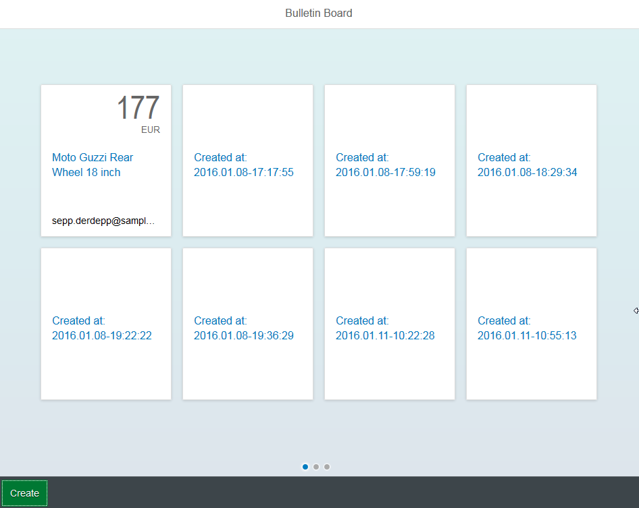
Reference/ Sample Microservices: bulletinboard
Cloud Foundry
Advertisement (ads)
HTTPS / REST
Users
Statistics
https://bulletinboard-ads-production.cfapps.sap.hana.ondemand.com/static/index.html
(backing) services
PostgreSQL
ELK

Slide 95
Github
Commit Stage
Integration Stage
Copy artifacts
Deploy
Integration Space
App
Staging Repository: Jenkins
Notes:
Integration_Stage/images/Exercise1_Overview_Classic.png

Slide 96
Github
Commit Stage
Integration Stage
Copy artifacts
Deploy
Integration Space
App
Staging Repository: Jenkins
Notes:
Integration_Stage/images/Exercise1_Overview_Classic.png

Slide 97
Reference/ Sample Microservices: bulletinboard
Cloud Foundry
Advertisement (ads)
HTTPS / REST
Users
Statistics
(backing) services
PostgreSQL
ELK

Slide 98
Cloud Foundry
Advertisement (ads)
HTTPS / REST
Users
Statistics
(backing) services
PostgreSQL
ELK

Slide 99
Old

Slide 100
Pods – logical hosts
IP: 10.10.10.1
IP: 10.10.10.2
Pod-A
Pod-B
container
nginx
container
nginx
container
proxy
volume
volume
Worker
Notes:
Recap: Pods can be considered as logical hosts and host 1..n containers.
Since every pod has its own IP address, it is possible to expose the same port on every pod (e.g. port 80 for a web server). Only within one pod you cannot expose the same port twice (so you cannot run 2 web server container in one pod and expose both on port 80).
Pods provide ephemeral (=non-persisted) storage. However pods are not meant to live forever. When they die, all the data inside is gone too. Use other resources to create persistent storage for your applications.

Slide 101
Sidecar pattern – or when to use multiple container in a pod
Application container
Helper container
IP: 10.10.10.2
Pod-B
container
nginx
container
proxy
volume
Notes:
We said that a pod may consist of more than one container. But when should you use such a feature? The so called ‘sidecar’ pattern gives a few ideas:
In general there is always one ‘main’ container, often also referred to as the application container. This primary container hosts the core logic of your application. In our example this is a ngnix webserver
The 2nd (sidecar) container provides augmentation to improve the application container. To do so, both container need to share certain resources like disk space or network.
Think of the following setup: You have a webserver serving on port 80 (plain http). To add https you would need to touch your application. Alternatively you could add a proxy container that augments your webserver with https. Simply let your primary container serve port 80 only to localhost and capture that traffic in your proxy container, which then provides https.
Another example would be a configuration update mechanism realized with a helper container. A nginx webserver reads its configuration from a file. If this file is updated, a restart would be required. Think of a helper container, which takes notice of the configuration change and restarts the nginx in order to make it re-load the configuration. This is possible, since both container share the same volume (disks) and also the process namespace (if configured properly).

Slide 102
Pods
A pod (as in a pod of whales or pea pod) is a group of one or more containers (such as Docker containers), with shared storage/network, and a specification for how to run the containers
Containers of a pod share localhost network interface
A pod can provision ephemeral storage or attach persistent storage
Pods are started by kubelet but can die any time without necessarily being re-scheduled
Pods can be probed by kubelet (liveness & readiness probe)
Most important pod phases / status:
Pending
Running
Succeeded
Failed
Unknown

Slide 103
Basic structure of most K8s resources
api the resource belongs to, e.g. “v1”
apiVersion
value
resource type, e.g. “pod”
kind
value
metadata
metadata like name, annotations or labels are maintained here
metadata object
spec
spec object
specification of the resource based on its “kind”
status
status object
Information supplied by k8s, not maintained by users
Notes:
Example for a resource with different structure: configMap
configMaps have no spec, but a data sections.
When looking at the api reference, you can see this basic structure too. Simply navigate to a resource, like pod, and see with fields and object there are. Usually fields have either a list or string/integer as values. Objects link to their object definition.

Slide 104
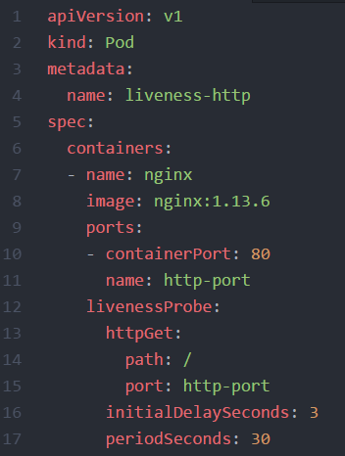
Pod definition - https://kubernetes.io/docs/api-reference/v1.8/#pod-v1-core
Resources of “kind:pod” belong to “apiVersion: v1”
Within “metadata” the pod’s name is specified
The pod’s “spec” provides all the necessary details, like the image to use, to actually start a container
The livenessProbe defines a check, to determine, if the pod is in a healthy state

Slide 105
Liveness & Readiness Probes
Respond with HTTP 200, if you are alive!
Send back the index.html, if you are ready!
HTTP 200 ‘OK’
index.html
nginx-pod
Notes:
Demo: http & exec liveness pods (see pod_exec_liveness & pod_http_liveness yaml files in the solutions folder)
Consequence of failed probe:
liveness: kill the container and restart it depending on the restart policy.
Readiness: mark pod as not ready and don’t route service traffic to it
Other options for probes:
TCP: can a connection be opened successfully?
EXEC: run a command and evaluate return/exit code

Slide 106
Demo
Notes:
Create a pod: ~/kubernetes/demo/02_pod_exec_liveness.yaml
Discuss the probe and how it should fail
Show how it fails & get restarted
Point out the failure threshold
Create a 2nd pod, this time with a web server: ~/kubernetes/demo/02_pod_http_liveness.yaml
Explain the http probe and how it should fill up the logs
Show logs of the container (will be the access log) and discuss the effect of the liveness probe
Access nginx:
Run kubectl port-forward pod/nginx-liveness-pod 8080:80
Open a browser and connect to 127.0.0.1:8080
Port-forward is a nice command to test access to something that you don’t want to expose (yet). However it is not recommended for any production like setup as the traffic is routed via the cluster’s API server

Slide 107
Namespaces
Namespace: your-namespace
Pod
Pod
Pod
Namespace: my-namespace
Pod
Pod
Pod
Worker
Worker
Worker

Slide 108
Namespaces
Logical realm for applications to run within
Isolate resources and restrict visibility to objects in the same namespace
Basic user management is handled on namespace level
Resource quotas / limits managed per namespace
Uniqueness of names required per namespace
Access to services in a different namespace via FQDN <service-name>.<namespace>
Use –n (--namespace) <namespace> switch with kubectl to access resources

Slide 109
Demo
Notes:
Show all namespaces in cluster
If not yet mentioned, explain that everyone has their own namespace. Please be a good citizen and don’t sabotage the others.
Query a pod from a dedicated namespace ( e.g. kube-system), explain “-n <namespace>” flag

Slide 110
What YOU will do in exercise #02
nginx
nginx
nginx
content
config
tls certs

