Slide 1
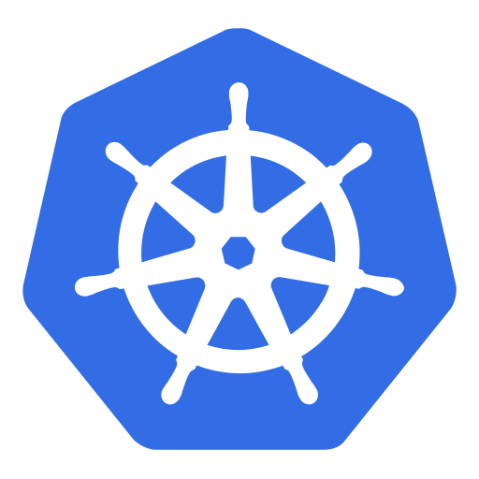
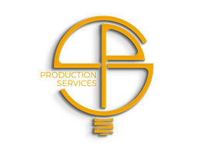
An (non-technical) introduction to
Kubernetes

Slide 2
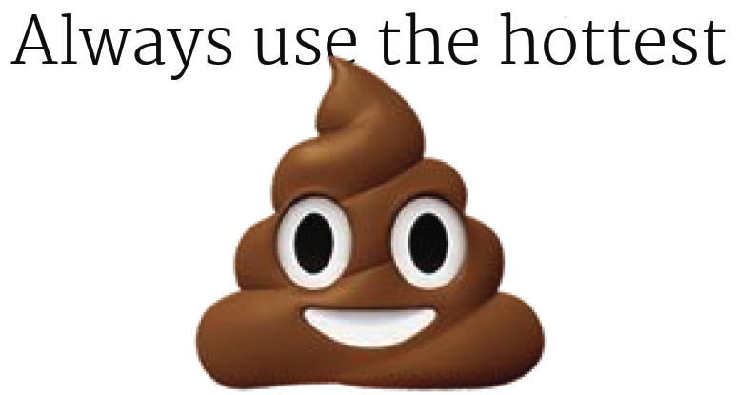
2016: Serverless Architecture
2017: Codeless Architecture
2018: Architectureless Architecture
https://twitter.com/benbjohnson/status/746049032699600897
Notes:
Docker hype started in 2013
Even more abstraction with “serverless”
However – does it really make sense? Probably not always…

Slide 3
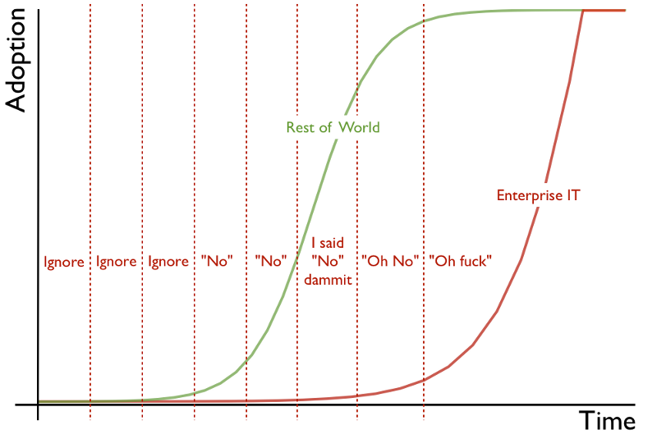
The enterprise IT adoption cycle
Adoption cycle graphic © 2012 Simon Wardley and CC BY-SA 3.0. Nicked from his blog and placed here by Andrew Back.
Notes:
Why are we talking about Docker & Kubernetes now?
Watch out for “serverless” to become more and more important

Slide 4
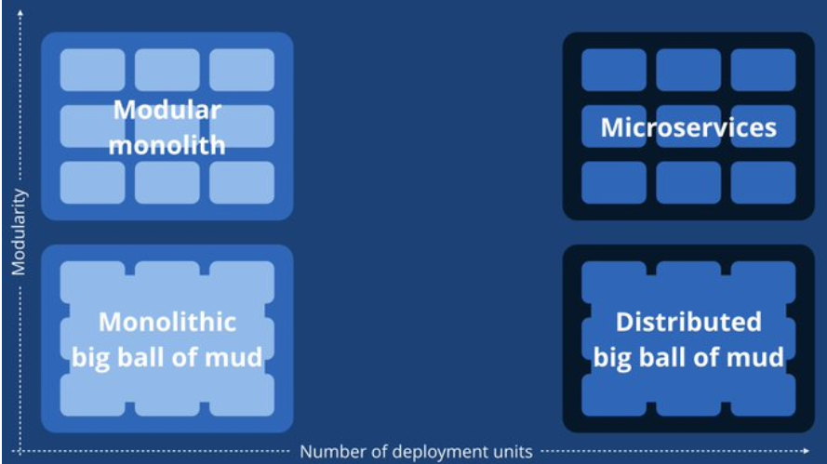
Containers will NOT fix a broken architecture!
https://twitter.com/simonbrown/status/847339104874381312
Notes:
“Since we introduced micro services, every outage is like a murder mystery”

Slide 5
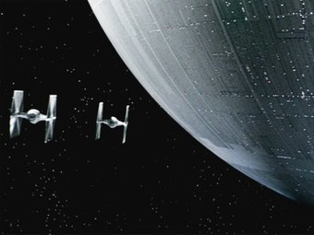
Here's a diagram of two microservices and their shared database.
https://twitter.com/mathiasverraes/status/711168935798902785
Notes:
How to tackle databases?
1 service => 1 database?
Containerize databases?

Slide 6
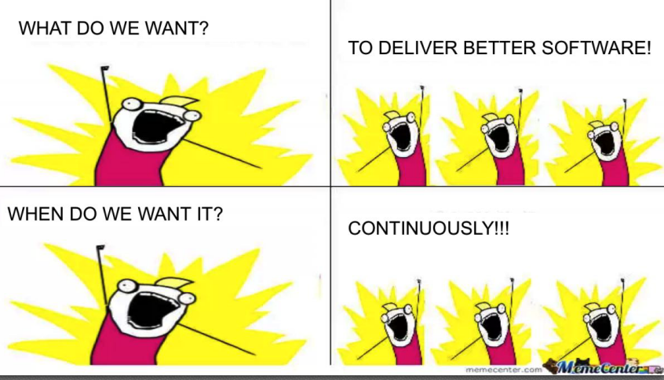
To make error is human.
To propagate error to all server in automatic way is #devops.
https://twitter.com/DEVOPS_BORAT/status/41587168870797312

Slide 7

But it works on my machine!
Notes:
Local isolation like in an aquarium is not ideal. Talking from docker host to docker host is complex due to port mappings.
However deploying your apps to the wide sea of Kubernetes, doesn’t solve this fully.

Slide 8

So, what is this Kubernetes all about then?
Do you remember, how fun it was to …
start and stop every container?
map ports and don’t get confused?
check the health of a container?
miss a volume on a different host?
…

Slide 9
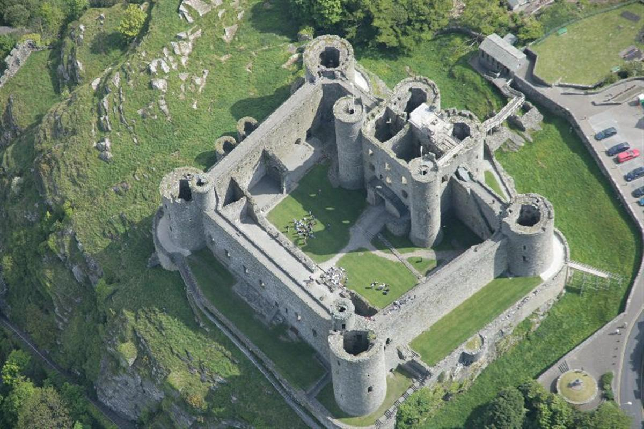
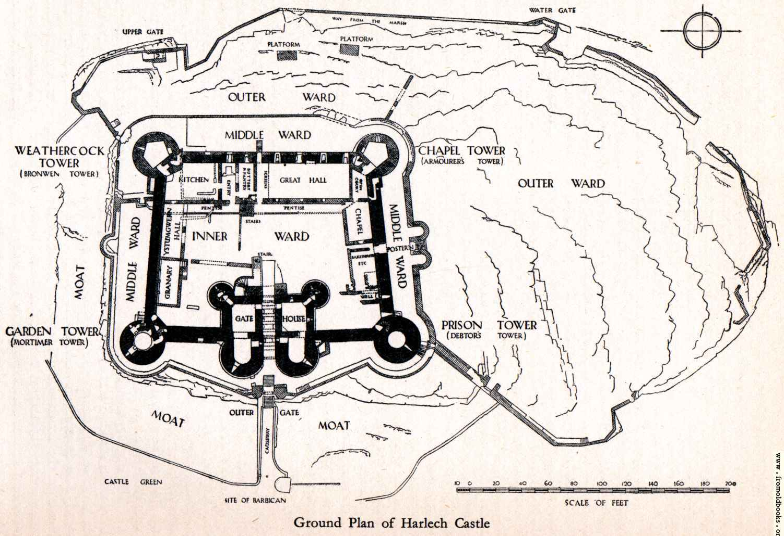
Tell me, what you want…
All it takes, is a description and some bricks…
Notes:
Kubernetes takes a “construction plan” and instantiates it as often as you want – as long as you have enough resources
What you describe, is what you get.

Slide 10
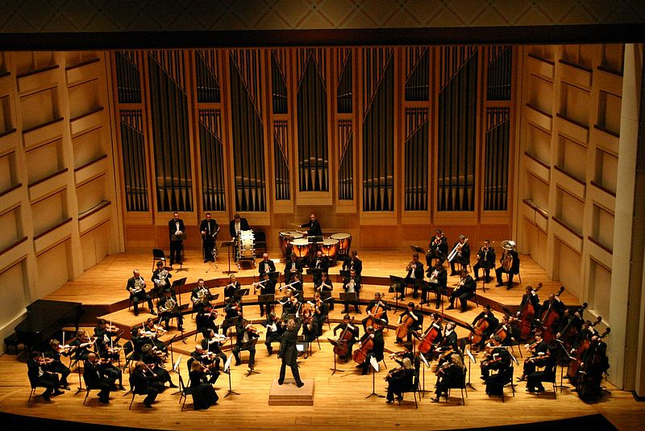
Orchestration
Notes:
Kubernetes orchestrates your workloads & applications – also several of them in parallel.

Slide 11
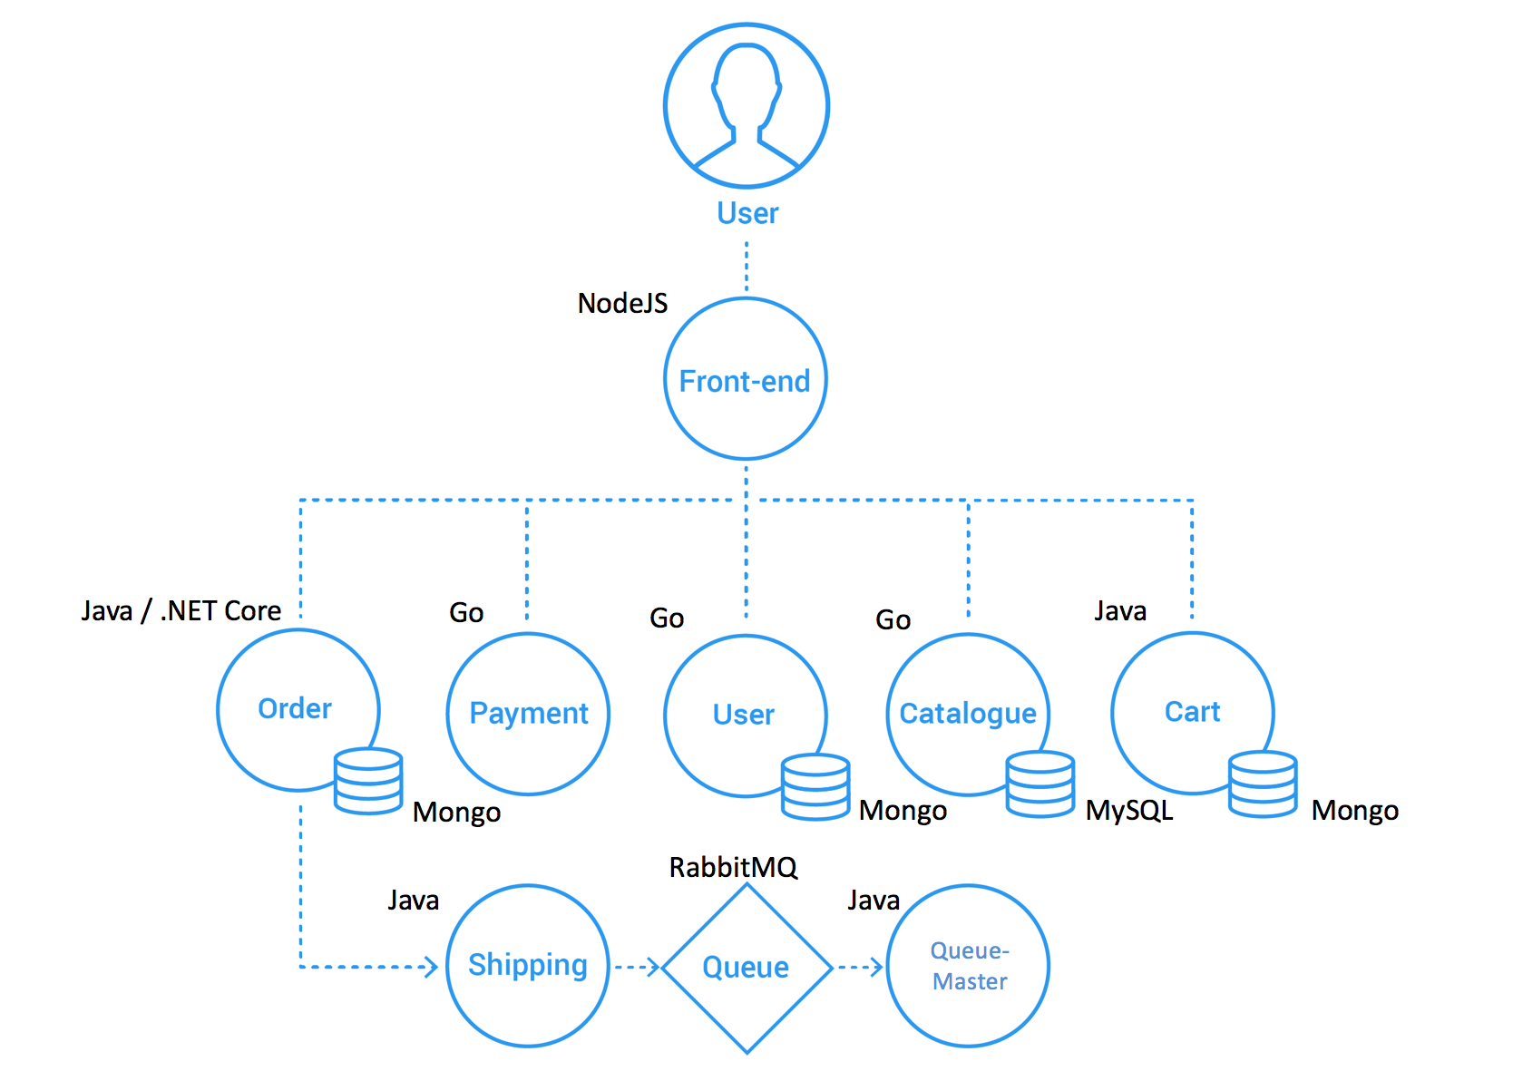
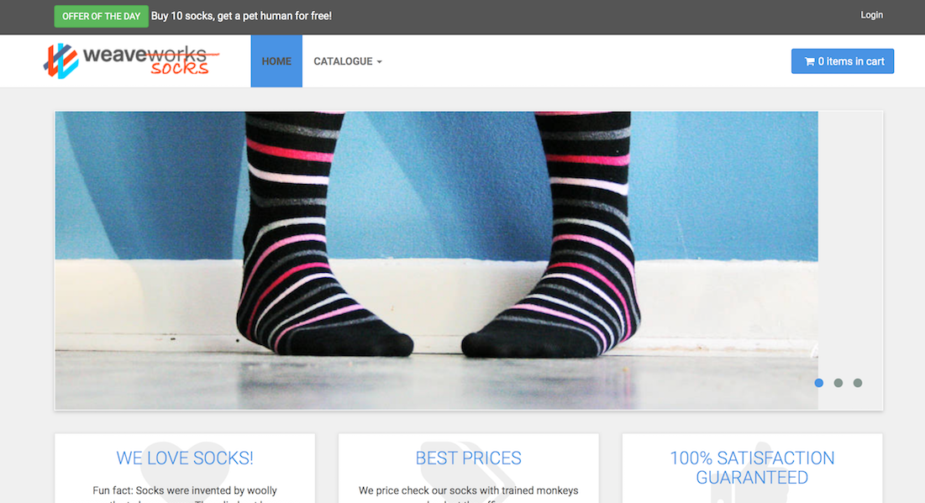
Getting started: let‘s buy some socks
Notes:
The demo is based on the “sock shop” e-commerce platform developed by weaveworks. This is a full-blown demo application, including content – however you have to wait ~2min until the content is fully loaded. To demo, create a “sock-shop” namespace and use the sock-shop.yaml from the kubernetes/solutions folder to deploy all components.
The design of the sock-shop is based a micro-services architecture and was containerized appropriately. See https://github.com/microservices-demo/microservices-demo/blob/master/internal-docs/design.md for further details

Slide 12
Some facts about K8s, kubernetes, …
Kubernetes = Greek for “helmsman” or “pilot”
Based on Google’s Borg – a cluster manager for container orchestration
Open sourced by Google and firstly announced in 2014
v1.0 was released in July 2015
By now K8s is governed by the Cloud Native Computing Foundation (CNCF)
Vanilla Kubernetes is the basis for commercial products like RedHat’s Openshift or CoreOS’ tectonic
New minor releases roughly every 3 month
Extensive list of beta features
Documentation: https://kubernetes.io/docs/home/ - concepts, tasks, API reference

Slide 13
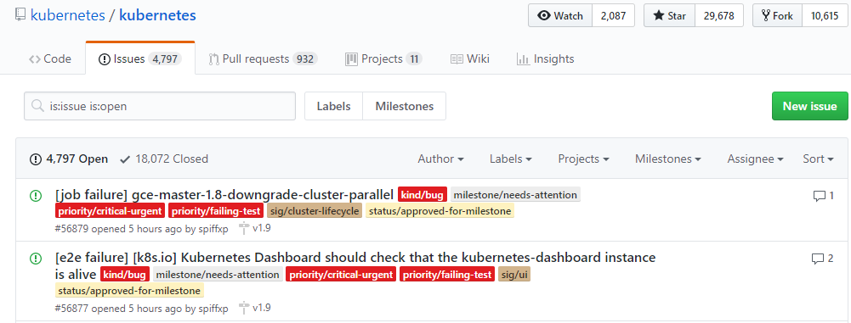
If it doesn’t always work as expected …
https://groups.google.com/forum/#!forum/kubernetes-users
https://github.com/kubernetes
https://github.com/kubernetes/community/blob/master/communication.md

Slide 14
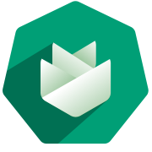
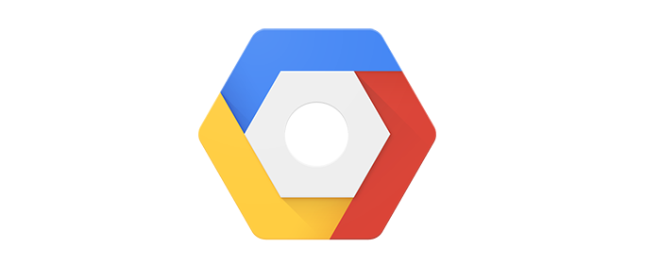

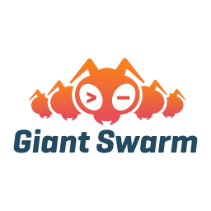
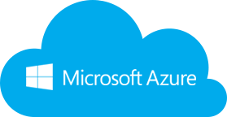
Wherefrom can I get a cluster?
Notes:
Gardener: SAP’s solution to managed Kubernetes

