Slide 1


Docker and Kubernetes
Hands-On Training
Thomas Buchner, STS Infrastructure
Hendrik Kahl, SLV ABAP Component Validation

Slide 2

Basics of Containers

Slide 3
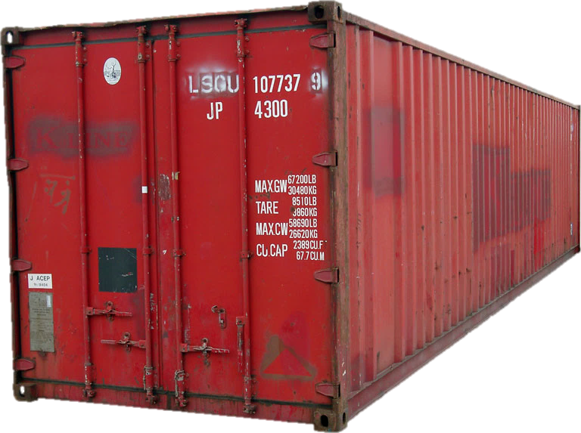
What is a Container?
App
(e.g. nginx)
Convenient package to ship „things“
Open specification
Stackable
Isolated
Portable
Lightweight
Tools
Libs
Notes:
Lots of the attributes of a regular ISO container apply to software containers.

Slide 4
A container is just a process bound by Linux Primitives.
Notes:
The Linux kernel does not know about containers at all – for it, containers are nothing more than just regular processes running on the system. They are managed like all other processes by the kernel.
The Linux kernel however offers several features that Docker and other container engines leverage to achieve an almost complete isolation of processes from each other. These features are outlined on the next slide and will be discussed in detail in “Members of the Docker Universe”.

Slide 5
Linux Primitives used by Containers
chroot
seccomp
cgroups
capabilities
netfilter
Namespaces
SELinux
AppArmor
netlink
Notes:
Containers make heavy use of features that are offered by the Linux kernel. These features are going to be described in detail on the following slides.

Slide 6
Linux Primitives used by Containers
Chroot
Changes the root directory for a process to any given directory
Namespaces
Different processes see different environments even though they are on the same host/OS
Seven different namespaces for
PID (process tree)
mnt (mount points)
Net (network interfaces and connectivity)
IPC (interprocess communication framework)
UTS (hostnames, date & time, etc.)
UID (user IDs and mappings)
cgroup (control groups for resource allocation)
Control groups (cgroups)
manage/limit resource allocation to individual processes
Prioritization ('nice' for a set of processes and not just one)
capabilities
without capabilities: root can do everything, everybody else may do nothing
38 granular facilities to control privileges
netfilter
firewall and packet manipulation (iptables/nftables)
can manipulate almost all network traffic going in/out a host
used to direct network packages to individual containers
Netlink
Interprocess communication between containers
SELinux/AppArmor
Security profiles to govern access to resources
seccomp
Limitation of allowed kernel syscalls
Unallowed syscalls lead to process termination

Slide 7




Filesystem isolation with chroot
/
Chroot makes any directory the topmost/root directory of a process
New process can only see files and directories under that special root directory
Provides file system isolation
bin
home
foo
/
container101
chroot
bin
container
lib
bin
usr
lib
usr
usr
Notes:
With chroot we can start a new process making a specified directory the new processes' topmost directory. Processes running in that chroot can only see those parts of the filesystem which are subdirectories of it.
Chroot is part of Unix and was initially integrated to test Unix installation routines. It is still very often used for bootstrapping a system during installation.
One problem with chroot is: since the process that gets started inside the chroot can no longer see the full filesystem, all files required to load and run that process must be copied to the chroot directory (and subdirectories) first - a tedious task that can take some time, and is trial and error.

Slide 8

Demo
Notes:
Demo for chroot
Within the repo go to the container-demos folder and run demo-01-chroot.sh
The script will do the setup of a minimal environment (basically only a bash + libs) and chroot into it.
Explain the importance of libraries to binaries. Without the corresponding libs in their respective directories, no binary will work. And after all, (container) processes are based on binaries.
It is also worth to mention, that the file system you chroot into is the foundation of every container. Luckily in most cases you can rely on others building the base images with all binaries and libs. The only thing you have to do as a developer is move your own stuff into it.
So if there is something called centos or ubuntu later, remember that this is no full-fledged OS but only a collection of bins/libs making your life a lot easier.

Slide 9
Process (and more) isolation with pid namespaces
Linux process tree
pid namespaces give a process a limited view on the process table
Only processes in the same pid namespace can see each other
Processes get new PIDs in their pid namespace
Still visible with their original PID outside of namespace
Same principle applies to mount, uid, cgroup, …, namespaces
1
3
27
16
namespaced process tree
1 (31)
49
51
31
4 (62)
7 (12)
62
12
Notes:
Man-page definition: A namespace wraps a global system resource in an abstraction that makes it appear to the processes within the namespace that they have their own isolated instance of the global resource. Changes to the global resource are visible to other processes that are members of the namespace, but are invisible to other processes [outside of that namespace]. One use of namespaces is to implement containers.
Linux offers namespaces for seven different resources: PID table, mount table, user mapping table, IPC, network stack, UTS (host and domain name) and cgroups.

Slide 10
Demo
Notes:
Demo for namespaces & unshare
Within the repo go to the container-demos folder and run demo-02-unshare.sh
The script will fork a new process with a separate PID namespace. It’ll also explore the space of the newly created processes. Please note, the demo does not use chroot.
With namespaces you can isolate aspects of a processes or process groups (like the process tree or networking stack). As mentioned on the previous slide, this is another building block for Linux containers to work.

Slide 11
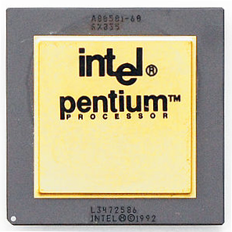

Resource limitations with cgroups
cgroups limit access of a process to system resources
Several processes can be in the same cgroup they all share the resource limit
cgroups offer resource control for
CPU
memory
block I/O
and others
cgroup
Process
Process
Process
Process
Notes:
Wikipedia definition: cgroups (abbreviated from control groups) is a Linux kernel feature that limits, accounts for, and isolates the resource usage (CPU, memory, disk I/O, network, etc.) of a collection of processes.
With cgroups, processes can be kept from eating up all system resources. Multiple processes can be added to one single cgroup - they will then all share the resource limits of it.

Slide 12
Demo
Notes:
Demo for cgroups
Within the repo go to the container-demos folder and run demo-03-cgroup.sh
The script will demonstrate how cgroups can be used to control processes. The example is focusing on CPU usage.
Docker as well as Kubernetes can make use of cgroups to manage resources in a container environment.

Slide 13


Container security with seccomp
Every program uses system calls to interact with the operating system
seccomp can block individual system calls
whitelisting
blacklisting
system call trapping
Application
system calls
write
stat
reboot
Kernel
Notes:
An application will eventually (after doing tons of nested library calls) call the operating system to do things - like reading or writing to files or sending data across the network. Talking to the operating system is done through system calls or syscalls. Syscalls are the interface between user space (where your application runs in) and kernel space (where the operating system does its job) and there are around 340 of them (syscalls).
While most system calls are necessary for programs to do their job (e.g. a program cannot even be loaded into memory without the “execve” system call) some are potentially dangerous and would allow a process to break free from its container or to cause harm to other containers (such as the reboot system call which would reboot the host terminating all containers on it).
With seccomp, individual system calls can be blocked to reduce the security risk which is commonly done in container environments (Docker for instance blocks around 40 system calls by default).

Slide 14
Demo
Notes:
Demo for seccomp based on Docker (for convenience)
Within the repo go to the container-demos folder and run demo-05-seccomp.sh
The script will demonstrate how seccomp profiles can be used to control access to the kernel via syscalls. To make things easier, this demo is based on Docker so it might give already an impression on how Docker works.
While the syscalls are blocked in this demo, it is worth to mention, that you can also implement trap wires to inform the underlying platform of what’s going on and potentially invoke countermeasures.

Slide 15
Let’s use these features to start our first container…
# cgexec –r cpu,memory,pids:/container unshare --pid --uts --mount --user --fork chroot container
cgroups resource limitation
chroot filesystem isolation
namespaces process isolation
Notes:
This commands start in fact three different processes: cgexec, unshare and chroot

Slide 16

Exercise #0 – Linux Primitives

Slide 17

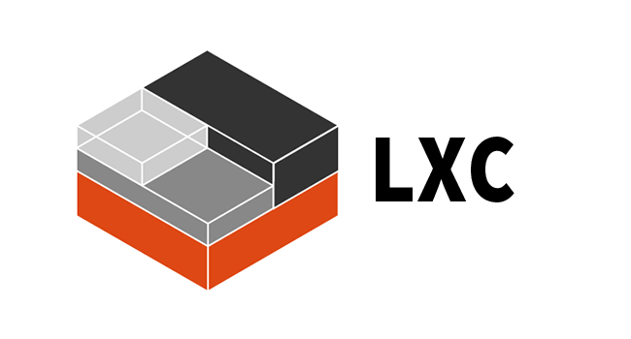
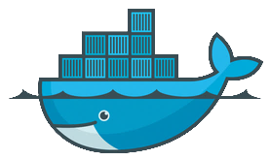


Container engines There is more than just Docker…
LXC / LXD
VM Containers in Linux kernel eventually enhanced by Ubuntu
Docker
That’s what we are talking about, since 2013
rkt [ˈr(ɒ)kit]
Container engine by CoreOS to replace Docker
cri-o
New lightweight container runtime to implements Kubernetes' container runtime interface
Notes:
There are several different container engines that make use of the container features of the Linux kernel.
The big player – and the one that SAP is focusing on – is Docker.
But there is LXC (this more or less started it all as some kind of lightweight virtualization), LXD (an extension to LXC from Ubuntu) and rkt (pronounced “Rocket”) by CoreOS. Since CoreOS was recently acquired by RedHat, we will see which direction it will head to…
Using docker at this point is safe since it is mainstream and possibly required changes moving to rkt should be small.

