Slide 1
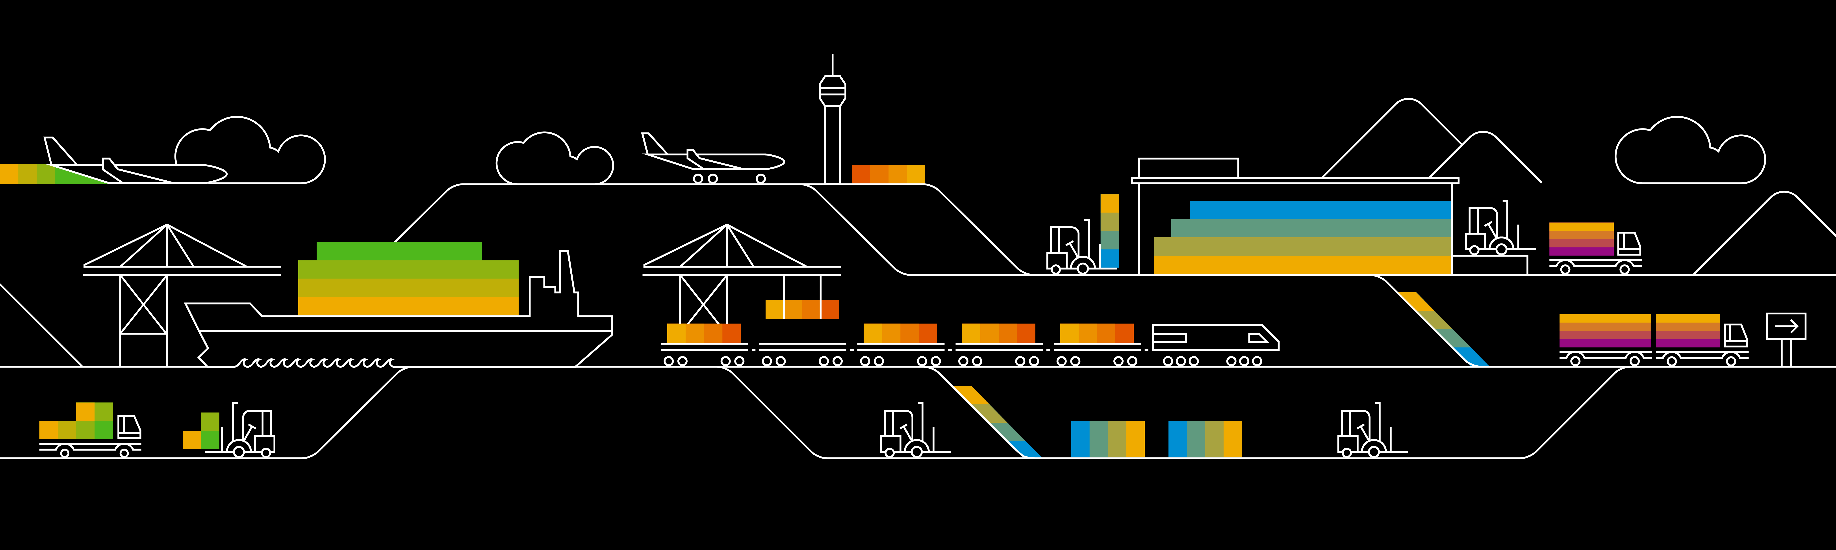

Kubernetes Ingress

Slide 2

Ingress
Services can only expose one backend
More backends involved, imply more services needed
Exposing several applications to the internet, requires multiple services ➔ multiple IP endpoints
Ingress resources can help:
Bundle services into one endpoint
Make application available via a URL
TLS support
…
Ingress
Service A
Service B
Service C
Pod A
Pod B
Pod C
Notes:
A service can only serve one backend. Complex applications may need more than one backend. With Ingress resources, several backends can be exposed via a single entrypoint
Allows to create a network entity on top of services to expose applications
Expose applications via a URL
Requires an “ingress-controller” inside the cluster
https://kubernetes.io/docs/concepts/services-networking/ingress/

Slide 3
How does it work?
Ingress
Ingress resource describes the desired state
Cluster specific “ingress controller” will enforce desired state
Creation of endpoints
Creation of an external loadbalancer
URL mapping
TLS termination
…
https://kubernetes.io/docs/concepts/services-networking/ingress/
https://github.com/kubernetes/ingress-nginx
Ingress-controller
Notes:
The ingress controller needs to be present in the respective cluster. It is configured to watch for new ingress objects being posted to the k8s api server.
Once an ingress resource is created, the controller will try to enforce the desired state. That can include the setup of URL & corresponding routing info etc.
Most common ingress controller is the “nginx ingress controller”

Slide 4
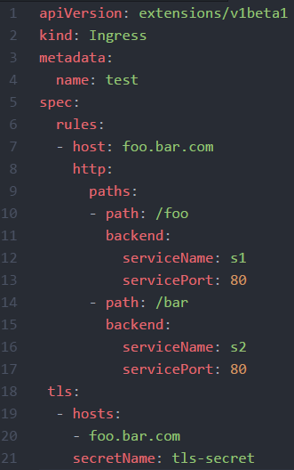
Ingress resource
spec with rules & managed hosts
Access foo.bar.com/foo to be forwarded to service s1 on port 80
Access foo.bar.com/bar to be forwarded to service s2 on port 80
The URL will support https with the certificates from tls-secret
Notes:
In the spec, there is a section about rules & TLS.
Rules define forwarding of incoming traffic to services.

Slide 5
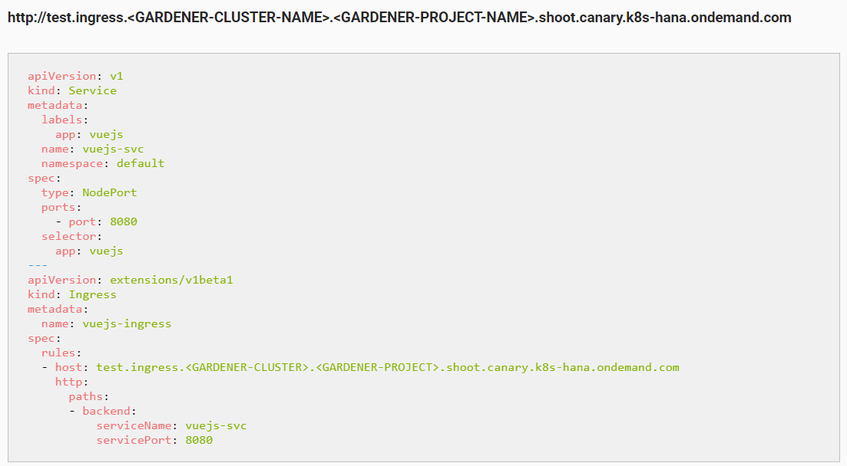
Ingress on Gardener
https://github.wdf.sap.corp/pages/kubernetes/gardener/doc/2017/01/16/howto-service-access.html
Notes:
With Gardener, you get an ingress controller for free ☺ it is also registered with a domain, so you will get your own sub-domain to register your URLs.
The schema is described in the Gardener how-to docs. You might need to adapt the ingress.yaml to your training project.

Slide 6
Demo Script
Prerequisites:
nginx service with nodePort or loadBalancer
Nginx deployment
generate certificate with CN=<FQDN hostname> based on Gardener ingress URL pattern
openssl req -x509 -nodes -days 365 -newkey rsa:2048 -keyout /tmp/nginx.key -out /tmp/nginx.crt -subj "/CN=nginx.ingress.dev01.k8s-train.k8s.sapcloud.io/O=nginx“
TLS secret: kubectl create secret tls nginx-ingress-tls --cert=/tmp/nginx.crt --key=/tmp/nginx.key
Adapted ingress.yaml to current gardener cluster & project + service
Deploy ingress.yaml
Show ingress resource in k8s
Show ingress controller in kube-sytem namespace
Call URL and show TLS, https, …

Slide 7
What was this something about a “controller”?
Observe
Analyze
Act
CRD
Pod
Operator
CRO
Pod
Notes:
About controller & the operator pattern:
In the beginning of our course we said: “Kubernetes is extensible”. You cannot only bring your workloads into container and onto Kubernetes, you can also enhance the way Kubernetes is working. We start with the simplest way of doing so – writing a “controller” or “operator”. It basically consists of 3 logical parts:
Observe - write a control loop, checking certain objects for their state.
Analyze – check the current state against a desired state (may be stored in a different resource, outside of the cluster, hardcoded, …)
Action – if there’s a difference between desired & current state, the controller should act and trigger a defined action to bring the observed objects into the desired state
Lets combine the controller/operator with another powerful mechanism in the K8s realm: “Custom Resource Definition/Object” API (CRD / CRO)
CRDs allow you to specify your own objects and integrate them with the K8s API (like a deployment or PVC). Once you defined a CRD, you can start to create objects of that type. But only if you have an operator watching for these objects, something will happen.
Example:
You want to run a distributed database on K8s. The actual instances are wrapped into a deployment. However for actions like backup or scaling, you would need to logon to each pod and prepare it manually. A possible solution would be to put scripts into the container images and trigger them. But it still is a manual action to trigger.
Instead writing a controller, that watch for certain annotations in the resources metadata is a very valid option. The controller could not only process the action associated with these annotations but also update them.
A slightly different approach would be to go with an API extension via CRD. Define a representation of your database as a custom resource definition and write an operator that observes/analyzes/acts on objects of this type.

Slide 8
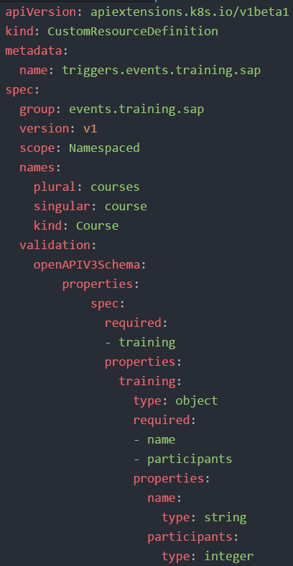
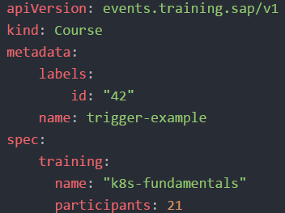
CRD/CRO Example
Newly created API endpoint
API specification
Validation schema to outline resource structure
Resource structured according to validation schema

