Slide 1
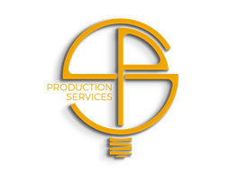
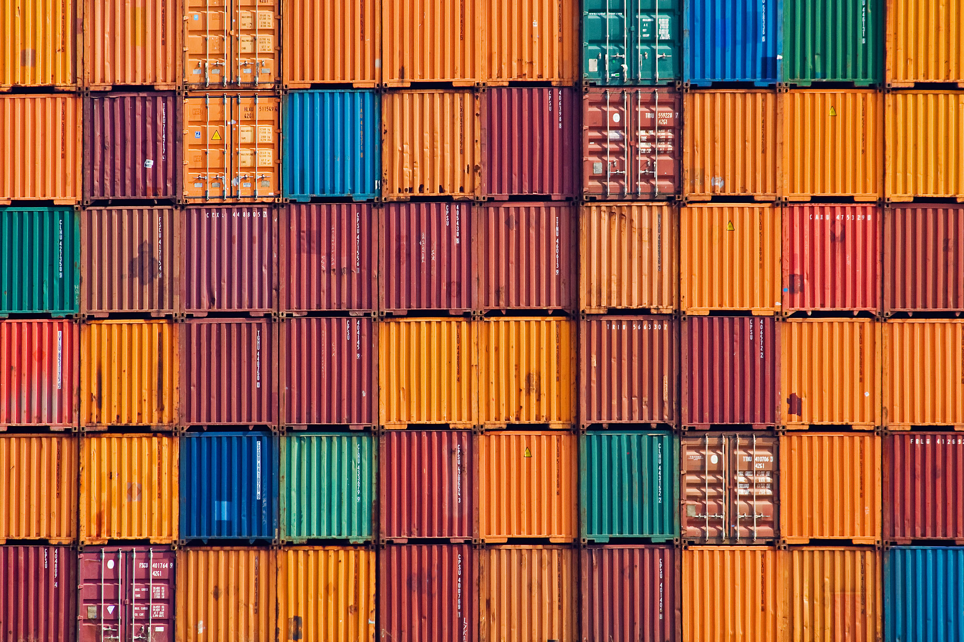

Containers are awesome! But why?

Slide 2
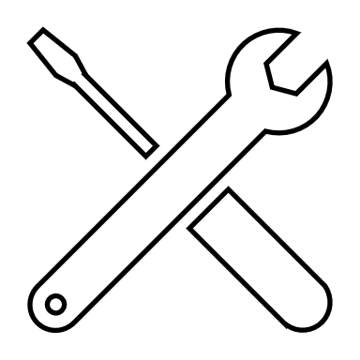
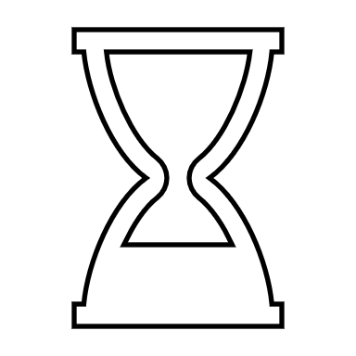
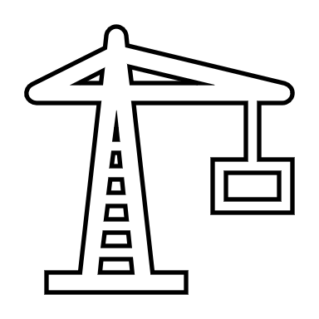


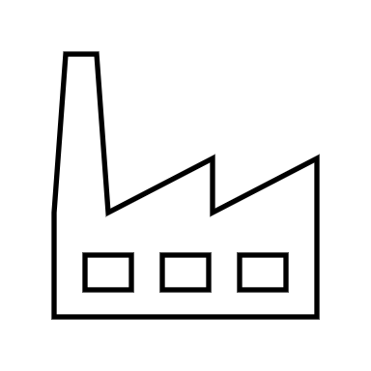
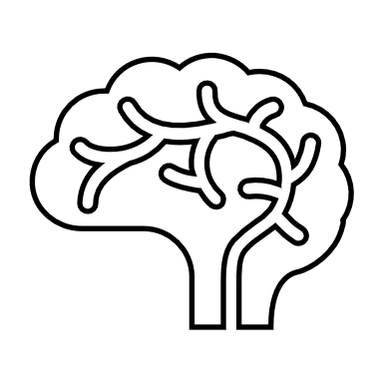

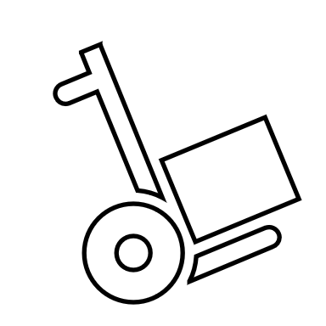
This is what we (do not) want!
Develop
Assemble & Ship
Deploy & Run
Notes:
Usually, we want to develop, ship and eventually run / operate software. What we do not want, is to deal with infrastructure operations and setting up complex systems to run our stack. Running through 100 pages of an installation manual is not the feasible, if you want to setup multiple instances in a short timeframe.
Also everyone want to use their preferred programming language like Go, Python, Java, …
So, what would be helpful in order to avoid complexity?
Here are some thoughts:
Automation
Run independent from physical hardware
Quick startup time
Service discovery
Plug & play capabilities for installation / scaling
Include all dependencies to create a closed system
Maintain only application related code / artifacts (no OS)

Slide 3
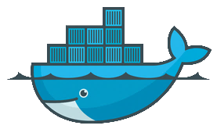
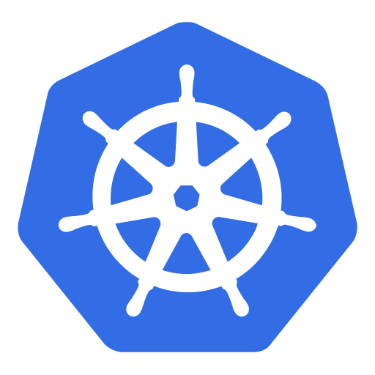
Container, Docker, Kubernetes
Develop
Assemble & Ship
Deploy & Run
Java, Go, C++, Ruby, …
Notes:
Container technology is a generic approach that helps to
Assemble
Ship
Deploy
Run
your software.
Docker is the container build engine & runtime. Kubernetes is a powerful orchestration platform on top.
With Docker you get:
Portability: build once – run anywhere
Immutability of your packages
Reproducibility / pack all dependencies
Stackable images
Sharing eco-system
Flexibility – i.e. the programming language doesn’t matter, because you can include the runtime in the container
Perfect fit with CI
With Kubernetes you get:
Platform capabilities:
Service discovery & network
Logging & monitoring
Elasticity & scaling
Extensibility
Storage
K8s is extensible + has a fast growing eco system (for helpful extensions)

Slide 4

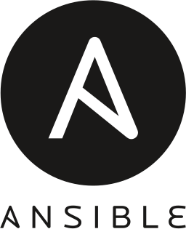

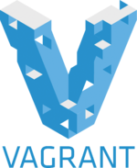

Why not simply use some automation tools and run VMs?
VM
VM
VM
nginx
nginx
nginx
nginx
Docker Runtime
Libraries
Libraries
Libraries
dockerd
nginx
nginx
nginx
MTA
MTA
OS
OS
OS
virtual HW
virtual HW
virtual HW
Libs
Libs
Libs
Tools
Tools
Libs
Libs
Libs
Host OS
Host OS
Hypervisor
Hardware
Hardware
Notes:
Isn’t a container just another VM?
There are lots of powerful tools to achieve most of the things mentioned previously.
With Vagrant & KVM or Hyper-V you can build & run VMs. Tools like ansible, chef or puppet apply configuration / setup environments
If you take a step back and look at the picture of the VM stack – what is it, that should be in the center? Probably the app and maybe some libraries. But certainly not some OS.
So what are the differences between containers and virtual machines? At first, they look similar – they both offer slicing up a host into isolated environments for applications.
Virtual machines need a Hypervisor which provides virtual hardware on which a regular operating system runs with your application running on top. Every VM has its own guest OS kernel, its own set of libraries and its own dedicated storage. The disadvantage to the VM landscape in the slide above is that is that you need to take care of all the guest OS’es (patches etc.), the VMs need quite a lot of resources for themselves (exist in memory for each VM) and it requires a fair amount of time to boot them up (because they are not shared).
Containers run directly on the OS kernel of the host, there is no Hypervisor and no guest OS. The containers are just regular processes that have been isolated from each other and from the host operating system but they all share the same operating system kernel and environment. The advantage is that there is no additional overhead for guest operating systems – containers start up almost instantly and require far less resources than VMs do.

Slide 5
A container is just a process bound by Linux Primitives.
Notes:
What can we derive from the previous slide? => it’s just another process
The Linux kernel does not know about containers at all – for it, containers are nothing more than just regular processes running on the system. They are managed like all other processes by the kernel.
The Linux kernel however offers several features that Docker and other container engines leverage to achieve an almost complete isolation of processes from each other. These features are outlined on the next slide and will be discussed in detail in “Members of the Docker Universe”.

Slide 6
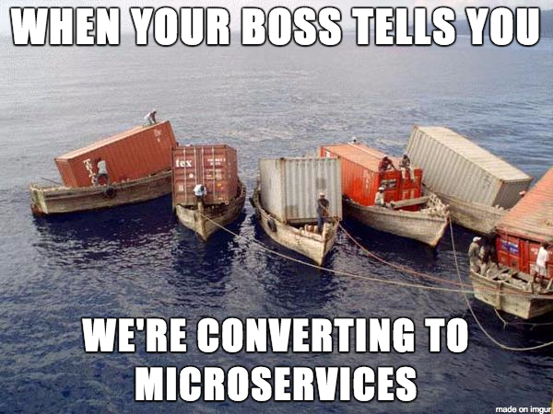
https://imgur.com/gallery/C8WPHxw
Notes:
Container <> Microservices – perfect fit?
With all those features in mind, one could easily come to the conclusion that container and microservices are the perfect fit. And this is mostly true. However container for themselves lack of certain capabilities like service discovery. To overcome these “gaps” there are container orchestrators – the most prominent one is Kubernetes.

Slide 7
Kubernetes Overview
MTA 6
Web 5
DB 3
IM 3
Kubernetes
Kubernetes
Web
Web
Web
Web
MTA
Web
MTA
MTA
MTA
MTA
MTA
DB
DB
IM
DB
IM
IM
Libs
Libs
Libs
Libs
Libs
Libs
Libs
Libs
To
Libs
To
To
To
Libs
To
Libs
Libs
Lb
Lb
Lb
Lb
Lb
Docker Runtime
Docker Runtime
Docker Runtime
dockerd
MTA
MTA
MTA
Web
Web
DB
dockerd
MTA
MTA
Web
DB
DB
IM
dockerd
MTA
Web
Web
IM
IM
Web
Libs
Libs
Libs
To
To
Libs
Libs
Libs
To
Libs
Libs
Libs
Libs
To
To
Libs
Libs
To
Lb
Lb
Lb
Lb
Lb
Lb
Host OS
Host OS
Host OS
Hardware
Hardware
Hardware
Notes:
What does Kubernetes do for us?
Workload distribution
Health checks / restarting
Service discovery
…
Lets assume, we want to run several services – 6 mail transfer agents (MTA , 5 web, a few databases on some instant messenger. Kubernetes automatically distributes the workload and takes care, that our quorum is fulfilled by re-scheduling failed instances.

Slide 8
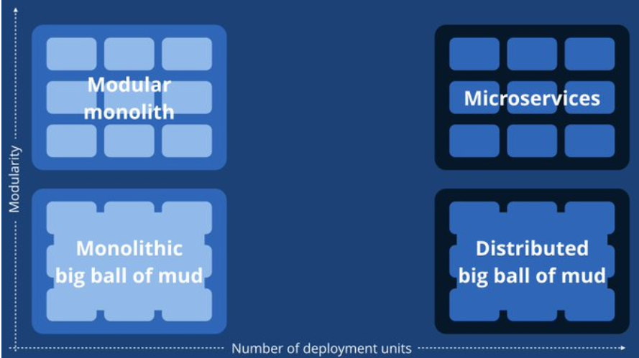
Containers will NOT fix a broken architecture!
https://twitter.com/simonbrown/status/847339104874381312
Notes:
“Since we introduced micro services, every outage is like a murder mystery”

Slide 9

Here's a diagram of two microservices and their shared database.
https://twitter.com/mathiasverraes/status/711168935798902785
Notes:
How to tackle databases?
Containerize databases?
Not every database is build in a way that it can run within a container (with PID 0). There is no perfect solution (yet).

Slide 10
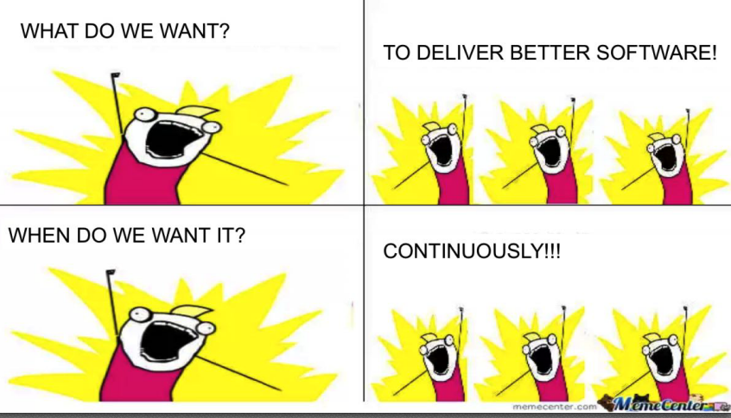
To make error is human.
To propagate error to all server in automatic way is #devops.
https://twitter.com/DEVOPS_BORAT/status/41587168870797312

Slide 11
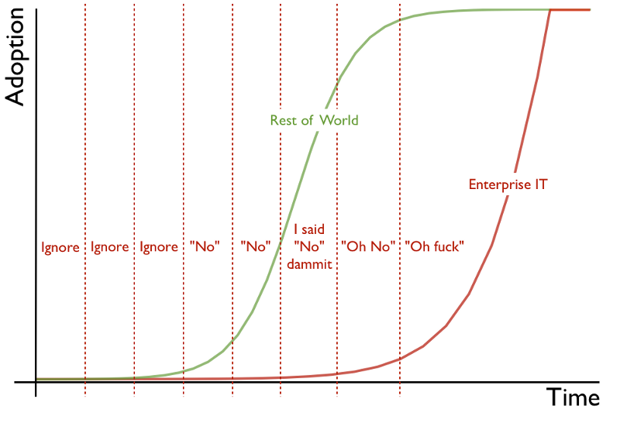
The enterprise IT adoption cycle
Adoption cycle graphic © 2012 Simon Wardley and CC BY-SA 3.0. Nicked from his blog and placed here by Andrew Back.
Notes:
If everything is that simple, why haven’t we adopted it yet?
Why are we talking about Docker & Kubernetes now?
Well, Docker & K8s are not “new” as such. The technology is around for quite some time. But it takes some time until a technology is “enterprise ready” + Enterprise IT takes some time to pick up trends. With Docker & K8s though, we’re somewhere doing quite well / are not that late.
Potentially next “big” thing: watch out for “serverless” to become more and more important => Buzzwords are “knative” or “kyma”

Slide 12
No „one size fits all“ - Cloud Foundry and Kubernetes
Business Applications
Cloud Foundry
High (leverage platform)
Platform support for dev + ops
Business Applications
Backing services
Kubernetes
Low (bring your own …)
Porting only (as-is)
New or major redesign
Redesign flexibility
Size = Resource consumption per microservice
Notes:
High level of support and platform services available, limited resource consumption per microservice and low level of legacy code are assumed (e.g. Currency Conversion, Consent Management etc) → Cloud Foundry recommended
Consequences: adopt microservice architecture and 12 factor app
New and existing Backing Service
Low level of platform service support assumed acceptable, direct infrastructure access needed (e.g. HANA, Data Hub, Machine Learning) → K8s recommended
Existing Business Application
High level of existing code assumed, high requirements for resource consumption per (micro)service, stateful apps or service mesh capabilities → K8s recommended

