Slide 1
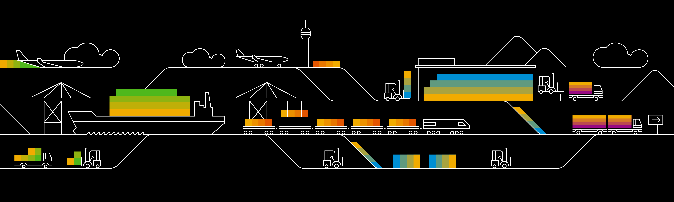
Kubernetes Namespaces and Pods

Slide 2
Pods – logical hosts
IP: 10.10.10.1
IP: 10.10.10.2
Pod-A
Pod-B
container
nginx
container
nginx
container
client
volume
volume
Worker

Slide 3
Pods
A pod (as in a pod of whales or pea pod) is a group of one or more containers (such as Docker containers), with shared storage/network, and a specification for how to run the containers
Containers of a pod share localhost network interface
A pod can provision ephemeral storage or attach persistent storage
Pods are started by kubelet but can die any time without necessarily being re-scheduled
Pods can be probed by kubelet (liveness & readiness probe)
Pod phases / status:
Pending
Running
Succeeded
Failed
Unknown

Slide 4
Basic structure of most K8s resources
api the resource belongs to, e.g. “v1”
apiVersion
value
resource type, e.g. “pod”
kind
value
metadata
metadata like name, annotations or labels are maintained here
metadata object
spec
spec object
specification of the resource based on its “kind”
status
status object
Information supplied by k8s, not maintained by users
Notes:
Example for a resource with different structure: configMap

Slide 5
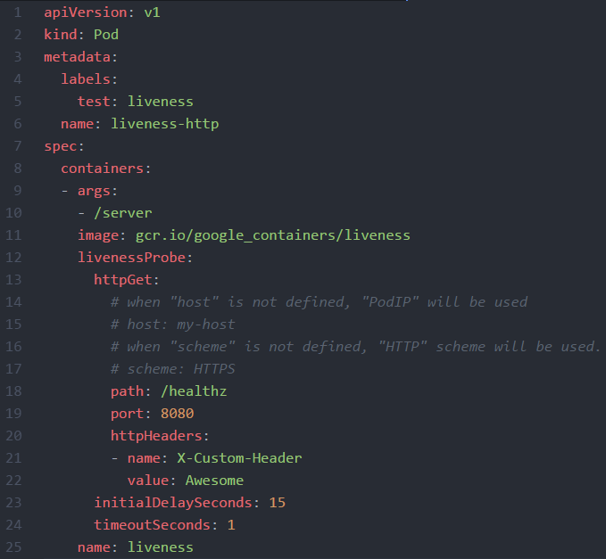
Pod definition - https://kubernetes.io/docs/api-reference/v1.8/#pod-v1-core
Resources of “kind:pod” belong to “apiVersion: v1”
Within “metadata” the pod’s name is specified
The pod’s “spec” provides all the necessary details, like the image to use, to actually start a container

Slide 6
Namespaces
Namespace: your-namespace
Pod
Pod
Pod
Namespace: my-namespace
Pod
Pod
Pod
Worker
Worker
Worker

Slide 7
Namespaces
Logical realm for applications to run within
Isolate resources and restrict visibility to objects in the same namespace
Basic user management is handled on namespace level
Resource quotas / limits managed per namespace
Uniqueness of names required per namespace
Access to services in a different namespace via FQDN <service-name>.<namespace>
Use –n (--namespace) <namespace> switch with kubectl to access resources

Slide 8
Demo
Show all namespaces in cluster
Query a pod from a dedicated namespace (kube-system)
Create a pod: https://github.wdf.sap.corp/raw/D051945/docker-k8s-training/master/kubernetes/pod_example.yaml

Slide 9
What YOU will do during the next exercise…
nginx
nginx
nginx
content
config
tls certs

