Slide 1
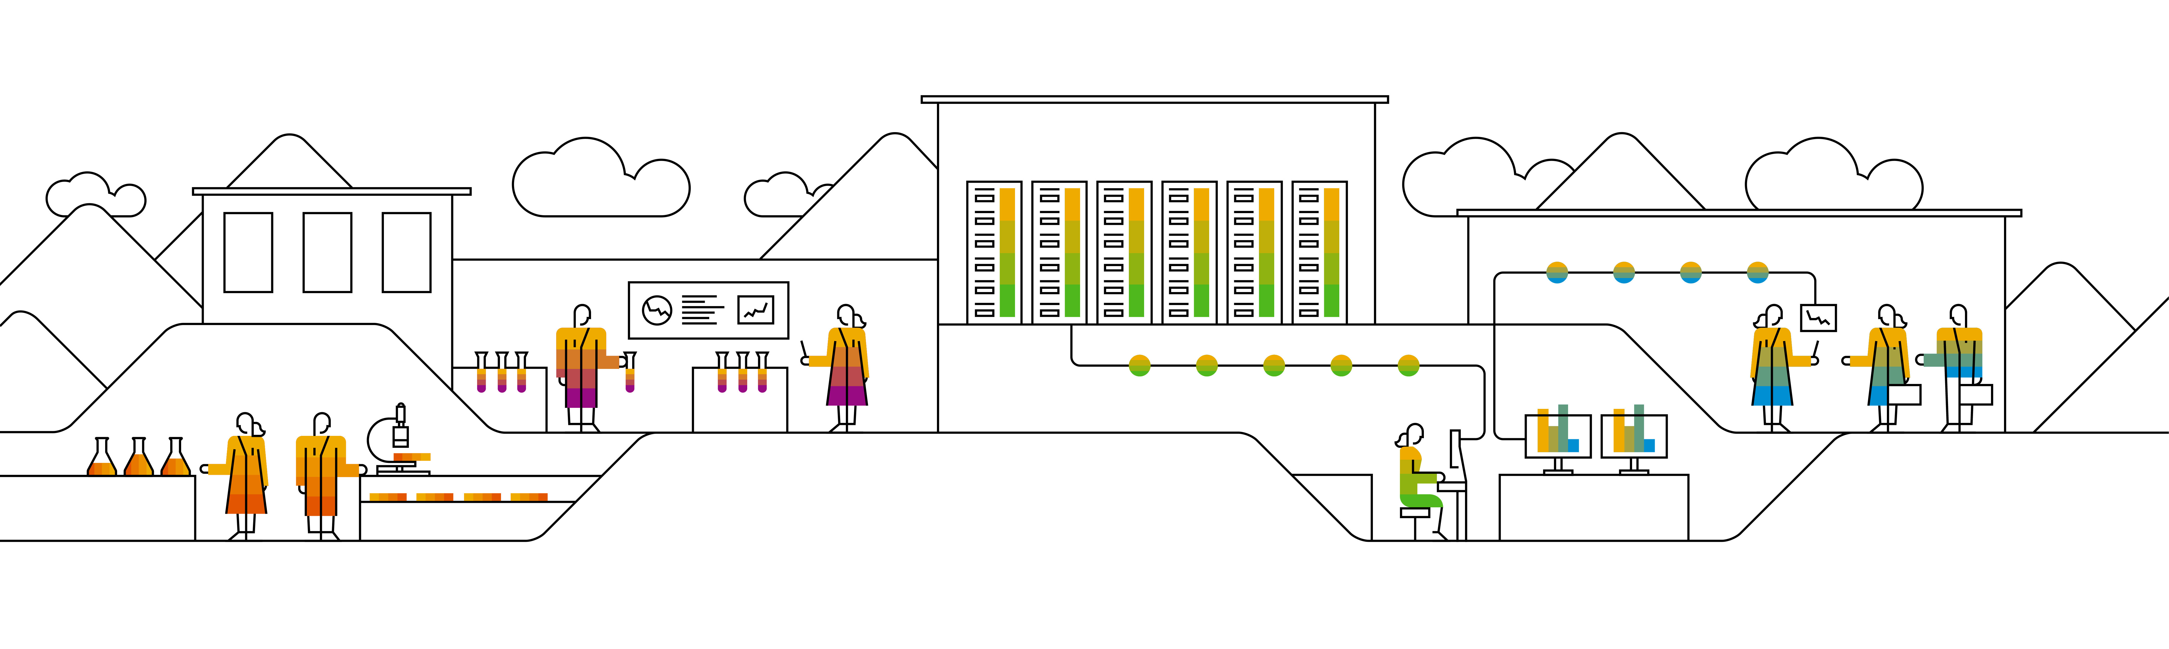
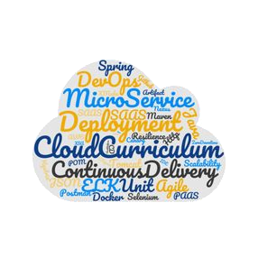

Kubernetes Microservice-based sample app: Bulletinboard

Slide 2
Goal of Day 4
Apply what you learned in day 1-3 on Docker & K8s, based on a sample application:
Cloud Curriculum Bulletinboard
Microservices with connected database and communication across to other microservice.
Keep it simple:
Bulletinboard: no security, Approuter, UAA, Multi Tenancy, etc.
Only basics K8s scenarios
No CD pipeline
Not 100% reference for later productive usage ! (Will be done in other training)

Slide 3
Bulletinboard-Application
From CloudNativeBootcamp by CloudCurriculumTeam
Notes:
The next slides show a happy path through the application.

Slide 4
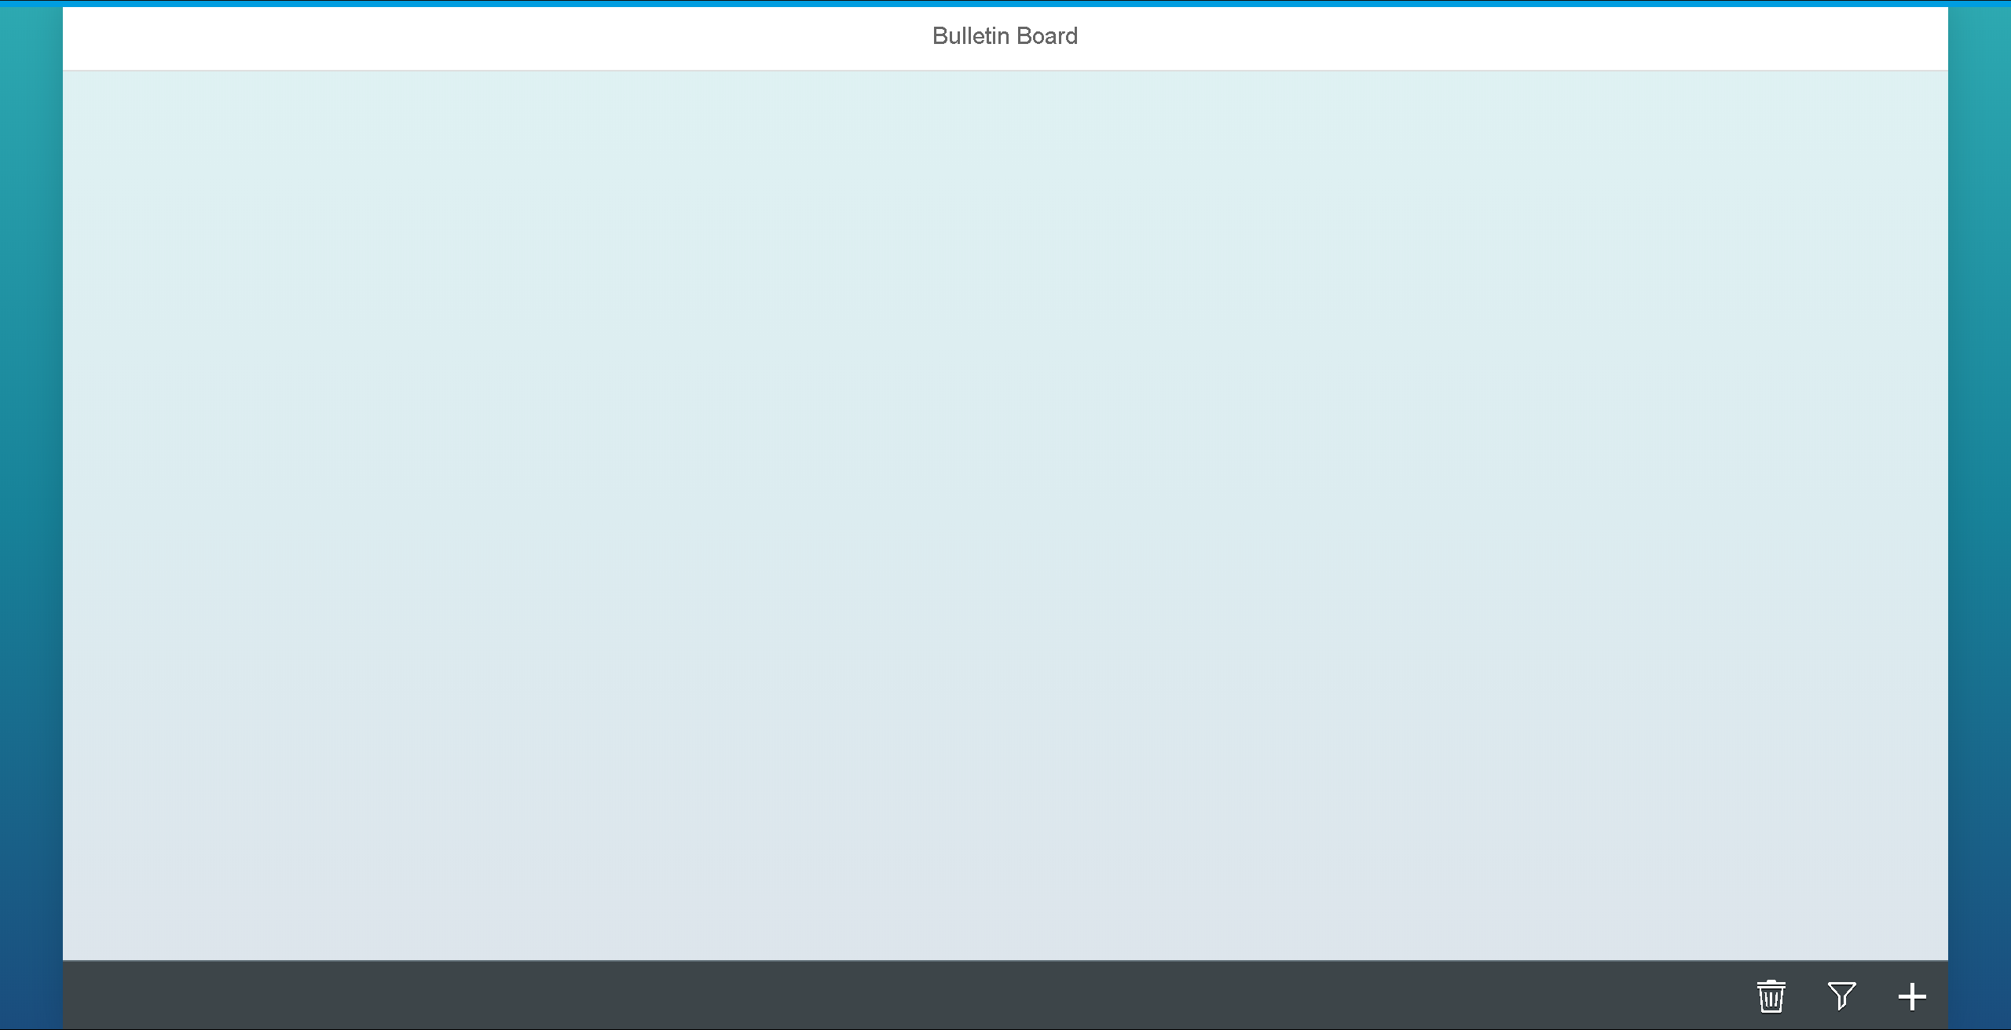
Notes:
The empty board – there currently are no advertisements. Let us create one.

Slide 5
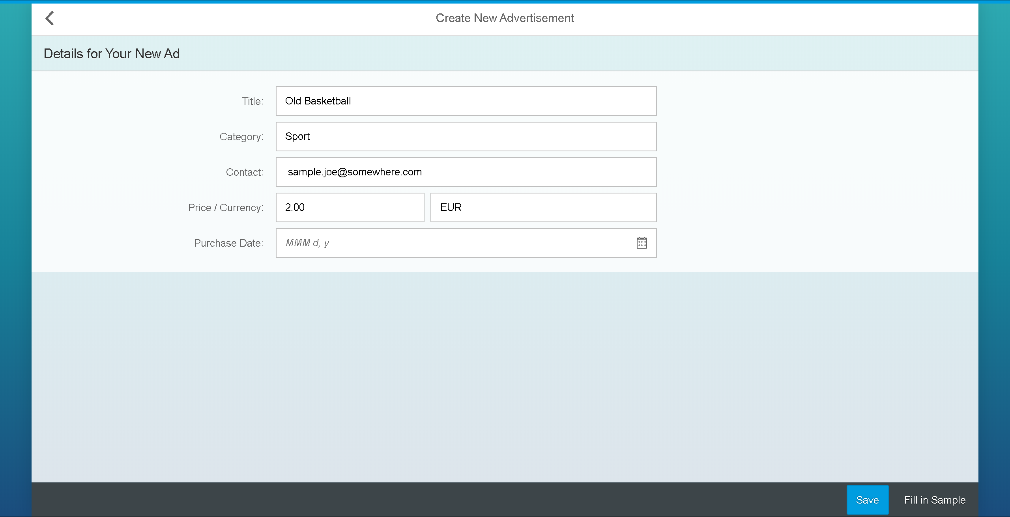
Notes:
Joe Sample wants to sell an old basketball for 2€. He does not remember when he bought the ball.
- There is a “Fill in Sample”-Button (this has nothing to do with JoeSample ;-) ) it just fills in the form with a pre defined ad.

Slide 6
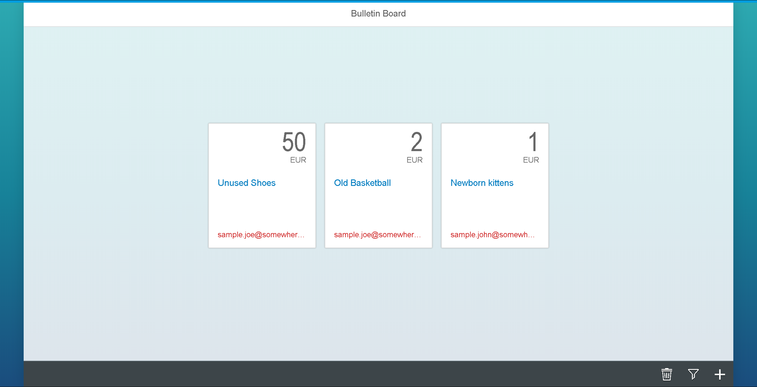
Notes:
You can see our new ad along with two others. (Created to see how multiple ads look like)
Notice that every user is “red”, which means he has bad reviews or no reviews at all.

Slide 7
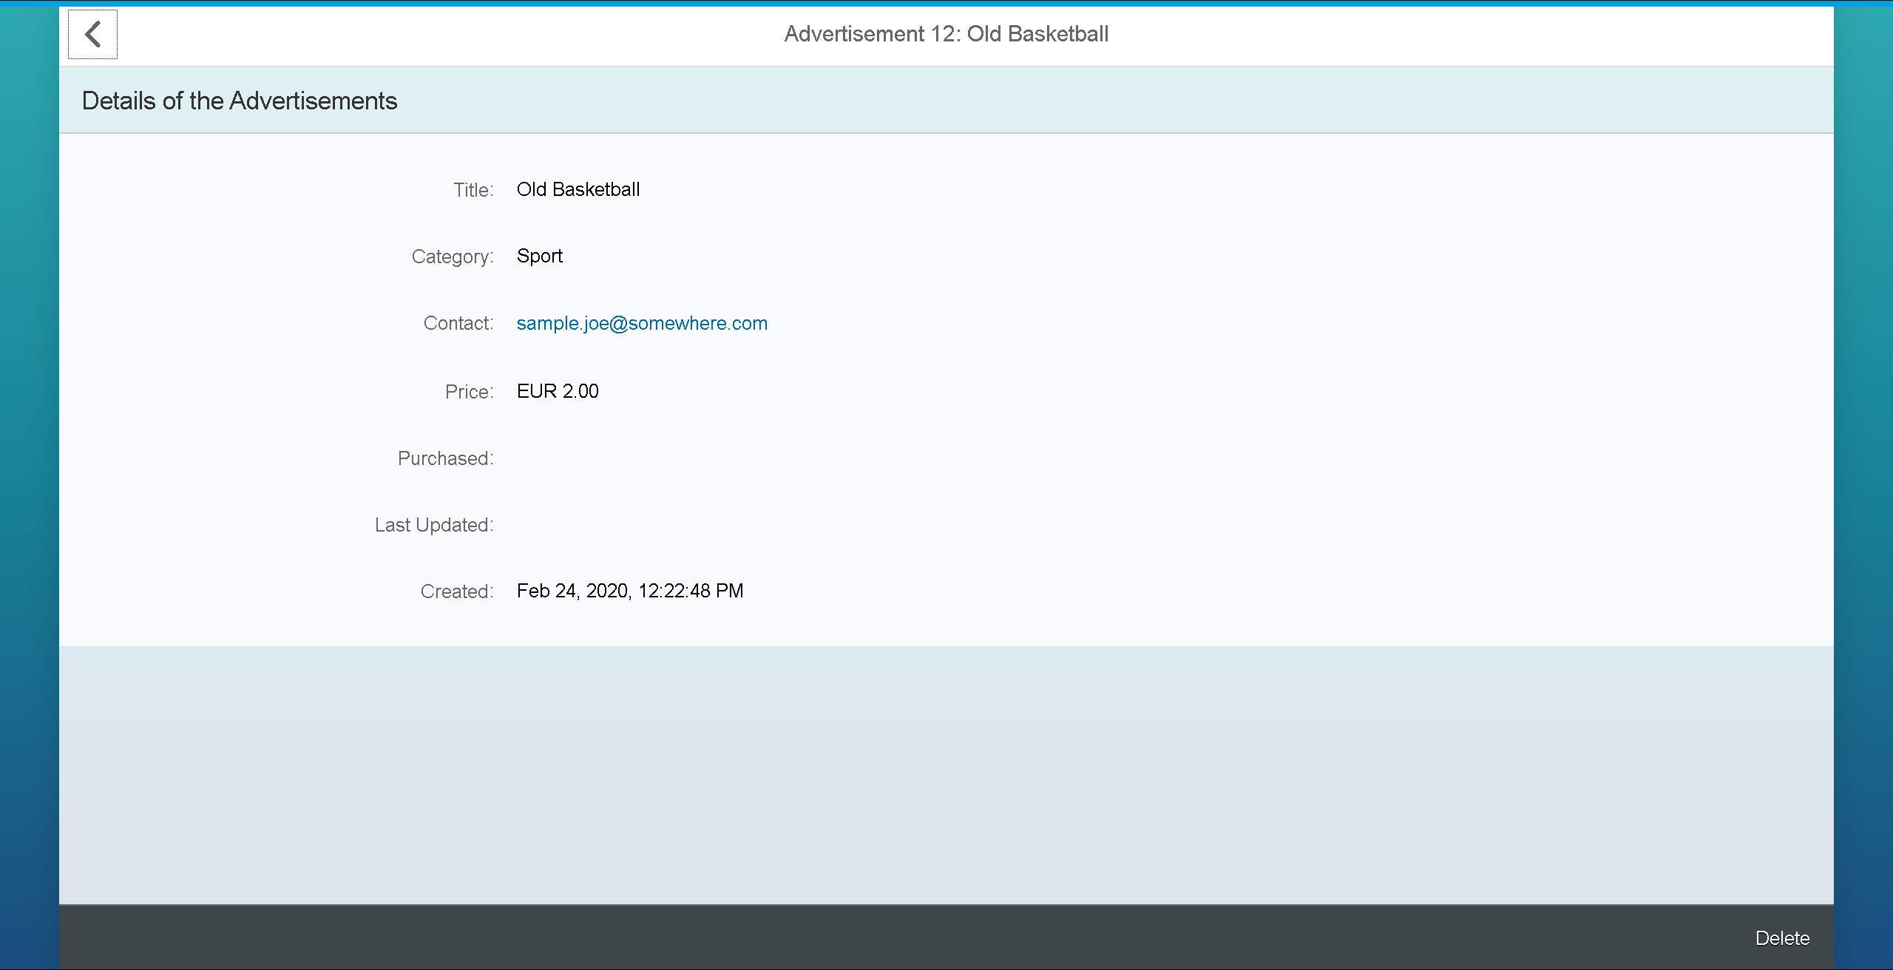
Notes:
This is the details view of our ad.
By clicking on the contact, we can navigate to the reviews service. The UI will look rather similar, a normal user maybe wont notice.

Slide 8
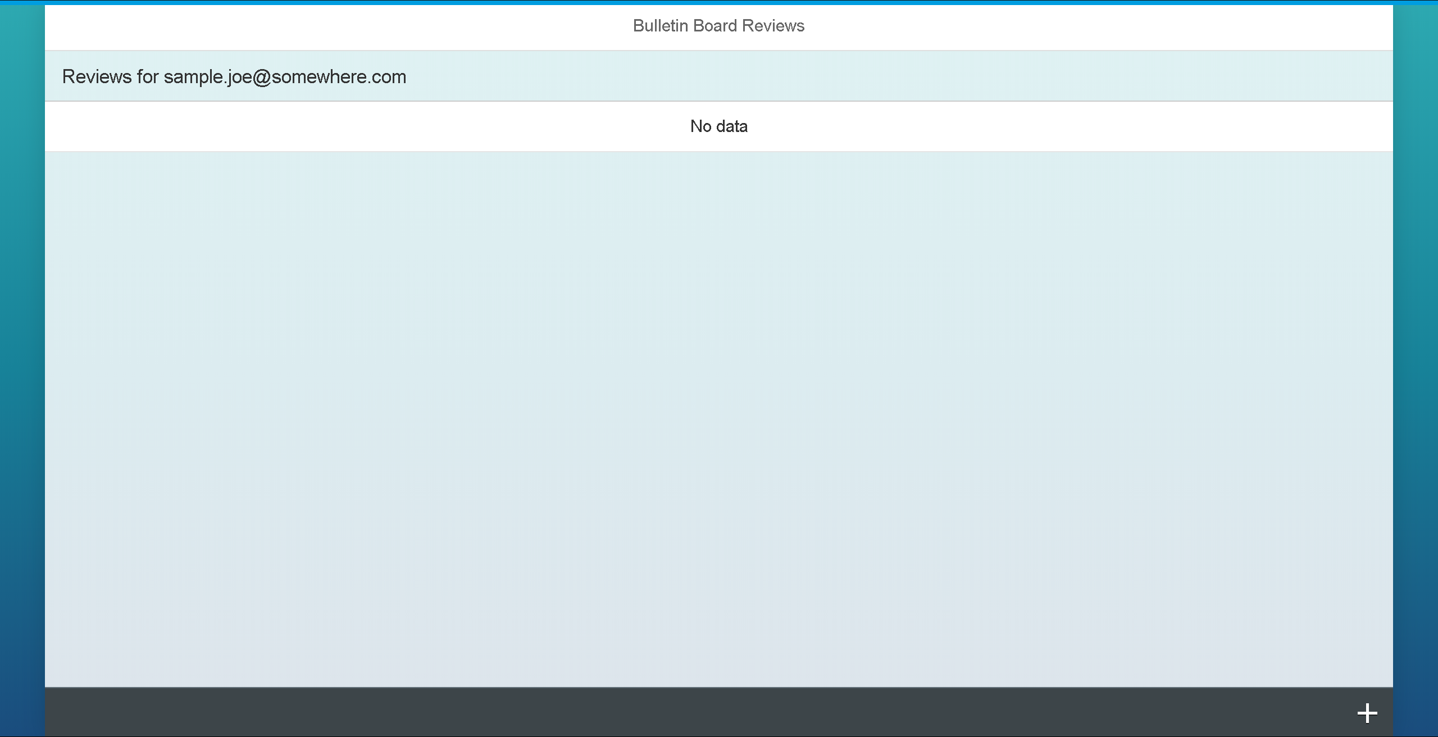
Notes:
This is the UI of the reviews service now. There are no reviews up until now, so lets create on.

Slide 9
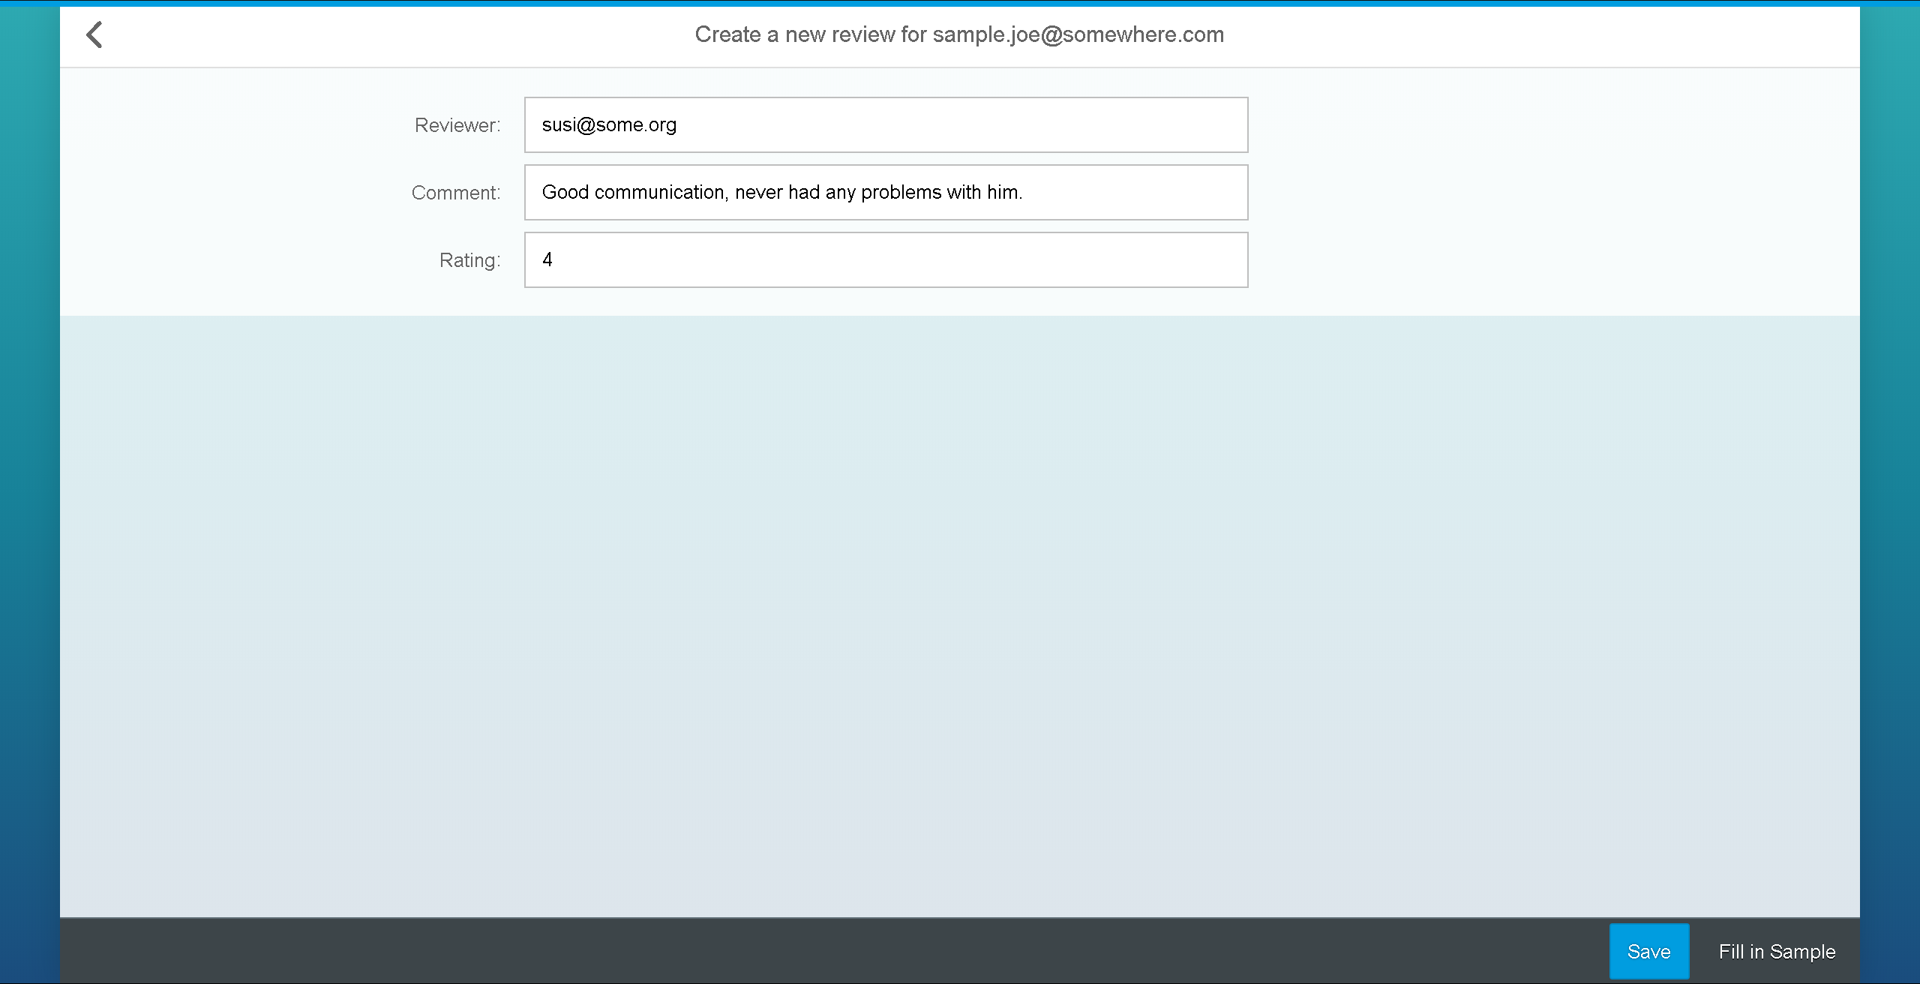
Notes:
Again there is a “Fill in Sample”-Button

Slide 10
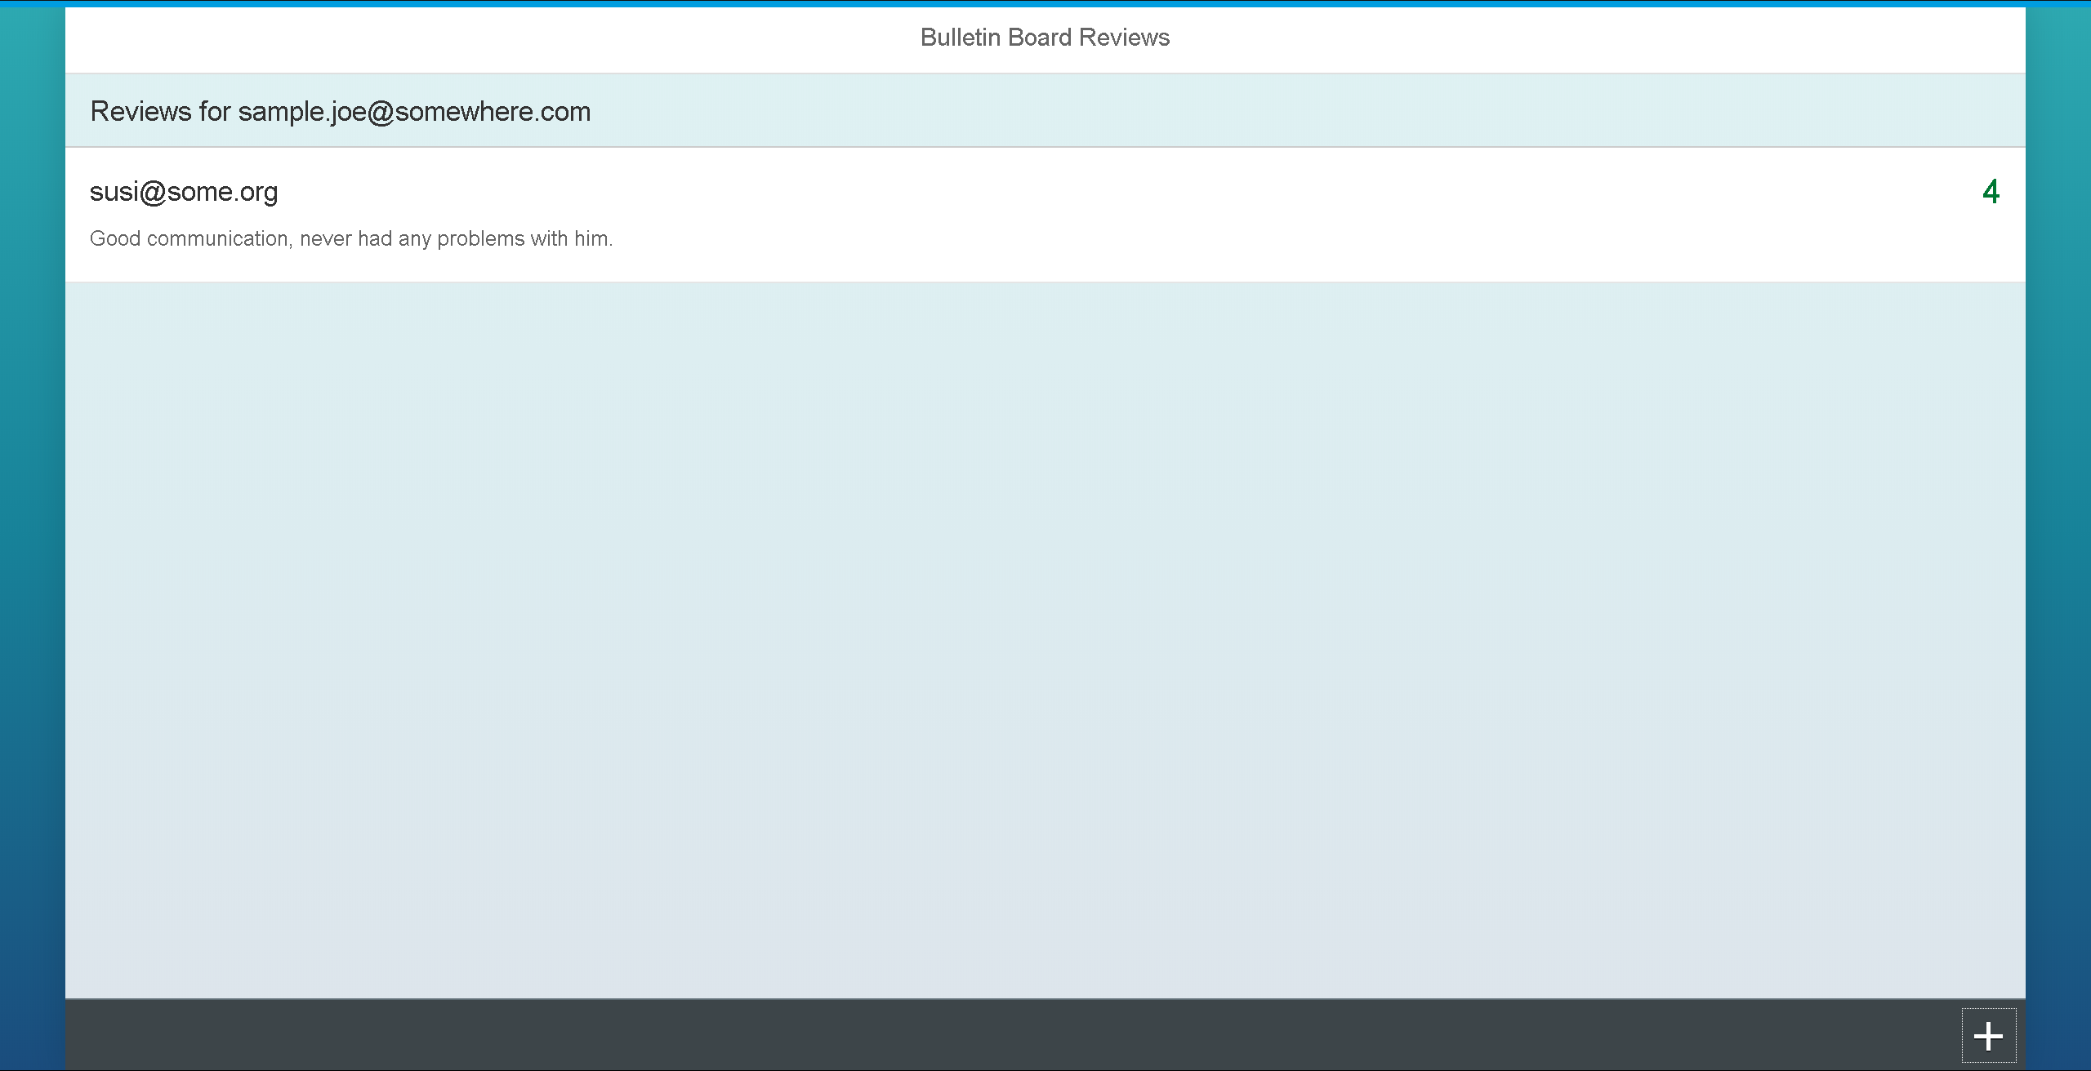
Notes:
Now we can see that there is a review in the list.

Slide 11
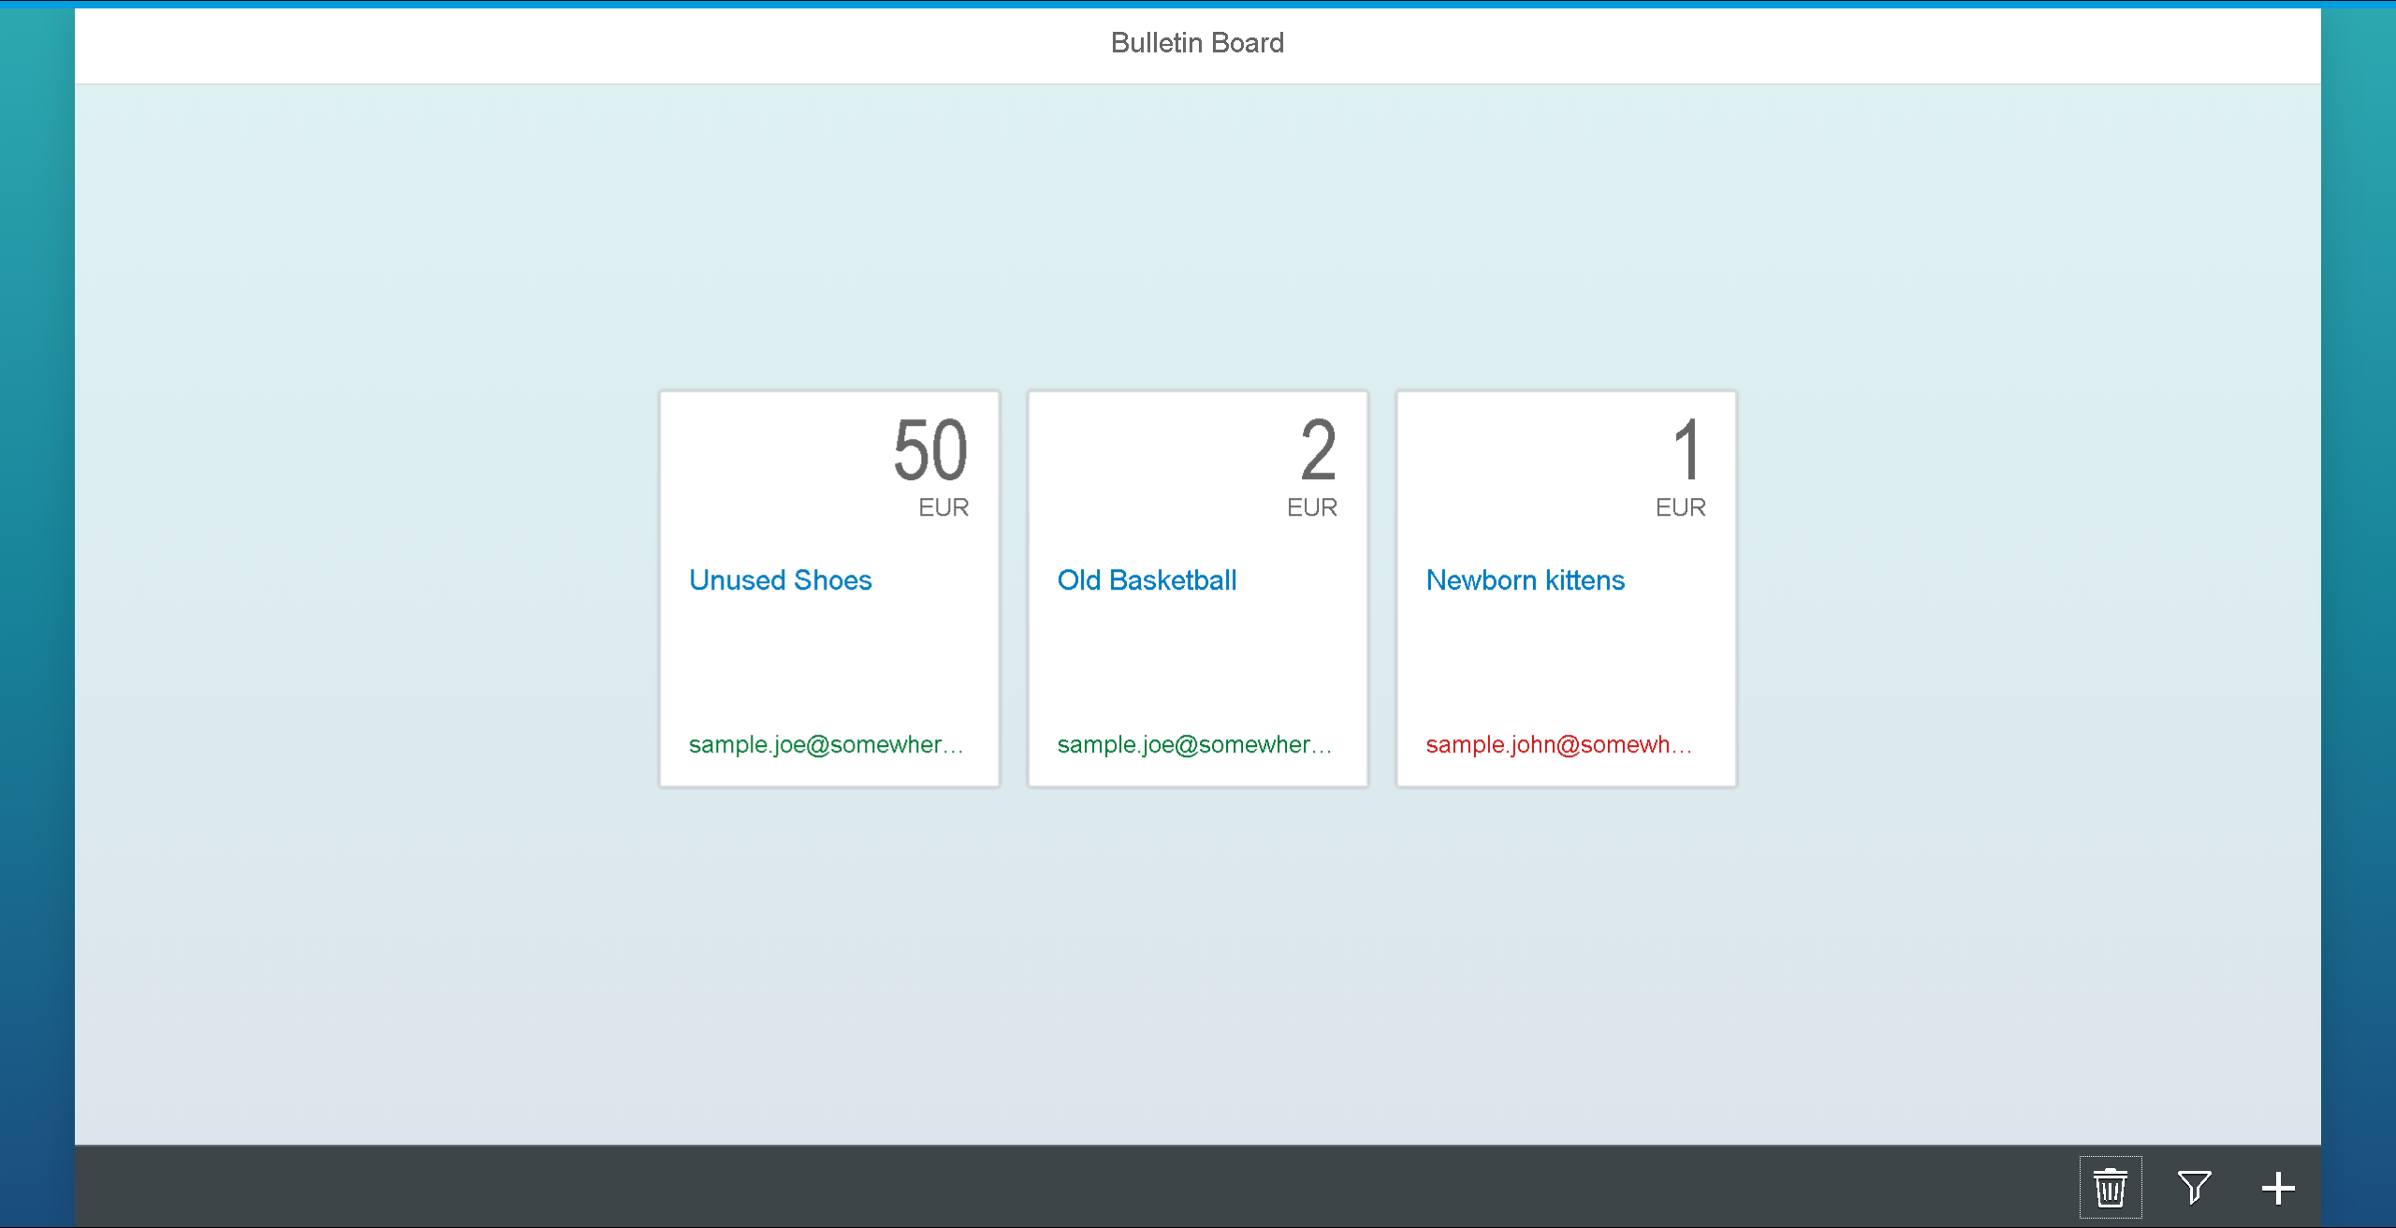
Notes:
Back to the bulletinboard ads, we can see that JoeSample now has a good rating.

Slide 12
How does the setup looks like?

Slide 13
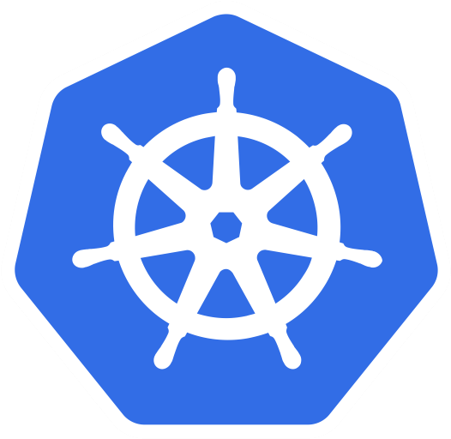
How to bring bulletinboard into K8s ?
HTTPS
bulletinboard- ads
bulletinboard-reviews
postgresql
postgresql

Slide 14
General considerations: Scaling - Option 1 DB gets multiple instances (if needed)
bulletinboard- ads
bulletinboard-reviews
postgresql
postgresql
postgresql
postgresql
postgresql
postgresql

Slide 15
General considerations: Scaling - Option 2 Both – app and DB get multiple instances (if needed)
bulletinboard- ads
bulletinboard-users
bulletinboard- ads
bulletinboard-users
bulletinboard- ads
bulletinboard-reviews
postgresql
postgresql
postgresql
postgresql
postgresql
postgresql

Slide 16
General considerations: Scaling - Option 3 App gets multiple instances (if needed)
bulletinboard- ads
bulletinboard-reviews
ü
postgresql
postgresql

Slide 17

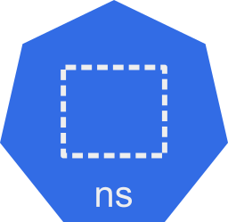

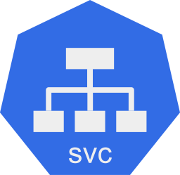
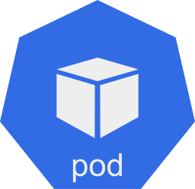
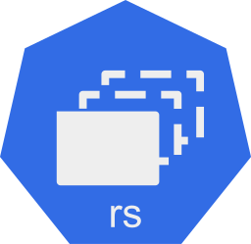
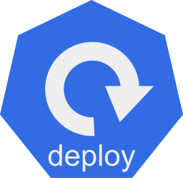
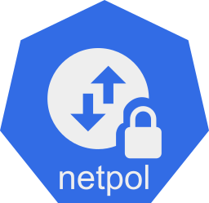
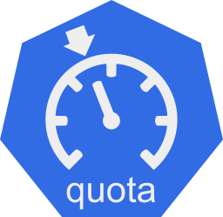
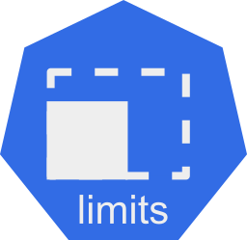
How to bring bulletinboard into K8s ?
?
… cluster, namespace, pod, deployment, statefulset, replicaset …

Slide 18


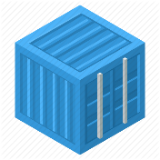
Bulletinboard in K8s: Target picture overall
ingr/ svc
ingr/svc
HTTPS
nwp
nwp
bulletinboard- ads
bulletinboard-reviews
cm
sec
pod
pod
deployment
deployment
svc
svc
nwp
postgresql
nwp
postgresql
sec
sec
pod
pod
statefulset
statefulset
Notes:
- Discuss statefulset vs deployment
- Discuss headless service vs ???
- Discuss service vs ingress

Slide 19
Bulletinboard in K8s: Labeling of resources
Necessary:
Pods need labels as target of services and network policies.
Pods labels are specified in podTemplate, so specify it at that level.
Nice to have:
A mechanism to identify groups different resources belong to.
We can filter by labels with kubectl get/delete

Slide 20
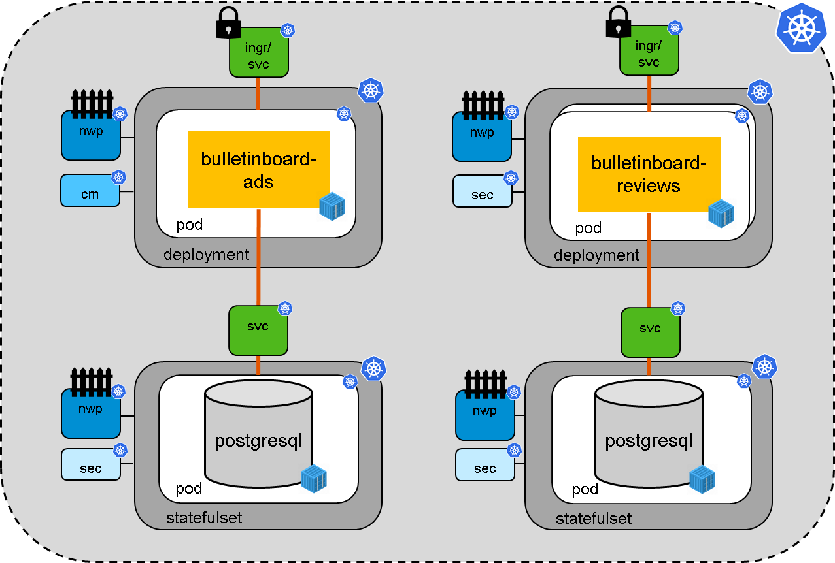
Bulletinboard in K8s: Labeling of resources
Module:
App
Component:
User
Component:
Ads
We decide for these reasons add two labels to all our resources. We make a vertical and horizontal cut in the resource picture:
Horizontally we distinguish between the app part and the DB part, and call these distinction module.
Vertically we distinguish between the ads part and the users part, and call these distinction component.
Module:
DB

Slide 21
Application in K8s: Steps to be taken
Ensure your Application is parameterizable/ ready for external configuration (In general/ K8s specific)
Create a Docker Image for your Application, considering parameterization/ external configuration
Create/ use an existing Docker Image for your Database, as well parametrizable.
Make available Application Docker Image in public available Docker registry, e.g. SAP Artifactory DMZ (and DB Docker Image, if not available on e.g. public Docker Hub)
Choose the right K8s entities for parameterization/ external configuration: ConfigMap and Secret
Choose the right K8s entities for your scenario – Stateless vs. Statefull and Horizontal Scaling: Deployment vs Statefulset.
Choose the right K8s entities for exposing your Application internal & external/Internet and network security, etc.: Service, Ingress, NetworkPolicy, etc.

