Slide 1

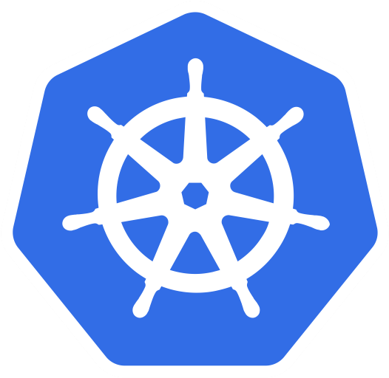


ingr/ svc
ingr/svc
nwp
nwp
bulletinboard- ads
bulletinboard-reviews
cm
sec
pod
pod
deployment
deployment
svc
svc
nwp
postgresql
nwp
postgresql
sec
sec
pod
pod
statefulset
statefulset
Notes:
- Discuss statefulset vs deployment
- Discuss headless service vs ???
- Discuss service vs ingress

Slide 2


ingr/ svc
ingr/svc
nwp
nwp
bulletinboard- ads
bulletinboard-reviews
cm
sec
pod
pod
deployment
deployment
svc
svc
nwp
postgresql
nwp
postgresql
sec
sec
pod
pod
statefulset
statefulset

Slide 3
ingr/ svc
ingr/svc
nwp
nwp
bulletinboard- ads
bulletinboard-reviews
cm
sec
pod
pod
deployment
deployment
svc
svc
nwp
postgresql
nwp
postgresql
ü
sec
sec
pod
pod
statefulset
statefulset

Slide 4


ingr/ svc
ingr/svc
nwp
nwp
bulletinboard- ads
bulletinboard-reviews
ü
cm
sec
pod
pod
deployment
deployment
svc
svc
nwp
postgresql
nwp
postgresql
ü
sec
sec
pod
pod
statefulset
statefulset

Slide 5

ingr/ svc
ingr/svc
nwp
nwp
bulletinboard- ads
bulletinboard-reviews
ü
cm
sec
pod
pod
deployment
deployment
ü
svc
svc
nwp
postgresql
nwp
postgresql
ü
sec
sec
pod
pod
statefulset
statefulset

Slide 6
pod DNS-name: ads-db-statefulset-0.ads-db-service
component:ads
module: db
service:
ads-db-service
selector: component:ads module:app
Docker container: postgres:9.6
secret: ads-db-secret
pod: ads-db-statefulset-0
statefulset: ads-db-statefulset

Slide 7
URL: bulletinboard-ads-<id>.ingress.<cluster>.<project>.shoot.canary.k8s-hana.ondemand.com
component: ads
ingress:
ads-app-ingress
module: app
service:
ads-app-service
selector: component:ads module:app
configmap: ads-app-configmap
bulletinboard- ads
configmap: ads-db-secret
ü
pod: ads-app…ent-xx-yy
deployment: ads-app-deployment

