Slide 1

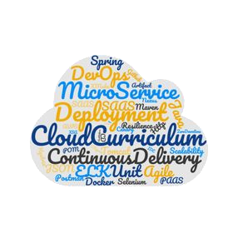

Pilot !
Kubernetes Microservice-based sample app: Bulletinboard

Slide 2
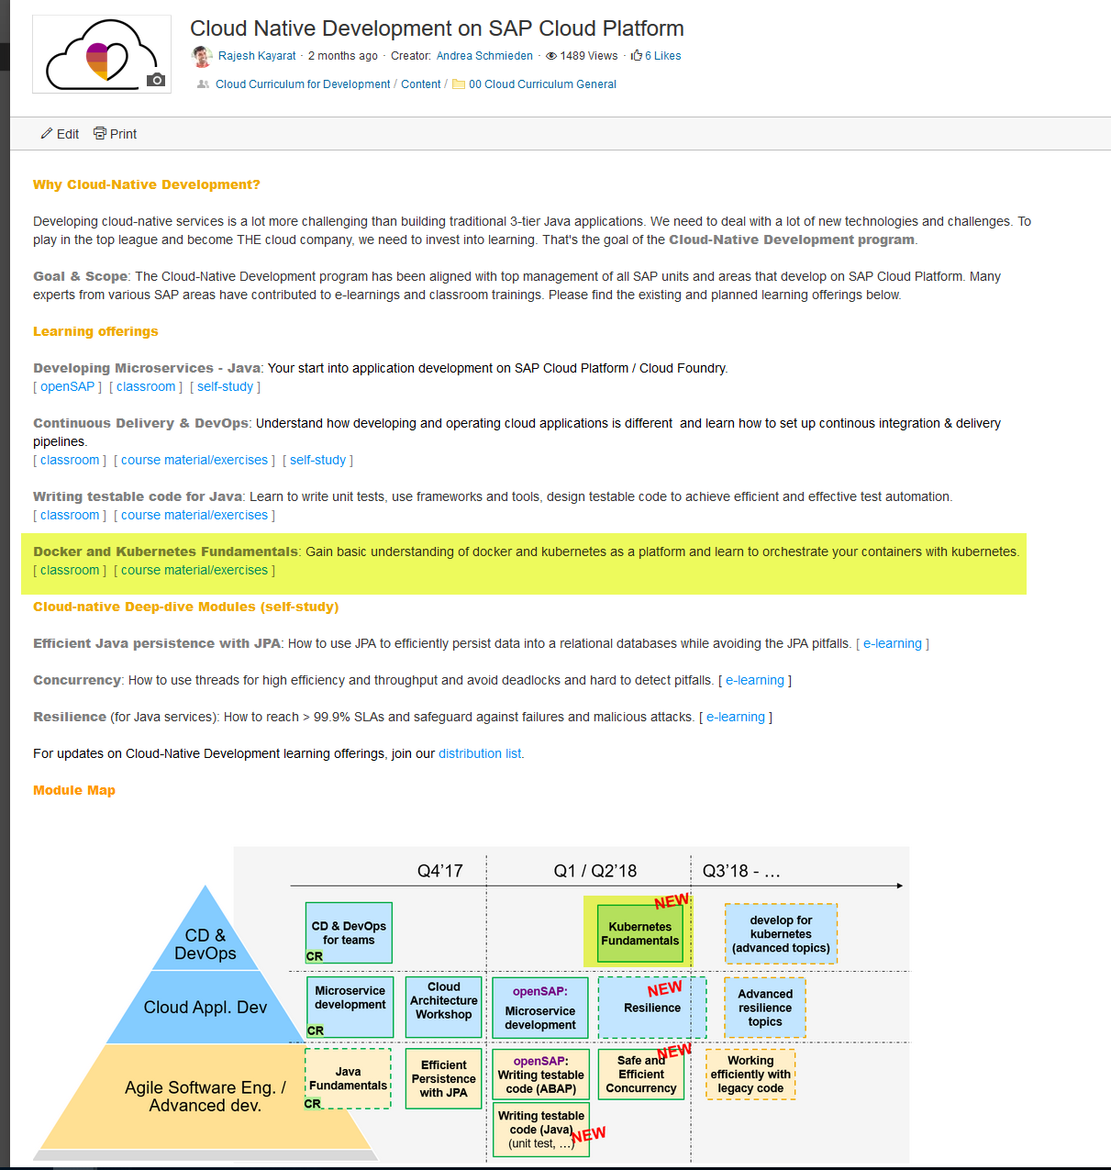
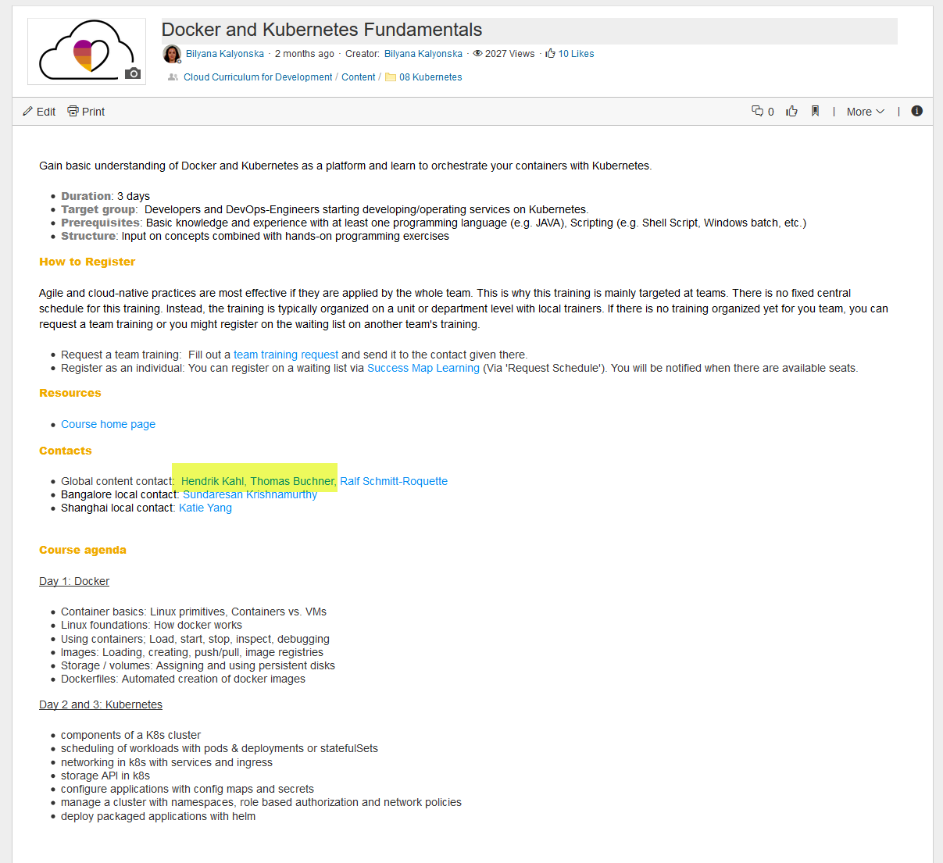
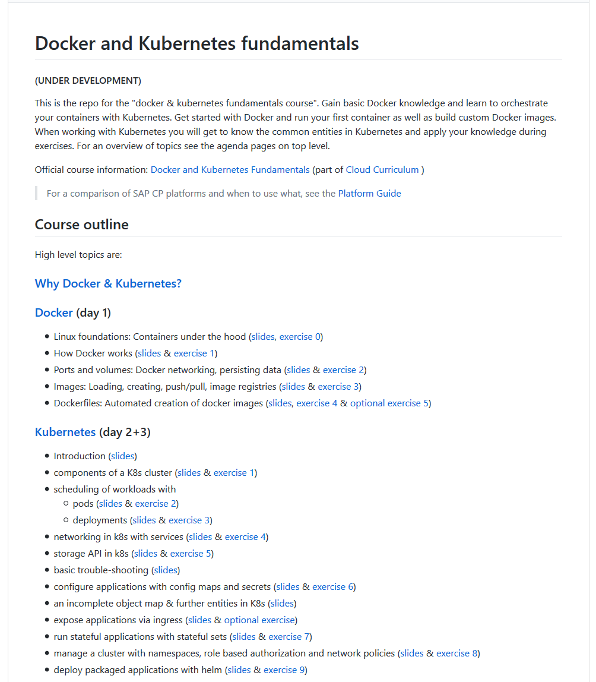
Cloud Curriculum: Docker & K8s Fundamentals training

Slide 3
Goal of Day 4
Apply what you learned in day 1-3 on Docker & K8s, based on a sample application/microservices with connected database and communication across to other microservice
Cloud Curriculum Bulletinboard
Keep it simple:
Bulletinboard: no security, Approuter, UAA, Multi Tenancy, etc.
Only basics K8s scenarios
No CD pipeline/ Docker image build, no upload to Docker Registry (e.g. SAP Artifactory) as part of the exercises (of course as demo)
Not 100% reference for later productive usage ! (Will be done in other training)

Slide 4
Changes from CF Bulletinboard RefApp to K8s Day4 Bulletinboard
CF Bulletinboard RefApp:
Not a complete business application
Used to show certain concepts
Start point for K8s-Day4- Bulletinboard
Still lots of components
Client
Components in CF
approuter
uaa-bulletinboard
bulletinboard-ads
bulletinboard-users
bulletinboard-statistics
application
UI
applogs-bulletinboard
postgresql-ads
mq-bulletinboard
postgresql-users
postgresql-users

Slide 5
Changes from CF Bulletinboard RefApp to K8s Day4 Bulletinboard
Changes:
Reduced Scope
Removed CF Components
Removed RabbitMQ
Client
Components in CF
approuter
uaa-bulletinboard
bulletinboard-ads
bulletinboard-users
bulletinboard-statistics
application
UI
applogs-bulletinboard
postgresql-ads
mq-bulletinboard
postgresql-users
postgresql-users

Slide 6
Code Changes to Ads application
We Removed:
Security/UAA Part
Multitenancy
RabbitMQ
Feature Flags
We added:
Environment variable to toggle calls to users
We changed:
VCAP_Services -> application-k8s.yml

Slide 7
Application in K8s: Steps to be taken
Ensure your Application is parameterizable/ ready for external configuration (In general/ K8s specific)
Create a Docker Image for your Application, considering parameterization/ external configuration
Create/ use an existing Docker Image for your Database, as well parametrizable.
Make available Application Docker Image in public available Docker registry, e.g. SAP Artifactory DMZ (and DB Docker Image, if not available on e.g. public Docker Hub)
Choose the right K8s entities for parameterization/ external configuration: ConfigMap and Secret
Choose the right K8s entities for your scenario – Stateless vs. Statefull and Horizontal Scaling: Deployment vs Statefulset.
Choose the right K8s entities for exposing your Application internal & external/Internet and network security, etc.: Service, Ingress, NetworkPolicy, etc.

Slide 8
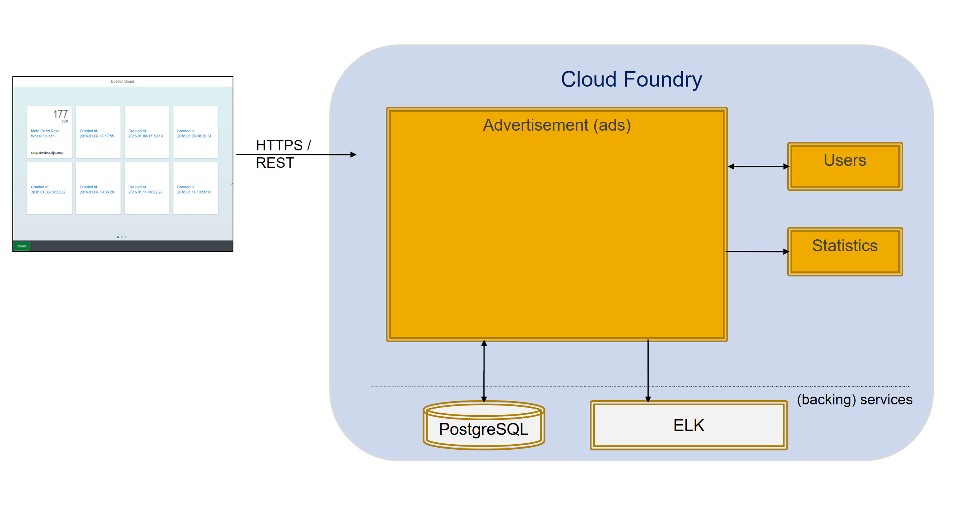
Cloud Curriculum, Reference/ Sample Microservice: bulletinboard

Slide 9
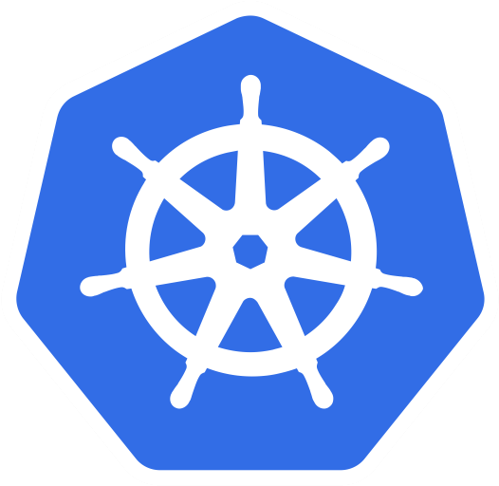
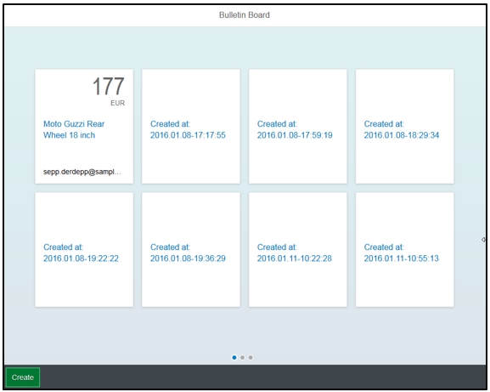
How to bring bulletinboard into K8s ?
HTTP/ REST
HTTPS/ REST
bulletinboard- ads
bulletinboard-users
postgresql
postgresql

Slide 10
General considerations: Scaling - Option 1 DB gets multiple instances (if needed)
bulletinboard- ads
bulletinboard-users
postgresql
postgresql
postgresql
postgresql
postgresql
postgresql

Slide 11
General considerations: Scaling - Option 2 Both – app and DB get multiple instances (if needed)
bulletinboard- ads
bulletinboard-users
bulletinboard- ads
bulletinboard-users
bulletinboard- ads
bulletinboard-users
postgresql
postgresql
postgresql
postgresql
postgresql
postgresql

Slide 12
General considerations: Scaling - Option 3 App gets multiple instances (if needed)
bulletinboard- ads
bulletinboard- ads
bulletinboard-users
ü
postgresql
postgresql

Slide 13

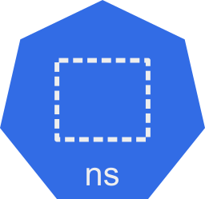




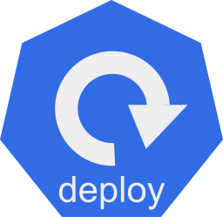
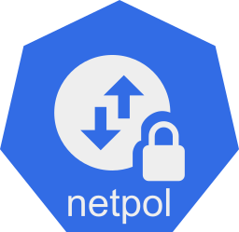


How to bring bulletinboard into K8s ?
?
… cluster, namespace, pod, deployment, statefulset, replicaset, … ???????

Slide 14
How to bring bulletinboard into K8s ?
?
… cluster, namespace, pod, deployment, statefulset, replicaset …

Slide 15
General considerations: external configuration for app and DB
ToDo

Slide 16


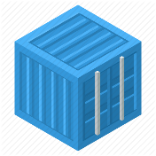
Bulletinboard in K8s: Target picture overall
ingr/ svc
HTTP/ REST
svc
HTTPS/ REST
nwp
nwp
bulletinboard- ads
bulletinboard-users
cm
cm
sec
pod
sec
pod
deployment
deployment
svc
svc
nwp
postgresql
nwp
postgresql
cm
cm
https://github.wdf.sap.corp/slvi/docker-k8s-training/blob/k8s-bulletinboard/kubernetes/k8s-bulletinboard/README.md
sec
pod
sec
pod
statefulset
statefulset
Notes:
- Discuss statefulset vs deployment
- Discuss headless service vs ???
- Discuss service vs ingress

Slide 17
Bulletinboard in K8s: Target picture overall
HTTPS/ REST
ingr/ svc
HTTP/ REST
svc
nwp
nwp
bulletinboard- ads
bulletinboard-users
cm
cm
sec
pod
sec
pod
deployment
deployment
svc
svc
nwp
postgresql
nwp
postgresql
cm
cm
sec
pod
sec
pod
statefulset
statefulset
Notes:
- Discuss statefulset vs deployment
- Discuss headless service vs ???
- Discuss service vs ingress

Slide 18
Bulletinboard in K8s: Target picture overall
HTTPS/ REST
ingr/ svc
HTTP/ REST
svc
nwp
nwp
bulletinboard- ads
bulletinboard-users
cm
cm
sec
pod
sec
pod
deployment
deployment
svc
svc
nwp
postgresql
nwp
postgresql
cm
cm
sec
pod
sec
pod
statefulset
statefulset

Slide 19
Bulletinboard in K8s: Target picture overall
ingr/ svc
HTTP/ REST
svc
HTTPS/ REST
nwp
nwp
bulletinboard- ads
bulletinboard-users
cm
cm
sec
pod
sec
pod
deployment
deployment
svc
svc
nwp
postgresql
nwp
postgresql
cm
cm
sec
pod
sec
pod
statefulset
statefulset
Notes:
- Discuss statefulset vs deployment
- Discuss headless service vs ???
- Discuss service vs ingress

Slide 20


Bulletinboard in K8s: Exercise “Ads DB“
ingr/ svc
HTTP/ REST
svc
HTTPS/ REST
nwp
nwp
bulletinboard- ads
bulletinboard-users
cm
cm
sec
pod
sec
pod
deployment
deployment
svc
svc
nwp
postgresql
nwp
postgresql
cm
cm
sec
pod
sec
pod
statefulset
statefulset
Notes:
- Discuss statefulset vs deployment
- Discuss headless service vs ???
- Discuss service vs ingress

Slide 21
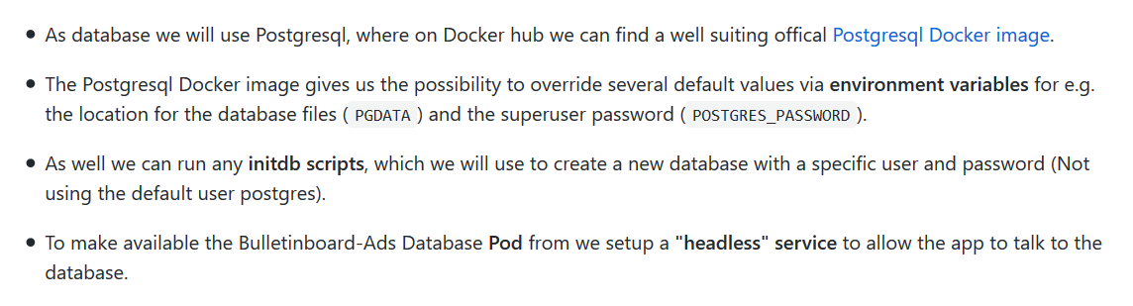
Ads:DB Docker Image
https://hub.docker.com/_/postgres/

Slide 22
Bulletinboard in K8s: ads DB
Configmap: - postgres db files path
Secret: - initdb.sql script - postgres superuser pw
Docker container: postgres:9.6
configmap: ads-db-configmap
secret: ads-db-secret
pod: ads-db-statefulset-0
statefulset: ads-db-statefulset

Slide 23
Bulletinboard in K8s: ads DB
pod DNS-name: ads-db-statefulset-0.ads-db-service
‘headless’ service:
ads-db-service
Docker container: postgres:9.6
configmap: ads-db-configmap
secret: ads-db-secret
pod: ads-db-statefulset-0
statefulset: ads-db-statefulset

Slide 24
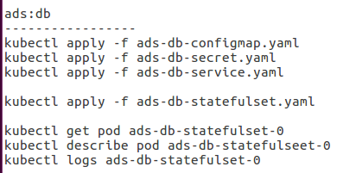
Bulletinboard in K8s: Dependencies across entities – ads DB
Statefulset:
‘ads-db-statefulset’
Service (headless):
‘ads-db-service’
Configmap:
‘ads-db-configmap’
Secret:
‘ads-db-secret’

Slide 25
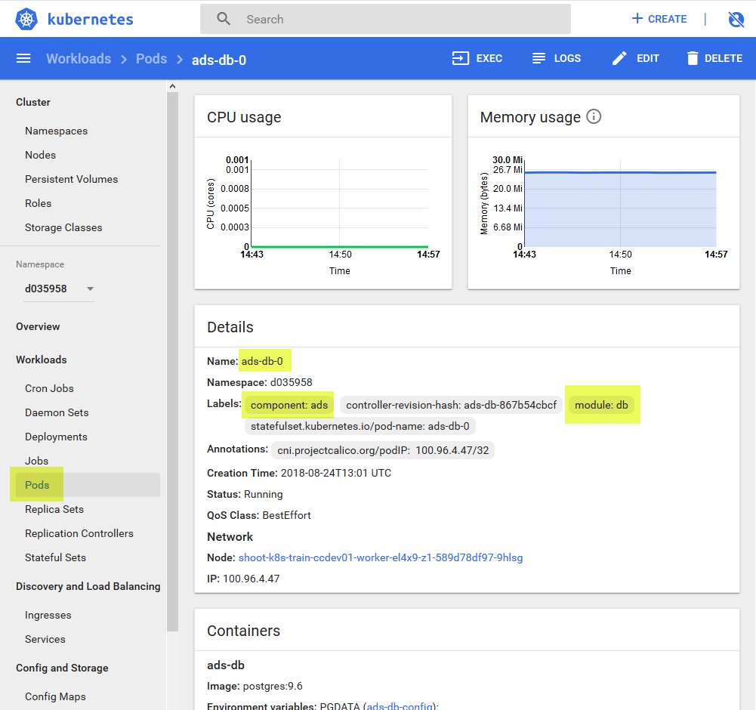
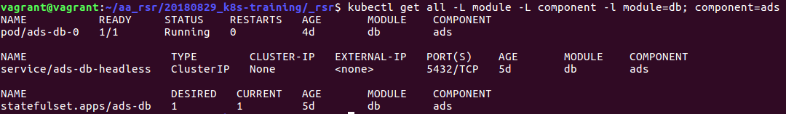
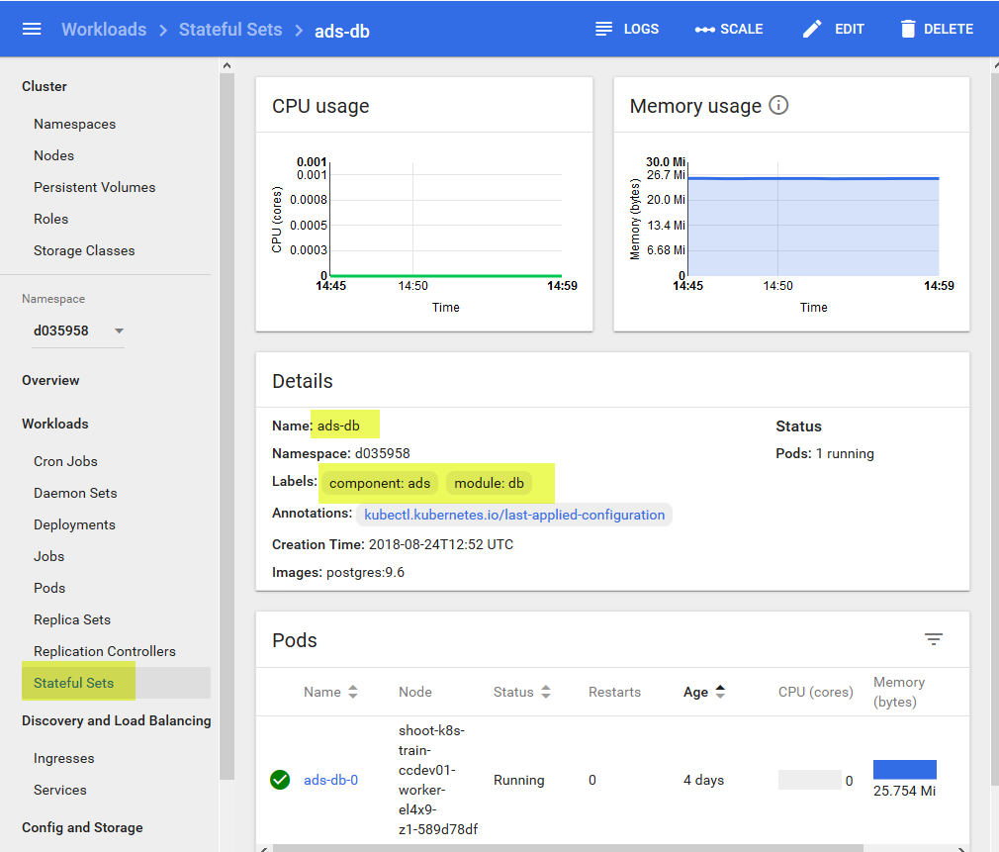
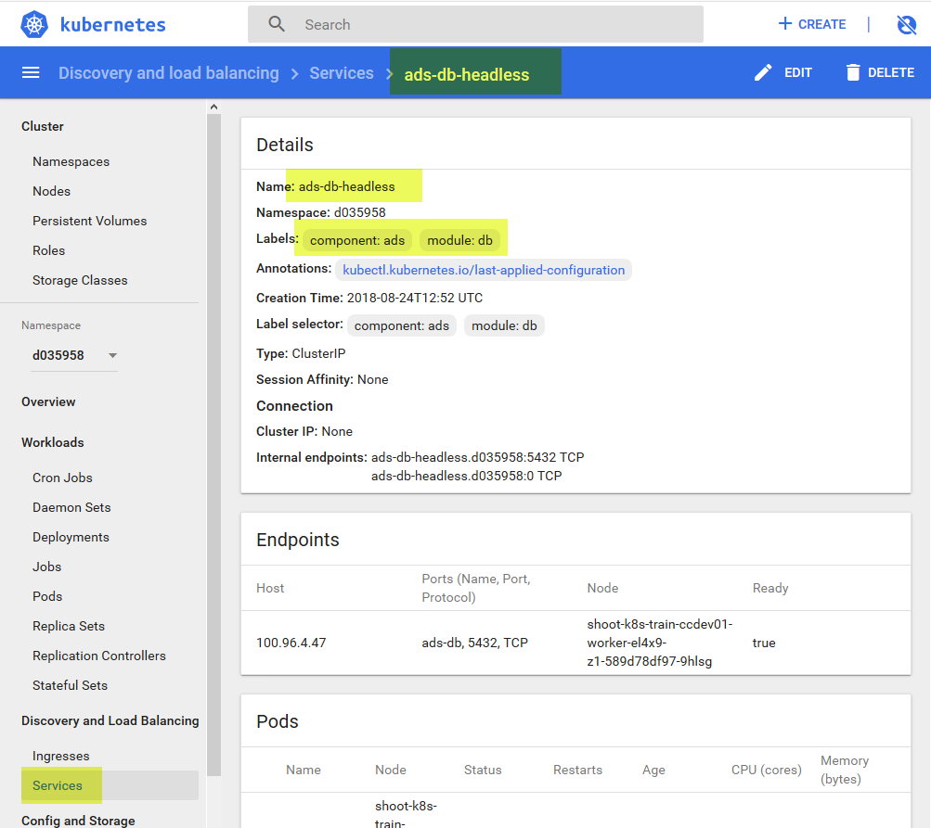
Bulletinboard in K8s: ads DB - labels
pod DNS-name: ads-db-0.ads-db-headless
‘headless’ service:
ads-db-headless
component: ads
module: db
configmap: ads-db-init
Docker container: postgres:9.6
configmap: ads-db
secret: ads-db-secrets
pod: ads-db-0
statefulset: ads-db

Slide 26
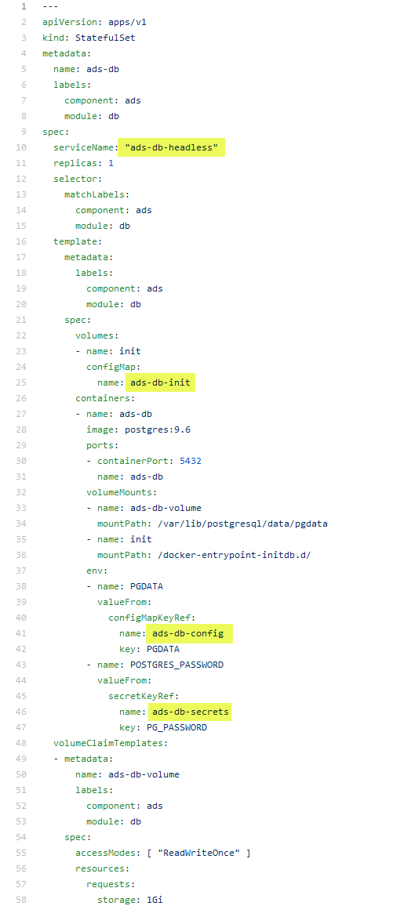
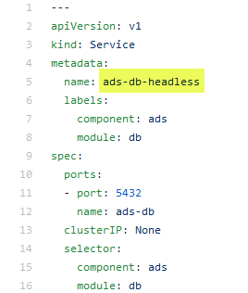
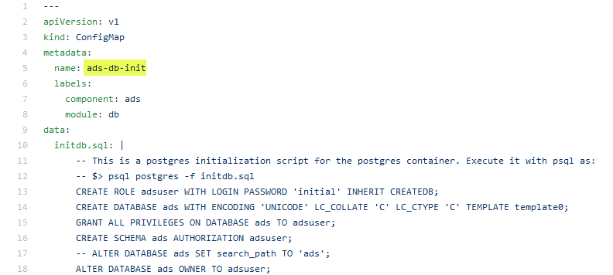
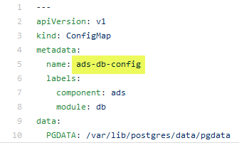
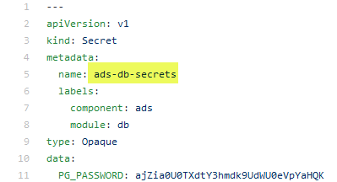
Bulletinboard in K8s: Ads:DB, Dependencies across entities - 2
ads-db-service.yaml
ads-db.yaml
old !
ads-db-init.yaml
ads-db-config.yaml
ads-db-secret.yaml
Notes:
ToDO
Adapt path …/data/pgdata
Rename secret PD_PASSWORD ?
Secrets → secret ?

Slide 27
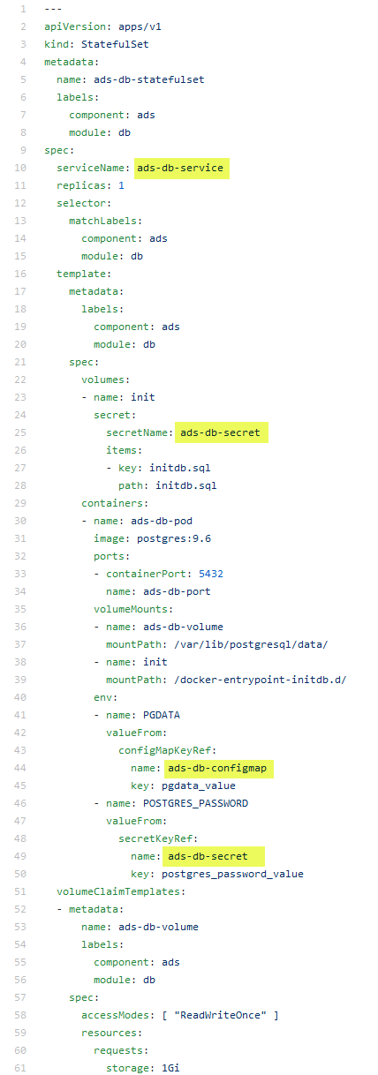
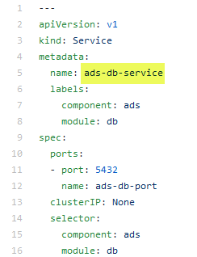
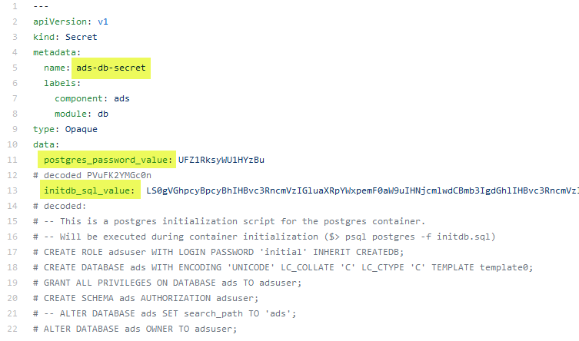
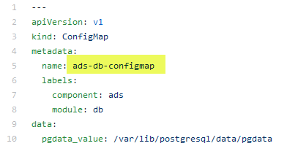
Bulletinboard in K8s: Ads:DB, Dependencies across entities - 2
ads-db-service.yaml
ads-db-statefulset.yaml
ads-db-secret.yaml
ads-db-configmap.yaml
https://github.wdf.sap.corp/slvi/docker-k8s-training/tree/k8s-bulletinboard/kubernetes/k8s-bulletinboard/solutions/ads

Slide 28
Bulletinboard in K8s: ads DB - labels
pod DNS-name: ads-db-statefulset-0.ads-db-service
‘headless’ service:
ads-db-service
component: ads
module: db
Docker container: postgres:9.6
configmap: ads-db-configmap
secret: ads-db-secret
pod: ads-db-statefulset-0
statefulset: ads-db-statefulset

Slide 29
Bulletinboard in K8s: ads DB – details labels & selector
selector: component: ads module: db
statefulset: ads-db-statefulset
component: ads
module: db
pod: ads-db-statefulset-0
component: ads
Docker container: postgres:9.6
module: db

Slide 30
Exercise 1: bulletinboard-ads DB

Slide 31
Bulletinboard in K8s: Exercise “ads App”
ingr/ svc
HTTP/ REST
svc
HTTPS/ REST
nwp
nwp
bulletinboard- ads
bulletinboard-users
cm
cm
sec
pod
sec
pod
deployment
deployment
svc
svc
nwp
postgresql
nwp
postgresql
cm
cm
ü
sec
pod
sec
pod
statefulset
statefulset
Notes:
- Discuss statefulset vs deployment
- Discuss headless service vs ???
- Discuss service vs ingress

Slide 32
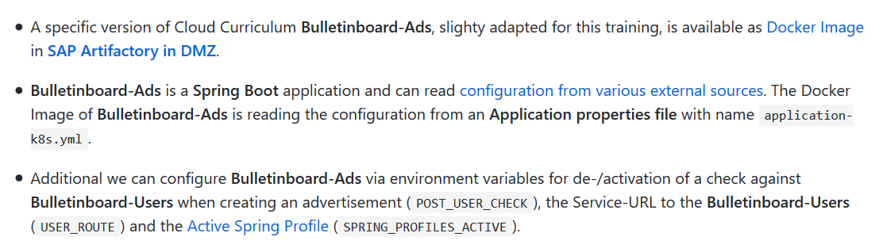
Ads:App Docker image
https://github.wdf.sap.corp/cc-refapp/cc-bulletinboard-ads-spring-boot/tree/migratedToK8s

Slide 33
Bulletinboard in K8s: Exercise “ads app”
ingr/ svc
HTTP/ REST
svc
nwp
nwp
bulletinboard- ads
bulletinboard-users
cm
cm
sec
pod
sec
pod
deployment
deployment
svc
svc
nwp
postgresql
nwp
postgresql
cm
cm
ü
sec
pod
sec
pod
statefulset
statefulset
Notes:
- Discuss statefulset vs deployment
- Discuss headless service vs ???
- Discuss service vs ingress

Slide 34
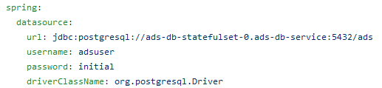
Bulletinboard in K8s: ads app
Configmap: - environment variables: user_route, spring_profile_active, post_user_check
Secret: - application-k8s.yml
configmap: ads-app-configmap
bulletinboard- ads
secret: ads-app-secret
pod: ads-app…ent-xx-yy
deployment: ads-app-deployment

Slide 35
Bulletinboard in K8s: ads app
…ingress.<cluster>.k8s-train.shoot.canary.k8s-hana.ondemand.com/ads
ingress:
ads-app-ingress
service:
ads-app-service
configmap: ads-app-configmap
bulletinboard- ads
configmap: ads-app-secret
pod: ads-app…ent-xx-yy
deployment: ads-app-deployment

Slide 36
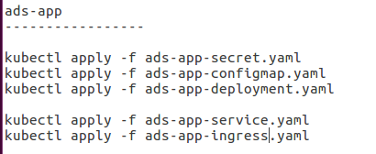
Bulletinboard in K8s: Dependencies across entities – Ads app
deployment:
‘ads-app-deployment’
Configmap:
‘ads-app-configmap’
Secret:
‘ads-app-secret’

Slide 37
Bulletinboard in K8s: ads DB - labels
pod DNS-name: ads-db-0.ads-db-headless
‘headless’ service:
ads-db-headless
component: ads
module: db
configmap: ads-db-init
Docker container: postgres:9.6
configmap: ads-db
secret: ads-db-secrets
pod: ads-db-0
statefulset: ads-db

Slide 38
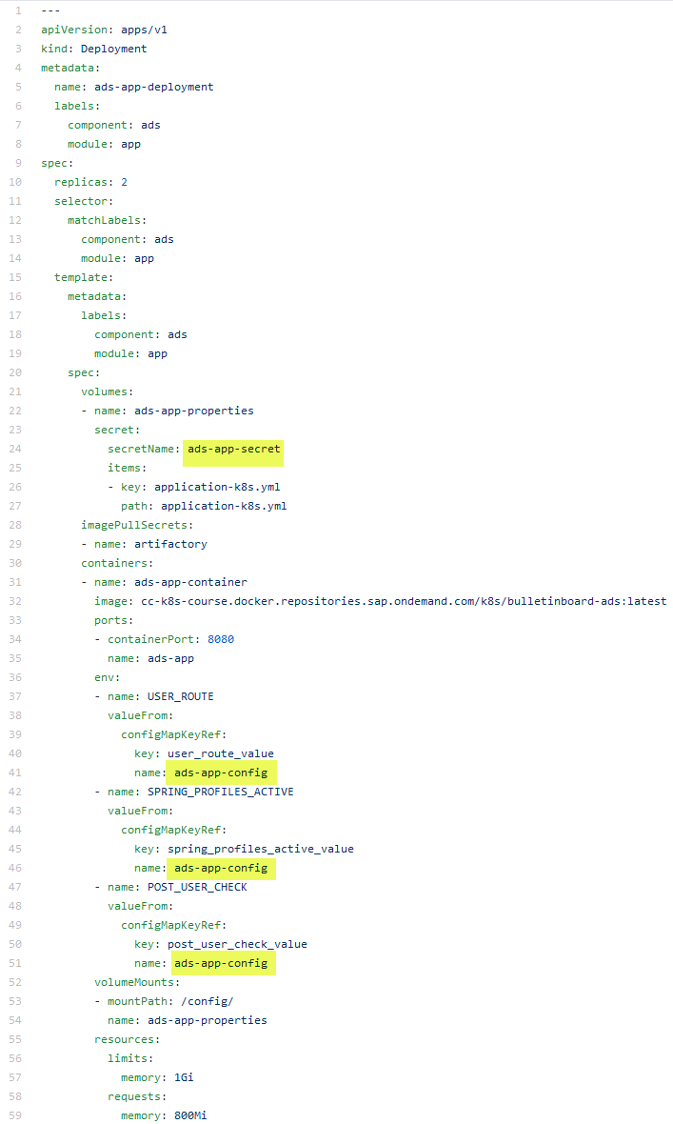
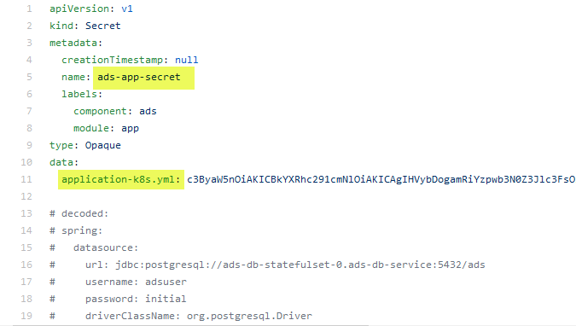
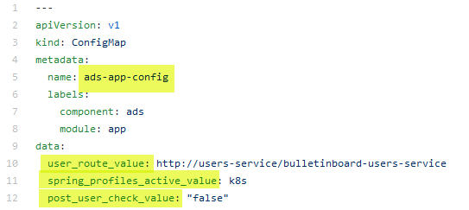
Bulletinboard in K8s: Ads:App, Dependencies across entities - 2
ads-app-deployment.yaml
ads-app-secret.yaml
ads-app-configmap.yaml
https://github.wdf.sap.corp/slvi/docker-k8s-training/tree/k8s-bulletinboard/kubernetes/k8s-bulletinboard/solutions/ads

Slide 39
Bulletinboard in K8s: ads app - labels
….ingress.<cluster>.k8s-train.shoot.canary.k8s-hana.ondemand.com/ads
component: ads
ingress:
ads-app-ingress
module: app
service:
ads-app-service
configmap: ads-app-configmap
bulletinboard- ads
secret: ads-app-secret
pod: ads-app…ent-xx-yy
deployment: ads-app-deployment

Slide 40
Bulletinboard in K8s: Target picture - labels
selector: component: ads module: app
deployment: ads-app-deployment
component: ads
module: app
replicaset: ads-app-deployment-xx
component: ads
module: app
pod: ads-app…ent-xx-yx
component: ads
pod: ads-app…ent-xx-yy
component: ads
pod: ads-app…ent-xx-yz
component: ads
Docker container: bulletinboard- ads:v.0x
module: app
Docker container: bulletinboard- ads:v0.x
module: app
Docker container: bulletinboard- ads:v.0x
module: db

Slide 41
Bulletinboard in K8s: Target picture - labels
selector: component: ads module: app
deployment: ads-app-deployment
component: ads
module: app
replicaset: ads-app-deployment-xx
component: ads
module: app
pod: ads-app…ent-xx-yx
component: ads
pod: ads-app…ent-xx-yy
component: ads
Docker container: bulletinboard- ads:v.0x
module: app
Docker container: bulletinboard- ads:v0.x
module: app

Slide 42
Exercise 1: bulletinboard-ads DB

Slide 43
Exercise 2: bulletinboard-ads App

Slide 44
Application in K8s: Steps to be taken
Ensure your Application is parameterizable/ ready for external configuration (In general/ K8s specific)
Create a Docker Image for your Application, considering parameterization/ external configuration
Create/ use an existing Docker Image for your Database, as well parametrizable.
Make available Application Docker Image in public available Docker registry, e.g. SAP Artifactory DMZ (and DB Docker Image, if not available on e.g. public Docker Hub)
Choose the right K8s entities for parameterization/ external configuration: ConfigMap and Secret
Choose the right K8s entities for your scenario – Stateless vs. Statefull and Horizontal Scaling: Deployment vs Statefulset.
Choose the right K8s entities for exposing your Application internal & external/Internet and network security, etc.: Service, Ingress, NetworkPolicy, etc.

Slide 45
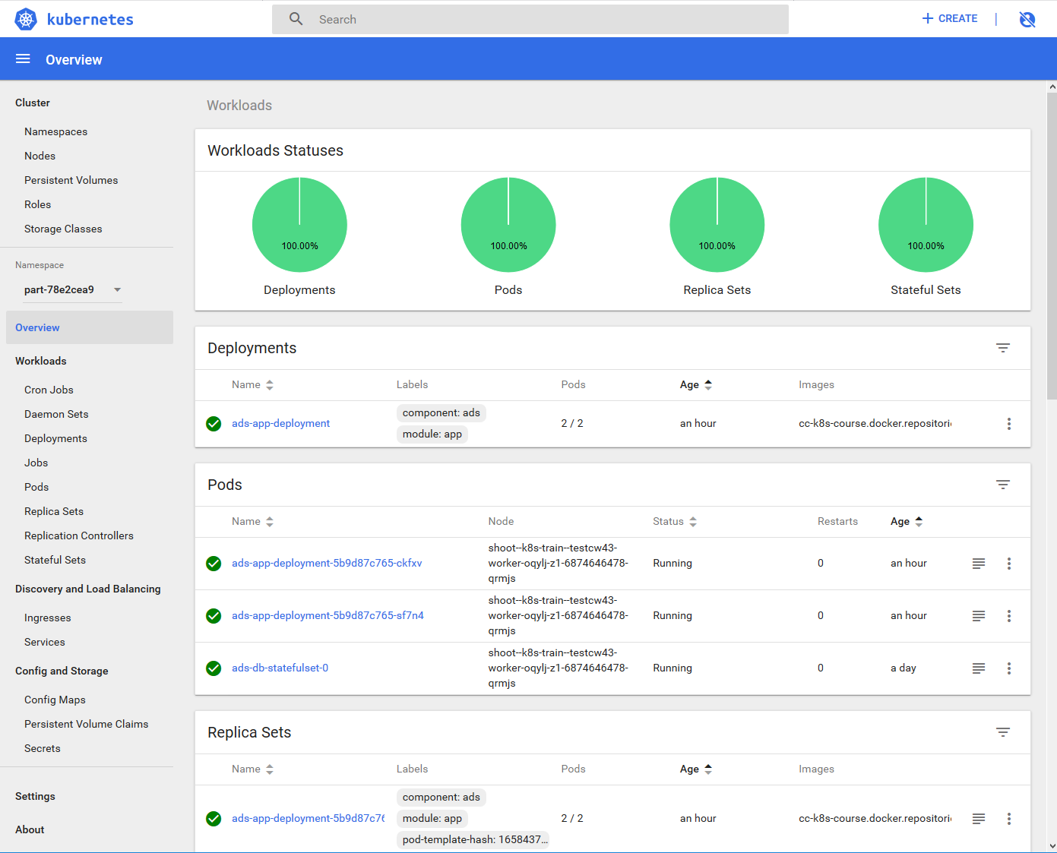
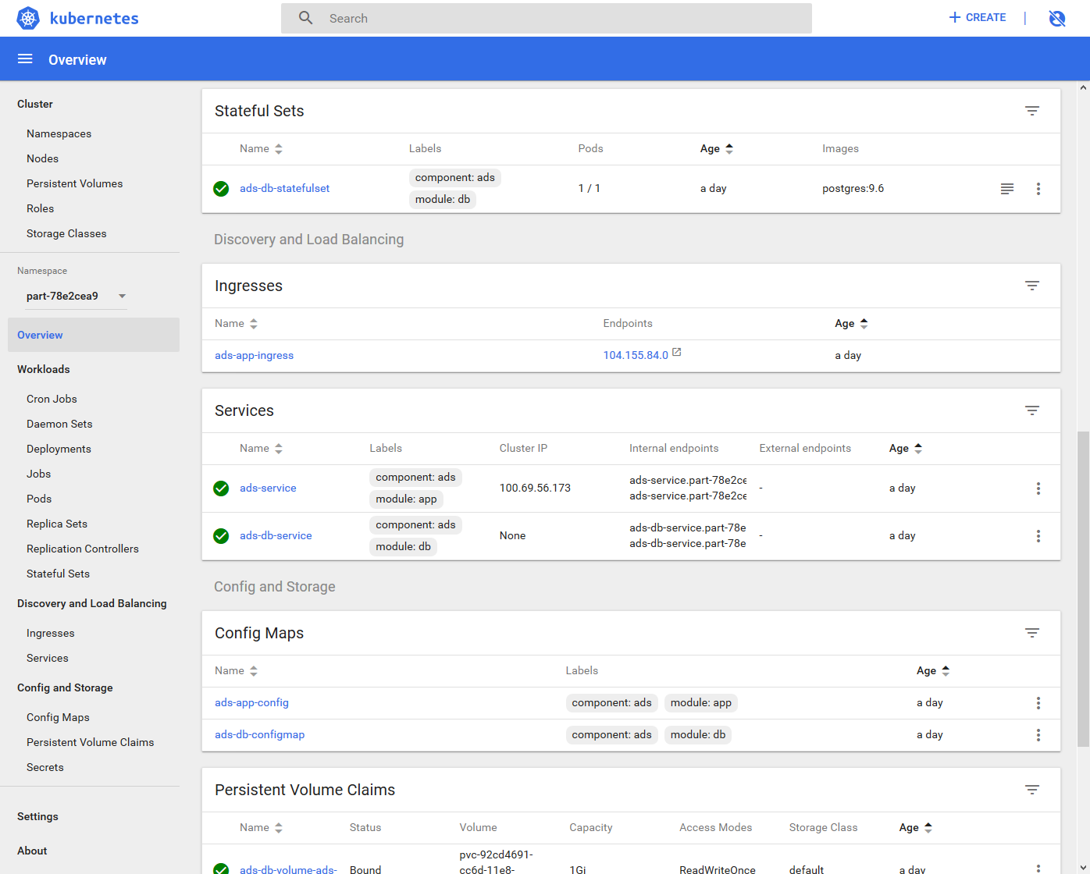
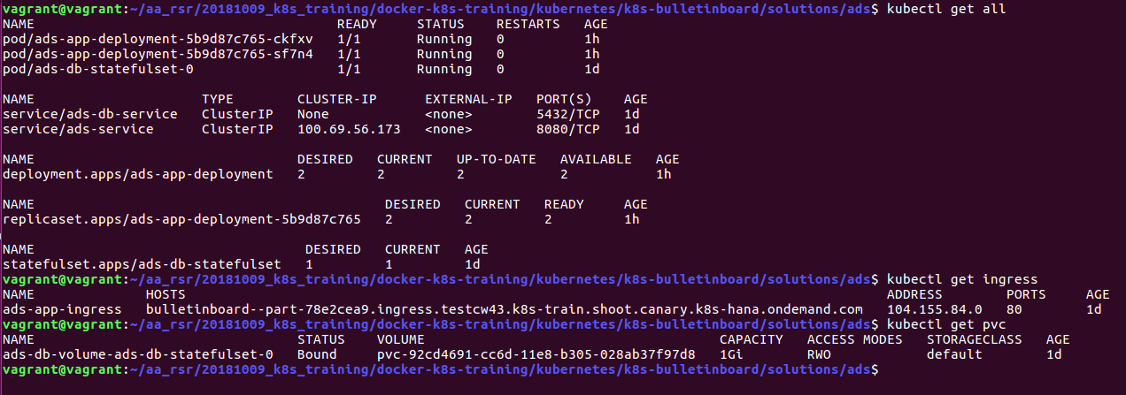
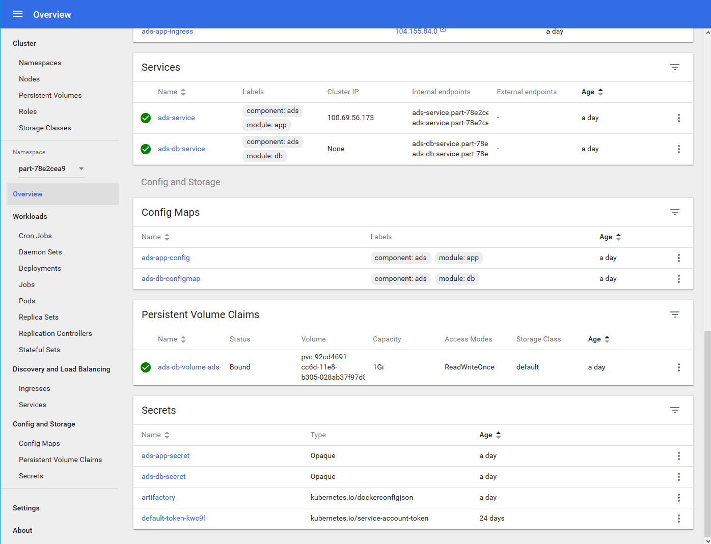
Bulletinboard in K8s:
https://api.testcw43.k8s-train.shoot.canary.k8s-hana.ondemand.com/api/v1/namespaces/kube-system/services/https:kubernetes-dashboard:/proxy/#!/overview?namespace=part-78e2cea9

Slide 46
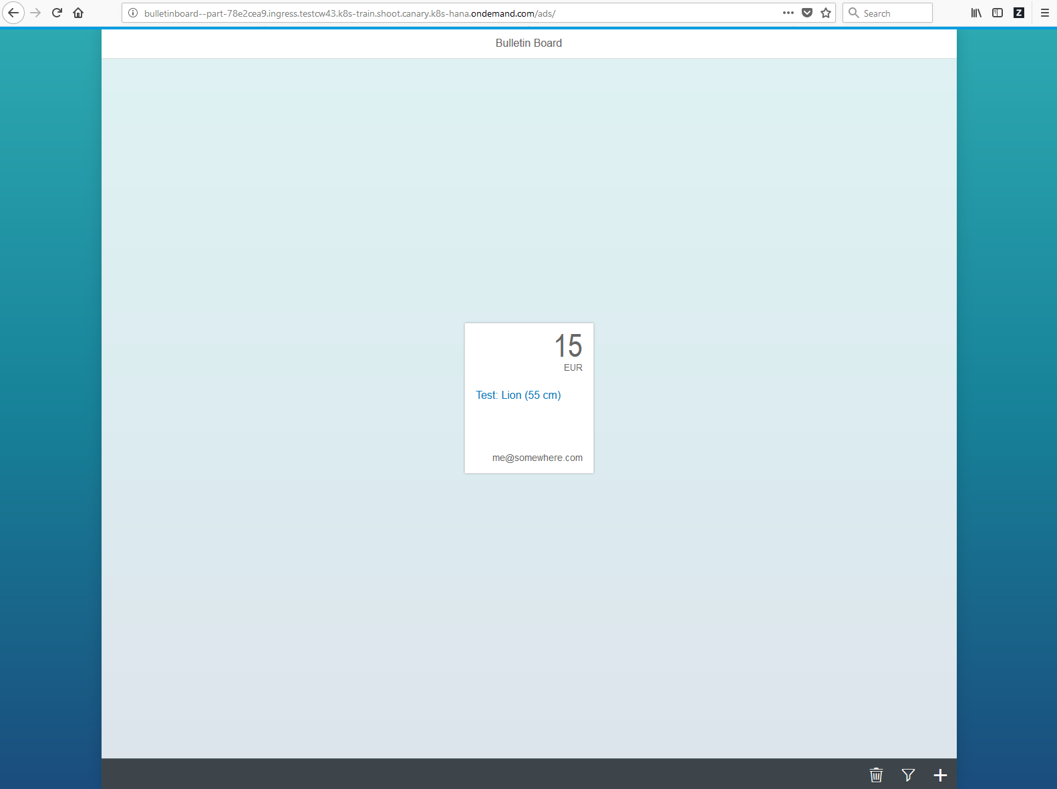
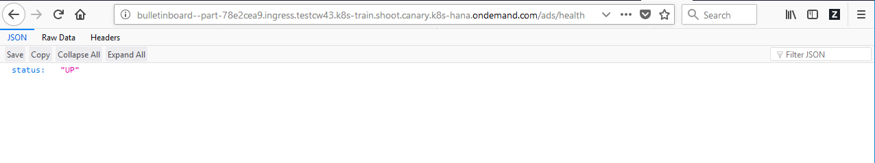
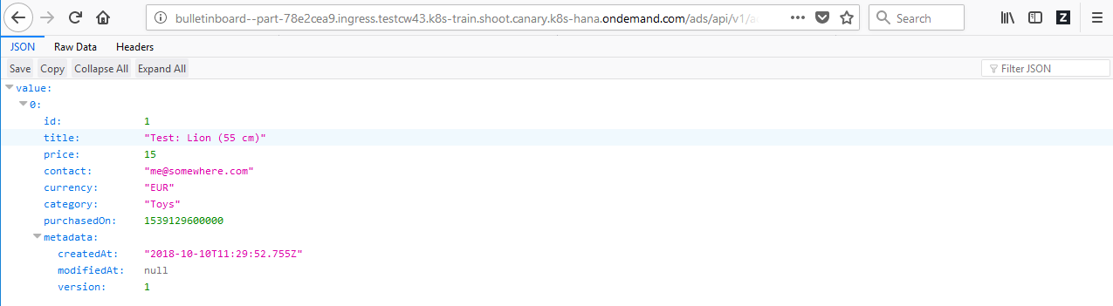
Bulletinboard in K8s:
http://bulletinboard--part-78e2cea9.ingress.testcw43.k8s-train.shoot.canary.k8s-hana.ondemand.com/ads/

Slide 47
Configmaps, Files and Mountpoints
Docker image
Filesystem: /bulletinboard*.jar /config/application-k8s.yml
Envs: SPRING_PROFILES_ACTIVE USER_ROUTE POST_CHECK_USER
bulletinboard- ads
component: ads
secret: ads-app-secret
module: app
configmap: ads-app-configmap
pod: ads-app-xx-yy
Docker image
Filesystem: /*/postgres /docker-entrypoint-initdb.d/initdb.sql /var/lib/postgres/data
Envs: PGDATA POSTGRES_PASSWORD
Postgresql
component: ads
module: db
VC-template: ads-db-volume
secret: ads-db-secrets
configmap: ads-db-configmap
pod: ads-db-statefulset-0
Notes:
Overview over where which value and file and data comes from.

Slide 48
Appendix

Slide 49
What YOU will do in exercise #0x
nginx
nginx
nginx
content
config
tls certs

Slide 50

Demo
Notes:
Show all namespaces in cluster
If not yet mentioned, explain that everyone has their own namespace. Please be a good citizen and don’t sabotage the others.
Query a pod from a dedicated namespace ( e.g. kube-system), explain “-n <namespace>” flag

