Slide 1

Kubernetes Deployments

Slide 2
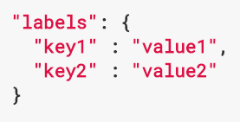

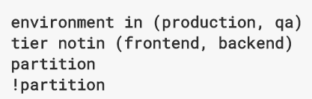
Introducing labels & selectors
Labels are key:value pairs in kubernetes
Labels are part of the “metadata” section of a resource
Basically everything can be labeled (pods, nodes, …)
Example: “release”:”stable”, “release”:”canary”
Based on labels Kubernetes offers selection / filtering / assignments
Equality-based selectors (true / false)
Set-based selectors (in, notin, exists)
https://kubernetes.io/docs/concepts/overview/working-with-objects/labels/

Slide 3
Why do we need labels & selectors?
“In an environment, where names can change and most thing are ephemeral, we need a mechanism to identify a single or a set of objects reliably”
Selector: app:nginx
app: nginx
app: nginx
app: nginx
Pod-A
Pod-B
New-Pod
Pod-C

Slide 4
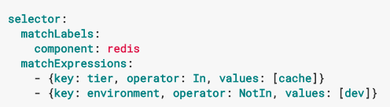
Using labels & selectors
Labels & selectors in resources
metadata.labels
selector
selector.matchLabel / selector.matchExpression
With kubectl:
Attach a label to a resource: “kubectl label pod mypod status=awesome”
Filter for labels: “kubectl get pods –l status=awesome”

Slide 5
Demo

Slide 6
Demo
Show labels of node pools
Label a pod that was created before
Query with labels

Slide 7
Architecture overview – components
kubectl
Master
Worker
API Server
kubelet
proxy
Docker
etcd
(distributed) key-value store
Scheduler
Pod
Pod
Controller Manager

Slide 8
Architecture overview – deployments
Namespace: your-namespace
Deployment
Selector: app:nginx
app: nginx
ReplicaSet
Selector: app:nginx
app: nginx
app: nginx
app: nginx
app: nginx
Pod
Pod
Pod
Notes:
How labels & selectors work here:
Names of pods can change
Labels stay the same
Only with labels pods related to rs/deployment can be determined reliably

Slide 9
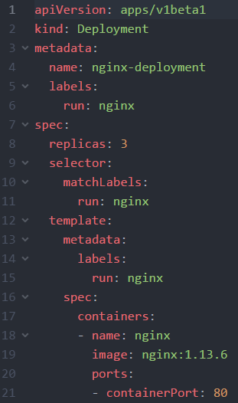
Deployments
Deployments are the default construct to run stateless applications in Kubernetes
Create a deployment from a yaml/json file or by “kubectl run <name> --image=<image>
Deployments create ReplicaSets, which then create pods
Resource type can scale
Support of rolling updates, versioning and roll-backs
All parts belonging to a deployment are identified by labels and corresponding selctors

Slide 10
What YOU will do during the next exercise…
nginx
nginx
nginx
content
config
tls certs

