Slide 1

Kubernetes ConfigMaps and Secrets

Slide 2
What‘s the issue?
How to supply credentials for an application running in Kubernets?
Avoid to store confidential data in images that may become publicly availalbe
Adapt configuration to various runtime environments / how keep the image generic?
Cluster A
Docker Hub
Image A
Image A
Cluster B
Image A

Slide 3
How to solve it?
Separate configuration & credentials from the application
Store them in their own objects
https://kubernetes.io/docs/concepts/configuration/secret
https://kubernetes.io/docs/tasks/configure-pod-container/configmap/
Namspace A
secret
IP: 10.10.10.1
Pod-A
container
nginx
configMap

Slide 4
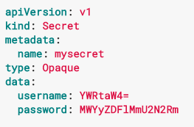
Secrets
Stores data base64 encoded
Is a map-object => can contain several key:value pairs in data section
Bound to a namespace
Can be read by anyone in namespace with watch/list ability
Risk: API server / etcd potentially store information in plaintext

Slide 5
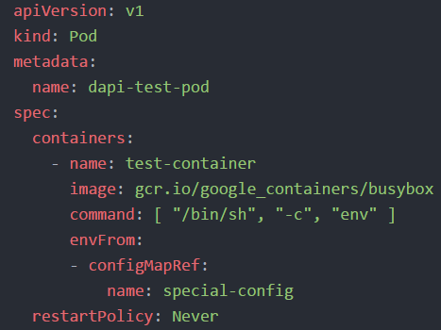
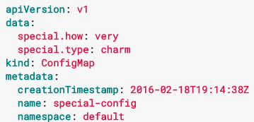
ConfigMaps
Is a map object
Stores information and allows to make them available to pods
Information can become environment variables or files in a directory
Can be created manually with values or from files / directories

Slide 6
Desired target state
service http / https
nginx
nginx
nginx
custom content
config
tls certs

