Slide 1

Kubernetes Core components

Slide 2
Architecture overview
kubectl
Master
Worker
API Server
kubelet
proxy
Docker
etcd
(distributed) key-value store
Scheduler
Pod
Pod
Controller Manager

Slide 3
Core Components - master
etcd
(distributed), high-availability key-value store
Persists state of the cluster
API Server
Central entry point to modify cluster state (i.e. schedule something)
Receives RESTful requests and initiates processing
Controller-Manager
watches etcd for replication tasks and uses the API to enforce the desired state
Scheduler
Assigns resources to nodes for execution

Slide 4
Core Components - worker
kubelet
Runs on every node in a cluster
Manages containers assigned to its node
Fulfills requests as specified in etcd (start, remove, …)
Monitors the state of the node
Actually starts containers
kube-proxy
Manages iptables on each node for services
Docker/rkt
Container runtime on the individual node
Pod
A the smallest, schedulable resource that is managed by kubelet on the node
Pods wrap around one or more (docker) containers

Slide 5
Core Components - clients
kubectl
Wraps requests to API server in human readable format
Cluster administration tasks
User tasks like scheduling of resources
Run `kubectl` or `kubectl <command> --help` to get detailed information
curl
http client that can send get & post requests
API server can be addressed with binaries like curl but also client packages for programming languages like go, python or java

Slide 6
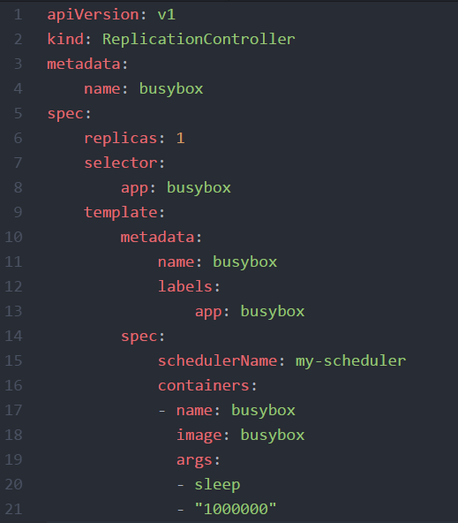
YAML
YAML: “YAML Ain't Markup Language”
YAML is a human friendly data serialization standard for all programming languages.
Indentation based
Supports key:value maps and lists
Supports nesting - a value can also contain another key:value map or a list

Slide 7
Infrastructure for this training
pvxka[01..22]
K8s-training cluster
.kube/config
API server IP
User
Access token
Name-space
Master
Worker
kubectl
API Server
Docker
Pod
Pod
@SAP
etcd
(distributed) key-value store
@GCP

Slide 8
What YOU will do during this training…
Networking layer
nginx
nginx
nginx
Container layer
content
config
tls certs
Persistence layer

Slide 9
Demo Info
Show access to cluster with kubectl
Show and explain kubeconfig with namespace etc.
Query API server with curl and get back the API’s
Kubectl get & describe nodes
SSH into one of the nodes and show kublet (ps aufx)

