Slide 1
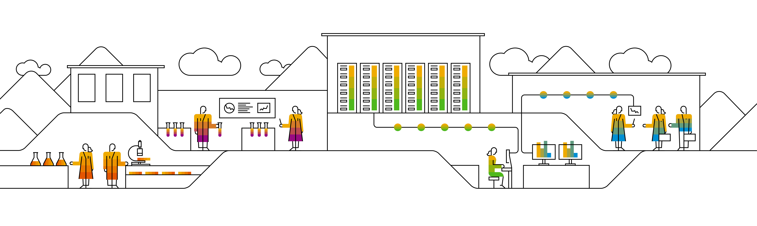

Kubernetes Core components

Slide 2

K8s from application point of view
Notes:
You can look at kubernetes from different perspectives – application centric as well as administrative. Lets start looking at k8s from the application point of view and which concepts k8s offers to run your code.
For an application, k8s is an abstraction of cpu, memory, I/O, network, storage, … which we can consume to run our code.

Slide 3
(incomplete) Kubernetes Concepts Map
Resource management
a resource for every purpose
Deployment
CronJob
Policies
ResourceQuota
PodSecurity Policy
LimitRange
DaemonSet
ReplicaSet
StatefulSet
Job
Network Policy
Node
Pod
IAM
networking
Container (your code)
Ingress
Service
Endpoint
ServiceAccount
data / persistence
(Cluster) Role
Volume
(Cluster) Rolebinding
ConfigMap
Persistent VolumeClaim
Secret
uses / controls
Notes:
Lets take a look at all the concepts that kubernetes knows and uses to run your code.
The central part remains our image, which contains the application we want to run. In the end Kubernetes runs lots and lots of container – however in a smart way ;)
But Kubernetes doesn’t allow you to schedule individual container, it wraps it into something called a “pod” – it can be considered as a logical host with 1..n container in it.
While deploying a pod manually works, it doesn’t allow to scale nor to run reliably. With deployments etc we get different constructs allowing to run one to many pods with different characteristics.
The networking entities provide cluster internal as well as external connectivity.
With the different data & persistence entities it is possible to store data as well as to inject configuration or passwords at runtime.
Policies provide a runtime security context on networking as well as container level.
Resources have also an API representation – you can get information about nodes and manage consumption per pod etc.
Finally cluster access and permissions is managed with the entities of the IAM group.
Further details:
Ingress:
Allows to create a network entity on top of services to expose applications
Expose applications via a URL
Requires an “ingress-controller” inside the cluster
https://kubernetes.io/docs/concepts/services-networking/ingress/
Endpoints are networking objects backing services to enable routing etc. Endpoints can be created manually to point to external applications. So external apps can be integrated into the cluster.
Network policies are the cluster’s firewall to regulate access to pods etc. They cover ingress and egress traffic cluster internally and externally. There are more info on this topic later.
Job/CronJob:
Schedule a pod and run as task to completion
CronJob allows to schedule jobs periodically
https://kubernetes.io/docs/concepts/workloads/controllers/jobs-run-to-completion/
DaemonSet
Ensures that all (or explicitly specified) nodes run a copy of a pod. For example a kube-proxy can run as a pod on every node managed by a daemonSet.
https://kubernetes.io/docs/concepts/workloads/controllers/daemonset/
StatefulSet
Manages the deployment and scaling of a set of pods, and provides guarantees about the ordering and uniqueness of these pods.
Similar to deployments, however it provides more stability with regards to names/identifiers
https://kubernetes.io/docs/concepts/workloads/controllers/statefulset/
Pod Security Policy
Defines conditions pods must run with.
Conditions cover aspects like runAsUser, file system groups, privileges of containers, … an more
https://kubernetes.io/docs/concepts/policy/pod-security-policy/
Resource Quotas
Set quotas on namespace level
Limit the number of resources (pod, pvc, service, …) allowed in this namespace => object count quota
Limit the resources allowed to be consumed by pods or other objects => (compute) resource quota
Can also enforce applications to specify minimal resources required and max resources wanted.
https://kubernetes.io/docs/concepts/policy/resource-quotas/
Roles: a role defines a setup of API objects that can be accessed in a certain way. Example: a role can allow only list/read access to pods. Another role could also allow to list/read, create & delete pods
Role Bindings: assign roles to service accounts /technical users

Slide 4

K8s from administrative point of view
Notes:
In order to understand k8s basic knowledge of the (physical) cluster components is essential.

Slide 5



Architecture overview (very high level)
kubectl
Master
Workers / Minions
Notes:
The API Server is the center piece. All requests towards the cluster go through it.
The cluster components also talk to the api server to sync their activities.

Slide 6
Architecture overview
kubectl
Master
Nodes
kubelet
proxy
API Server
Docker
etcd
(distributed) key-value store
Pod
Pod
Container
Container
Scheduler
Controller Manager
Notes:
The API Server is the center piece. All requests towards the cluster go through it.
The cluster components also talk to the api server to sync their activities.

Slide 7
Core Components - master
etcd
(distributed), high-availability key-value store
Persists state of the cluster
API Server
Central entry point to modify and inspect the cluster state.
Receives RESTful requests and persists changes in etcd.
Controller-Manager
Manages controllers. Various controllers are working to align the spec of a resource with its state.
Scheduler
Binds pods to nodes for execution
Notes:
Example: replicationcontroller: Will see that the specified number of pods for an replication controller resource is really running.

Slide 8
Core Components - worker
kubelet
Runs on every node in a cluster
Manages the containers running on the worker node
Talks to API Server to see if new pods are bound to worker node
Monitors the state of the node
Actually starts containers
kube-proxy
Implements virtual IPs for services in the cluster network.
Docker/rkt
Container runtime on the individual node
Pod
The smallest, schedulable resource that is managed by the kubelet on the node
Pods wrap around one or more (docker) containers
Notes:
For kube-proxy: https://kubernetes.io/docs/concepts/services-networking/service/#virtual-ips-and-service-proxies

Slide 9
Core Components - clients
kubectl
Command line client for Kubernetes. Talks via REST to the API Server.
Cluster administration tasks
User tasks like creating, deleting and modifying of resources
Run `kubectl` or `kubectl <command> --help` to get detailed information
The rest api can also be used directly with tools like curl.
There are official client libraries for the REST API at least for go, python or java.

Slide 10
What happens if we run nginx?
Run nginx
kubectl
Master
Nodes
Nodes
kubelet
proxy
API Server
kubelet
proxy
Docker
etcd
(distributed) key-value store
Pod
Pod
Docker
Container
Container
Scheduler
Container
Container
Controller Manager
Notes:
Now that we explained all the components, let’s walk through an example and see them in action.
The user wants to run an nginx webserver and declares this wish via kubectl to the cluster’s API server.
The API server stores the desired state in etcd
The controller manager will engage the replication controller which will create pod resources according to the required number of replicas.
The scheduler monitors the API server for unscheduled pods and assigns a node to the pod definition (stored in etcd)
The kubelet monitors, if there are new pods to be scheduled on its worker note. If yes, it takes action -> start a container and update the pods status
https://medium.com/jorgeacetozi/kubernetes-master-components-etcd-api-server-controller-manager-and-scheduler-3a0179fc8186

Slide 11
What happens if we run nginx?
The user wants to run an nginx webserver and declares this wish via kubectl to the cluster’s API server
“run nginx”
kubectl
1
Nodes
Master
Nodes
kubelet
proxy
API Server
kubelet
proxy
Docker
etcd
(distributed) key-value store
Pod
Pod
Docker
Container
Container
Scheduler
Container
Container
Controller Manager
Notes:
Now that we explained all the components, let’s walk through an example and see them in action.
The user wants to run an nginx webserver and declares this wish via kubectl to the cluster’s API server, e.g. “kubectl run nginx --image=nginx:1.12.2“
The API server stores the desired state in etcd
The controller manager will engage the replication controller which will create pod resources according to the required number of replicas.
The scheduler monitors the API server for unscheduled pods and assigns a node to the pod definition (stored in etcd)
The kubelet monitors, if there are new pods to be scheduled on its worker note. If yes, it takes action -> start a container and update the pods status
https://medium.com/jorgeacetozi/kubernetes-master-components-etcd-api-server-controller-manager-and-scheduler-3a0179fc8186

Slide 12
What happens if we run nginx?
“run nginx”
The API server stores the desired state in etcd
kubectl
1
Nodes
Master
Nodes
kubelet
proxy
API Server
2
kubelet
proxy
Docker
etcd
(distributed) key-value store
Pod
Pod
Docker
Container
Container
Scheduler
Container
Container
Controller Manager
Notes:
Now that we explained all the components, let’s walk through an example and see them in action.
The user wants to run an nginx webserver and declares this wish via kubectl to the cluster’s API server, e.g. “kubectl run nginx --image=nginx:1.12.2“
The API server stores the desired state in etcd
The controller manager will engage the replication controller which will create pod resources according to the required number of replicas.
The scheduler monitors the API server for unscheduled pods and assigns a node to the pod definition (stored in etcd)
The kubelet monitors, if there are new pods to be scheduled on its worker note. If yes, it takes action -> start a container and update the pods status
https://medium.com/jorgeacetozi/kubernetes-master-components-etcd-api-server-controller-manager-and-scheduler-3a0179fc8186

Slide 13
What happens if we run nginx?
The controller manager will engage the replication controller which will create pod resources according to the required number of replicas.
“run nginx”
kubectl
1
Nodes
Master
Nodes
kubelet
proxy
API Server
2
kubelet
proxy
Docker
etcd
(distributed) key-value store
Pod
Pod
Docker
Container
Container
Scheduler
3
Container
Container
Controller Manager
Notes:
Now that we explained all the components, let’s walk through an example and see them in action.
The user wants to run an nginx webserver and declares this wish via kubectl to the cluster’s API server, e.g. “kubectl run nginx --image=nginx:1.12.2“
The API server stores the desired state in etcd
The controller manager will engage the replication controller which will create pod resources according to the required number of replicas.
The scheduler monitors the API server for unscheduled pods and assigns a node to the pod definition (stored in etcd)
The kubelet monitors, if there are new pods to be scheduled on its worker note. If yes, it takes action -> start a container and update the pods status
https://medium.com/jorgeacetozi/kubernetes-master-components-etcd-api-server-controller-manager-and-scheduler-3a0179fc8186

Slide 14
What happens if we run nginx?
The scheduler monitors the API server for unscheduled pods and assigns a node to the pod definition (stored in etcd)
“run nginx”
kubectl
1
Nodes
Master
Nodes
kubelet
proxy
API Server
2
kubelet
proxy
Docker
etcd
(distributed) key-value store
Pod
Pod
Docker
4
Container
Container
Scheduler
3
Container
Container
Controller Manager
Notes:
Now that we explained all the components, let’s walk through an example and see them in action.
The user wants to run an nginx webserver and declares this wish via kubectl to the cluster’s API server, e.g. “kubectl run nginx --image=nginx:1.12.2“
The API server stores the desired state in etcd
The controller manager will engage the replication controller which will create pod resources according to the required number of replicas.
The scheduler monitors the API server for unscheduled pods and assigns a node to the pod definition (stored in etcd)
The kubelet monitors, if there are new pods to be scheduled on its worker note. If yes, it takes action -> start a container and update the pods status
https://medium.com/jorgeacetozi/kubernetes-master-components-etcd-api-server-controller-manager-and-scheduler-3a0179fc8186

Slide 15
What happens if we run nginx?
The kubelet monitors, if there are new pods to be scheduled on its worker note. If yes, it takes action -> start a container and update the pods status
“run nginx”
kubectl
1
Nodes
Master
5
Nodes
kubelet
proxy
API Server
2
kubelet
proxy
Docker
etcd
(distributed) key-value store
Pod
Pod
Docker
4
Container
Container
Scheduler
3
Container
Container
Controller Manager
Notes:
Now that we explained all the components, let’s walk through an example and see them in action.
The user wants to run an nginx webserver and declares this wish via kubectl to the cluster’s API server, e.g. “kubectl run nginx --image=nginx:1.12.2“
The API server stores the desired state in etcd
The controller manager will engage the replication controller which will create pod resources according to the required number of replicas.
The scheduler monitors the API server for unscheduled pods and assigns a node to the pod definition (stored in etcd)
The kubelet monitors, if there are new pods to be scheduled on its worker note. If yes, it takes action -> start a container and update the pods status
https://medium.com/jorgeacetozi/kubernetes-master-components-etcd-api-server-controller-manager-and-scheduler-3a0179fc8186

Slide 16
What happens if we run nginx?
Observe
Analyze
Act
Control loops
Check API for changes
Current state
Desired state
Detect delta
Enforce the desired state
Notes:
Based on the previous example, can we describe an abstraction of the schema? => Observe, Analyze, Act
The user declares the desired state and the cluster takes care of its fulfillment. This holds true for all actions like create, update/patch or deletion of a resource.
Observe - a control loop, checking certain objects for their state.
Analyze – check the current state against a desired state (may be stored in a different resource, outside of the cluster, hardcoded, …)
Action – if there’s a difference between desired & current state, the controller should act and trigger a defined action to bring the observed objects into the desired state

Slide 17
API Structure
/api -- core objects like pods or services /api/<apigroup> -- added later as the API grew
/ api / <version> / namespaces / <ns> / <resource-type-name> / <resource-name>
<ns> / <resource-type-name> / <resource-name>
<ns> / <resource-type-name> / <resource-name>
Notes:
The api is structured in different groups/version. Within these, namespaces group a set of resources. Within a namespace group names have to be unique.

Slide 18
API Versioning
v1alpha1 -- cluster may explode, volatile api changes expected v1beta1 -- generally stable v1 -- GA (general availability)
Notes:
beta:
aims for backwards compatibility,
may have bugs
used in production with caution
v1 / GA:
no bugs of course
available until deprecated (3 releases or max 1 year)

Slide 19
Namespaces
Logical realm for applications to run within
Isolate resources and restrict visibility to objects in the same namespace
Basic user management is handled on namespace level
Resource quotas / limits managed per namespace
Uniqueness of names required per namespace
Access to services in a different namespace via FQDN <service-name>.<namespace>
Use –n (--namespace) <namespace> switch with kubectl to access resources

Slide 20
Namespaces
Namespace: your-namespace
Pod
Pod
Pod
Namespace: my-namespace
Pod
Pod
Pod
Node
Node
Node
Notes:
Logical realm for applications to run within
Isolate resources and restrict visibility to objects in the same namespace
Basic user management is handled on namespace level
Resource quotas / limits managed per namespace
Uniqueness of names required per namespace
Access to services in a different namespace via FQDN <service-name>.<namespace>
Use –n (--namespace) <namespace> switch with kubectl to access resources

Slide 21
Namespaces within the training cluster
Namespace: kube-system
DNS
Proxy
Addons
Hosts cluster-wide components & administrative workloads
Namespace: default
Demo-1
Demo-2
Demo-3
Hosts any workload and is the default target for all kubectl commands, if no namespace is specified
Namespace: part-6b4305ca
workload
workload
workload
Environment of participants to run all exercises
Notes:
Kube-system:
This namespace usually hosts components which are administrative or should be available as cluster wide services. Typically these are the DNS, network components like the kube-proxy & calico or node-exporter (collecting node metrics)… But also addons like the ingress controller are hosted there. Kube-system exists in almost all clusters
Default:
Is just like any other namespace. However if no namespace target is specified (via kubectl -n or within the context of the kube.config), the default namespace is targeted. Default exists in almost all clusters.
Part-6b4305ca:
Participant namespaces are created as part of the training preparation. Each participant gets an individual namespace and the kube.config has a corresponding entry in the context section to send all requests to this namespace per default.

Slide 22
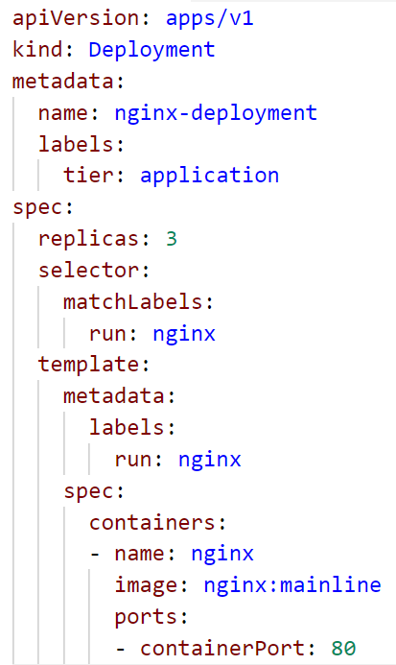
YAML
YAML: “YAML Ain't Markup Language”
YAML is a human friendly data serialization standard for all programming languages.
Indentation based
Supports key:value maps and lists
Supports nesting - a value can also contain another key:value map or a list

Slide 23
Infrastructure for this training
local participant VM
K8s-training cluster
.kube/config
API server IP
User
Access token
Name-space
Master
Nodes
kubectl
API Server
Docker
Pod
Pod
@SAP
etcd
(distributed) key-value store
Gardener on GCP

Slide 24

Demo
Notes:
Call kubectl without any sub-command and explain how to get more info
Show and explain kubectl config *
Explain KUBECONFIG env variable & the default location ~/.kube/config
Show the kubeconfig yaml file with the current context and the namespace
Show access to cluster with kubectl -> kubectl get nodes
Explain basic syntax of kubectl [verb] [resource type] [specific resource by name or label] [options / switches like –o yaml]
Show kubectl get & describe nodes and talk about details of the node, like resource utilization or docker version
Show all namespaces in cluster, if not yet mentioned, explain that everyone has their own namespace. Please be a good citizen and don’t sabotage the others.
Query a pod from a dedicated namespace ( e.g. kube-system), explain “-n <namespace>” flag
Run kubectl proxy &
Open localhost:8001 in browser and show api tree, traverse through it and go to namespace kube-system and show some pods
Query API server with curl (again via localhost)
If you have kubectl version v1.11 or higher:
Show kubectl api-versions => similar to what you did with the proxy, just easier
Show kubectl api-resources => gives info about all the cluster resources incl short names!

Slide 25
What YOU will do during this training…
Networking layer
nginx
nginx
nginx
Application layer
content
config
tls certs
Persistence layer

Slide 26

Exercise 01
Notes:
~10min

