Slide 1
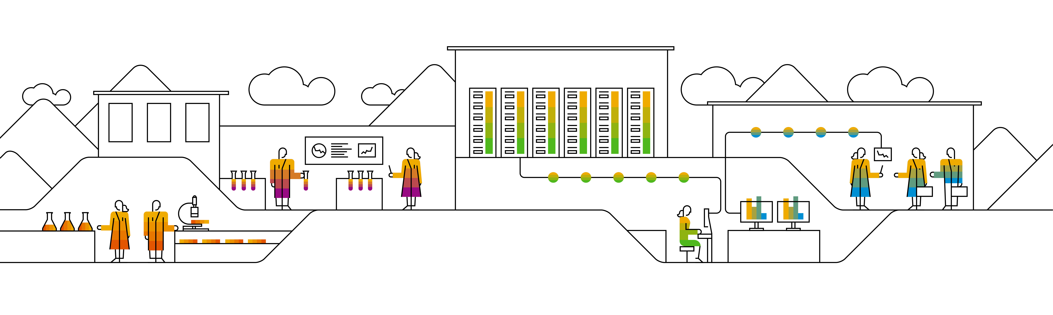

Kubernetes Persistence

Slide 2
What‘s the issue?
Pods are ephemeral and can vanish any moment
Data residing in a pod will vanish with the pod
IP: 10.10.10.1
Pod-A
container
nginx
Container FS
Notes:
Pods provide only ephemeral storage. When a pod is killed, all data is gone. This section is all about the creation & usage of storage in the context of Kubernetes.

Slide 3
How to solve it?
Let the pod access persistent storage
Kubernetes offers different types of storage integration:
https://kubernetes.io/docs/concepts/storage/volumes/
IP: 10.10.10.1
Pod-A
Storage backend
Container:
mount as /mnt/
reference
Notes:
Add the reference to the storage to the pod definition in spec.volumes
Refer to the spec.volumes entries in the container spec and define to which location the bind-mount should point. If the container places data at /mnt/, it will be persisted on the actual storage

Slide 4
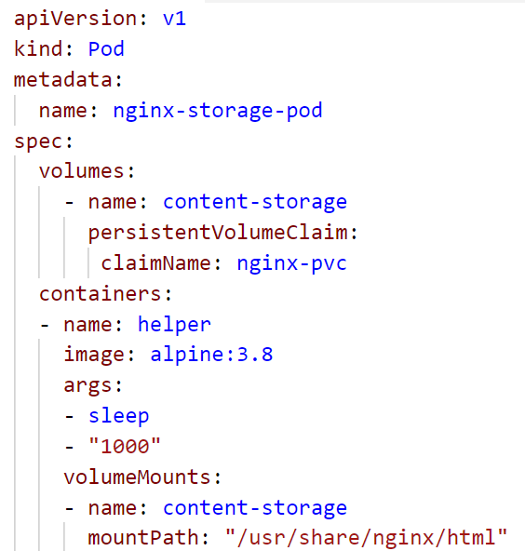
Volumes & VolumeMounts
Volumes are part of the PodSpec object
Provide direct access to storage
Available for a lot of backends
local storage (nfs, hostPath, ceph)
cloud storage (Azure, GCP, AWS,…)
Make storage available in a container via VolumeMounts as part of the container specification
Special volumes:
emptyDir
secret
configMap
Notes:
To use persistent storage within a container, firstly you need to make it available to the pod.
This is done by specifying a volume object on PodSpec level.
A volume could link to a NFS share, some local storage cluster like ceph or glusterfs or even access the storage provided by cloud platforms like GCP, AWS or Azure.
It is also possible to share storage that is part of a cluster node itself (hostPath). However this is quite dangerous as you need to ensure this storage is available (incl. content) on every single cluster node.
In addition there are other special volume types:
emptyDir: temporary storage, usually to cache or test something. Its lifecycle is bound to the pod and therefore data is ephemeral as well
Secret & configMaps: hold confidential or configuration data and are accessed also via the volumes interface.

Slide 5

What happens in the background …
Node
bind mount /mnt/gce-pd-volume into container file system
Docker
Pod
Container
/usr/share/nginx/html
10 GB Persistent Disk
/dev/sdb
Mount disk to node
/mnt/gce-pd-volume/
Notes:
While abstraction is easy to work with, it is also quite helpful to know, what is happening in the background.
When declaring the pod spec with it’s volume mount section, in the end it refers to some physical storage. To get actual access to it, the disk needs to be mounted to the node first. Only then the docker daemon can use a bind mount to make the disk available to the container.

Slide 6
Are there drawbacks of direct storage integration?
Notes:
Drawbacks:
Maintain credentials to access storage within the pod
Have dependencies to infrastructure already at pod level
Hard to manage data lifecycle
Does it scale with the number of pods?
There are several ways of adding storage. Of course you can attach storage directly as a so called volume. However there might be drawbacks doing so. Hence we introduce a different way involving another abstraction layer.

Slide 7
Storage with PersistentVolumes & PersistentVolumeClaims
User space
Administrator space
Pod-A
Persistent Volume Claim
Persistent Volume
Physical storage
container
nginx
Use the claim as a volume in a pod.
Note: the claim has a separate lifecycle.
Create a Persistent Volume Claim to bind the Persistent Volume
Persistent Volumes objects represent physical storage
Notes:
Managing storage is a distinct problem from managing compute. The PersistentVolume subsystem provides an API for users and administrators that abstracts details of how storage is provided from how it is consumed. To do this we introduce two new API resources: PersistentVolume and PersistentVolumeClaim.
A PersistentVolume (PV) is a piece of storage in the cluster that has been provisioned by an administrator. It is a resource in the cluster just like a node is a cluster resource. PVs are volume plugins like Volumes, but have a lifecycle independent of any individual pod that uses the PV. This API object captures the details of the implementation of the storage, be that NFS, iSCSI, or a cloud-provider-specific storage system.
A PersistentVolumeClaim (PVC) is a request for storage by a user. It is similar to a pod. Pods consume node resources and PVCs consume PV resources. Pods can request specific levels of resources (CPU and Memory). Claims can request specific size and access modes (e.g., can be mounted once read/write or many times read-only).

Slide 8
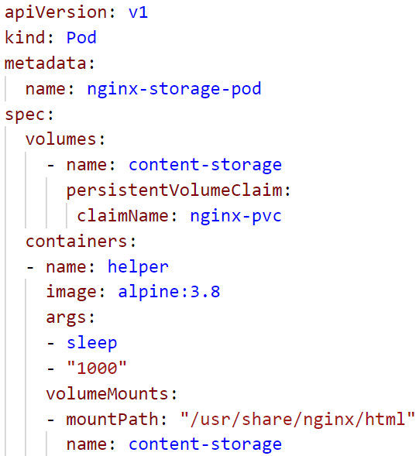
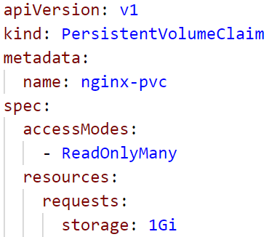
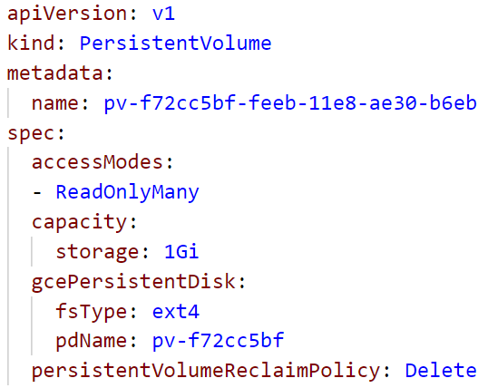
Storage with PersistentVolumes & PersistentVolumeClaims
PV:PVC is always 1:1
PV size must match or exceed PVC requested size
PVC is used as volume within the pod
PVC referenced by Pod
PV is bound to PVC
Notes:
1 PV is always bound by exactly 1 PVC. There is no real order but Kubernetes tries to create matches between requested and provisioned size.
Problem: the match making is based on “equals or greater”. So if the PVC requests 1GB but there is only one PVC with 50GB available, it will be bound nevertheless (and “waste” 49GB)

Slide 9
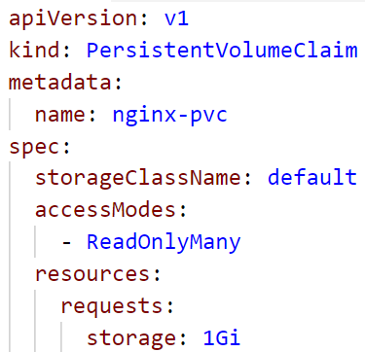
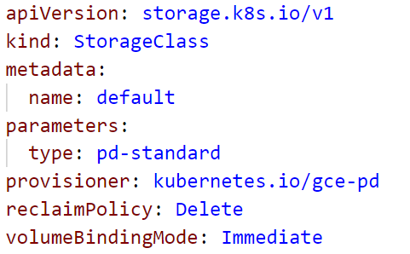
Storage Classes
Provisions a PV for based on PVC request
Overcomes need to manually provision PV (which is not namespaced and could be claimed by anybody)
PVC references storage class as part of its spec
Storage class provisions a PV matching the request
Notes:
Due to the PV-PVC bind mechanism, it might happen that storage is claimed by the “wrong” requests. Storage classes overcome this issue by reversing the order. Firstly create a PVC and the storage class provides a fitting PV.
On Kubernetes level a storage class is a piece of software running inside the cluster that also is able to administer the storage backend.

Slide 10

PV/PVC lifecycle
User creates a PVC to request storage
PVC will be bound to PV
Storage Class
Persistent Volume
Persistent Volume Claim
Persistent Volume Claim
Physical storage
Storage Class is triggered to fulfill request
Upon PVC deletion reclaim policy is executed
Notes:
Upon deletion of the claim object the persistent volume becomes “unbound”.
There are 3 scenarios:
Retain: nothing happens, the PV will remain until an administrator deals with it. The data is not (yet) deleted.
Delete: together with the PVC also the PV will be deleted. All data is gone.
Recycle (deprecated): remove all data and make PV available to be bound again by a different PVC

Slide 11
PV/PVC lifecycle
Persistent Volume Claim
Deleting a PVC could cause the following:
Retain – PV still exists including all data
Delete – delete the PV and all data
Recycle – delete data and make PV available again to be bound by a different PVC
Persistent Volume
Notes:
Upon deletion of the claim object the persistent volume becomes “unbound”.
There are 3 scenarios:
Retain: nothing happens, the PV will remain until an administrator deals with it. The data is not (yet) deleted.
Delete: together with the PVC also the PV will be deleted. All data is gone.
Recycle (deprecated): remove all data and make PV available to be bound again by a different PVC

Slide 12
Access Modes
RWO = read-write once
Only 1 pod can mount the PVC
ROX = read-only many
Multiple pods can mount read-only or 1 pod read-write
RWX = read-write many
Multiple pods can mount read-write
Pod A1
IP: 10.10.10.1
Pod A2
Persistent Volume Claim
Persistent Volume
Physical storage
IP: 10.10.10.2
Pod A3
IP: 10.10.10.3
Storage backend has to support access modes
Notes:
Modes depend on the storage backend (physical storage). Example for RWX is NFS
https://kubernetes.io/docs/concepts/storage/persistent-volumes/#access-modes

Slide 13

What happens in the background …
Node 1
10 GB Persistent Disk
Node 2
Docker
Docker
Pod
Pod
Container
/usr/share/nginx/html
Container
/usr/share/nginx/html
/dev/sdb
Mount disk read-write
/mnt/gce-pd-volume/
/mnt/gce-pd-volume/
Notes:
While abstraction is easy to work with, it is also quite helpful to know, what is happening in the background.
When declaring the pod spec with it’s volume mount section, in the end it refers to some physical storage. To get actual access to it, the disk needs to be mounted to the node first. Only then the docker daemon can use a bind mount to make the disk available to the container.

Slide 14
What happens in the background …
Node 1
10 GB Persistent Disk
Node 2
Docker
Docker
Pod
Pod
Container
/usr/share/nginx/html
Container
/usr/share/nginx/html
/dev/sdb
Stop container
umount disk
/mnt/gce-pd-volume/
/mnt/gce-pd-volume/
Notes:
While abstraction is easy to work with, it is also quite helpful to know, what is happening in the background.
When declaring the pod spec with it’s volume mount section, in the end it refers to some physical storage. To get actual access to it, the disk needs to be mounted to the node first. Only then the docker daemon can use a bind mount to make the disk available to the container.

Slide 15
What happens in the background …
Node 1
10 GB Persistent Disk
Node 2
Docker
Docker
Pod
Pod
Container
/usr/share/nginx/html
Container
/usr/share/nginx/html
/dev/sdb
Mount disk read-only
/mnt/gce-pd-volume/
/mnt/gce-pd-volume/
Notes:
While abstraction is easy to work with, it is also quite helpful to know, what is happening in the background.
When declaring the pod spec with it’s volume mount section, in the end it refers to some physical storage. To get actual access to it, the disk needs to be mounted to the node first. Only then the docker daemon can use a bind mount to make the disk available to the container.

Slide 16
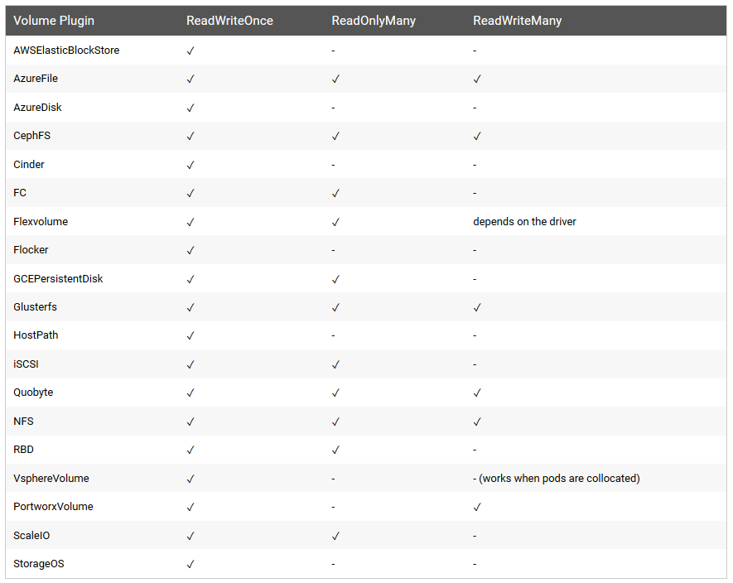
Persistent Volume Types - Access Modes
Notes:
https://kubernetes.io/docs/concepts/storage/persistent-volumes/#types-of-persistent-volumes
https://kubernetes.io/docs/concepts/storage/persistent-volumes/#access-modes

Slide 17

Demo
Notes:
Create a PVC from yaml
Show the storage class reference in the PVC yaml and the corresponding storage class within the cluster (kubectl get storageclass). These have to match!
Query the PV’s and outline the connection between the PVC in the namespace and the PV. Print out the PV yaml and highlight that there is no namespace as PV resources are not namespaced.
Create a pod where the PVC is mounted. Discuss the volume & volumeMount section and highlight the matching names for the volume within the pod spec to make it referenceable.
Once the pod is created, logon to it and create some content.
In parallel, create a deployment that attempts to mount the same PVC.
Discuss the error message (kubectl describe pod <pod of a deployment>)
Outline the implication of the access-mode. If the PVC is already bound once in RWO mode, it cannot be bound in any other mode.
To get the example working the first pod would need to be removed and all other pods would need to be re-created.

Slide 18
What YOU will do in exercise #05
nginx
nginx
nginx
Add persistent storage to your pods
content
config
tls certs

Slide 19
Storage with PersistentVolumes & PersistentVolumeClaims
PV:PVC is always 1:1
PV size must match or exceed PVC requested size
PVC is used as volume within the pod
PVC referenced by Pod
PV is bound to PVC
Notes:
1 PV is always bound by exactly 1 PVC. There is no real order but Kubernetes tries to create matches between requested and provisioned size.
Problem: the match making is based on “equals or greater”. So if the PVC requests 1GB but there is only one PVC with 50GB available, it will be bound nevertheless (and “waste” 49GB)

