Slide 1
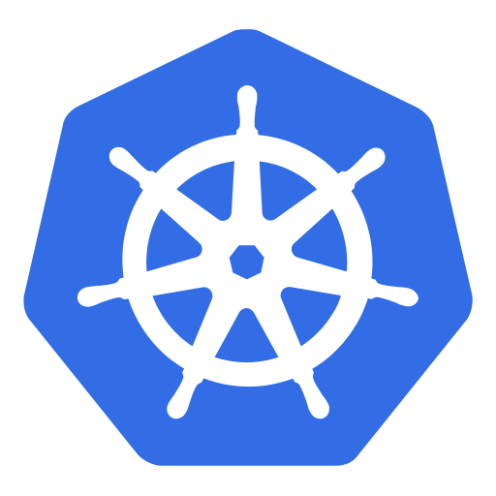
How to setup a
Dev-Cluster @GCP (via the web UI)

Slide 2
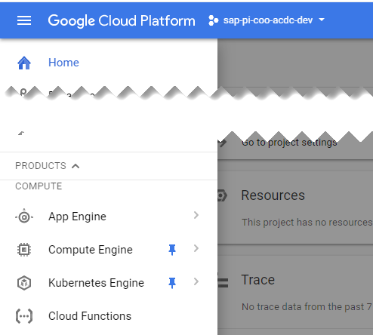
Logon to GCP (https://console.cloud.google.com/)
(2) Open the “menu”
(1) Make sure to select the correct project
(3) Choose to the “Kubernetes Engine”
(4) Click “create cluster” on the next screen

Slide 3
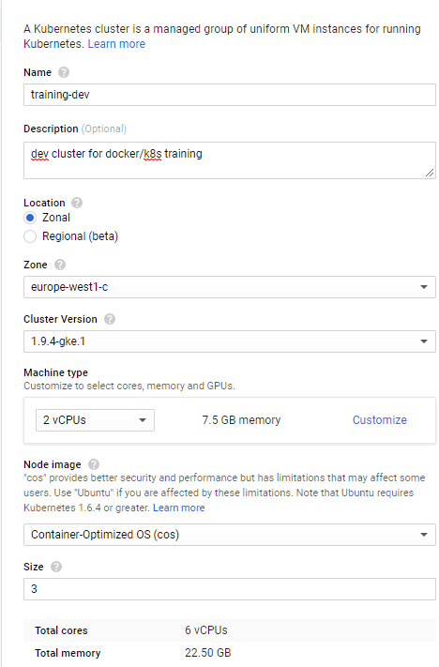
Cluster creation dialogue (1)
Give the cluster a name
Decide which data center to use (e.g. Belgium)
Choose your initial k8s version (upgrades are possible later)
Choose the size of your cluster nodes (VM’s). You can add further pools with different VM sizes later.

Slide 4
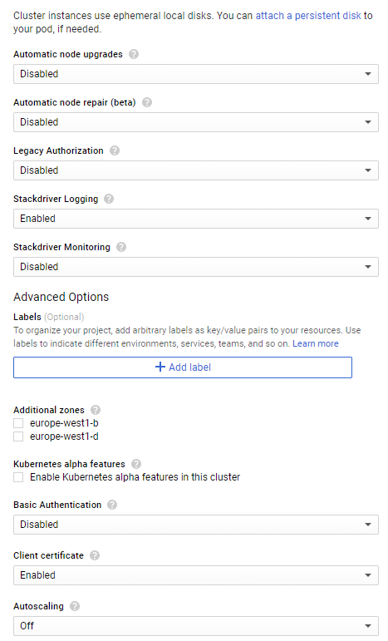
Cluster creation dialogue (2)
Check & decide, if you want to use dedicated beta features
Disable legacy authorization
No high availability needed, thus no additional zones required
Disable basic authentication

Slide 5
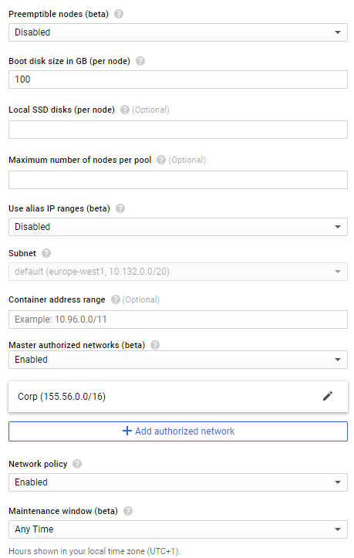
Cluster creation dialogue (3)
Default value of 100GB boot disk is ok
Enable master authorized networks. The API server of the cluster will only accept incoming requests from corresponding source IPs.
SAP owned CIDR is 155.56.0.0/16
Enable network policy to get the calico add-on. Required for exercises later

Slide 6
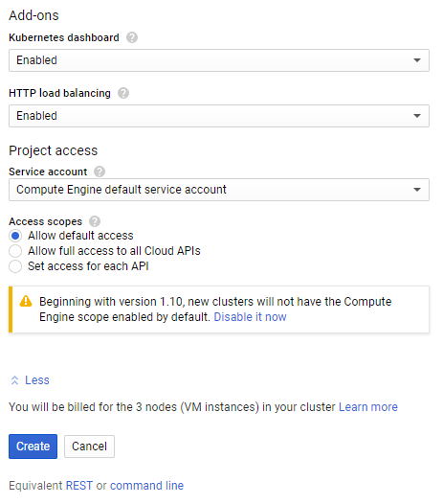
Cluster creation dialogue (4)
You need the http load balancing to get services of type “loadBalancer” working
Create the cluster ☺

Slide 7
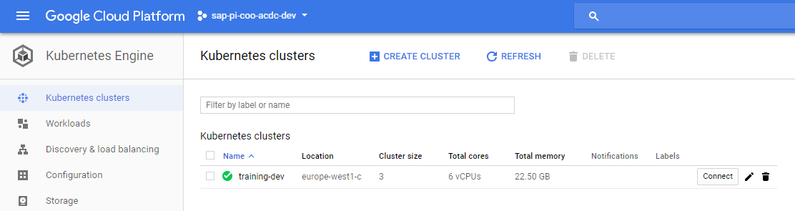
Get the kubeconfig
Make sure, you’re on the right project and open the kubernetes engine view
Select your cluster and click “connect”

Slide 8
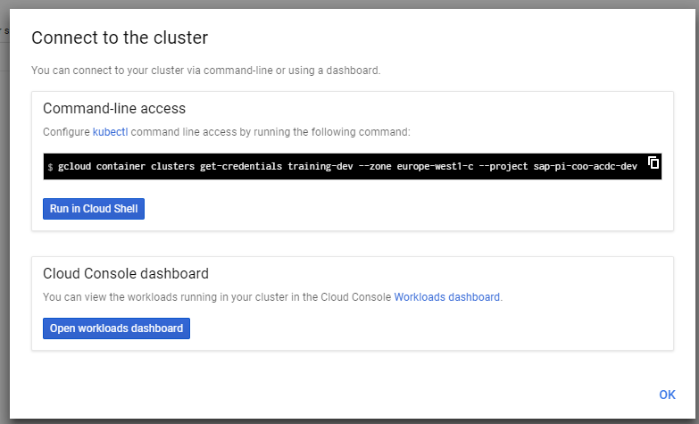
Get the kubeconfig
Copy the gcloud command and run it locally
Prerequisites:
- Have a local kubectl & gcloud sdk
- gcloud sdk needs to be initialized and connected to your GCP account & project
https://cloud.google.com/sdk/

Slide 9
In case you’re working with multiple clusters…
Run:
“kubectl config get-contexts” → gives you all clusters to which you have locally stored config. Each is referred to as a “context”
“kubectl config current-context” → get the currently used context
“kubectl config use-context <context-name>” → switch to another context

