Slide 1
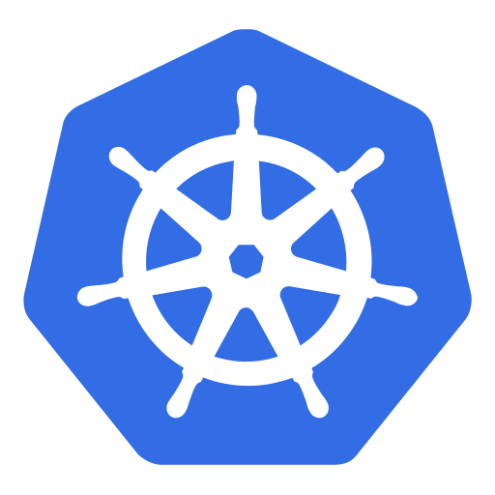

An (non-technical) introduction to
Kubernetes

Slide 2
We have isolated containers!
https://i.kym-cdn.com/photos/images/original/001/142/233/897.gif
Notes:
Though isolation of individual apps is one of many goals achieved with container technology, it introduces new issues.
How should these container work together?
How can the communicate?
Kubernetes helps with an advanced network concepts as well as service discovery features.

Slide 3

So, what is this Kubernetes all about then?
Do you remember, how fun it was to …
start and stop every container?
map ports and don’t get confused?
check the health of a container?
miss a volume on a different host?
…

Slide 4
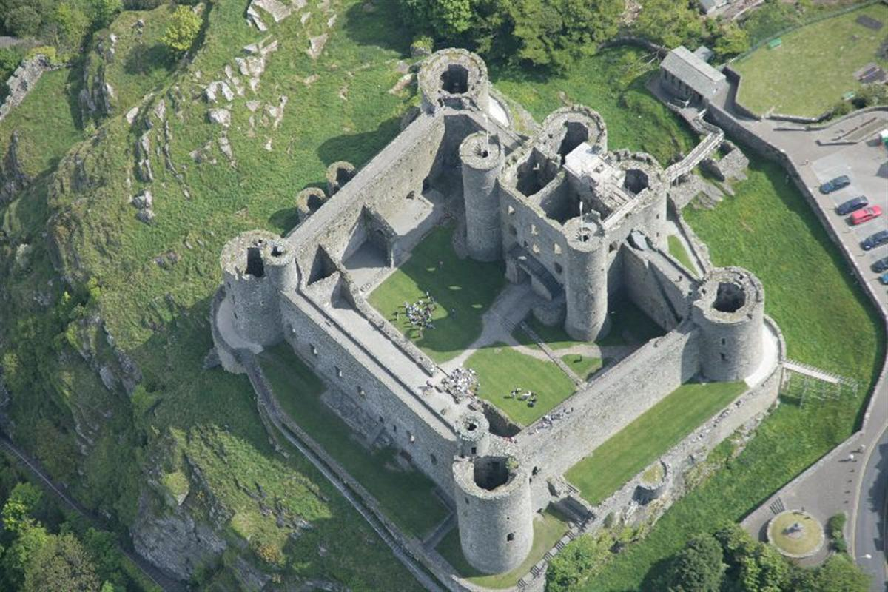
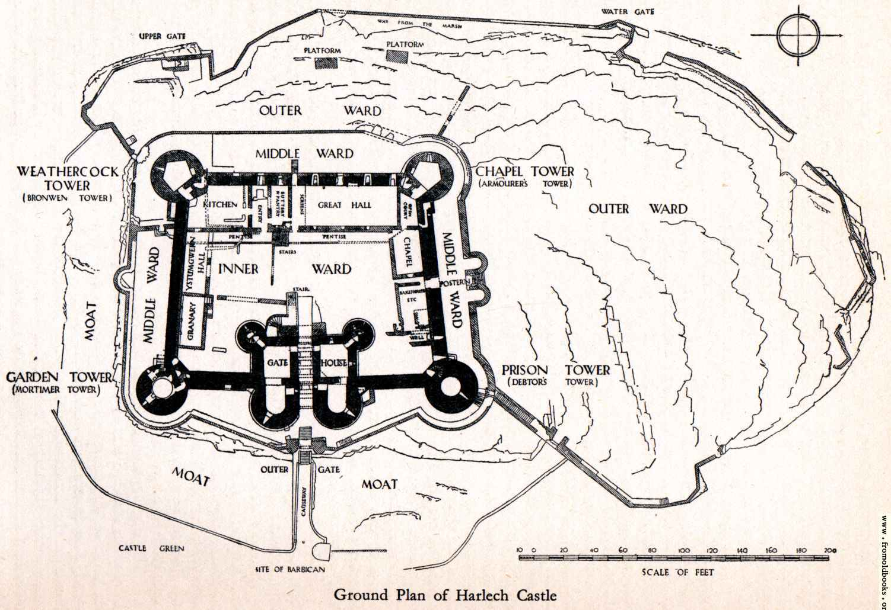
Tell me, what you want…
All it takes, is a description and some bricks…
Notes:
Kubernetes takes a “construction plan” and instantiates it as often as you want – as long as you have enough resources
What you describe, is what you get.

Slide 5
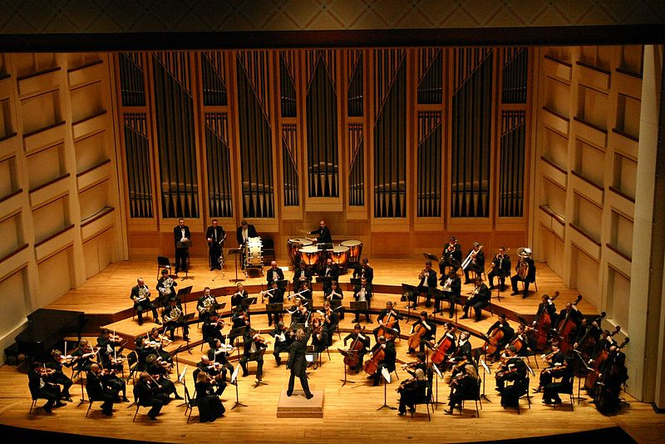
Orchestration
Notes:
Kubernetes orchestrates your workloads & applications – also several of them in parallel.

Slide 6
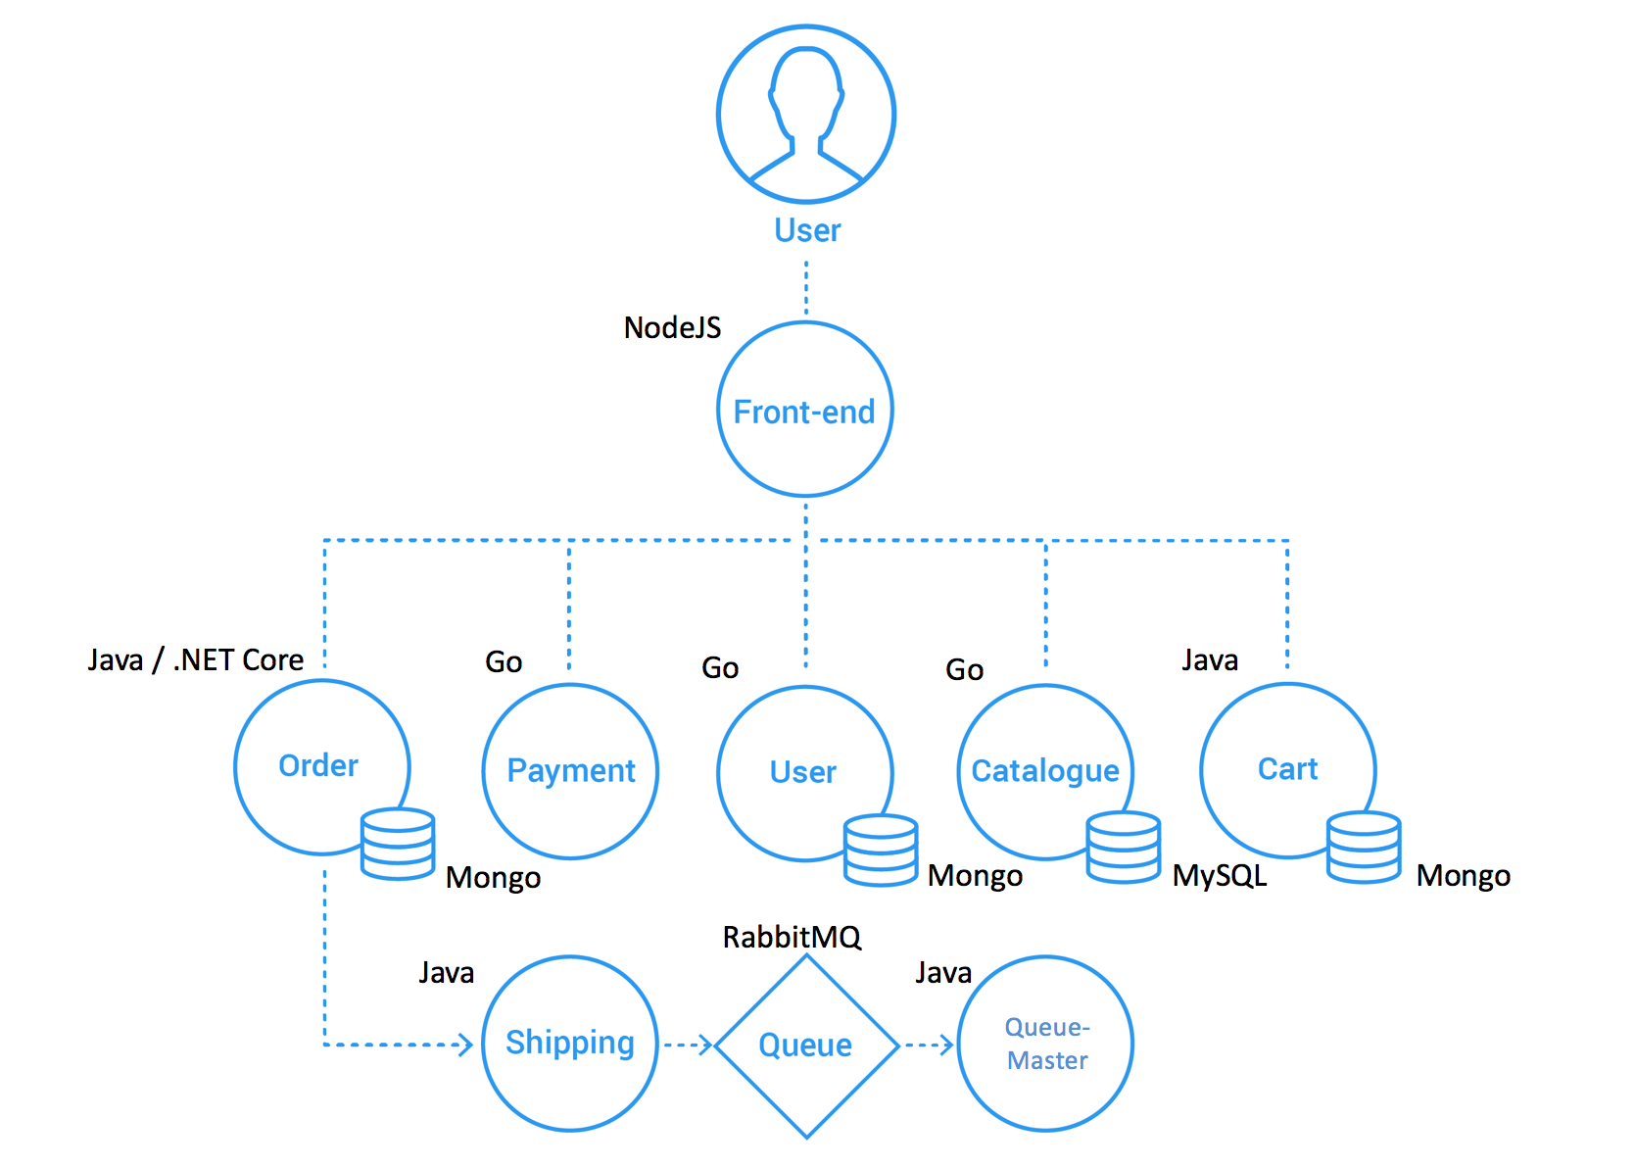
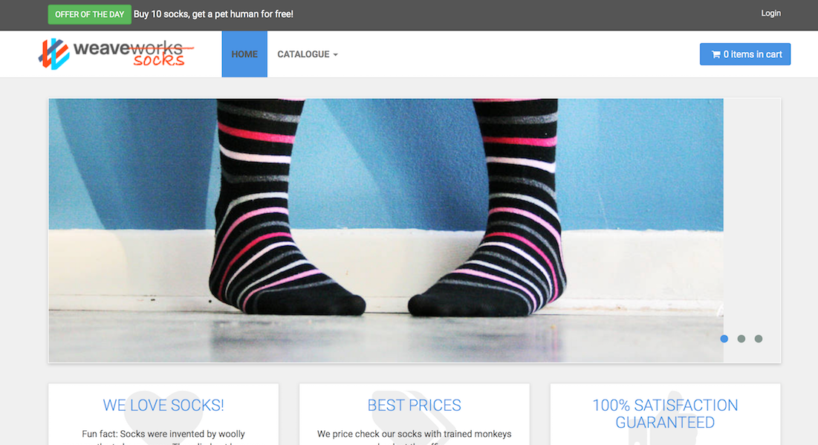
Getting started: let‘s buy some socks
Notes:
The demo is based on the “sock shop” e-commerce platform developed by weaveworks. This is a full-blown demo application, including content – however you have to wait ~2min until the content is fully loaded.
To demo use the sock-shop.yaml from the kubernetes/demo folder to deploy all components. Adapt the host on the Ingress according to the cluster-name and project-name, used within your training (line with ‘host: sock-shop.ingress.<cluster-name>.<project-name>.shoot.canary.k8s-hana.ondemand.com’) before you call ‘kubectl apply –f sock-shop.yaml’.
You can find all needed K8s entities in the namespace ‘sock-shop’, which gets automatically created.
The URL to call the sock-shop in the browser is: sock-shop.ingress.<cluster-name>.<project-name>.shoot.canary.k8s-hana.ondemand.com (e.g. http://sock-shop.ingress.wdfcw43a.k8s-train.shoot.canary.k8s-hana.ondemand.com/)
The design of the sock-shop is based a micro-services architecture and was containerized appropriately. See https://github.com/microservices-demo/microservices-demo/blob/master/internal-docs/design.md for further details

Slide 7
Some facts about K8s, kubernetes, …
Kubernetes = Greek for “helmsman” or “pilot”
Based on Google’s Borg – a cluster manager for container orchestration
Open sourced by Google and firstly announced in 2014
v1.0 was released in July 2015
By now K8s is governed by the Cloud Native Computing Foundation (CNCF)
Vanilla Kubernetes is the basis for commercial products like RedHat’s Openshift or CoreOS’ tectonic
New minor releases roughly every 3 month
Extensive list of beta features
Documentation: https://kubernetes.io/docs/home/ - concepts, tasks, API reference

Slide 8
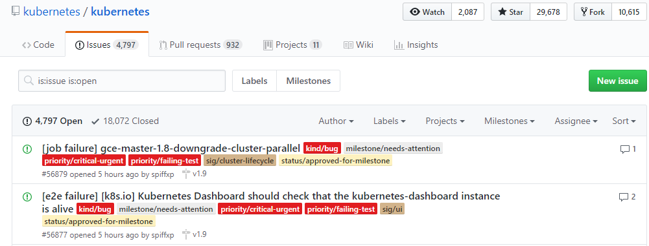
If it doesn’t always work as expected …
https://groups.google.com/forum/#!forum/kubernetes-users
https://github.com/kubernetes
https://github.com/kubernetes/community/blob/master/communication.md

Slide 9
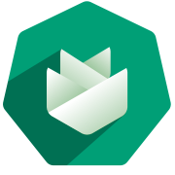
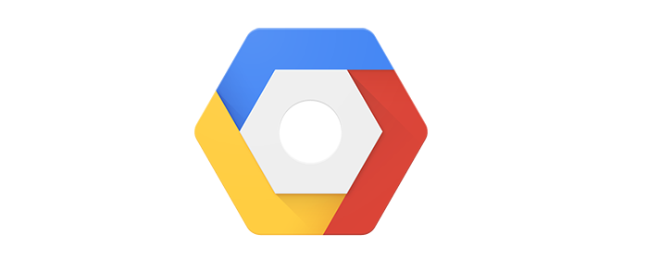

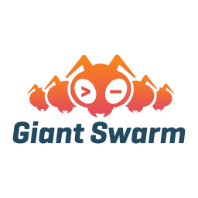
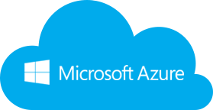
Wherefrom can I get a cluster?
Notes:
Gardener: SAP’s solution to managed Kubernetes

Slide 10
Appendix

Slide 11
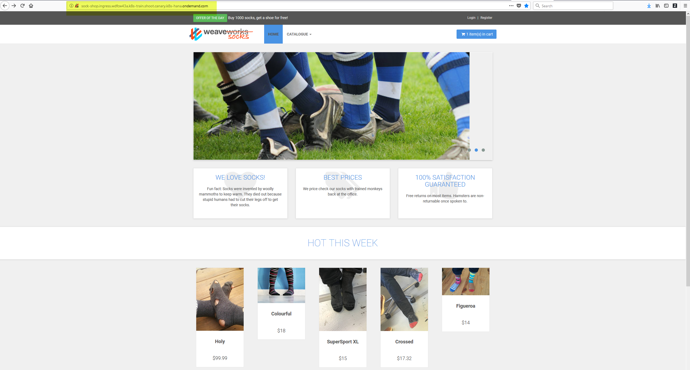
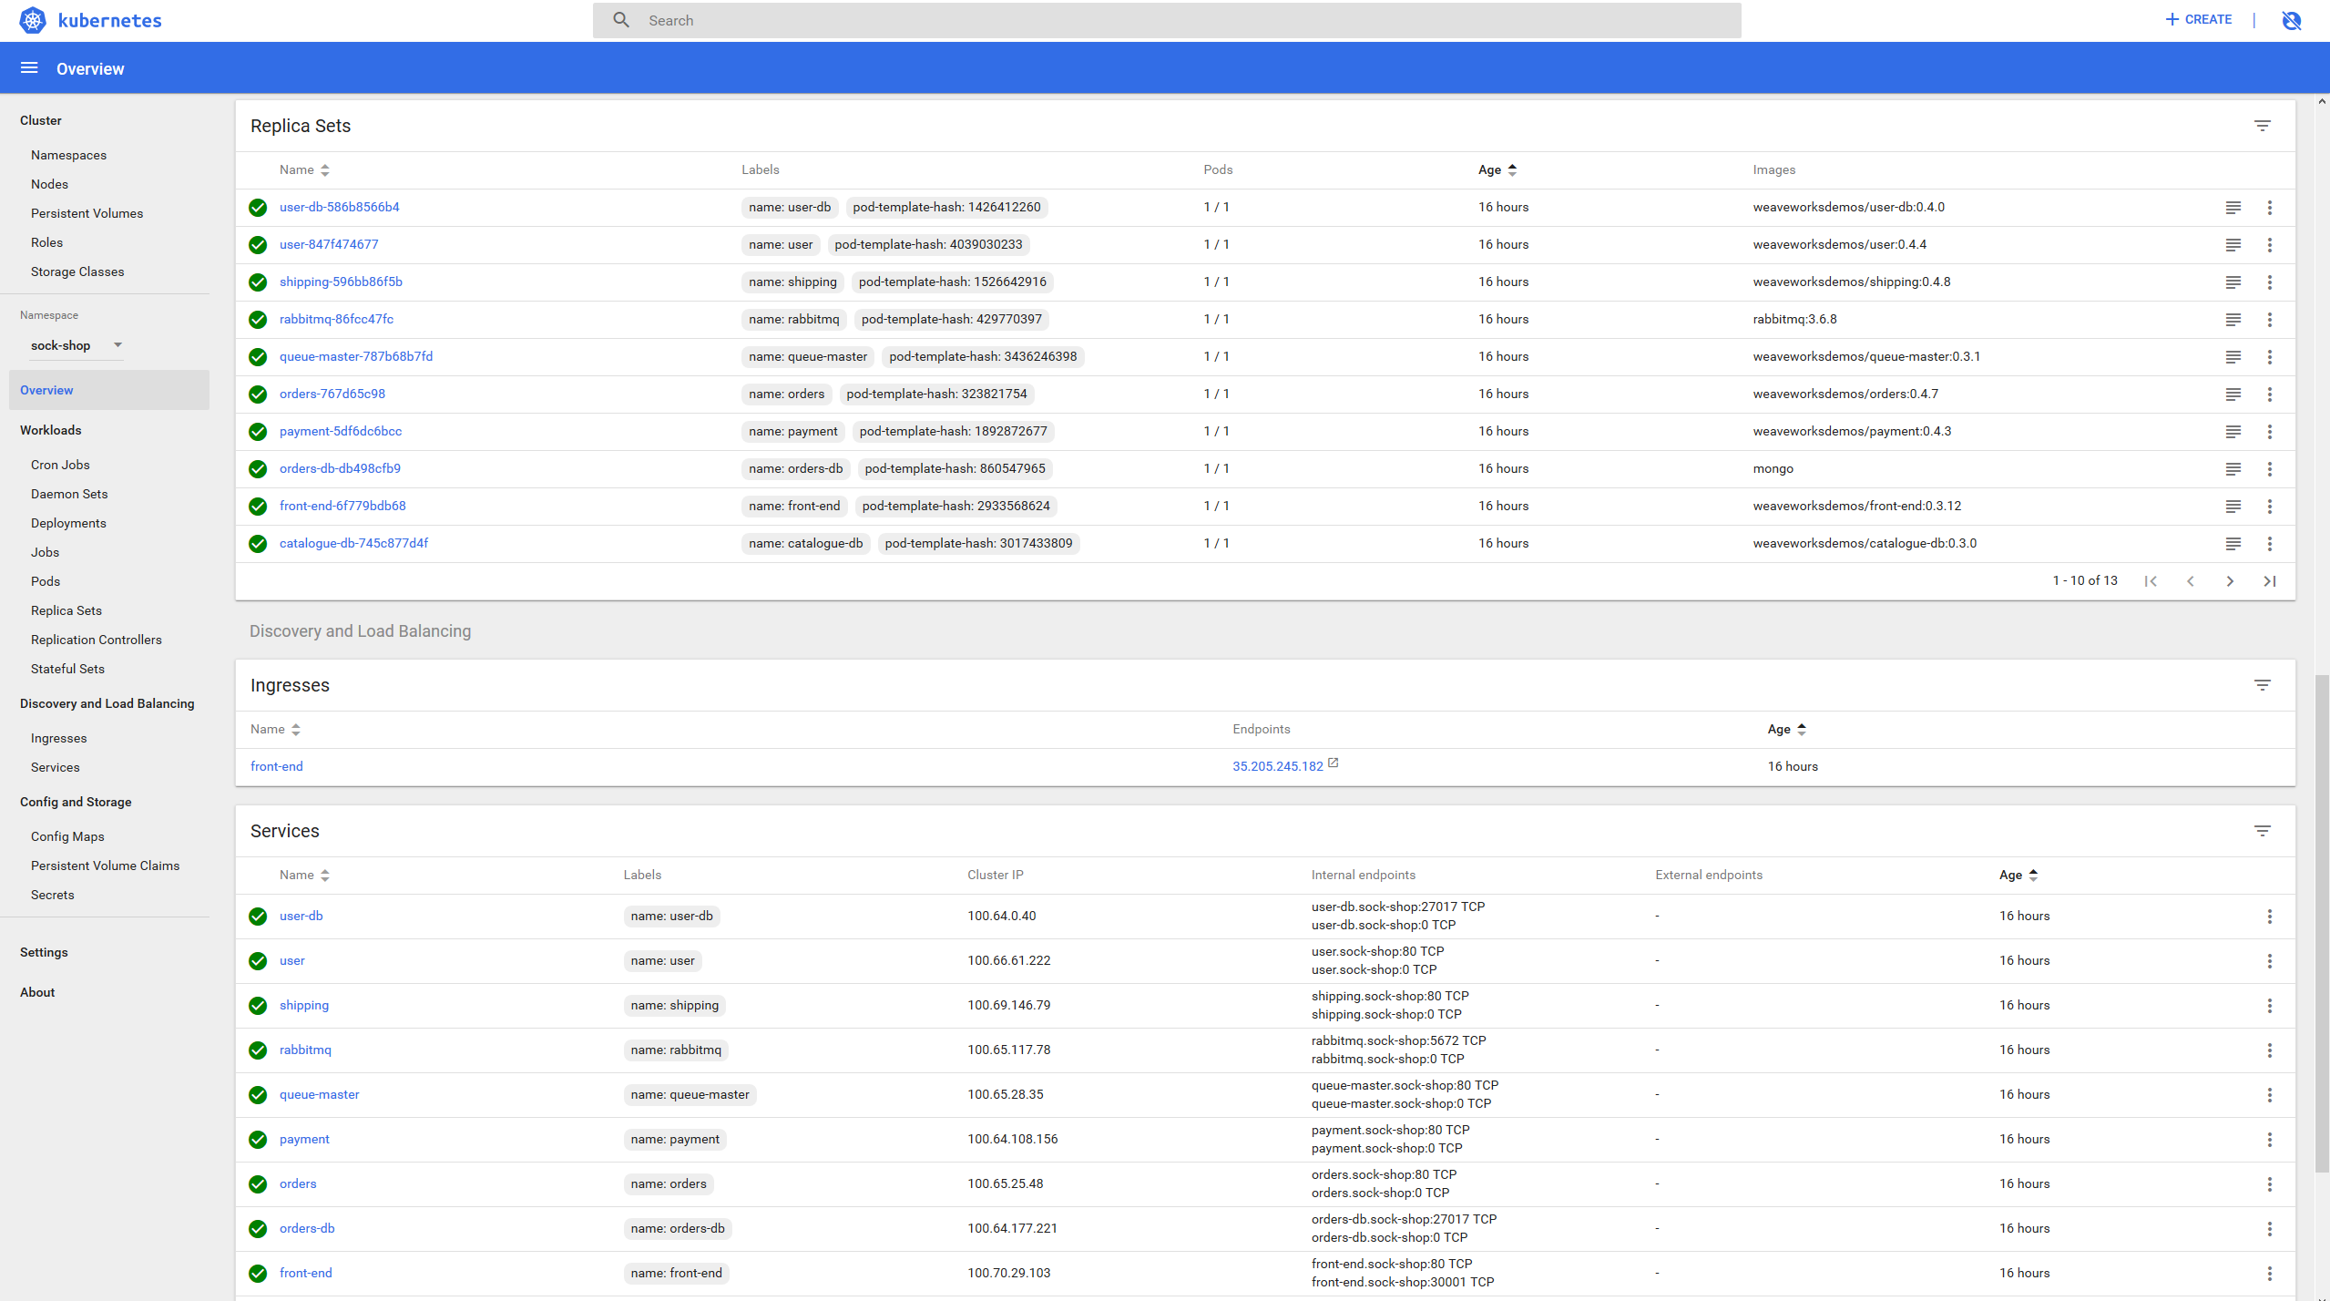
Sock-Shop in Trainings Cluster

