Slide 1
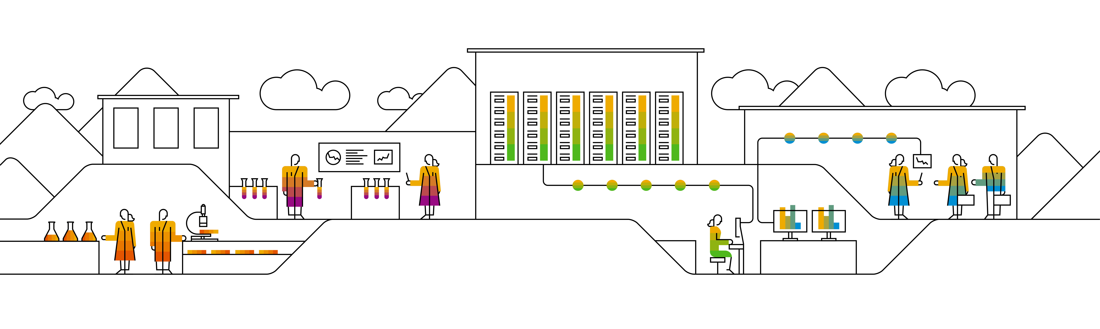
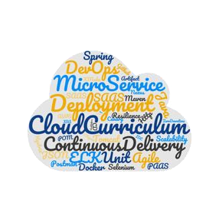

Bulletinboard Exercise 1 – Build and Push Images

Slide 2
Where do images come from?
We learned to build docker images ourselves on day 1.
The cluster is running in the public internet and can only pull images from publicly available registries.
(i.e. not from your local machine)
We can use SAP Artifactory, DockerHub, or the private registry provided for the training.
We will use the one for the training.
You used it already on day 1.
You need username/password to be able to push and pull images to/from that registry
The cluster also needs those credentials! We learned about ImagePullSecrets!

Slide 3
Bulletinboard Exercise 2 – Bulletinboard-Ads database

Slide 4


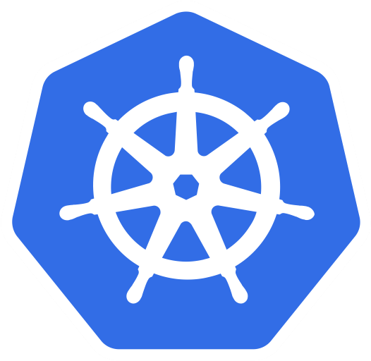
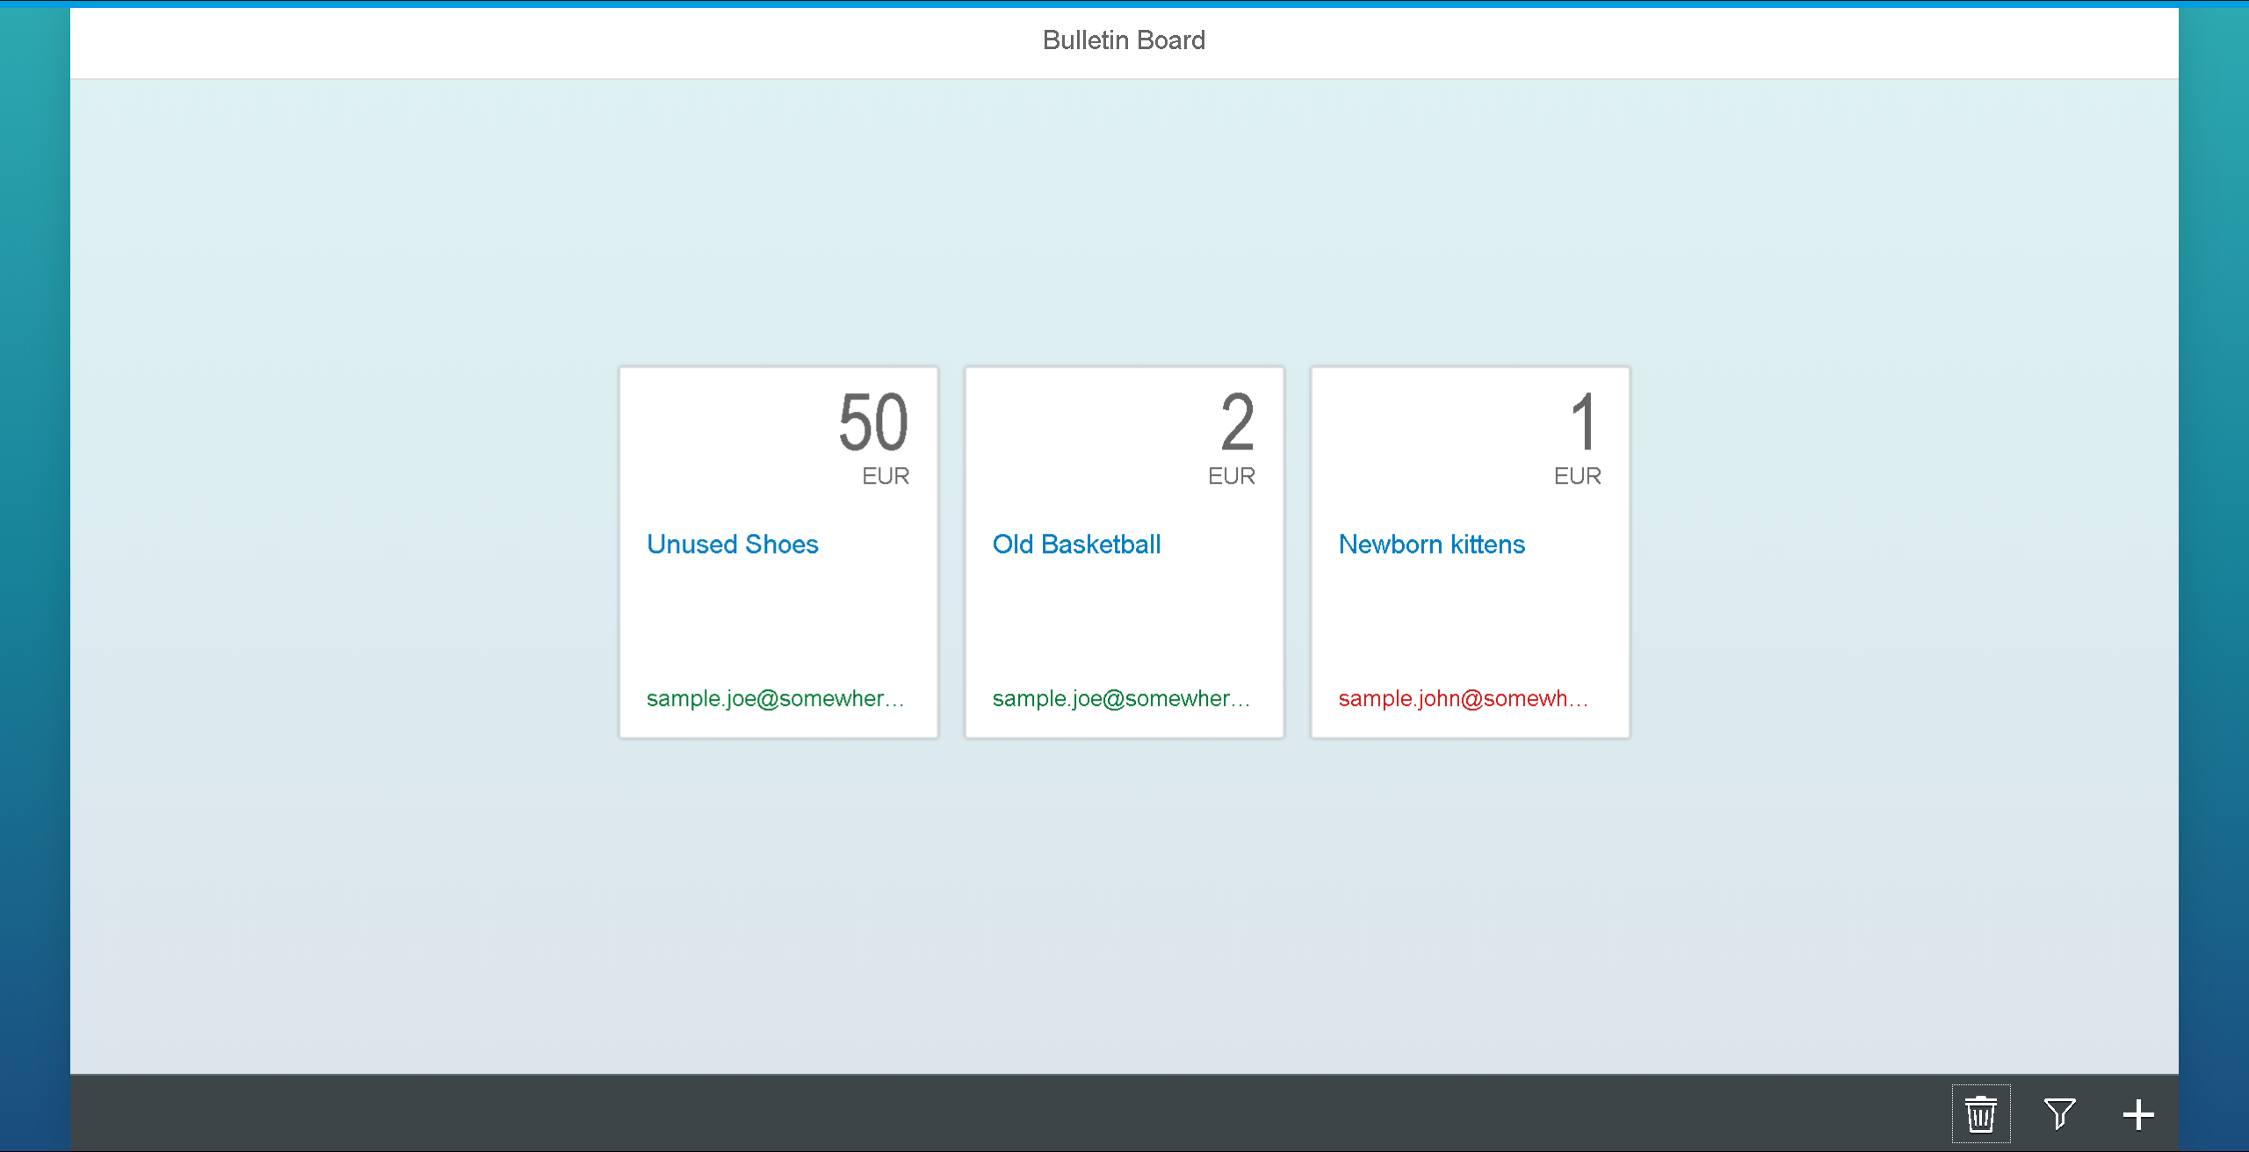

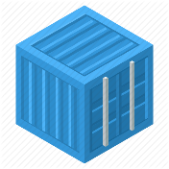
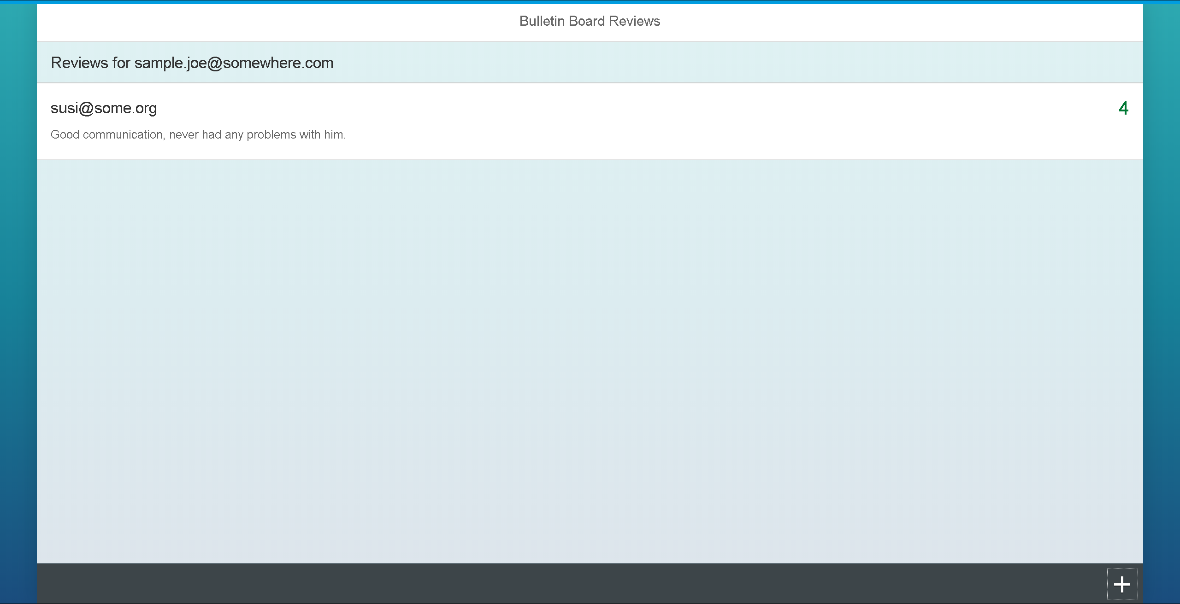
Bulletinboard: Exercise 2 - Scope
ingr/ svc
ingr/svc
HTTPS
nwp
nwp
bulletinboard- ads
bulletinboard-reviews
cm
sec
pod
pod
deployment
deployment
svc
svc
nwp
postgresql
nwp
postgresql
sec
sec
pod
pod
statefulset
statefulset

Slide 5
Bulletinboard: Exercise 2 – Focused View
pod DNS-name: ads-db-statefulset-0.ads-db-service
component:ads
Labels
component:ads
module:db
Secret
only one key-value-pair
password for database user
Service
“headless”
targeting our labels
StatefulSet
Replicas: 1
postgres docker image
Environment variables:
Pass password from secret
module: db
service:
ads-db-service
selector: component:ads module:app
Docker container: postgres:9.6
secret: ads-db-secret
pod: ads-db-statefulset-0
statefulset: ads-db-statefulset

Slide 6
Bulletinboard Exercise 3 – Bulletinboard-Ads App

Slide 7
Bulletinboard: Exercise 3 - Scope
REVIEWS_HOST
ingr/ svc
REVIEWS_HOST_INTERNAL
ingr/svc
HTTPS
nwp
nwp
bulletinboard- ads
bulletinboard-reviews
cm
sec
pod
pod
deployment
deployment
svc
svc
nwp
postgresql
nwp
postgresql
ü
sec
sec
pod
pod
statefulset
statefulset
Notes:
Reviews can be targeted directly or via the ingress. Bulletinboard-Ads needs to know both addresses. One for accessing the content. -> internal connection, passed through envvar 'REVIEWS_HOST_INTERNAL'
One for providing a redirect for a user -> external connection, passed through envvar 'REVIEWS_HOST'

Slide 8
Bulletinboard: Exercise 3 – Focused View
URL: bulletinboard-ads-<id>.ingress.<cluster>.<project>.shoot.canary.k8s-hana.ondemand.com
component: ads
Labels
Secret
Reuse “ads-db-secret”
Configmap
URL of Database
URL of Bulletinboard-Reviews Ingress
URL of Bulletinboard-Reviews Service
Service
Ingress
One host without TLS (yet)
Targeting the service
Deployment
Replicas: 1
Selfbuild docker image
Environment variables:
Pass password from secret
Pass URLs from configmap
ImagePullSecret
ingress:
ads-app-ingress
module: app
service:
ads-app-service
selector: component:ads module:app
configmap: ads-app-configmap
bulletinboard- ads
configmap: ads-db-secret
ü
pod: ads-app-…-xx-yy
deployment: ads-app-deployment

Slide 9
Bulletinboard Exercise 4 – Bulletinboard-Reviews via Helm

Slide 10


Bulletinboard: Exercise 4 - Scope
ingr/ svc
ingr/svc
HTTPS
nwp
nwp
bulletinboard- ads
bulletinboard-reviews
ü
cm
sec
pod
pod
deployment
deployment
svc
svc
nwp
postgresql
nwp
postgresql
ü
sec
sec
pod
pod
statefulset
statefulset

Slide 11
How Helm does work again?
Helm charts can be used in different ways:
… as plain files
… as a packaged archive (e.g. tgz)
… as a reference to an archive stored in a central repository
In the Git-Repository of this course you can find a package archive.
To install this chart correctly the following variables have to be set:
App.Image
App.ImagePullSecret (optional - defaults to 'training-registry')
Ingress.Domain
Ingress.ShortName
Ingress.LongName
You can use a yaml file or pass the variables via command line.
$ helm install <release-name> bulletinboard-reviews-chart.tgz --values customValues.yaml

Slide 12
Bulletinboard Exercise 5 – NetworkPolicies and TLS for ads

Slide 13

Bulletinboard: Exercise 5 - Scope
ingr/ svc
ingr/svc
HTTPS
nwp
nwp
bulletinboard- ads
bulletinboard-reviews
ü
cm
sec
pod
pod
deployment
deployment
ü
svc
svc
nwp
postgresql
nwp
postgresql
ü
sec
sec
pod
pod
statefulset
statefulset

Slide 14
What was that with Network Policies?
The restricted pods are targeted via labels.
2 policyTypes:
Ingress: rules for incoming traffic
Egress: rules for outgoing traffic
3 kind of rules:
ipBlock:
Allow traffic from/to a given CIDR
podSelector:
Allow traffic from/to Pods with specified labels
namespaceSelector:
Allow traffic from/to Pods in namespaces with specified labels
podSelectors and namespaceSelectors can be used together

Slide 15
Network Policy for Ads:DB
Ingress:
Allow traffic from ads:app
Egress:
no egress traffic
Pods Ads:DB only receives requests from Ads:App
Pods Ads:DB don’t send any requests to anybody.
bulletinboard- ads
component: ads
module: app
pod: ads-app…ent-xx-yy
Postgresql
component: ads
module: db
pod: ads-db-statefulset-0
Notes:
Who is “talking” to ads:db? A: ads:app
In which direction does the traffic go? -> Ingress
Does ads:db talk to anybody by itself? -> no Egress

Slide 16
Network Policies for Ads:App
Request to Reviews
Ingress:
Allow traffic from ingress-controller in kube-system namespace
Egress:
Allow traffic to kube-DNS
Allow traffic to Ads:DB
Allow traffic to Reviews
app: nginx-ingress
Ingress-controller
bulletinboard- ads
component: ads
component: controller
gardener.cloud/purpose: kube-system
module: app
origin: gardener
pod
pod: ads-app…ent-xx-yy
Request to: ads-db-statefulset-0
Namespace: kube-system
Namespace: <your Namespace>
Request to dns: get ip of ads-db-statefulset-0
k8s-app: kube-dns
Postgresql
component: ads
Kube-DNS
module: db
pod
pod: ads-db-statefulest-0

