Slide 1

Containers
under the hood

Slide 2
Linux Features
Namespaces
Isolation of resources per process
7 different namespaces
netfilter
Firewall and packet manipulation
cgroups
Manage resource allocation
Netlink
Interprocess communication between containers
SELinux/AppArmor
Security profiles to govern access to resources
capabilities
Granular control of privileges
seccomp
Limitation of syscalls to processes
Docker Runtime
dockerd
Container
Container
Container
Container
Linux
namespaces
Netlink
SELinux
netfilter
seccomp
capabilities
cgroups
AppArmor
Hardware
Notes:
Containers make heavy use of features that are offered by the Linux kernel. These features are going to be described in detail on the following slides.

Slide 3
Linux Features
Chroot
Changes the root directory for a process to any given directory
Namespaces
Different processes see different environments even though they are on the same host/OS
Seven different namespaces for
PID (process tree)
mnt (mount points)
Net (network interfaces and connectivity)
IPC (interprocess communication framework)
UTS (hostnames, date & time, etc.)
UID (user IDs and mappings)
cgroup (control groups for resource allocation)
Control groups (cgroups)
manage/limit resource allocation to individual processes
Prioritization ('nice' for a set of processes and not just one)
capabilities
without capabilities: root can do everything, everybody else may do nothing
38 granular facilities to control privileges
netfilter
firewall and packet manipulation (iptables/nftables)
can manipulate almost all network traffic going in/out a host
used to direct network packages to individual containers
Netlink
Interprocess communication between containers
SELinux/AppArmor
Security profiles to govern access to resources
seccomp
Limitation of allowed kernel syscalls
Unallowed syscalls lead to process termination

Slide 4




Filesystem isolation with chroot
/
Chroot makes any directory the topmost/root directory of a process
New process can only see files and directories under that special root directory
Provides file system isolation
bin
home
foo
/
container101
chroot
bin
container
lib
bin
usr
lib
usr
usr
Notes:
With chroot we can start a new process making a specified directory the new processes' topmost directory. Processes running in that chroot can only see those parts of the filesystem which are subdirectories of it.
Chroot is part of Unix and was initially integrated to test Unix installation routines. It is still very often used for bootstrapping a system during installation.
One problem with chroot is: since the process that gets started inside the chroot can no longer see the full filesystem, all files required to load and run that process must be copied to the chroot directory (and subdirectories) first - a tedious task that can take some time, and is trial and error.

Slide 5

Demo
Notes:
Demo for chroot
Within the repo go to the container-demos folder and run demo-01-chroot.sh
The script will do the setup of a minimal environment (basically only a bash + libs) and chroot into it.
Explain the importance of libraries to binaries. Without the corresponding libs in their respective directories, no binary will work. And after all, (container) processes are based on binaries.
It is also worth to mention, that the file system you chroot into is the foundation of every container. Luckily in most cases you can rely on others building the base images with all binaries and libs. The only thing you have to do as a developer is move your own stuff into it.
So if there is something called centos or ubuntu later, remember that this is no full-fledged OS but only a collection of bins/libs making your life a lot easier.

Slide 6
Process (and more) isolation with pid namespaces
Linux process tree
pid namespaces give a process a limited view on the process table
Only processes in the same pid namespace can see each other
Processes get new PIDs in their pid namespace
Still visible with their original PID outside of namespace
Same principle applies to mount, uid, cgroup, …, namespaces
1
3
27
16
namespaced process tree
1 (31)
49
51
31
4 (62)
7 (12)
62
12
Notes:
Man-page definition: A namespace wraps a global system resource in an abstraction that makes it appear to the processes within the namespace that they have their own isolated instance of the global resource. Changes to the global resource are visible to other processes that are members of the namespace, but are invisible to other processes [outside of that namespace]. One use of namespaces is to implement containers.
Linux offers namespaces for seven different resources: PID table, mount table, user mapping table, IPC, network stack, UTS (host and domain name) and cgroups.

Slide 7
Demo
Notes:
Demo for namespaces & unshare
Within the repo go to the container-demos folder and run demo-02-unshare.sh
The script will fork a new process with a separate PID namespace. It’ll also explore the space of the newly created processes. Please note, the demo does not use chroot.
With namespaces you can isolate aspects of a processes or process groups (like the process tree or networking stack). As mentioned on the previous slide, this is another building block for Linux containers to work.

Slide 8
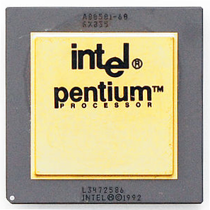

Resource limitations with cgroups
cgroups limit access of a process to system resources
Several processes can be in the same cgroup they all share the resource limit
cgroups offer resource control for
CPU
memory
block I/O
and others
cgroup
Process
Process
Process
Process
Notes:
Wikipedia definition: cgroups (abbreviated from control groups) is a Linux kernel feature that limits, accounts for, and isolates the resource usage (CPU, memory, disk I/O, network, etc.) of a collection of processes.
With cgroups, processes can be kept from eating up all system resources. Multiple processes can be added to one single cgroup - they will then all share the resource limits of it.

Slide 9
Demo
Notes:
Demo for cgroups
Within the repo go to the container-demos folder and run demo-03-cgroup.sh
The script will demonstrate how cgroups can be used to control processes. The example is focusing on CPU usage.
Docker as well as Kubernetes can make use of cgroups to manage resources in a container environment.

Slide 10


Container security with seccomp
Every program uses system calls to interact with the operating system
seccomp can block individual system calls
whitelisting
blacklisting
systemcall trapping
Application
system calls
write
stat
reboot
Kernel
Notes:
An application will eventually (after doing tons of nested library calls) call the operating system to do things - like reading or writing to files or sending data across the network. Talking to the operating system is done through system calls or syscalls. Syscalls are the interface between user space (where your application runs in) and kernel space (where the operating system does its job) and there are around 340 of them (syscalls).
While most system calls are necessary for programs to do their job (e.g. a program cannot even be loaded into memory without the “execve” system call) some are potentially dangerous and would allow a process to break free from its container or to cause harm to other containers (such as the reboot system call which would reboot the host terminating all containers on it).
With seccomp, individual system calls can be blocked to reduce the security risk which is commonly done in container environments (Docker for instance blocks around 40 system calls by default).

Slide 11
Demo
Notes:
Demo for seccomp based on Docker (for convenience)
Within the repo go to the container-demos folder and run demo-05-seccomp.sh
The script will demonstrate how seccomp profiles can be used to control access to the kernel via syscalls. To make things easier, this demo is based on Docker so it might give already an impression on how Docker works.
While the syscalls are blocked in this demo, it is worth to mention, that you can also implement trap wires to inform the underlying platform of what’s going on and potentially invoke countermeasures.

Slide 12
Let’s use these features to start our first container…
# cgexec –r cpu,memory,pids:/container unshare --pid --uts --mount --user --fork chroot container
cgroups resource limitation
chroot filesystem isolation
namespaces process isolation
Notes:
This commands start in fact three different processes: cgexec, unshare and chroot

Slide 13

Exercise #0 – Linux Primitives

Slide 14
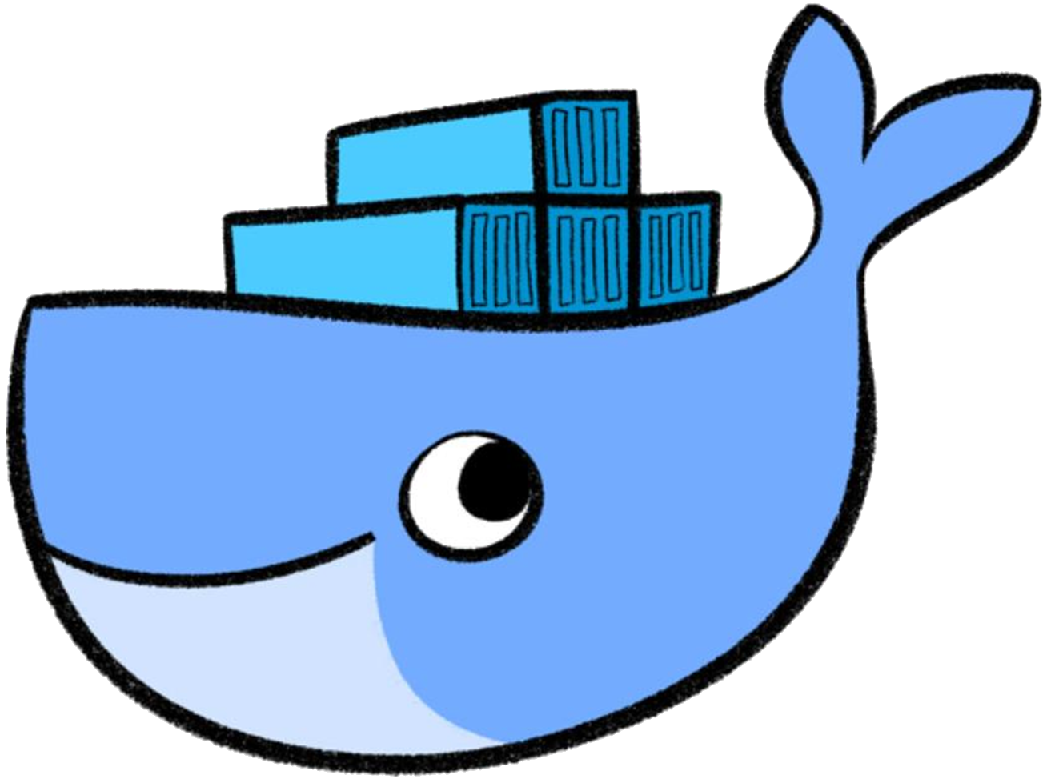
Containers made easy

Slide 15
Let’s start our first container… the easy way!
$ docker run container
cgroups resource limitation
chroot filesystem isolation
namespaces process isolation
seccomp & capabilities additional security
iptables network routing
and more…
Notes:
You actually specify an image name as argument of the docker run but that will be explained in the next few slides.

Slide 16
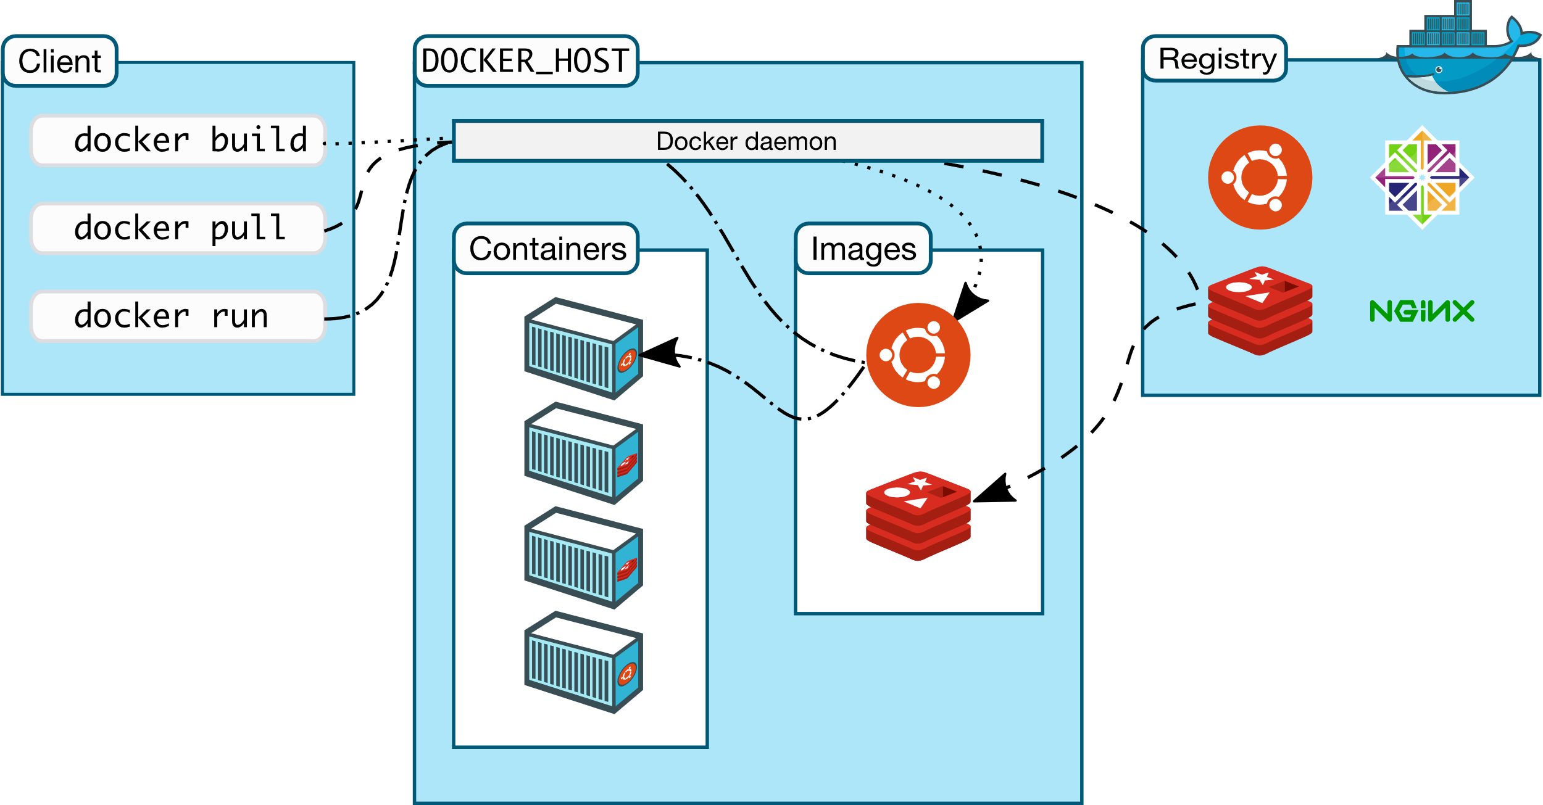
Docker eco-system
https://docs.docker.com/engine/docker-overview/
Notes:
Docker offers more than “just” running containers. It brings a complete eco-system of building, persisting and sharing containers.
The client triggers the docker host to execute actions related to container lifecycle, but also building, downloading & sharing images. The Docker Registry concepts allows to store images permanently. The most famous registry is the docker hub.

Slide 17


Images
Images are filesystem snapshots that function as the root filesystem of a container at startup + some metadata.
They can be
pulled from a registry
created from a Dockerfile or by committing changes.
Images consist of several layers that are stacked upon each other.
$ docker images
REPOSITORY TAG IMAGE ID CREATED SIZE
test_nginx latest ee56ce14b382 3 days ago 108MB
<none> <none> 2af6607c94b9 13 days ago 108MB
debian latest 6d83de432e98 4 weeks ago 100MB
busybox latest 6ad733544a63 4 weeks ago 1.13MB
$

Slide 18

Docker‘s client/server architecture
ReST
Docker Runtime
docker client
dockerd
nginx
nginx
Docker daemon is the control entity of everything (docker runtime)
Docker client (the docker command) just tells the daemon what to do
Communication through HTTP based ReST API
when on same host: Unix socket /var/run/docker.sock
when on different hosts: via port HTTP port 2375 or HTTPS port 2376
Buildinög images: everything is transferred from client to dockerd
Libs
Libs
Host OS
Hardware
Notes:
Docker is a client-server architecture. The docker command you use to interact with Docker does nothing but talk to the Docker daemon. All the magic of pinning up containers, downloading images and even building images is done inside the Docker daemon. Communication between the Docker client and the Docker daemon happens through a ReST API over http/https.
If both, docker client and docker daemon, run on the same host, communication will take place through a socket file (/var/run/docker.sock). It is however also possible to have the Docker client on your local laptop and the Docker daemon on a computer somewhere totally different. In that case, communication goes through TCP, the target port on the Docker daemon will be 2375 for unencrypted HTTP and 2376 for TLS secured HTTPS.
Note:
If you want to talk to dockerd directly, you can do so using curl (you will need curl and libcurl >= 7.40): curl --unix-socket /var/run/docker.sock http://localhost/containers/json
Or use your web browser if you enabled dockerd‘s TCP socket: http://<hostname>:2375/containers/json

Slide 19
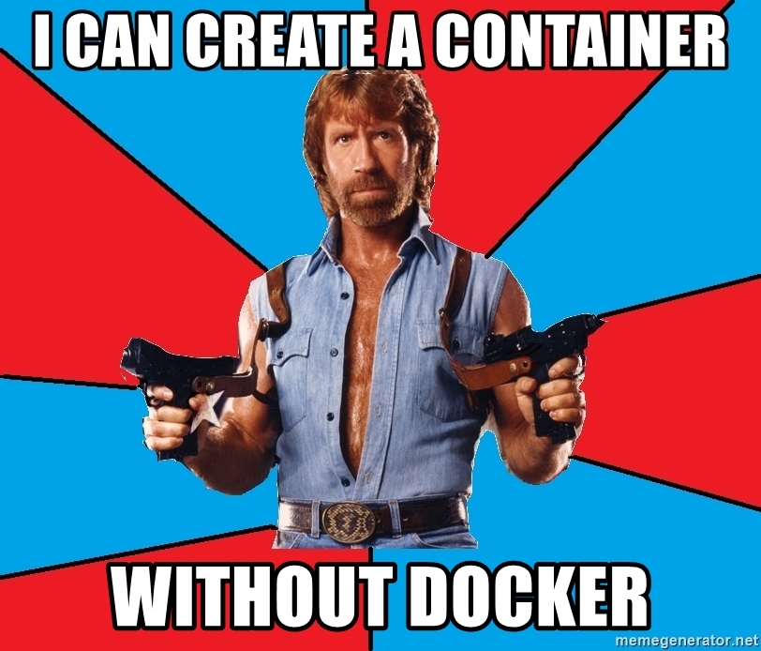

Slide 20

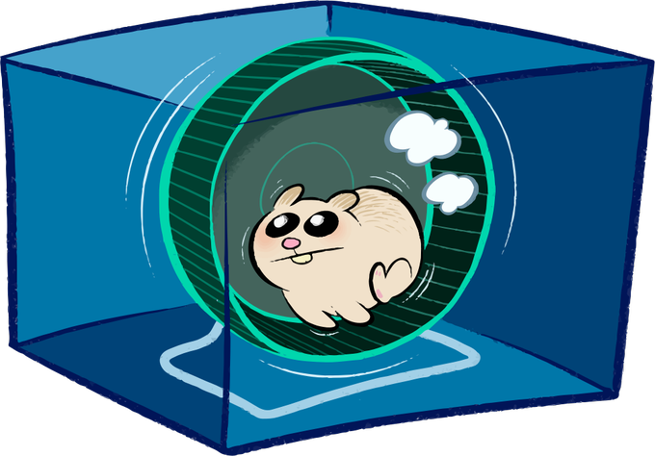
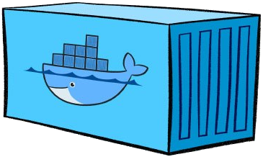
A look into the docker engine
Docker daemon is the central entry point for all API requests
dockerd
Container runtime to handle container lifecycle based on OCI specs
containerd
shim process which takes over parent ownership of a running container
containerd-shim
containerd-shim
containerd-shim
runc
runc
runc
runc actually starts the container
Notes:
The docker daemon works as central entry point. It receives API requests and is home of docker specific features.
Containerd actually is the container runtime. It is a refactored part of the former docker engine and handles the complete lifecycle of a container. It works on the basis of the open container initiative (OCI) specifications for container runtimes. Containerd also depends on OCI compatible images (root file system + container.json)
Containerd instructs runc to start a container. Runc sets up all the linux magic with cgroups etc and forks the container’s PID #1. Afterwards it will exit(0) and handover parent ownership of the container to containerd-shim. The shim module is there to decouple the daemon and container processes.
Details can be found here:
https://containerd.io/
https://www.slideshare.net/PhilEstes/diving-through-the-layers-investigating-runc-containerd-and-the-docker-engine-architecture
https://hackernoon.com/docker-containerd-standalone-runtimes-heres-what-you-should-know-b834ef155426?gi=c8140ae48de2

Slide 21
Configuration of the Docker daemon
Different places to configure the Docker daemon
systemd unit drop-in : environment settings
/etc/sysconfig/docker : system unit file for dockerd
/etc/docker/config.json : general config options for drivers, etc…
systemd unit drop-in
dockerd
/etc/docker/config.json
Example: Setting up the proxy server
Proxy is an environment setting
/etc/sysconfig/docker
[Service]
Environment="http_proxy=http://proxy.wdf.sap.corp:8080"
Environment="https_proxy=http://proxy.wdf.sap.corp:8080"
/etc/systemd/system/docker.service.d/proxy

Slide 22
Exercise #1 – Setting up Docker

