Slide 1
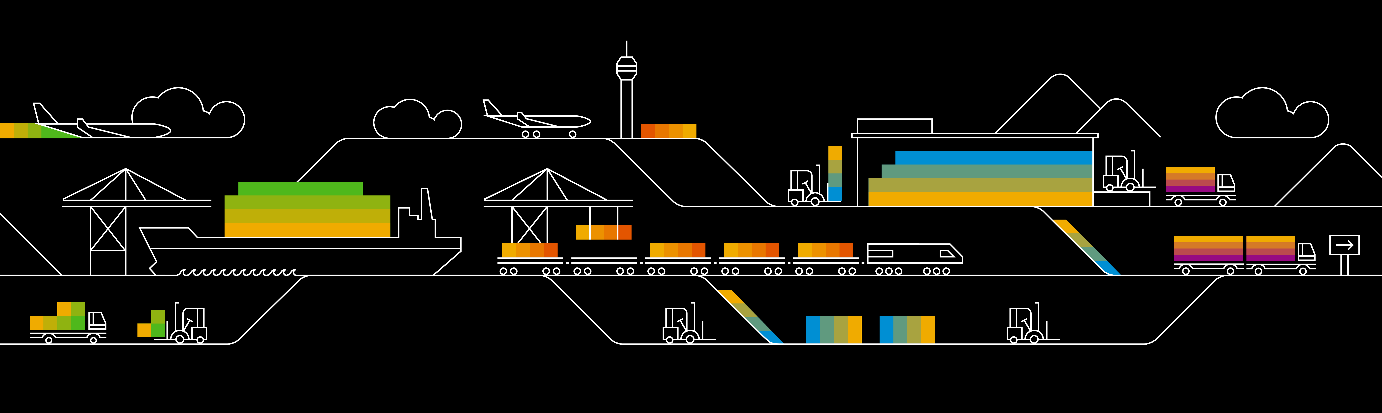
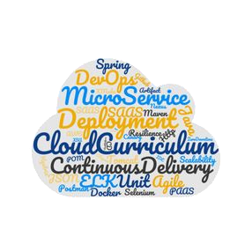

D R A F T Under Construction !
Kubernetes Microservice-based sample app: Bulletinboard

Slide 2

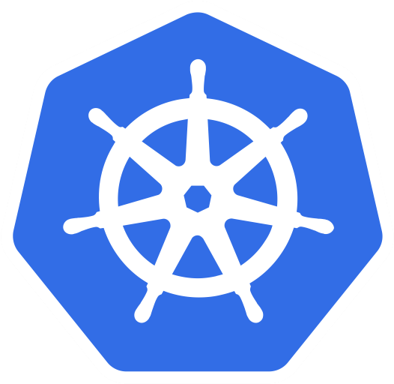
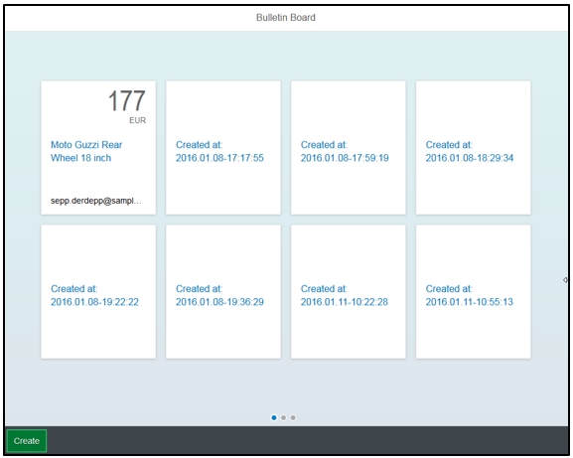

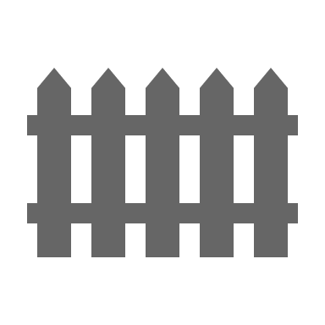
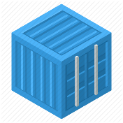
Bulletinboard in K8s: Exercise “Network policies & TLS for Ads app”
ingr/ svc
HTTP/ REST
svc
HTTPS/ REST
nwp
nwp
bulletinboard- ads
bulletinboard-users
cm
cm
ü
sec
pod
sec
pod
deployment
deployment
svc
svc
nwp
postgresql
nwp
postgresql
cm
cm
ü
sec
pod
sec
pod
statefulset
statefulset
Notes:
- Discuss statefulset vs deployment
- Discuss headless service vs ???
- Discuss service vs ingress

Slide 3
More on Network Policies
2 policyTypes:
Ingress: rules for incoming traffic
Egress: rules for outgoing traffic
3 kinds of Rules:
ipBlock: range of IP addresses given as CIDR
podSelector: labels of Pods allowed
namespaceSelector: labels of Namespaces
Last two can be combined to specify certain pods in certain namespases (since 1.11)

Slide 4
Network Policy for Ads:DB
Ingress:
Allow traffic from ads:app
Egress:
no egress traffic
Pods Ads:DB only receives requests from Ads:App
Pods Ads:DB don’t send any requests to anybody.
bulletinboard- ads
component: ads
module: app
pod: ads-app…ent-xx-yy
Postgresql
component: ads
module: db
pod: ads-db-statefulset-0
Notes:
Who is “talking” to ads:db? A: ads:app
In which direction does the traffic go? -> Ingress
Does ads:db talk to anybody by itself? -> no Egress

Slide 5
Network Policies for Ads:App
Ingress:
Allow traffic from ingress-controller in kube-system namespace
Egress:
Allow traffic to kube-DNS
Allow traffic to Ads:DB
app: nginx-ingress
Ingress-controller
bulletinboard- ads
component: ads
component: controller
name: kube-system
module: app
origin: gardener
pod
pod: ads-app…ent-xx-yy
Request to: ads-db-0….
Namespace: kube-system
Namespace: <your Space>
Request to dns: get ip of ads-db-0….
k8s-app: kube-dns
Postgresql
component: ads
Kube-DNS
module: db
pod
pod: ads-db-statefulest-0

Slide 6
Exercise 3: Network policies & TLS

Slide 7
Appendix

Slide 8
What YOU will do in exercise #0x
nginx
nginx
nginx
content
config
tls certs

Slide 9

Demo
Notes:
Show all namespaces in cluster
If not yet mentioned, explain that everyone has their own namespace. Please be a good citizen and don’t sabotage the others.
Query a pod from a dedicated namespace ( e.g. kube-system), explain “-n <namespace>” flag

