Slide 1
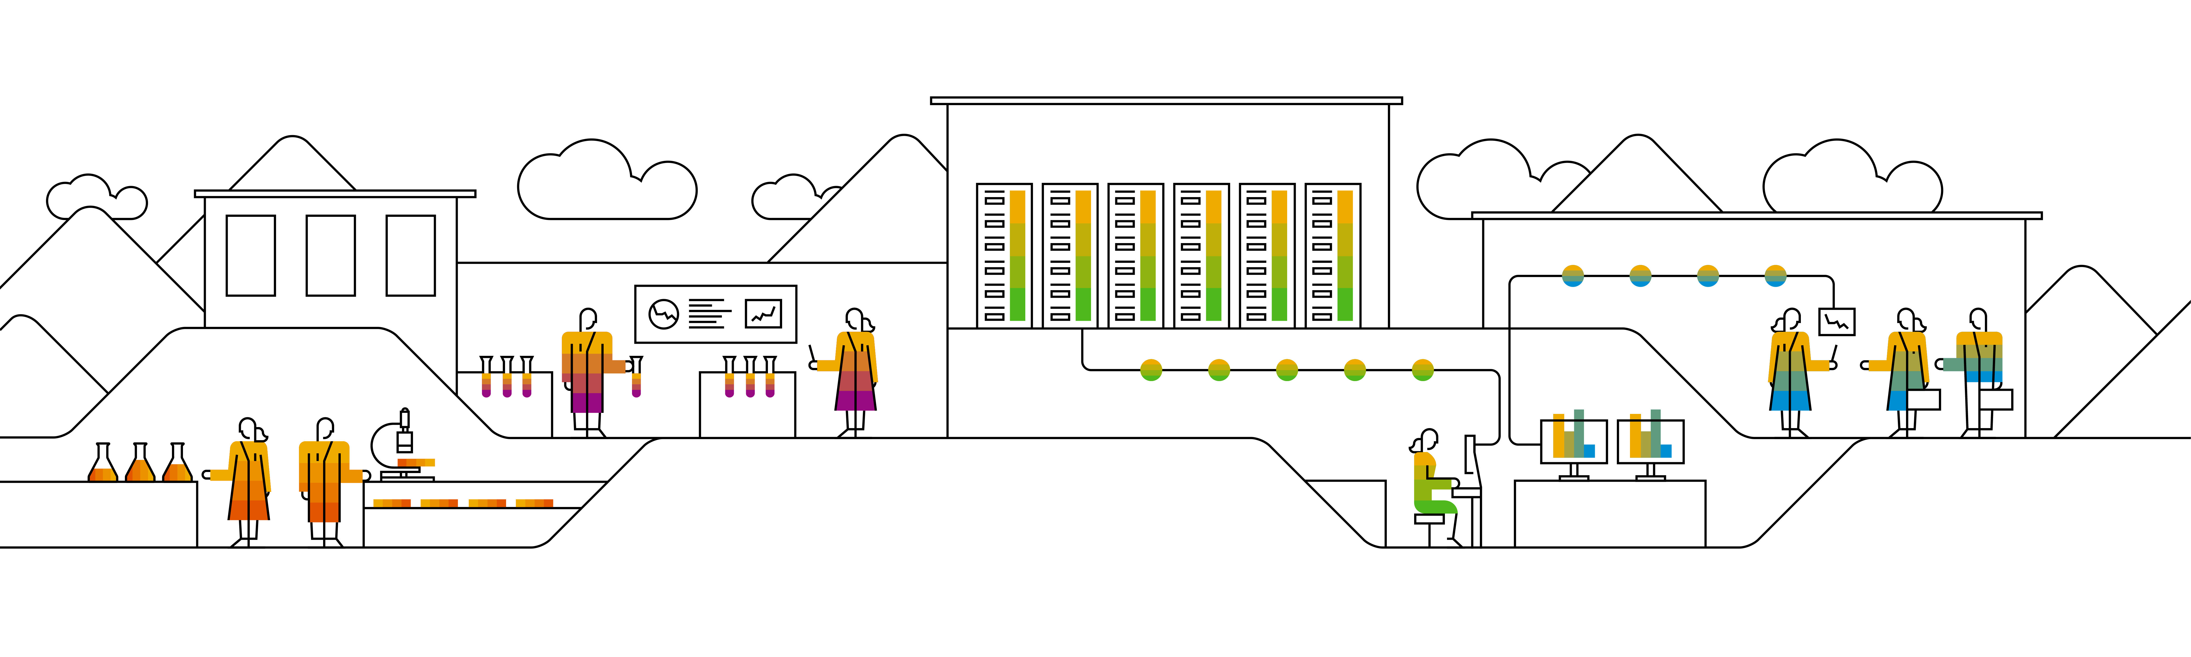

Kubernetes Deployments

Slide 2
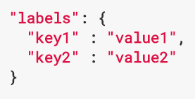

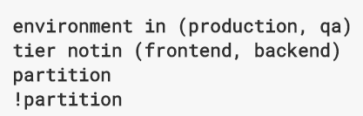
Introducing labels & selectors
Labels are key:value pairs in kubernetes
Labels are part of the “metadata” section of a resource
Basically everything can be labeled (pods, nodes, …)
Example: “release”:”stable”, “release”:”canary”, “com.sap/product-name”:”hana”
Based on labels Kubernetes offers selection / filtering / assignments
Equality-based selectors (true / false)
Set-based selectors (in, notin, exists)
https://kubernetes.io/docs/concepts/overview/working-with-objects/labels/
Notes:
Before actually talking about the deployment resource, we need to introduce one of the fundamental concepts of Kubernetes: labels & selectors.
Basically, labels are key-value pairs and you can attach them to almost everything in Kubernetes. Keys can have a prefix separated by “/”. The parts of the key must be DNS compatible names. Labels are part of the metadata-section of a resource description and of course you can attach multiple labels to one resource.
But what are labels good for, if there is no selection mechanism to evaluate them? Kubernetes label selectors are the answer to this questions.
Selectors can be used in kubectl queries but also as part of resource definitions to define dependencies or even hierarchies of managed objects.
Mostly the selectors are part of the resource’s spec sections.

Slide 3

Why do we need labels & selectors?
“In an environment, where names can change and most thing are ephemeral, we need a mechanism to identify a single or a set of objects reliably”
Selector: species: koopa
species: koopa
species: koopa
species: koopa
koopa-A
koopa-B
koopa-C
Pod-C
Notes:
Labels are used to identify and bundle pods or nodes or any other resource, where it seem useful.
Pod names are not reliable because they are usually generated. To identify a set of same pods, a label helps.

Slide 4
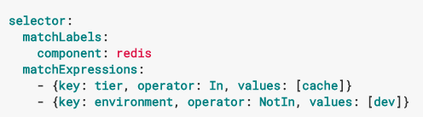
Using labels & selectors
Labels & selectors in resources
metadata.labels
selector
selector.matchLabel / selector.matchExpression
With kubectl:
Attach a label to a resource: “kubectl label pod mypod status=awesome”
Filter for labels: “kubectl get pods –l status=awesome”
Notes:
As already said, labels are part of the metadata section and selectors usually occur in the spec sections.
Additionally manual labeling is possible via kubectl and label selectors can be added to kubectl queries.

Slide 5

Demo
Notes:
This demo should familiarize participants with the labeling system.
Show labels
of nodes: kubectl get nodes --show-labels
of pods in kube-system namespace: kubectl get pods -n kube-system --show-labels
Show selection based on labels:
Select a group of pods from kube-system namespace by their labels (e.g. kubect get pods -n kube-system -l component=node-exporter)
Select a group based only based on key existence: kubectl get pods -n kube-system -l component
Label a pod from previous demo (re-create if necessary)
kubectl label pod <name> awesome=hair
Query labeled pod

Slide 6


Deployments
Original
Deployment defines replica count, used image and more
Selector
species = koopa
ReplicaSet spawns pods as defined in spec template & adds a generation label
Pods are identified by labels:
species=koopa generation=green-shell
species=koopa generation=green-shell

Slide 7
Deployments
Deployment defines replica count, used image and more
Selector
species = koopa
ReplicaSet spawns pods as defined in spec template & adds a label ‘generation’
Pods are identified by labels:
species=koopa generation=green-shell
species=koopa generation=green-shell

Slide 8

Updating Deployments
Original
Deployment initiates update
Scale down, but keep ReplicaSet
New ReplicaSet
New label set:
species=koopa generation=red-shell

Slide 9
Updating Deployments
Deployment initiates update
Scale down, but keep ReplicaSet
New ReplicaSet
New label set:
species=koopa generation=red-shell
Notes:
Set/ change docker image for deployment:
kubectl set image deployment/nginx nginx=nginx:mainline
Rollback rollout:
kubectl rollout undo deployment/nginx

Slide 10
Architecture overview – deployments
Namespace: your-namespace
Deployment
Selector: app:nginx
app: nginx
ReplicaSet
Selector: app:nginx
app: nginx
app: nginx
app: nginx
app: nginx
Pod
Pod
Pod
Notes:
How labels & selectors work here:
Names of pods can change
Labels stay the same
Only with labels pods related to rs/deployment can be determined reliably
Why deployments?
You don’t want to know and manage individual pods. You would like to specify a template and instantiate it as often as you wish. Also you want to manage the group of pods e.g. in terms of docker image used.
The deployment gives you these management capabilities. In it’s resource description (yaml file) you specify a pod template, how pods should be labeled and of course a corresponding selector to identify your pods.
On cluster level the deployment creates & manages a replica set which then manages the pods.
If you update the number of replicas, this will be sent to the replicaSet and the desired state is enforced via the replicaSet.
Upon update of the image, a new replicaSet will be created and the old one will be set to replica=0. This way you can roll-back to your old replicaSet (by scaling it up again).

Slide 11
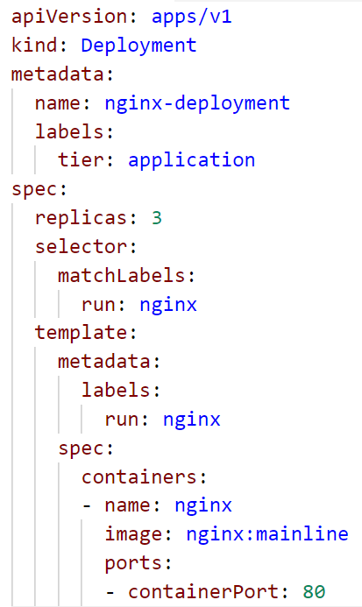
Deployments
Deployments are the default construct to run stateless applications in Kubernetes
Create a deployment from a yaml/json file or by “kubectl create deployment <name> --image=<image>
Deployments create ReplicaSets, which then create pods
Resource type can scale
Support of rolling updates, versioning and roll-backs
All parts belonging to a deployment are identified by labels and corresponding selctors
Notes:
Labels with red arrows pointing to have to match

Slide 12
Demo
Notes:
Explain deployments in a demo
Use the “kubectl create deployment <name> --image=<image>” command to create a deployment (note that “run” generators are deprecated for everything but pods)
Show the replica set with labels
Point out that the replica set is a “hidden” component used to manage pods & generations. A user should not interact directly with a replica set
Scale up (kubectl scale deployment|replicaset <name> --replicas=5)
Scale up the replica set & show pods -> replica set is managed by deployment and thus overruled.
Scale up the deployment
Show the pods with labels
Delete a pod & in parallel “watch kubectl get pods” to monitor the creation/deletion of pods
Don’t forget to mention that a deployment can be created also from yaml file (with way more options to customize -> like the labels).
Optional: do a demo for updating (assuming your deployment is called “nginx”)
Run “kubectl rollout status deployment nginx” in a separate shell
In parallel: “kubectl set image deployment/nginx nginx=nginx:mainline --record” ➔ make sure to set an image tag that differs from your first revision
Point out, that the “--record“ parameter will “ log” the command and write it to the deployment’s annotations
“kubectl rollout history deployment nginx” ➔ you should see 2 revisions incl. the “change-cause”
Optional: do a demo for a rollback
Re-run the “set image” command while using an invalid version tag (like “invalid” or something with a typo)
Check the rollout status ➔ there should be one pod with the new image version in an error status & at least 2 pods of the previous revision up and running.
Explain the rolling update strategy and why there is only one pod in status error ➔ maxUnavailable (kubectl explain deployment.spec.strategy.rollingUpdate)
Do the rollback: kubectl rollout undo deployment nginx

Slide 13
What YOU will do in exercise #03
Create a deployment to manage multiple instances
nginx
nginx
nginx
content
config
tls certs

Slide 14
Appendix

Slide 15
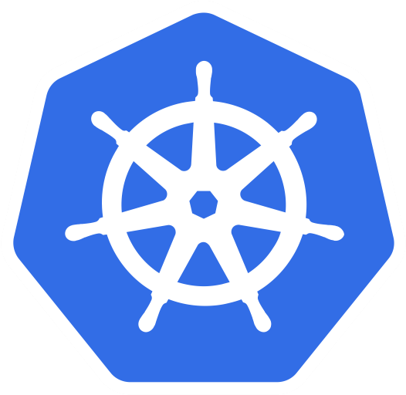
Sample Application: Bulletinboard
bulletinboard- ads
bulletinboard- ads
bulletinboard-users
postgresql
postgresql

Slide 16
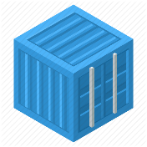
Bulletinboard in K8s: ads DB – details labels & selector
selector: component: ads module: db
statefulset: ads-db-statefulset
component: ads
module: db
pod: ads-db-statefulset-0
component: ads
Docker container: postgres:9.6
module: db

Slide 17
Bulletinboard in K8s: labels & selectors
selector: component: ads module: app
deployment: ads-app-deployment
component: ads
module: app
replicaset: ads-app-deployment-xx
component: ads
module: app
pod: ads-app…ent-xx-yx
component: ads
pod: ads-app…ent-xx-yy
component: ads
Docker container: bulletinboard- ads:v.0x
module: app
Docker container: bulletinboard- ads:v0.x
module: app

